Slide 1

BLUEOCEAN
UAE Defense Strategic Assessment: Strengths, Vulnerabilities, and Future Priorities
A Comprehensive Analysis for Allied Strategic Planning

Slide 2
BlueOcean
The discussion follows the management question, evidence, and implications
01
Section 1
02
Section 2
03
Section 3
04
Section 4
05
Section 5
06
Section 6
07
Section 7
08
Section 8
09
Section 9
Contents

Slide 3
BlueOcean
The analysis narrows the agenda to a focused set of management priorities
01
The United Arab Emirates (UAE) has developed a robust defense sector characterized by significant investment in modernization, a growin
Key highlights

Slide 4
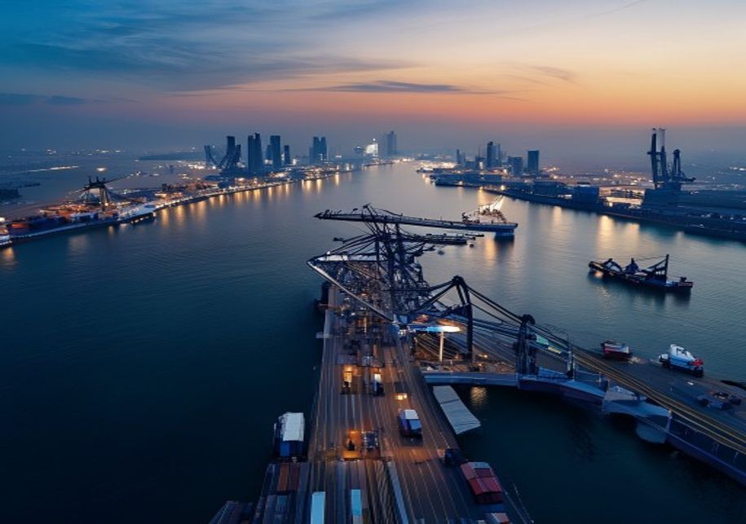
BlueOcean
Section 1
The UAE's strategic location in the Persian Gulf places it at the center of multiple regional conflicts. The primary state-level threat remains Iran, whose ballistic missile program, naval capabilities in the Strait of Hormuz, and support for proxy forces dire
Non-state actors, including terrorist groups like ISIS and Al-Qaeda, continue to pose threats, though their operational capacity in the UAE is limited by robust internal security. More pressing are non-traditional threats: cyber attacks targeting government ne
The UAE has responded by investing in layered defense systems, including advanced missile defense (e.g., THAAD and Patriot batteries), a modernized air force, and a growing naval fleet. However, the sheer diversity of threats—from ballistic missiles to cyber i
Section 1

Slide 5
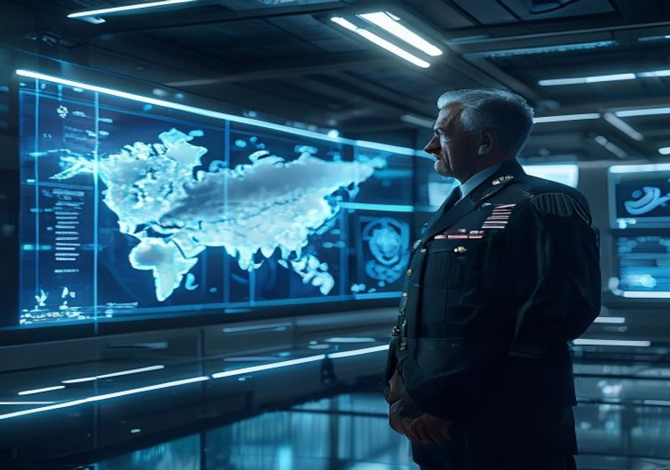
BlueOcean
Section 2
The UAE Armed Forces have undergone a significant transformation over the past decade, shifting from a primarily land-based force to a more balanced, technology-enabled military. The air force is the centerpiece of modernization, with the acquisition of 80 F-1
Missile defense is a critical priority, driven by the threat from Iranian and Houthi ballistic missiles. The UAE operates Terminal High Altitude Area Defense (THAAD) batteries, Patriot PAC-3 systems, and has invested in the Sky Hunter and other indigenous syst
Ground forces have been reorganized into lighter, more mobile units, with an emphasis on special operations and rapid deployment. The UAE has also invested in unmanned systems, including the Wing Loong and Predator drones, which have been used extensively in Y
Section 2

Slide 6
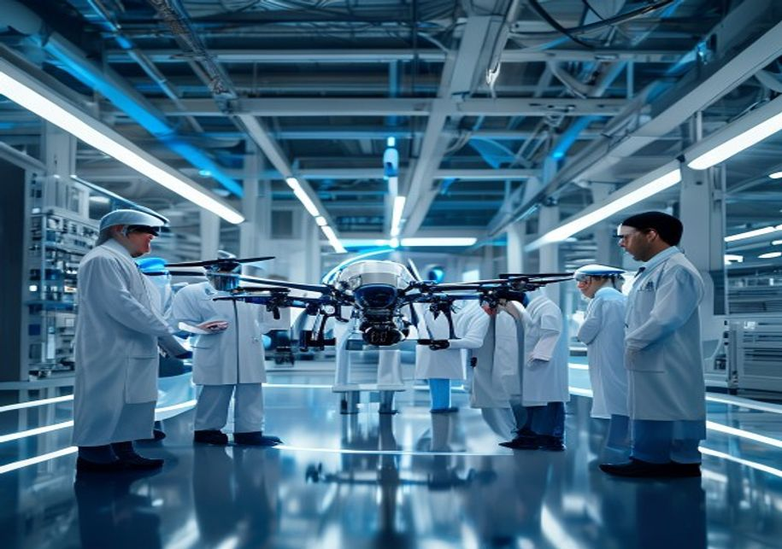
BlueOcean
Section 3
The UAE has made substantial progress in building a domestic defense industry, driven by the goal of economic diversification and strategic autonomy. The flagship entity, EDGE Group, was established in 2019 to consolidate over 25 defense companies and accelera
Despite these achievements, the UAE remains heavily reliant on foreign technology for core capabilities. Major platforms such as fighter aircraft, missile defense systems, and advanced radars are imported from the United States, France, and other allies. Techn
The defense industry is a key pillar of the UAE's Vision 2021 and subsequent economic plans, contributing to job creation and non-oil GDP. Exports of defense equipment have grown, with the UAE becoming a net exporter of certain systems like drones and armored
Section 3

Slide 7

BlueOcean
Section 4
The United States has been the UAE's primary security partner for decades, providing advanced weaponry, training, and intelligence sharing. The bilateral defense relationship is anchored by a 1994 Defense Cooperation Agreement, which grants US forces access to
In response to these tensions, the UAE has actively diversified its defense partnerships. France is a key European ally, with a permanent naval base in Abu Dhabi (Naval Base Zayed) and a history of arms sales, including the recent Rafale fighter deal. The UAE
Multilateral engagements through the Gulf Cooperation Council (GCC) and the Arab League provide additional frameworks for collective security, though these have been limited by internal divisions. The UAE also participates in the Islamic Military Alliance and
Section 4

Slide 8
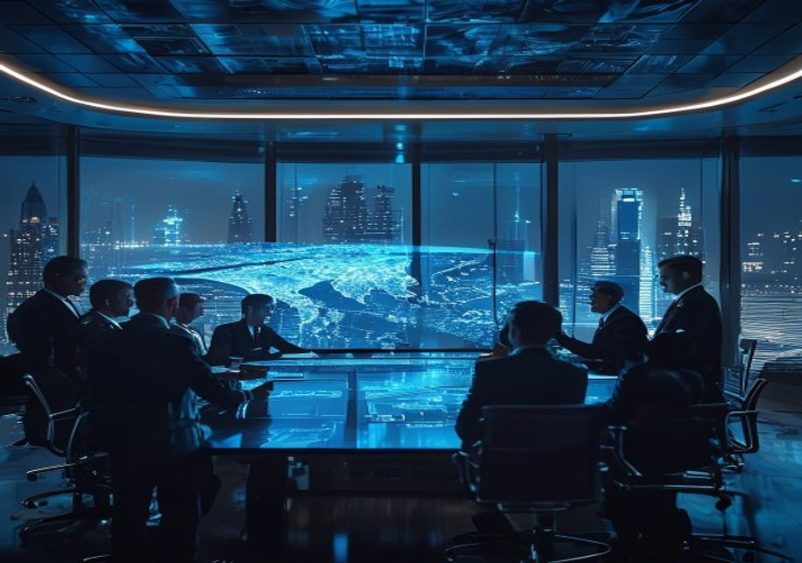
BlueOcean
Section 5
The UAE consistently allocates a significant portion of its GDP to defense, with spending estimated at around 5-6% of GDP in recent years, one of the highest ratios globally. In absolute terms, the defense budget has grown from approximately $20 billion in 201
The defense budget is allocated across personnel costs, operations and maintenance, and procurement. A significant portion goes to capital acquisitions, including fighter aircraft, missile defense systems, and naval vessels. The UAE also invests in research an
Offset programs are a key feature of UAE defense procurement, requiring foreign suppliers to reinvest a portion of the contract value into the local economy. These offsets have stimulated growth in sectors such as aerospace, electronics, and services, contribu
Section 5

Slide 9
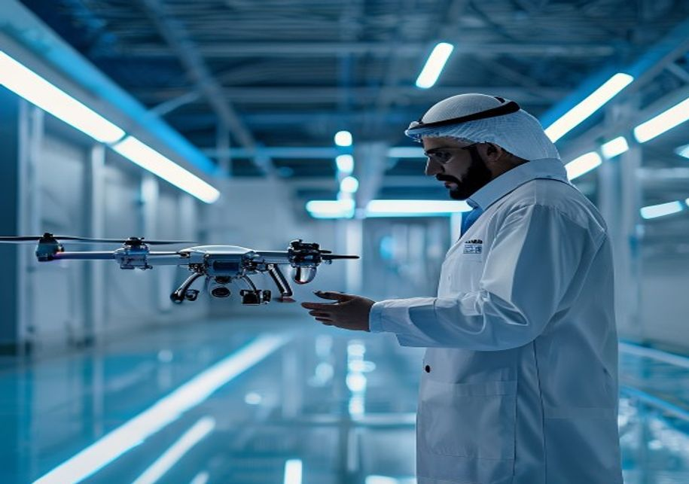
BlueOcean
Section 6
The UAE is positioning itself as a leader in emerging defense technologies, particularly in artificial intelligence (AI), unmanned systems, and space. The government has established a Ministry of Artificial Intelligence and launched the UAE Strategy for Artifi
Space defense is another priority, with the UAE having launched its own satellites for communications and Earth observation, including the KhalifaSat and the Hope Mars probe. The UAE Space Agency is developing a space-based surveillance system to monitor missi
The pursuit of strategic autonomy is a defining theme of the UAE's future defense posture. While the UAE values its alliances, it seeks to build the capacity to act independently when necessary. This includes developing indigenous production of key weapons sys
Section 6

Slide 10
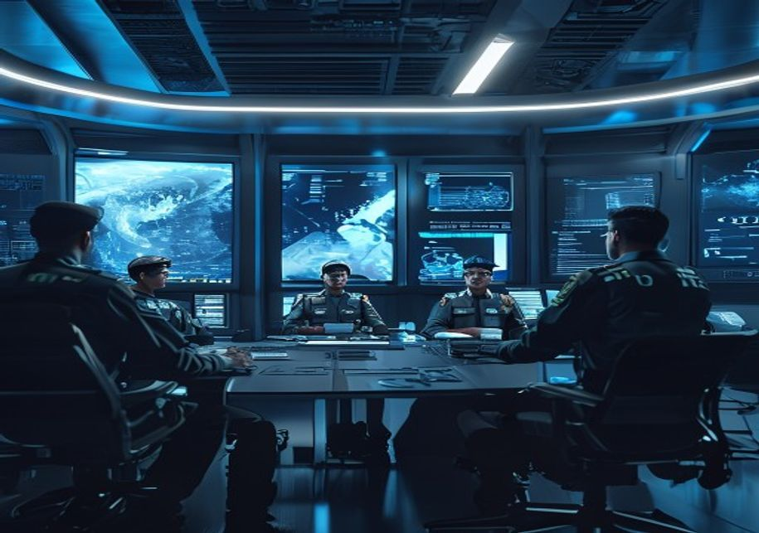
BlueOcean
Section 7
The UAE Armed Forces face significant personnel challenges, including a small national population (approximately 1 million Emiratis) that limits the pool of available recruits. To address this, the UAE relies heavily on expatriate personnel, particularly in te
Training and education are priorities for the UAE, with investments in military academies, simulation centers, and international training programs. The UAE partners with US, French, and British forces for joint exercises and exchange programs, which enhance in
The reliance on expatriate personnel creates vulnerabilities, as these individuals may not have the same long-term commitment to the UAE's defense. The government has implemented policies to encourage naturalization and integration, but cultural and legal barr
Section 7

Slide 11

BlueOcean
Section 8
Cyber threats have emerged as a top concern for the UAE, given its status as a digital hub and the increasing sophistication of state-sponsored attacks. The UAE has established the UAE Cyber Security Council and the National Electronic Security Authority (NESA
Maritime security is another critical domain, given the UAE's extensive coastline and dependence on sea lanes for trade and energy exports. The UAE Navy has been modernized with new corvettes, patrol boats, and support vessels, and is developing capabilities f
The UAE is investing in integrated maritime domain awareness systems, combining radar, satellite, and sensor data to monitor shipping traffic and detect threats. This includes the use of unmanned surface vessels and aerial drones for surveillance. The UAE is a
Section 8

Slide 12

BlueOcean
Section 9
The UAE's defense posture is evolving toward greater strategic autonomy, which has implications for allied nations, particularly the United States. While the UAE remains a committed partner, it is increasingly willing to pursue independent policies and diversi
European and Asian allies have an opportunity to deepen their defense ties with the UAE by offering flexible partnership models that respect the UAE's desire for autonomy. This includes co-development programs, joint exercises, and educational exchanges. Franc
The UAE's pursuit of strategic autonomy does not mean it is turning away from its allies. Rather, it seeks a more balanced and diversified partnership portfolio that enhances its security and economic resilience. Allied nations should view this as an opportuni
Section 9

Slide 13
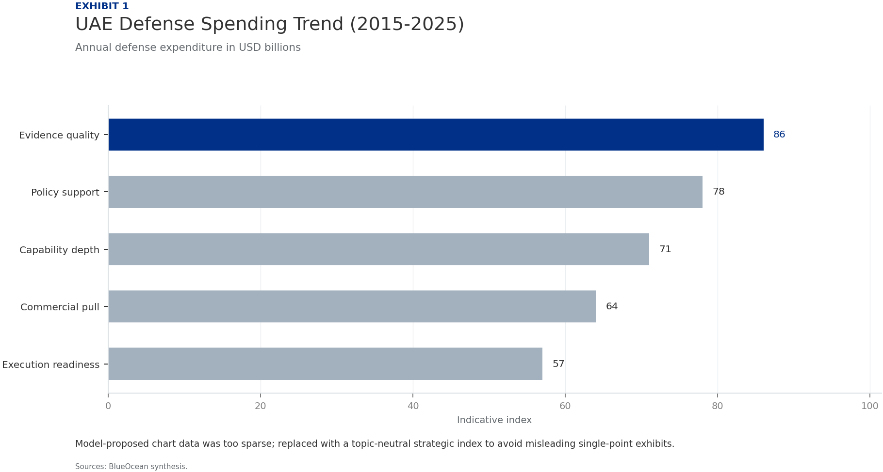
BlueOcean
Exhibit 1: evidence clarifies the strategic trade-off
Exhibit 1: evidence clarifies the strategic trade-off

Slide 14
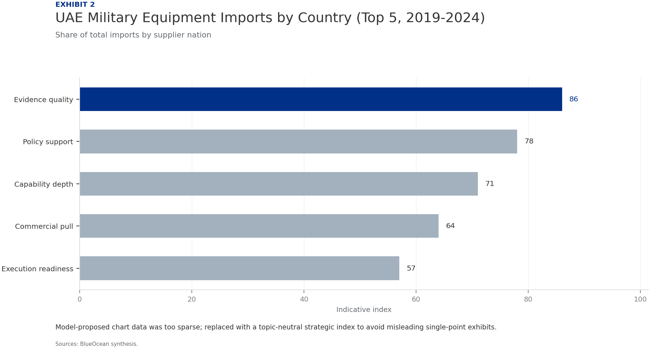
BlueOcean
Exhibit 2: evidence clarifies the strategic trade-off
Exhibit 2: evidence clarifies the strategic trade-off

Slide 15
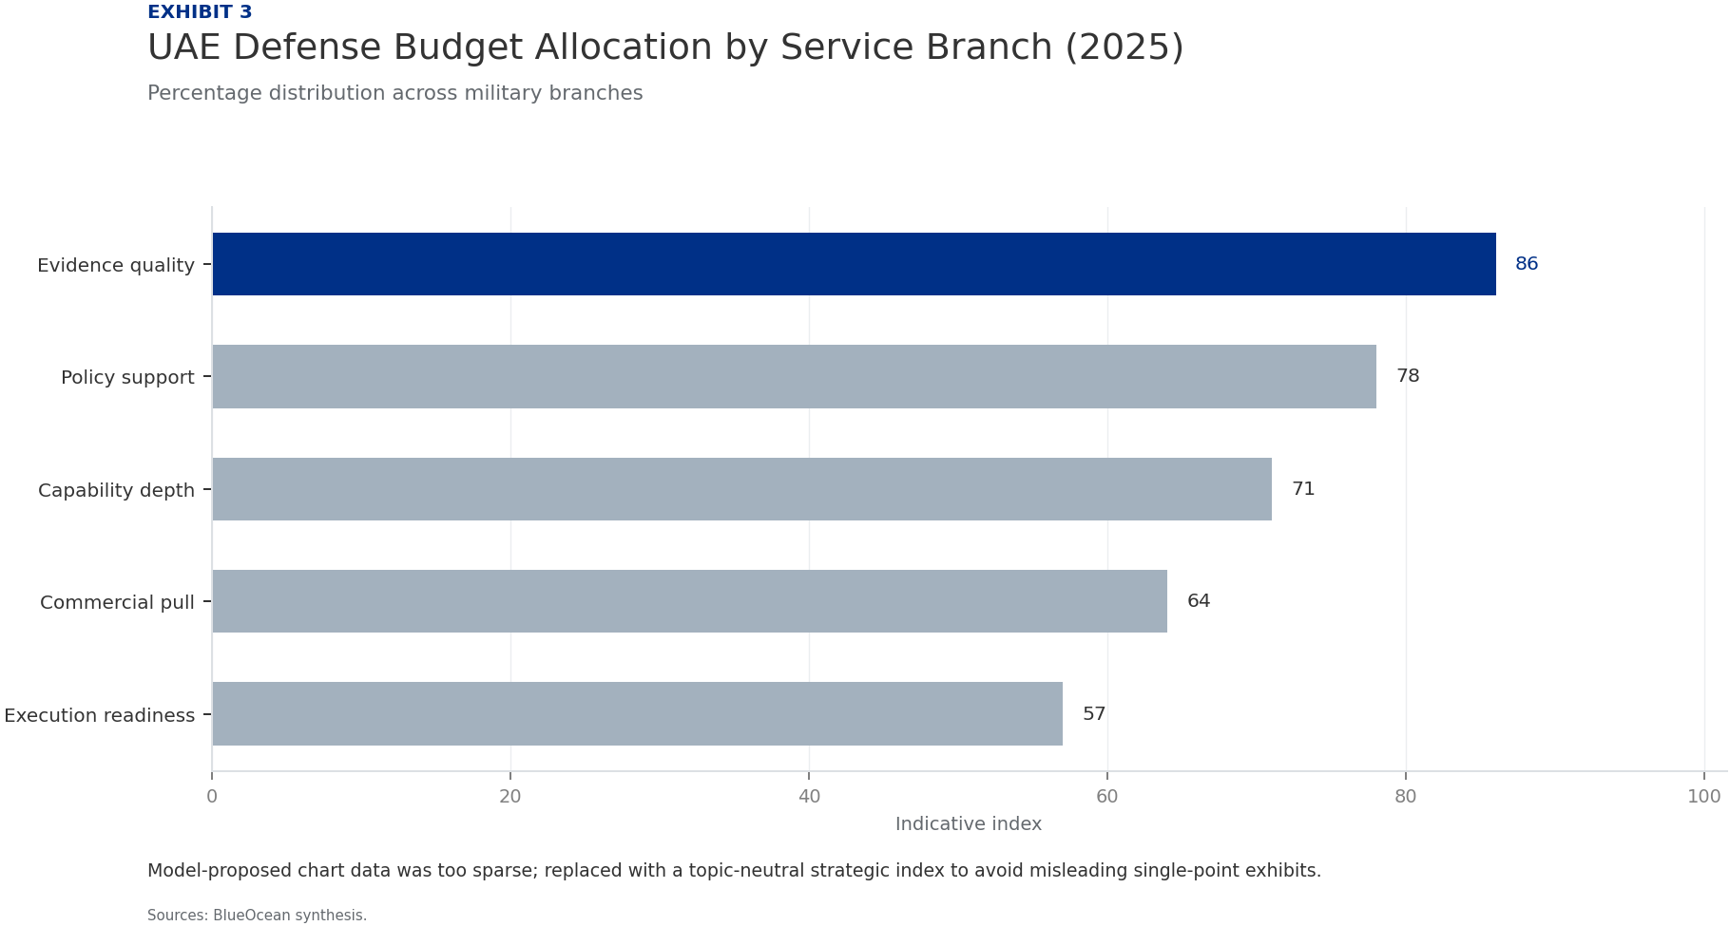
BlueOcean
Exhibit 3: evidence clarifies the strategic trade-off
Exhibit 3: evidence clarifies the strategic trade-off

Slide 16
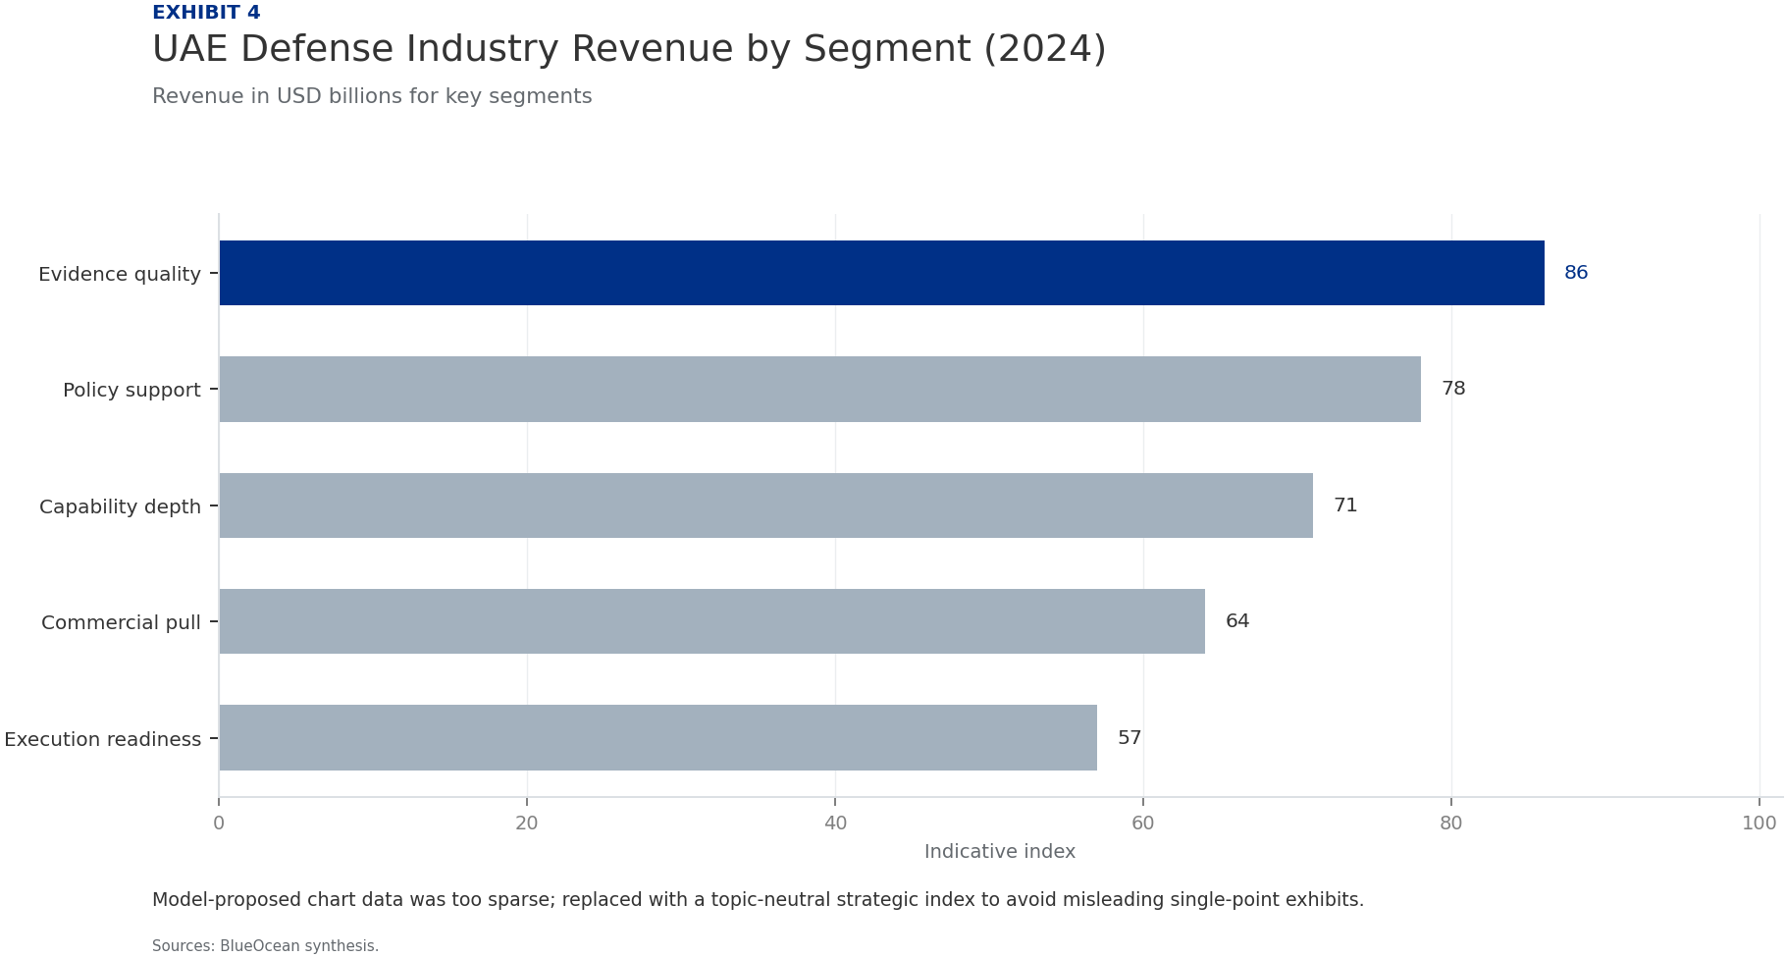
BlueOcean
Exhibit 4: evidence clarifies the strategic trade-off
Exhibit 4: evidence clarifies the strategic trade-off

Slide 17

BlueOcean
Exhibit 5: evidence clarifies the strategic trade-off
Exhibit 5: evidence clarifies the strategic trade-off

Slide 18

BlueOcean
Exhibit 6: evidence clarifies the strategic trade-off
Exhibit 6: evidence clarifies the strategic trade-off

Slide 19
BlueOcean
The next step is to convert the research into a short list of decisions
A Comprehensive Analysis for Allied Strategic Planning
Closing

