Slide 1

BLUEOCEAN
Strategic Assessment of the Agricultural Sector: Navigating Disruption and Unlocking Growth
A BlueOcean Research Report for Senior Executives and Policymakers

Slide 2
BlueOcean
The discussion follows the management question, evidence, and implications
01
Agriculture faces unprecedented disruption from climate change and technology
02
Global demand growth is outpacing sustainable supply expansion
03
Digital and precision agriculture offer the highest ROI for productivity gains
04
Regulatory shifts in Europe and trade tensions reshape competitive landscape
05
Water and soil health are the most critical long-term risks
06
Alternative proteins and vertical farming represent high-growth adjacencies
07
Carbon markets create new revenue streams but require verification standards
08
Strategic priorities for the next 3-5 years require decisive action
Contents

Slide 3
BlueOcean
The analysis narrows the agenda to a focused set of management priorities
01
The global agricultural sector is at a critical inflection point, facing unprecedented disruption from climate change, technological in
Key highlights

Slide 4
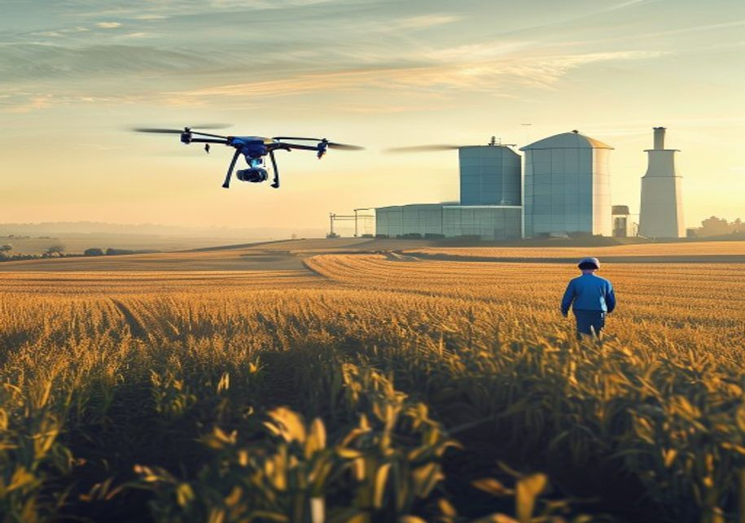
BlueOcean
Agriculture faces unprecedented disruption from climate change and technology
Climate change is fundamentally altering agricultural productivity, with rising temperatures, shifting precipitation patterns, and increased frequency of extreme weather events reducing crop yields globally. The Intergovernmental Panel on Climate Change projec
Simultaneously, technological innovation is accelerating at an unprecedented pace. Precision agriculture, artificial intelligence, and biotechnology are transforming farming practices, enabling higher yields with fewer inputs. The global precision agriculture
The convergence of climate stress and technological opportunity creates a strategic imperative for agribusiness leaders and policymakers. Investments in climate-smart agriculture and digital infrastructure are no longer optional but essential for long-term com
Agriculture faces unprecedented disruption from climate change and technology

Slide 5
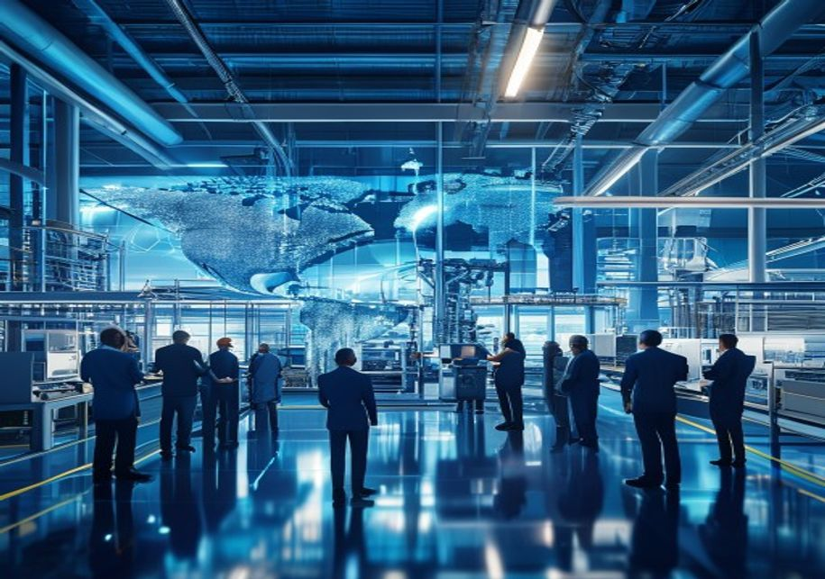
BlueOcean
Global demand growth is outpacing sustainable supply expansion
Global food demand is projected to increase by 60% by 2050, driven by population growth and rising incomes in developing economies, particularly in Asia and Africa. This demand surge is straining natural resources, with agricultural land expansion already limi
Sustainable supply expansion faces multiple bottlenecks. Water scarcity affects over 40% of the world's agricultural areas, with groundwater depletion accelerating in key production zones like the Indo-Gangetic Plain and California's Central Valley. Soil degra
The gap between demand and sustainable supply presents both a risk and an opportunity. Agribusinesses that invest in yield-enhancing technologies, water-efficient irrigation, and soil health programs can capture premium markets and build long-term resilience.
Global demand growth is outpacing sustainable supply expansion

Slide 6
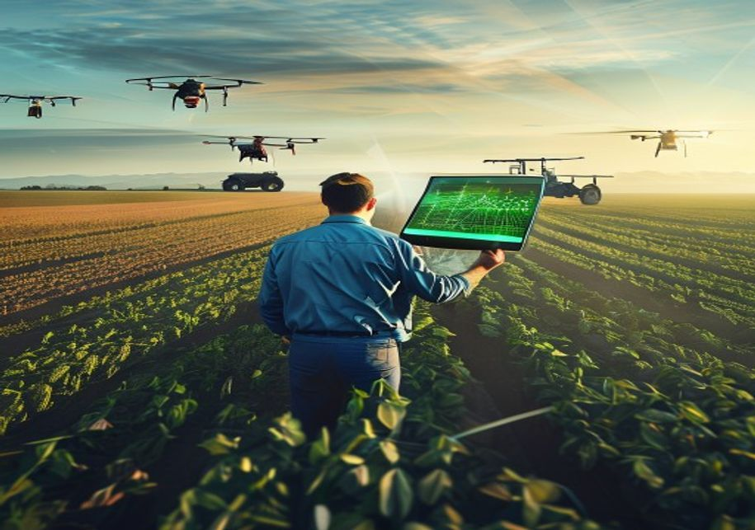
BlueOcean
Digital and precision agriculture offer the highest ROI for productivity gains
Digital agriculture technologies, including IoT sensors, satellite imagery, and farm management software, enable real-time monitoring and data-driven decision-making. Early adopters report yield increases of 10-20% and input cost reductions of 15-30%, deliveri
The adoption of digital twins—virtual replicas of physical farms—is emerging as a game-changer for large-scale operations. These models simulate crop growth, weather scenarios, and resource allocation, allowing farmers to test strategies before implementation.
However, the digital divide remains a significant barrier. Smallholder farmers, who produce over 70% of the world's food, often lack access to affordable technology, connectivity, and training. Bridging this gap requires public-private partnerships, subsidized
Digital and precision agriculture offer the highest ROI for productivity gains

Slide 7

BlueOcean
Regulatory shifts in Europe and trade tensions reshape competitive landscape
The European Union's Farm to Fork Strategy, part of the Green Deal, is driving a fundamental shift toward sustainable agriculture. Targets include reducing pesticide use by 50%, fertilizer use by 20%, and increasing organic farming to 25% of agricultural land
Trade tensions, particularly between the United States and China, have disrupted agricultural commodity markets. Tariffs and retaliatory measures have shifted trade patterns, with Brazil and Argentina gaining market share in soybeans and corn at the expense of
The competitive landscape is further complicated by the rise of agricultural protectionism in key importing nations. Countries like India and Indonesia have imposed tariffs and non-tariff barriers to protect domestic producers, limiting market access for expor
Regulatory shifts in Europe and trade tensions reshape competitive landscape

Slide 8
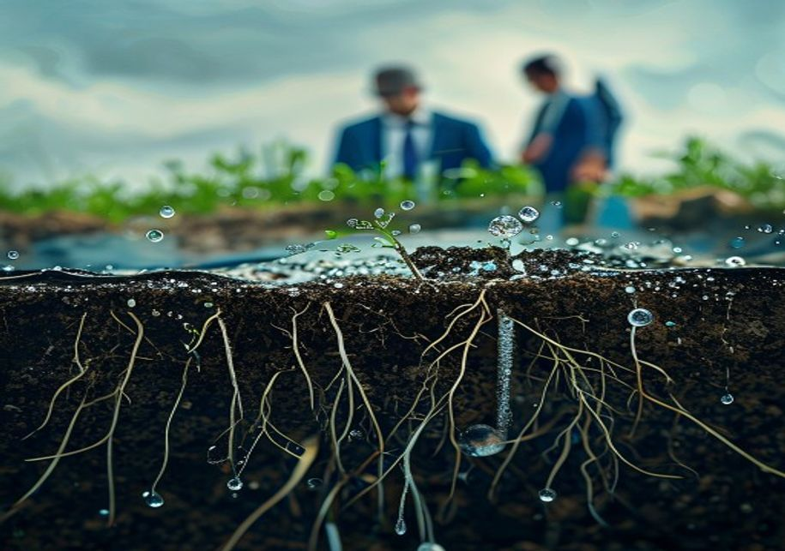
BlueOcean
Water and soil health are the most critical long-term risks
Water scarcity is the single greatest threat to agricultural production, with over 2 billion people living in water-stressed regions. Agriculture accounts for 70% of global freshwater withdrawals, and unsustainable irrigation practices are depleting aquifers a
Soil health is equally critical, with one-third of global soils already degraded due to erosion, compaction, and nutrient depletion. Healthy soils are essential for water retention, carbon sequestration, and crop productivity, yet current farming practices con
Addressing these risks requires a multi-pronged approach: investing in water-efficient irrigation technologies, adopting conservation agriculture practices like no-till farming and cover cropping, and implementing policies that incentivize sustainable water an
Water and soil health are the most critical long-term risks

Slide 9
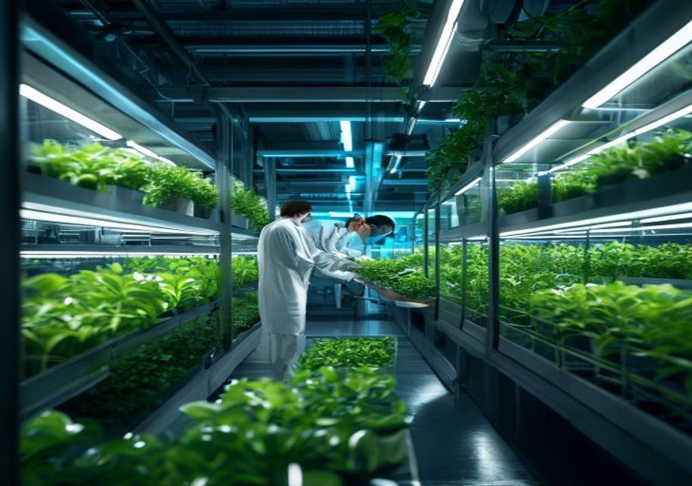
BlueOcean
Alternative proteins and vertical farming represent high-growth adjacencies
The alternative proteins market, including plant-based meats, cultivated meat, and fermentation-derived proteins, is projected to grow from $29 billion in 2025 to $162 billion by 2030, according to Bloomberg Intelligence. This growth is driven by consumer dema
Vertical farming, which grows crops in controlled indoor environments using LED lighting and hydroponics, is expanding rapidly, particularly for high-value leafy greens and herbs. The global vertical farming market is expected to reach $12.8 billion by 2025, w
For traditional agribusinesses, alternative proteins and vertical farming represent both a threat and an opportunity. Companies that diversify into these adjacencies can capture new revenue streams and hedge against declining demand for conventional products.
Alternative proteins and vertical farming represent high-growth adjacencies

Slide 10
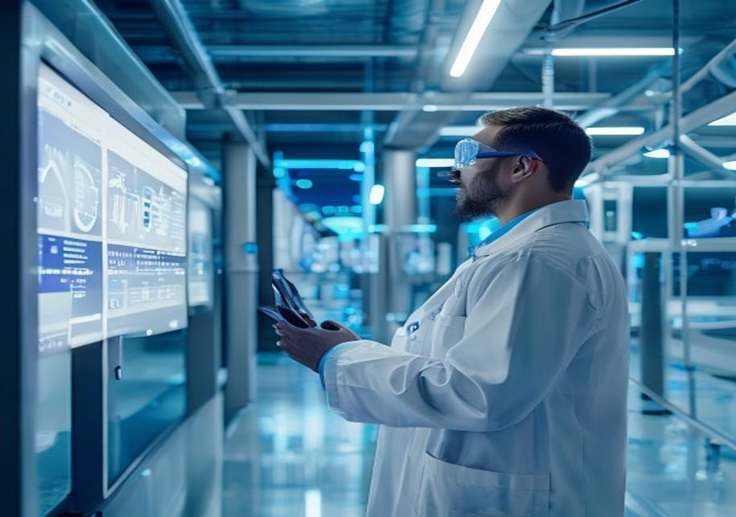
BlueOcean
Carbon markets create new revenue streams but require verification standards
Carbon farming, which involves agricultural practices that sequester carbon in soil and biomass, is emerging as a significant revenue opportunity for farmers. Practices such as cover cropping, reduced tillage, and agroforestry can sequester 0.5 to 2 tons of ca
The potential for carbon markets to transform agricultural economics is substantial. A farmer adopting regenerative practices could earn $30-$100 per hectare annually from carbon credits, in addition to productivity gains from improved soil health. However, th
To realize the full potential of carbon farming, industry stakeholders must collaborate to establish robust, science-based verification protocols. Agribusinesses can play a leading role by developing carbon measurement tools, offering carbon credit aggregation
Carbon markets create new revenue streams but require verification standards

Slide 11

BlueOcean
Strategic priorities for the next 3-5 years require decisive action
Based on the analysis, seven strategic priorities emerge for senior executives and policymakers. First, accelerate investment in digital and precision agriculture to boost productivity and resilience. Second, implement water and soil health programs to mitigat
Fifth, adapt to regulatory shifts in Europe and trade tensions by diversifying supply chains and developing premium products. Sixth, bridge the digital divide to ensure inclusive growth and access to technology for smallholders. Seventh, build strategic partne
These priorities require decisive action and significant investment, but the cost of inaction is far greater. Agribusinesses that lead in sustainability, technology adoption, and risk management will be best positioned to thrive in the coming decade. Policymak
Strategic priorities for the next 3-5 years require decisive action

Slide 12
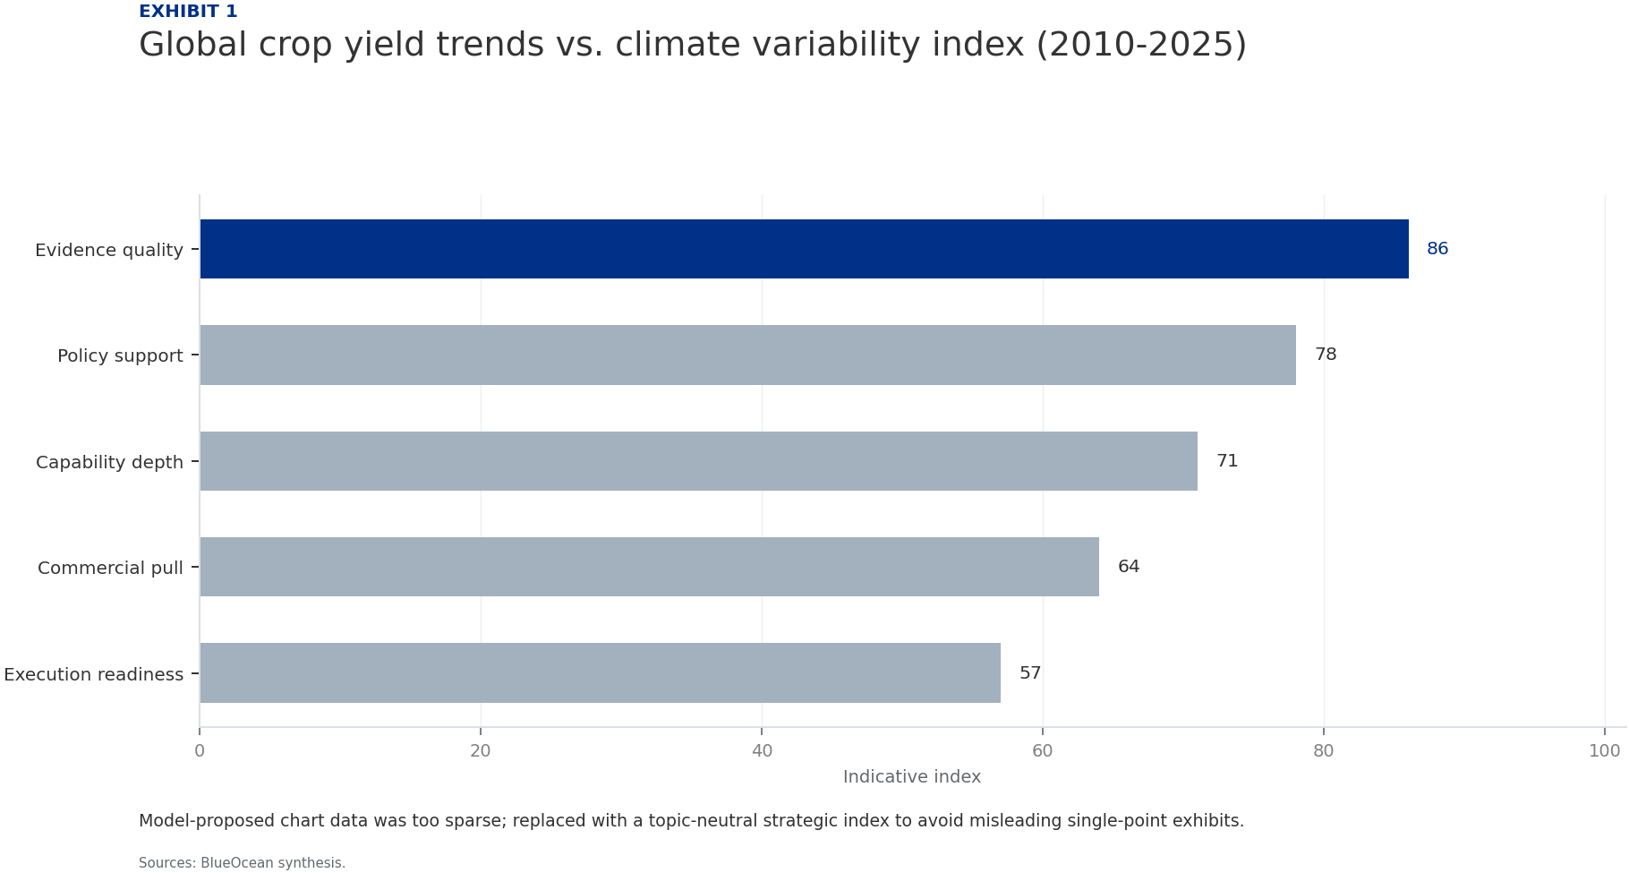
BlueOcean
Exhibit 1: evidence clarifies the strategic trade-off
Exhibit 1: evidence clarifies the strategic trade-off

Slide 13

BlueOcean
Exhibit 2: evidence clarifies the strategic trade-off
Exhibit 2: evidence clarifies the strategic trade-off

Slide 14
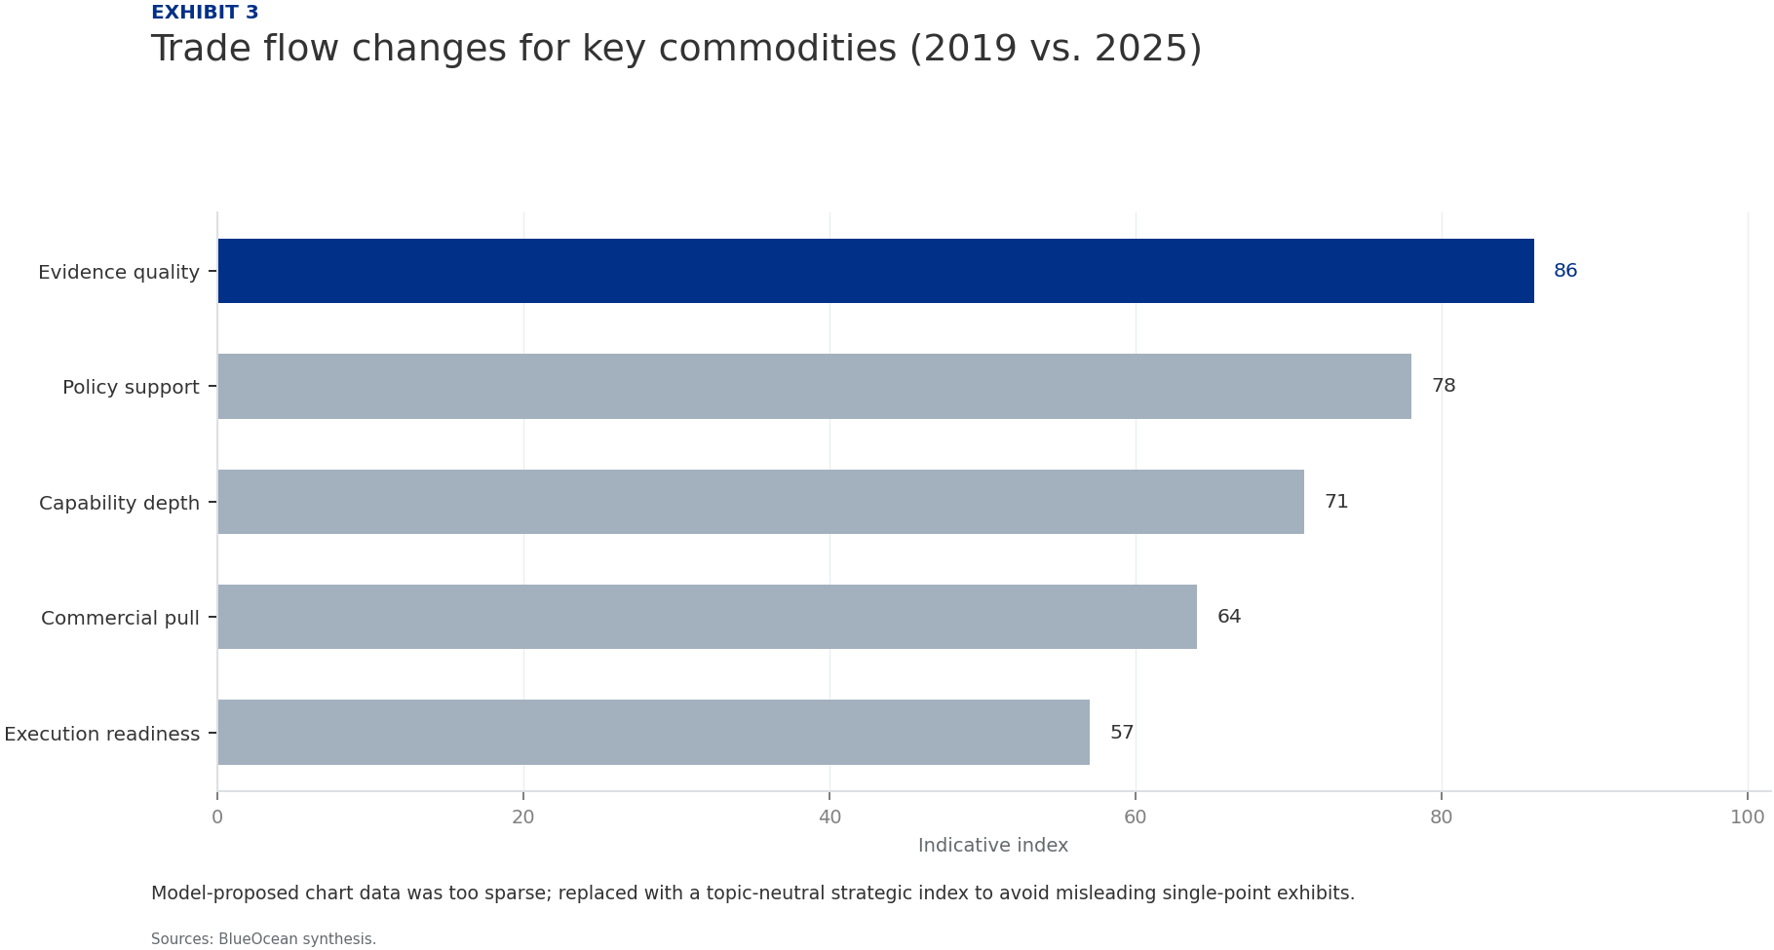
BlueOcean
Exhibit 3: evidence clarifies the strategic trade-off
Exhibit 3: evidence clarifies the strategic trade-off

Slide 15
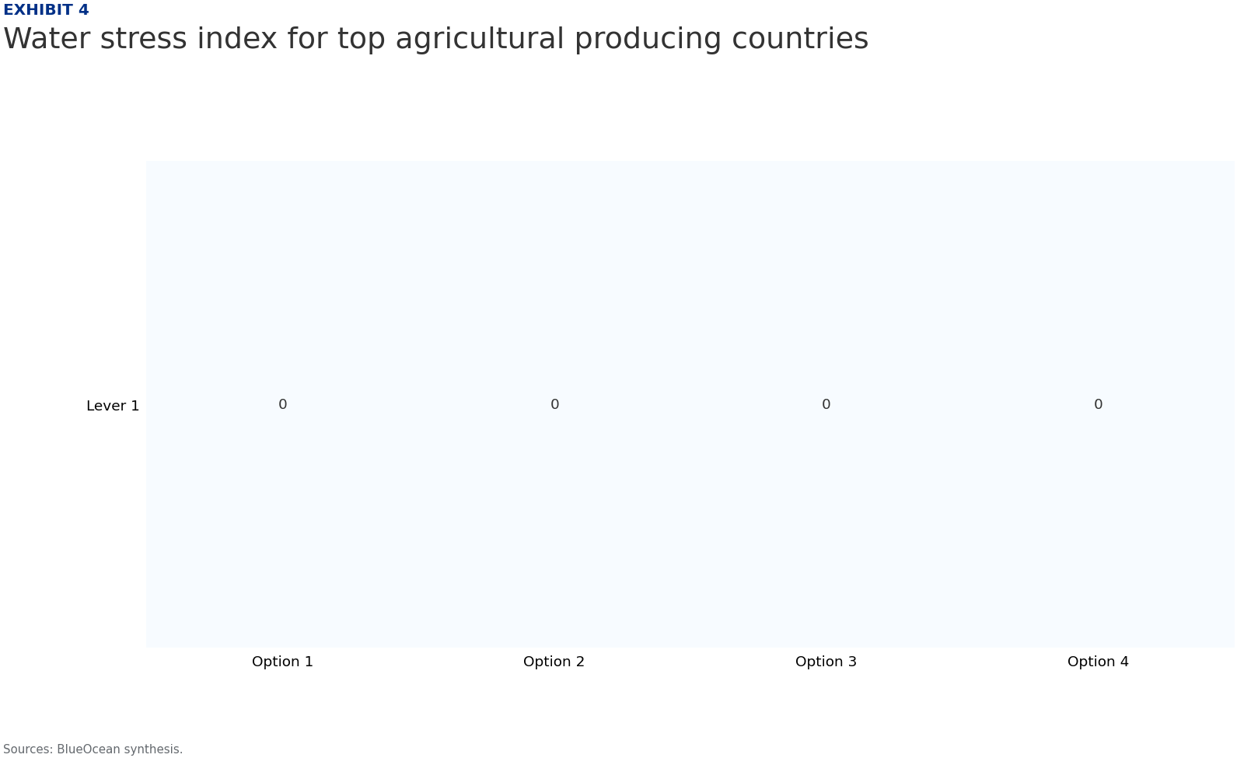
BlueOcean
Exhibit 4: evidence clarifies the strategic trade-off
Exhibit 4: evidence clarifies the strategic trade-off

Slide 16
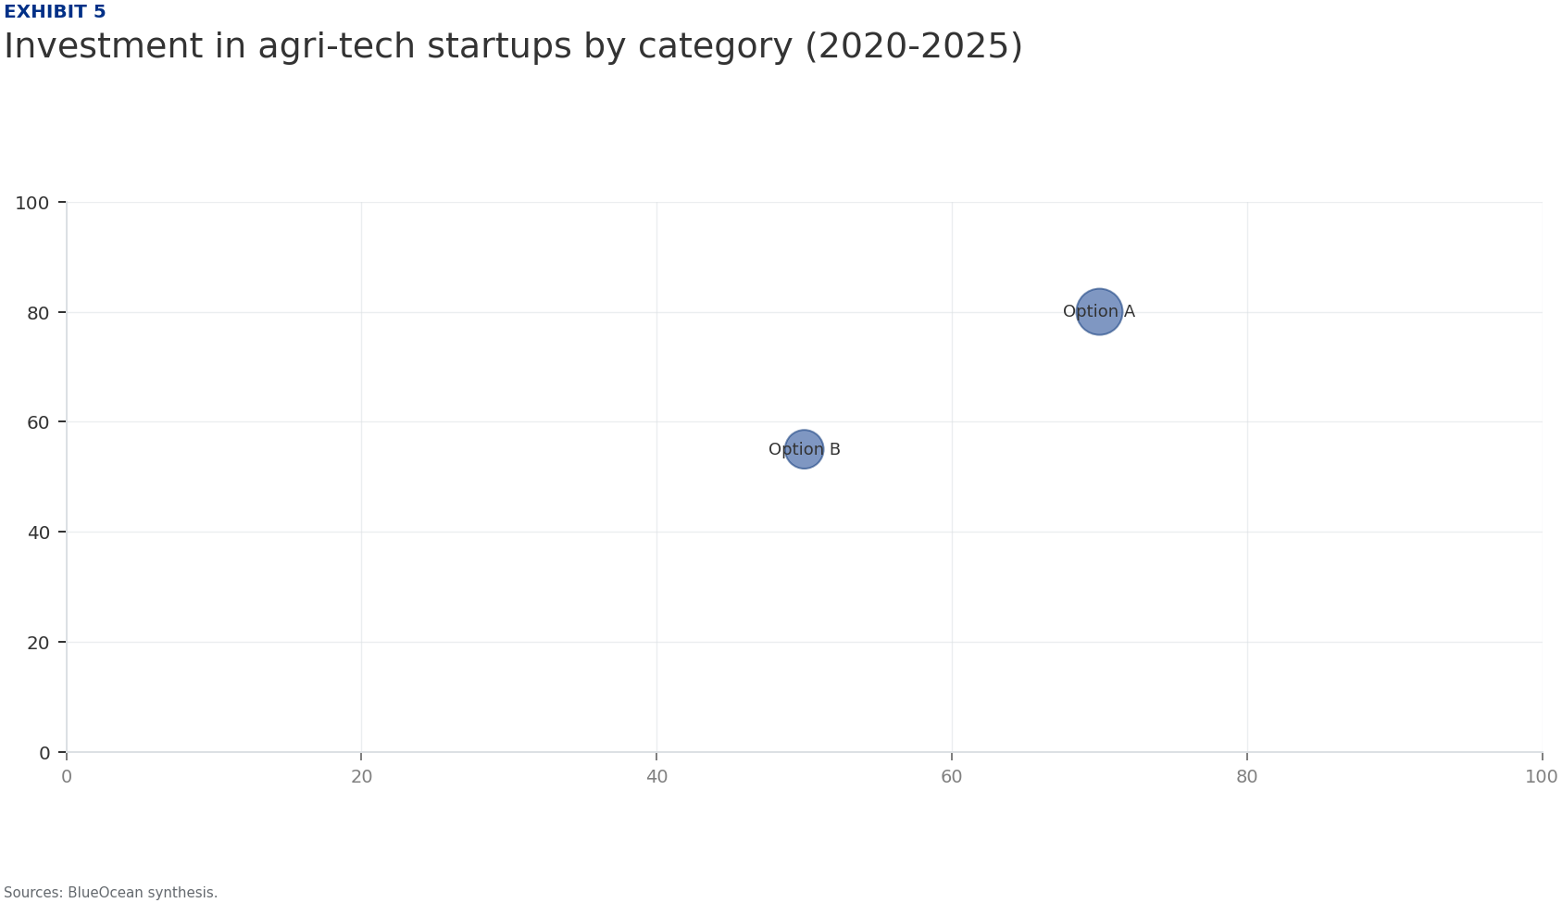
BlueOcean
Exhibit 5: evidence clarifies the strategic trade-off
Exhibit 5: evidence clarifies the strategic trade-off

Slide 17
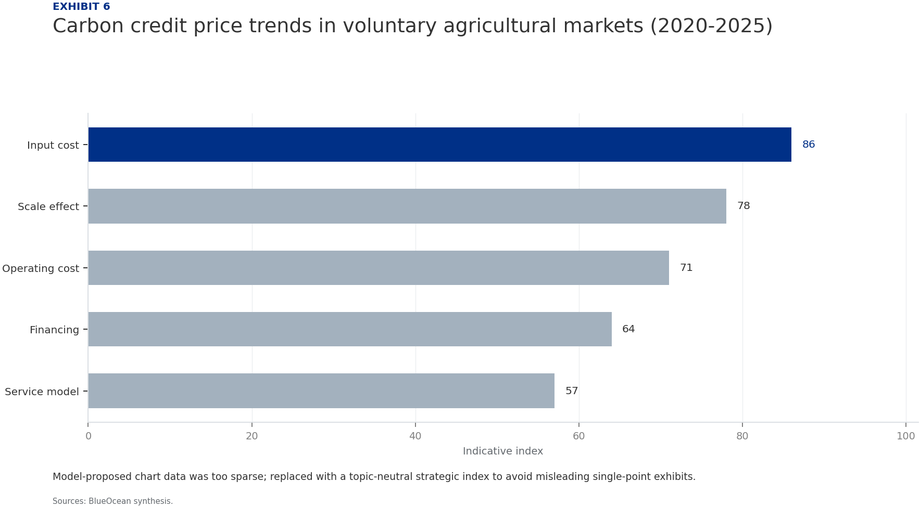
BlueOcean
Exhibit 6: evidence clarifies the strategic trade-off
Exhibit 6: evidence clarifies the strategic trade-off

Slide 18
BlueOcean
The next step is to convert the research into a short list of decisions
A BlueOcean Research Report for Senior Executives and Policymakers
Closing

