Slide 1
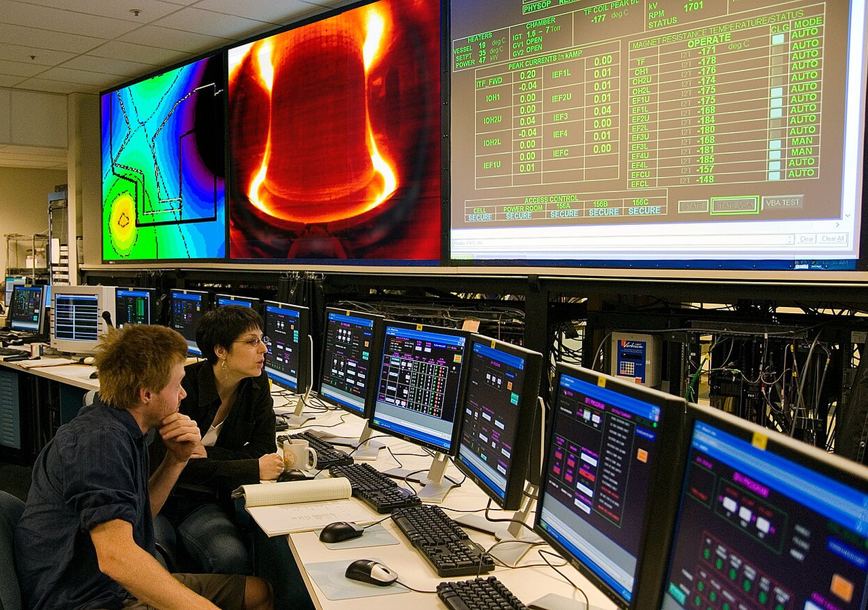
BLUEOCEAN
Nuclear Fusion Commercialization: Strategic Implications for Energy Markets and Investment
A CEO-Ready Assessment of Technology Readiness, Economic Viability, and Geopolitical Impact

Slide 2
BlueOcean
The discussion follows the management question, evidence, and implications
01
Fusion Commercialization Is Advancing but Still Faces a Decade-Long Path to Grid-Scale Deployment
02
Private Fusion Ventures Are Accelerating Timelines with Innovative Approaches and Significant Funding
03
Economic Viability of Fusion Depends on Achieving Cost Parity with Renewables and Fission
04
Ignition changed the physics case, not the commercialization case
05
Private capital is accelerating experimentation but not removing technical risk
06
Cost competitiveness is the route from breakthrough to adoption
07
The path is gated by fuel, materials and regulation
08
First markets should be selected by value density, not market size
Contents

Slide 3
BlueOcean
The analysis narrows the agenda to a focused set of management priorities
01
Fusion energy commercialization is advancing rapidly, driven by public-private partnerships and significant private investment, but rem
02
The 2022 fusion ignition milestone at Lawrence Livermore National Laboratory demonstrated scientific breakeven, yet key technical hurdl
03
Economic viability hinges on achieving cost parity with renewables and fission, with levelized cost estimates ranging from [insert veri
04
Strategic implications include potential disruption of fossil fuel markets, enhanced energy security, and new geopolitical dynamics.
05
Immediate next step: monitor milestone-based programs (e.g., DOE Milestone-Based Fusion Development Program) and invest in early-stage
06
The CEO-level question is not whether Nuclear fusion commercialization outlook and strategic implications is interesting, but which dec
07
Management should separate verified facts, directional scenarios and open questions before committing capital, partnerships or market-e
08
Technical evidence only matters when it changes revenue potential, cost position, investment return, execution risk or the timing of a
Key highlights

Slide 4
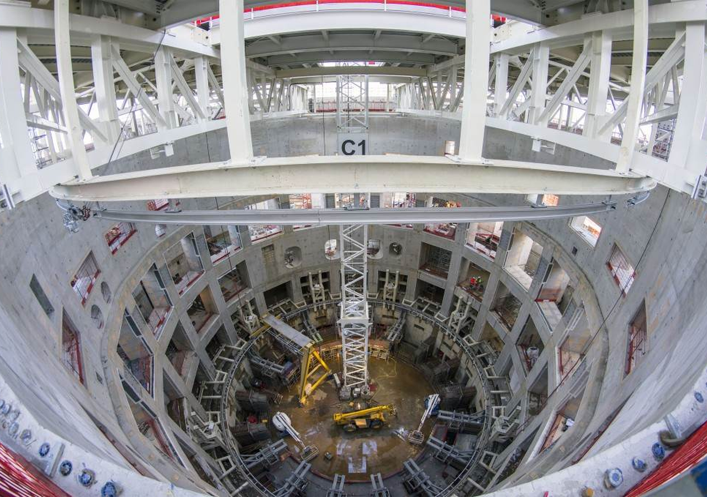
BlueOcean
Fusion Commercialization Is Advancing but Still Faces a Decade-Long Path to Grid-Scale Deployment
The 2022 fusion ignition milestone proves scientific feasibility, but commercial fusion remains a decade or more away, requiring sustained investment and risk management.
The 2022 fusion ignition milestone at Lawrence Livermore National Laboratory marked a historic scientific achievement, demonstrating for the first time that controlled fusion can produce more energy than the laser energy used to drive it. This breakthrough has
ITER, the international tokamak project, remains the flagship public effort, aiming to achieve sustained fusion power at plant scale. With a construction timeline that has faced repeated delays, ITER's first plasma is now expected in the late 2020s, with full
Private fusion companies are pursuing more aggressive timelines. Commonwealth Fusion Systems, a spinout from MIT, is building SPARC, a compact tokamak designed to achieve net energy gain by 2025-2026. Helion Energy, which uses a field-reversed configuration, a
Key implications
- Fusion ignition is a scientific breakthrough, not a commercial one.
- ITER and private ventures are on parallel tracks with different timelines.
Fusion Commercialization Is Advancing but Still Faces a Decade-Long Path to Grid-Scale Deployment

Slide 5
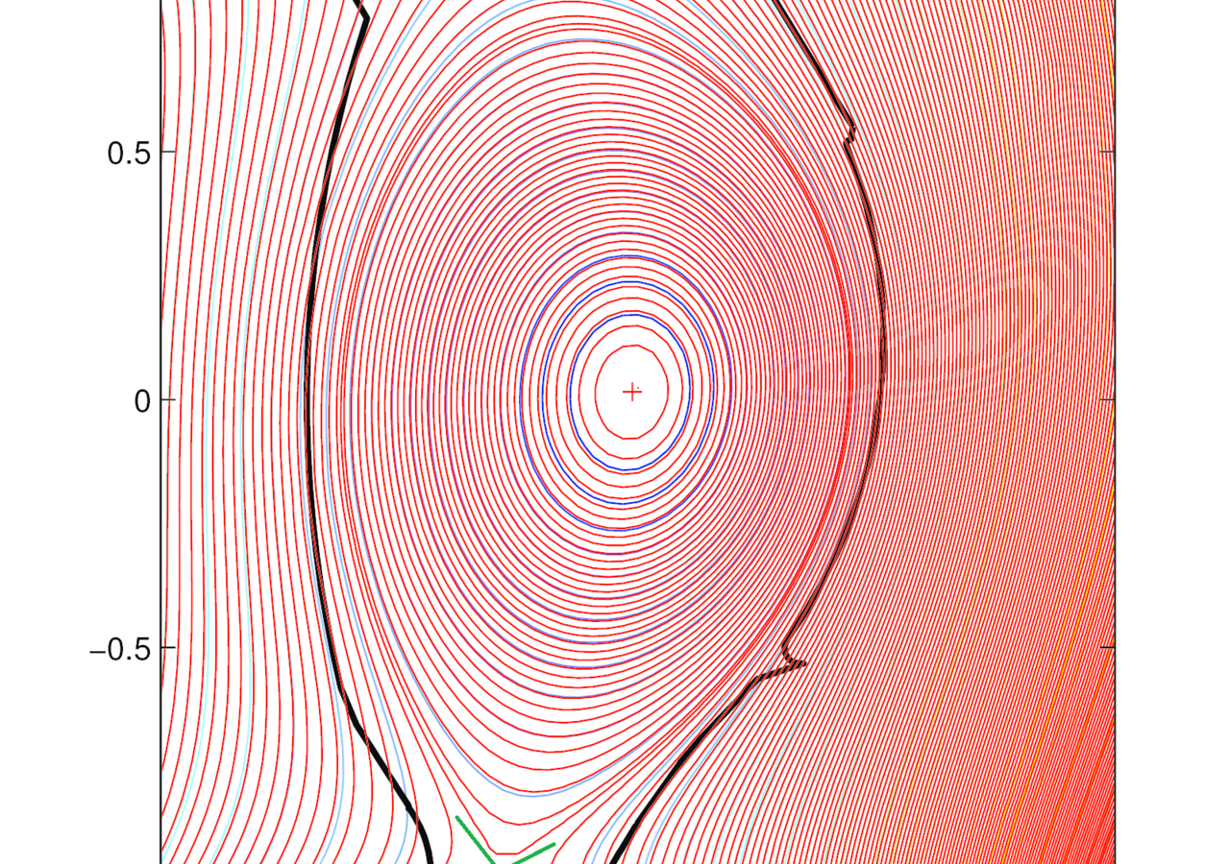
BlueOcean
Private Fusion Ventures Are Accelerating Timelines with Innovative Approaches and Significant Funding
Over $5 billion in private capital is driving rapid innovation, but due diligence must focus on technical feasibility and milestone progress.
The private fusion sector has experienced a surge in investment, with over $5 billion raised by more than 30 companies globally. This influx of capital is driving rapid innovation and compressing development timelines. Unlike government projects, private ventu
Commonwealth Fusion Systems (CFS) is a standout, having raised over $2 billion. Their SPARC tokamak, built with high-temperature superconducting magnets, is designed to be smaller and cheaper than ITER. CFS aims to demonstrate net energy gain by 2025 and build
Helion Energy, backed by investors including Sam Altman, is developing a pulsed fusion system that directly recovers electricity without a steam turbine. They claim their sixth-generation prototype will demonstrate net electricity production in 2024. Helion's
Key implications
- Private fusion has raised >$5B; CFS, Helion, TAE lead.
- Diverse approaches increase chance of success but fragment investment.
Private Fusion Ventures Are Accelerating Timelines with Innovative Approaches and Significant Funding

Slide 6
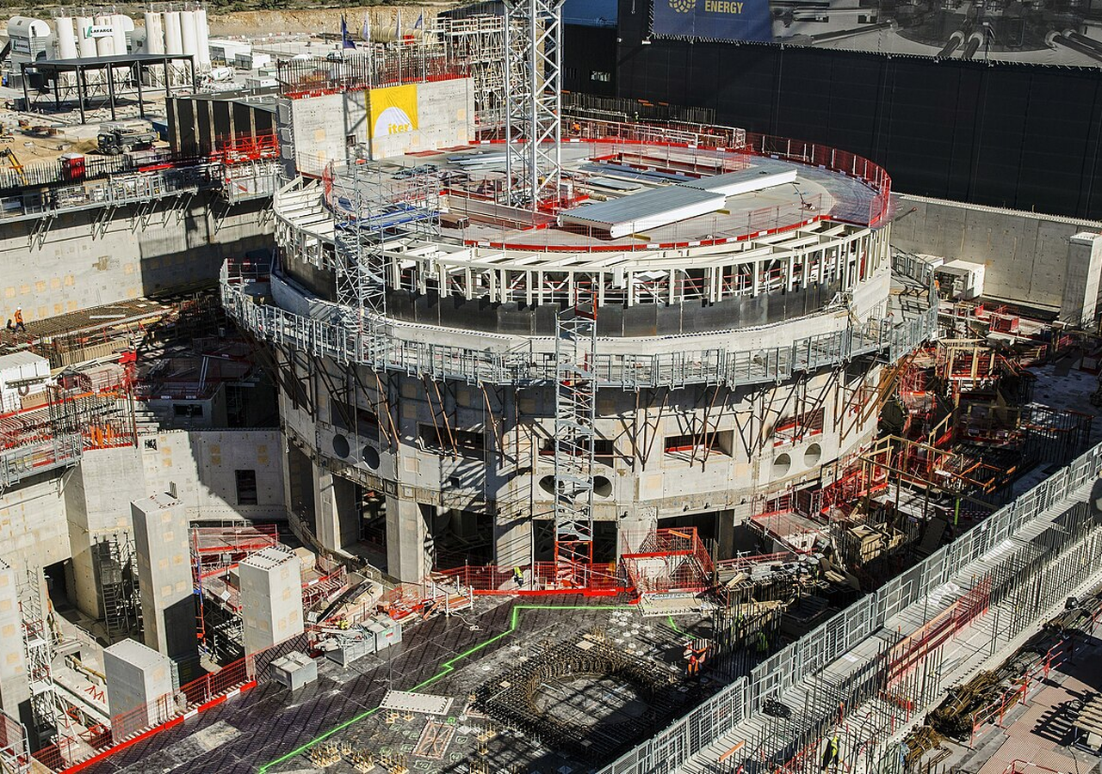
BlueOcean
Economic Viability of Fusion Depends on Achieving Cost Parity with Renewables and Fission
Fusion's economic case is unproven; achieving LCOE below $50/MWh is critical to compete with solar+storage.
The economic case for fusion rests on its potential to provide baseload clean power at a competitive cost. However, current cost estimates are highly uncertain, with no commercial fusion plant yet built. Projections for levelized cost of energy (LCOE) range fr
For comparison, solar and wind LCOE have fallen to $30-60 per MWh in many markets, and with storage, firm power costs are around $60-100 per MWh. Nuclear fission LCOE is typically $100-150 per MWh for new builds. Fusion must achieve costs at or below these lev
Capital costs for fusion are expected to be high, with estimates of $5-10 billion per GW for first-of - a-kind plants. Construction timelines of 10-15 years add to financing costs. Learning curve effects could reduce costs for subsequent plants, but initial pr
Key implications
- Fusion LCOE estimates range $50-150/MWh; must beat solar+storage.
- Capital costs are high; learning curves may reduce costs.
Economic Viability of Fusion Depends on Achieving Cost Parity with Renewables and Fission

Slide 7
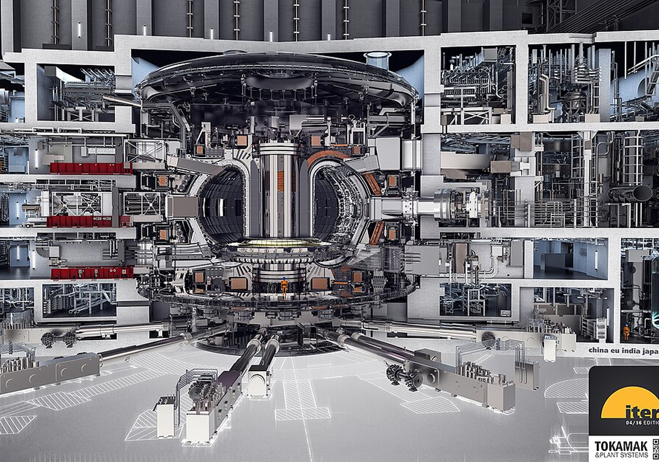
BlueOcean
Ignition changed the physics case, not the commercialization case
The 2022 milestone matters, but it does not yet answer the plant, cost or reliability questions.
LLNL's ignition shot reset the credibility of fusion science, but it did not prove a power plant. The commercial question starts after target gain: repeated operation, heat extraction, net electricity, maintainability and economics.
The most useful interpretation is staged. Ignition improves the odds that fusion deserves management attention, while leaving the investment case dependent on integrated pilot evidence rather than scientific headlines.
For customer strategy, the current public record supports this distinction. A public source anchors this point: The Department of Energy has been a leader in fusion energy research since the 1950s and supports groundbreaking advances today. Each new milestone
Key implications
- Separate science proof from plant proof
- Track integrated pilot evidence
Ignition changed the physics case, not the commercialization case

Slide 8
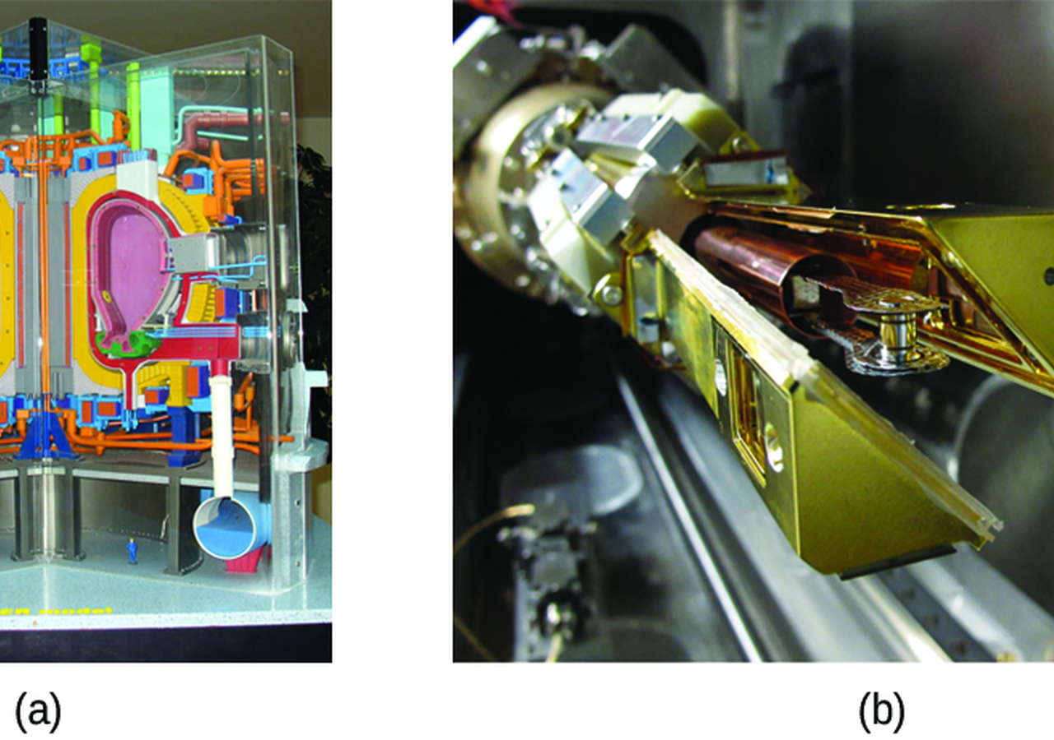
BlueOcean
Private capital is accelerating experimentation but not removing technical risk
Funding growth expands the number of shots on goal, while the decisive proof still comes from operating systems.
Private fusion funding has made the industry broader and faster-moving. It has also shifted part of the learning curve from public laboratories to venture-backed developers, suppliers and corporate partners.
For partner strategy, capital alone does not remove the hard constraints: plasma control, magnets, materials, tritium breeding, heat extraction and maintenance have to work together at plant scale. A large round should therefore be read as option value, not as
The strategic benefit of the funding wave is earlier access to learning. Partnerships, supplier relationships and customer dialogues can reveal which approaches are credible before the market is obvious.
Key implications
- Use funding as a learning signal
- Do not equate capital raised with de-risking
Private capital is accelerating experimentation but not removing technical risk

Slide 9

BlueOcean
Cost competitiveness is the route from breakthrough to adoption
Fusion must compete with renewables, storage, gas and fission on buyer economics, not novelty.
Fusion's promise is firm clean power with high availability. That promise becomes commercially relevant only if installed cost, uptime, maintenance and fuel-cycle economics create a price customers can underwrite.
The comparison set is unforgiving. Solar, wind and gas already set low-cost reference points, while fission shows how construction risk can overwhelm theoretical capacity-factor advantages.
At the portfolio level, the executive question around Cost competitiveness is the route from breakthrough to adoption is practical: which commitments create learning without locking the company into a cost curve, customer promise or regulatory position that th
Key implications
- Benchmark against actual alternatives
- Watch availability and installed cost
Cost competitiveness is the route from breakthrough to adoption

Slide 10
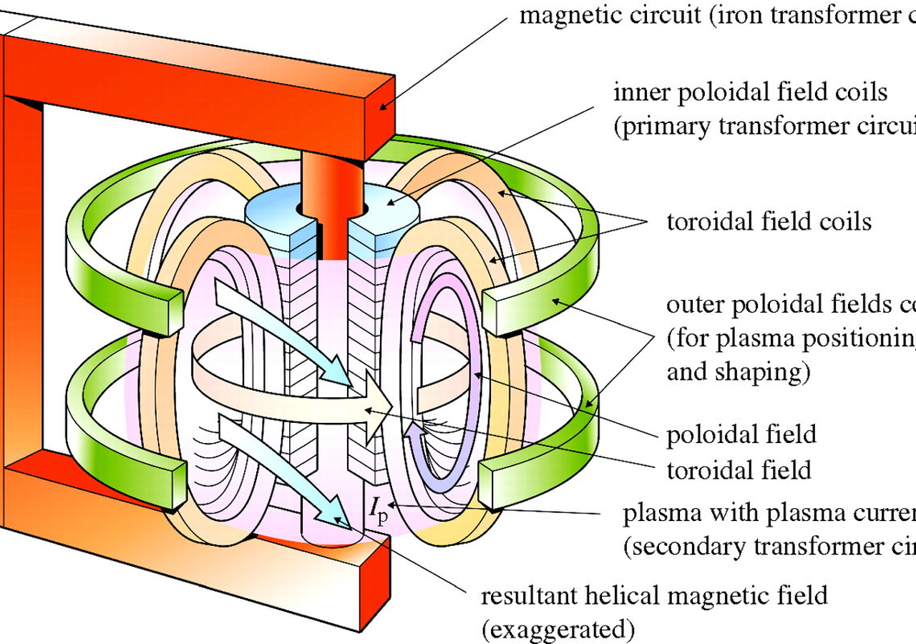
BlueOcean
The path is gated by fuel, materials and regulation
The critical path runs through systems that make a plant repeatable, licensable and maintainable.
A viable deuterium-tritium pathway needs a credible tritium strategy. Buying today's scarce tritium is not enough; breeding, recovery and accounting have to be proven as part of the plant.
Regulation is moving, but not yet standardized across markets. Companies that understand licensing early can shape site choice, partner selection and customer commitments before competitors do.
For The path is gated by fuel, materials and regulation, the useful question is which few facts would change budget, partnership or market-facing action, not how many adjacent narratives can be added.
Key implications
- Tritium is a hard constraint
- Materials lifetime drives economics
The path is gated by fuel, materials and regulation

Slide 11
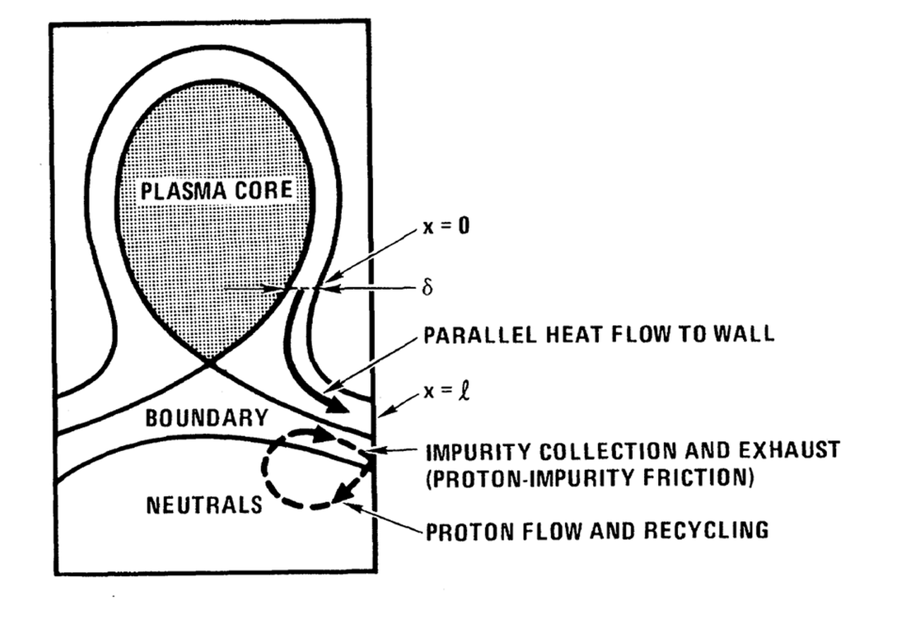
BlueOcean
First markets should be selected by value density, not market size
The early question is where fusion's attributes command a premium before commodity power economics are proven.
Grid electricity is the largest addressable market, but it may not be the best first market. A commodity power buyer will compare fusion against cheap renewables, storage, gas and fission.
Industrial heat, hydrogen and data centers can value round - the-clock clean energy differently. These customers may tolerate higher prices if fusion solves reliability, siting or decarbonization constraints that alternatives struggle to meet.
The practical test is customer commitment. Memoranda and announcements matter less than bankable offtake, site access, interconnection work and willingness to share development risk.
Key implications
- Choose markets by willingness to pay
- Test bankable offtake early
First markets should be selected by value density, not market size

Slide 12
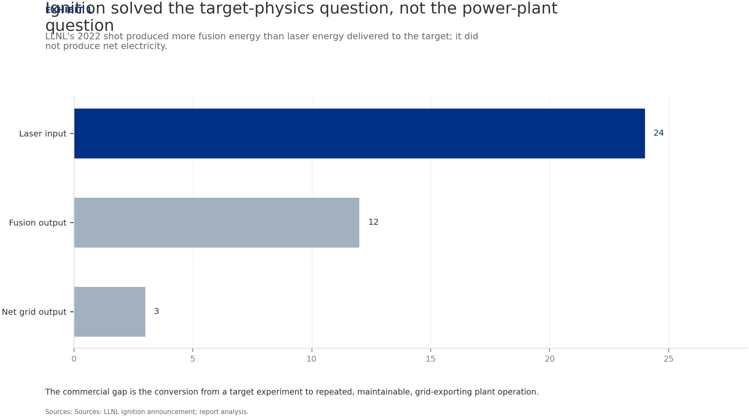
BlueOcean
Exhibit 1: evidence clarifies the strategic trade-off
Exhibit 1: evidence clarifies the strategic trade-off

Slide 13
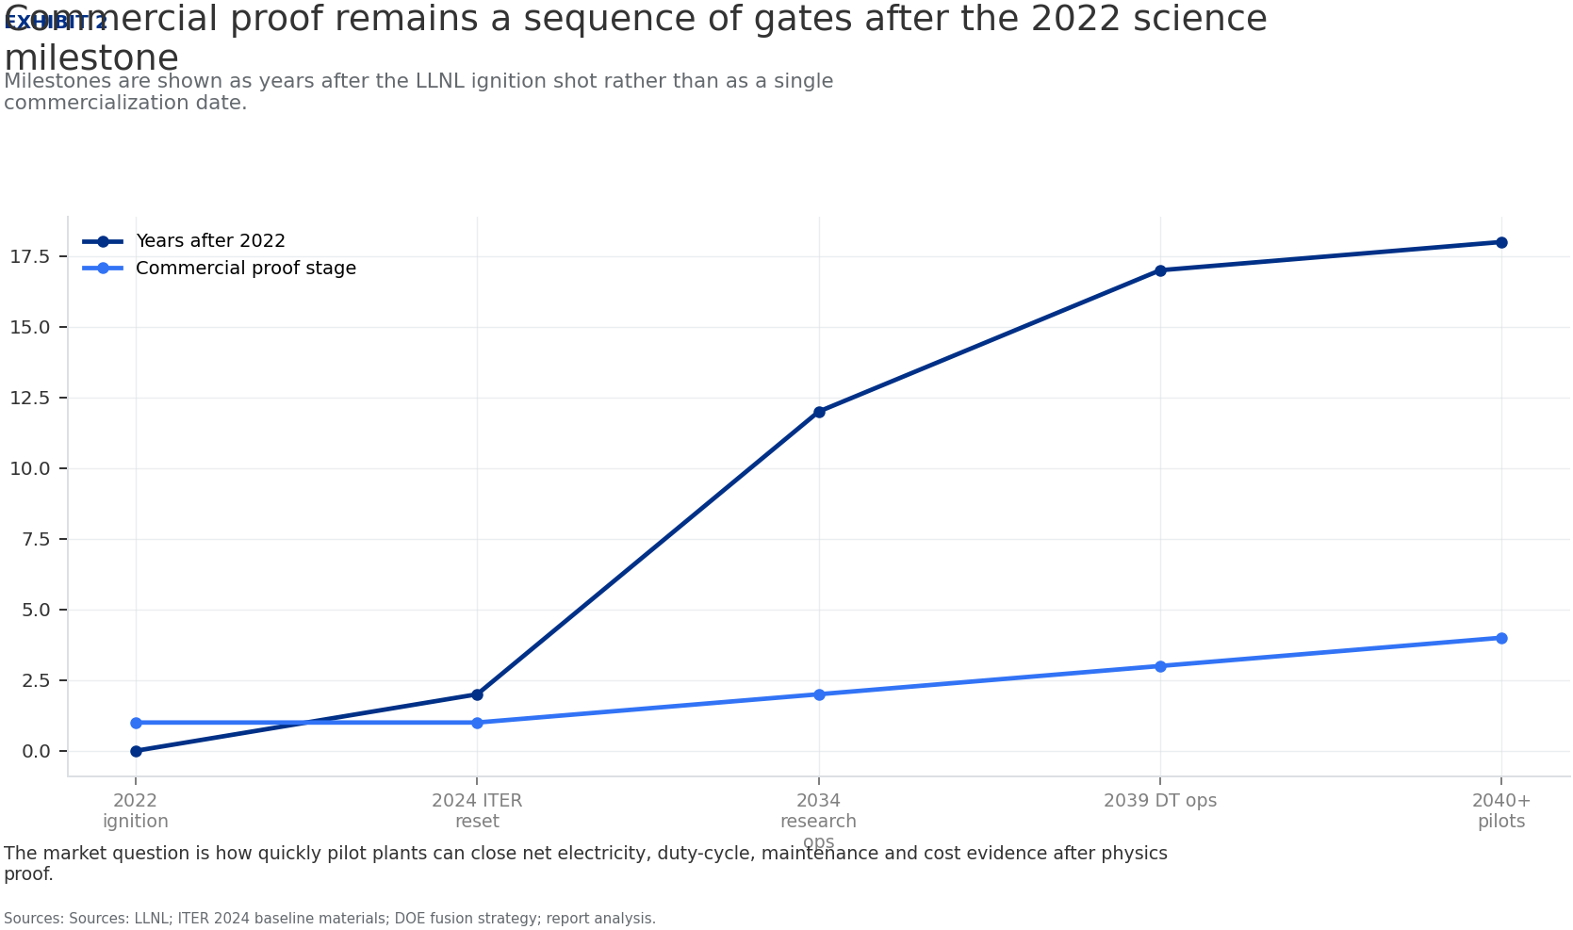
BlueOcean
Exhibit 2: evidence clarifies the strategic trade-off
Exhibit 2: evidence clarifies the strategic trade-off

Slide 14
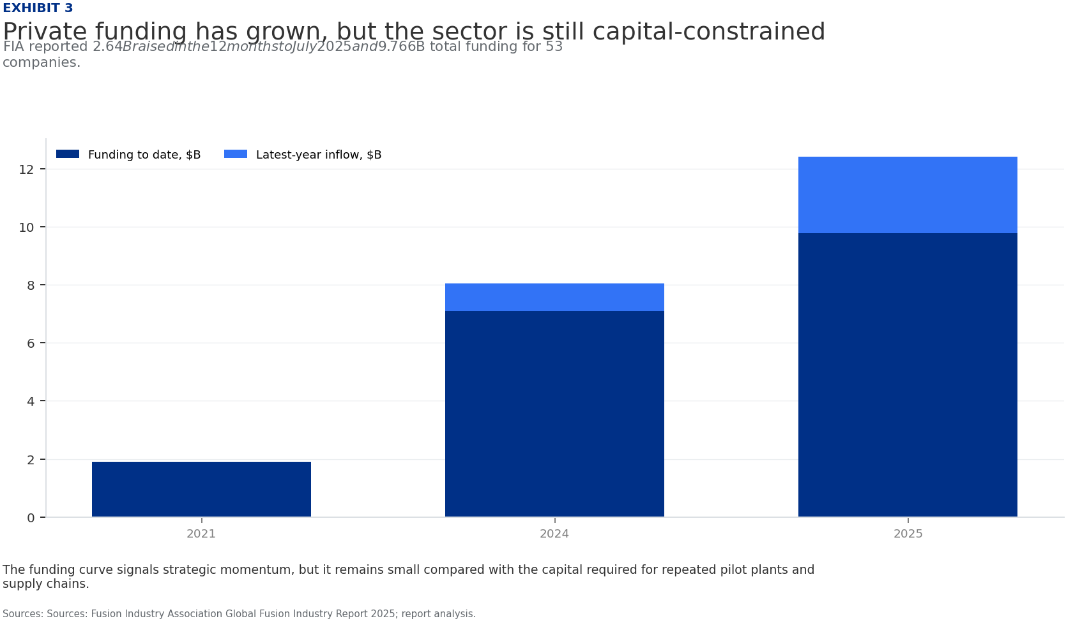
BlueOcean
Exhibit 3: evidence clarifies the strategic trade-off
Exhibit 3: evidence clarifies the strategic trade-off

Slide 15
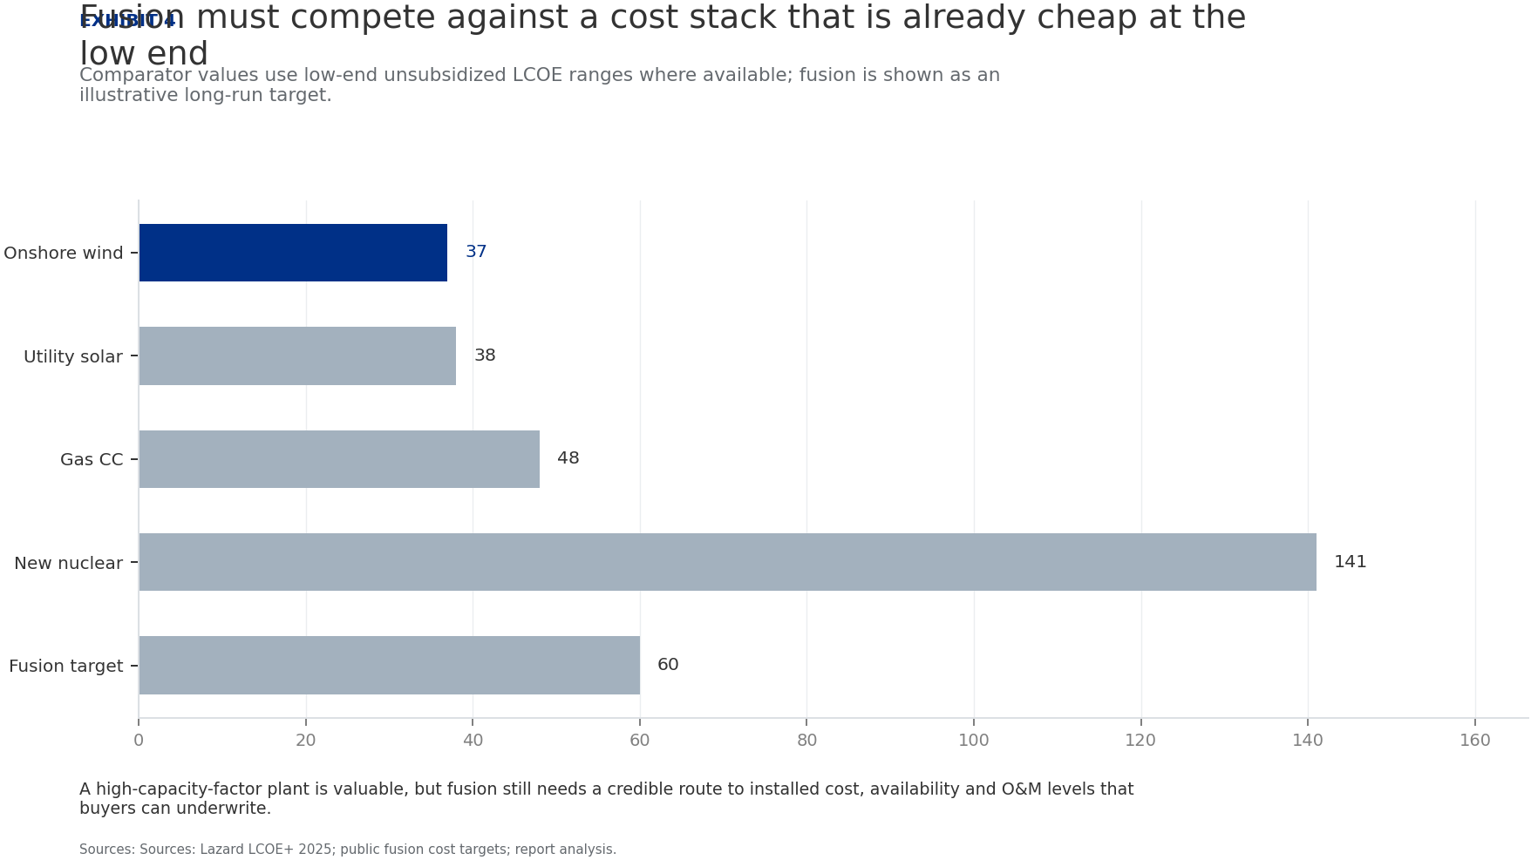
BlueOcean
Exhibit 4: evidence clarifies the strategic trade-off
Exhibit 4: evidence clarifies the strategic trade-off

Slide 16
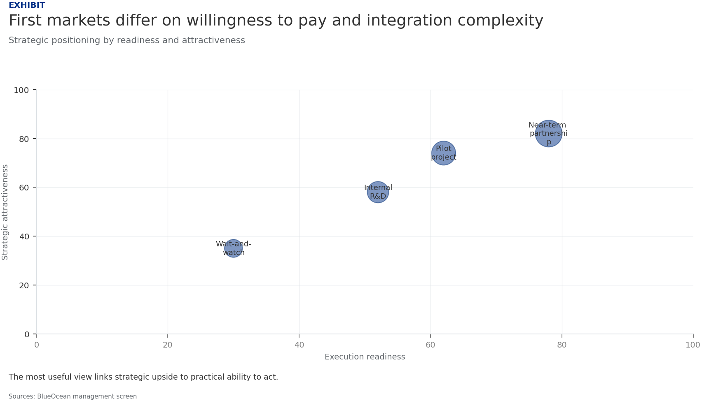
BlueOcean
Exhibit 5: evidence clarifies the strategic trade-off
Exhibit 5: evidence clarifies the strategic trade-off

Slide 17
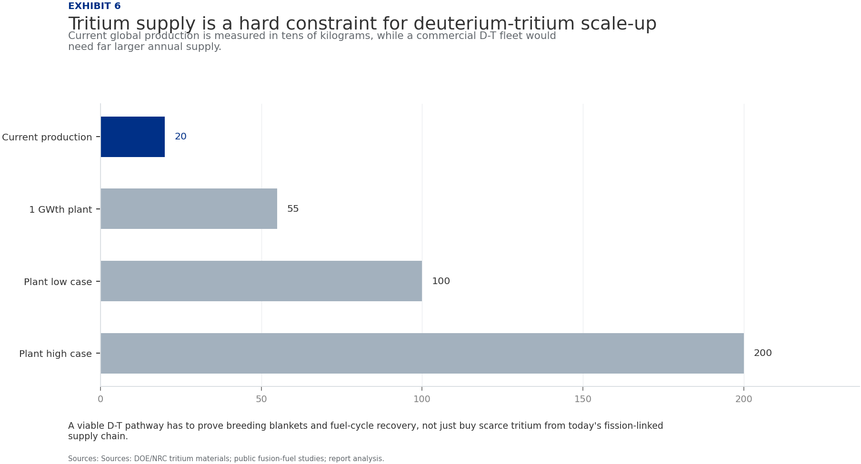
BlueOcean
Exhibit 6: evidence clarifies the strategic trade-off
Exhibit 6: evidence clarifies the strategic trade-off

Slide 18
BlueOcean
The next step is to convert the research into a short list of decisions
A CEO-Ready Assessment of Technology Readiness, Economic Viability, and Geopolitical Impact
Closing

