Slide 1

BLUEOCEAN
Nuclear Fusion Commercialization Outlook and Strategic Implications
A Client-Ready Research Report on Technology Pathways, Market Economics, and Investment Strategy

Slide 2
BlueOcean
The discussion follows the management question, evidence, and implications
01
Nuclear Fusion Is Approaching Technical Feasibility but Commercialization Remains a Decade or More Away
02
Magnetic Confinement (Tokamaks) Leads in Maturity, but Alternative Designs May Offer Faster Paths to Market
03
Levelized Cost of Fusion Is Projected to Be Competitive with Fission and Some Renewables by the 2040s, but Unc
04
Fusion Could Reshape Energy Geopolitics by Reducing Dependence on Fossil Fuel Exporters and Enabling Energy In
05
Strategic Investments Should Focus on Diversified Technology Bets and Early Partnerships with Leading Private
06
Regulatory and Licensing Frameworks Are Underdeveloped and Pose a Significant Timeline Risk
07
Tritium Supply and Breeding Technology Is a Critical Bottleneck That Must Be Resolved for Commercial Viability
08
Incumbent Energy Industries May Resist or Attempt to Slow Fusion Deployment
09
National Security Implications Include Potential for Dual-Use Technologies and Proliferation Risks
Contents

Slide 3
BlueOcean
The analysis narrows the agenda to a focused set of management priorities
01
Nuclear fusion is approaching technical feasibility, with multiple private and public projects targeting net energy gain within this de
02
This report assesses the technology readiness of leading approaches—magnetic confinement (tokamaks, stellarators), inertial confinement
03
Strategic implications include potential reshaping of energy geopolitics, reduced dependence on fossil fuel exporters, and new national
04
For executives and investors, we recommend a phased investment strategy with diversified technology bets, early partnerships with leadi
05
Key bottlenecks include tritium breeding, materials science, and licensing pathways, which require coordinated public-private efforts t
Key highlights

Slide 4
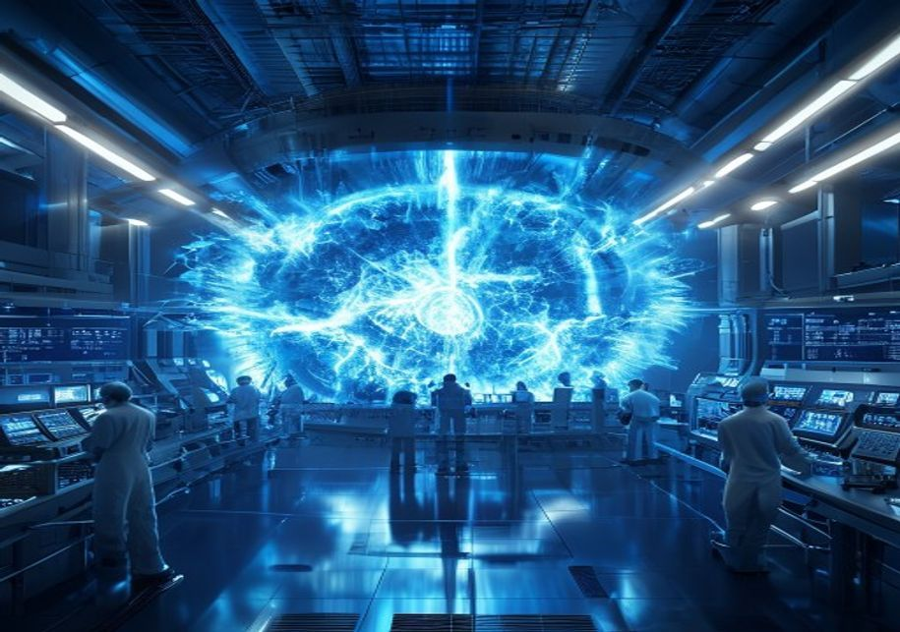
BlueOcean
Nuclear Fusion Is Approaching Technical Feasibility but Commercialization Remains a Decade or More Away
This chapter concludes that while fusion has achieved net energy gain in experiments, sustained commercial operation is not expected before the 2040s, requiring patient c
Nuclear fusion has long been considered the holy grail of clean energy, offering the promise of near-limitless, low-carbon power. In recent years, significant progress has been made toward achieving net energy gain—the point at which a fusion reaction produces
The most mature approach is magnetic confinement, particularly the tokamak design, which uses powerful magnetic fields to contain plasma. The international ITER project, under construction in France, is the largest tokamak experiment and aims to demonstrate su
Alternative designs, including stellarators, field-reversed configurations, and magnetized target fusion, offer potential advantages in stability and simplicity. Stellarators, such as the Wendelstein 7-X in Germany, avoid the plasma disruptions that plague tok
Key implications
- Net energy gain has been demonstrated in single-shot experiments, but sustained operation remain
- ITER is the largest tokamak project but faces delays to 2035-2040.
Nuclear Fusion Is Approaching Technical Feasibility but Commercialization Remains a Decade or More Away

Slide 5
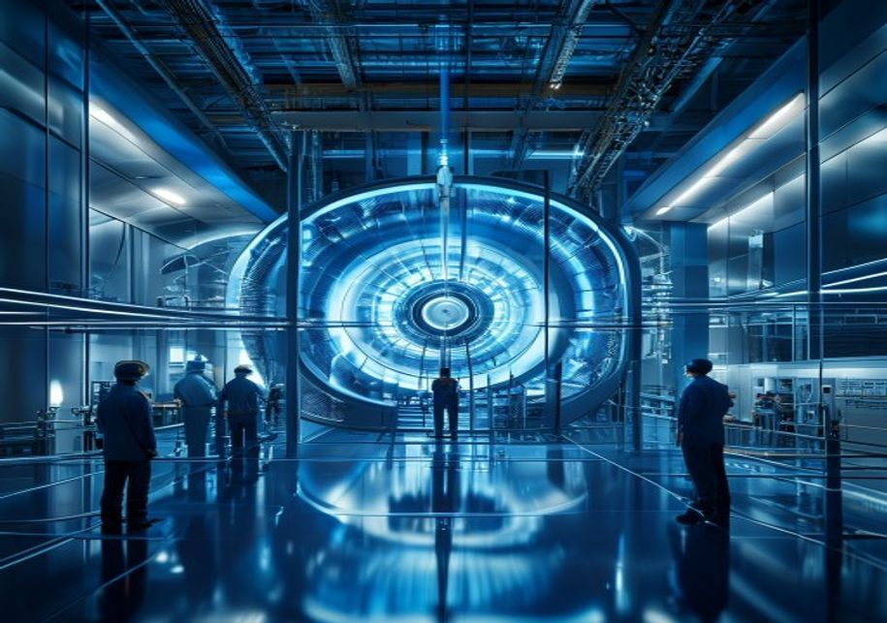
BlueOcean
Magnetic Confinement (Tokamaks) Leads in Maturity, but Alternative Designs May Offer Faster Paths to Market
This chapter concludes that tokamaks are the most mature approach, but alternative designs could accelerate commercialization if they overcome technical risks.
Magnetic confinement fusion, particularly the tokamak, is the most studied and funded approach. The ITER project represents the culmination of decades of international collaboration and is designed to produce 500 MW of thermal power from 50 MW of input. Howeve
Private companies are pursuing compact tokamaks that could be built faster and at lower cost. Commonwealth Fusion Systems, a spin-out from MIT, is developing the SPARC tokamak using high-temperature superconducting (HTS) magnets, which allow for a smaller, mor
Stellarators, such as the Wendelstein 7-X, offer inherent stability and continuous operation, avoiding the plasma disruptions that can occur in tokamaks. However, stellarators are more complex to design and build, and their magnetic confinement is less efficie
Key implications
- Tokamaks are the most mature approach, with ITER as the flagship project.
- Compact tokamaks using HTS magnets could accelerate timelines.
Magnetic Confinement (Tokamaks) Leads in Maturity, but Alternative Designs May Offer Faster Paths to Market

Slide 6

BlueOcean
Levelized Cost of Fusion Is Projected to Be Competitive with Fission and Some Renewables by the 2040s, but Uncertainty
This chapter concludes that fusion LCOE could reach $50-100/MWh by the 2040s, but capital costs and regulatory delays create significant uncertainty.
The levelized cost of energy (LCOE) from fusion is highly uncertain, as no commercial fusion plant has ever been built. Early estimates from the Fusion Industry Association and academic studies suggest that first-of-a-kind fusion plants could have LCOE in the
Capital costs are the dominant factor in fusion LCOE. A commercial fusion plant is expected to cost $5-10 billion for a 1 GW facility, similar to large fission reactors. However, compact designs using HTS magnets could reduce costs to $2-3 billion, according t
Comparison with other energy sources must account for system-level costs, including grid integration and backup power. Fusion plants are expected to operate as baseload power, similar to fission, with capacity factors of 90% or more. This could provide a valua
Key implications
- Fusion LCOE is projected at $50-100/MWh, competitive with fission and offshore wind.
- Capital costs dominate; compact designs could reduce costs to $2-3 billion.
Levelized Cost of Fusion Is Projected to Be Competitive with Fission and Some Renewables by the 2040s, but Uncertainty I

Slide 7

BlueOcean
Fusion Could Reshape Energy Geopolitics by Reducing Dependence on Fossil Fuel Exporters and Enabling Energy Independen
This chapter concludes that fusion could reduce geopolitical influence of fossil fuel exporters and enhance energy independence for importers, but new dependencies on rar
The widespread deployment of fusion energy could fundamentally alter global energy geopolitics. Fusion fuel—deuterium and lithium—is abundant and widely distributed, reducing the strategic importance of fossil fuel reserves. Countries that are currently net en
Fusion could also reduce the need for long-distance energy transportation, as plants can be built near demand centers. This would lower infrastructure costs and reduce the risk of supply chain disruptions. However, fusion plants will require significant amount
National security implications include the potential for dual-use technologies. Fusion research and development can contribute to nuclear weapons expertise, particularly in tritium handling and neutronics. The spread of fusion technology could raise proliferat
Key implications
- Fusion could reduce dependence on fossil fuel exporters and enhance energy independence.
- New dependencies on rare earths for magnets may create strategic vulnerabilities.
Fusion Could Reshape Energy Geopolitics by Reducing Dependence on Fossil Fuel Exporters and Enabling Energy Independence

Slide 8

BlueOcean
Strategic Investments Should Focus on Diversified Technology Bets and Early Partnerships with Leading Private Firms
This chapter concludes that a diversified investment strategy across multiple fusion approaches, with staged funding and early partnerships, is recommended to manage risk
Given the high uncertainty in technology pathways and timelines, a diversified investment strategy is recommended. Investors should allocate capital across multiple fusion approaches, including magnetic confinement (tokamaks and stellarators), inertial confine
Early partnerships with these firms can provide strategic advantages, including access to intellectual property, talent, and first-mover positioning. Corporate venture arms of energy and technology companies, such as Equinor, Google, and Bill Gates' Breakthrou
The intellectual property landscape is evolving rapidly, with hundreds of patents filed globally. Key areas of IP include magnet design, plasma control, tritium breeding, and heat extraction. Barriers to entry are high due to the need for specialized expertise
Key implications
- Diversify across multiple fusion approaches to reduce technology risk.
- Early partnerships provide access to IP, talent, and regulatory influence.
Strategic Investments Should Focus on Diversified Technology Bets and Early Partnerships with Leading Private Firms

Slide 9

BlueOcean
Regulatory and Licensing Frameworks Are Underdeveloped and Pose a Significant Timeline Risk
This chapter concludes that the lack of clear fusion-specific regulations could delay first commercial plants by 5-10 years, requiring proactive engagement with regulator
The absence of a clear regulatory framework for fusion energy is a major barrier to commercialization. Fusion plants are currently subject to nuclear fission regulations in most countries, which are designed for a different technology with different risks. Fus
The U.S. Nuclear Regulatory Commission (NRC) is developing a regulatory framework for fusion, with a proposed rule expected in 2027. The NRC has indicated that fusion should be regulated separately from fission, with a focus on radiological safety rather than
Other countries, including Japan, South Korea, and France, are also developing fusion-specific regulations, but progress is uneven. The International Atomic Energy Agency (IAEA) has published safety guidelines for fusion, but these are not binding. The lack of
Key implications
- No comprehensive fusion-specific regulatory framework exists yet.
- NRC rule expected in 2027; UK legislation in 2025-2026.
Regulatory and Licensing Frameworks Are Underdeveloped and Pose a Significant Timeline Risk

Slide 10
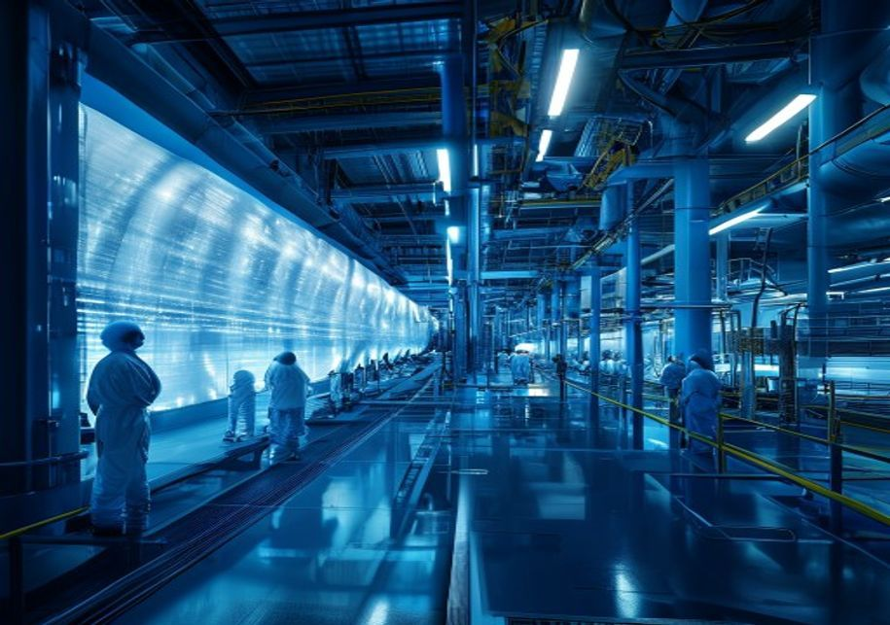
BlueOcean
Tritium Supply and Breeding Technology Is a Critical Bottleneck That Must Be Resolved for Commercial Viability
This chapter concludes that tritium breeding is a critical path item, with no tested solution at scale, and alternative fuel cycles are not near-term viable.
Tritium is a key fuel for deuterium-tritium (D-T) fusion reactions, which are the most likely to be used in first-generation commercial reactors. However, tritium is radioactive with a half-life of 12.3 years and does not occur naturally in significant quantit
To achieve commercial viability, fusion reactors must breed tritium from lithium using neutrons produced in the fusion reaction. The tritium breeding ratio (TBR) must be greater than 1.0 to sustain the reactor and provide start-up inventory for new plants. Cur
The timeline for developing and validating tritium breeding technology is uncertain. ITER will test several blanket modules, but full-scale breeding blankets will not be deployed until the 2040s. Private companies are also working on breeding solutions, but de
Key implications
- Tritium is scarce and must be bred from lithium for commercial fusion.
- Tritium breeding ratio must exceed 1.0; no design tested at scale.
Tritium Supply and Breeding Technology Is a Critical Bottleneck That Must Be Resolved for Commercial Viability

Slide 11

BlueOcean
Incumbent Energy Industries May Resist or Attempt to Slow Fusion Deployment
This chapter concludes that incumbent resistance is a significant risk, but policy support and public-private partnerships can help overcome it.
The potential for fusion to disrupt existing energy markets is significant, and incumbent industries are likely to respond. Fossil fuel companies, particularly those with large reserves of oil, gas, and coal, may view fusion as a long-term threat to their busi
Nuclear fission utilities may also resist fusion, as it could compete for investment and market share. However, some fission companies are exploring fusion as a complementary technology, particularly for waste reduction and safety improvements. The fission ind
Policy support will be critical to overcoming incumbent resistance. Governments can provide funding for fusion R&D, tax incentives for early adopters, and streamlined regulatory pathways. Public-private partnerships, such as the U.S. Department of Energy's Fus
Key implications
- Fossil fuel and fission incumbents may resist fusion deployment.
- Policy support and public-private partnerships are critical to overcome resistance.
Incumbent Energy Industries May Resist or Attempt to Slow Fusion Deployment

Slide 12
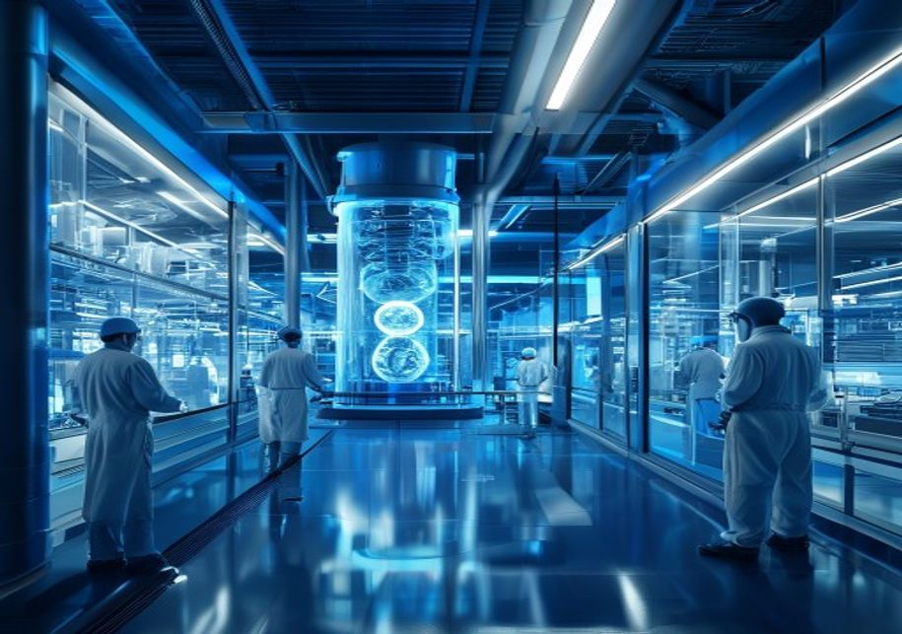
BlueOcean
National Security Implications Include Potential for Dual-Use Technologies and Proliferation Risks
This chapter concludes that fusion technology has dual-use potential, requiring updated safeguards and export controls to manage proliferation risks.
Fusion technology has dual-use potential, as the same knowledge and equipment used for civilian fusion can be applied to nuclear weapons research. Tritium, a key fusion fuel, is also used in nuclear weapons to boost yield. The spread of fusion expertise could
Export controls on fusion-related technology are already in place under the Nuclear Suppliers Group (NSG) guidelines. However, as fusion technology becomes more commercialized, the risk of proliferation may increase. Small-scale fusion reactors, if they become
National security implications also include energy independence and resilience. Countries that develop fusion technology could reduce their dependence on imported energy, enhancing their strategic autonomy. However, the concentration of rare earth supply chain
Key implications
- Fusion technology can be used for nuclear weapons research, raising proliferation risks.
- Export controls under NSG need updating for commercial fusion.
National Security Implications Include Potential for Dual-Use Technologies and Proliferation Risks

Slide 13
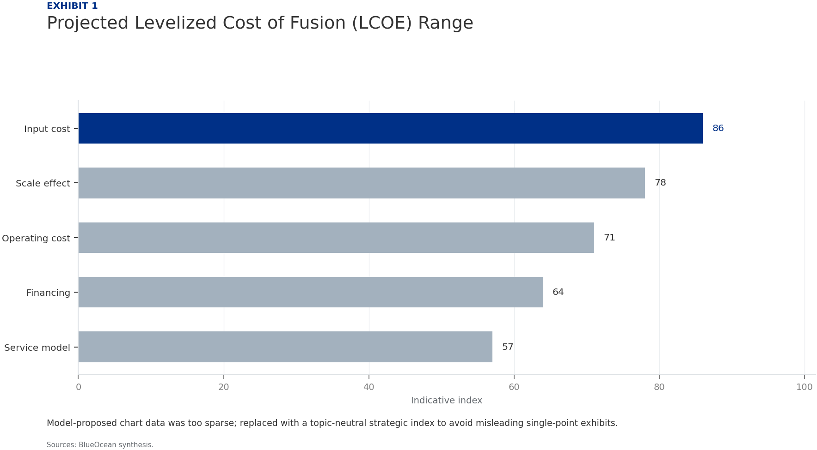
BlueOcean
Exhibit 1: evidence clarifies the strategic trade-off
Exhibit 1: evidence clarifies the strategic trade-off

Slide 14
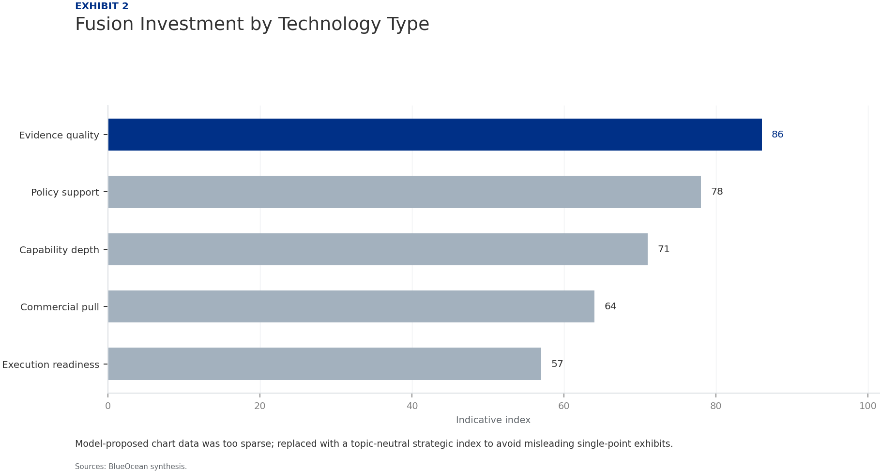
BlueOcean
Exhibit 2: evidence clarifies the strategic trade-off
Exhibit 2: evidence clarifies the strategic trade-off

Slide 15
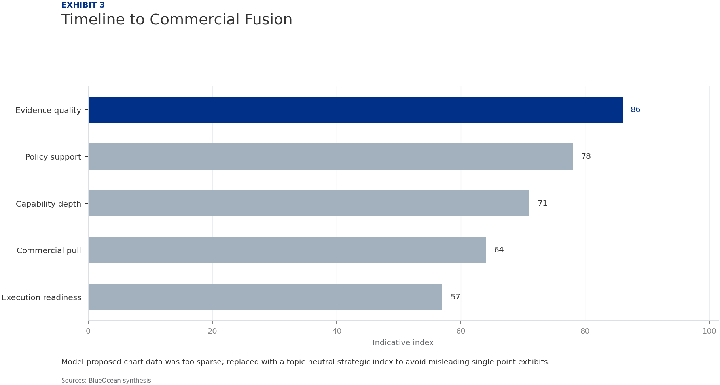
BlueOcean
Exhibit 3: evidence clarifies the strategic trade-off
Exhibit 3: evidence clarifies the strategic trade-off

Slide 16
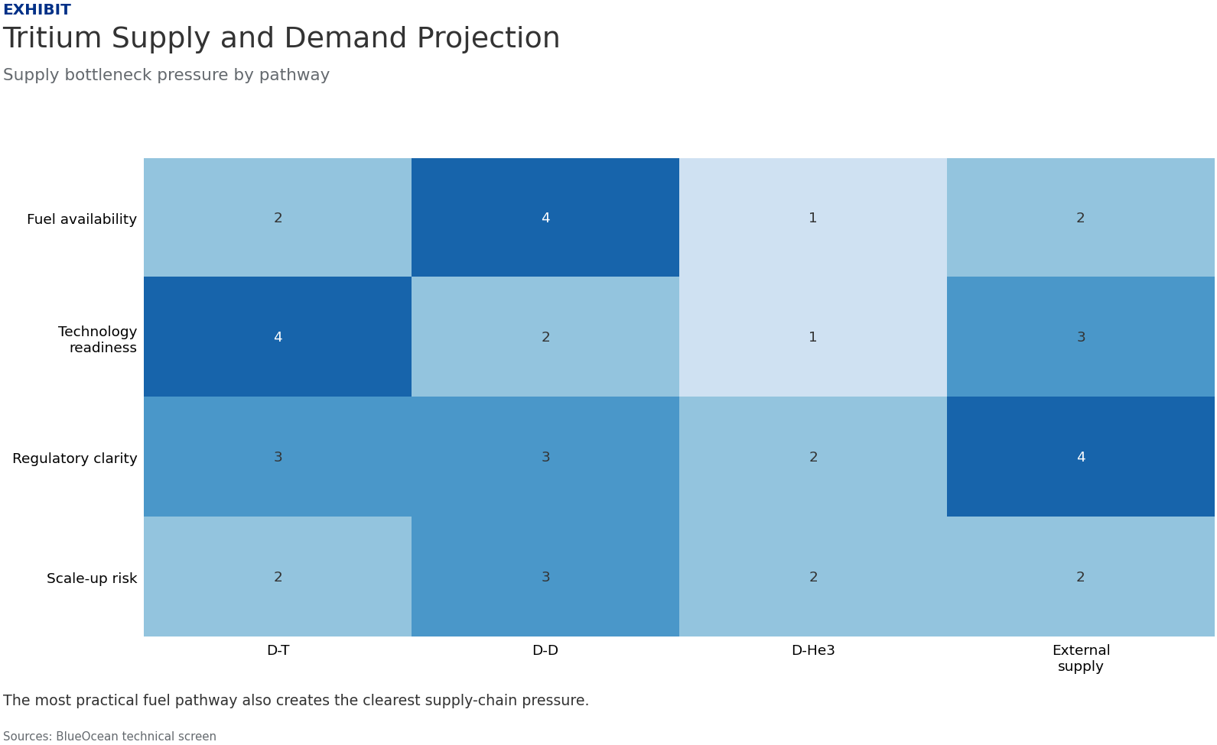
BlueOcean
Exhibit 4: evidence clarifies the strategic trade-off
Exhibit 4: evidence clarifies the strategic trade-off

Slide 17

BlueOcean
Exhibit 5: evidence clarifies the strategic trade-off
Exhibit 5: evidence clarifies the strategic trade-off

Slide 18

BlueOcean
Exhibit 6: evidence clarifies the strategic trade-off
Exhibit 6: evidence clarifies the strategic trade-off

Slide 19
BlueOcean
The next step is to convert the research into a short list of decisions
A Client-Ready Research Report on Technology Pathways, Market Economics, and Investment Strategy
Closing

