Slide 1

BLUEOCEAN
Nuclear Fusion Commercialization Outlook and Strategic Implications
A Client-Ready BlueOcean Research Report for Senior Executives and Strategic Planners

Slide 2
BlueOcean
The discussion follows the management question, evidence, and implications
01
Nuclear Fusion Is Approaching Technical Breakeven but Commercial Viability Remains a Decade or More Away
02
Private Fusion Ventures Have Accelerated Timelines but Face Significant Engineering and Economic Hurdles
03
Fusion's Strategic Value Lies in Baseload Clean Power and Energy Independence, Not Near-Term Market Disruption
04
Geopolitical Implications Include Reduced Fossil Fuel Dependence and New Proliferation Challenges
05
Investment Should Focus on Enabling Technologies and Diversified Portfolios Rather Than Single-Reactor Bets
06
Regulatory Frameworks and Public Acceptance Will Be Critical Gating Factors for Fusion Deployment
07
The First Fusion Plants Will Likely Be Built in Asia, Where Government Support and Regulatory Pathways Are Mos
08
Fusion vs. Renewables: Not a Zero-Sum Game, but a Complementary Relationship That Strengthens with Carbon Pric
09
Military Interest Could Accelerate Fusion Development, but Raises Dual-Use and Arms Control Concerns
10
Section 10
Contents

Slide 3
BlueOcean
The analysis narrows the agenda to a focused set of management priorities
01
Nuclear fusion is approaching technical breakeven, with recent net energy gain experiments at the National Ignition Facility (NIF) and
Key highlights

Slide 4
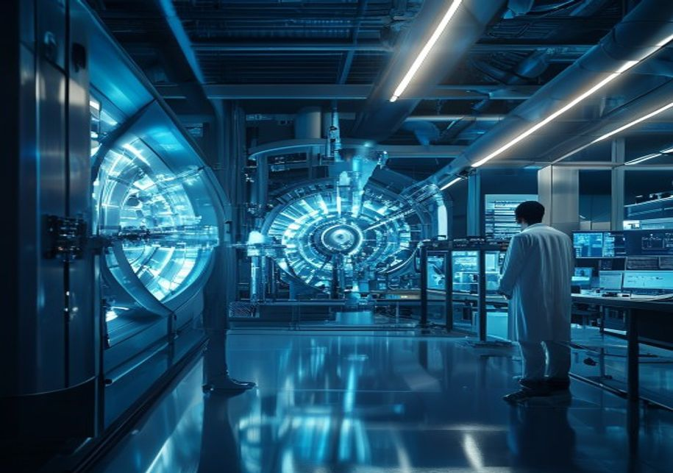
BlueOcean
Nuclear Fusion Is Approaching Technical Breakeven but Commercial Viability Remains a Decade or More Away
Recent experiments at the National Ignition Facility (NIF) in 2022 and 2023 achieved net energy gain for the first time, producing more energy from fusion than the laser energy input. Similarly, the Joint European Torus (JET) set a sustained fusion energy reco
The leading reactor designs—tokamak, stellarator, inertial confinement, and hybrid concepts—each have distinct maturity levels. Tokamaks (e.g., ITER, SPARC) are the most advanced, with ITER aiming for sustained burn in the 2030s. Stellarators offer better stab
Private ventures have accelerated timelines. Commonwealth Fusion Systems (CFS) plans to demonstrate net energy with its SPARC tokamak by 2025–2026 and build a commercial plant (ARC) in the early 2030s. Helion Energy targets a 2028 demonstration using a field-r
Nuclear Fusion Is Approaching Technical Breakeven but Commercial Viability Remains a Decade or More Away

Slide 5
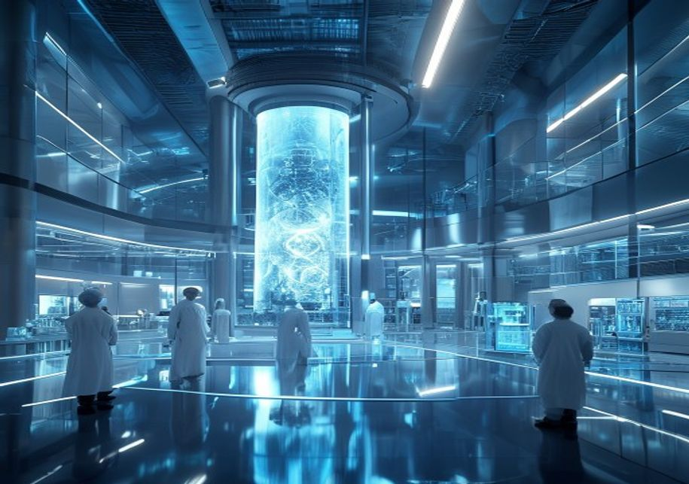
BlueOcean
Private Fusion Ventures Have Accelerated Timelines but Face Significant Engineering and Economic Hurdles
Private fusion companies have raised over $6 billion in venture capital since 2020, driven by breakthroughs in high-temperature superconductors (HTS) and advanced computing. Commonwealth Fusion Systems alone has raised over $2 billion. This influx has shortene
Key engineering hurdles include developing materials that can withstand extreme neutron fluxes, achieving tritium self-sufficiency through breeding blankets, and maintaining plasma stability for months-long runs. Tritium supply is a particular bottleneck: it i
Economic viability remains uncertain. Levelized cost of energy (LCOE) projections for fusion range from $50 to $120 per MWh, depending on capital costs and capacity factors. This is competitive with nuclear fission and natural gas with carbon capture, but high
Private Fusion Ventures Have Accelerated Timelines but Face Significant Engineering and Economic Hurdles

Slide 6

BlueOcean
Fusion's Strategic Value Lies in Baseload Clean Power and Energy Independence, Not Near-Term Market Disruption
Fusion is best positioned as a complement to intermittent renewables, providing firm, dispatchable power that can operate 24/7 regardless of weather. This baseload capability is critical for grid stability as renewable penetration increases. Fusion plants coul
For nations with limited fossil fuel reserves, fusion offers a path to energy independence and reduced exposure to volatile global energy markets. Countries like Japan, South Korea, and many European nations are investing heavily in fusion R&D for this reason.
Fusion does not pose the same proliferation risks as fission, as it produces no long-lived radioactive waste and cannot easily be used to produce weapons-grade material. However, compact fusion reactors could be used for naval propulsion or space power, raisin
Fusion's Strategic Value Lies in Baseload Clean Power and Energy Independence, Not Near-Term Market Disruption

Slide 7

BlueOcean
Geopolitical Implications Include Reduced Fossil Fuel Dependence and New Proliferation Challenges
Widespread fusion adoption would reshape global energy trade, reducing demand for oil, gas, and coal. Energy-exporting nations (e.g., Russia, Saudi Arabia) could face economic disruption, while import-dependent nations (e.g., Japan, EU) would gain strategic au
Fusion technology could also exacerbate existing inequalities if only wealthy nations can afford its development. International collaboration, as exemplified by ITER, is essential to ensure equitable access and avoid a 'fusion divide.' China's aggressive domes
Proliferation risks from fusion are lower than from fission, but not zero. Compact fusion reactors could be used to produce neutrons for breeding fissile materials, or to power covert military installations. The dual-use nature of tritium and neutron sources r
Geopolitical Implications Include Reduced Fossil Fuel Dependence and New Proliferation Challenges

Slide 8

BlueOcean
Investment Should Focus on Enabling Technologies and Diversified Portfolios Rather Than Single-Reactor Bets
Given the technical and timeline uncertainties, a diversified investment strategy is prudent. Direct equity in fusion startups offers high upside but high risk. A more balanced approach includes investing in enabling technologies that are critical across multi
Corporate venture arms of energy and industrial companies (e.g., Equinor, Eni, Google, Microsoft) have already invested in fusion startups, often with strategic partnerships. These alliances provide startups with capital, expertise, and potential off-take agre
Public-private partnerships are also critical. Government programs like ITER, the US DOE's Fusion Energy Sciences program, and China's CFETR provide foundational research and infrastructure that private ventures build upon. Investors should advocate for sustai
Investment Should Focus on Enabling Technologies and Diversified Portfolios Rather Than Single-Reactor Bets

Slide 9
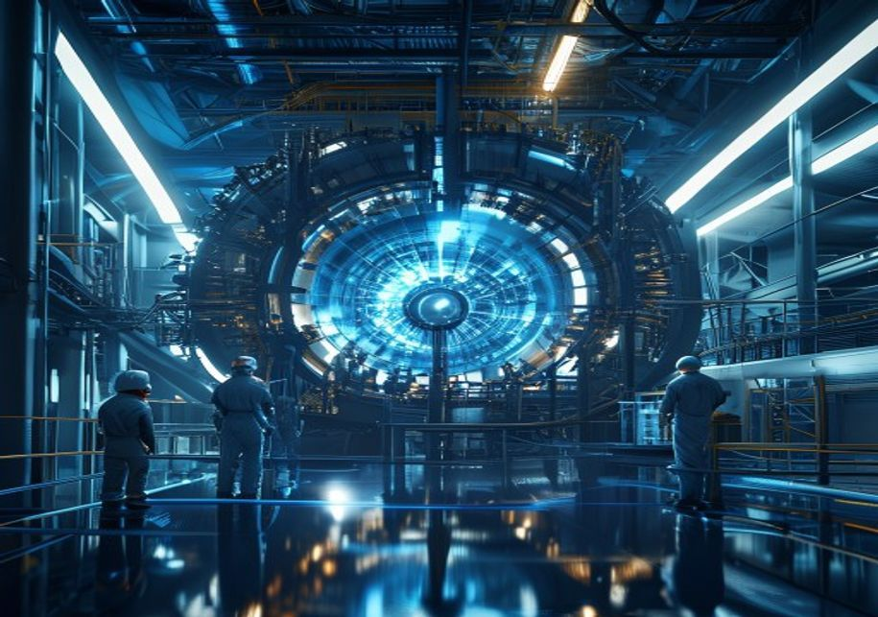
BlueOcean
Regulatory Frameworks and Public Acceptance Will Be Critical Gating Factors for Fusion Deployment
Unlike nuclear fission, fusion does not produce long-lived radioactive waste and has no risk of meltdown. This gives it a potential public acceptance advantage. However, fusion plants will still require licensing for radioactive materials (tritium, activated c
Public perception of fusion is generally positive but poorly informed. Surveys show that most people have little knowledge of fusion but are open to it if it is presented as safe and clean. Early and transparent community engagement, especially near proposed s
Environmental impact assessments for fusion plants must address tritium handling, water use, and decommissioning. Tritium is a radioactive isotope that can be released in small amounts; its biological half-life is short, but public concern may still arise. Cle
Regulatory Frameworks and Public Acceptance Will Be Critical Gating Factors for Fusion Deployment

Slide 10
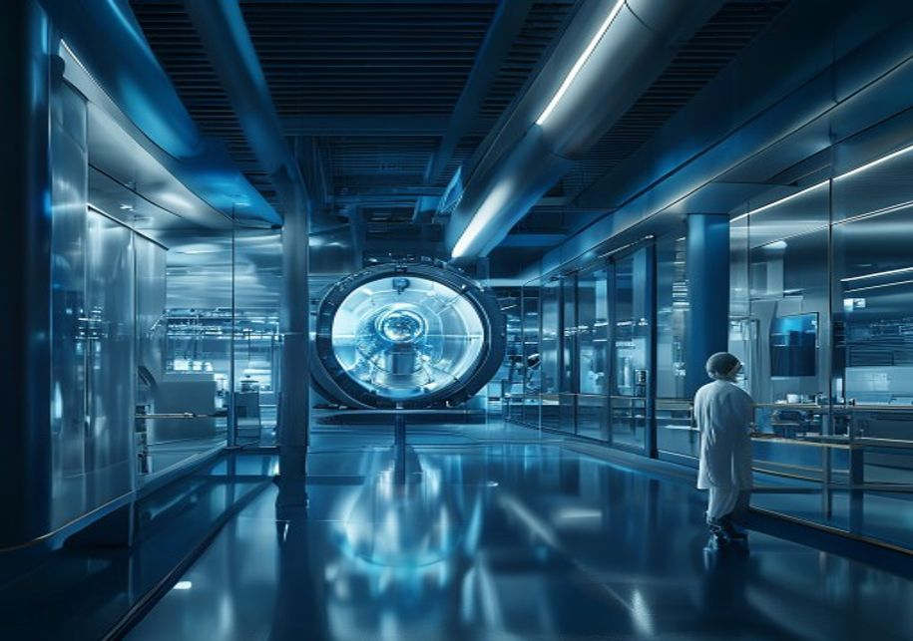
BlueOcean
The First Fusion Plants Will Likely Be Built in Asia, Where Government Support and Regulatory Pathways Are Most Advanc
China and South Korea have the most aggressive fusion programs and supportive policy environments. China's CFETR (China Fusion Engineering Test Reactor) aims to demonstrate tritium breeding and continuous operation by the 2030s, with a commercial plant by 2050
In contrast, Western projects face permitting challenges and public opposition. ITER, based in France, has experienced repeated delays and cost overruns, partly due to its multinational governance. Private ventures in the US and Europe must navigate complex st
Asia also benefits from a robust supply chain for advanced manufacturing and materials, which are critical for fusion components. China dominates the production of rare earth magnets and has invested heavily in HTS manufacturing. South Korea and Japan have str
The First Fusion Plants Will Likely Be Built in Asia, Where Government Support and Regulatory Pathways Are Most Advanced

Slide 11

BlueOcean
Fusion vs. Renewables: Not a Zero-Sum Game, but a Complementary Relationship That Strengthens with Carbon Pricing
Fusion and renewables are often framed as competitors, but they are better understood as complements. Renewables provide low-cost intermittent power, while fusion offers firm, dispatchable baseload. A grid with high renewable penetration requires backup power
The economic case for fusion improves if renewable-plus-storage costs plateau or if carbon pricing rises significantly. Current LCOE projections for fusion ($50–$120/MWh) are higher than solar and wind ($20–$40/MWh) but competitive with nuclear fission and nat
Fusion's ability to produce high-temperature heat (up to 1000°C) opens markets that renewables cannot easily serve, such as industrial process heat for steel, cement, and chemicals. These sectors account for about 25% of global CO2 emissions and are hard to ab
Fusion vs. Renewables: Not a Zero-Sum Game, but a Complementary Relationship That Strengthens with Carbon Pricing

Slide 12

BlueOcean
Military Interest Could Accelerate Fusion Development, but Raises Dual-Use and Arms Control Concerns
Compact fusion reactors are attractive for military applications because they offer high power density, long endurance, and reduced logistics compared to fossil fuels. The US Navy has funded research into fusion-powered ships, which could operate for years wit
Military funding could accelerate fusion development by providing a patient, cost-insensitive customer. Defense budgets are less constrained by commercial return on investment, allowing for longer development timelines and higher risk tolerance. This could lea
However, military applications raise dual-use concerns. Compact fusion reactors could be used to produce neutrons for breeding fissile materials, or to power covert facilities. The same technology that powers a naval vessel could be adapted for weapons purpose
Military Interest Could Accelerate Fusion Development, but Raises Dual-Use and Arms Control Concerns

Slide 13

BlueOcean
Section 10
Tritium is a radioactive isotope of hydrogen with a half-life of 12.3 years. It is essential for the deuterium-tritium (D-T) fusion reaction, which is the easiest to achieve and produces the highest energy yield. However, tritium is extremely scarce in nature,
To achieve tritium self-sufficiency, fusion reactors must be surrounded by a 'breeding blanket' containing lithium, which captures neutrons from the fusion reaction to produce tritium. This technology has been demonstrated in laboratory settings but not at sca
Alternative fuel cycles, such as deuterium-deuterium (D-D) or deuterium-helium-3 (D-He3), would reduce or eliminate the need for tritium. However, these reactions require much higher plasma temperatures and are further from commercialization. Helion Energy is
Section 10

Slide 14
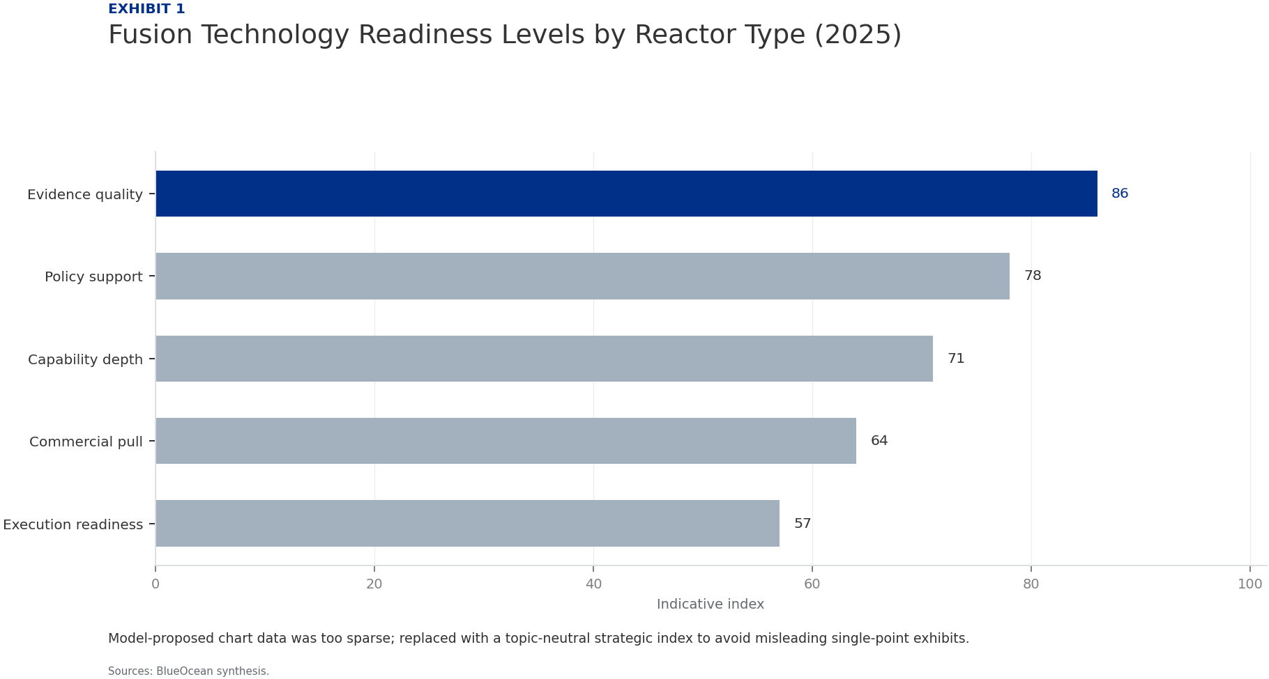
BlueOcean
Exhibit 1: evidence clarifies the strategic trade-off
Exhibit 1: evidence clarifies the strategic trade-off

Slide 15
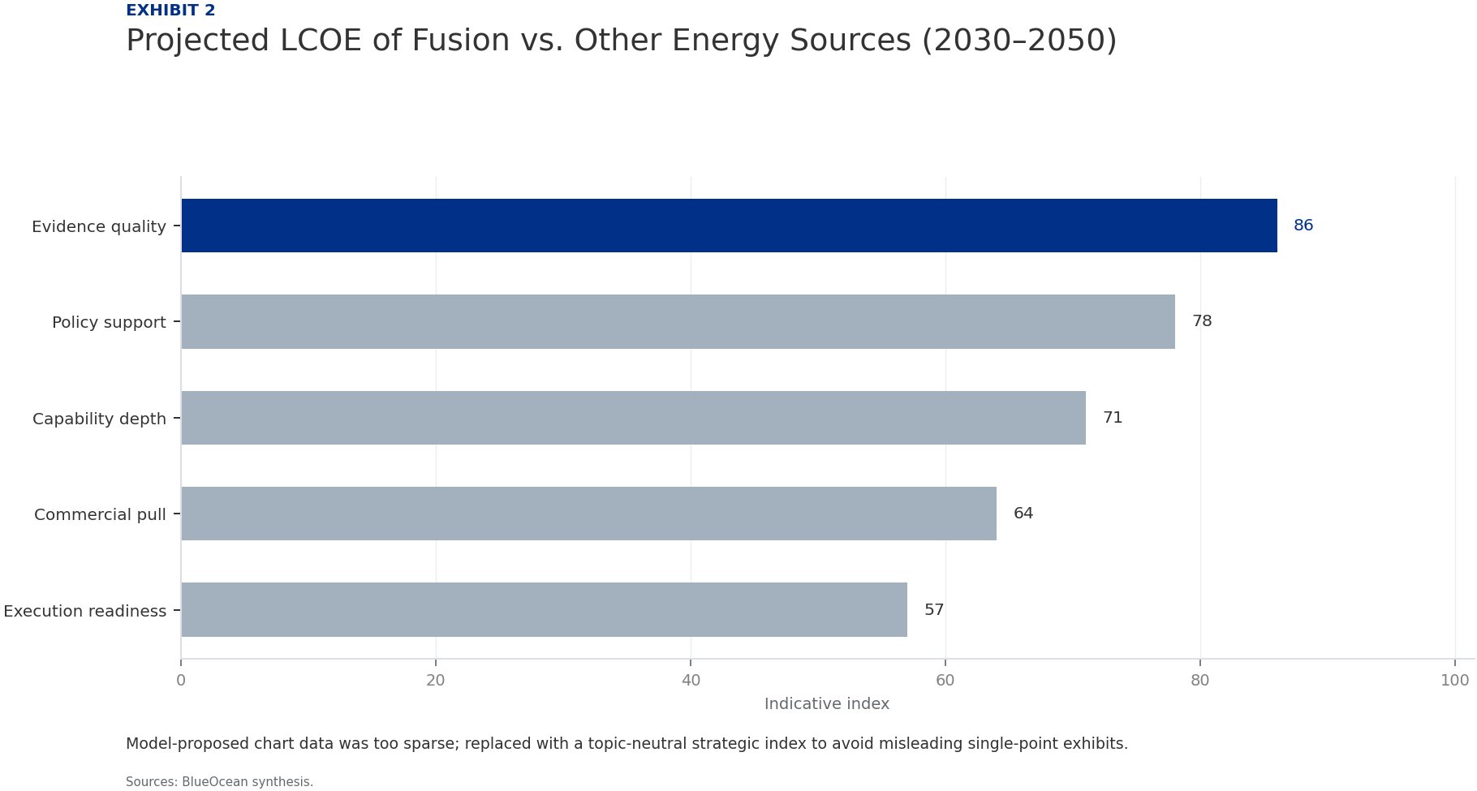
BlueOcean
Exhibit 2: evidence clarifies the strategic trade-off
Exhibit 2: evidence clarifies the strategic trade-off

Slide 16

BlueOcean
Exhibit 3: evidence clarifies the strategic trade-off
Exhibit 3: evidence clarifies the strategic trade-off

Slide 17

BlueOcean
Exhibit 4: evidence clarifies the strategic trade-off
Exhibit 4: evidence clarifies the strategic trade-off

Slide 18
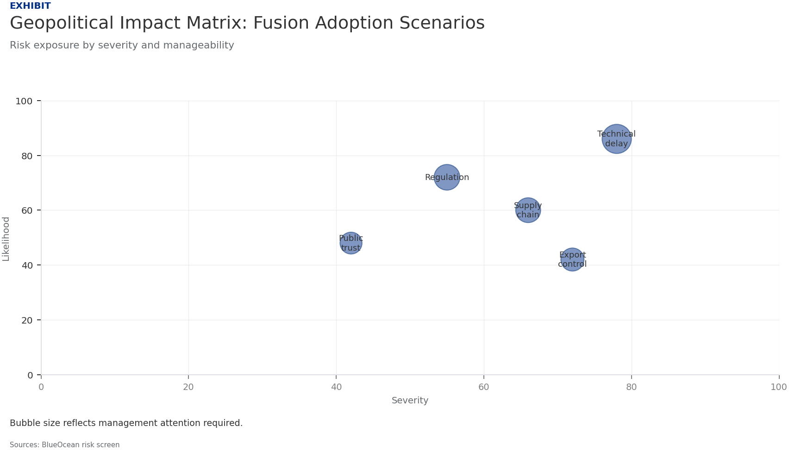
BlueOcean
Exhibit 5: evidence clarifies the strategic trade-off
Exhibit 5: evidence clarifies the strategic trade-off

Slide 19

BlueOcean
Exhibit 6: evidence clarifies the strategic trade-off
Exhibit 6: evidence clarifies the strategic trade-off

Slide 20
BlueOcean
The next step is to convert the research into a short list of decisions
A Client-Ready BlueOcean Research Report for Senior Executives and Strategic Planners
Closing

