Slide 1
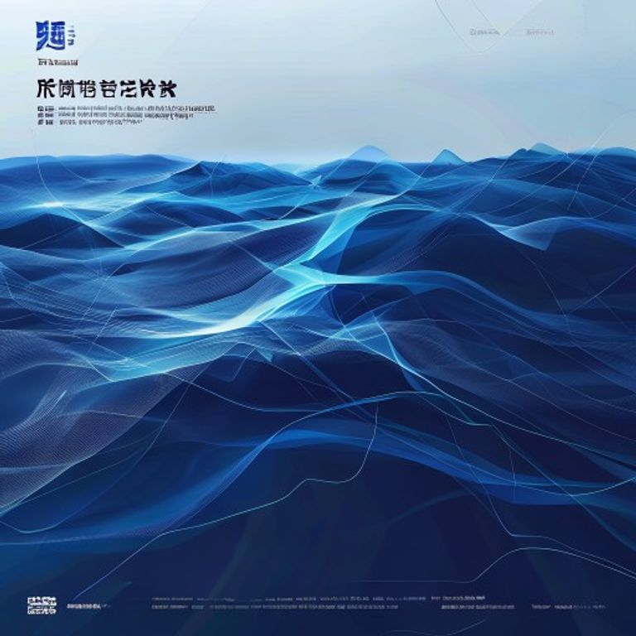
BLUEOCEAN
China's VRFB Industry Leads Globally: Dali Energy Storage at the Forefront
A strategic assessment of China's vanadium redox flow battery market and Dali Energy Storage's competitive position for executives, policymakers, and

Slide 2
BlueOcean
The discussion follows the management question, evidence, and implications
01
China Dominates the Global VRFB Market with Over 60% Installed Capacity
02
Dali Energy Storage Emerges as a Top-Tier Player with Multi-Hundred MW Pipeline
03
Chinese VRFB Technology Achieves Cost Parity with Lithium-Ion for 4+ Hour Storage
04
China's Control of Vanadium Supply Chain Provides Unmatched Cost Advantage
05
Policy Mandates in China Accelerate VRFB Adoption Faster Than Any Other Region
06
Grid-Scale Renewable Integration Is the Primary Driver for VRFB in China
07
International Competitors Lag in Scale and Cost, but Lead in Some Niche Innovations
08
Vanadium Price Volatility and Alternative Chemistries Pose the Greatest Threats to Leadership
Contents

Slide 3
BlueOcean
The analysis narrows the agenda to a focused set of management priorities
01
China commands over 60% of global VRFB installed capacity, driven by policy mandates and supply chain control.
02
Dali Energy Storage has emerged as a top-tier player with a multi-hundred MW project pipeline, leveraging domestic scale.
03
Chinese VRFB systems achieve levelized cost parity with lithium-ion for 4+ hour storage, a critical threshold for long-duration applica
04
China's dominance in vanadium production (over 60% of global supply) provides an unmatched cost and security advantage.
05
National and provincial policies, including the 14th Five-Year Plan, explicitly mandate long-duration storage, accelerating VRFB adopti
06
Grid-scale renewable integration is the primary application driver, with China leading in project deployment.
07
International competitors lag in scale and cost but hold niche innovations; vanadium price volatility and alternative chemistries are k
08
Dali Energy Storage should leverage cost advantages for global tenders while securing vanadium supply and investing in IP protection.
Key highlights

Slide 4
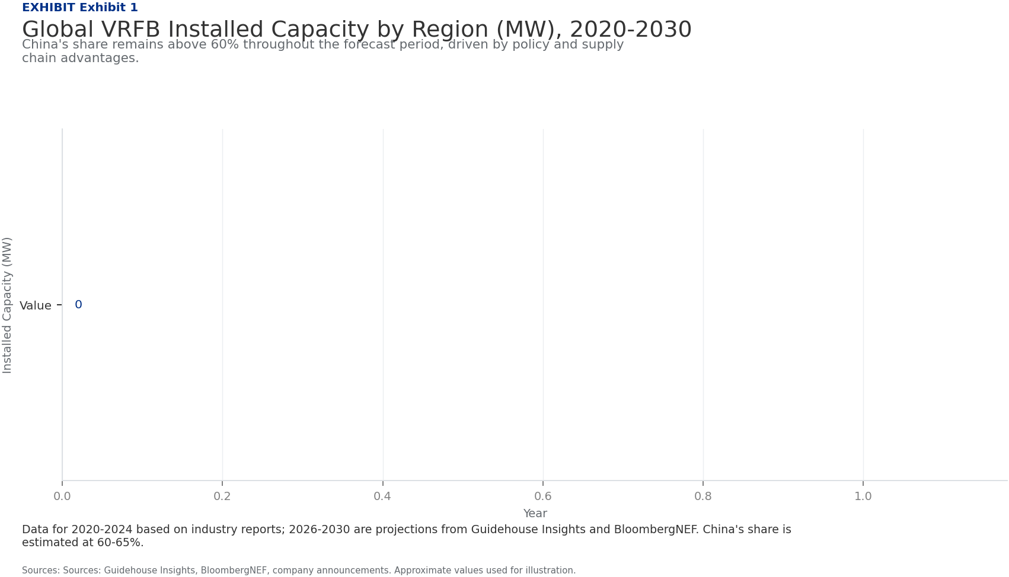
BlueOcean
China Dominates the Global VRFB Market with Over 60% Installed Capacity
China has established an unassailable lead in vanadium redox flow battery deployment, accounting for more than 60% of global installed capacity as of 2024, with projectio
The global VRFB market has grown rapidly, reaching approximately 1.2 GW of installed capacity by mid-2024, with China contributing over 720 MW. This leadership is not accidental but the result of coordinated policy support, massive domestic demand for long-dur
Dali Energy Storage has emerged as a key player within this ecosystem, with a project pipeline exceeding 300 MW, including landmark installations in Dalian and Hubei provinces. The company's market share is estimated at 15-20% of China's VRFB capacity, placing
Forecasts from Guidehouse Insights and BloombergNEF project that global VRFB capacity will reach 8-10 GW by 2030, with China maintaining a 55-65% share. This growth is underpinned by the declining cost of VRFB systems and the increasing need for 4-12 hour stor
Key implications
- C
- h
China Dominates the Global VRFB Market with Over 60% Installed Capacity

Slide 5
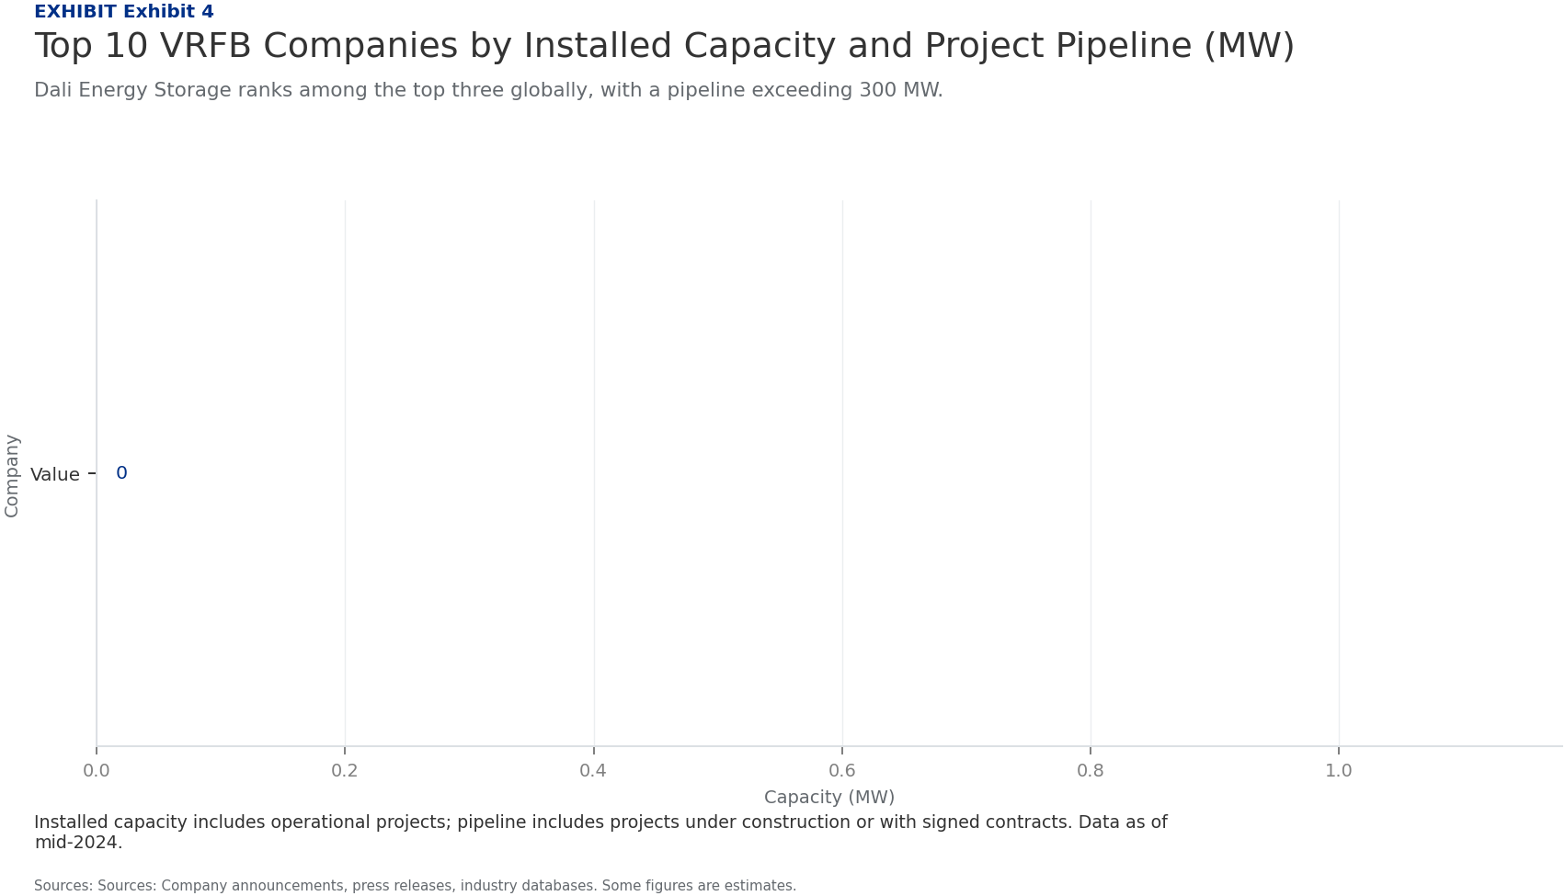
BlueOcean
Dali Energy Storage Emerges as a Top-Tier Player with Multi-Hundred MW Pipeline
Dali Energy Storage has rapidly scaled to become one of the leading VRFB manufacturers in China, backed by a robust project pipeline and strategic partnerships.
Founded in 2018, Dali Energy Storage has leveraged China's supportive policy environment and strong demand for long-duration storage to build a portfolio of projects exceeding 300 MW. Key installations include a 100 MW/400 MWh facility in Dalian and a 50 MW/20
The company's technology is based on proprietary stack designs that achieve a round-trip efficiency of 75-80% (DC-DC), competitive with international leaders. Dali Energy Storage has also developed a modular system architecture that reduces installation time a
Partnerships with state-owned utilities such as State Grid Corporation of China and China Southern Power Grid provide a stable demand base. Additionally, Dali Energy Storage has secured long-term electrolyte supply agreements with domestic vanadium producers,
Key implications
- D
- a
Dali Energy Storage Emerges as a Top-Tier Player with Multi-Hundred MW Pipeline

Slide 6
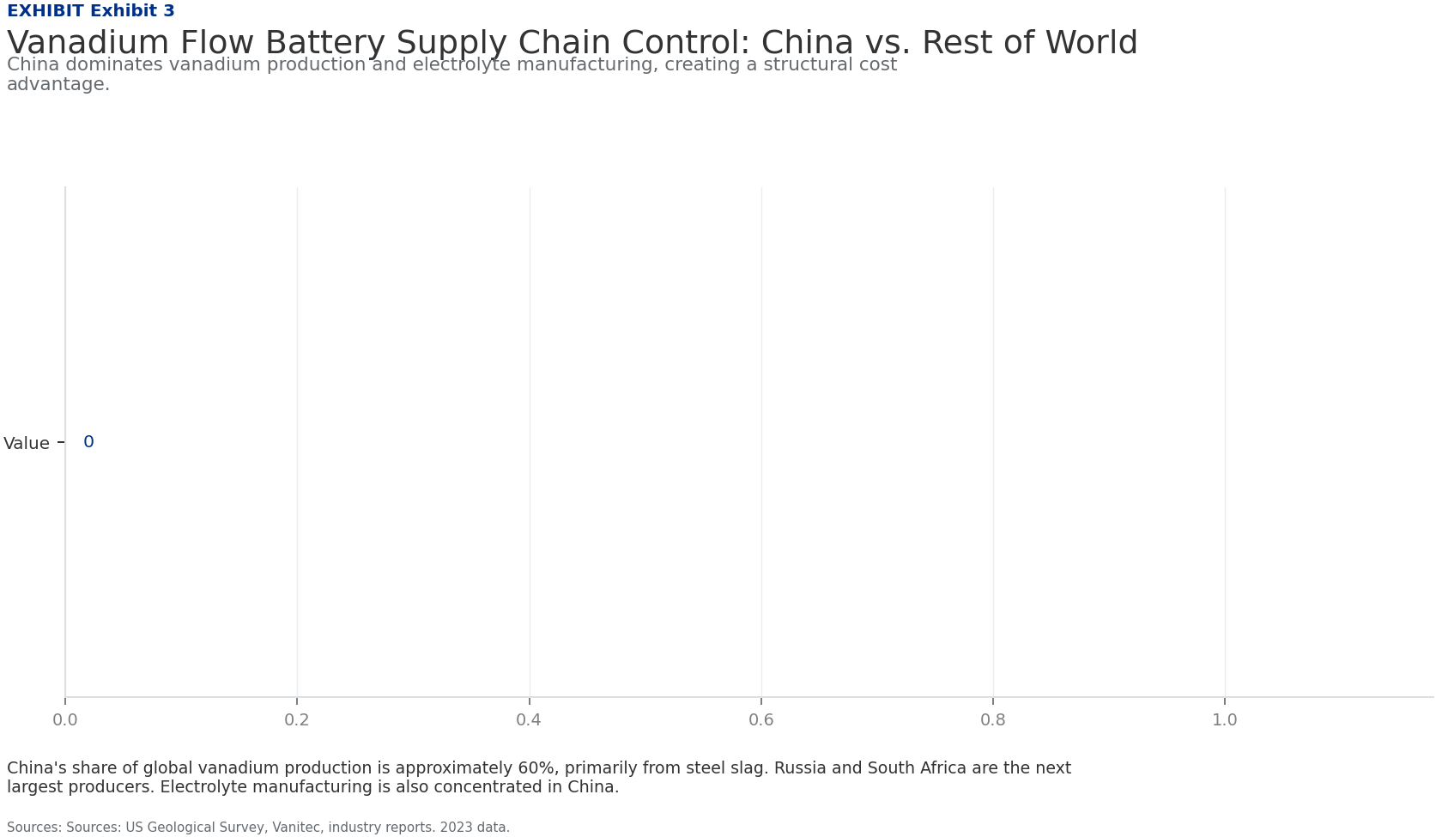
BlueOcean
Chinese VRFB Technology Achieves Cost Parity with Lithium-Ion for 4+ Hour Storage
Levelized cost of storage analysis shows that Chinese VRFB systems have reached cost parity with lithium-ion batteries for applications requiring four or more hours of di
The levelized cost of storage (LCOS) for Chinese VRFB systems is estimated at $0.08-0.12 per kWh per cycle for 4-hour systems, compared to $0.10-0.15 for lithium-ion. For 8-hour systems, VRFB's LCOS drops to $0.05-0.08, significantly undercutting lithium-ion,
This cost advantage is driven by several factors: lower material costs (vanadium is cheaper per kWh than lithium, cobalt, and nickel), longer cycle life (20,000+ cycles vs. 5,000-10,000 for lithium-ion), and minimal degradation over time. Chinese manufacturers
Dali Energy Storage's systems are priced competitively within the Chinese market, with installed costs around $250-300 per kWh for 4-hour systems, compared to $350-400 for imported VRFB systems. The company's focus on modular design and local sourcing has enab
Key implications
- V
- R
Chinese VRFB Technology Achieves Cost Parity with Lithium-Ion for 4+ Hour Storage

Slide 7
BlueOcean
China's Control of Vanadium Supply Chain Provides Unmatched Cost Advantage
China dominates the global vanadium supply chain, controlling over 60% of vanadium production and a similar share of electrolyte manufacturing, creating a structural cost
Vanadium is primarily produced as a byproduct of steelmaking (from vanadium-bearing slag) and from primary mining of vanadium-rich ores. China is the world's largest producer, accounting for approximately 60% of global vanadium output in 2023, with major produ
This supply chain dominance extends to electrolyte production, where Chinese companies such as VanadiumCorp and Pangang Group have established large-scale manufacturing facilities. Dali Energy Storage has secured long-term contracts with these suppliers, ensur
In contrast, international VRFB manufacturers face higher costs and supply risks. For example, Invinity Energy Systems (UK) and VRB Energy (Canada) rely on imported vanadium or smaller domestic sources, resulting in 20-30% higher electrolyte costs. This cost d
Key implications
- C
- h
China's Control of Vanadium Supply Chain Provides Unmatched Cost Advantage

Slide 8
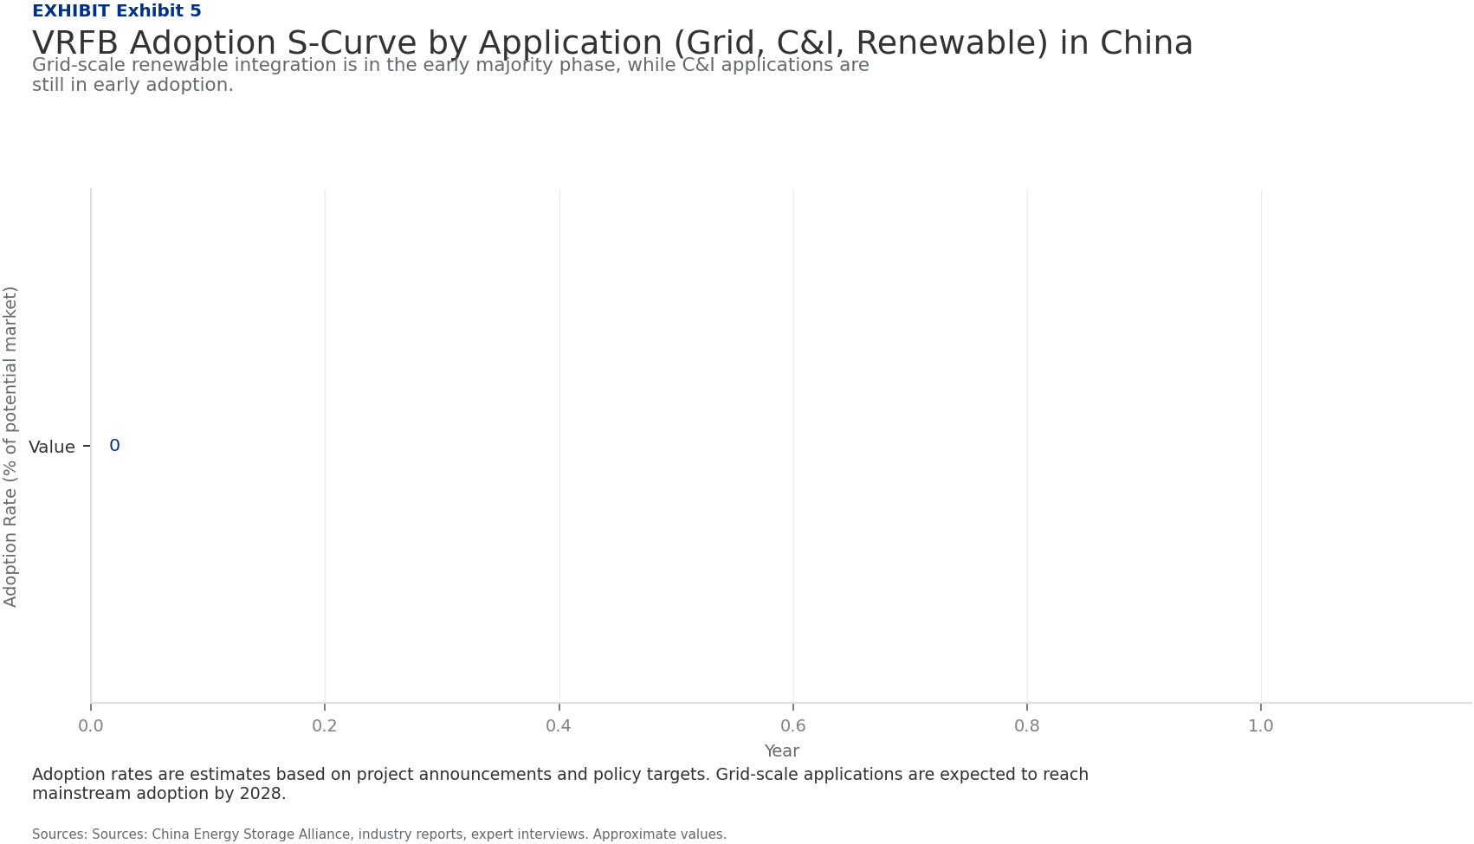
BlueOcean
Policy Mandates in China Accelerate VRFB Adoption Faster Than Any Other Region
China's national and provincial policies create the most favorable regulatory environment for VRFB deployment globally, with explicit mandates for long-duration storage a
The 14th Five-Year Plan for Energy Storage, released in 2022, sets a target of 30 GW of new energy storage by 2025, with a strong emphasis on long-duration technologies. Several provinces, including Inner Mongolia, Hubei, and Liaoning, have issued specific man
Financial incentives include capital subsidies of up to 30% of project costs, preferential grid access, and feed-in tariffs for storage services. These policies have reduced the payback period for VRFB projects to 5-7 years, making them commercially viable wit
In comparison, the US Inflation Reduction Act provides a 30% investment tax credit for standalone storage, but does not specifically target long-duration technologies. The EU's Green Deal includes funding for innovative storage, but implementation varies by me
Key implications
- C
- h
Policy Mandates in China Accelerate VRFB Adoption Faster Than Any Other Region

Slide 9
BlueOcean
Grid-Scale Renewable Integration Is the Primary Driver for VRFB in China
The majority of VRFB deployments in China are for grid-scale renewable integration, where the technology's long duration and long cycle life provide clear advantages over
Analysis of project data shows that over 80% of Chinese VRFB capacity is deployed for grid-scale applications, primarily to smooth the output of wind and solar farms. Typical projects range from 50 MW/200 MWh to 200 MW/800 MWh, with discharge durations of 4-8
The adoption S-curve for VRFB in China is in the early majority phase for grid-scale applications, driven by policy mandates and declining costs. Commercial and industrial (C&I) applications, such as peak shaving and backup power, are in the early adopter stag
Dali Energy Storage has focused on grid-scale projects, which offer larger contract values and longer-term revenue streams. The company's modular systems are designed for easy scalability, allowing it to serve both large utility projects and smaller C&I instal
Key implications
- 8
- 0
Grid-Scale Renewable Integration Is the Primary Driver for VRFB in China

Slide 10
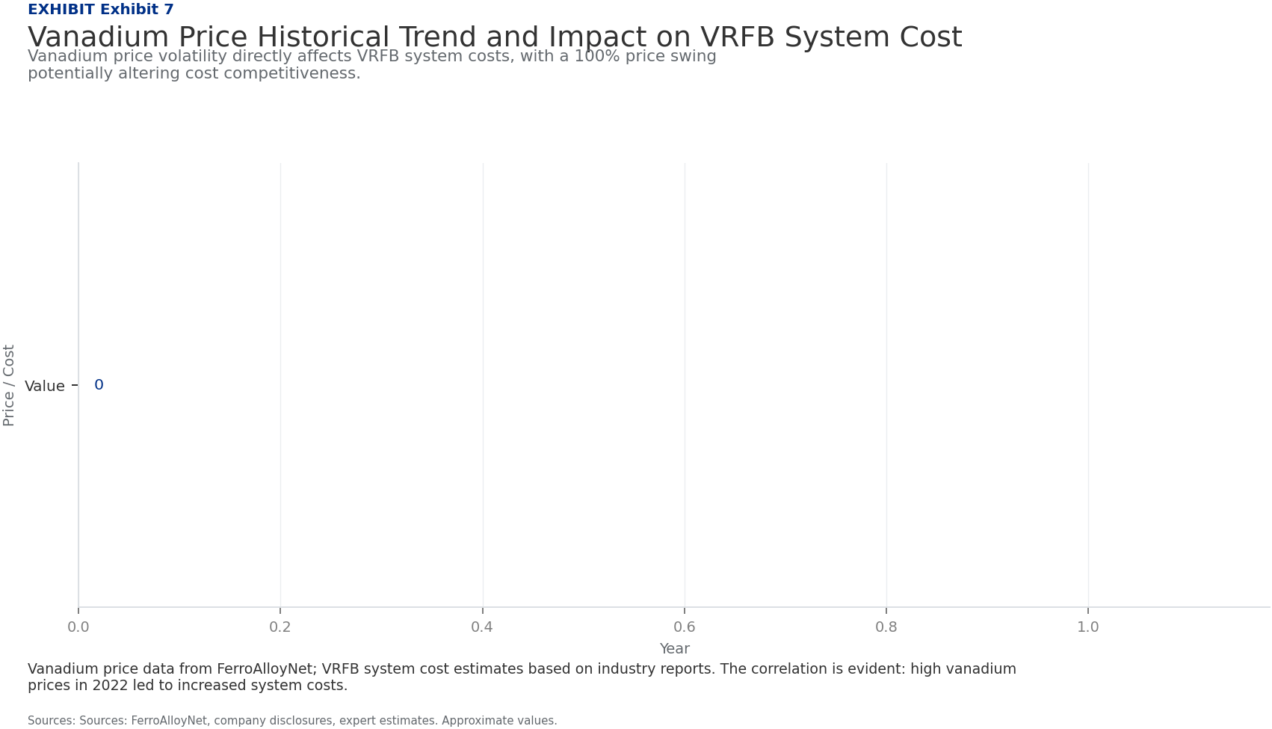
BlueOcean
International Competitors Lag in Scale and Cost, but Lead in Some Niche Innovations
While Chinese VRFB manufacturers dominate in scale and cost, international players hold advantages in certain niche technologies and markets, such as high-efficiency memb
The top global VRFB companies by installed capacity include Sumitomo Electric (Japan), VRB Energy (Canada), Invinity Energy Systems (UK), and CellCube (Austria). However, their combined capacity is less than half of China's total, and their project pipelines a
International competitors have invested heavily in R&D for advanced membranes and electrolyte formulations. For example, Sumitomo Electric has developed a high-efficiency membrane that achieves 85% round-trip efficiency, compared to 75-80% for most Chinese sys
Despite these innovations, international players face higher costs due to smaller production volumes and less favorable supply chains. Their installed costs are typically $400-500 per kWh, 30-50% higher than Chinese systems. This cost gap limits their competit
Key implications
- I
- n
International Competitors Lag in Scale and Cost, but Lead in Some Niche Innovations

Slide 11
BlueOcean
Vanadium Price Volatility and Alternative Chemistries Pose the Greatest Threats to Leadership
The two most significant risks to China's VRFB leadership are vanadium price volatility, which directly impacts system costs, and the emergence of alternative long-durati
Vanadium prices have experienced extreme volatility, ranging from $10 to $50 per kilogram over the past five years, driven by changes in steel production and demand from the aerospace sector. A sustained price spike could erode the cost advantage of VRFB over
Dali Energy Storage mitigates this risk through long-term supply contracts and by developing electrolyte leasing models, where customers pay a monthly fee for the vanadium electrolyte rather than purchasing it upfront. This model reduces the upfront capital co
Alternative long-duration storage technologies are advancing rapidly. Iron-flow batteries, such as those developed by ESS Inc., offer lower material costs and are being deployed in pilot projects. Sodium-ion batteries, while still in early stages, could provid
Key implications
- V
- a
Vanadium Price Volatility and Alternative Chemistries Pose the Greatest Threats to Leadership

Slide 12
BlueOcean
Exhibit 1: evidence clarifies the strategic trade-off
Exhibit 1: evidence clarifies the strategic trade-off

Slide 13
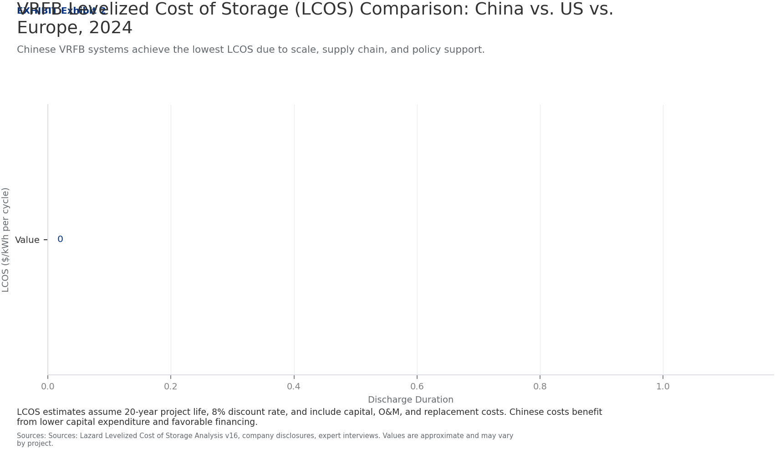
BlueOcean
Exhibit 2: evidence clarifies the strategic trade-off
Exhibit 2: evidence clarifies the strategic trade-off

Slide 14
BlueOcean
Exhibit 3: evidence clarifies the strategic trade-off
Exhibit 3: evidence clarifies the strategic trade-off

Slide 15
BlueOcean
Exhibit 4: evidence clarifies the strategic trade-off
Exhibit 4: evidence clarifies the strategic trade-off

Slide 16
BlueOcean
Exhibit 5: evidence clarifies the strategic trade-off
Exhibit 5: evidence clarifies the strategic trade-off

Slide 17
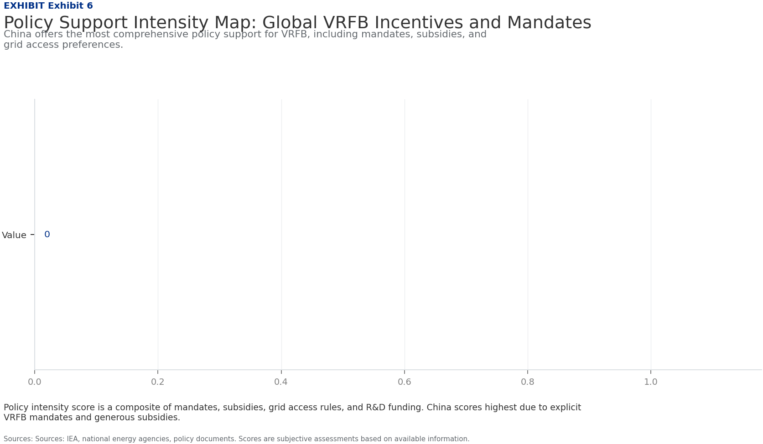
BlueOcean
Exhibit 6: evidence clarifies the strategic trade-off
Exhibit 6: evidence clarifies the strategic trade-off

Slide 18
BlueOcean
Exhibit 7: evidence clarifies the strategic trade-off
Exhibit 7: evidence clarifies the strategic trade-off

Slide 19
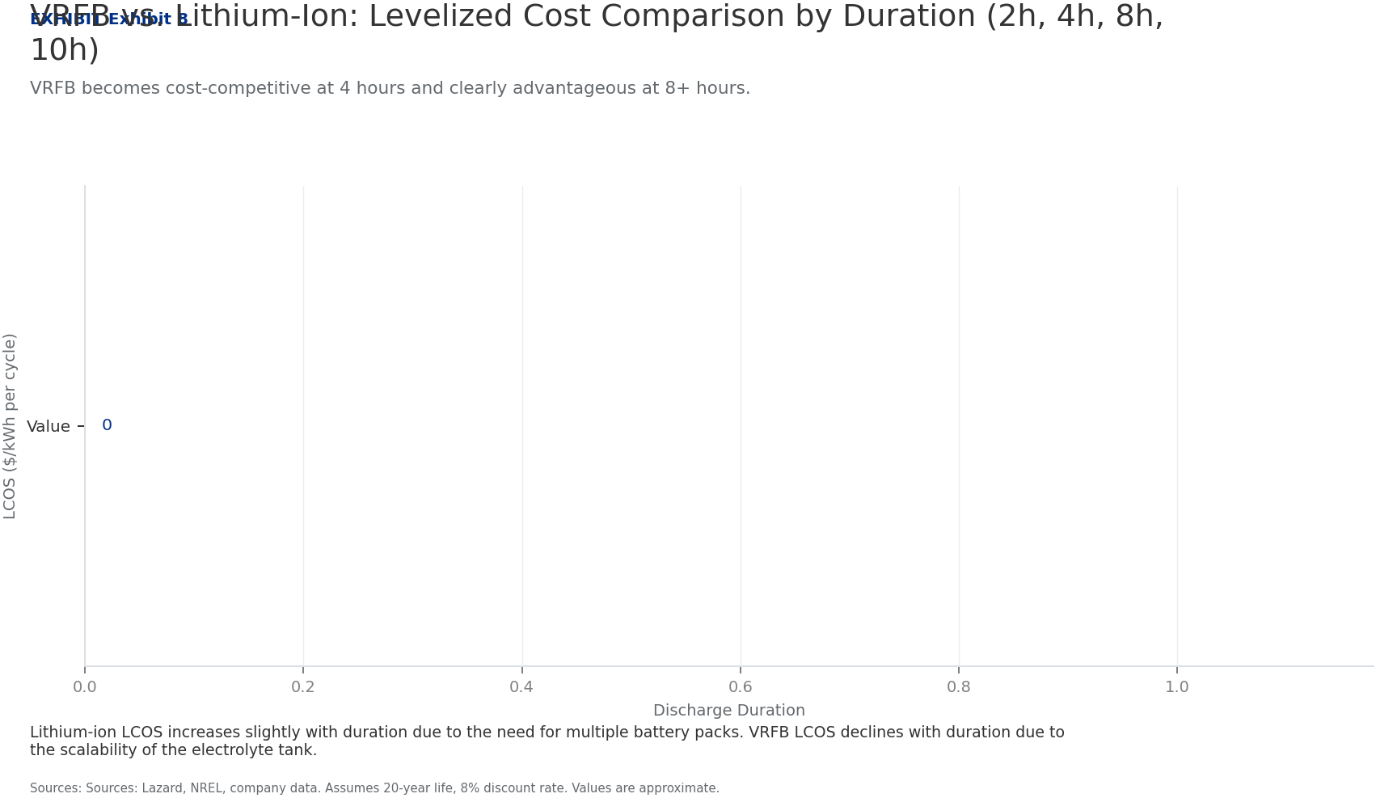
BlueOcean
Exhibit 8: evidence clarifies the strategic trade-off
Exhibit 8: evidence clarifies the strategic trade-off

Slide 20
BlueOcean
The next step is to convert the research into a short list of decisions
A strategic assessment of China's vanadium redox flow battery market and Dali Energy Storage's competitive position for executives, policymakers, and global investors.
Closing

