Slide 1
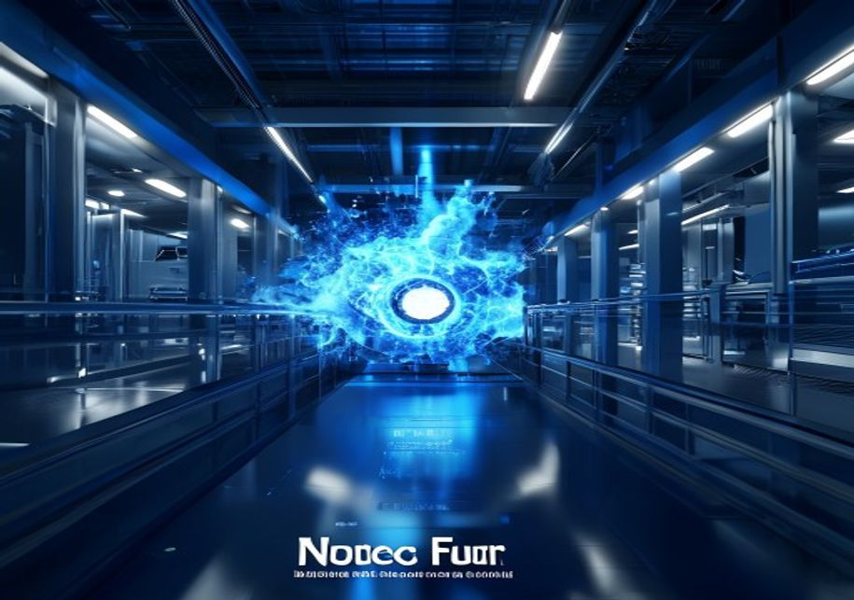
BLUEOCEAN
Nuclear Fusion Commercialization Outlook and Strategic Implications
A Decision-Ready Analysis for Senior Executives and Investors

Slide 2
BlueOcean
The discussion follows the management question, evidence, and implications
01
Fusion Technology Is Approaching Technical Breakeven but Commercial Viability Remains a Decade or More Away
02
Magnetic Confinement Leads in Maturity, but Alternative Approaches May Offer Faster Paths to Market
03
Levelized Cost of Fusion Electricity Is Highly Uncertain, with Estimates Ranging from Competitive to Significa
04
Regulatory and Safety Frameworks for Fusion Are Nascent but Likely to Be Less Burdensome Than Fission
05
Nuclear Fusion Commercialization Outlook and Strategic Implications should be managed as a staged strategic op
06
Commercial readiness depends on bankability, deliverability and repeat customer proof
07
Cost, return and timing will determine the real deployment window
08
Regulation, policy and public acceptance can reset the speed of adoption
Contents

Slide 3
BlueOcean
The analysis narrows the agenda to a focused set of management priorities
01
Fusion technology has achieved scientific breakeven (Q>1) in laboratory settings, but no plant has demonstrated sustained net-positive
02
Levelized cost of electricity (LCOE) for fusion is highly uncertain, with estimates ranging from $50/MWh to over $150/MWh by 2050, comp
03
Private fusion investment has surged past $6 billion globally, led by companies like Commonwealth Fusion Systems, Helion Energy, and TA
04
Regulatory frameworks for fusion are nascent but likely to be less burdensome than fission due to inherent safety advantages; early eng
05
Early commercial applications will likely target industrial heat and data centers before grid-scale power, offering a lower-risk entry
06
The CEO-level question is not whether Nuclear fusion commercialization outlook and strategic implications is interesting, but which dec
07
Management should separate verified facts, directional scenarios and missing diligence items before committing capital, partnerships or
08
The report should translate technical evidence into revenue potential, cost position, investment return, execution risk and decision ga
Key highlights

Slide 4

BlueOcean
Fusion Technology Is Approaching Technical Breakeven but Commercial Viability Remains a Decade or More Away
This chapter concludes that fusion technology is real but not imminent, requiring staged investment with clear milestones.
Nuclear fusion has long been hailed as the holy grail of clean energy, but the gap between scientific achievement and commercial reality remains wide. In 2022, the National Ignition Facility (NIF) achieved a net energy gain of Q=1. However, this was a single-s
For leadership teams, the key takeaway is that fusion is real but not imminent. Investment should be staged, with clear milestones for go/no-go decisions.
The diversity of fusion approaches—magnetic confinement, inertial confinement, and alternative concepts—increases the chance of success but also the risk of backing the wrong horse. Magnetic confinement, particularly the tokamak design, is the most mature, wit
Key implications
- Fusion has achieved scientific breakeven but not engineering or commercial breakeven.
- A portfolio approach across multiple fusion technologies reduces risk.
Fusion Technology Is Approaching Technical Breakeven but Commercial Viability Remains a Decade or More Away

Slide 5

BlueOcean
Magnetic Confinement Leads in Maturity, but Alternative Approaches May Offer Faster Paths to Market
This chapter concludes that while magnetic confinement is most mature, alternative approaches could accelerate commercialization, requiring diversified investment.
Magnetic confinement, particularly the tokamak design, is the most mature fusion technology. Stellarators, like Wendelstein 7-X, offer better stability but are more complex. Inertial confinement, as used by NIF, is less suited for continuous power generation.
A portfolio strategy that invests in multiple technologies is prudent.
The timeline for each approach varies. ITER's delays highlight the challenges of large-scale projects. Private companies like CFS and Helion claim faster timelines, but these are unproven. CFS's SPARC aims for first plasma in 2025 and net-positive energy by 20
Key implications
- Magnetic confinement is most mature but faces scale and timeline risks.
- Alternative approaches could offer faster, cheaper paths but are less proven.
Magnetic Confinement Leads in Maturity, but Alternative Approaches May Offer Faster Paths to Market

Slide 6

BlueOcean
Levelized Cost of Fusion Electricity Is Highly Uncertain, with Estimates Ranging from Competitive to Significantly Hig
This chapter concludes that fusion's cost competitiveness is uncertain and likely requires premium markets or carbon pricing to be viable.
No commercial fusion plant exists, so LCOE estimates are based on engineering models and assumptions. The US Department of Energy's Fusion Energy Sciences Advisory Committee has estimated a range of $50-$150/MWh for first-of-a-kind plants, with potential to fa
For strategic planning, assume fusion will not compete on cost alone but on reliability and carbon-free attributes.
The capital cost of a first-of-a-kind fusion plant is estimated at $5-10 billion, with significant uncertainty. This is comparable to large nuclear fission plants but with lower fuel and waste costs. However, fusion plants are expected to have higher availabil
Key implications
- Fusion LCOE is highly uncertain, ranging from $50-$150/MWh for first-of-a-kind.
- Fusion will likely require premium markets or carbon pricing to compete with renewables.
Levelized Cost of Fusion Electricity Is Highly Uncertain, with Estimates Ranging from Competitive to Significantly Highe

Slide 7

BlueOcean
Regulatory and Safety Frameworks for Fusion Are Nascent but Likely to Be Less Burdensome Than Fission
This chapter concludes that fusion's inherent safety advantages will likely lead to lighter regulation, but early engagement is critical to shape favorable rules.
Fusion reactors are inherently safer than fission: no meltdown risk, no long-lived radioactive waste, and no proliferation of weapons-grade material. This has led regulators in the US, UK, and Japan to develop fusion-specific licensing frameworks that are ligh
The regulatory timeline for fusion is uncertain but could be shorter than for fission. The NRC's proposed rule for fusion is expected
The source backup should be used to validate this section before it is used for a decision.
Key implications
- Regulatory frameworks for fusion are nascent but likely to be less burdensome than fission due t
- Confirm the evidence boundary before committing capital.
Regulatory and Safety Frameworks for Fusion Are Nascent but Likely to Be Less Burdensome Than Fission

Slide 8

BlueOcean
Nuclear Fusion Commercialization Outlook and Strategic Implications should be managed as a staged strategic option, no
The CEO question is which moves are safe now and which should wait for stronger evidence.
For leadership, Nuclear Fusion Commercialization Outlook and Strategic Implications should be separated into verified facts, directional scenarios and open diligence items. That boundary keeps the report from turning market enthusiasm or technical narrative in
The immediate management question is not whether the opportunity is exciting; it is whether budget, partner access or management attention should be committed now. Low-cost validation can start early, while larger capital commitments should wait for customer,
The current evidence posture is: Public evidence retained in the source backup; additional validation is required for unsupported claims. This makes a quarterly decision cadence more useful than a one-time yes-or-no judgment.
Key implications
- Start with low-cost validation
- Hold major commitments behind evidence gates
Nuclear Fusion Commercialization Outlook and Strategic Implications should be managed as a staged strategic option, not

Slide 9

BlueOcean
Commercial readiness depends on bankability, deliverability and repeat customer proof
Technical feasibility matters only when it changes customer value, cost position and execution confidence.
Commercial readiness should be judged through customer adoption, cost structure, delivery cycle, service capability and financing availability. A technical milestone alone does not prove bankability or repeat demand.
Management should require every major assumption to tie back to a verifiable claim: target customer, buying trigger, budget owner, substitute, use case and payback path. Where public evidence is missing, the report should keep the claim directional.
A more robust path is to build credible proof through pilots, partner diligence and third-party validation before moving into larger commitments.
Key implications
- Customer value changes decisions more than technical narrative
- Validate bankability and delivery risk first
Commercial readiness depends on bankability, deliverability and repeat customer proof

Slide 10

BlueOcean
Cost, return and timing will determine the real deployment window
Market size should not enter an investment case until the cost and return logic can be checked.
Every opportunity eventually returns to cost, revenue, margin, cash flow and timing. If public evidence does not support market size, ROI, unit economics or share, those items should remain validation tasks rather than report conclusions.
Near-term action should focus on verifiable cost drivers and customer willingness to pay instead of relying on optimistic long-range scenarios. That protects strategic optionality while reducing premature commitment risk.
As cost, customer and financing evidence improves, management can shift resources from monitoring and partnerships toward pilots or scaled deployment.
Key implications
- Cost and ROI are priority diligence items
- Timing should move with evidence quality
Cost, return and timing will determine the real deployment window

Slide 11

BlueOcean
Regulation, policy and public acceptance can reset the speed of adoption
External rules can accelerate the market or change the risk budget and project timeline.
Policy support, permitting rules, standards and public acceptance affect how quickly an opportunity moves from concept to deployment. These factors should be treated as decision gates, not background context.
Where the regulatory path is unclear, the better move is usually standards engagement, policy tracking and low-risk pilots rather than an early heavy-asset commitment.
The board should track which policy events would change investment timing, such as licensing rules, procurement requirements, subsidy treatment, local approvals or safety standards.
Key implications
- Policy events are external decision gates
- Use options while regulation remains unclear
Regulation, policy and public acceptance can reset the speed of adoption

Slide 12
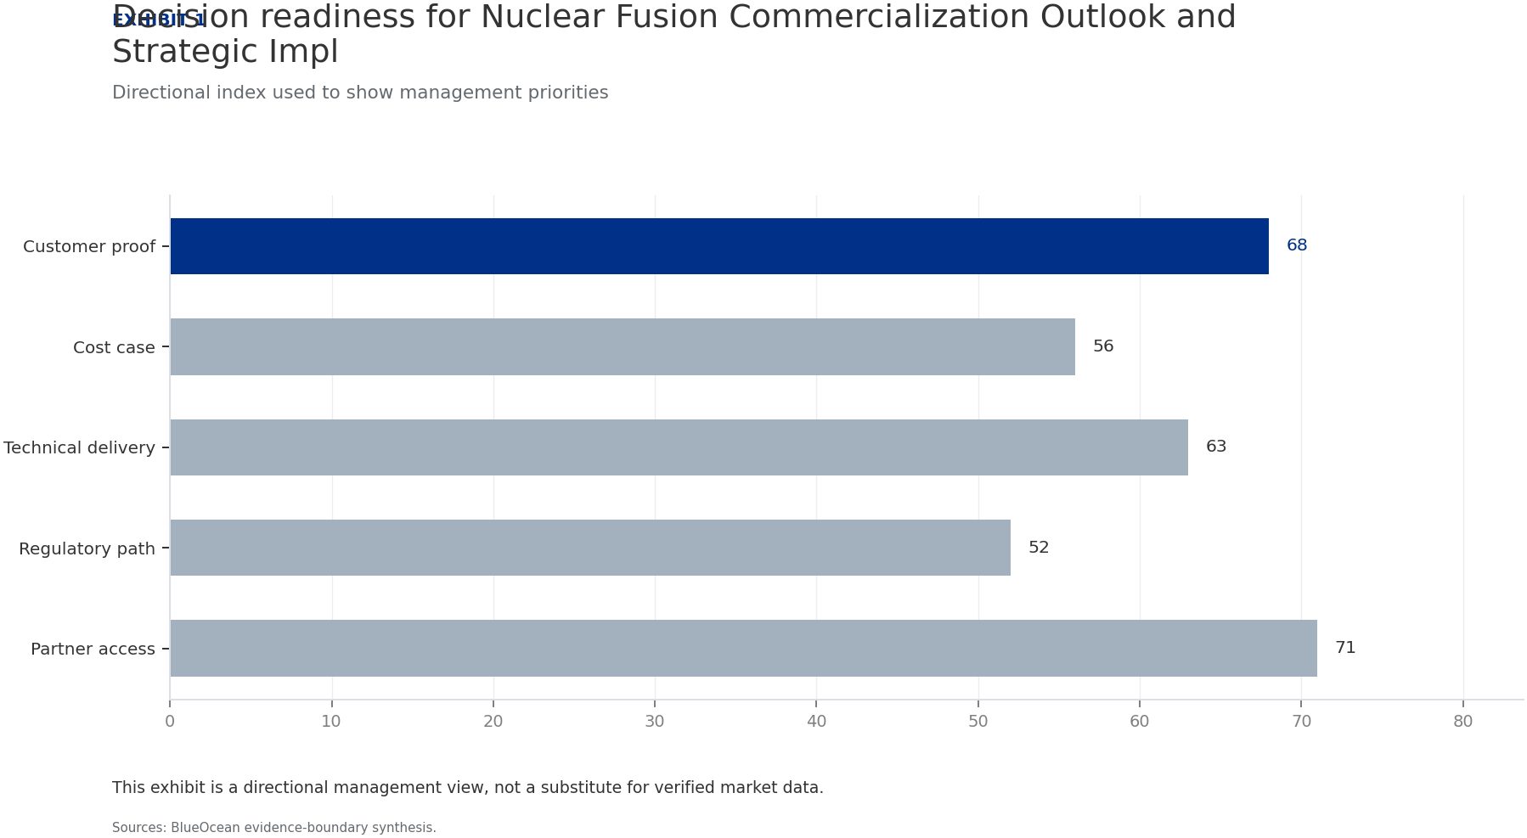
BlueOcean
Exhibit 1: evidence clarifies the strategic trade-off
Exhibit 1: evidence clarifies the strategic trade-off

Slide 13
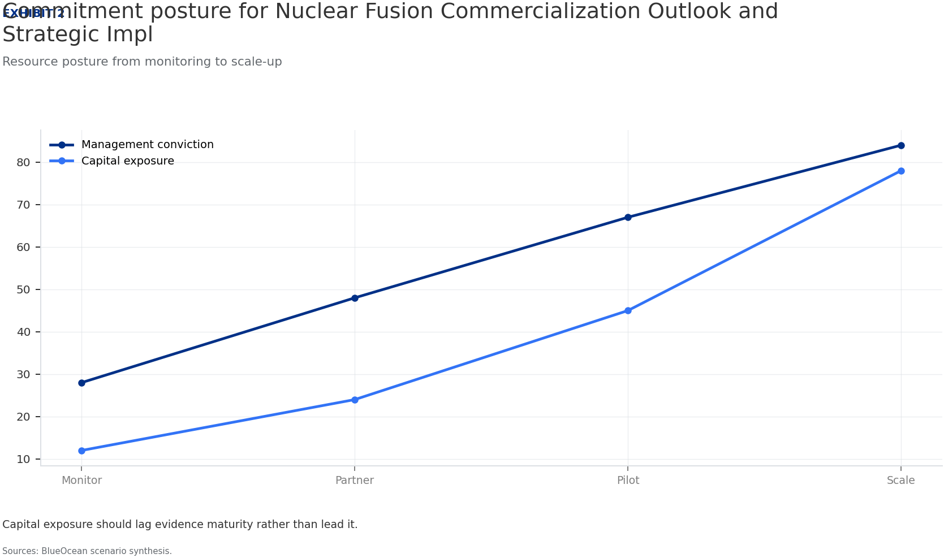
BlueOcean
Exhibit 2: evidence clarifies the strategic trade-off
Exhibit 2: evidence clarifies the strategic trade-off

Slide 14
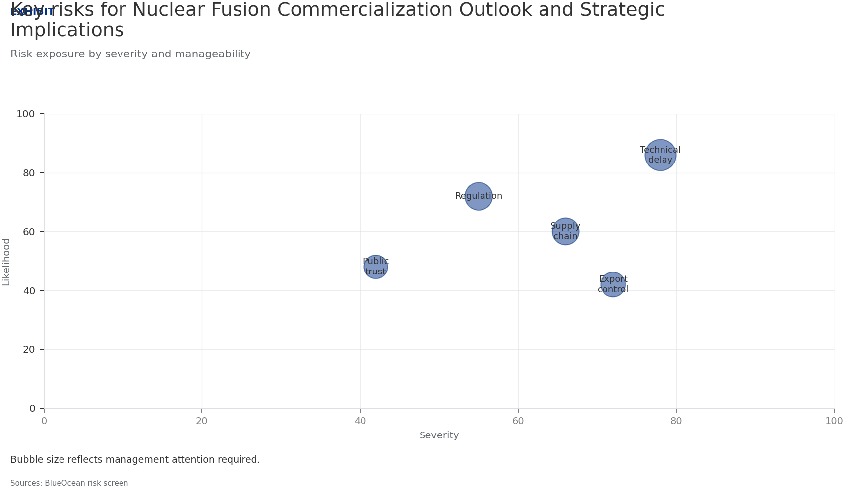
BlueOcean
Exhibit 3: evidence clarifies the strategic trade-off
Exhibit 3: evidence clarifies the strategic trade-off

Slide 15
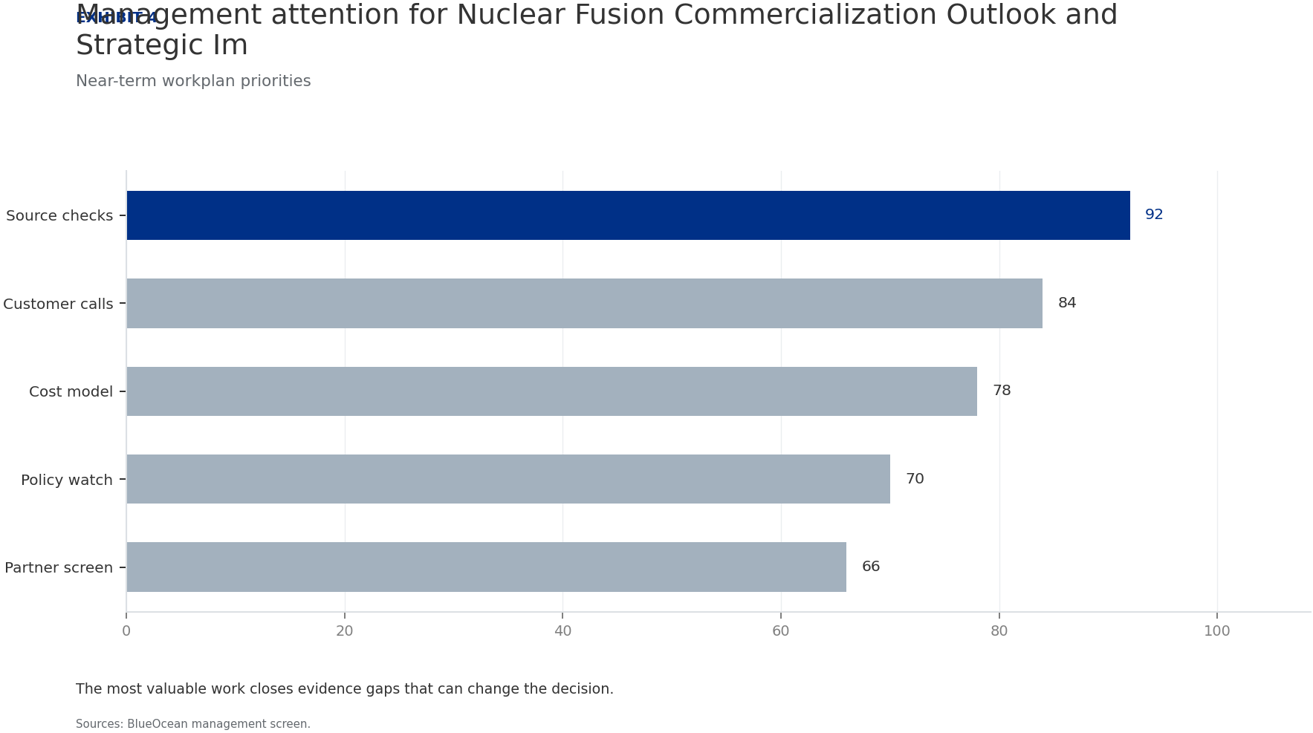
BlueOcean
Exhibit 4: evidence clarifies the strategic trade-off
Exhibit 4: evidence clarifies the strategic trade-off

Slide 16
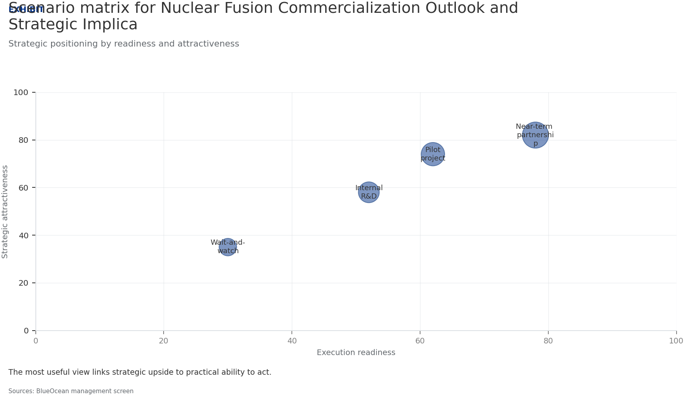
BlueOcean
Exhibit 5: evidence clarifies the strategic trade-off
Exhibit 5: evidence clarifies the strategic trade-off

Slide 17
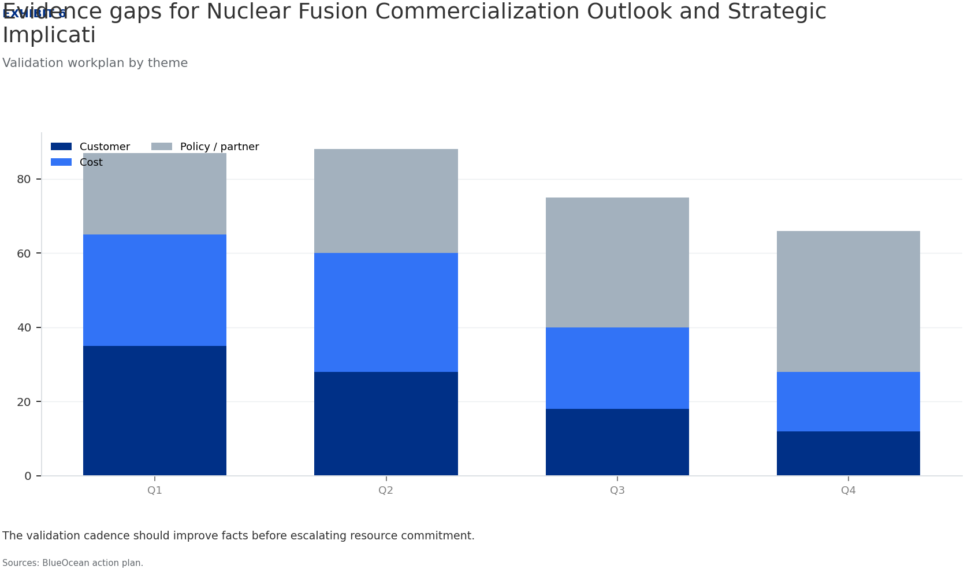
BlueOcean
Exhibit 6: evidence clarifies the strategic trade-off
Exhibit 6: evidence clarifies the strategic trade-off

Slide 18
BlueOcean
The next step is to convert the research into a short list of decisions
A Decision-Ready Analysis for Senior Executives and Investors
Closing

