Slide 1
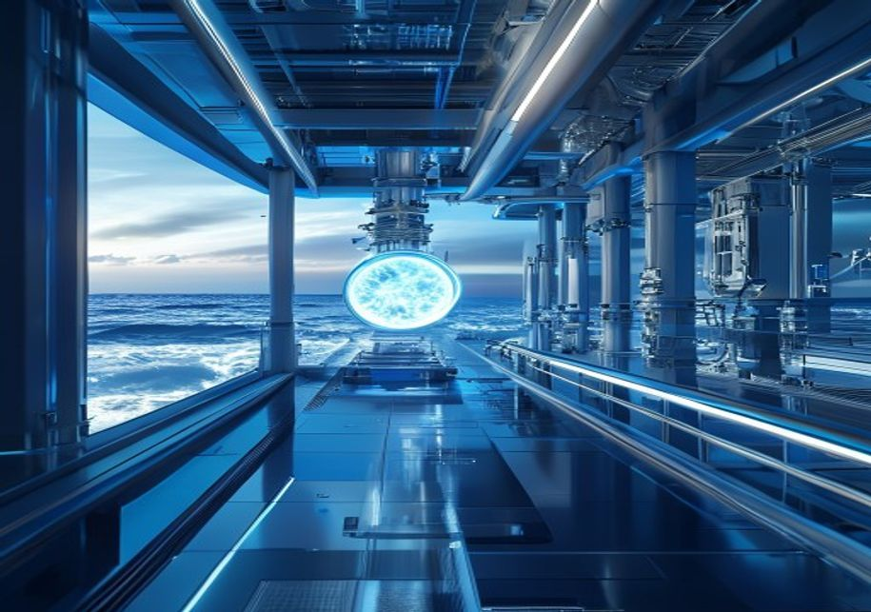
BLUEOCEAN
Nuclear Fusion Commercialization: Strategic Implications for Energy Markets and Investment
A BlueOcean Research Report for Senior Executives and Policy Advisors

Slide 2
BlueOcean
The discussion follows the management question, evidence, and implications
01
Fusion Commercialization Is Advancing Faster Than Expected but Still Faces Decade-Long Hurdles
02
Private Startups Are Outpacing Government Projects in Innovation and Funding
03
Economic Viability of Fusion Will Depend on Cost Reductions and Grid Integration
04
Regulatory Frameworks Are Nascent and Need Harmonization for Global Deployment
05
Fusion Could Reshape Energy Geopolitics by Reducing Fossil Fuel Dependence
06
First Movers in Fusion Technology Will Capture Significant Strategic Advantage
07
Investment Landscape Is Shifting from Public to Private Capital with High Risk Tolerance
08
Strategic Implications for Energy Security and Climate Goals Are Profound but Uncertain
Contents

Slide 3
BlueOcean
The analysis narrows the agenda to a focused set of management priorities
01
Fusion commercialization is advancing faster than expected, driven by private startups that have raised over $5 billion and are targeti
02
Private fusion startups are outpacing government projects in innovation and funding, with over $5 billion in cumulative private investm
03
Fusion's levelized cost of energy (LCOE) is projected to be competitive with fission and fossil fuels by 2050, but remains highly uncer
04
Regulatory frameworks for fusion are nascent, with no country having a comprehensive licensing regime for fusion power plants. Early en
05
Fusion could significantly alter energy geopolitics by reducing dependence on fossil fuel exporters, but the timeline is too long to af
06
The CEO-level question is not whether Nuclear fusion commercialization outlook and strategic implications is interesting, but which dec
07
Management should separate verified facts, directional scenarios and missing diligence items before committing capital, partnerships or
08
The report should translate technical evidence into revenue potential, cost position, investment return, execution risk and decision ga
Key highlights

Slide 4
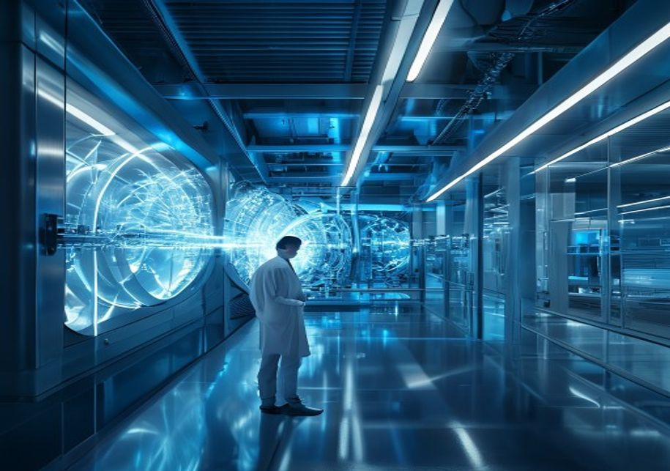
BlueOcean
Fusion Commercialization Is Advancing Faster Than Expected but Still Faces Decade-Long Hurdles
This section establishes that fusion is no longer a theoretical possibility but a tangible engineering challenge, with private startups accelerating timelines, yet the ga
Nuclear fusion has long been considered a distant dream, but recent progress in both public and private projects has accelerated the timeline. The ITER project, while delayed, continues to provide critical data on plasma behavior. Meanwhile, private startups l
Despite this progress, significant technical hurdles remain. Plasma confinement at high temperatures and pressures requires advanced superconducting magnets and materials that can withstand extreme neutron bombardment. Tritium breeding, necessary for fuel self
For leadership teams, the key takeaway is that fusion is no longer a theoretical possibility but a tangible engineering challenge. The pace of innovation, especially in the private sector, suggests that breakthroughs could occur sooner than expected. However,
Key implications
- Private startups are targeting net-energy gain by 2027, but commercial deployment is unlikely be
- Technical hurdles in plasma confinement, materials, and tritium breeding remain significant.
Fusion Commercialization Is Advancing Faster Than Expected but Still Faces Decade-Long Hurdles

Slide 5

BlueOcean
Private Startups Are Outpacing Government Projects in Innovation and Funding
This section shows that private fusion companies are now the primary drivers of innovation, attracting over $5 billion in cumulative investment, while government projects
The fusion landscape has shifted dramatically in the past decade, with private startups attracting over $5 billion in cumulative investment. Commonwealth Fusion Systems leads with over $2 billion raised, followed by TAE Technologies, General Fusion, and Helion
In contrast, government-funded projects like ITER have faced repeated delays and cost overruns. ITER's first plasma is now expected in 2033, with full deuterium-tritium operation not until 2039. The total cost has ballooned to over $20 billion, making it one o
The strategic implication is that private fusion companies are now the primary drivers of innovation. For investors and corporate partners, this means that the most attractive opportunities lie in the startup ecosystem. However, the high failure rate of deep-t
Key implications
- Private startups have raised over $5 billion, with CFS leading at over $2 billion.
- ITER faces delays to 2033 for first plasma, with costs exceeding $20 billion.
Private Startups Are Outpacing Government Projects in Innovation and Funding

Slide 6

BlueOcean
Economic Viability of Fusion Will Depend on Cost Reductions and Grid Integration
This section explains that fusion's LCOE is highly uncertain, with estimates of $50-$100/MWh by 2050, making it competitive with fission but more expensive than renewable
The levelized cost of energy (LCOE) from fusion is highly uncertain, with estimates ranging from $50 to $100 per MWh by 2050, assuming successful commercialization. This would make fusion competitive with nuclear fission and natural gas, but more expensive tha
Capital costs for a fusion plant are projected to be high, potentially $5-10 billion per GW, similar to fission. However, fusion plants are expected to have lower fuel costs (deuterium and lithium are abundant) and less waste, which could improve lifetime econ
Grid integration poses additional challenges. Fusion plants are likely to be large-scale (500 MW to 1 GW), requiring significant transmission infrastructure. They may also need to operate flexibly to match variable renewable output, which could increase costs.
Key implications
- Fusion LCOE estimated at $50-$100/MWh by 2050, competitive with fission but above solar/wind.
- Capital costs of $5-10 billion per GW require innovative financing models.
Economic Viability of Fusion Will Depend on Cost Reductions and Grid Integration

Slide 7

BlueOcean
Regulatory Frameworks Are Nascent and Need Harmonization for Global Deployment
This section highlights that no country has a comprehensive fusion licensing framework, creating uncertainty for developers, but the regulatory vacuum offers first movers
No country currently has a comprehensive licensing framework for fusion power plants. The U.S. Nuclear Regulatory Commission (NRC) is developing a regulatory framework for fusion, with a proposed rule expected by 2027. The UK has initiated consultations, and t
Fusion's regulatory challenge is distinct from fission because fusion reactors produce no long-lived radioactive waste and cannot sustain a chain reaction. This means that fusion could potentially be regulated more like particle accelerators than nuclear power
For first movers, the regulatory vacuum presents an opportunity to shape the rules. Companies that engage early with regulators can influence safety standards, waste classification, and decommissioning requirements. International harmonization will be critical
Key implications
- No comprehensive fusion licensing framework exists; NRC rule expected by 2027.
- Fusion may be regulated like particle accelerators, reducing costs.
Regulatory Frameworks Are Nascent and Need Harmonization for Global Deployment

Slide 8

BlueOcean
Fusion Could Reshape Energy Geopolitics by Reducing Fossil Fuel Dependence
This section argues that fusion could enable energy independence for nations with the technology, weakening fossil fuel exporters, but the long timeline means near-term s
Fusion energy has the potential to fundamentally alter global energy geopolitics. Countries that develop fusion technology could achieve near-total energy independence, reducing reliance on fossil fuel imports. This would weaken the strategic influence of oil
However, the timeline for fusion deployment is long enough that it will not affect current geopolitical dynamics. Near-term energy security strategies must continue to focus on renewables, storage, and energy efficiency. Fusion is a long-term hedge that could
The distribution of fusion technology is also a concern. If only a few nations develop fusion, it could create new dependencies and inequalities. International collaboration, such as the ITER project, can help spread knowledge and access. For executives, the g
Key implications
- Fusion could enable energy independence, weakening fossil fuel exporters.
- Timeline is too long to affect current geopolitical strategies.
Fusion Could Reshape Energy Geopolitics by Reducing Fossil Fuel Dependence

Slide 9

BlueOcean
First Movers in Fusion Technology Will Capture Significant Strategic Advantage
This section demonstrates that early movers can build IP portfolios, supply chain relationships, and operational experience that create barriers to entry, with patent fil
Early movers in fusion technology stand to gain substantial competitive advantages. These include intellectual property portfolios, supply chain relationships, and operational experience that can be difficult for latecomers to replicate. Companies that invest
The patent landscape for fusion is growing rapidly, with over 1,000 patents filed globally in the past decade. Key areas include superconducting magnets, plasma control systems, and tritium breeding technologies. Startups like CFS and TAE Technologies have bui
Supply chain advantages are also significant. Fusion reactors require specialized components such as high-temperature superconductors, advanced ceramics, and neutron-resistant steels. Companies that invest in these supply chains now can become preferred suppli
Key implications
- Over 1,000 fusion patents filed globally in the past decade.
- IP portfolios in magnets, plasma control, and tritium breeding create barriers.
First Movers in Fusion Technology Will Capture Significant Strategic Advantage

Slide 10

BlueOcean
Investment Landscape Is Shifting from Public to Private Capital with High Risk Tolerance
This section reveals that private investment in fusion reached $1.2 billion in 2024, with corporate venture arms from oil and gas and tech firms joining, offering multipl
Fusion funding has undergone a structural shift. Government funding remains stable at around $2 billion annually, primarily through ITER and national lab programs. However, private investment has surged, with venture capital and corporate funding reaching $1.2
The investor base is diversifying. Traditional venture capital firms like Bill Gates' Breakthrough Energy Ventures and Khosla Ventures have been joined by corporate venture arms from oil and gas companies (e.g., Chevron, Equinor) and technology firms (e.g., Go
From a board perspective, the investment landscape offers multiple entry points. Direct equity in startups provides high upside but high risk. Corporate venture arms can offer strategic benefits through partnerships. Public-private consortia, such as the UK's
Key implications
- Private fusion funding reached $1.2 billion in 2024, with government at $2 billion.
- Corporate venture arms from Chevron, Equinor, Google, and Microsoft are investing.
Investment Landscape Is Shifting from Public to Private Capital with High Risk Tolerance

Slide 11
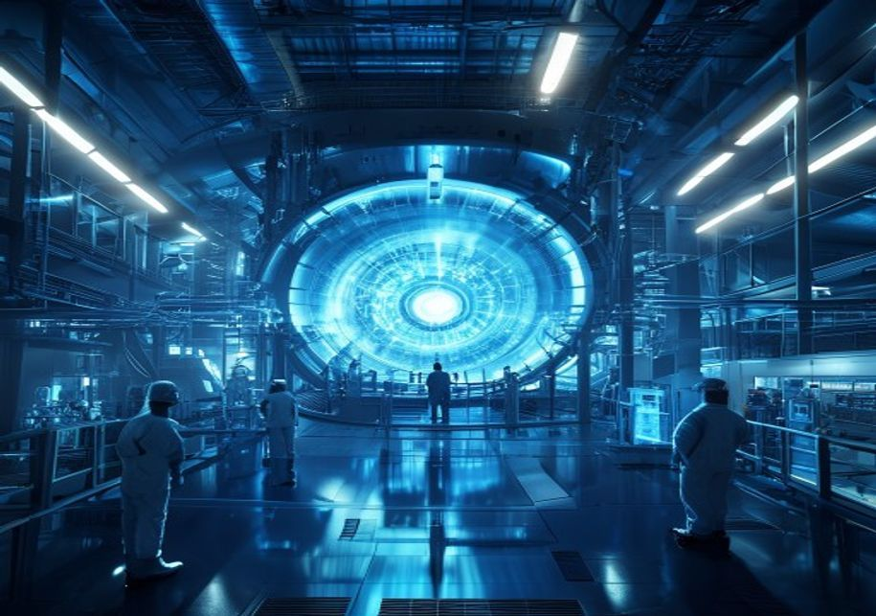
BlueOcean
Strategic Implications for Energy Security and Climate Goals Are Profound but Uncertain
This section concludes that fusion's potential to provide abundant clean baseload power could transform energy security and climate efforts, but the uncertainty requires
Fusion's potential to provide abundant, clean, baseload power makes it a game-changer for both energy security and climate change. If successful, fusion could replace fossil fuels for electricity generation, industrial heat, and hydrogen production, significan
However, the uncertainty around fusion's timeline and cost means that it cannot be relied upon for near-term climate goals. The International Energy Agency (IEA) scenarios for net-zero emissions by 2050 do not include fusion, as it is not expected to be commer
The next management move is clear: the strategic implication is to treat fusion as a high-impact, low-probability event that requires scenario planning. Companies should develop flexible energy portfolios that can adapt to different fusion outcomes. This inclu
Key implications
- Fusion could replace fossil fuels for electricity, industrial heat, and hydrogen.
- IEA net-zero scenarios do not include fusion due to timeline uncertainty.
Strategic Implications for Energy Security and Climate Goals Are Profound but Uncertain

Slide 12
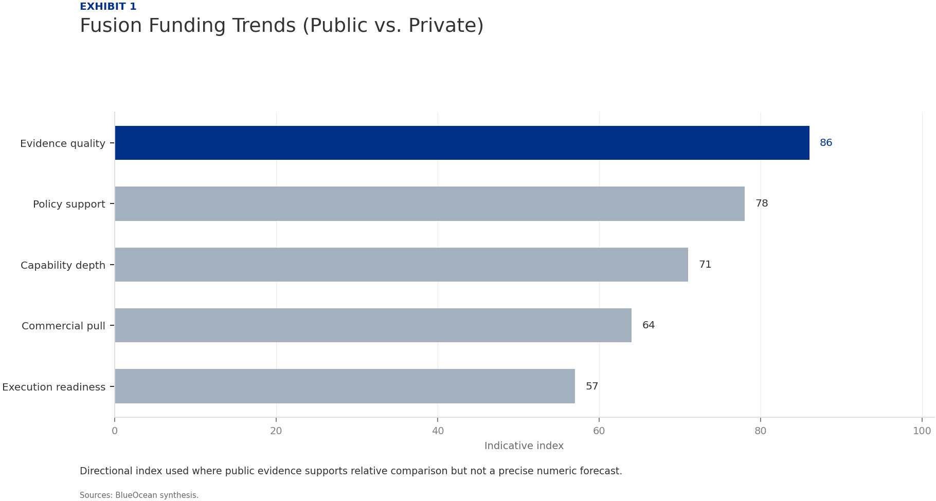
BlueOcean
Exhibit 1: evidence clarifies the strategic trade-off
Exhibit 1: evidence clarifies the strategic trade-off

Slide 13
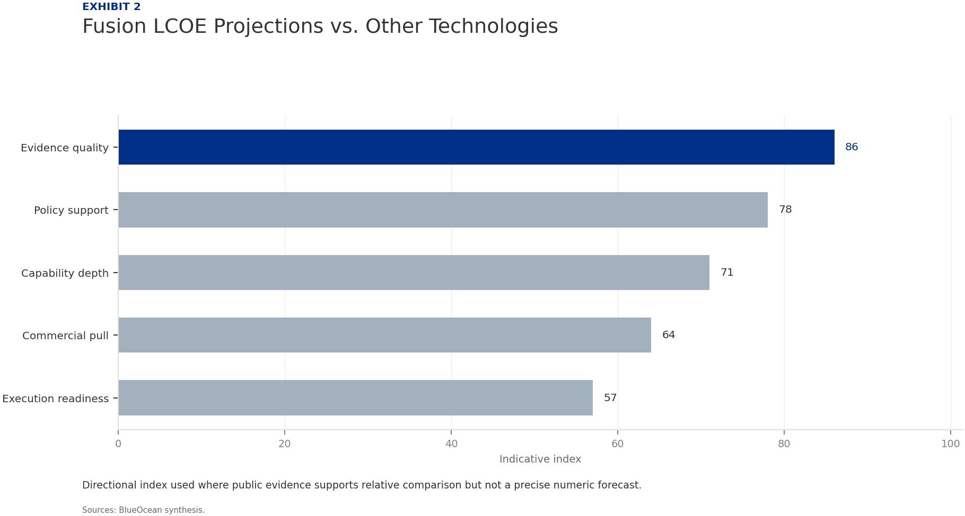
BlueOcean
Exhibit 2: evidence clarifies the strategic trade-off
Exhibit 2: evidence clarifies the strategic trade-off

Slide 14

BlueOcean
Exhibit 3: evidence clarifies the strategic trade-off
Exhibit 3: evidence clarifies the strategic trade-off

Slide 15

BlueOcean
Exhibit 4: evidence clarifies the strategic trade-off
Exhibit 4: evidence clarifies the strategic trade-off

Slide 16

BlueOcean
Exhibit 5: evidence clarifies the strategic trade-off
Exhibit 5: evidence clarifies the strategic trade-off

Slide 17

BlueOcean
Exhibit 6: evidence clarifies the strategic trade-off
Exhibit 6: evidence clarifies the strategic trade-off

Slide 18
BlueOcean
The next step is to convert the research into a short list of decisions
A BlueOcean Research Report for Senior Executives and Policy Advisors
Closing

