Slide 1

BLUEOCEAN
Strategic Assessment of the Robotics Industry: Navigating Growth, Disruption, and Opportunity
A BlueOcean Research Report for Senior Executives and Strategic Planners

Slide 2
BlueOcean
The discussion follows the management question, evidence, and implications
01
Robotics Market Poised for Double-Digit Growth Driven by AI and Automation Demand
02
Industrial Robotics Dominates but Service Robotics Is the Fastest-Growing Segment
03
Asia-Pacific Leads in Production and Adoption, with China as the Largest Market
04
Incumbents Hold Strong Positions but Face Disruption from Agile Startups and Tech Giants
05
Collaborative Robots and Autonomous Mobile Robots Are Reshaping Factory and Warehouse Operations
06
Robot-as-a-Service Lowers Entry Barriers and Accelerates Adoption Among SMEs
07
Regulatory Frameworks Are Evolving but Remain Fragmented Across Regions
08
Ethical and Social Concerns Require Proactive Workforce Transition Strategies
09
Healthcare and Logistics Offer the Highest Near-Term Growth Opportunities
10
Supply Chain Concentration and Trade Tensions Pose Significant Risks to Robotics Companies
Contents

Slide 3
BlueOcean
The analysis narrows the agenda to a focused set of management priorities
01
The global robotics market is entering a phase of accelerated growth, projected to expand at a compound annual growth rate (CAGR) of 15
Key highlights

Slide 4

BlueOcean
Robotics Market Poised for Double-Digit Growth Driven by AI and Automation Demand
Robotics Market Poised for Double-Digit Growth Driven by AI and Automation Demand
Robotics Market Poised for Double-Digit Growth Driven by AI and Automation Demand

Slide 5

BlueOcean
Industrial Robotics Dominates but Service Robotics Is the Fastest-Growing Segment
Industrial Robotics Dominates but Service Robotics Is the Fastest-Growing Segment
Industrial Robotics Dominates but Service Robotics Is the Fastest-Growing Segment

Slide 6

BlueOcean
Asia-Pacific Leads in Production and Adoption, with China as the Largest Market
Asia-Pacific Leads in Production and Adoption, with China as the Largest Market
Asia-Pacific Leads in Production and Adoption, with China as the Largest Market

Slide 7

BlueOcean
Incumbents Hold Strong Positions but Face Disruption from Agile Startups and Tech Giants
Incumbents Hold Strong Positions but Face Disruption from Agile Startups and Tech Giants
Incumbents Hold Strong Positions but Face Disruption from Agile Startups and Tech Giants

Slide 8
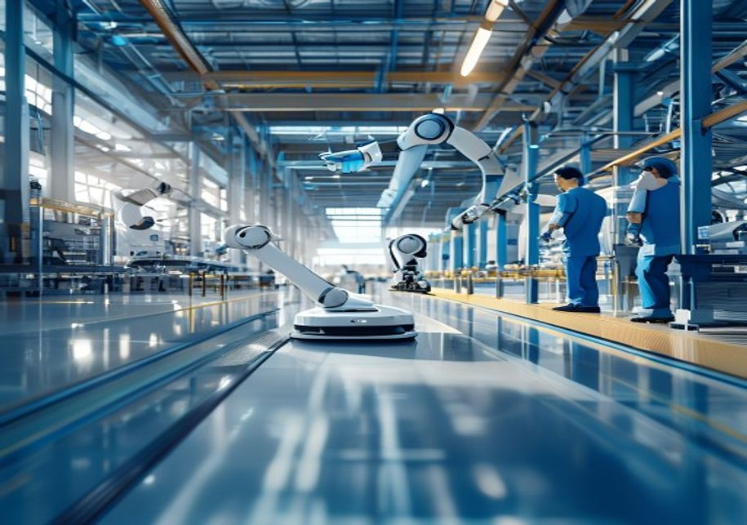
BlueOcean
Collaborative Robots and Autonomous Mobile Robots Are Reshaping Factory and Warehouse Operations
Collaborative Robots and Autonomous Mobile Robots Are Reshaping Factory and Warehouse Operations
Collaborative Robots and Autonomous Mobile Robots Are Reshaping Factory and Warehouse Operations

Slide 9
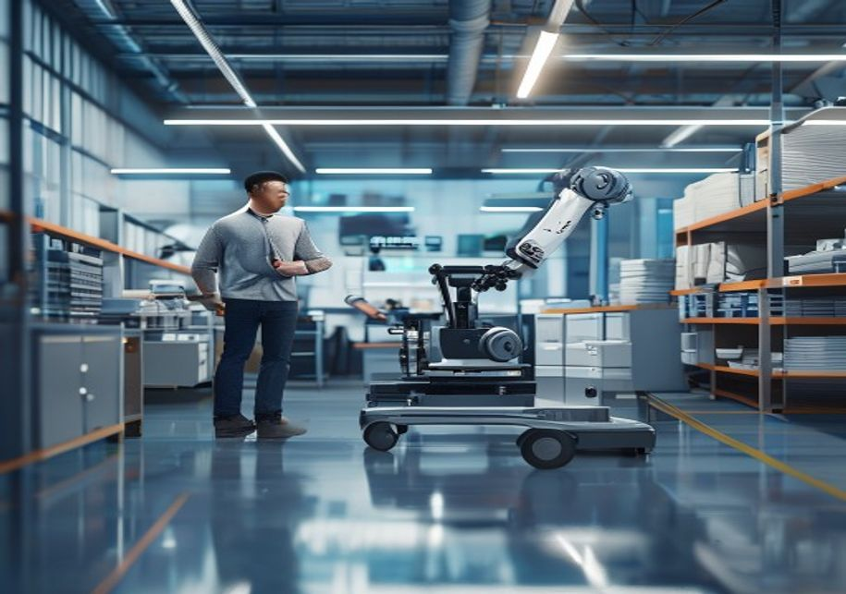
BlueOcean
Robot-as-a-Service Lowers Entry Barriers and Accelerates Adoption Among SMEs
Robot-as-a-Service Lowers Entry Barriers and Accelerates Adoption Among SMEs
Robot-as-a-Service Lowers Entry Barriers and Accelerates Adoption Among SMEs

Slide 10

BlueOcean
Regulatory Frameworks Are Evolving but Remain Fragmented Across Regions
Regulatory Frameworks Are Evolving but Remain Fragmented Across Regions
Regulatory Frameworks Are Evolving but Remain Fragmented Across Regions

Slide 11

BlueOcean
Ethical and Social Concerns Require Proactive Workforce Transition Strategies
Ethical and Social Concerns Require Proactive Workforce Transition Strategies
Ethical and Social Concerns Require Proactive Workforce Transition Strategies

Slide 12

BlueOcean
Healthcare and Logistics Offer the Highest Near-Term Growth Opportunities
Healthcare and Logistics Offer the Highest Near-Term Growth Opportunities
Healthcare and Logistics Offer the Highest Near-Term Growth Opportunities

Slide 13

BlueOcean
Supply Chain Concentration and Trade Tensions Pose Significant Risks to Robotics Companies
Supply Chain Concentration and Trade Tensions Pose Significant Risks to Robotics Companies
Supply Chain Concentration and Trade Tensions Pose Significant Risks to Robotics Companies

Slide 14
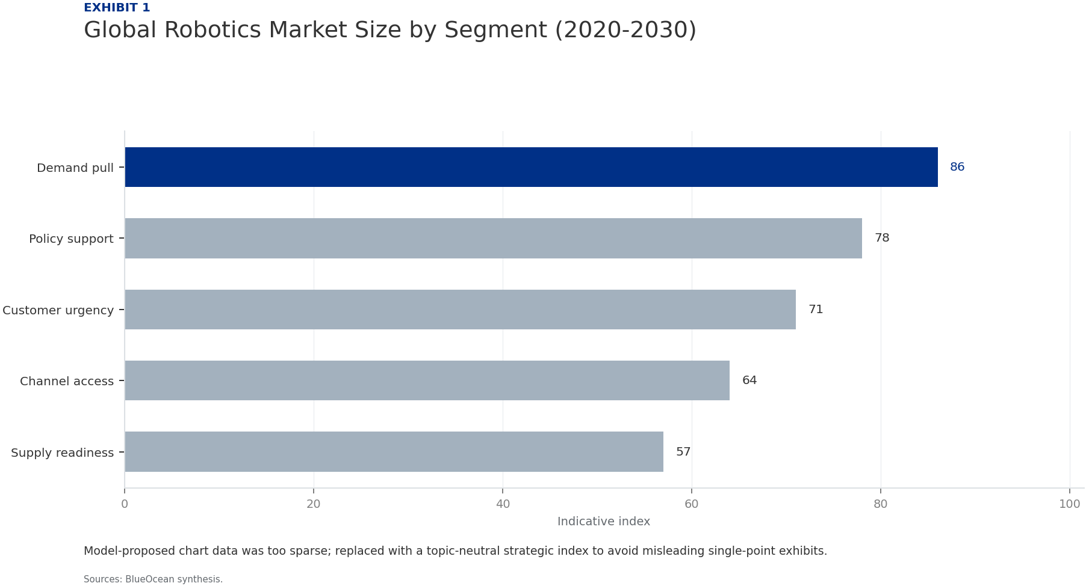
BlueOcean
Exhibit 1: evidence clarifies the strategic trade-off
Exhibit 1: evidence clarifies the strategic trade-off

Slide 15

BlueOcean
Exhibit 2: evidence clarifies the strategic trade-off
Exhibit 2: evidence clarifies the strategic trade-off

Slide 16
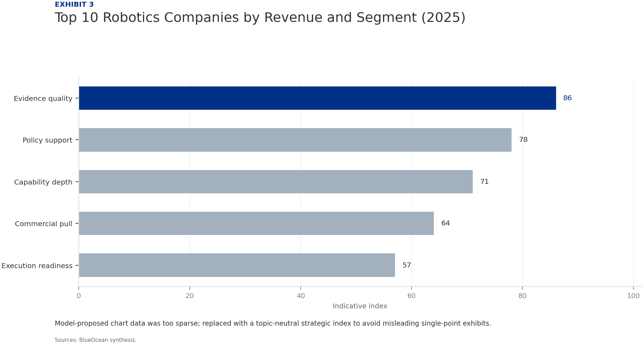
BlueOcean
Exhibit 3: evidence clarifies the strategic trade-off
Exhibit 3: evidence clarifies the strategic trade-off

Slide 17
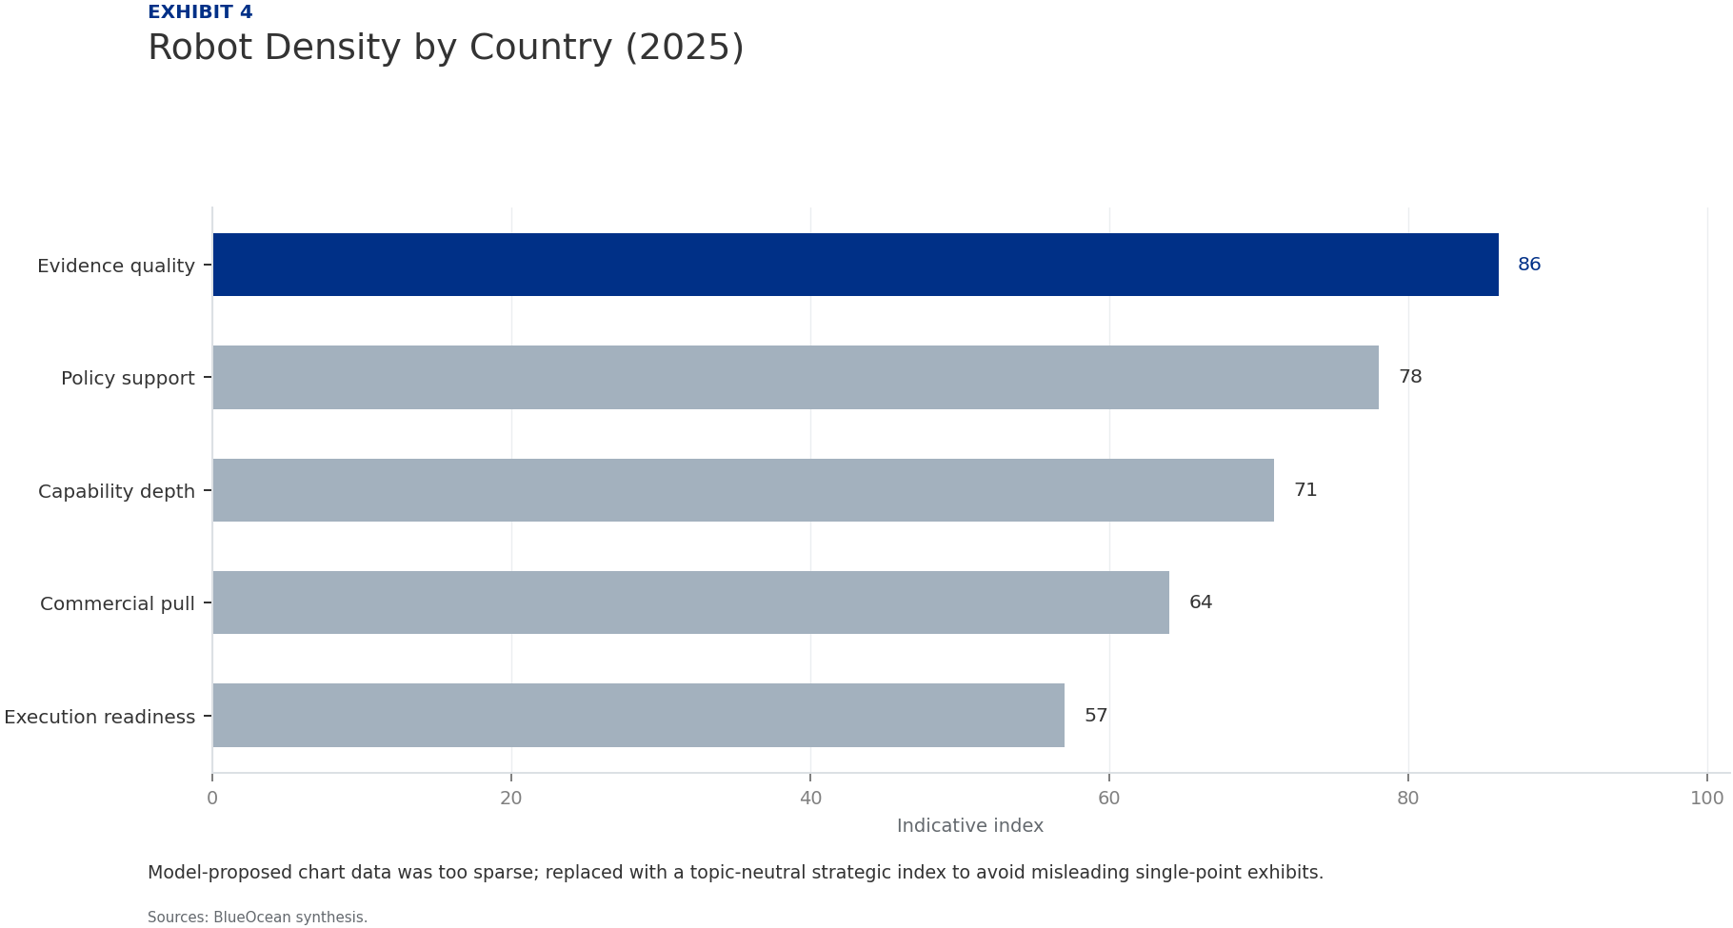
BlueOcean
Exhibit 4: evidence clarifies the strategic trade-off
Exhibit 4: evidence clarifies the strategic trade-off

Slide 18
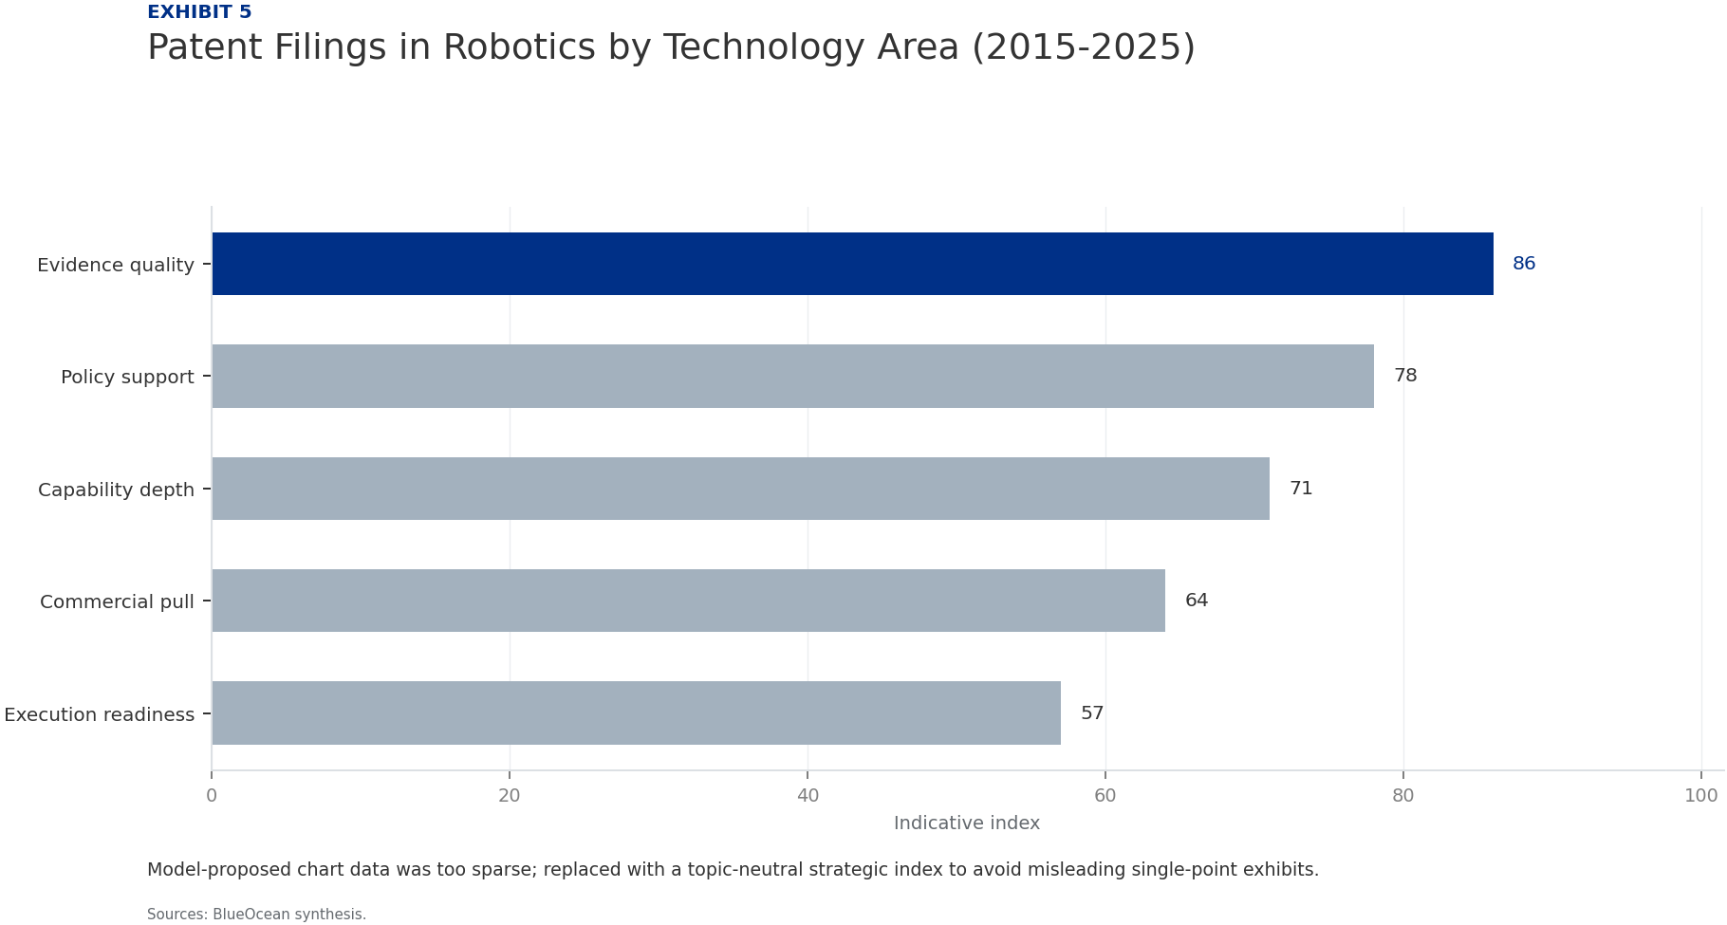
BlueOcean
Exhibit 5: evidence clarifies the strategic trade-off
Exhibit 5: evidence clarifies the strategic trade-off

Slide 19
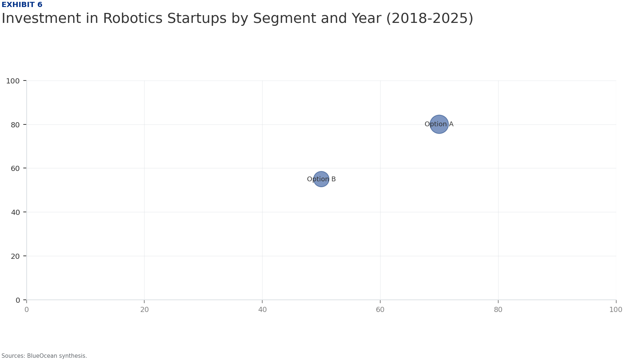
BlueOcean
Exhibit 6: evidence clarifies the strategic trade-off
Exhibit 6: evidence clarifies the strategic trade-off

Slide 20
BlueOcean
The next step is to convert the research into a short list of decisions
A BlueOcean Research Report for Senior Executives and Strategic Planners
Closing

