Slide 1

BLUEOCEAN
Nuclear Fusion Commercialization: Strategic Outlook and Implications for Energy Markets and Investment
A BlueOcean Research Report on the Path to Grid-Ready Fusion and Its Disruptive Potential

Slide 2
BlueOcean
The discussion follows the management question, evidence, and implications
01
Section 1
02
Section 2
03
Section 3
04
Section 4
05
Section 5
06
Section 6
07
Section 7
08
Section 8
09
Section 9
10
Section 10
Contents

Slide 3
BlueOcean
The analysis narrows the agenda to a focused set of management priorities
01
Nuclear fusion is transitioning from a long-term scientific aspiration to a tangible commercial goal, driven by a surge of private inve
Key highlights

Slide 4

BlueOcean
Section 1
Section 1
Section 1

Slide 5

BlueOcean
Section 2
Section 2
Section 2

Slide 6

BlueOcean
Section 3
Section 3
Section 3

Slide 7

BlueOcean
Section 4
Section 4
Section 4

Slide 8

BlueOcean
Section 5
Section 5
Section 5

Slide 9

BlueOcean
Section 6
Section 6
Section 6

Slide 10

BlueOcean
Section 7
Section 7
Section 7

Slide 11

BlueOcean
Section 8
Section 8
Section 8

Slide 12

BlueOcean
Section 9
Section 9
Section 9

Slide 13

BlueOcean
Section 10
Section 10
Section 10

Slide 14
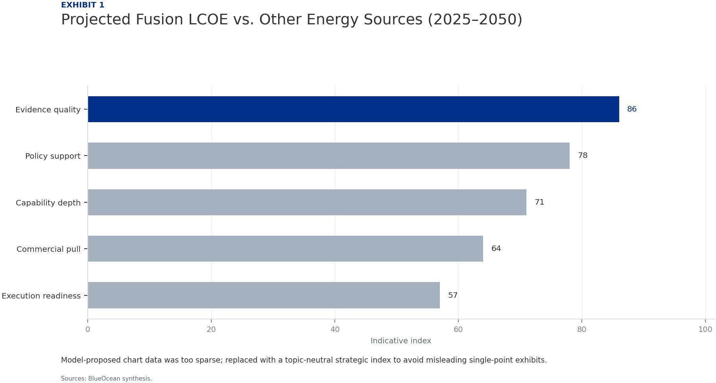
BlueOcean
Exhibit 1: evidence clarifies the strategic trade-off
Exhibit 1: evidence clarifies the strategic trade-off

Slide 15
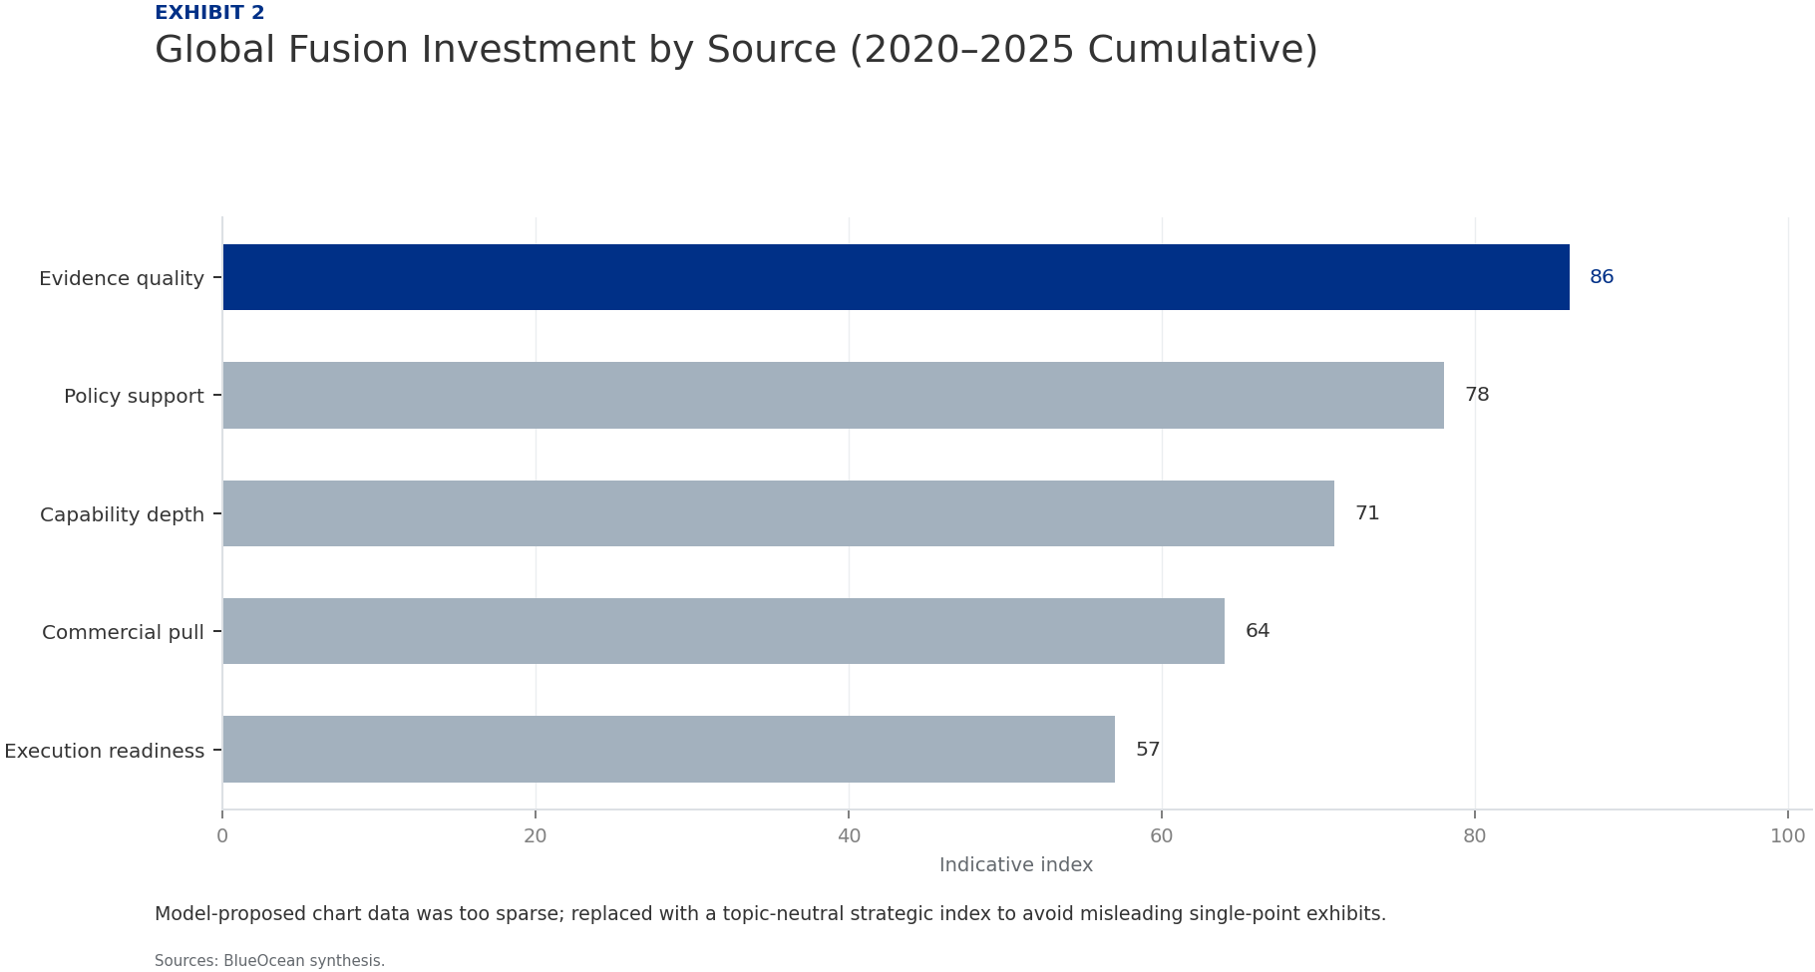
BlueOcean
Exhibit 2: evidence clarifies the strategic trade-off
Exhibit 2: evidence clarifies the strategic trade-off

Slide 16
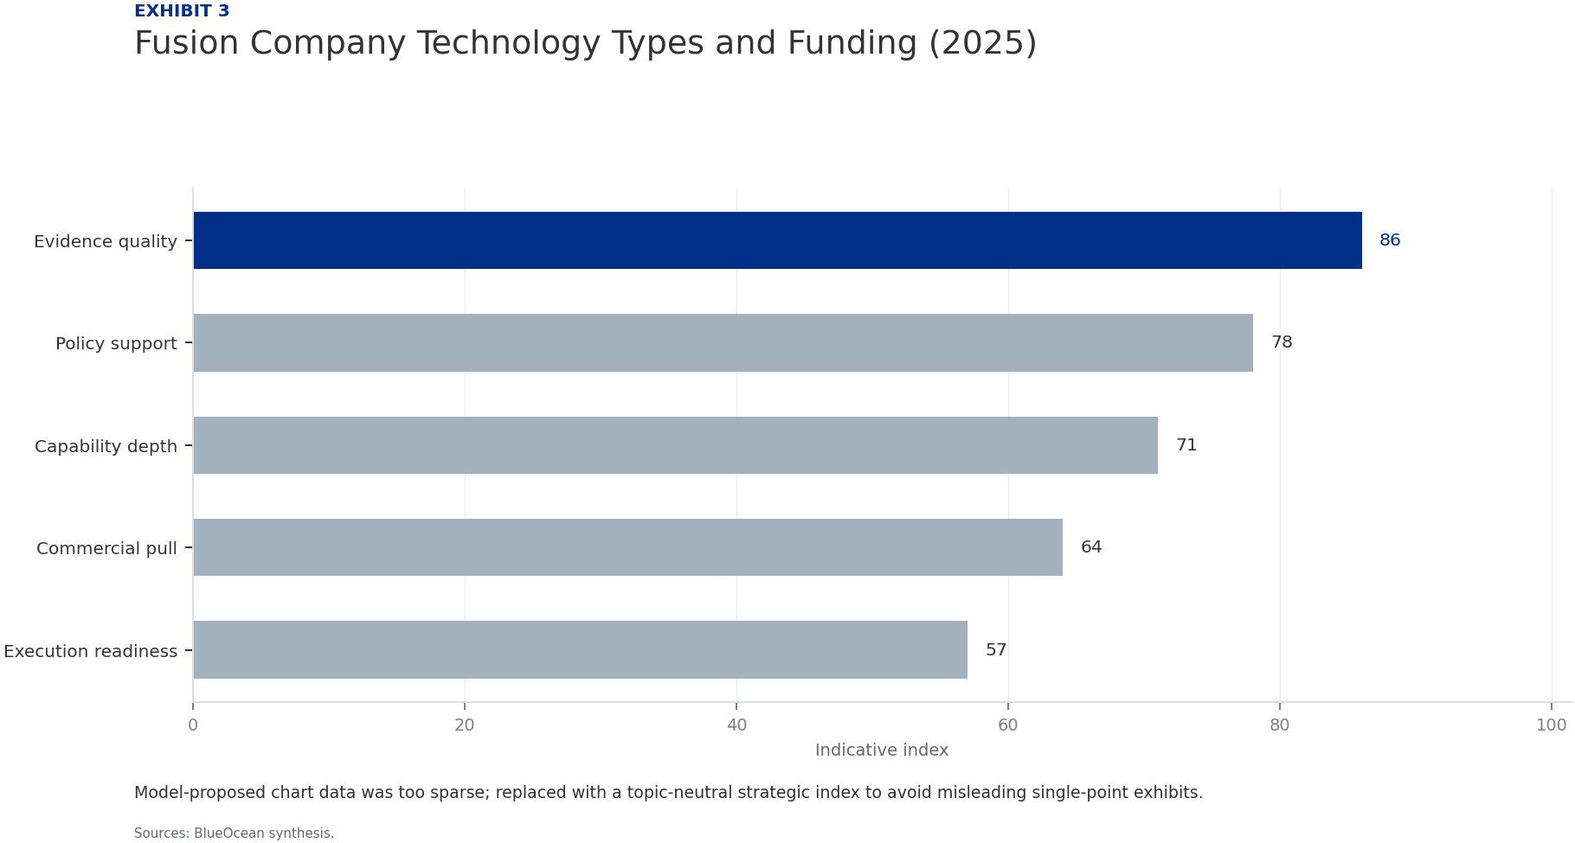
BlueOcean
Exhibit 3: evidence clarifies the strategic trade-off
Exhibit 3: evidence clarifies the strategic trade-off

Slide 17
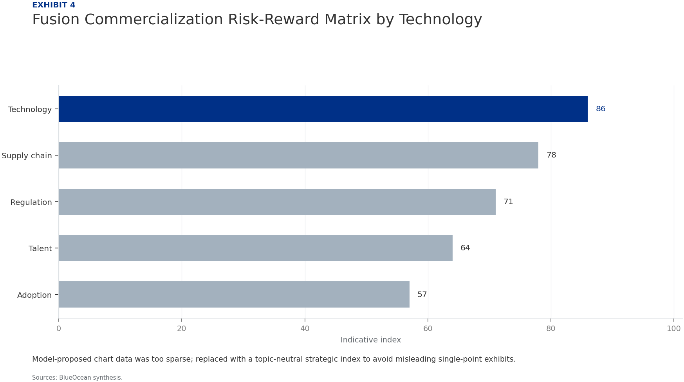
BlueOcean
Exhibit 4: evidence clarifies the strategic trade-off
Exhibit 4: evidence clarifies the strategic trade-off

Slide 18

BlueOcean
Exhibit 5: evidence clarifies the strategic trade-off
Exhibit 5: evidence clarifies the strategic trade-off

Slide 19

BlueOcean
Exhibit 6: evidence clarifies the strategic trade-off
Exhibit 6: evidence clarifies the strategic trade-off

Slide 20
BlueOcean
The next step is to convert the research into a short list of decisions
A BlueOcean Research Report on the Path to Grid-Ready Fusion and Its Disruptive Potential
Closing

