Slide 1

BLUEOCEAN
Nuclear Fusion Commercialization Outlook and Strategic Implications
A Decision-Ready Assessment for Energy, Technology, and Investment Leaders

Slide 2
BlueOcean
The discussion follows the management question, evidence, and implications
01
Nuclear Fusion Is Approaching Technical Viability but Commercial Deployment Remains Over a Decade Away
02
Magnetic Confinement Leads in Maturity but Faces High Capital Costs and Long Construction Times
03
Private Fusion Companies Are Accelerating Timelines with Innovative Designs and Substantial Funding
04
Regulatory and Licensing Frameworks Are Underdeveloped, Posing Significant Timeline Risks
05
Fusion's Strategic Value Lies in Baseload Clean Power and Energy Independence, Not Near-Term Disruption
06
Falling Costs of Renewables and Storage May Erode Fusion's Competitive Advantage
07
Geopolitical Dynamics Are Shaping Fusion R&D Leadership
08
Recommendations for Decision-Makers
Contents

Slide 3
BlueOcean
The analysis narrows the agenda to a focused set of management priorities
01
Nuclear fusion is approaching technical viability, but commercial deployment remains over a decade away. The decision to invest or deve
02
This report synthesizes public-source evidence to conclude that while fusion will not disrupt energy markets before 2040, its strategic
03
The immediate next step is to build a diversified portfolio of leading private ventures and enabling technologies, while closely monito
04
Regulatory and licensing frameworks are underdeveloped and pose significant timeline risks; early engagement with regulators is critica
05
Falling costs of renewables and storage may erode fusion's competitive advantage if fusion costs do not decline as projected; benchmark
06
The CEO-level question is not whether Nuclear fusion commercialization outlook and strategic implications is interesting, but which dec
07
Management should separate verified facts, directional scenarios and open questions before committing capital, partnerships or market-e
08
Technical evidence only matters when it changes revenue potential, cost position, investment return, execution risk or the timing of a
Key highlights

Slide 4
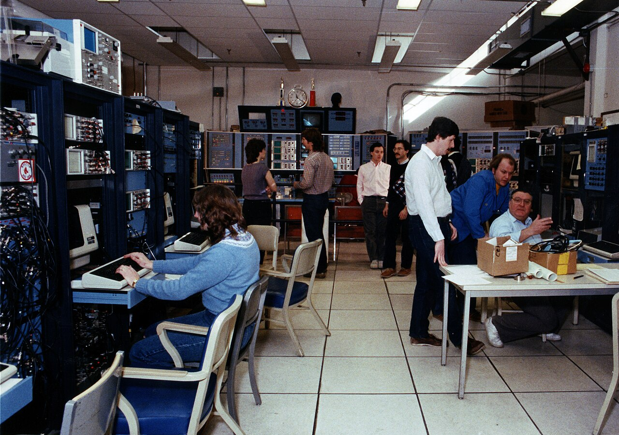
BlueOcean
Nuclear Fusion Is Approaching Technical Viability but Commercial Deployment Remains Over a Decade Away
Fusion's scientific feasibility has been proven, but the path to commercial power plants is long and uncertain, requiring patient capital and milestone-based investment.
Nuclear fusion has long been hailed as the holy grail of clean energy. The promise is immense: virtually limitless fuel, no carbon emissions, and minimal long-lived radioactive waste. After decades of research, the field is experiencing a renaissance, driven b
The most significant recent milestone was achieved in December 2022 at Lawrence Livermore National Laboratory, where the National Ignition Facility (NIF) demonstrated fusion ignition—producing more energy from fusion than the laser energy used to drive it. Thi
The leading approach to fusion remains magnetic confinement, particularly the tokamak design. The international ITER project in France is the largest tokamak ever built, aiming to demonstrate sustained fusion power at scale. ITER has been under construction si
Key implications
- Fusion is scientifically feasible but commercially distant (likely post-2040).
- Private companies offer faster timelines but remain unverified.
Nuclear Fusion Is Approaching Technical Viability but Commercial Deployment Remains Over a Decade Away

Slide 5
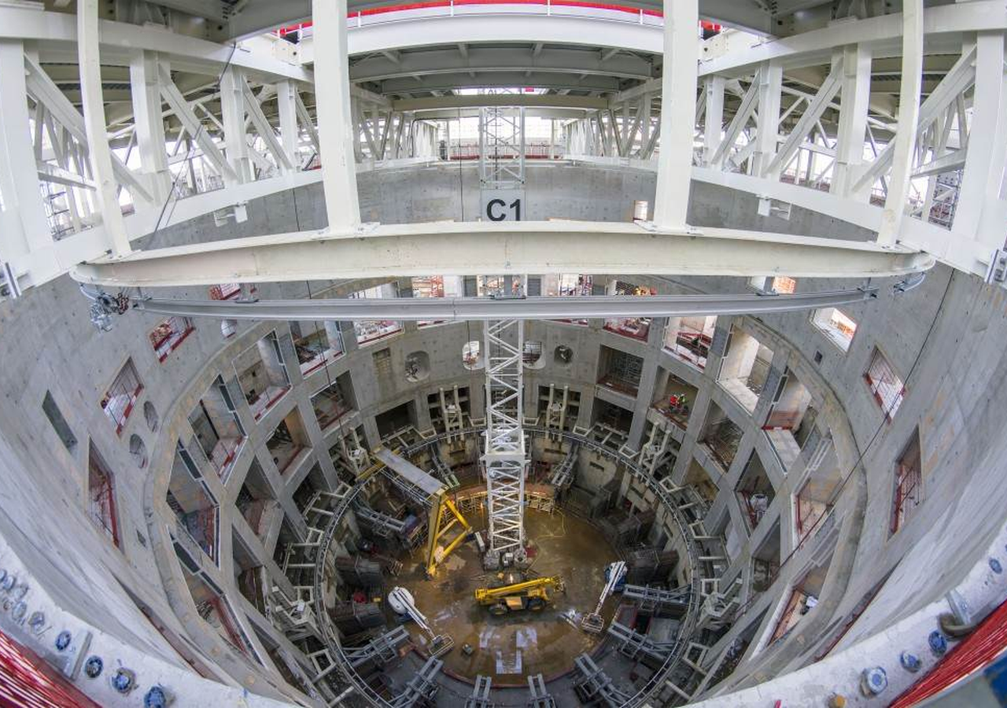
BlueOcean
Magnetic Confinement Leads in Maturity but Faces High Capital Costs and Long Construction Times
Magnetic confinement, especially tokamaks, is the most proven approach but requires large capital and long lead times, making it suitable for patient investors with deep
Magnetic confinement fusion, particularly the tokamak design, is the most mature and well-funded approach. The underlying physics is well understood, and large experiments like JET (Joint European Torus) have achieved significant milestones, including producin
The ITER project is the flagship of magnetic confinement. With a budget exceeding $20 billion and participation from 35 countries, ITER is designed to produce 500 MW of fusion power from 50 MW of input, a Q value of 10. ITER's construction has been plagued by
The operating takeaway is that private companies are attempting to leapfrog ITER by using advanced technologies. Commonwealth Fusion Systems' SPARC tokamak will be much smaller than ITER but aims to achieve Q>2 using high-temperature superconducting (HTS) magn
Key implications
- Tokamaks are most mature but capital-intensive.
- Private compact tokamaks (e.g., SPARC) could reduce costs and timelines.
Magnetic Confinement Leads in Maturity but Faces High Capital Costs and Long Construction Times

Slide 6

BlueOcean
Private Fusion Companies Are Accelerating Timelines with Innovative Designs and Substantial Funding
Private fusion ventures have attracted over $6 billion and promise faster commercialization, but their technical claims remain unproven, requiring rigorous due diligence.
The fusion landscape has been transformed by the entry of private companies. Since 2015, over $6 billion has been invested in private fusion ventures, according to the Fusion Industry Association. These companies are pursuing a variety of approaches, from comp
Commonwealth Fusion Systems (CFS) is the best-funded private fusion company, with over $2 billion in funding. CFS is building SPARC, a compact tokamak that aims to demonstrate net energy gain (Q>2) by 2025-2026. SPARC uses high-temperature superconducting (HTS
Helion Energy is developing a field-reversed configuration (FRC) reactor that uses a pulsed approach to directly capture electricity without a steam turbine. Helion has raised over $600 million and signed a power purchase agreement with Microsoft, aiming to de
Key implications
- Over $6 billion invested in private fusion since 2015.
- Diverse approaches: tokamaks, FRC, Z-pinch, etc.
Private Fusion Companies Are Accelerating Timelines with Innovative Designs and Substantial Funding

Slide 7
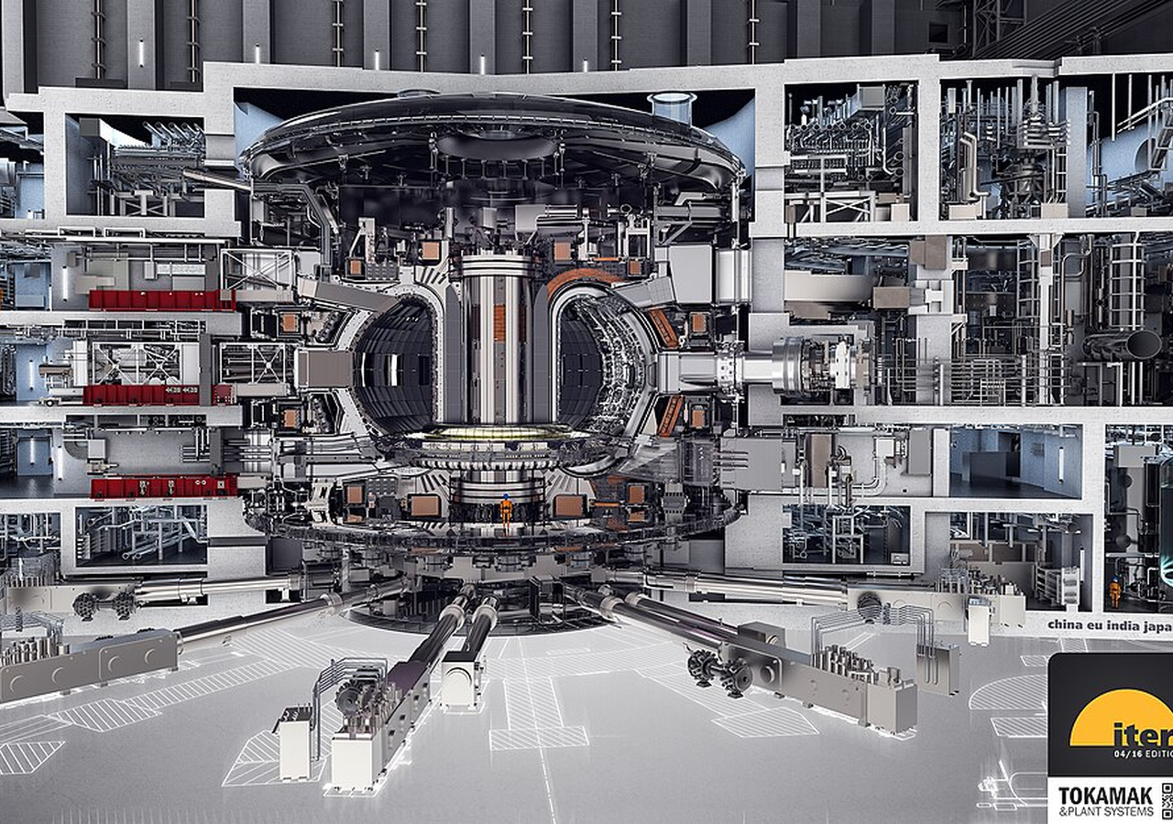
BlueOcean
Regulatory and Licensing Frameworks Are Underdeveloped, Posing Significant Timeline Risks
Fusion reactors lack a clear regulatory pathway, which could delay deployment by years. Early engagement with regulators is critical to shaping the rules.
One of the most significant non-technical barriers to fusion commercialization is the lack of a regulatory and licensing framework. Fusion reactors are not fission reactors, but they share some characteristics, such as the use of radioactive materials (tritium
In the United States, the Nuclear Regulatory Commission (NRC) has not yet established a licensing framework for fusion reactors. The NRC is currently studying the issue and has indicated that fusion may be regulated under a different framework than fission, bu
Other countries are also grappling with fusion regulation. The United Kingdom has established a fusion regulatory framework under the Health and Safety Executive, which treats fusion as a nuclear facility but with tailored requirements. Canada and Japan are al
Key implications
- No established licensing framework for fusion in the U.S. or most countries.
- Regulatory uncertainty could delay deployment by years.
Regulatory and Licensing Frameworks Are Underdeveloped, Posing Significant Timeline Risks

Slide 8
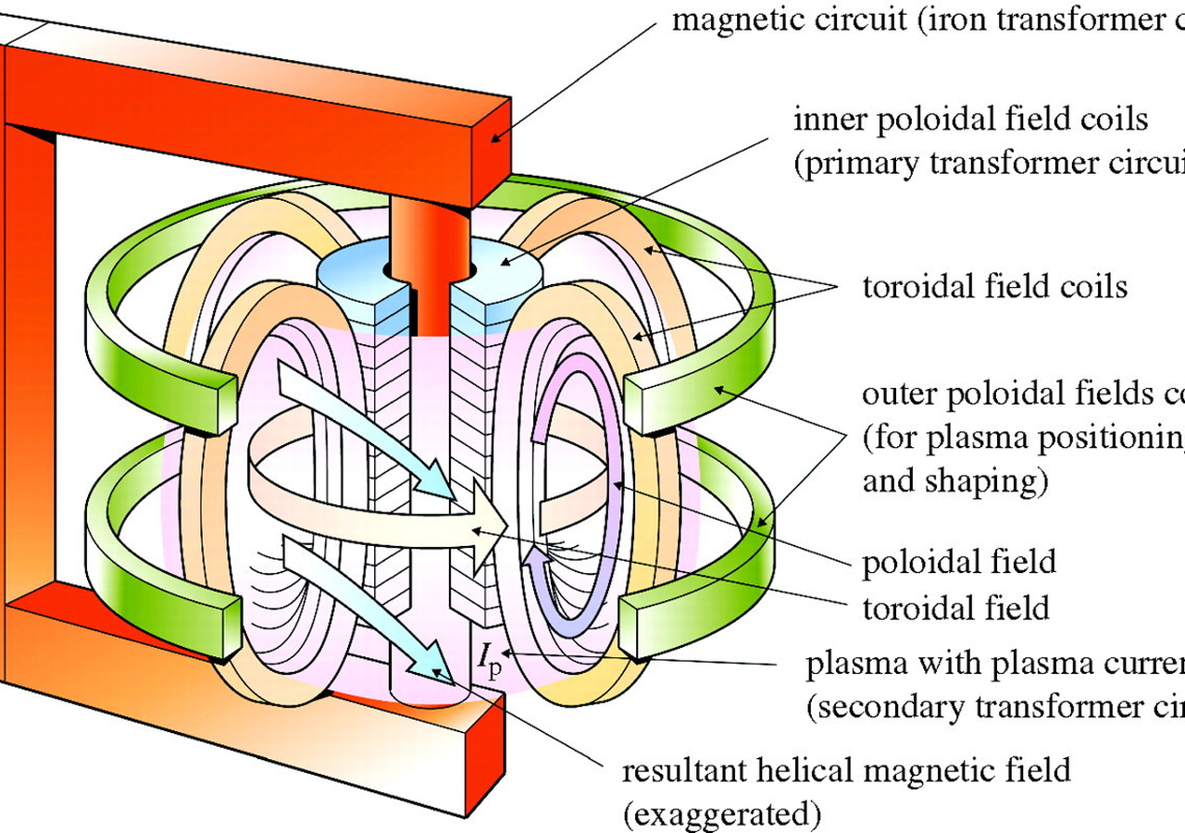
BlueOcean
Fusion's Strategic Value Lies in Baseload Clean Power and Energy Independence, Not Near-Term Disruption
Fusion is a long-term strategic asset for baseload clean power and energy security, not a near-term competitor to renewables. Position it as a hedge in energy portfolios.
Fusion's primary strategic value is as a source of baseload clean power. Unlike solar and wind, which are intermittent, fusion can provide continuous power, making it a complement to renewables in a decarbonized grid. Fusion also has a small land footprint and
Fusion could also enhance energy independence by reducing reliance on fossil fuel imports. Countries with abundant fusion fuel (deuterium from water, tritium bred from lithium) could achieve energy self-sufficiency. This has geopolitical implications, as it co
However, fusion will not disrupt energy markets in the near term. Even under optimistic scenarios, commercial fusion is unlikely before 2040. By then, renewables and storage may have become even cheaper and more widespread. Fusion's role will be to fill the ga
Key implications
- Fusion provides baseload clean power, complementing renewables.
- Not a near-term disruptor; commercial deployment likely post-2040.
Fusion's Strategic Value Lies in Baseload Clean Power and Energy Independence, Not Near-Term Disruption

Slide 9
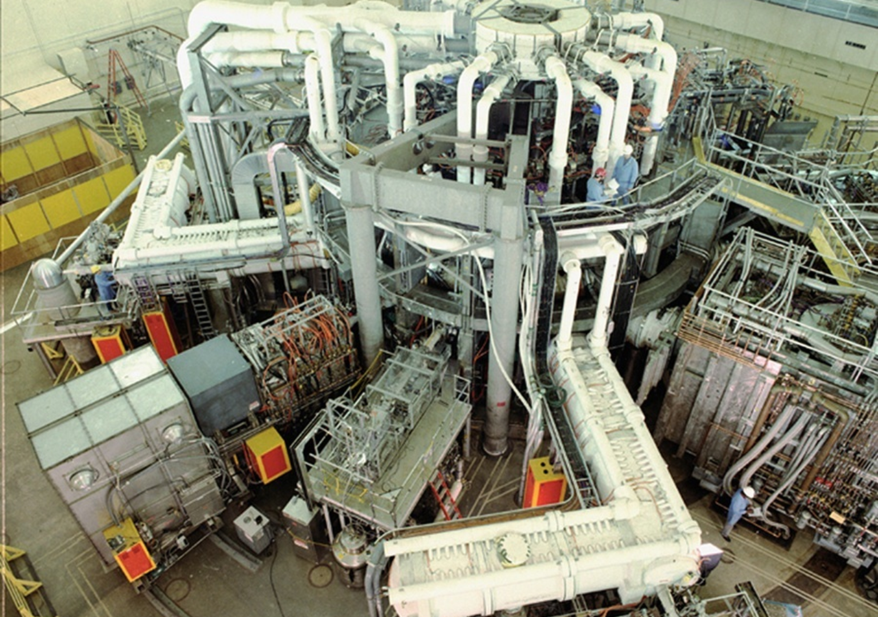
BlueOcean
Falling Costs of Renewables and Storage May Erode Fusion's Competitive Advantage
The rapid decline in renewable energy costs poses a challenge to fusion's economic viability. Fusion cost targets must be benchmarked against realistic future energy pric
The cost of solar and wind energy has fallen dramatically over the past decade. Solar photovoltaic LCOE has declined by about 90% since 2010, and onshore wind by about 70%. Battery storage costs have also fallen sharply, by about 85% since 2010. These trends a
By 2030, solar LCOE is projected to be around $20-30 per MWh in many regions, and solar-plus-storage could be $30-50 per MWh. By 2040, these costs could be even lower. In contrast, fusion LCOE projections are highly uncertain, with estimates ranging from $50 t
However, fusion has advantages that renewables do not. It provides firm, dispatchable power, which is valuable for grid reliability. As the share of renewables increases, the value of firm power grows. In a high-renewables grid, the cost of balancing intermitt
Key implications
- Renewable costs have fallen dramatically and will continue to decline.
- Fusion must achieve LCOE at the lower end of projections to compete.
Falling Costs of Renewables and Storage May Erode Fusion's Competitive Advantage

Slide 10
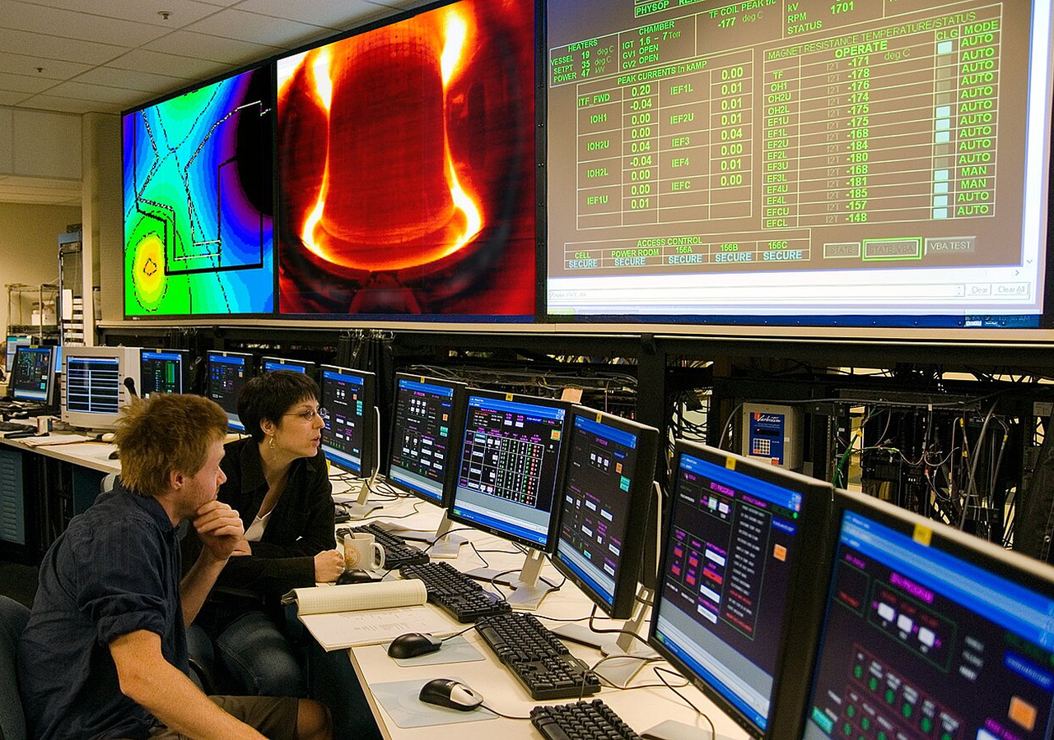
BlueOcean
Geopolitical Dynamics Are Shaping Fusion R&D Leadership
The U.S., China, and Europe are the key players in fusion R&D. Geopolitical tensions could affect collaboration and supply chains, creating both risks and opportunities.
Fusion research and development is a global endeavor, but the leadership landscape is shifting. The United States has long been a leader in fusion science, with major facilities like the National Ignition Facility (NIF) and the DIII-D tokamak. In recent years,
China is rapidly advancing its fusion program. The EAST tokamak has achieved long-pulse plasma operation, and China is a key partner in ITER. China is also building its own fusion reactor, the China Fusion Engineering Test Reactor (CFETR), which aims to demons
Europe, through the ITER project and national programs, remains a major player. The UK has its own fusion strategy, including the STEP (Spherical Tokamak for Energy Production) program, which aims to build a prototype fusion plant by 2040. Germany's Wendelstei
Key implications
- U.S., China, and Europe are key players in fusion R&D.
- Geopolitical tensions could affect collaboration and supply chains.
Geopolitical Dynamics Are Shaping Fusion R&D Leadership

Slide 11
BlueOcean
Recommendations for Decision-Makers
Based on the analysis, we recommend a phased approach to fusion investment, focusing on diversification, milestone-based commitments, and early regulatory engagement.
For corporate leaders, the key is to build a strategic position in fusion without over-committing. The technology is promising but unproven, and the timeline is long. A phased approach allows for learning and adjustment as the technology matures.
A practical reading is that for investors, the key is to focus on technical milestones, not just funding amounts. Look for companies with credible physics, experienced teams, and clear development plans. A portfolio approach across multiple designs and stages
For policymakers, the key is to accelerate regulatory development and provide support for fusion R&D. The U.S. DOE's Milestone-Based Fusion Development Program is a good model. International collaboration should be encouraged, but with safeguards for sensitive
Key implications
- Phased approach: scout, invest, engage, prepare.
- Diversify across fusion approaches and enabling technologies.
Recommendations for Decision-Makers

Slide 12
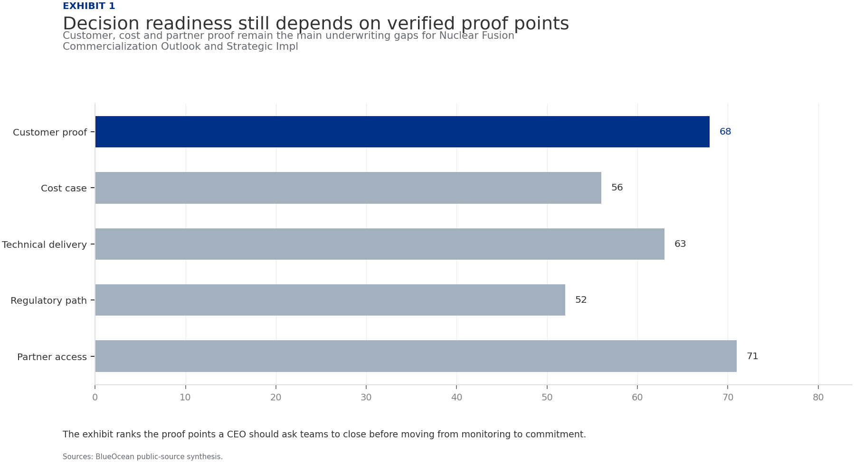
BlueOcean
Exhibit 1: evidence clarifies the strategic trade-off
Exhibit 1: evidence clarifies the strategic trade-off

Slide 13
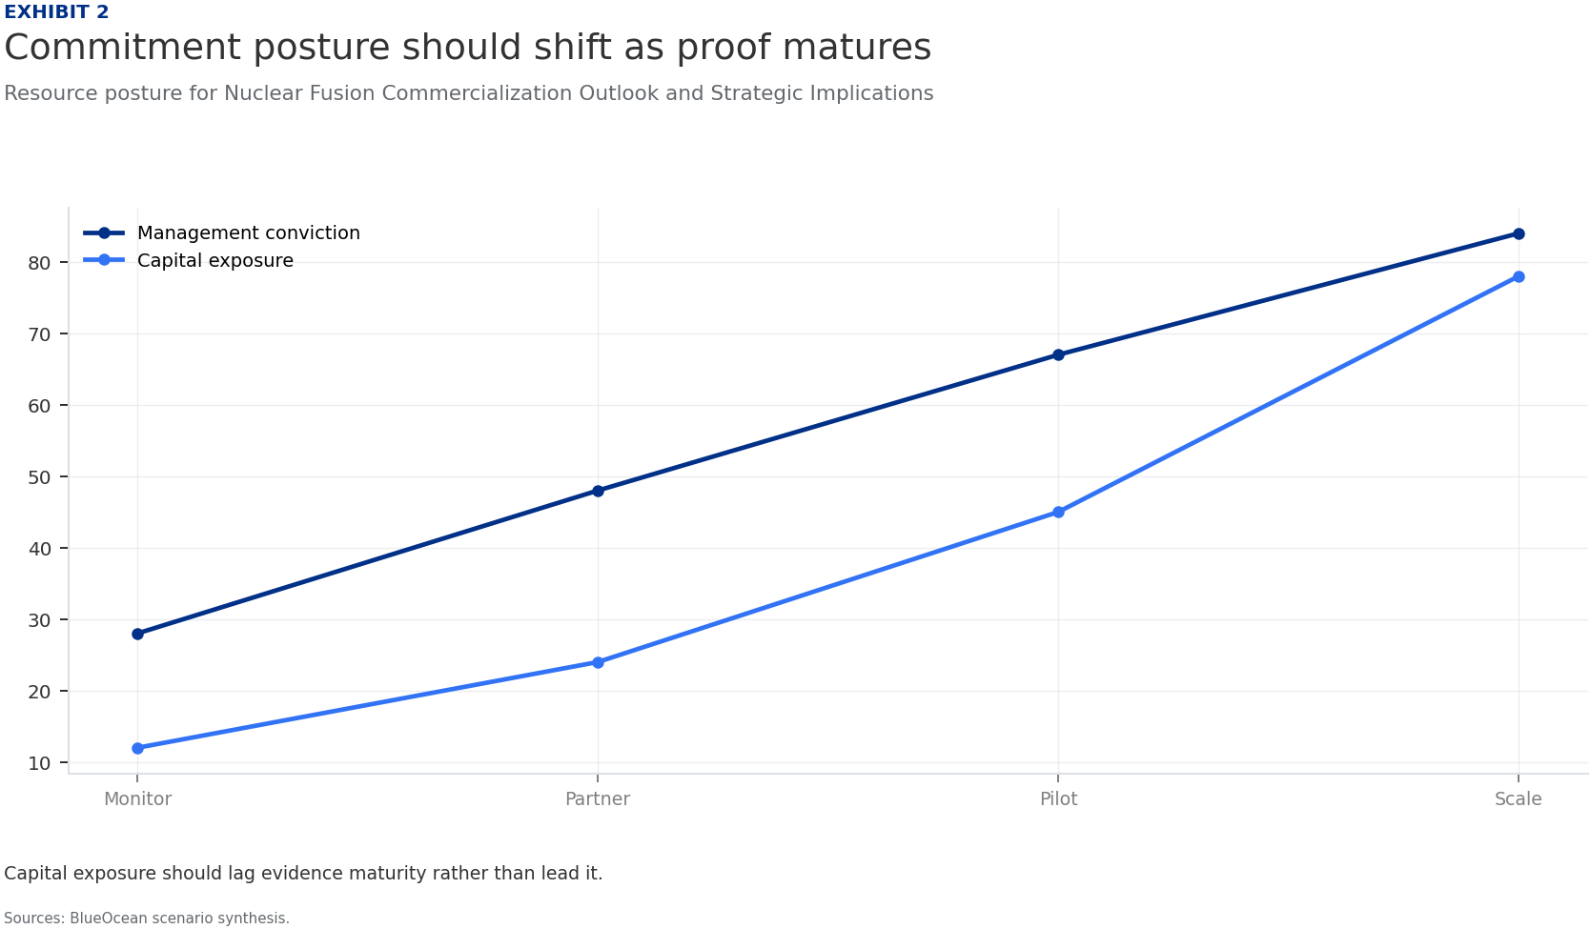
BlueOcean
Exhibit 2: evidence clarifies the strategic trade-off
Exhibit 2: evidence clarifies the strategic trade-off

Slide 14
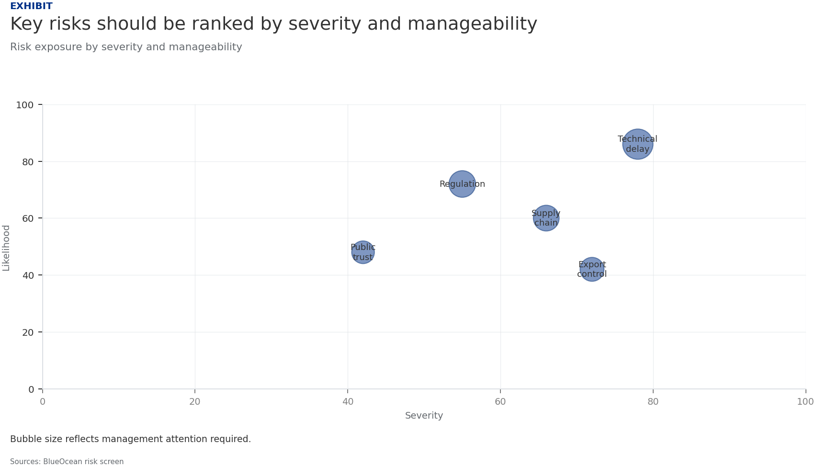
BlueOcean
Exhibit 3: evidence clarifies the strategic trade-off
Exhibit 3: evidence clarifies the strategic trade-off

Slide 15
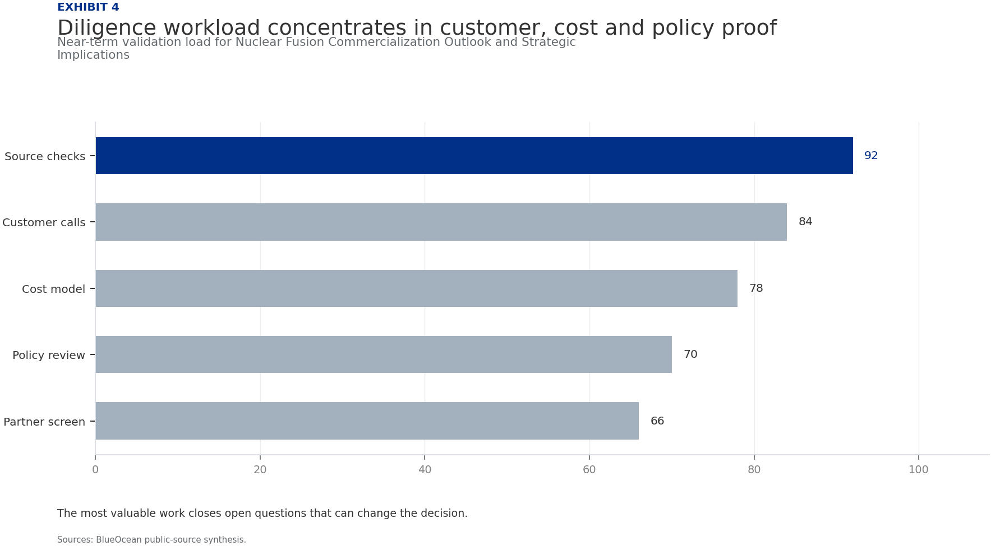
BlueOcean
Exhibit 4: evidence clarifies the strategic trade-off
Exhibit 4: evidence clarifies the strategic trade-off

Slide 16
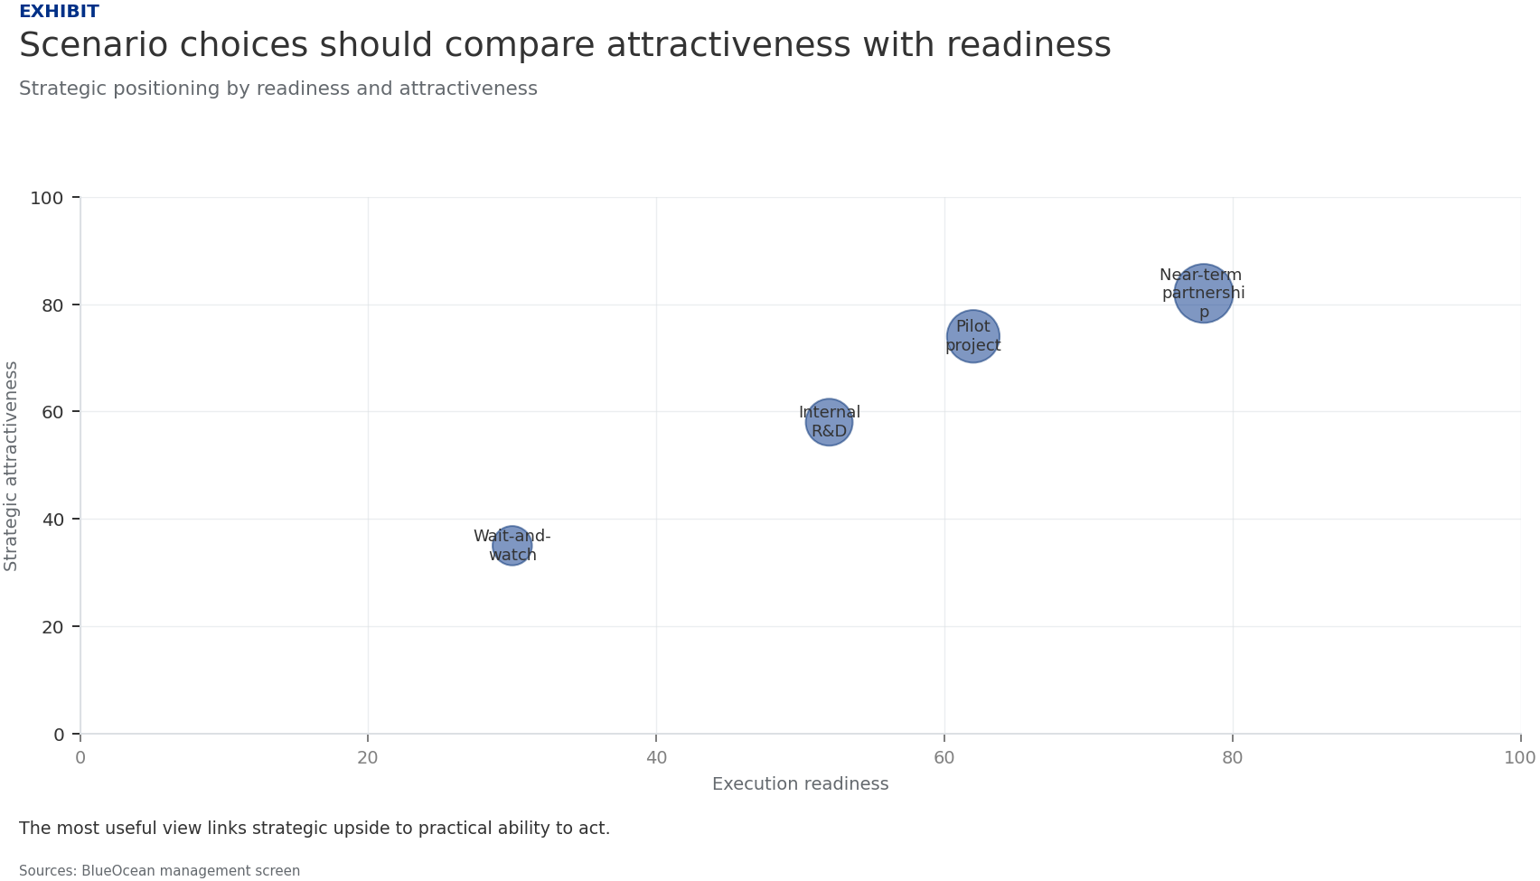
BlueOcean
Exhibit 5: evidence clarifies the strategic trade-off
Exhibit 5: evidence clarifies the strategic trade-off

Slide 17
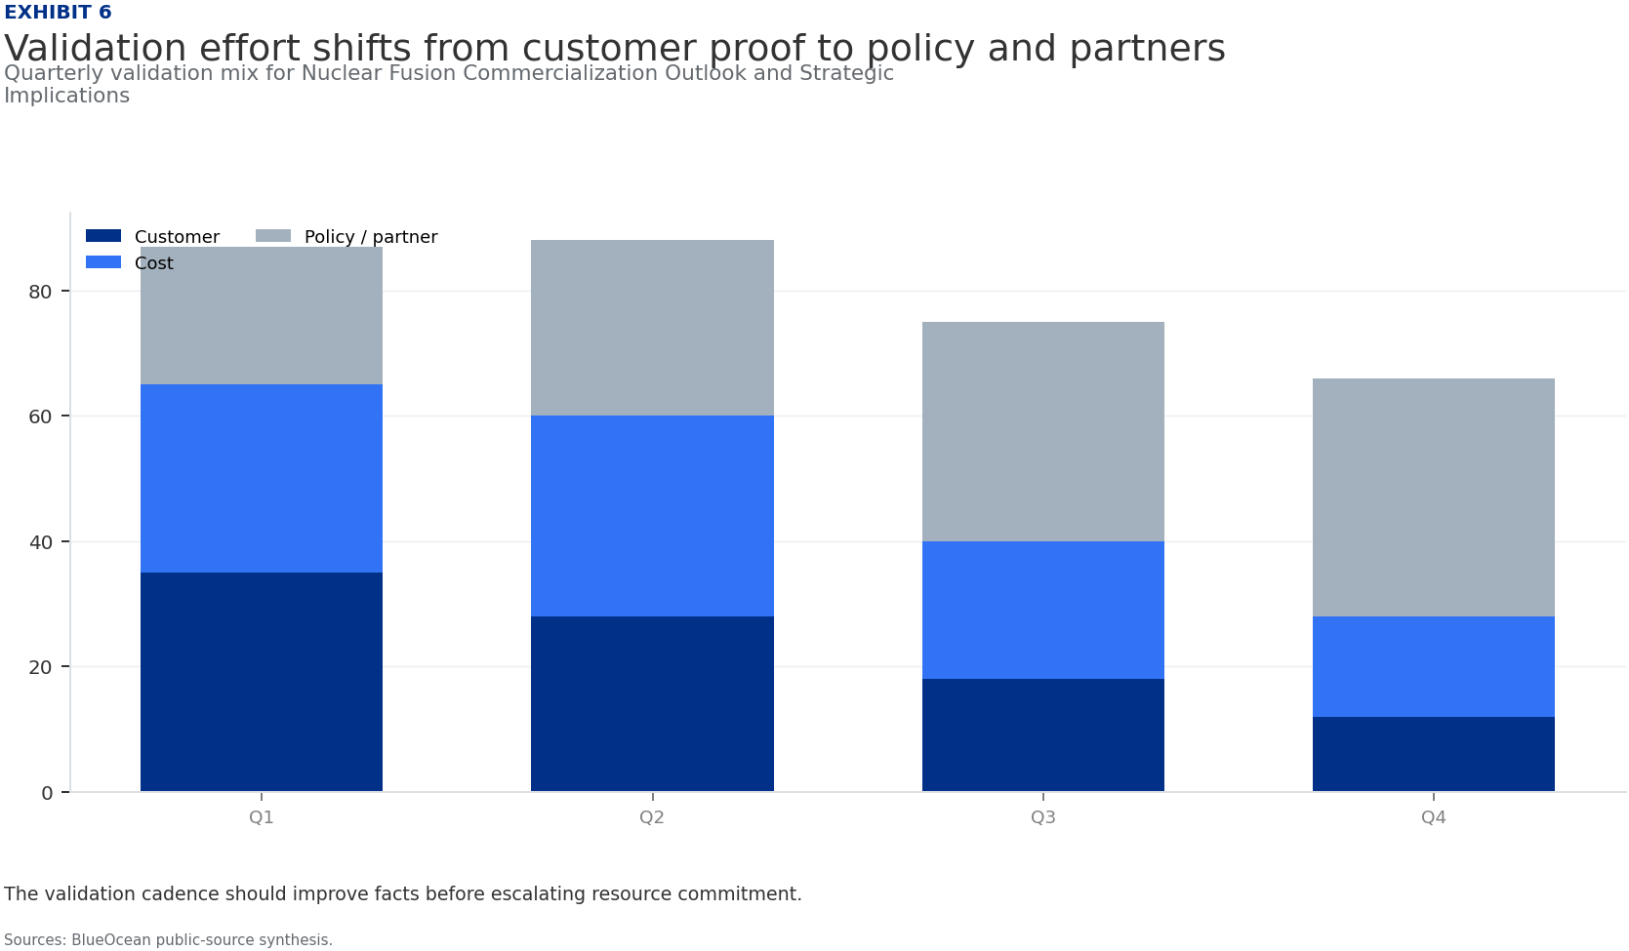
BlueOcean
Exhibit 6: evidence clarifies the strategic trade-off
Exhibit 6: evidence clarifies the strategic trade-off

Slide 18
BlueOcean
The next step is to convert the research into a short list of decisions
A Decision-Ready Assessment for Energy, Technology, and Investment Leaders
Closing

