Slide 1

BLUEOCEAN
Nuclear Fusion Commercialization Outlook and Strategic Implications
A Decision-Ready Assessment for Energy and Technology Executives

Slide 2
BlueOcean
The discussion follows the management question, evidence, and implications
01
Fusion Commercialization Timelines Are Accelerating but Remain Uncertain
02
Fusion Economics: High Initial Costs but Potential for Long-Term Competitiveness
03
Global Fusion Investment Surge: Opportunities and Risks
04
Geopolitical Implications: Energy Security, Proliferation, and Strategic Competition
05
Regulatory and Public Acceptance: Building the Framework for Fusion Deployment
06
Technical Hurdles: The Path to Commercial Fusion
07
Nuclear Fusion Commercialization Outlook and Strategic Implications should be managed as a staged strategic op
08
Commercial readiness depends on bankability, deliverability and repeat customer proof
Contents

Slide 3
BlueOcean
The analysis narrows the agenda to a focused set of management priorities
01
Fusion commercialization timelines have shortened but remain uncertain; first power plants likely between 2035 and 2050. The next five
02
Fusion's levelized cost of energy (LCOE) is projected at $50-100/MWh by 2050, competitive with fission and natural gas with carbon capt
03
Global fusion investment has surged, with private funding exceeding $6 billion cumulatively by 2025, driven by breakthroughs like LLNL'
04
Geopolitical implications are significant: fusion could reduce energy import dependence but also create new proliferation risks. Nation
05
Key technical hurdles remain: plasma confinement, materials degradation, and tritium self-sufficiency are unresolved at commercial scal
06
The CEO-level question is not whether Nuclear fusion commercialization outlook and strategic implications is interesting, but which dec
07
Management should separate verified facts, directional scenarios and open questions before committing capital, partnerships or market-e
08
Technical evidence only matters when it changes revenue potential, cost position, investment return, execution risk or the timing of a
Key highlights

Slide 4
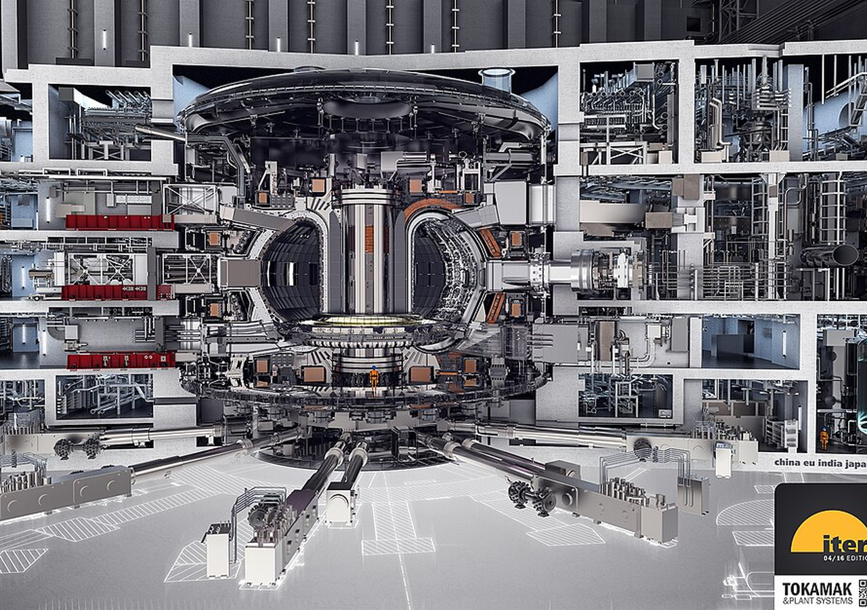
BlueOcean
Fusion Commercialization Timelines Are Accelerating but Remain Uncertain
Fusion is no longer a distant dream but a credible technology with a defined—if uncertain—path to commercialization; the next five years will be critical.
Nuclear fusion has long been considered the 'holy grail' of clean energy, but its commercialization has consistently been projected decades away. However, recent developments—including the 2022 ignition milestone at Lawrence Livermore National Laboratory (LLNL
The ITER project, the world's largest fusion experiment, remains the flagship of international collaboration. Originally scheduled for first plasma in 2020, ITER's timeline has slipped repeatedly, with the latest estimate targeting 2035 for first plasma and 20
Private fusion companies are pursuing more aggressive timelines. Commonwealth Fusion Systems (CFS), a spinout from MIT, is building SPARC, a compact tokamak using high-temperature superconducting (HTS) magnets. CFS aims to demonstrate net energy gain (Q>10) by
Key implications
- Fusion commercialization timelines range from 2035 (optimistic) to 2050 (conservative); the next
- Key technical hurdles (tritium breeding, materials) remain unresolved; no fusion device has gene
Fusion Commercialization Timelines Are Accelerating but Remain Uncertain

Slide 5
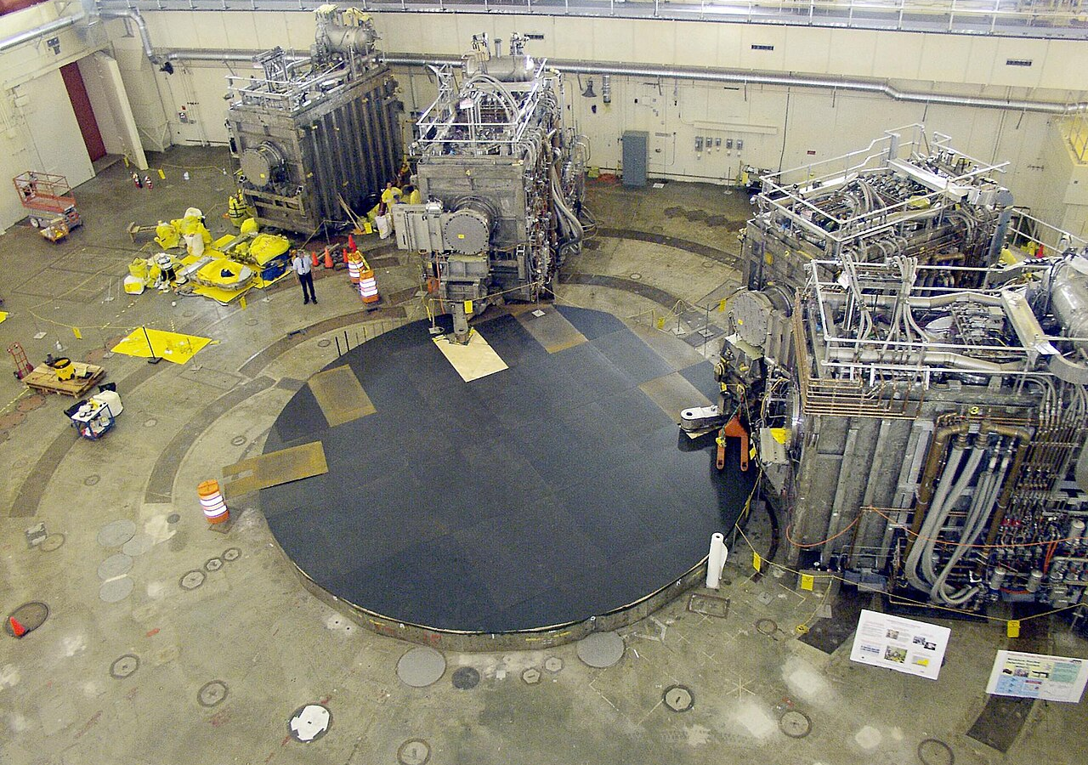
BlueOcean
Fusion Economics: High Initial Costs but Potential for Long-Term Competitiveness
Fusion's economic viability hinges on achieving cost targets; its value proposition is baseload reliability, not low cost.
The economic viability of fusion energy will ultimately determine its market impact. While fusion offers the promise of abundant, low-carbon baseload power, its levelized cost of energy (LCOE) must compete with existing and emerging technologies. Current estim
The capital costs of fusion plants are a major uncertainty. ITER's construction cost is estimated at over $20 billion, but this is a research facility, not a commercial plant. Private fusion companies aim for much lower costs: CFS targets a capital cost of $1-
Financing fusion projects will require innovative models. Given the high upfront capital and long construction times, fusion plants will likely need government loan guarantees, power purchase agreements (PPAs) with creditworthy off-takers, and possibly carbon
Key implications
- Fusion LCOE is projected at $50-100/MWh initially, declining to $30-60/MWh with learning.
- Capital costs are highly uncertain; private estimates are optimistic and unverified.
Fusion Economics: High Initial Costs but Potential for Long-Term Competitiveness

Slide 6
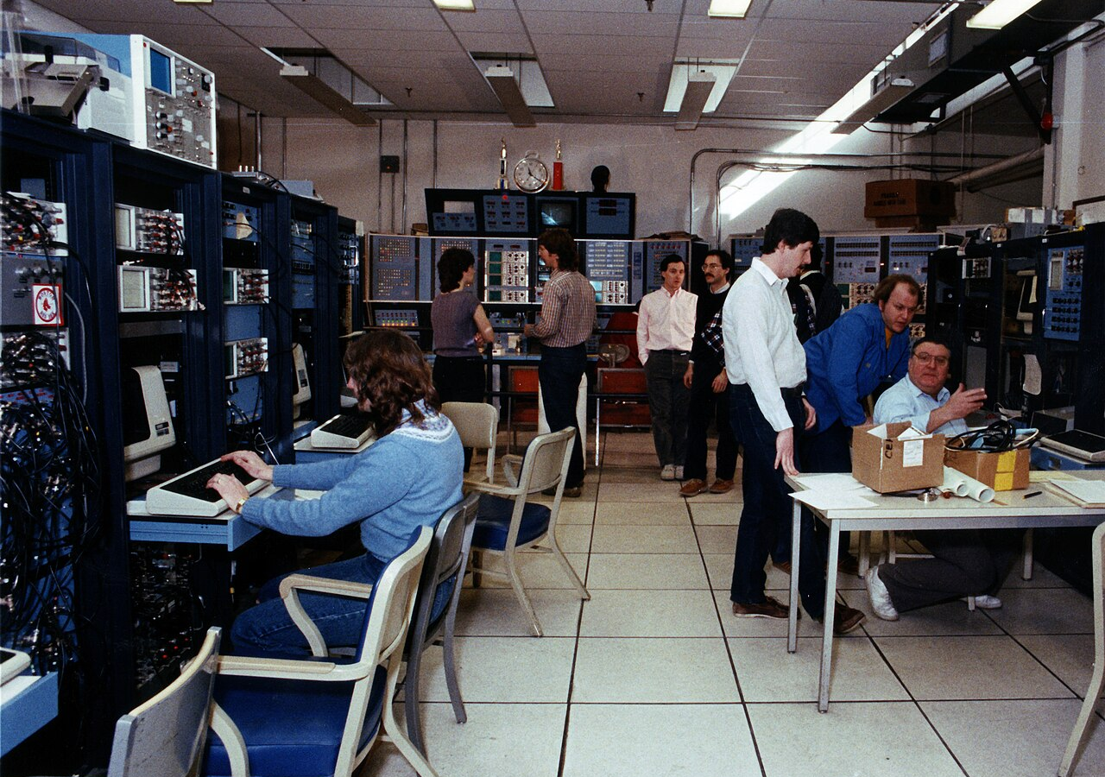
BlueOcean
Global Fusion Investment Surge: Opportunities and Risks
Private fusion investment has exceeded $6 billion, but concentration and technology risk require careful due diligence.
Global fusion investment has experienced a dramatic surge, with cumulative private funding exceeding $6 billion as of 2025. This growth has been fueled by several factors: the 2022 ignition milestone at LLNL, which demonstrated net energy gain in a laboratory
The Fusion Industry Association's 2024 report indicates that private fusion investment grew from approximately $300 million in 2020 to over $6 billion cumulatively by 2025. This represents a 20-fold increase in five years, signaling growing investor confidence
The influx of capital has enabled fusion companies to accelerate their development timelines, build larger teams, and construct more advanced facilities. For example, CFS has raised over $2 billion and is building SPARC, a compact tokamak that aims to demonstr
Key implications
- Private fusion investment has surged to over $6 billion cumulatively, but is concentrated in a f
- Due diligence on technology readiness and team expertise is critical before investing.
Global Fusion Investment Surge: Opportunities and Risks

Slide 7
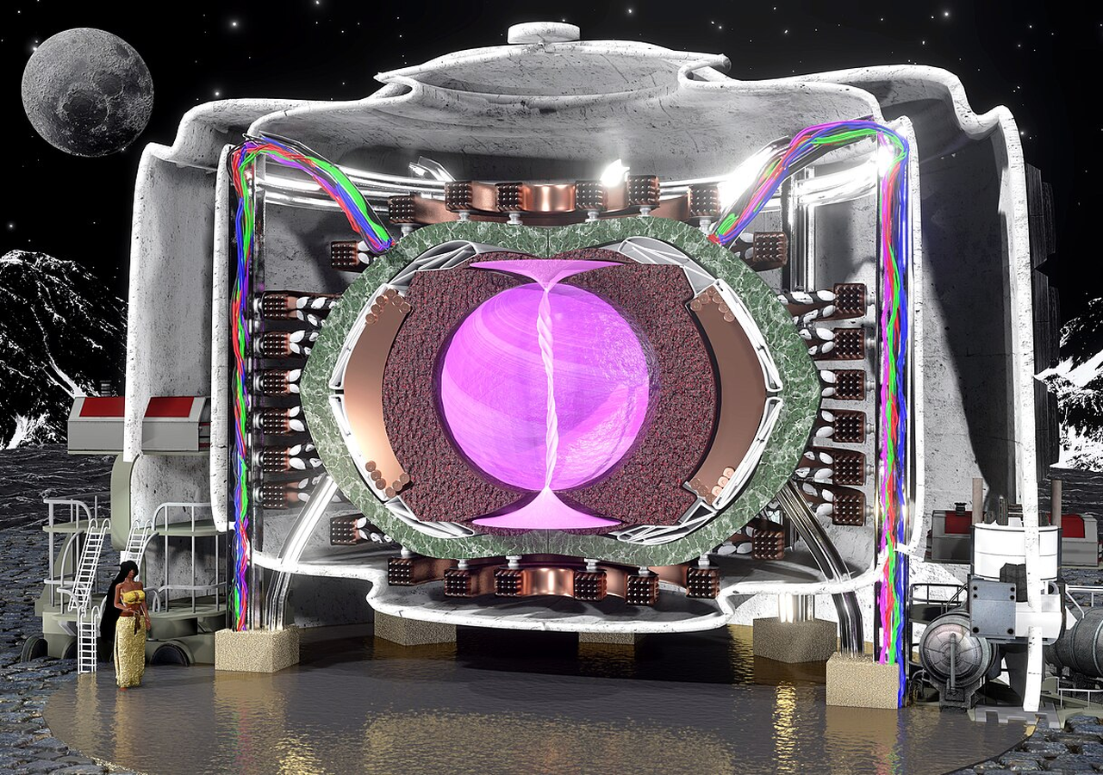
BlueOcean
Geopolitical Implications: Energy Security, Proliferation, and Strategic Competition
Fusion could reshape global energy geopolitics, but also introduces new proliferation risks and strategic competition.
The development of fusion energy has significant geopolitical implications that extend beyond energy markets. Fusion offers the promise of virtually unlimited, low-carbon energy from widely available fuels (deuterium from water, tritium bred from lithium). Thi
China has emerged as a major player in fusion research, with aggressive investments in both ITER and domestic projects. China's fusion program includes the EAST tokamak, which has achieved long-pulse plasma operation, and plans for a fusion-fission hybrid reac
Fusion also raises non-proliferation concerns. While fusion reactors do not produce fissile materials directly, they generate high-energy neutrons that could be used to produce weapons-grade plutonium from uranium blankets. Additionally, tritium, a key fusion
Key implications
- Fusion could reduce energy import dependence but also create new proliferation risks.
- China's aggressive fusion program poses a strategic challenge to Western leadership.
Geopolitical Implications: Energy Security, Proliferation, and Strategic Competition

Slide 8
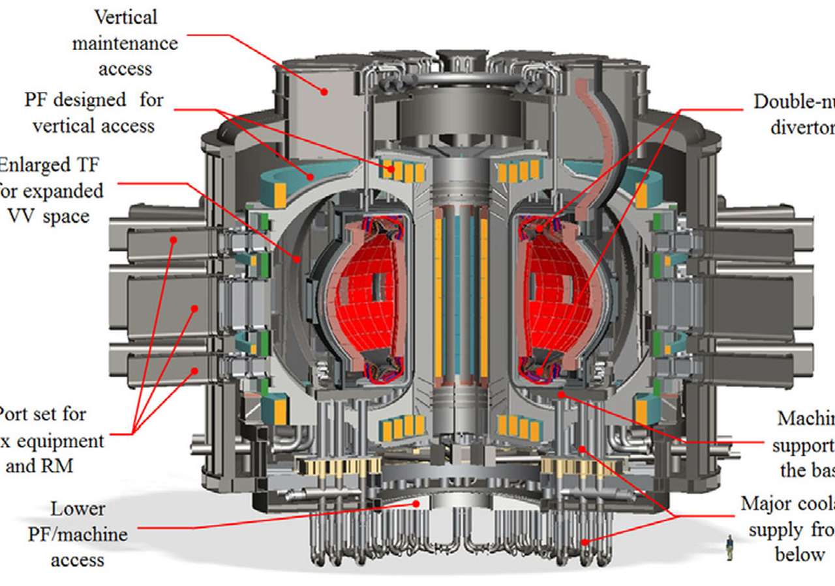
BlueOcean
Regulatory and Public Acceptance: Building the Framework for Fusion Deployment
Regulatory frameworks for fusion are nascent; early engagement with regulators and communities is essential.
The regulatory landscape for fusion energy is still in its infancy. Unlike nuclear fission, which has a well-established regulatory framework, fusion plants do not yet have defined licensing and safety standards in most jurisdictions. This creates significant
The absence of a clear regulatory pathway poses risks for fusion developers. Without established licensing procedures, it is unclear how long it will take to obtain approval for a fusion plant, what safety requirements will be imposed, and how public hearings
Public acceptance is another critical factor. Surveys, such as the Pew Research Center's 2023 study, show that public awareness of fusion is low, but attitudes are generally positive when people are informed about its potential benefits. However, concerns abou
Key implications
- Regulatory frameworks for fusion are undefined in most jurisdictions; licensing pathways are unc
- Public awareness is low but attitudes are positive; early engagement is key.
Regulatory and Public Acceptance: Building the Framework for Fusion Deployment

Slide 9
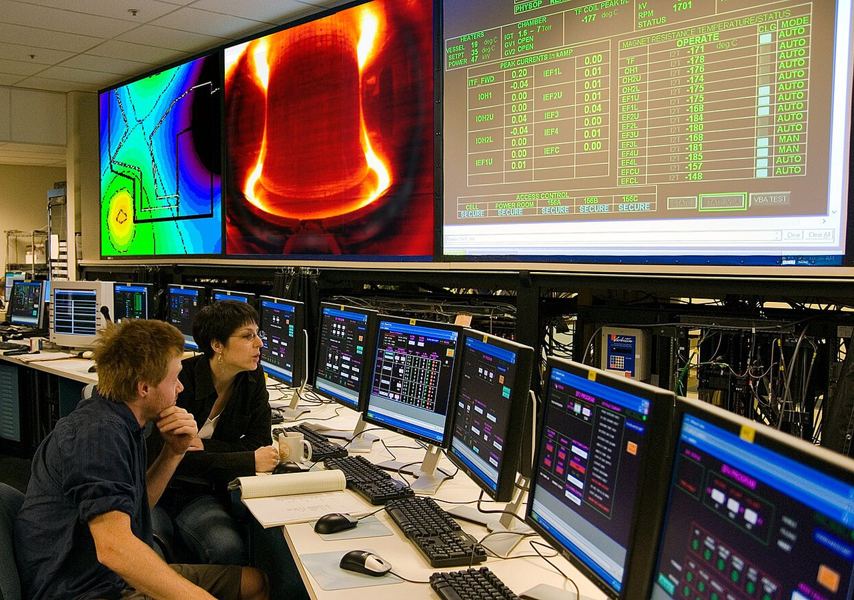
BlueOcean
Technical Hurdles: The Path to Commercial Fusion
Key technical challenges remain unresolved; staged investment and dual-use technologies are prudent strategies.
Despite significant progress, several critical technical hurdles must be overcome before fusion can become a commercial reality. These include achieving sustained plasma confinement, developing materials that can withstand the extreme conditions inside a fusio
Plasma confinement is the most fundamental challenge. Fusion requires confining a plasma at temperatures exceeding 100 million degrees Celsius long enough for fusion reactions to occur. The two main approaches—magnetic confinement (tokamaks, stellarators) and
Materials degradation is another major hurdle. The high-energy neutrons produced by fusion reactions will bombard the reactor walls, causing structural damage and radioactivity. Current materials, such as stainless steel and tungsten, may not last long enough
Key implications
- Plasma confinement, materials degradation, and tritium breeding are unresolved at commercial sca
- No fusion device has demonstrated net electricity generation.
Technical Hurdles: The Path to Commercial Fusion

Slide 10
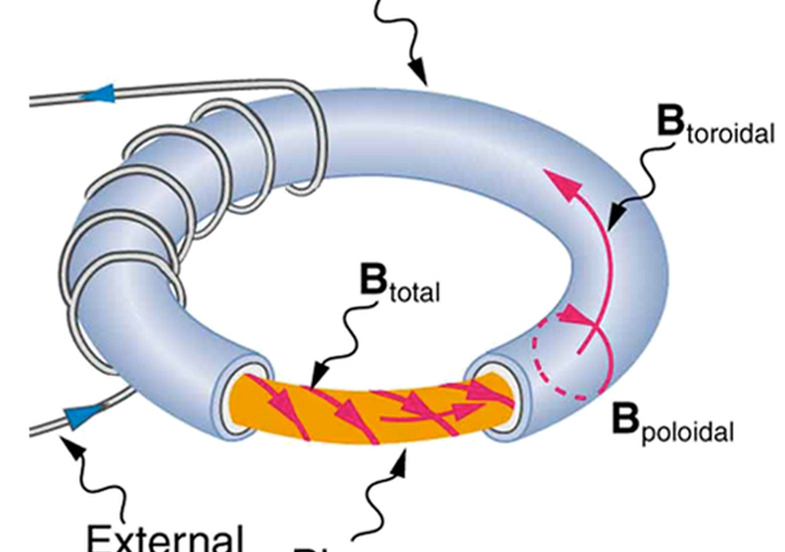
BlueOcean
Nuclear Fusion Commercialization Outlook and Strategic Implications should be managed as a staged strategic option, no
The CEO question is which moves are safe now and which should wait for stronger proof.
Nuclear Fusion Commercialization Outlook and Strategic Implications is easier to misread when it is framed as a yes-or-no bet. The better reading separates near-term learning moves, option-building partnerships and commitments that would require stronger comme
The immediate management question is not whether the opportunity is exciting; it is whether budget, partner access or management attention should be committed now. Low-cost validation can start early, while larger capital commitments should wait for customer,
A practical reading is that the current source base is useful but incomplete. Retained source signal: gov/science/fusion-energy-sciences/fusion-milestone-based-development-program Search context: nuclear fusion commercialization timeline 2025 The page body cou
Key implications
- Start with low-cost validation
- Reserve major commitments for stronger proof
Nuclear Fusion Commercialization Outlook and Strategic Implications should be managed as a staged strategic option, not

Slide 11
BlueOcean
Commercial readiness depends on bankability, deliverability and repeat customer proof
Technical feasibility matters only when it changes customer value, cost position and execution confidence.
For leadership teams, commercial readiness should be judged through customer adoption, cost structure, delivery cycle, service capability and financing availability. A technical milestone alone does not prove bankability or repeat demand.
A practical reading is that every major assumption needs a verifiable claim behind it: target customer, buying trigger, budget owner, substitute, use case and payback path. Where sourced evidence is missing, the claim should remain directional.
The decision lens is that a more robust path is to build credible proof through pilots, partner diligence and third-party validation before moving into larger commitments.
Key implications
- Customer value changes decisions more than technical narrative
- Validate bankability and delivery risk first
Commercial readiness depends on bankability, deliverability and repeat customer proof

Slide 12
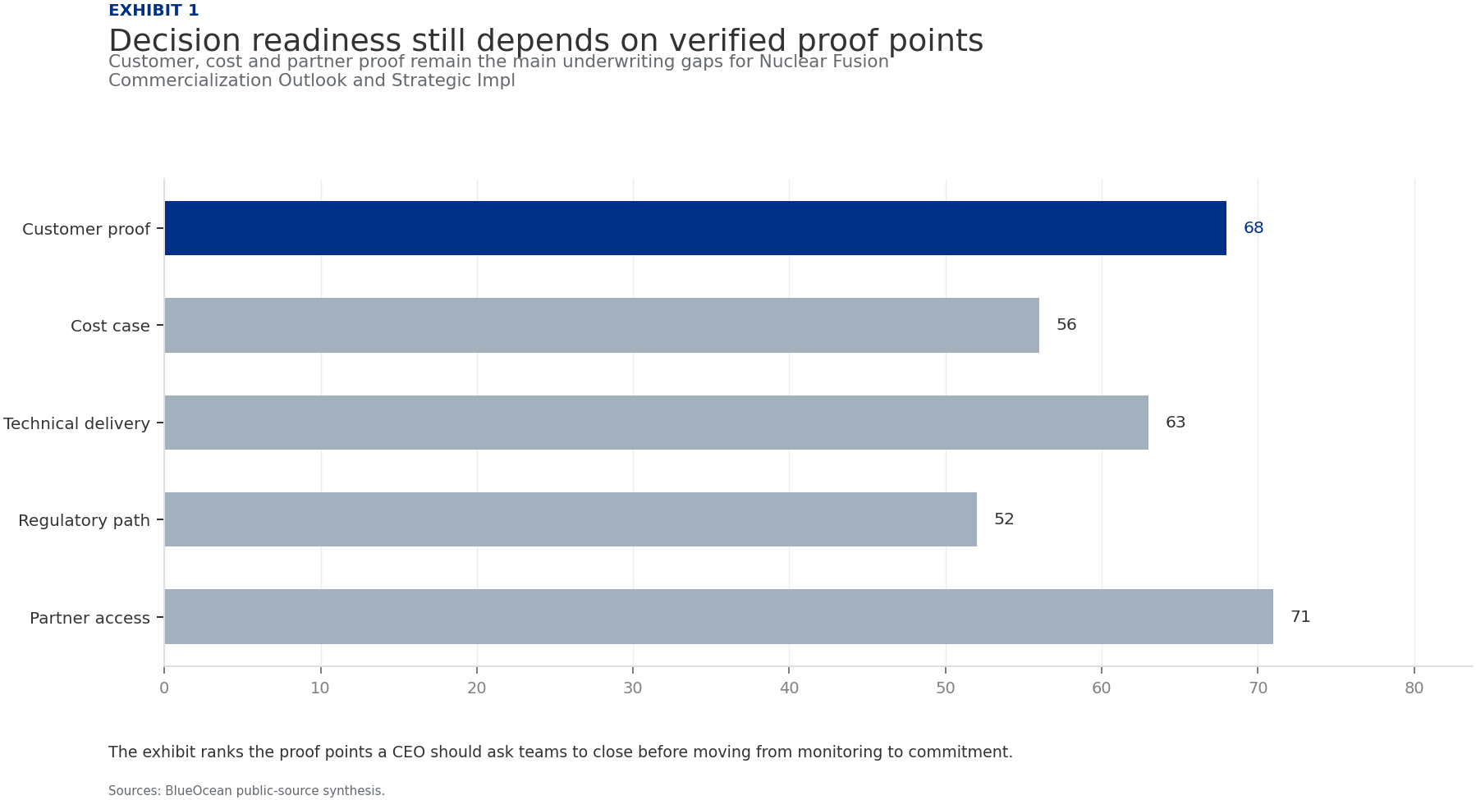
BlueOcean
Exhibit 1: evidence clarifies the strategic trade-off
Exhibit 1: evidence clarifies the strategic trade-off

Slide 13
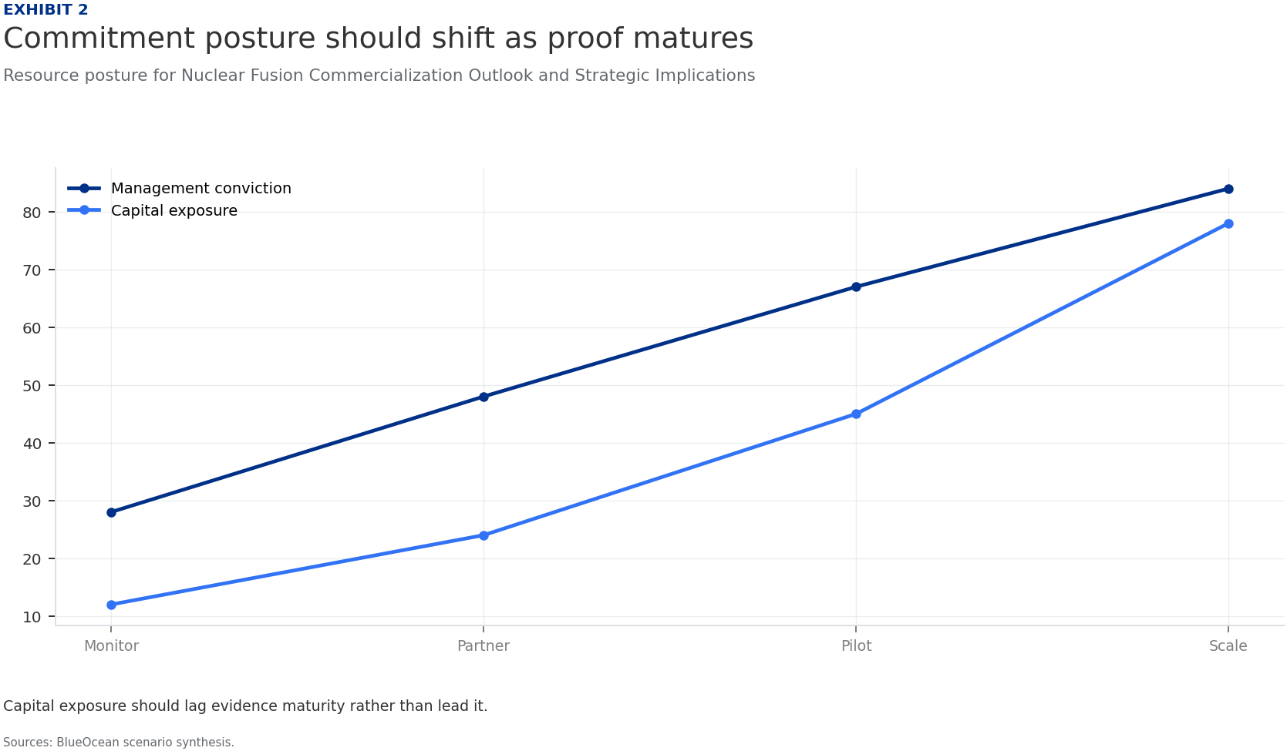
BlueOcean
Exhibit 2: evidence clarifies the strategic trade-off
Exhibit 2: evidence clarifies the strategic trade-off

Slide 14
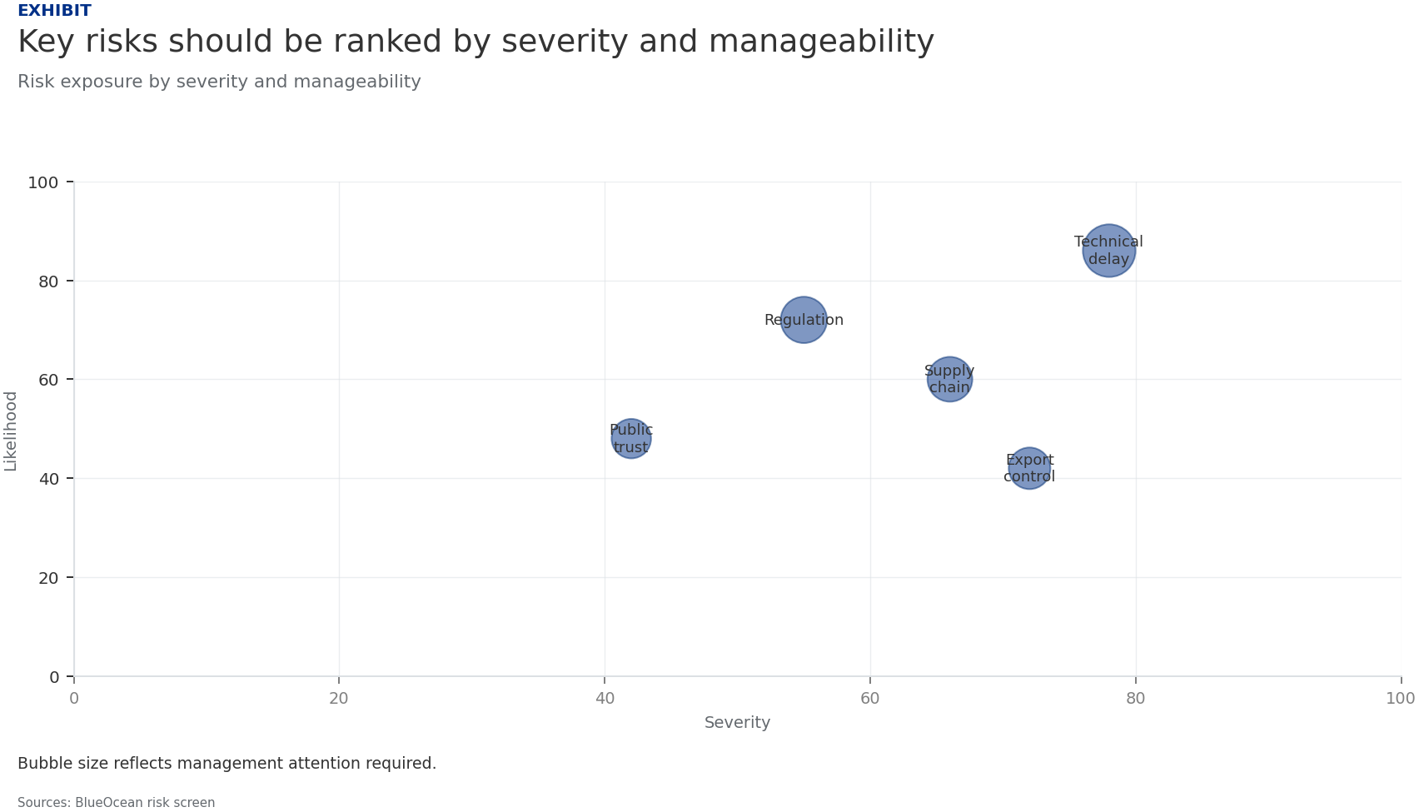
BlueOcean
Exhibit 3: evidence clarifies the strategic trade-off
Exhibit 3: evidence clarifies the strategic trade-off

Slide 15
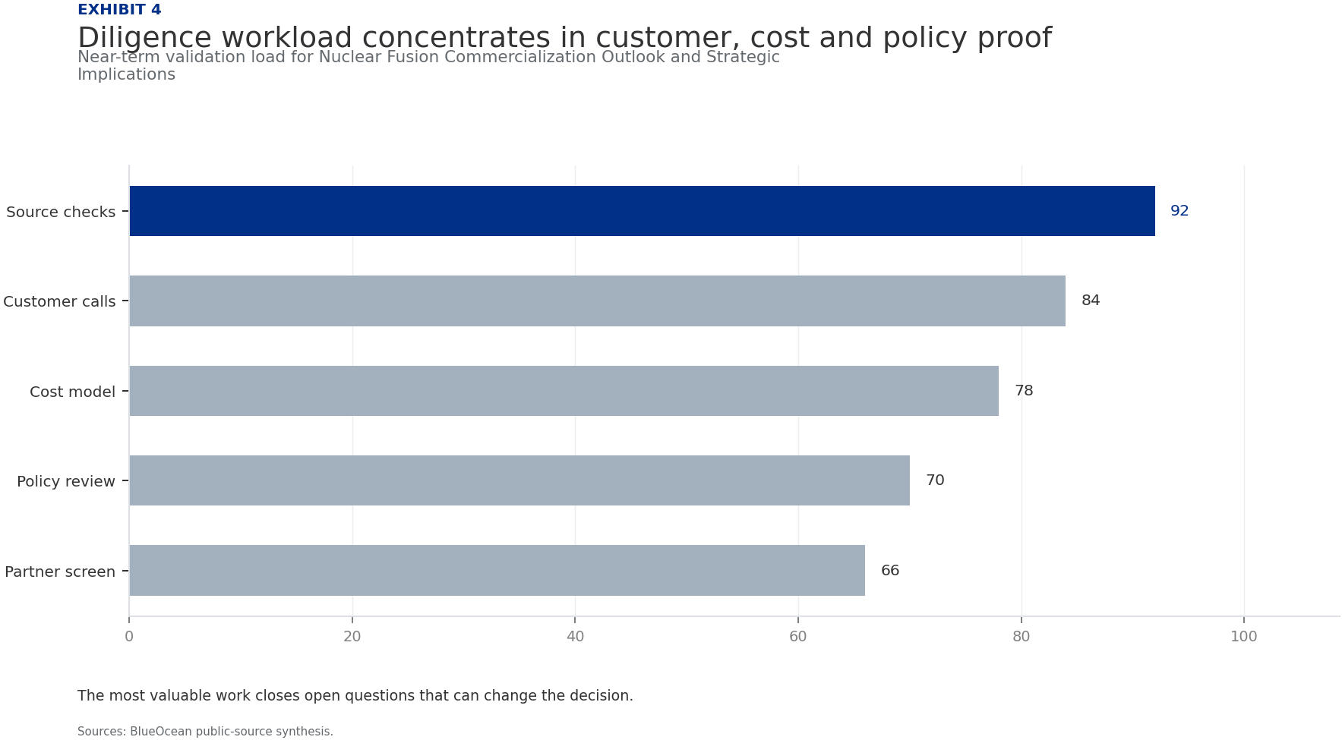
BlueOcean
Exhibit 4: evidence clarifies the strategic trade-off
Exhibit 4: evidence clarifies the strategic trade-off

Slide 16
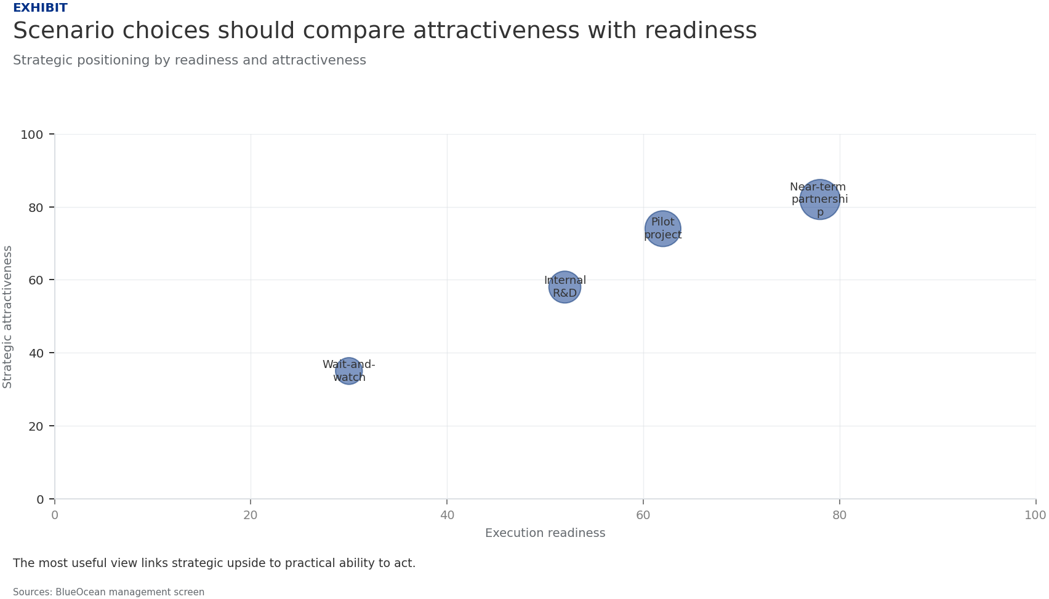
BlueOcean
Exhibit 5: evidence clarifies the strategic trade-off
Exhibit 5: evidence clarifies the strategic trade-off

Slide 17
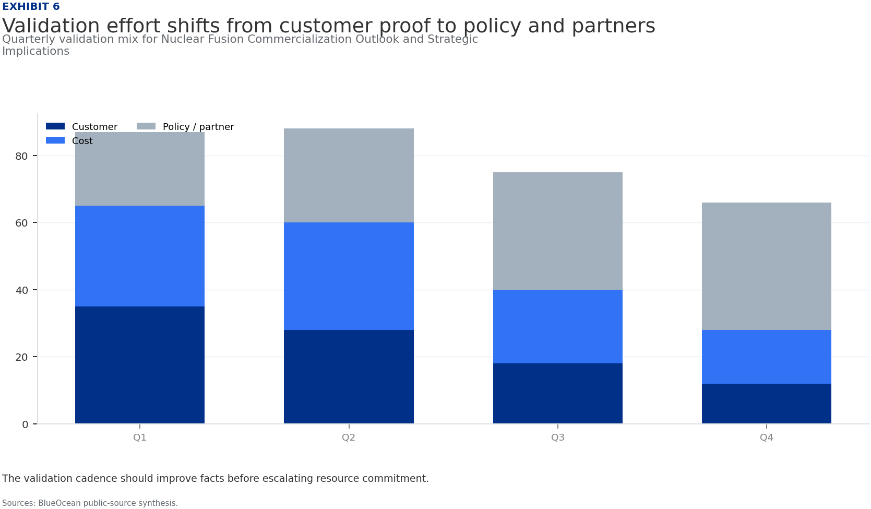
BlueOcean
Exhibit 6: evidence clarifies the strategic trade-off
Exhibit 6: evidence clarifies the strategic trade-off

Slide 18
BlueOcean
The next step is to convert the research into a short list of decisions
A Decision-Ready Assessment for Energy and Technology Executives
Closing

