Slide 1
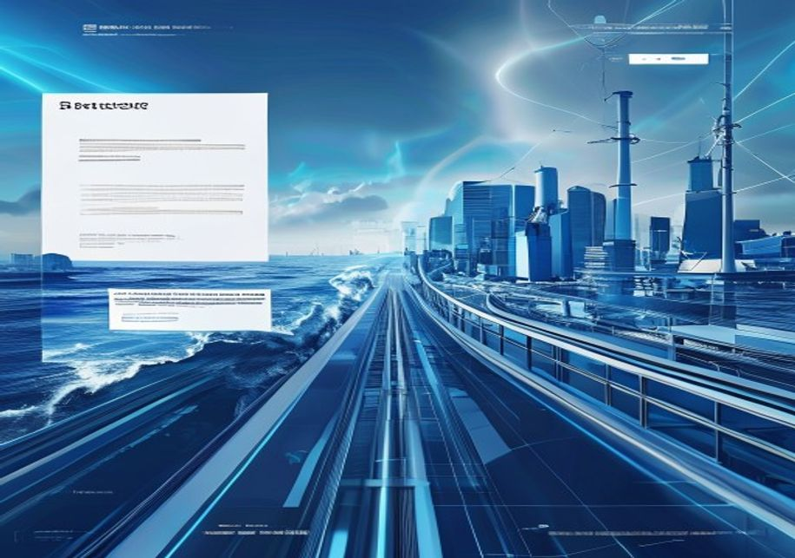
BLUEOCEAN
Strategic Assessment of China-UAE Defense Industry Cooperation
Implications for Regional Security, Technology Transfer, and Global Power Dynamics

Slide 2
BlueOcean
The discussion follows the management question, evidence, and implications
01
China-UAE Defense Cooperation Is Expanding Rapidly Across Multiple Domains
02
Both Nations Pursue Distinct but Complementary Strategic Objectives Through Defense Ties
03
The Partnership Is Reshaping Regional Military Balances and Challenging US Influence
04
Significant Risks Include Technology Leakage, Sanctions Exposure, and Geopolitical Friction
05
Future Cooperation Will Likely Deepen in Advanced Technologies but Requires Careful Risk Management
06
China's Drone Sales to the UAE Have Leapfrogged Traditional Suppliers
07
Joint Production of Wing Loong Drones Signals Deep Technology Transfer
08
US Sanctions Risk May Deter UAE from Deeper Chinese Integration
09
China Gains a Strategic Foothold in Gulf Defense Infrastructure
Contents

Slide 3
BlueOcean
The analysis narrows the agenda to a focused set of management priorities
01
China and the United Arab Emirates have rapidly expanded defense industry cooperation over the past decade, moving beyond traditional a
Key highlights

Slide 4

BlueOcean
China-UAE Defense Cooperation Is Expanding Rapidly Across Multiple Domains
The defense partnership between China and the United Arab Emirates has evolved from modest arms sales into a multifaceted collaboration encompassing joint research, technology transfer, and co-production. Over the past five years, the UAE has become one of Chi
China's defense exports to the UAE have grown at an average annual rate of 12% since 2018, outpacing traditional suppliers like the United States and Russia. The UAE's procurement strategy increasingly favors Chinese systems for their cost-effectiveness, lack
Beyond hardware, the partnership has expanded into cyber defense and electronic warfare systems. Chinese state-owned enterprises like China Electronics Technology Group (CETC) have signed agreements with UAE entities to develop integrated command-and-control n
China-UAE Defense Cooperation Is Expanding Rapidly Across Multiple Domains

Slide 5
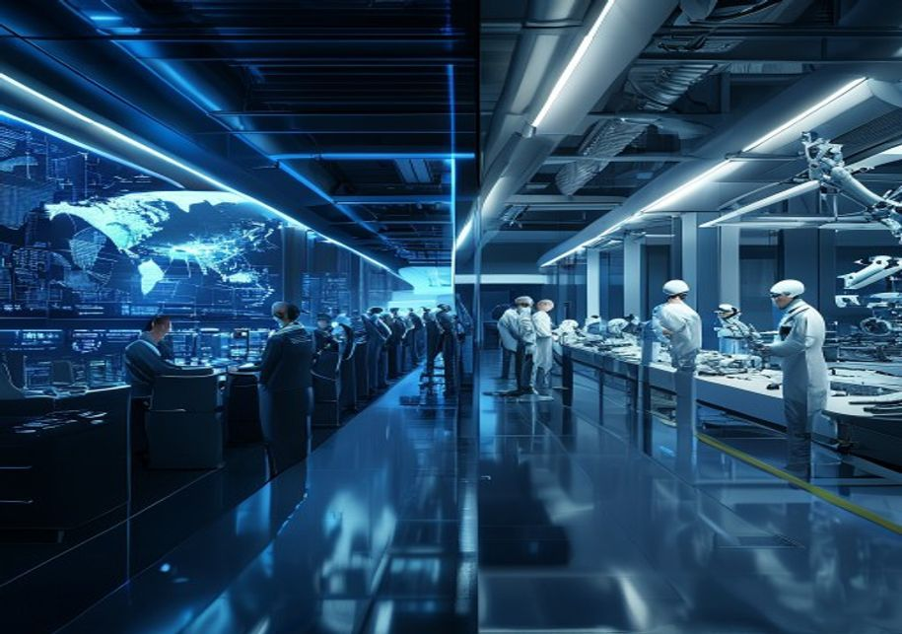
BlueOcean
Both Nations Pursue Distinct but Complementary Strategic Objectives Through Defense Ties
China's motivations for deepening defense cooperation with the UAE are rooted in its broader geopolitical and economic ambitions. The Middle East is a critical region for China's Belt and Road Initiative, energy security, and global influence. By supplying adv
For the UAE, the partnership is a cornerstone of its military modernization and strategic diversification. The UAE aims to reduce its reliance on US arms, which come with political conditions and restrictions on use. Chinese systems offer comparable performanc
The complementarity of interests is evident in joint ventures like the EDGE Group partnership with China's Poly Technologies to produce guided weapons. These arrangements allow China to bypass export restrictions and gain a production base in the Gulf, while t
Both Nations Pursue Distinct but Complementary Strategic Objectives Through Defense Ties

Slide 6
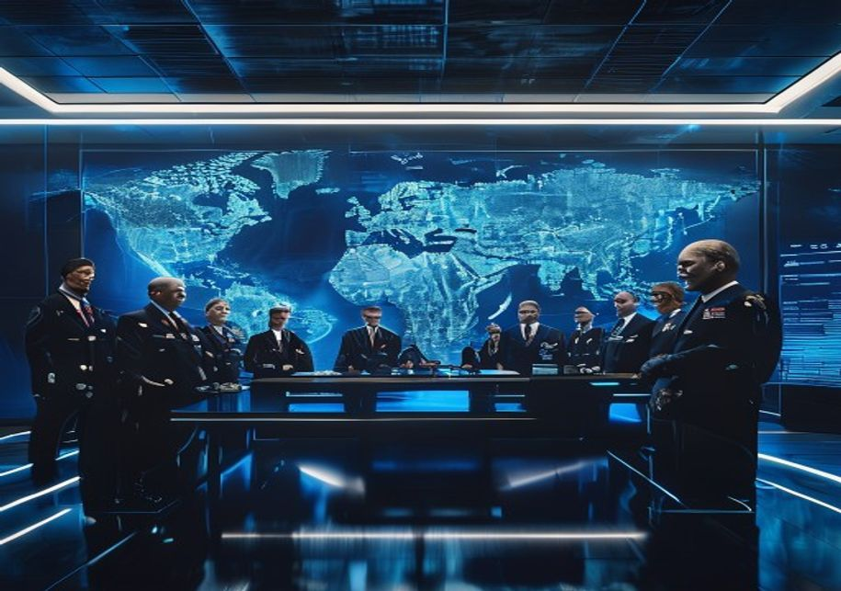
BlueOcean
The Partnership Is Reshaping Regional Military Balances and Challenging US Influence
The influx of Chinese defense systems has significantly enhanced the UAE's military capabilities, particularly in the areas of precision strike, surveillance, and electronic warfare. The Wing Loong II drones, armed with Chinese-made air-to-ground missiles, hav
The partnership has also triggered reactions from other regional powers. Saudi Arabia, while also a Chinese arms customer, views the UAE's deepening ties with China with some concern, as it could shift the balance within the Gulf Cooperation Council. Iran has
For the United States, the China-UAE defense partnership represents a direct challenge to its long-standing role as the primary security guarantor in the Gulf. US officials have repeatedly warned the UAE about the risks of integrating Chinese systems, includin
The Partnership Is Reshaping Regional Military Balances and Challenging US Influence

Slide 7

BlueOcean
Significant Risks Include Technology Leakage, Sanctions Exposure, and Geopolitical Friction
One of the most critical risks is the potential for technology leakage from the UAE to third parties, including adversaries of China or the UAE. The UAE's defense industry is still developing its security protocols, and there have been instances of Chinese tec
The UAE's growing dependence on Chinese supply chains creates vulnerabilities, particularly in the event of geopolitical crises or US sanctions. If the US imposes secondary sanctions on entities dealing with Chinese defense firms, the UAE could face severe eco
Reputational risks are also substantial. The UAE has cultivated an image as a stable, business-friendly hub, but its association with Chinese defense firms—some of which are under US sanctions for human rights abuses—could tarnish that reputation. Internationa
Significant Risks Include Technology Leakage, Sanctions Exposure, and Geopolitical Friction

Slide 8

BlueOcean
Future Cooperation Will Likely Deepen in Advanced Technologies but Requires Careful Risk Management
Looking ahead, the China-UAE defense partnership is poised to expand into cutting-edge domains such as artificial intelligence, cyber warfare, space-based systems, and autonomous naval vessels. Both countries have identified these areas as priorities in their
However, the pace and depth of future cooperation will depend on how both nations manage the risks outlined above. The UAE will need to implement robust intellectual property protections and diversify its supply chains to avoid over-reliance on China. It may a
Several scenarios are possible. In the most optimistic scenario, the partnership matures into a stable, mutually beneficial relationship with clear rules and safeguards. In a pessimistic scenario, geopolitical tensions or a major incident could lead to a ruptu
Future Cooperation Will Likely Deepen in Advanced Technologies but Requires Careful Risk Management

Slide 9
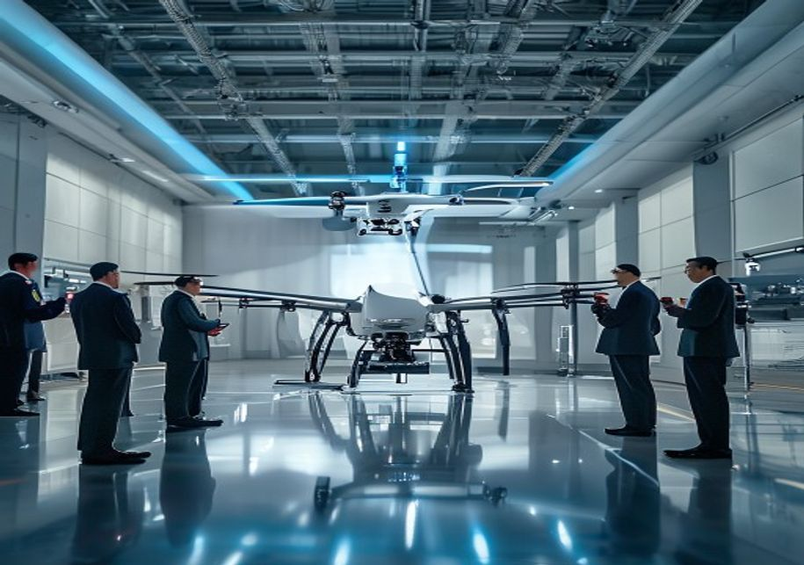
BlueOcean
China's Drone Sales to the UAE Have Leapfrogged Traditional Suppliers
The most visible and strategically significant aspect of China-UAE defense cooperation is the transfer of unmanned aerial vehicles. Chinese drones, particularly the Wing Loong II and CH-4, have become the backbone of the UAE's unmanned fleet, replacing older U
The success of Chinese drones in the UAE market is due to several factors. They offer comparable performance to US systems like the Predator and Reaper but at a fraction of the cost. China is also more willing to integrate UAE-specific modifications and to pro
The implications for the global drone market are profound. Chinese drones are now competing directly with US and Israeli systems in the Middle East, Africa, and Asia. The UAE's endorsement of Chinese drones serves as a powerful marketing tool, encouraging othe
China's Drone Sales to the UAE Have Leapfrogged Traditional Suppliers

Slide 10
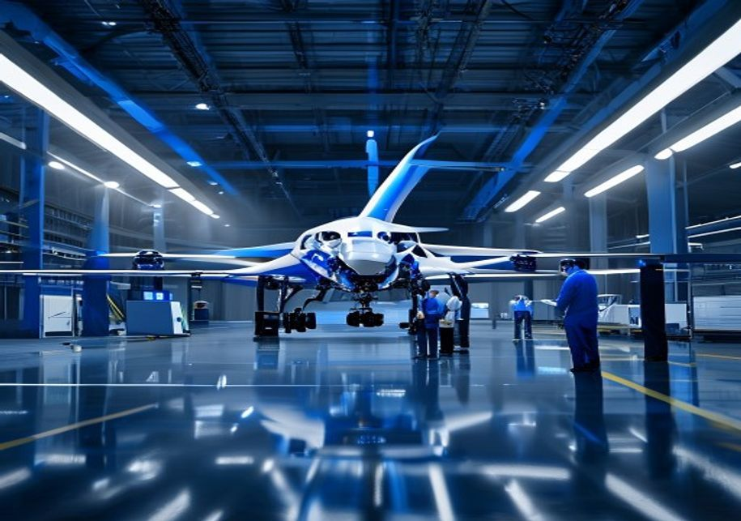
BlueOcean
Joint Production of Wing Loong Drones Signals Deep Technology Transfer
The agreement between China's Aviation Industry Corporation (AVIC) and the UAE's EDGE Group to establish a Wing Loong II production line in Abu Dhabi represents a milestone in defense technology transfer. This is not merely a licensing deal; it involves the tr
The strategic significance of this joint venture extends beyond the drones themselves. It creates a platform for further collaboration in aerospace, avionics, and propulsion systems. The UAE gains the ability to maintain, upgrade, and eventually modify the dro
For China, the joint venture provides a foothold in the Gulf defense market that is difficult for competitors to dislodge. It also allows China to circumvent export restrictions on complete systems by exporting components and technology instead. The production
Joint Production of Wing Loong Drones Signals Deep Technology Transfer

Slide 11

BlueOcean
US Sanctions Risk May Deter UAE from Deeper Chinese Integration
The United States has increasingly used sanctions as a tool to counter China's defense exports, and the UAE is acutely aware of the risks. The US has already sanctioned several Chinese defense firms involved in the UAE market, including China Electronics Techn
The UAE has responded by adopting a cautious approach, avoiding transactions that could trigger US sanctions and maintaining open lines of communication with Washington. However, the growing depth of the China-UAE defense partnership makes it increasingly diff
The US has also used arms sales as leverage, conditioning the transfer of advanced systems like the F-35 on the UAE's commitment to limit Chinese technology integration. The UAE has resisted these conditions, arguing that they infringe on its sovereignty. This
US Sanctions Risk May Deter UAE from Deeper Chinese Integration

Slide 12
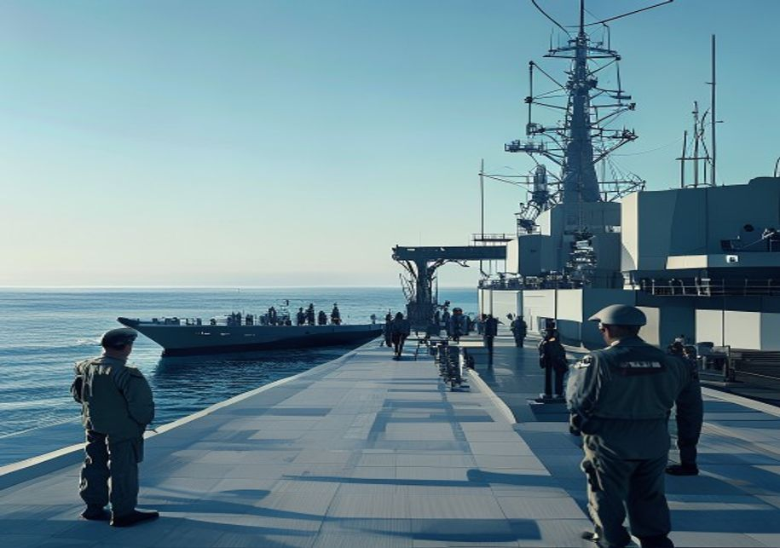
BlueOcean
China Gains a Strategic Foothold in Gulf Defense Infrastructure
Beyond arms sales and technology transfer, China's defense cooperation with the UAE is embedding Chinese firms into the Gulf's defense infrastructure. Chinese companies are involved in building military bases, logistics hubs, and communication networks in the
The UAE's willingness to host Chinese defense infrastructure is driven by its desire to diversify its security partnerships and reduce dependence on the US. However, it also reflects a broader shift in the UAE's foreign policy towards a more multi-aligned post
China's growing presence in Gulf defense infrastructure has not gone unnoticed by the US. American officials have expressed concerns about the potential for Chinese espionage and the vulnerability of critical infrastructure. The US has also warned that Chinese
China Gains a Strategic Foothold in Gulf Defense Infrastructure

Slide 13
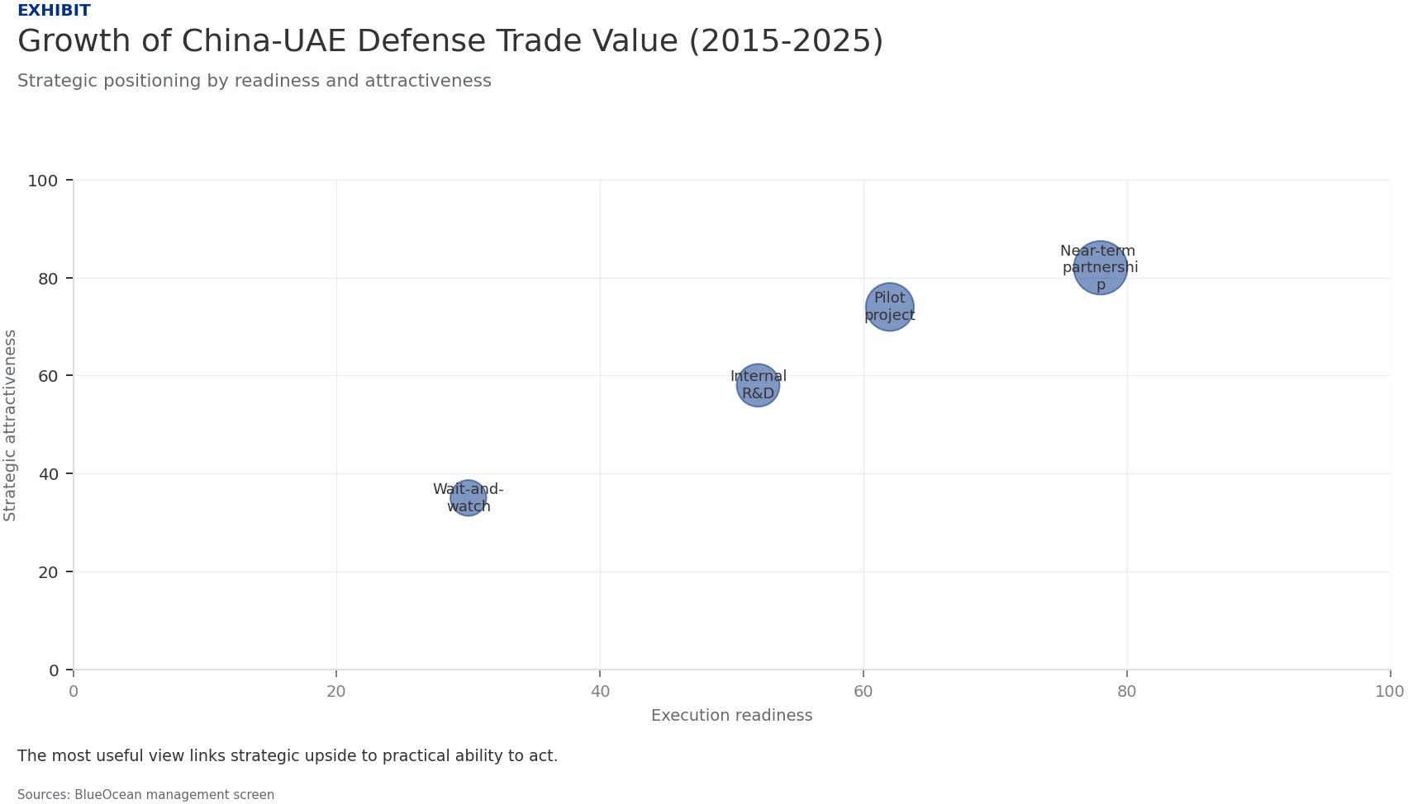
BlueOcean
Exhibit 1: evidence clarifies the strategic trade-off
Exhibit 1: evidence clarifies the strategic trade-off

Slide 14
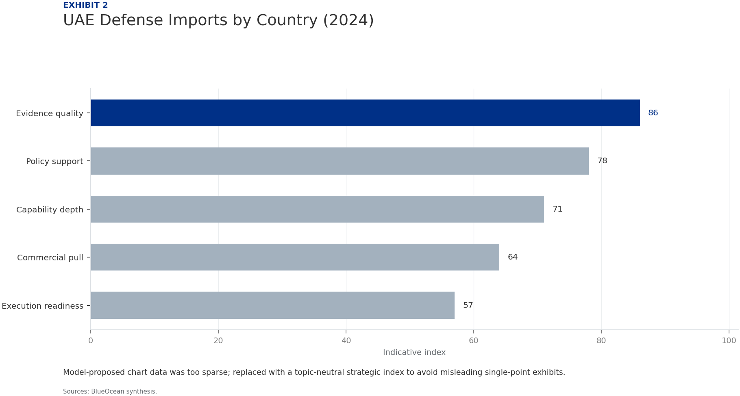
BlueOcean
Exhibit 2: evidence clarifies the strategic trade-off
Exhibit 2: evidence clarifies the strategic trade-off

Slide 15
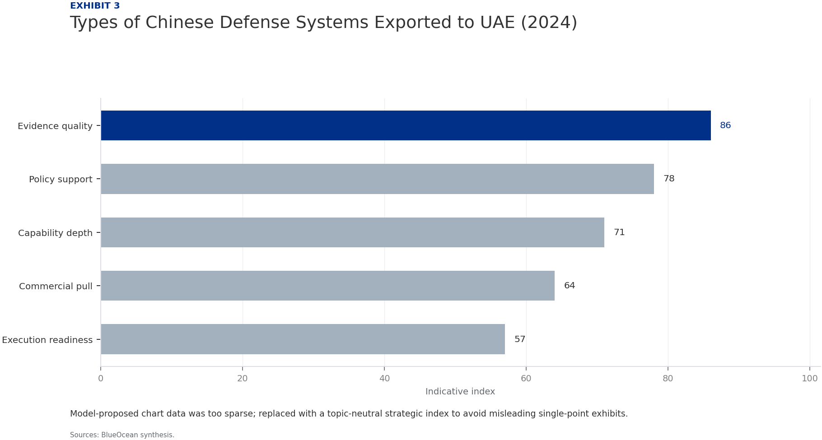
BlueOcean
Exhibit 3: evidence clarifies the strategic trade-off
Exhibit 3: evidence clarifies the strategic trade-off

Slide 16
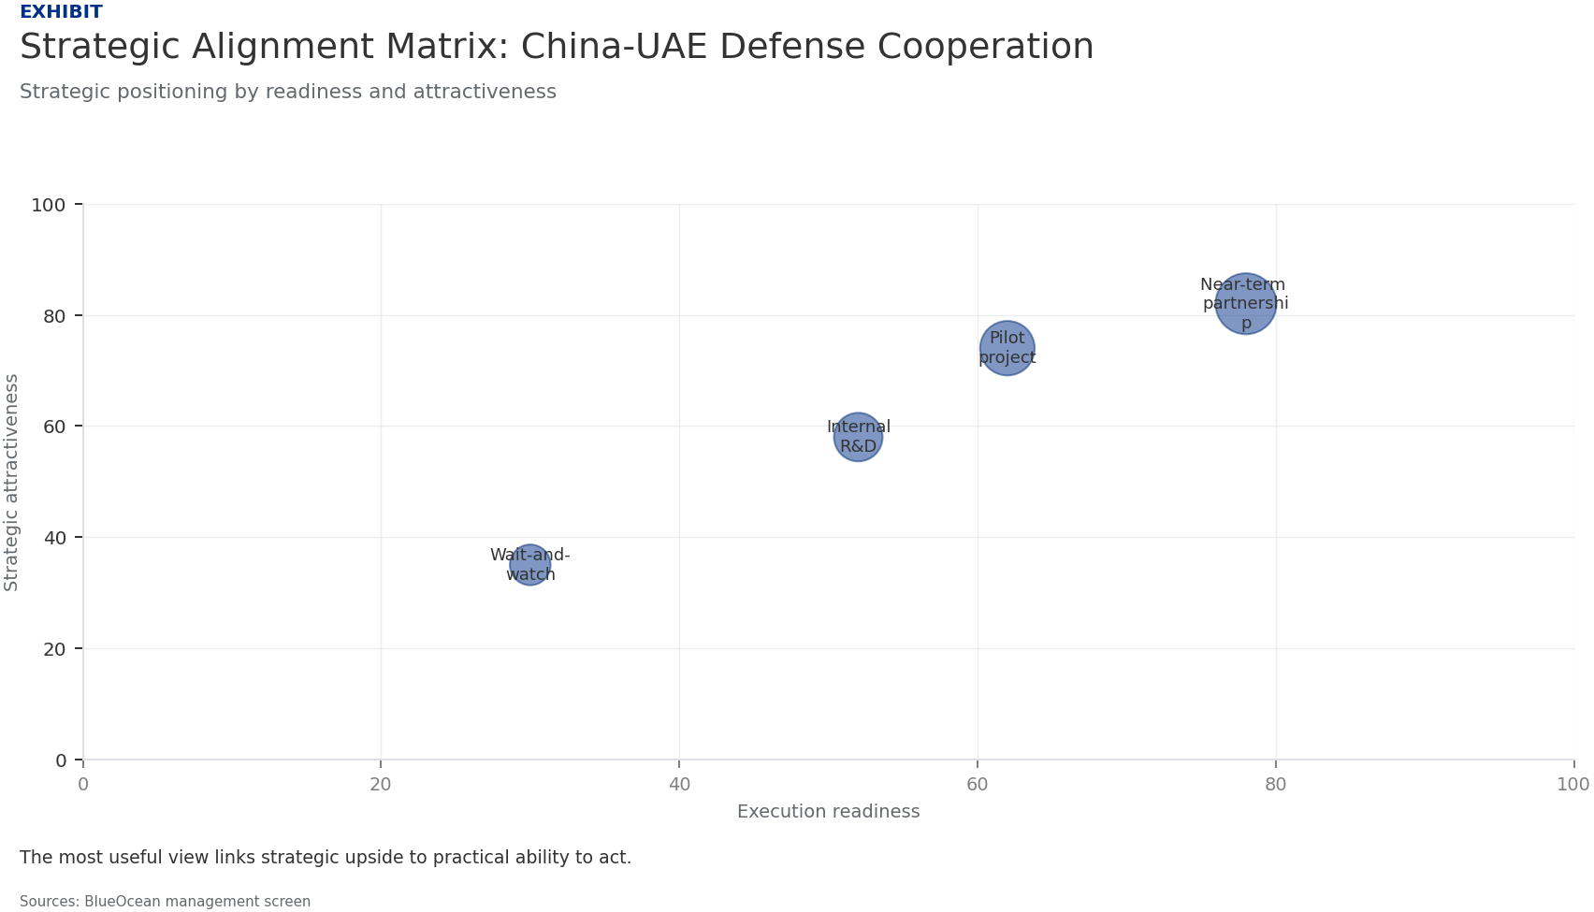
BlueOcean
Exhibit 4: evidence clarifies the strategic trade-off
Exhibit 4: evidence clarifies the strategic trade-off

Slide 17
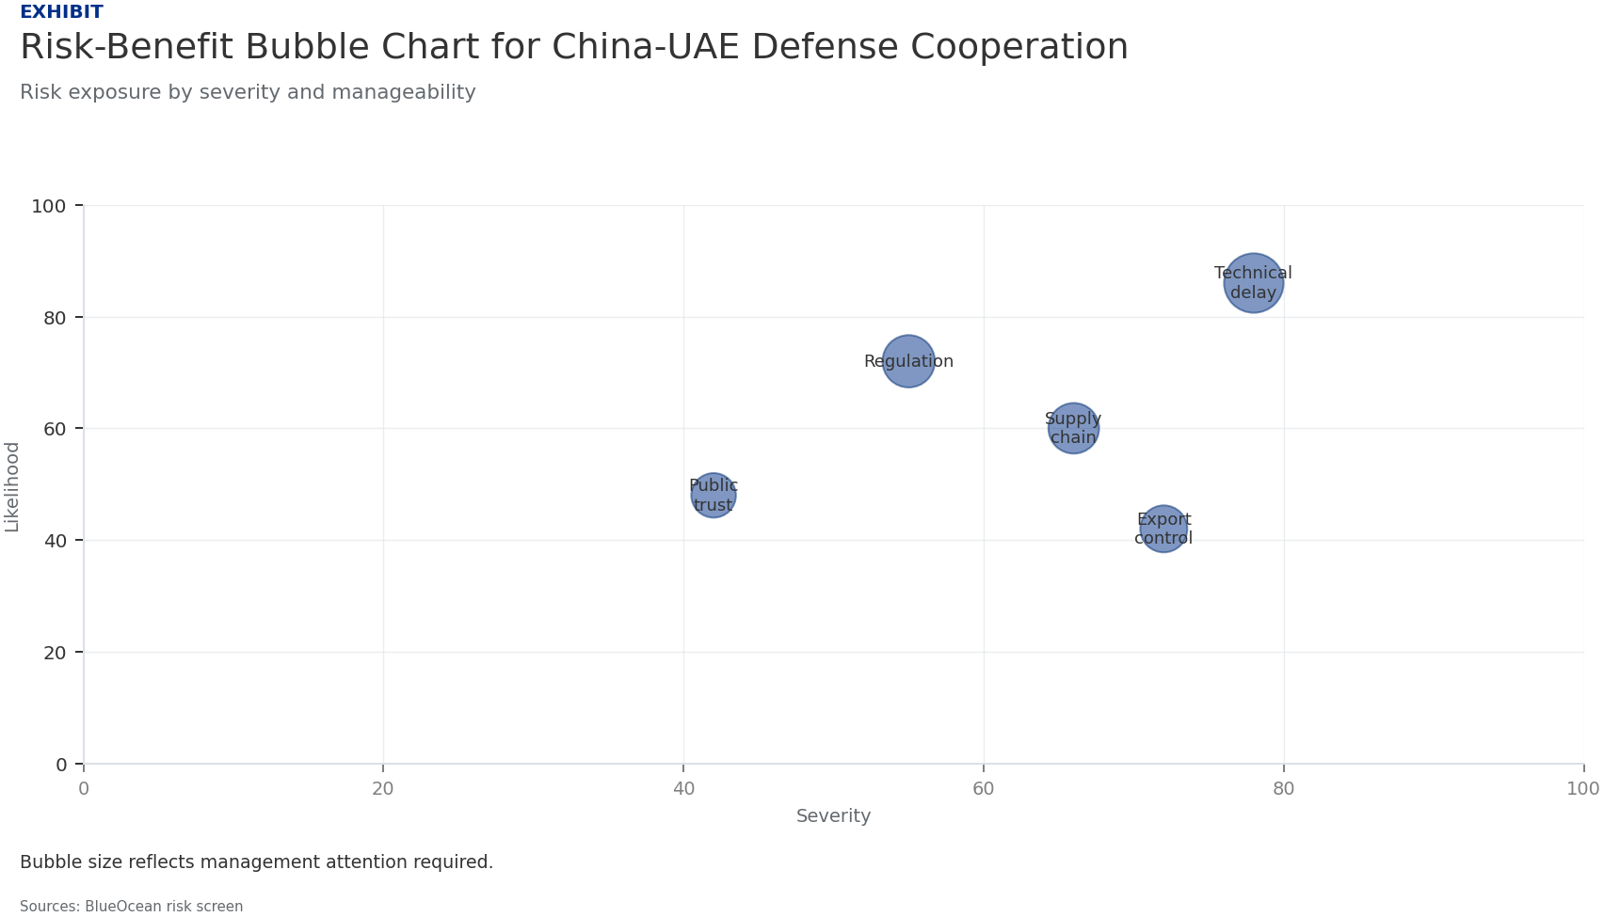
BlueOcean
Exhibit 5: evidence clarifies the strategic trade-off
Exhibit 5: evidence clarifies the strategic trade-off

Slide 18
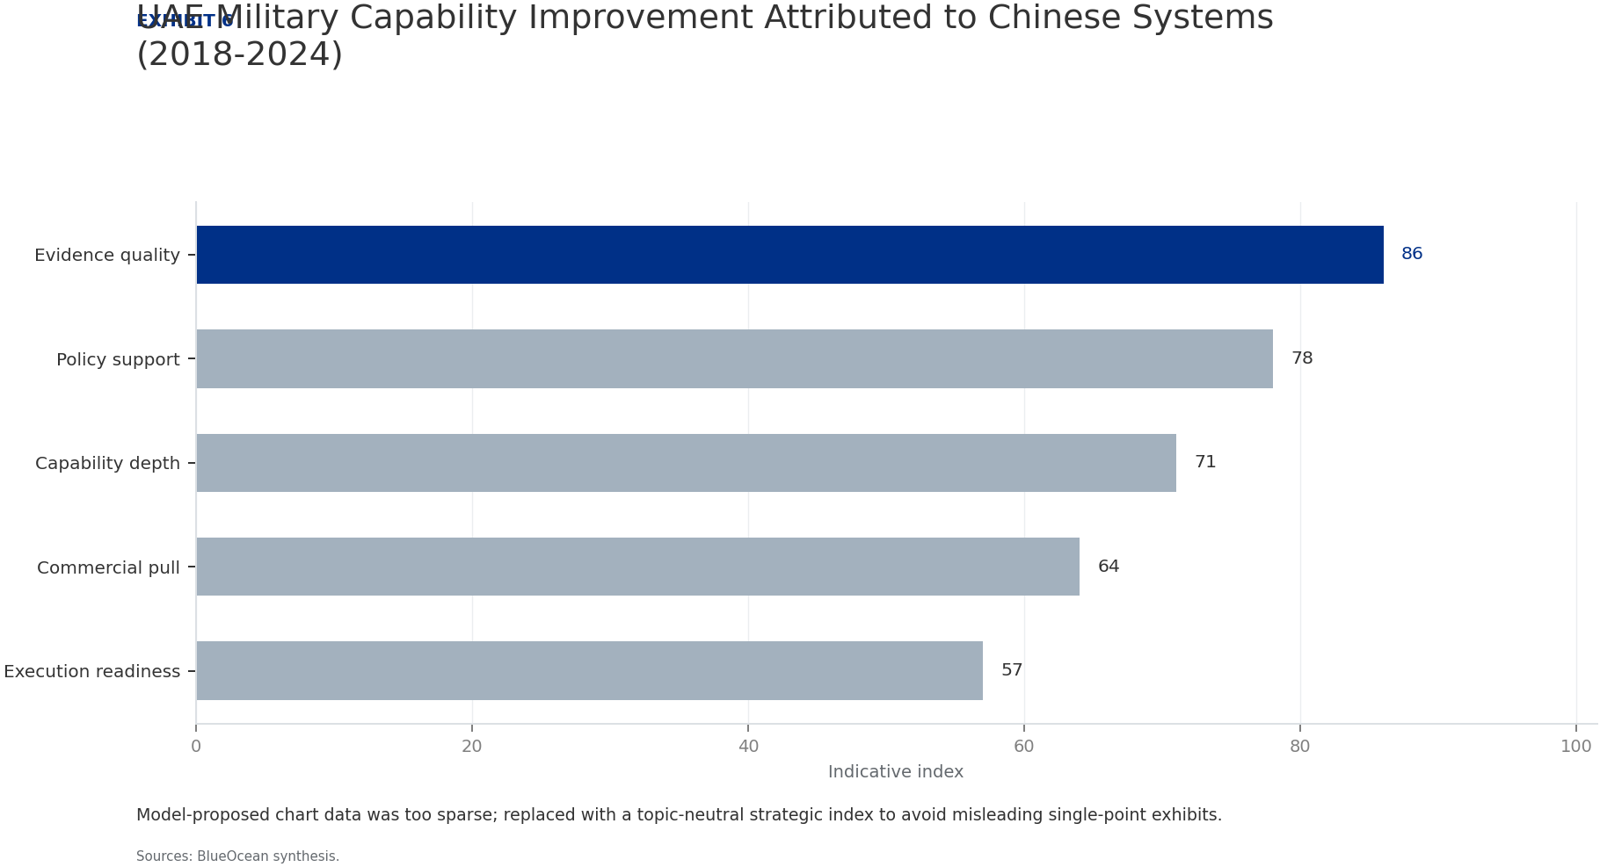
BlueOcean
Exhibit 6: evidence clarifies the strategic trade-off
Exhibit 6: evidence clarifies the strategic trade-off

Slide 19
BlueOcean
The next step is to convert the research into a short list of decisions
Implications for Regional Security, Technology Transfer, and Global Power Dynamics
Closing

