Slide 1
ELEN 21/COEN 21: Introduction to Logic Design
Lectures 11 & 12: Synchronous Sequential Logic
Radhika S. Grover
Electrical Engineering Department
Santa Clara University
rgrover@scu.edu

Slide 2
Outline
Synchronous sequential logic:
Sequential Circuits
Latches
Flip-Flops
Analysis of clocked sequential circuits
HDL or sequential circuits
State reduction and assignment
Design procedure
ELEN 21/COEN 21 Lectures 11-12

Slide 3
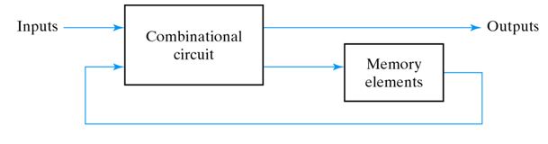
Sequential circuits
Sequential circuit consists of a combinational circuit with storage elements to form a feedback path.
Sequential circuits have memory i.e. they remember the past.
ELEN 21/COEN 21 Lectures 11-12

Slide 4
Synchronous circuits cont.
Two types: Synchronous and Asynchronous
Synchronous sequential circuit: behavior can be defined from knowledge of its signals at discrete instants of time.
  Uses flip-flops
ELEN 21/COEN 21 Lectures 11-12

Slide 5
Latches
Latches are circuits for storing binary information.
They are used in asynchronous sequential circuits.
Flip-flops are constructed from latches.
Types of latches:
  SR Latch
  D latch
ELEN 21/COEN 21 Lectures 11-12

Slide 6
SR Latch
Circuit with two cross-coupled NOR gates or two cross-coupled NAND gates.
Has two useful states: set state and reset state.
  Q=1, Q’=0 Q=0, Q’=1
  Here Q and Q’ are outputs and are normally complement of each other.
ELEN 21/COEN 21 Lectures 11-12

Slide 7
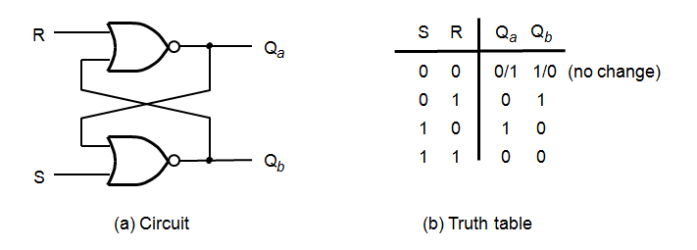
SR Latch with NOR gates
ELEN 21/COEN 21 Lectures 11-12
Notes:
Input = 0 0 is storage state
Input = 1 1 is forbidden state – output is indeterminate if both inputs go to 0 simultaneously

Slide 8
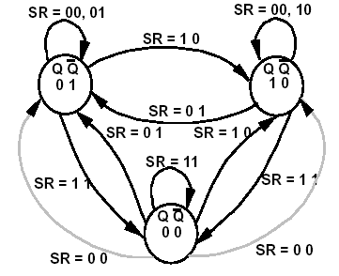
SR Latch state diagram
ELEN 21/COEN 21 Lectures 11-12

Slide 9
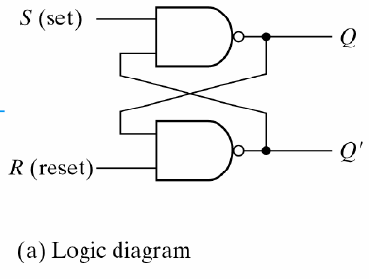
SR Latch with NAND gates
(b) Function table
S R Q Q’
1 1 Q Q’
0 1 1 0
1 0 0 1
0 0 1 1
Forbidden state
What is the state transition diagram?
ELEN 21/COEN 21 Lectures 11-12
Notes:
If circuit is in forbidden state, the output cannot be determined if both states go to 1 simultaneously – results in a race condition.

Slide 10
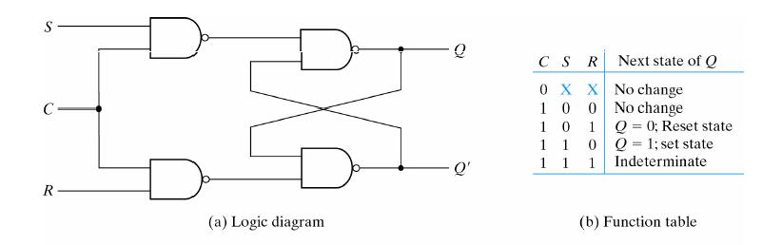
SR Latch with Control input
Holds state when C is low.
ELEN 21/COEN 21 Lectures 11-12

Slide 11
D latch
D latch eliminates the indeterminate state in SR latch.
Circuit ensures that both inputs S and R are never equal to one at the same time.
D latch has only two inputs, D(data) and C(Control).
With C=0 circuit cannot change state.
ELEN 21/COEN 21 Lectures 11-12

Slide 12
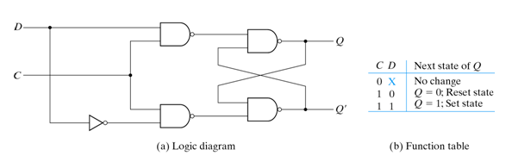
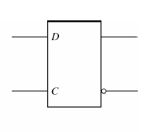
D latch
D latch: Passes input D to output Q when C is high and holds state (i.e. ignores the input D) when C is low.
ELEN 21/COEN 21 Lectures 11-12

Slide 13
Flip-flops
State of a latch or flip-flop is switched by a change in control input.
In a latch when a control input is at level 1, any changes in input produce change in output and state of latch.
Flip-flops change state only during signal transition.
ELEN 21/COEN 21 Lectures 11-12

Slide 14
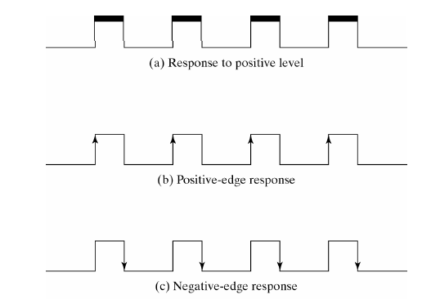
Clock response in latches and Flip-flops
ELEN 21/COEN 21 Lectures 11-12

Slide 15
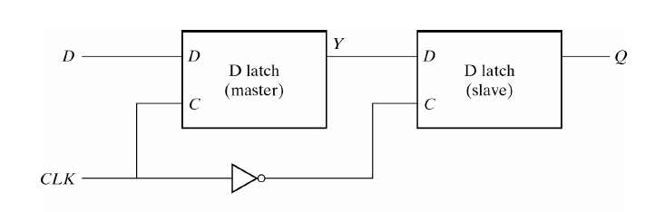
Edge triggered D Flip-Flop
This circuit passes the input D to the output Q only at the negative-edge of the controlling clock CLK.
ELEN 21/COEN 21 Lectures 11-12

Slide 16
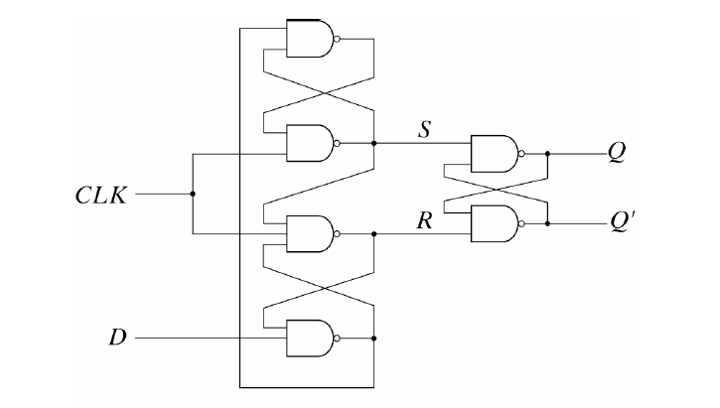
D-type positive-edge-triggered flip-flop
Another way to construct a D-type flip-flop using three SR-latches.
ELEN 21/COEN 21 Lectures 11-12

Slide 17
D-type positive-edge-triggered flip-flop
When CLK = 0, S = R = 1 => no change in output.
CLK = 1:
  D = 0 => R = 0 => Q = 0 (reset state)
  If D changes to 1 while R = 0, no change in R. Flip-flop is locked.
    CLK transitions to 0, R = 1, and flip-flop maintains previous output.
  Positive edge triggered: D is transferred to Q when clock goes from 0 to 1.
  Negative edge triggered: D is transferred to Q when clock goes from 1 to 0.
ELEN 21/COEN 21 Lectures 11-12

Slide 18
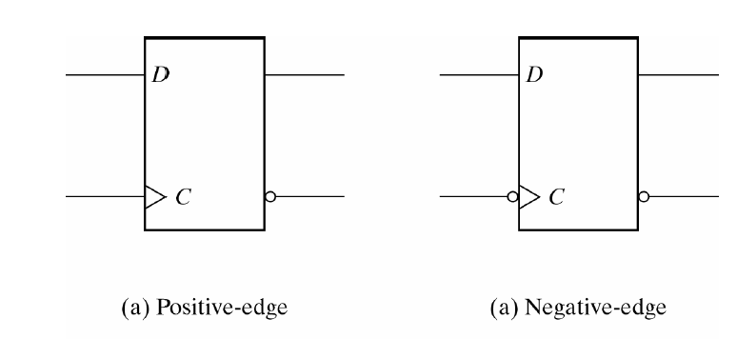
Graphic symbol for edge-triggered D flip-flop
ELEN 21/COEN 21 Lectures 11-12

Slide 19
Timing Parameters
Setup time: Minimum time for which D input must be maintained at a constant value prior to the occurrence of the clock.
Hold time: Minimum time for which D input must not change after the application of the positive transition of the clock.
Propagation delay: time interval between the trigger edge and stabilization of the output to a new state (T_{cq} for an edge triggered register and T_{dq} for a latch).
Input must remain stable and unchanged for a period of time around the clocking event in order to be recognized.
Setup time
Hold time
ELEN 21/COEN 21 Lectures 11-12

Slide 20
JK Flip-Flop
Other flip-flops can be constructed from D flip-flops:
JK flip-flop
T flip-flop
JK flip-flop performs 3 operations:
Set it to 1
Reset it to 0
Complement its output
ELEN 21/COEN 21 Lectures 11-12

Slide 21
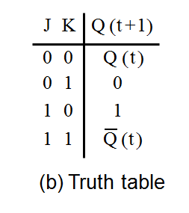
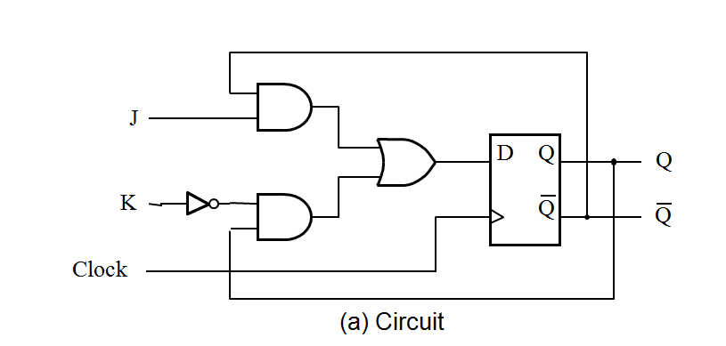
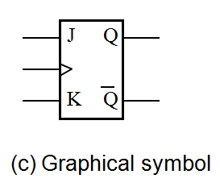
JK Flip-flop
ELEN 21/COEN 21 Lectures 11-12

Slide 22
JK Flip-Flop
D = JQ’ + K’Q
J = 1, K = 0, D = Q’ + Q = 1. (next clock edge sets flip-flop)
J=0, K=1, D= 0, next clock edge resets flip-flop.
J=K=1 D = Q’, next clock edge complements output.
ELEN 21/COEN 21 Lectures 11-12

Slide 23

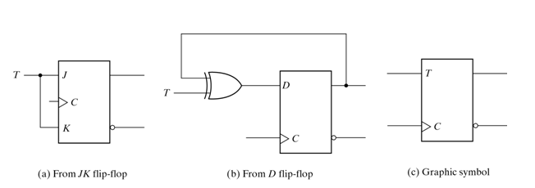
T Flip-Flop
D = T Q
= TQ’ + QT’
ELEN 21/COEN 21 Lectures 11-12

Slide 24
Characteristic Tables
JK Flip-Flop
J K Q(t+1)
0 0 Q(t) No change
0 1 0 Reset
1 0 1 Set
1 1 Q’(t) Complement
D Flip-Flop
D Q(t+1)
0 0 Reset
1 1 Set
T Flip-Flop
T Q(t+1)
0 Q(t) No change
1 Q’(t) Complement
ELEN 21/COEN 21 Lectures 11-12

Slide 25
Characteristic equations
D flip-flop:
Q(t+1) = D
JK flip-flop:
Q(t+1) = JQ’ + K’Q
T flip-flop:
Q(t+1) = TQ’ + T’Q
ELEN 21/COEN 21 Lectures 11-12

Slide 26
State diagrams
D flip-flop
T flip-flop
1
0
0
1
1
0
1
0
0
1
0
1
ELEN 21/COEN 21 Lectures 11-12

Slide 27
State Assignment and Reduction
State reduction: reduction in the number of flip-flops in a sequential circuit.
State reduction algorithms: procedures for reducing number of state in a state table, while keeping external input-output requirements unchanged.
m flip-flops produce 2^{m} states -> reducing number of states may or may not reduce number of flip-flops.
ELEN 21/COEN 21 Lectures 11-12

Slide 28
State Assignment and Reduction
State reduction: reduction in the number of flip-flops in a sequential circuit.
State reduction algorithms: procedures for reducing number of state in a state table, while keeping external input-output requirements unchanged.
m flip-flops produce 2^{m} states -> reducing number of states may or may not reduce number of flip-flops.
ELEN 21/COEN 21 Lectures 11-12

Slide 29
Design Procedure for synchronous sequential circuits
Derive state diagram for circuit from word descriptions.
Reduce the number of states if necessary.
Assign binary values to the states.
Obtain binary coded state table.
Derive simplified flip-flop input and output equations.
Draw the logic diagram.
ELEN 21/COEN 21 Lectures 11-12

Slide 30
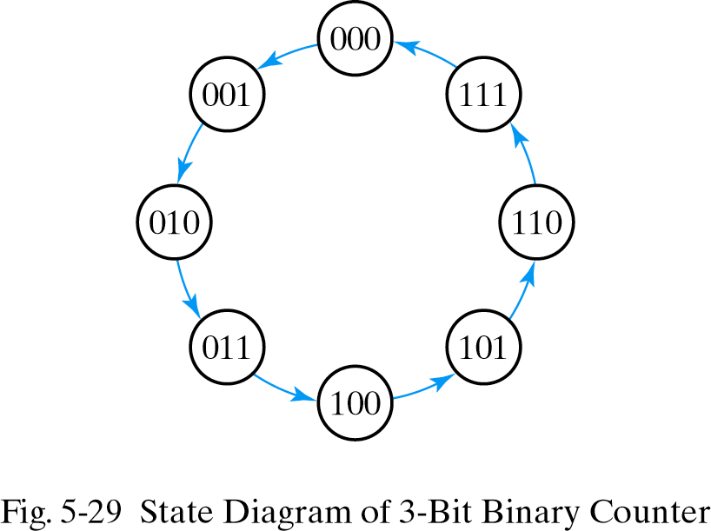
Example: Synthesize a 3-bit binary counter using T Flip-Flops
A 3-bit binary counter repeats binary count sequence from 000 to 111.
ELEN 21/COEN 21 Lectures 11-12

Slide 31
State Table for 3-bit Binary Counter
Present state Next state Flip-Flop inputs
A₂ A₁ A₀ A₂ A₁ A₀ T_{A2} T_{A1} T_{A0}
0 0 0 0 0 1 0 0 1
0 0 1 0 1 0 0 1 1
0 1 0 0 1 1 0 0 1
0 1 1 1 0 0 1 1 1
1 0 0 1 0 1 0 0 1
1 0 1
1 1 0
1 1 1
ELEN 21/COEN 21 Lectures 11-12

Slide 32
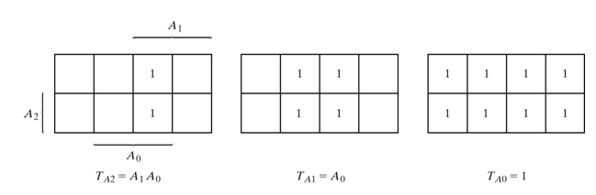
Maps for 3-bit Binary counter
ELEN 21/COEN 21 Lectures 11-12

Slide 33
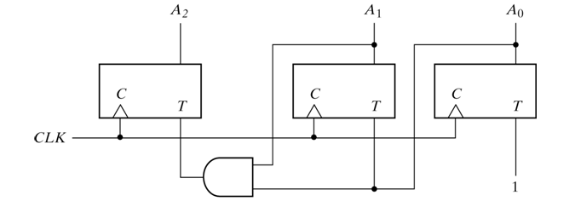
Synthesis of 3-bit counter using T flip-flops
ELEN 21/COEN 21 Lectures 11-12

Slide 34
BCD Counter
Counts in binary-coded decimal from 0000 to 1001 and back to 0000.
Derive the circuit through sequential design procedure.
State table, maps, input equations, output equation and circuit realization.
An output y = 1 to enable cascading and turn on count of next-higher significant decade.
ELEN 21/COEN 21 Lectures 11-12

Slide 35
State Table for BCD Counter (Complete the table)
Present State Next State Output Flip-Flop Inputs
Q₈ Q₄ Q₂ Q₁ Q₈ Q₄ Q₂ Q₁ y TQ₈ TQ₄ TQ₂ TQ₁
0 0 0 0 0 0 0 1 0 0 0 0 1
0 0 0 1 0 0 1 0 0 0 0 1 1
0 0 1 0 0 0 1 1 0 0 0 0 1
0 0 1 1 0 1 0 0 0 0 1 1 1
0 1 0 0 0 1 0 1 0 0 0 0 1
0 1 0 1 0 1 1 0 0 0 0 1 1
0 1 1 0 0 1 1 1 0 0 0 0 1
0 1 1 1 0
1 0 0 0 0
1 0 0 1 1
ELEN 21/COEN 21 Lectures 11-12

Slide 36
Flip Flop input equations for BCD Counter
Unused states for minterms in states 10 to 15 are taken as don’t care.
T_{Q1} = 1
T_{Q2} = Q₈’Q₁
T_{Q4} = Q₂Q₁
T_{Q8} = Q₈Q₁ + Q₄Q₂Q₁
y = Q₈Q₁
Draw the circuit for the BCD counter using these functions.
ELEN 21/COEN 21 Lectures 11-12

Slide 37
Design Procedure for synchronous sequential circuits
Derive state diagram for circuit from word descriptions.
Reduce the number of states if necessary.
Assign binary values to the states.
Obtain binary coded state table.
Derive simplified flip-flop input and output equations.
Draw the logic diagram.
ELEN 21/COEN 21 Lectures 11-12

Slide 38
Example: Synthesize a 3-bit binary counter using T Flip-Flops
A 3-bit binary counter repeats binary count sequence from 000 to 111.
ELEN 21/COEN 21 Lectures 11-12

Slide 39
State Table for 3-bit Binary Counter
Present state Next state Flip-Flop inputs
A₂ A₁ A₀ A₂ A₁ A₀ T_{A2} T_{A1} T_{A0}
0 0 0 0 0 1 0 0 1
0 0 1 0 1 0 0 1 1
0 1 0 0 1 1 0 0 1
0 1 1 1 0 0 1 1 1
1 0 0 1 0 1 0 0 1
1 0 1
1 1 0
1 1 1
ELEN 21/COEN 21 Lectures 11-12

Slide 40
Maps for 3-bit Binary counter
ELEN 21/COEN 21 Lectures 11-12

Slide 41
Synthesis of 3-bit counter using T flip-flops
ELEN 21/COEN 21 Lectures 11-12

Slide 42
BCD Counter
Counts in binary-coded decimal from 0000 to 1001 and back to 0000.
Derive the circuit through sequential design procedure.
State table, maps, input equations, output equation and circuit realization.
An output y = 1 to enable cascading and turn on count of next-higher significant decade.
ELEN 21/COEN 21 Lectures 11-12

Slide 43
State Table for BCD Counter (Complete the table)
Present State Next State Output Flip-Flop Inputs
Q₈ Q₄ Q₂ Q₁ Q₈ Q₄ Q₂ Q₁ y TQ₈ TQ₄ TQ₂ TQ₁
0 0 0 0 0 0 0 1 0 0 0 0 1
0 0 0 1 0 0 1 0 0 0 0 1 1
0 0 1 0 0 0 1 1 0 0 0 0 1
0 0 1 1 0 1 0 0 0 0 1 1 1
0 1 0 0 0 1 0 1 0 0 0 0 1
0 1 0 1 0 1 1 0 0 0 0 1 1
0 1 1 0 0 1 1 1 0 0 0 0 1
0 1 1 1 0
1 0 0 0 0
1 0 0 1 1
ELEN 21/COEN 21 Lectures 11-12

Slide 44
Flip Flop input equations for BCD Counter
Unused states for minterms in states 10 to 15 are taken as don’t care.
T_{Q1} = 1
T_{Q2} = Q₈’Q₁
T_{Q4} = Q₂Q₁
T_{Q8} = Q₈Q₁ + Q₄Q₂Q₁
y = Q₈Q₁
Draw the circuit for the BCD counter using these functions.
ELEN 21/COEN 21 Lectures 11-12

Slide 45
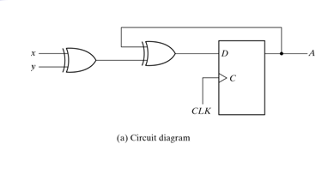
Example: Analysis with D Flip-Flops
ELEN 21/COEN 21 Lectures 11-12

Slide 46
Analysis with D Flip-Flops cont.
For the previous sequential circuit with D Flip-Flop:
D_{A} =
A(t+1) =
Use characteristic equation or state table to obtain next state values.
ELEN 21/COEN 21 Lectures 11-12

Slide 47
Analysis with JK Flip-Flops
Next state values of a sequential circuit with JK flip-flops can be determined as:
Determine the flip-flop input equations in terms of the present state and input variables.
List the binary values of each input equation.
Use the corresponding flip-flop characteristic table to determine the next state values in state table.
ELEN 21/COEN 21 Lectures 11-12

Slide 48
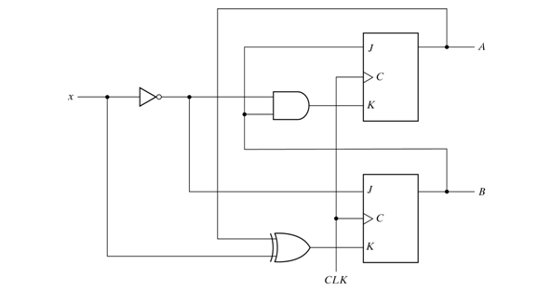
Example: Sequential circuit with JK Flip-Flop
ELEN 21/COEN 21 Lectures 11-12

Slide 49
Flip-flop input equations
J_{A}=
J_{B}=
K_{A}=
K_{B}=
ELEN 21/COEN 21 Lectures 11-12

Slide 50
Characteristic equations for flip-flops
A(t+1) =
B(t+1) =
Substitute the values of J_{A} and K_{A} from input equations to get state equation for A:
  A(t+1) =
Substitute the values of J_{B} and K_{B} from input equations to get state equation for B:
  B(t+1) =
ELEN 21/COEN 21 Lectures 11-12

Slide 51
State Table for Sequential Circuit with JK Flip-Flops
Present Input Next State
State
A B x A B
0 0 0
0 0 1
0 1 0
0 1 1
1 0 0
1 0 1
1 1 0
1 1 1
ELEN 21/COEN 21 Lectures 11-12

Slide 52
State Diagram
ELEN 21/COEN 21 Lectures 11-12

Slide 53
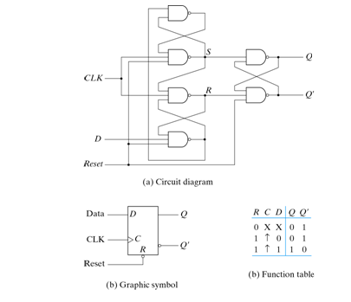
D flip-flop with Asynchronous reset
ELEN 21/COEN 21 Lectures 11-12

Slide 54
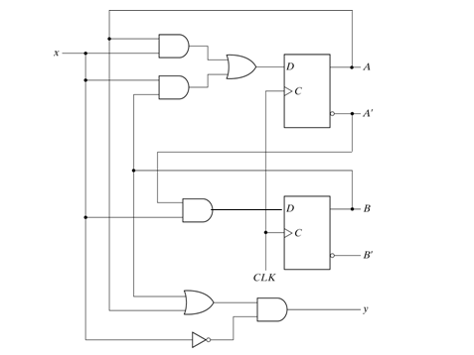
Example: Clocked Sequential Circuit
ELEN 21/COEN 21 Lectures 11-12

Slide 55
Analysis of previous circuit
A(t+1) =
B(t+1) =
y(t) =
ELEN 21/COEN 21 Lectures 11-12

Slide 56
State table or Transition Table
State Table: contains time sequence of inputs, outputs and flip-flop states.
Present state Input Next state Output
A B x A B y
0 0 0 0 0 0
0 0 1 0 1 0
0 1 0 0 0 1
0 1 1 1 1 0
1 0 0 0 0 1
1 0 1 1 0 0
1 1 0 0 0 0
1 1 1 1 0 0
ELEN 21/COEN 21 Lectures 11-12

Slide 57
Another form of state table
Present state Next state Output
x=0 x=1 x=0 x=1
AB AB AB y y
00 00 01 0 0
01 00 11 1 0
10 00 10 1 0
11 00 10 1 0
ELEN 21/COEN 21 Lectures 11-12

Slide 58
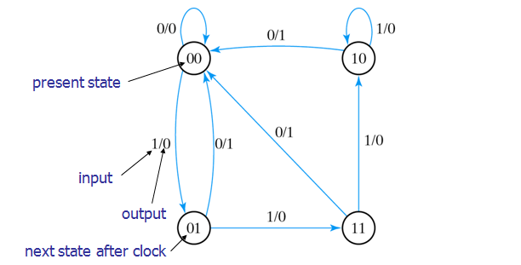
State Diagram
ELEN 21/COEN 21 Lectures 11-12

Slide 59
Summary
SR Latch
Different types of flip flops: D, JK and T
Excitation tables
State diagrams
Analysis of sequential circuits
ELEN 21/COEN 21 Lectures 11-12

