Slide 1
TITLE: ARIAL BOLD 36 PT.
Presenter’s Name: Arial Bold 24 pt.
Presenter’s Title: Arial Narrow 20 pt.
SCHOOL OF ENGINEERING

Slide 2
Section Title: Arial Bold 32 pt.
SCHOOL OF ENGINEERING

Slide 3
Title: Aerial Bold 28 pt.; Title Case
Subtitle: Arial bold italic 22 pt.; sentence style
Body: Arial narrow bold 24 pt.; bullet: Webdings;
sentence case
  Sub-bullets: Arial Narrow 20 pt.; Bullet: Webdings;
    Second sub-bullet
    Third sub-bullet
SCHOOL OF ENGINEERING

Slide 4
Bullet Format
Use “smart” quotes
Fiscal years should be formatted as FY ’01
Highlight in this color for overheads
Hyperlink: www.scu.edu
Correct dashes used: -, –, —
SCHOOL OF ENGINEERING

Slide 5
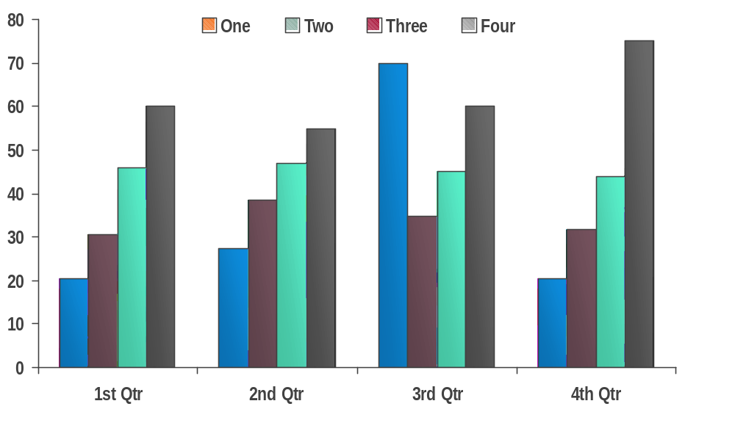
Chart Example
Source: Placeholder for notes, etc. 14 pt..
SCHOOL OF ENGINEERING

Slide 6
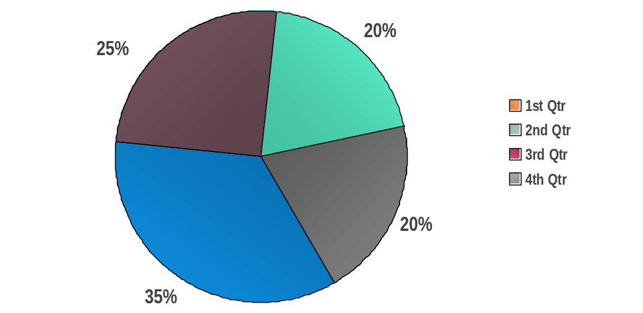
Pie Chart Example
Source: Placeholder for notes, etc. 14 pt..
SCHOOL OF ENGINEERING

Slide 7
Table Example
 | 1st Qtr | 2nd Qtr | 3rd Qtr | 4th Qtr
Secure 1 |  |  |  | 
Secure 2 |  |  | 
Secure 3 |  |  |  | 
Secure 4 |  |  |  | 
Secure 5 |  |  |  | 
Secure 6 |  |  | 
Secure 7 |  |  |  | 
Source: Placeholder for notes, etc. 14 pt..
SCHOOL OF ENGINEERING

Slide 8
Text with Graphic on Right
Large Label
Body: Arial narrow bold 24 pt.; bullet: Webdings;
sentence case
  Sub-bullets: Arial Narrow 20 pt.; Bullet: Webdings;
    Second sub-bullet
    Third sub-bullet
Small Label
Small Label
SCHOOL OF ENGINEERING

Slide 9
Sample Quote
“When a billion wireless phones wake up in
the next few years, a distributed architecture
will be the only way people will be able to
receive the information they need.”
Anonymous
Title
Company
SCHOOL OF ENGINEERING

Slide 10
Color Palette
Primary colors
Highlights
Solid
white
text
white
text
black
text
black
text
white
text
white
text
white
text
black
text
white
text
201
452
124
415
5565
201
1665
124
201
Use this style for PPT objects
(To apply this style to an object use the “format painter”)
SCHOOL OF ENGINEERING

Slide 11
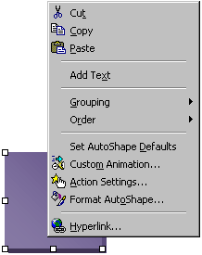
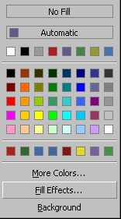
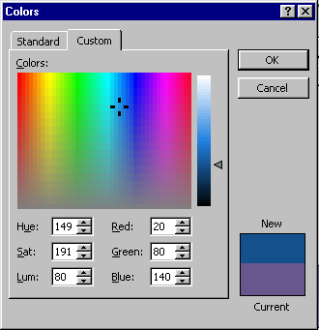
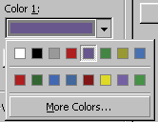
How To Apply Different Colors To Objects
Use this way if you don’t see a color you want to use from the “Graphics Elements” slide
Step 1
Step 2
Step 3
Step 4
Final Result
Right mouse click on the object you want to change and select “Format AutoShape” from the pop-up
Click on the “Color” pop-up and select “Fill Effects”
Select
“More Colors”
Select the new
color you want and click “OK”
SCHOOL OF ENGINEERING

Slide 12
Slide Transitions
All slides: “wipe right”
SCHOOL OF ENGINEERING

Slide 13
Out-of-Bounds
Graphics and text should not extend into this red area
SCHOOL OF ENGINEERING

