Slide 1
ELEN 21/COEN 21: Introduction to Logic Design
Lectures 1 & 2: Logic Circuits
Radhika S. Grover
Electrical Engineering Department
Santa Clara University
rgrover@scu.edu

Slide 2
Lecture 1: Introduction to logic circuits
Overview:
Basic Definitions
Truth Tables
Basic Theorems and Properties of Boolean Algebra
Boolean Functions
Canonical and Standard Forms
Other Logic Operations
Digital Logic Gates

Slide 3
A binary switch
^{x}
⁼
⁰
^{x}
⁼
¹
^{(a) Two states of a switch}
^{S}
^{x}
^{(b) Symbol for a switch}

Slide 4
Basic functions
^{S}
^{S}
^{Power}
^{supply}
^{x1}
^{x2}
^{Light}
(a) The logical AND function (series connection)
^{S}
^{x1}
^{Power}
^{Light}
^{supply}
^{S}
^{x2}
(b) The logical OR function (parallel connection)

Slide 5
An inverting circuit
R
Power
supply
x
S
Light

Slide 6
Truth tables
A truth table is a table of all possible combinations of the variables showing the relation between
- the values the variables can take and
- the result of the operation.
Truth table show operations in a compact form.

Slide 7
Truth table for AND, OR operations

Slide 8
Boolean Algebra
A set of elements is any collection of objects having a common property.
Common Postulates :
Closure : A set S is closed w.r.t. a binary operator if, for every pair of elements of S, the binary operator specifies a rule for obtaining a unique element of S.
E.g. set of natural numbers N = {1, 2, 3, 4..} is closed w.r.t. binary operator + but not binary operator −.

Slide 9
Basic Definitions
Associative Law: A binary operator on a set S is said to be associative whenever
Commutative Law: A binary operator on a set S is said to be commutative whenever
Identity Law: A set S is said to have an identity element with respect to a binary operation on S if there exists an element e S with the property

Slide 10
Basic Definitions cont.
Inverse: A set S having the identity element e with respect to a binary operator is said to have an inverse whenever for every x S there exists and element y S such that
Distributive Law: If and · are two binary operators on a set S, is said to be distributive over whenever
A field is a set of elements together with two binary operators, each having properties 1 through 5, and both operators combined to give property 6.

Slide 11
Boolean Algebra
Boolean algebra has a set of elements B and two binary operators + and · provided the following (Huntington) postulates are satisfied:
1 (a) Closure with respect to the operator +.
(b) Closure with respect to the operator ·.
2 (a) An identity element with respect to + denoted by 0 : x + 0 = 0 + x = x.
(b) An identity element with respect to · designated by 1: x · 1 = 1 · x = x.
3(a) Commutative with respect to +: x + y = y + x
(b) Commutative with respect to · : x · y = y · x

Slide 12
Boolean Algebra cont.
4 (a) · is distributive over +: x ·(y + z) = (x · y) + (x · z)
(b) + is distributive over ·: x + (y · z) = (x + y) · (x + z)
5. For every element x B, there is an element x’ B called complement of x such that (a) x + x’ = 1 and
(b) x · x’ = 0
6. There exists at least two elements, x, y B such that x ≠ y.
+ and · have operation rules equivalent to AND and OR.

Slide 13
Difference between Boolean algebra and arithmetic/ordinary algebra
Associative law holds for Boolean algebra, while Huntington postulates do not include associative law.
Distributive law of + over · is valid for Boolean algebra, but not ordinary algebra.
Boolean algebra does not have subtraction or division operations.
Complement is not available in ordinary algebra
Ordinary algebra deals with real numbers. Two-valued Boolean algebra ( or boolean algebra) deals only with two elements: 0 and 1.

Slide 14
Duality
Duality principle: Every algebraic expression deducible from the postulates of Boolean algebra remains valid if the operators and identity elements are interchanged.
i.e. simply interchange OR and AND operators and replace 1’s by 0’s and 0’s by 1’s.

Slide 15
Basic Theorems
Theorem 1(a): x + x = x
Proof: x + x = (x + x) · 1 from postulate 2(b)
= (x + x) · (x + x’) (5a)
= x + xx’ (4b)
= x + 0 (5b)
= x (2a)

Slide 16
Basic Theorems cont.
Theorem 1(b): x · x = x
Proof: x · x = (xx + 0) from postulate 2(a)
= xx + xx’ (5b)
= x(x + x’) (4a)
= x · 1 (5a)
= x (2b)

Slide 17
Basic Theorems cont.
Theorem 2(a): x + 1 = 1
Proof: x + 1 = 1 · (x + 1) from postulate 2(b)
= (x + x’) · (x + 1) (5a)
= x + x’ · 1 (4b)
= x + x’ (2b)
= 1 (5a)
Theorem 2(b): x · 0 = 0 by duality

Slide 18
Basic Theorems cont.
Theorem 3: (x’)’ = x
Proof: x + x’ = 1 and x · x’ = 0 from postulate 5
Complement of x’ is x and (x’)’
Since complement is unique,
(x’)’ = x

Slide 19
Basic Theorems cont.
Theorem 6(a): x + xy = x
Proof: x + xy = x · 1 + xy from postulate 2(b)
= x(1 + y) (4a)
= x(y + 1) (3a)
= x · 1 (2a)
= x (2b)
Theorem 6(b): x (x + y ) = x by duality

Slide 20
Summary of Postulates and Theorems of Boolean Algebra
Postulate 2 (a) x+0 = x (b) x·1=x
Postulate 5 (a) x+x’ =1 (b) x·x’=0
Theorem 1 (a) x+x = x (b) x·x=x
Theorem 2 (a) x+1=1 (b) x·0=0
Theorem 3 (x’)’ = x
Postulate 3 (a) x+y = y+x (b) xy = yx
Theorem 4 (a) x+(y+z) = (x+y)+z (b) x(yz) = (xy)z
Postulate 4 (a) x(y+z) = xy+xz (b)x+yz = (x+y)(x+z)
Theorem 5 (a) (x+y)’=x’y’ (b) (xy)’ = x’ + y’
Theorem 6 (a) x + xy = x (b) x(x + y) = x

Slide 21
Example: Verify Theorem 6(a) using truth tables
x y xy x + xy
0 0 0 0
0 1 0 0
1 0 0 1
1 1 1 1
Verify the other theorems using truth tables.

Slide 22
Operator Precedence
Operator precedence for evaluating Boolean expressions is:
Parenthesis
NOT
AND
OR
E.g. (x+y)’ , x’y’

Slide 23
Basic gates
^{x}
¹
^{x}
²
^{x}
¹
^{x}
⋅
^{x}
^{x}
⋅
^{x}
⋅
…
⋅
^{x}
^{x}
¹
²
¹
²
^{n}
²
^{(a) AND gates}
^{x}
^{n}
^{x}
¹
^{x}
²
^{x}
¹
^{x}
^{x}
¹
⁺
^{x}
²
^{x}
¹
⁺
^{x}
²
⁺
…
⁺
^{x}
^{n}
²
^{(b) OR gates}
^{x}
^{n}
^{x}
^{x}
^{(c) NOT gate}

Slide 24
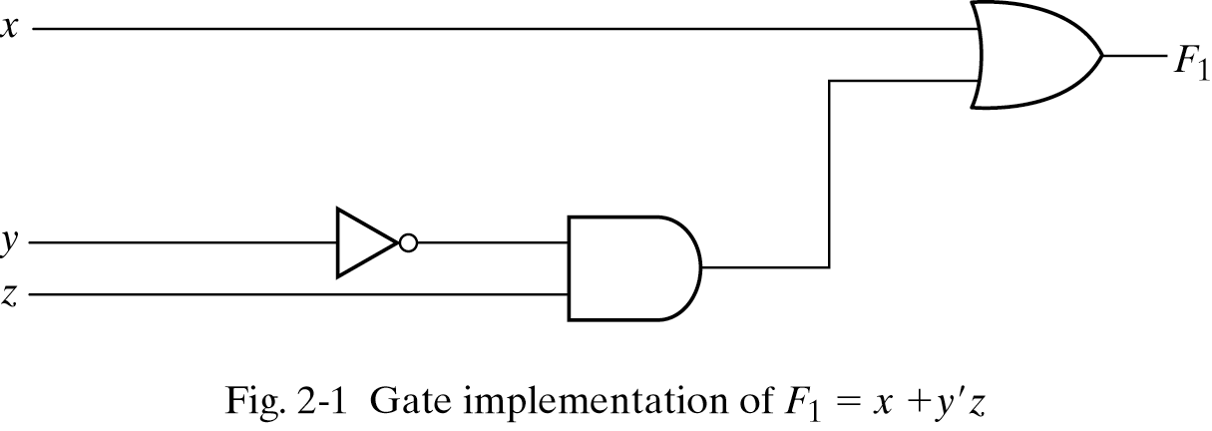
Boolean Functions
Boolean function F₁ = x +y’z

Slide 25
Other Boolean functions
Implement Boolean functions F₂ = x’y’z + x’yz + xy’ and F₃ = xy’ + x’z

Slide 26
Literal
Each term in a Boolean expression is implemented with gates.
Each variable within the term is an input to the gate.
Literal is a single variable within a term that may be complemented or not.
Example: F₂ has 3 terms and 8 literals.
How many terms and literals does F₃ have?

Slide 27
Example
Simplify x(x’ + y) to a minimum number of literals.
Simplify (x+y)(x+y’) to a minimum number of literals.

Slide 28
Exercise
Simplify using Boolean algebra:
AB+A(B+C)+B(B+C)
(AB’(C+BD)+A’B’)C
A’BC+AB’C’+A’B’C’+AB’C+ABC

Slide 29
Complement of a function
Complement of function F is F’.
Obtained by interchanging 1’s for 0’s and 0’s for 1’s.
Complement can be through DeMorgan’s Theorems (Theorem 5): (x+y)’ = x’y’ and (xy)’ = x’ + y’
Prove the three-variable form of DeMorgan’s theorem:
(A+B+C)’ = A’B’C’

Slide 30
3-variable form of DeMorgan’s theorem
(A + B + C)’ = (A + x)’ let B+C=x
= A’x’ theorem 5(a)
= A’(B+C)’ substitute B+C=x
= A’(B’C’ ) theorem 5(a)
= A’B’C’ theorem 4(b)

Slide 31
Exercise
Apply DeMorgan’s theorem:
(A+B+C)’D
(ABC+DE)’
Simplify:
(AB+AC)’+A’B’C

Slide 32
Representing a function
A function can be represented in one of the following ways:
Standard form
Canonical form

Slide 33
Standard forms
Standard forms:
Sum of products : Boolean expression containing AND terms.
e.g. F = y’ + xy +x’yz’
Product of sums: Boolean expression containing OR terms.
e.g. F = x(y’+z)(x’ + y + z)
Non-Standard forms:
E.g. F = AB + C(D + E)

Slide 34
Exercise
Convert the following expressions to SOP form
AB+B(CD+EF)
(A+B)(B+C+D)

Slide 35
Canonical forms
Canonical form: Boolean function expressed as a sum-of-minterms or product-of-maxterms.
E.g. f₁=x’y’z + xy’z’ + xyz = m₁ + m₄ + m₇
E.g. f₂ = (x + y + z)(x + y + z’)(x + y’ + z)(x’ + y + z)
=M₀M₁M₂M₄

Slide 36
Maxterms and Minterms
Minterms : A product term in which each of the n variables of an n variable function appears once.
represented as m_{j}
Maxterms : dual of Minterms
represented as M_{j}
Sum of Minterms is also called canonical sum–of–products
Product of Maxterms is also called canonical product-of-sums

Slide 37
Minterms for function with 3 binary variables
x y z Minterm Minterm designation
0 0 0 x’y’z’ m₀
0 0 1 x’y’z m₁
0 1 0 x’yz’ m₂
0 1 1 x’yz m₃
1 0 0 xy’z’ m₄
1 0 1 xy’z m₅
1 1 0 xyz’ m₆
1 1 1 xyz m₇

Slide 38
Maxterms for function with 3 binary variables
x y z Maxterm Maxterm designation
0 0 0 x+y+z M₀
0 0 1 x+y+z’ M₁
0 1 0 x+y’+z M₂
0 1 1 x+y’+z’ M₃
1 0 0 x’+y+z M₄
1 0 1 x’+y+z’ M₅
1 1 0 x’+y’+z M₆
1 1 1 x’+y’+z’ M₇

Slide 39
Example
Express the Boolean function F = A + B’C in a sum of minterms.
(Hint: Write A as AB(C+C’) + AB’(C+C’) and B’C as B’ (C+C’))
Convert the following expressions to canonical SOP form
AB+B(CD+EF)
(A+B)(B+C+D)

Slide 40
Short notation for functions
F(A, B, C) = ∑m(1, 4, 5, 6, 7) (sum of minterms)
The same function can also be expressed as:
F(A, B, C) = ∏(0, 2, 3) (product of maxterms)
F’(A, B, C) = ∑(0, 2, 3) = m₀ + m₂ + m₃
Therefore, (F’(A, B, C))’ = F(A, B, C)
= (m₀ + m₂ + m₃)’
= M₀ M₂ M₃
= ∏M(0, 2, 3)

Slide 41
Exercise
Find the minimal SOP and minimal POS realizations of the following truth table:

Slide 42
Solution
^{x}
²
^{f}
^{x}
³
^{x}
¹
(a) A minimal sum-of-products realization
^{x}
¹
^{x}
³
^{f}
^{x}
²
(b) A minimal product-of-sums realization
Notes:
Hint
X2’x3+x3’x1=x2’x3+x3’x1+x1X2’
=(x2’+x3’)(x3+x1)

Slide 43
Exercise: Deriving a function from a truth table
Express the following functions in truth tables, and then derive the function from the truth table in sum-of-products form and product-of-sums form.
F = x + y
F = xy’
F = xy + x’y’
F = x + yz
F = x + y’
Draw the gate level representations for each of these functions.

Slide 44
Other logic operations
XOR f = xy’ + x’y
NOR f = (x + y)’
Complement f = x’
Identity f = 1
XNOR f = xy + x’y’
NAND f = (xy)’
Give the truth tables for each of the above logic operations

Slide 45
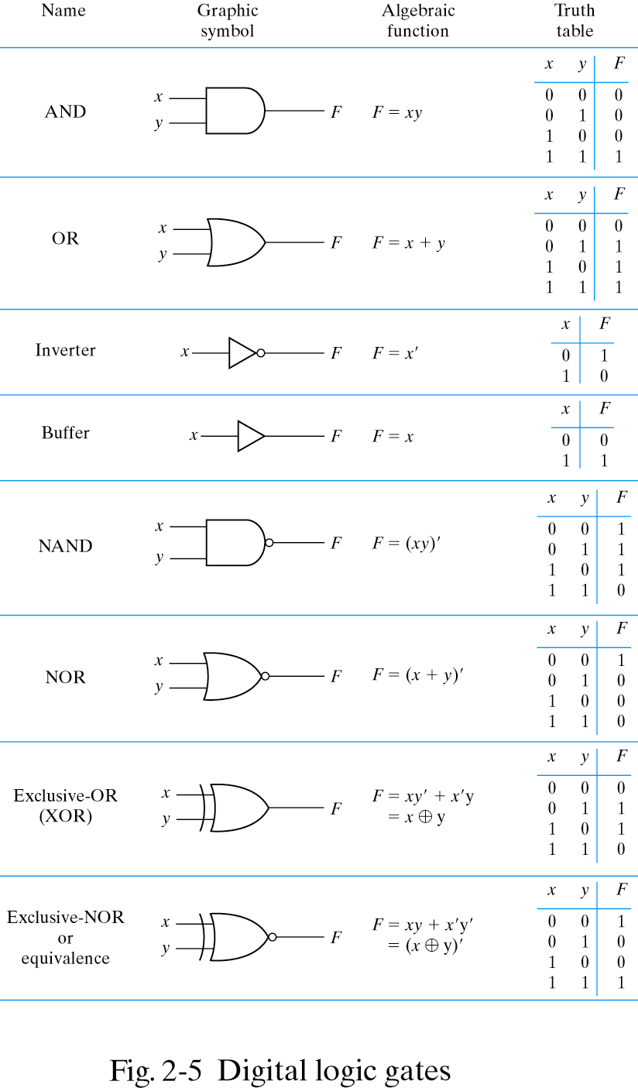
Digital logic gates

Slide 46
7404
V
DD
Gnd
(b) Structure of 7404 chip

Slide 47
The 74244 buffer chip

Slide 48
An implementation of f = x1x2 + x2’x3.
VDD
7404
7408
7432
x
1
x
2
x
3
f

Slide 49
Summary
Introduction to logic circuits
Truth tables
Boolean algebra: postulates and theorems
Minimizing a function using boolean algebra
SOP, POS
Designing a logic circuit from a truth table
CMOS transistors
Standard gates

