Slide 1
ELEN 21/COEN 21: Introduction to Logic Design
Lectures 13 & 14: Registers and counters
Radhika S. Grover
Electrical Engineering Department
Santa Clara University
rgrover@scu.edu

Slide 2
Synchronous Sequential Logic
Overview:
Registers
State Reduction and Assignment
Counters
ELEN 21/COEN 21 Lectures 13-14

Slide 3
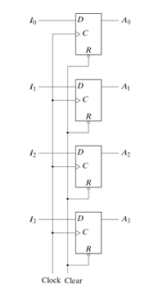
4-bit Register
C input: clock triggers all D-type flip-flops and the binary data at the four inputs is transferred into the 4-bit register.
R input = 0: all the flip-flops are reset asynchronously.
R inputs must be maintained at logic 1 during normal operation.
ELEN 21/COEN 21 Lectures 13-14

Slide 4
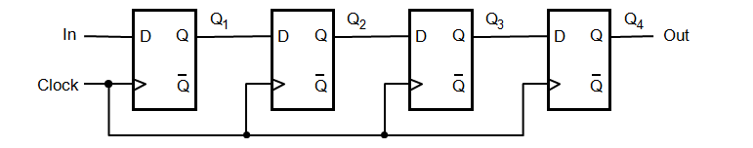
Shift Register
Every CLK pulse shifts contents of the register one bit position to the right.
ELEN 21/COEN 21 Lectures 13-14

Slide 5
Universal Shift Register
Bidirectional shift and parallel load capability.
Capabilities:
Clear control to clear register.
Clock input
Shift-right control
Shift-left control
Parallel-load control
n parallel lines
Control state
ELEN 21/COEN 21 Lectures 13-14

Slide 6
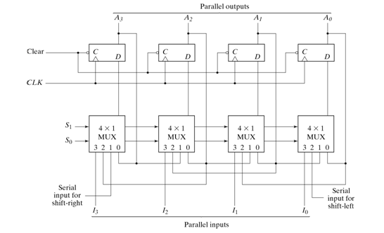
Universal Shift Register
ELEN 21/COEN 21 Lectures 13-14

Slide 7
Function Table for 4-bit universal shift register
Mode Control
s1 s0 Register Operation
0 0 No change
0 1 Shift register
1 0 Shift left
1 1 Parallel Load
ELEN 21/COEN 21 Lectures 13-14

Slide 8
4-bit Binary Synchronous Up Counter
A common clock triggers all flip-flops simultaneously in synchronous counters .
Flip-flop complements if
T = 1 or J = K =1
Flip-flop is complemented when all bits in lower significant positions are equal to 1.
ELEN 21/COEN 21 Lectures 13-14

Slide 9
Derivation of Binary Synchronous Up Counter
Clock cycle
Q
2
Q
1
Q
0
Q
changes
0
0
0
0
1
Q
changes
1
0
0
1
2
2
0
1
0
3
0
1
1
4
1
0
0
5
1
0
1
6
1
1
0
7
1
1
1
8
0
0
0
ELEN 21/COEN 21 Lectures 13-14

Slide 10
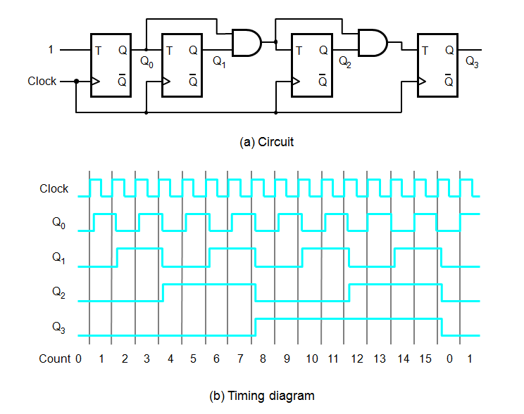
ELEN 21/COEN 21 Lectures 13-14

Slide 11
4-bit Binary Counter with D flip-flops
Enable
D
Q
Q
0
Q
D
Q
Q
1
Q
D
Q
Q
2
Q
D
Q
Q
3
Q
Clock
Output
carry
ELEN 21/COEN 21 Lectures 13-14

Slide 12
4-bit Binary Counter with Parallel Load
4-bit register has parallel load capacity and can function as a counter.
Load = 1: disables the count operation and causes a transfer of data from the four data inputs into the four flip-flops.
Load = 0: circuit starts count operation.
ELEN 21/COEN 21 Lectures 13-14

Slide 13
Counter with Parallel-Load
Enable
0
D
1
D
Q
Q
0
0
Q
0
D
Q
Q
1
D
1
1
Q
0
D
Q
Q
2
D
2
1
Q
0
D
Q
Q
3
D
3
1
Q
Output
Load
carry
Clock
ELEN 21/COEN 21 Lectures 13-14

Slide 14
BCD Counter
Counts in binary-coded decimal from 0000 to 1001 and back to 0000.
Derive the circuit through sequential design procedure.
State table, maps, input equations, output equation and circuit realization.
An output y = 1 to enable cascading and turn on count of next-higher significant decade.
ELEN 21/COEN 21 Lectures 13-14

Slide 15
A two-digit BCD counter
1
Enable
0
D
0
Q
0
0
D
1
Q
1
0
D
Q
BCD
0
2
2
0
D
3
Q
3
Load
Clock
Clock
Clear
Enable
0
D
0
Q
0
0
D
1
Q
1
0
D
Q
BCD
1
2
2
0
D
3
Q
3
Load
Clock
ELEN 21/COEN 21 Lectures 13-14

Slide 16
Ring Counter
Start control signal presets the leftmost FF to 1 and clears others.
A 1 is shifted through the ring at successive clock cycles.
Produces these outputs in 4-bit counter: 1000, 0100, 0010, 0001.
ELEN 21/COEN 21 Lectures 13-14

Slide 17
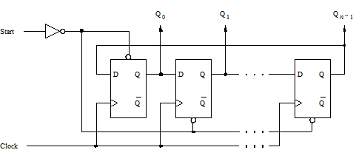
Ring Counter
ELEN 21/COEN 21 Lectures 13-14

Slide 18
Johnson Counter
Instead of Q output, feed the Q’ output of the last stage back to the first stage.
In the sequence only a single bit differs for two consecutive codes:
0000,1000,1100,1110,1111,0111,0011,0001,0000,etc.
ELEN 21/COEN 21 Lectures 13-14

Slide 19
Summary
4-bit Register
Shift Register
Universal Shift Register
4-bit Binary Synchronous Up Counter
4-bit Binary Counter with Parallel Load
BCD Counter
Ring Counter
Johnson Counter
ELEN 21/COEN 21 Lectures 13-14

