Slide 1
ELEN/COEN 21: Introduction to Logic Design
Lectures 9 & 10: Comparators, multipliers and other combinational circuits
Radhika S. Grover
Electrical Engineering Department
Santa Clara University

Slide 2
Combinational Logic
Overview:
Binary Adder-Subtractor
Decimal Adder
Binary Multiplier
Magnitude Comparator

Slide 3
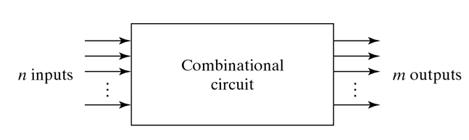
Block diagram of Combinational Circuits

Slide 4
Carry Propagation
Carry has to propagate through the full adders to get the final sum.
The longest propagation delay time in an adder is the time it takes the carry to propagate through the full adders.
This is a limiting factor on the speed with which two numbers can be added.

Slide 5
Carry lookahead
Technique to reduce the carry propagation time in a parallel adder.
Basic idea: generate the carries for subsequent stages using previous input bits directly (instead of waiting for the addition from the previous stages to complete).
Uses carry propagate and carry generate terms.

Slide 6
Carry Lookahead
P_{i} = A_{i} B_{i}
G_{i} = A_{i}B_{i}
P_{i} is carry propagate
G_{i} is carry generate
The output sum S_{i} = P_{i} C_{i}
Output carry C_{i+1} = G_{i} + P_{i}C_{i}
Write the Boolean equations from each stage:
C₀ = input carry
C₁ =
C₂ =
C₃ =

Slide 7
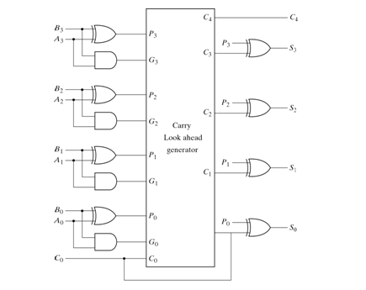
4-bit adder with carry lookahead

Slide 8
Carry Lookahead Adder
All output carries are generated after a delay through _______ levels of logic gates.
Outputs S₁ through S₃ have equal propagation times.
How is this better than the carry propagate adder?

Slide 9
4-bit adder subtractor
Addition subtraction operation can be combined into one circuit with one common binary adder.
Done by including an exclusive-OR gate with each full adder.
Only one of circuit needed for addition/subtraction for both signed and unsigned numbers (interpretation of result is different).

Slide 10
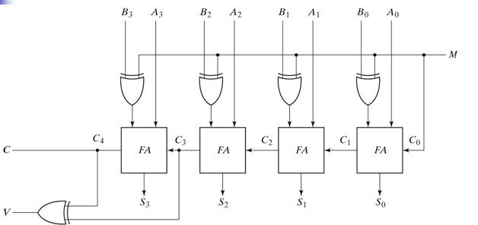
4-bit adder subtractor

Slide 11
Overflow
Add two n-bit numbers and sum is n+1 bit -> overflow.
Overflow is a problem because the number of bits for result is finite.
Overflow can occur only if the two numbers added are both positive or negative.
Example:
Carry: 0 1 1 0
+70 0 1000110 -70 1 0111010
+80 0 1010000 -80 1 0110000
+150 1 0010110 -150 0 1101010
Negative number!
Positive number!

Slide 12
Detecting overflow
Overflow has occurred if:
Carry out of sign bit position ≠ Carry into sign bit position
Carry: 0 1 1 0
+70 0 1000110 -70 1 0111010
+80 0 1010000 -80 1 0110000
+150 1 0010110 -150 0 1101010
Negative number!
Positive number!
What kind of circuit can detect overflow?

Slide 13
Decimal Adder
BCD Adder: Adds two decimal digits in BCD with an input carry from previous stage.
Each input digit does not exceed 9, the output sum cannot be greater than 9 + 9 + 1 = 19.
BCD Digits are first added in a 4-bit binary adder (result ranges from 0 to 19).
If the output sum is greater than 9, add a binary 6 (0110) to convert it to BCD.

Slide 14
Decimal Adder cont.
Condition for a correction can be given by:
C = K + Z₈Z₄ + Z₈Z₂
When C=1, it is necessary to add 0110 to the binary sum and provide an output carry to next stage.

Slide 15
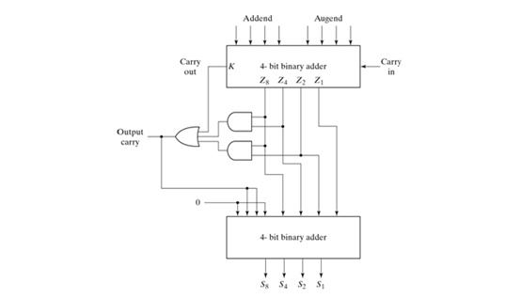
Decimal Adder cont.

Slide 16
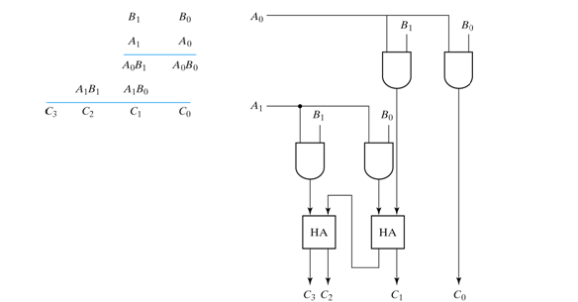
Binary Multiplier

Slide 17
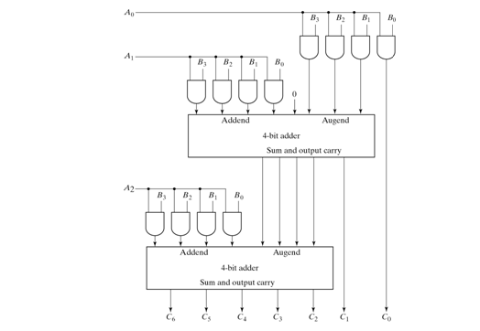
4-bit by 3-bit binary multiplier

Slide 18
Magnitude Comparator
A = A₃A₂A₁A₀
B = B₃B₂B₁B₀
Let x_{i} = A_{i}B_{i} + A_{i}’ B_{i}’ for i = 0, 1, 2, 3
i.e. x_{i} = 1 only if pair of bits in position i are equal.
(A = B) = x₃x₂x₁x₀
(A > B) = A₃B₃’ + x₃A₂B₂’ + x₃x₂A₁B₁’ + x₃x₂x₁A₀B₀’
(A < B) = A₃’B₃ + x₃A₂’B₂ + x₃x₂A₁’B₁ + x₃x₂x₁A₀’B₀

Slide 19
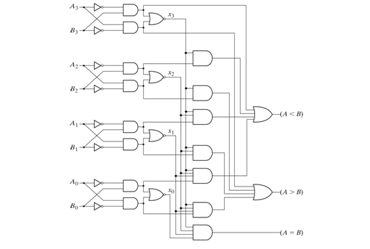
4-bit magnitude comparator

