Slide 1
Correlation between monthly figures for traffic accidents and weather figures in Münster region.
Impana Somashekar(yt75exud)
23038900

Slide 2
Introduction
Numerous accidents have been reported in recent months
Adverse weather presents distinct challenges for drivers, affecting visibility and road conditions.
The country's extensive road network and diverse climate give rise to a intricate interplay between traffic patterns and atmospheric influences.

Slide 3
Is there are relationship between the monthly figures of t raffic accidents and the number of weather figures in Munich region?
Analyzing the frequency of accidents involves a comprehensive examination of variables such as month and year, intricately combined with corresponding weather conditions.
Looking at the development over the time.

Slide 4
Datasources
Monthly figures for traffic accidents
Monthly weather figures
By Munich Statistical Office
Provides the monthly weather data with features like humidity, air temperature since year 2000
By Munich Statistical Office
Provides the number of accidents for Munich region with month and year

Slide 5
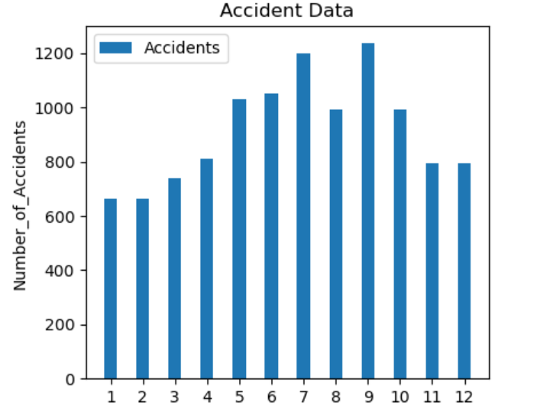
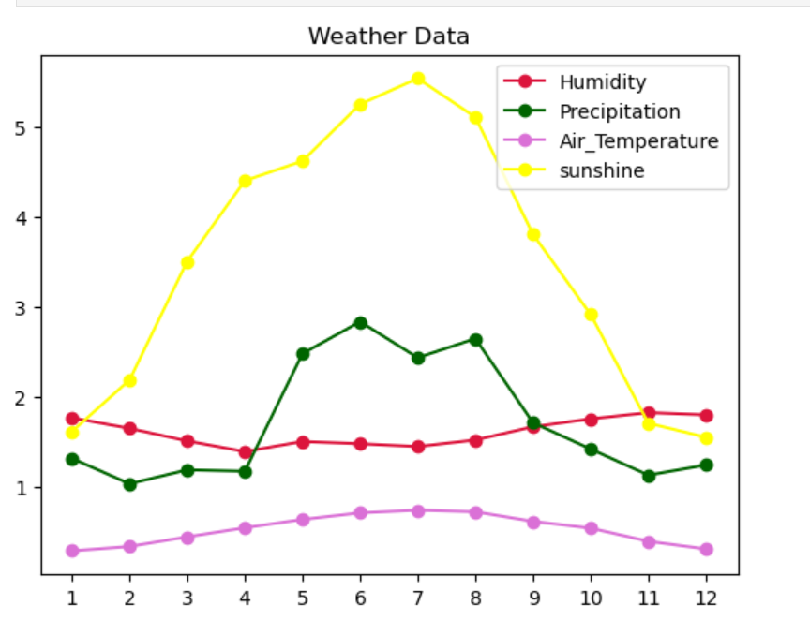
Results

Slide 6
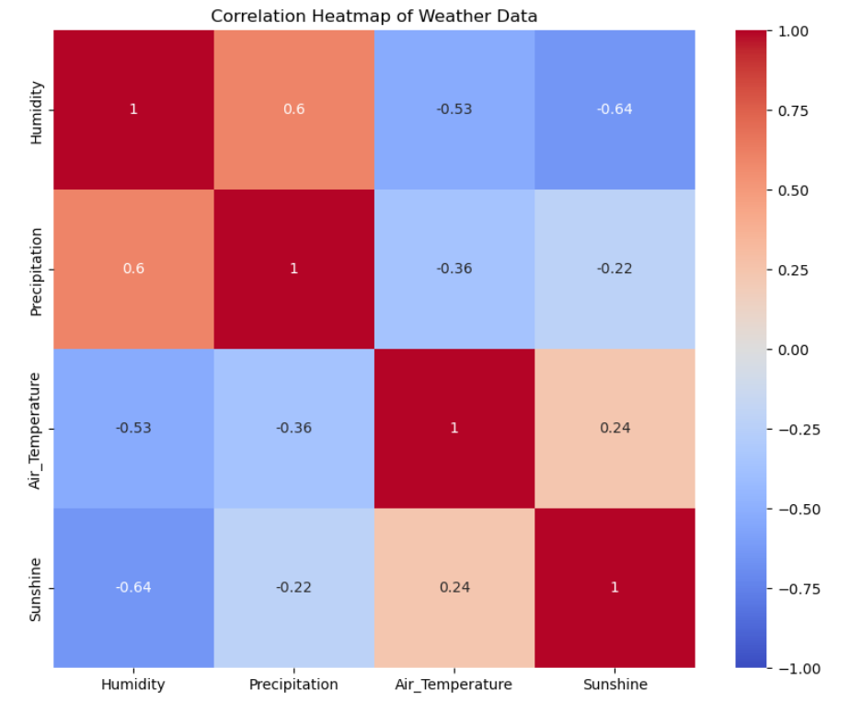

Slide 7
Conclusion
The correlation analysis between Munich's monthly accident figures and weather variables provides crucial insights into their dynamic relationships.
A good correlation was found between the rate of accident and the weather data, particularly between temperature, humidity, and sunshine exhibit substantial positive correlations, indicating synchronized fluctuations and interconnected dynamics.
A marked negative relationship is observed between sunshine and precipitation, emphasizing opposing variations in these weather factors.
The analysis used just 12 data points, which may limit the reliability of the correlation
Future work should include more data points and more granular temporal and spatial analysis
Adapting to seasonal variations and weather impacts is vital for ensuring proactive decision-making and maintaining safe transportation in Munich.

Slide 8


Thank you☺

