Slide 1
Sentiment Analysis on Amazon Product Reviews
Yasamin Tabatabaee
netid: syt3
Team name: AmazonSentiment
CS410 Final course project presentation

Slide 2
Motivation: Why sentiment analysis of reviews?
Sentiment analysis of textual data provides insight into the opinions, emotions and attitudes of people towards objects and topics.
In the case of product reviews, it can be useful for marketing researchers and producers to understand the needs of users and the factors that contribute to their satisfaction or dissatisfaction of a product.
When new users want to buy a product, they are influenced by the reviews and ratings of previous users.
Reviews can have a determining effect on how a product performs in the market and can also be important to investors.
Notes:
Sentiment analysis of textual data provides insight into the opinions, emotions and attitudes of people towards objects and topics.
In the case of product reviews, it can be useful for marketing researchers and producers to understand the needs of users and the factors that contribute to their satisfaction or dissatisfaction of a product. Additionally, when new users want to buy a product, they are influenced by the reviews and ratings of previous users, so the reviews that a product gets can have a determining effect on how it performs in the market and can also be important to investors. Therefore, developing methods for sentiment analysis of customer reviews can be useful from many aspects.

Slide 3
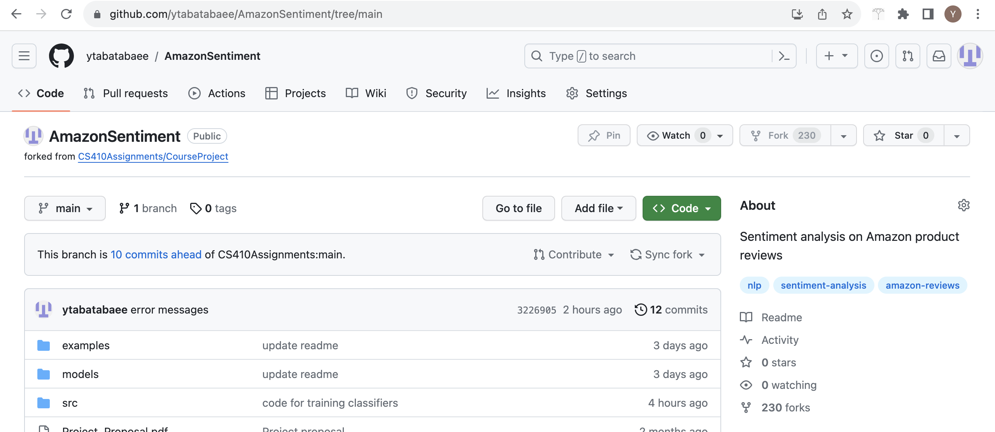
Project outcome
Software for sentiment analysis: https://github.com/ytabatabaee/AmazonSentiment/tree/main
The Github site includes the report, code documentation, and other files

Slide 4
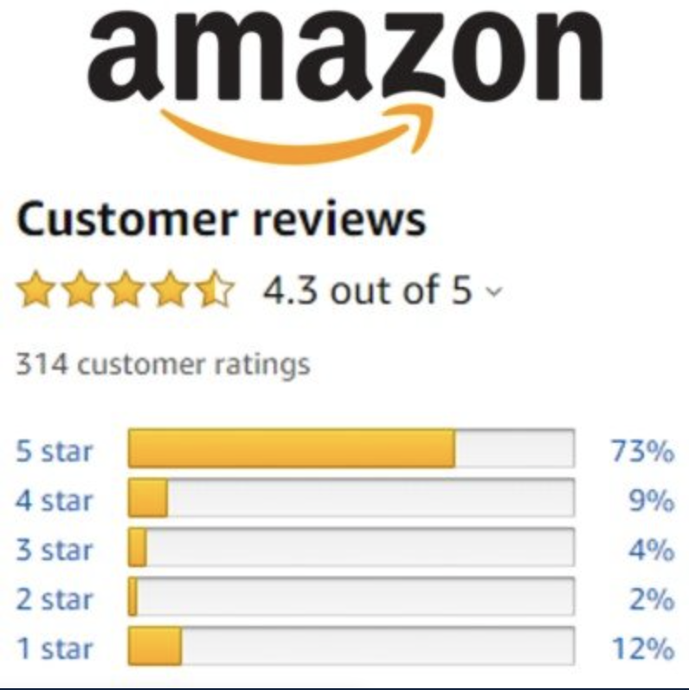
Data
Amazon Review Dataset from UCSD at https://nijianmo.github.io/amazon/index.html
The dataset was published in 2018, and contains more than 233 million Amazon reviews between the years 1996 to 2018 from 29 different product categories, as well as additional information and metadata for each product.
We selected 8 categories (Fashion, Software, Appliances, Gift Cards, Magazine Subscriptions, Prime Pantry, Luxury Beauty, All Beauty) with at most 200K reviews from each

Slide 5
Code and Implementation
All the code is available at https://github.com/ytabatabaee/AmazonSentiment/tree/main/src
The code is implemented in Python 3, and uses the following packages:

Slide 6
Software Usage

