Slide 1

Sentiment Analysis on Amazon Product Reviews
Yasamin Tabatabaee
netid: syt3
Team name: AmazonSentiment
CS410 Final course project presentation, Fall 2023
Notes:
Hello everyone, I’m Yasamin Tabatabaee and in this tutorial I’m going to present my CS 410 course project in which I have implemented a software for sentiment analysis on amazon product reviews.

Slide 2
Motivation: Why sentiment analysis of reviews?
Sentiment analysis of text data provides insight into the opinions, emotions and attitudes of people towards objects and topics.
In the case of product reviews, it can be useful for marketing researchers and producers to understand the needs of users and the factors that contribute to their satisfaction or dissatisfaction of a product.
When new users want to buy a product, they are influenced by the reviews and ratings of previous users.
Reviews can have a determining effect on how a product performs in the market and can also be important to investors.
Notes:
This project has several motivations. Sentiment analysis of text data provides insight into the opinions, emotions and attitudes of people towards objects and topics.
In the case of product reviews, it can be useful for marketing researchers and producers to understand the needs of users and the factors that contribute to their satisfaction or dissatisfaction of a product.
Additionally, when new users want to buy a product, they are influenced by the reviews and ratings of previous users, so the reviews that a product gets can have a determining effect on how it performs in the market and can also be important to investors. Therefore, developing methods for sentiment analysis of customer reviews can be useful in many ways.

Slide 3
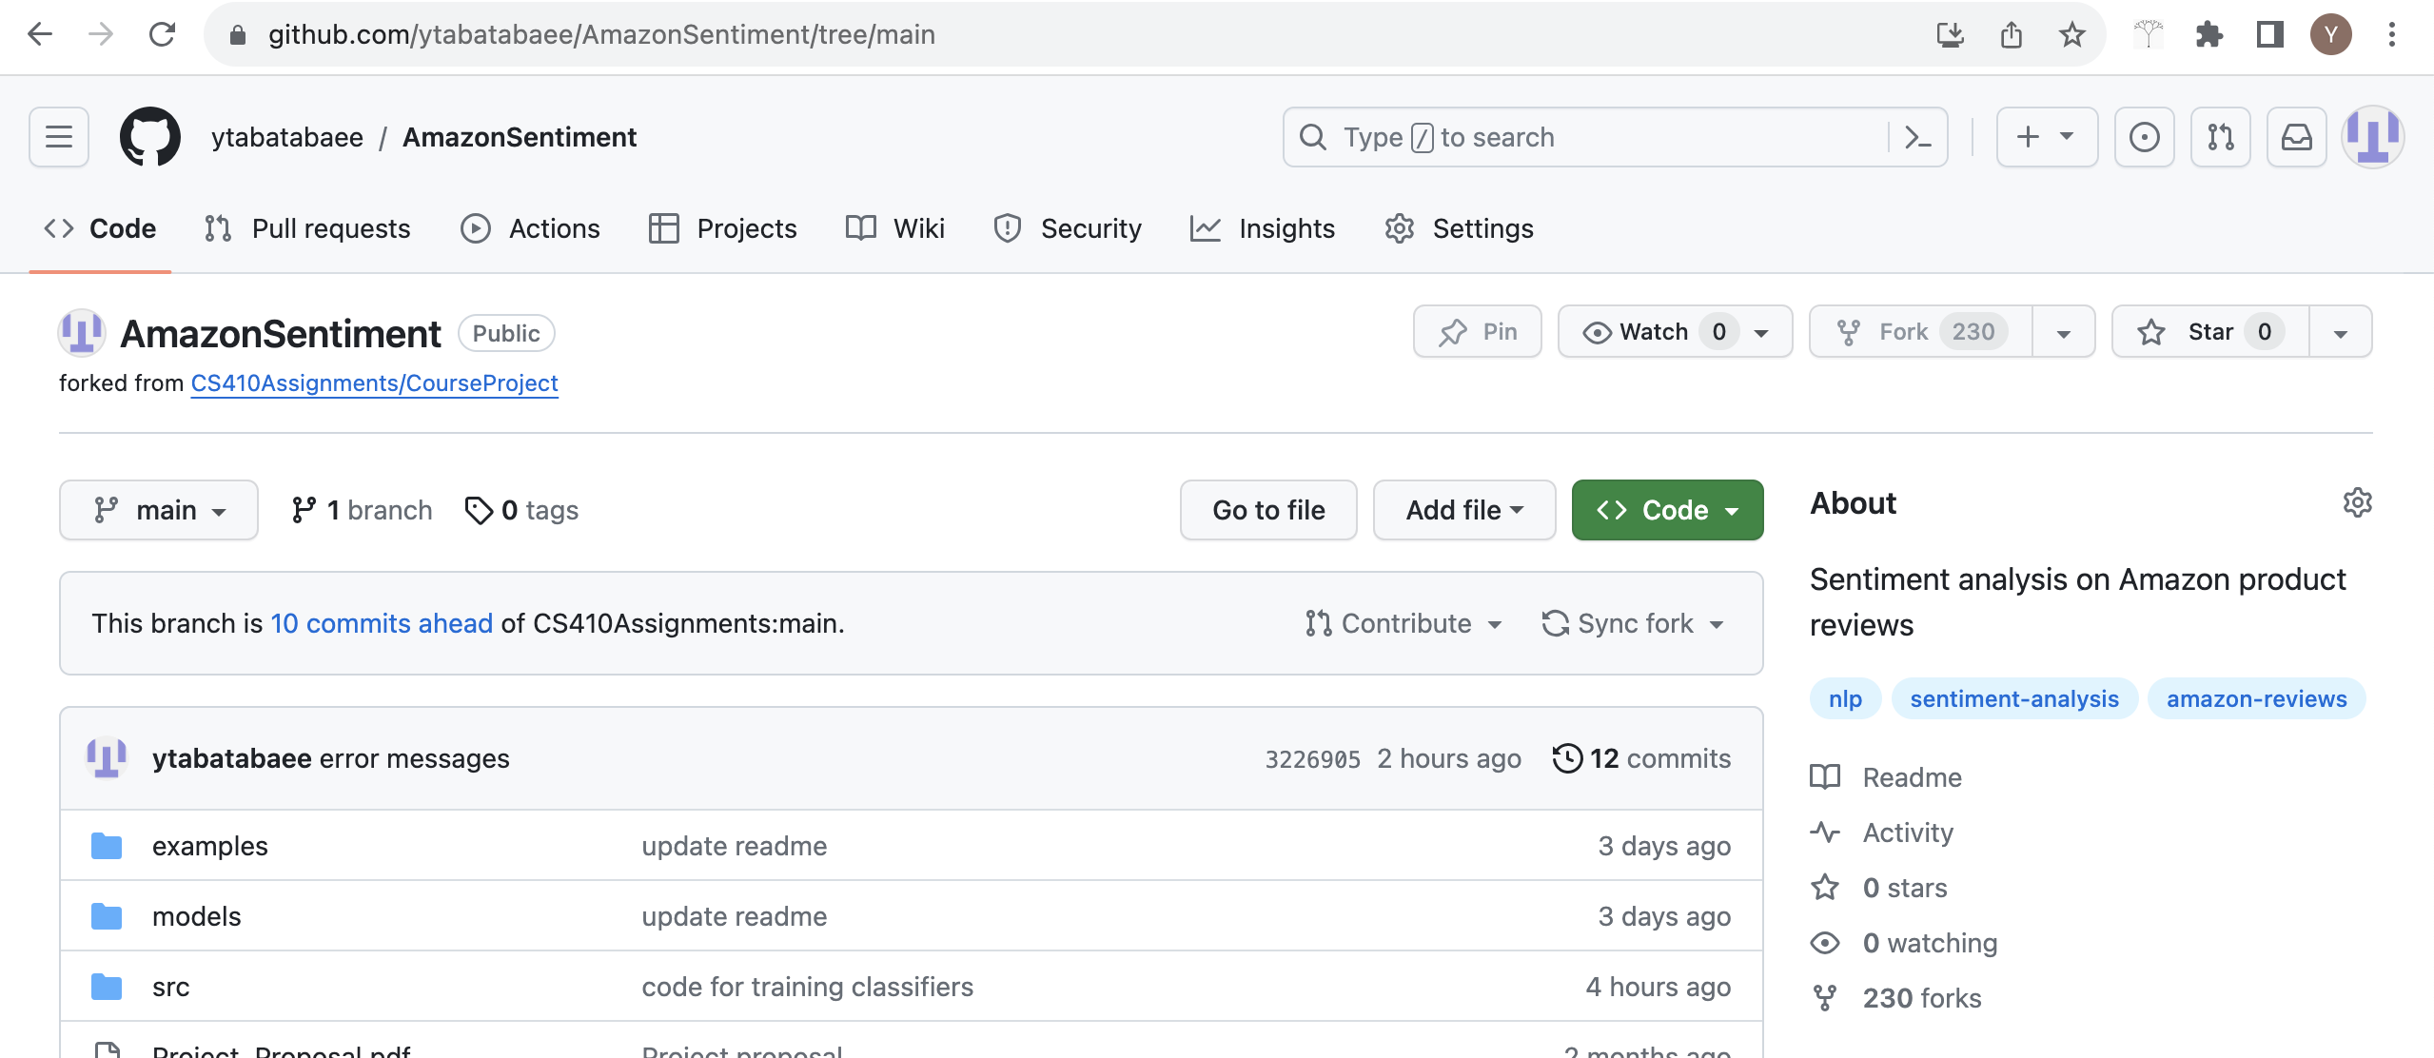
Project outcome
Software for sentiment analysis: https://github.com/ytabatabaee/AmazonSentiment/tree/main
The Github site includes the report, code documentation, and other files
Notes:
The github site of the project is located at this link, and includes the documentation , code and reports of the project. at the end of this tutorial, I will go through this website and show you the function of the code

Slide 4
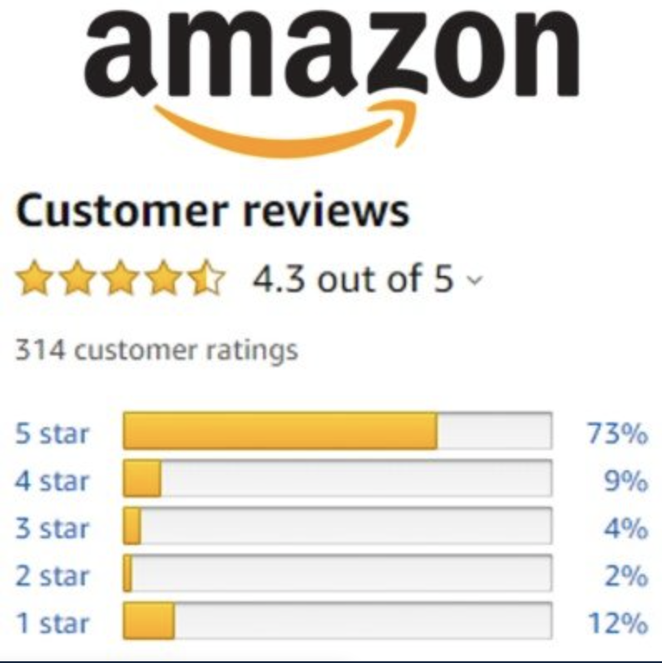
Data
Amazon Review Dataset from UCSD at https://nijianmo.github.io/amazon/index.html
The dataset was published in 2018, and contains more than 233 million Amazon reviews between the years 1996 to 2018 from 29 different product categories, as well as additional information and metadata for each product.
We selected 8 categories (Fashion, Software, Appliances, Gift Cards, Magazine Subscriptions, Prime Pantry, Luxury Beauty, All Beauty) with at most 200K reviews from each
Notes:
the dataset I used in this project was a collection of amazon reviews published in 2018 that included in total 233 million reviews form 29 product categories from over 22 years, but I use a small collection of this data including reviews from only 8 categories with at most 200K reviews from each

Slide 5
Code and Implementation
All the code is available at https://github.com/ytabatabaee/AmazonSentiment/tree/main/src
The code is implemented in Python 3, and uses the following packages: scikit-learn (v1.2.2), questionary, nltk, Numpy, Pandas, seaborn (v0.13.0+), wordcloud and Matplotlib.
The jupyter notebook /src/Amazon_reviews_analysis.ipynb contains a report on the results of the data analysis on the Amazon review data and training the sentiment analysis classifiers.
The final software is sentiment_analyzer.py , /src/preprcessing.py includes the code for preprocessing the review data and /src/training.py includes the code for training the classifiers.
Notes:
the code is available from the src folder in the github project, and its implemented in python3, and uses the following packages and libraries. And the main report of the results of the project is a jupyter notebook called Amazon_review_analysis located in the src folder that includes both results for data analysis and results for training the sentiment classifiers. The final software is sentiment_analyzer.py in the main folder. You can see further details about the code and implementation in the github readme file.

Slide 6
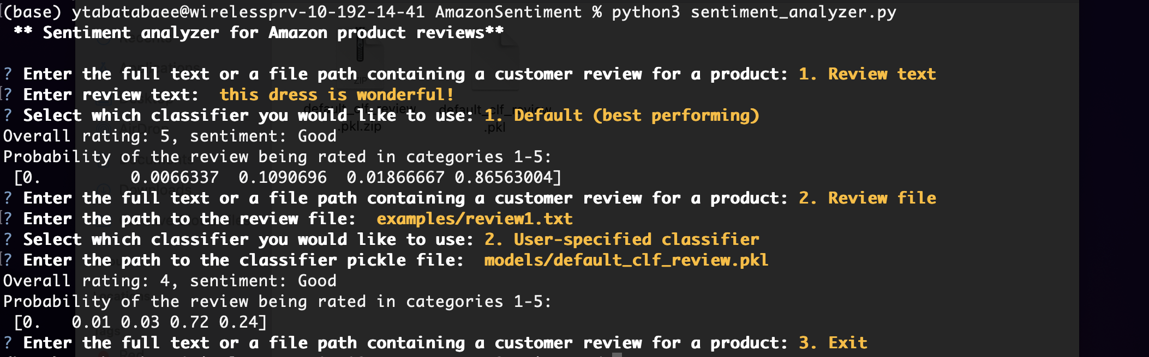
Software
Run python3 sentiment_analyzer.py in the command line.
The main software is implemented with questionary, and follows a series of questions that takes a review and a classifier as input and predicts the sentiment of a review
Notes:
To run the software, you can simply open a command line in the project directory and run the command python3 sentiment_analyzer.py. The software is implemented with the library questionary, and takes a review and a classifier as input and predicts the sentiment of a review, we will next show an example of the usage of the software

Slide 7
Software Usage

