Slide 1
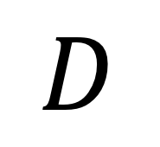
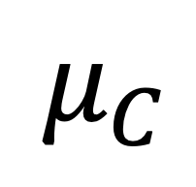
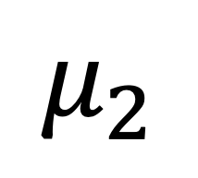
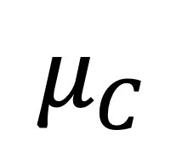
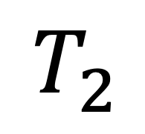
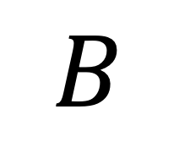
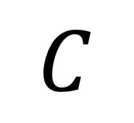
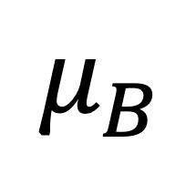
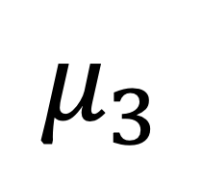
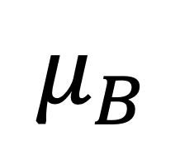
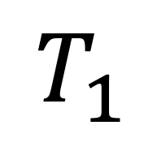
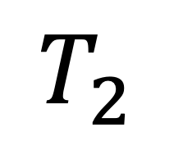
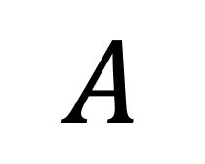
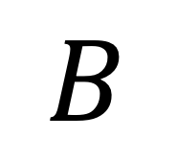
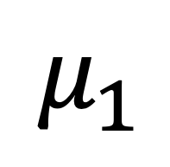
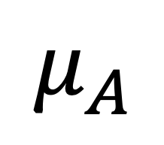
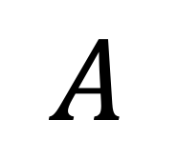
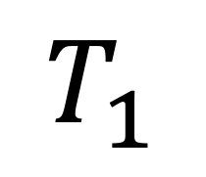
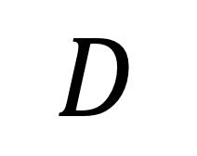
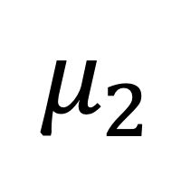
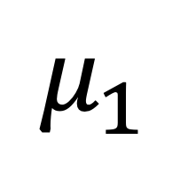
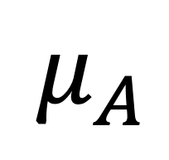
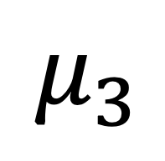
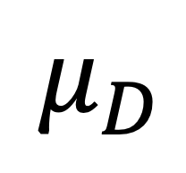
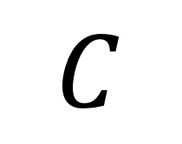
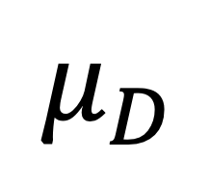
$$μ_{3}$$
$$μ_{3}$$
$$μ_{1}$$
$$μ_{2}$$
$$T_{2}$$
$$μ_{2}$$
$$T_{1}$$
$$T_{2}$$
$$T_{1}$$
$$μ_{1}$$
$$μ_{A}$$
$$μ_{C}$$
$$μ_{D}$$
$$μ_{B}$$
$$μ_{C}$$
$$μ_{A}$$
$$μ_{B}$$
$$μ_{D}$$
$$A$$
$$B$$
$$C$$
$$D$$
$$A$$
$$B$$
$$C$$
$$D$$

Slide 2
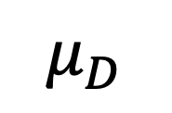

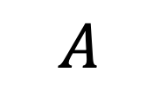
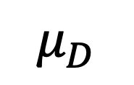


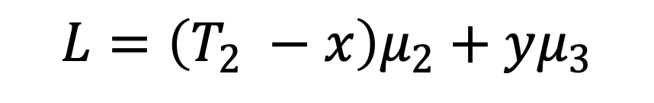

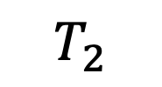
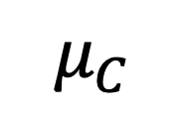
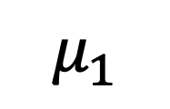

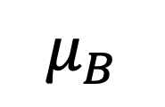
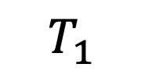
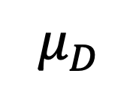
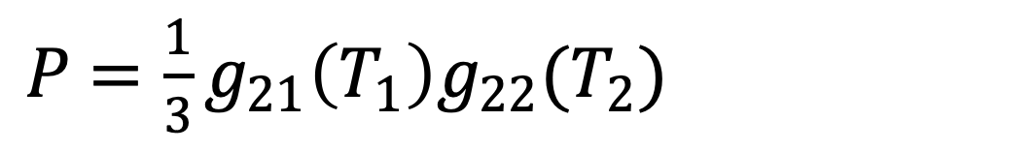
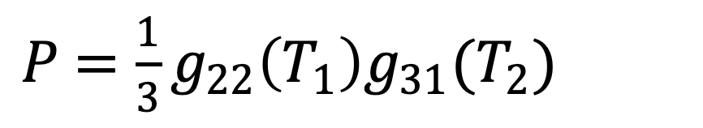
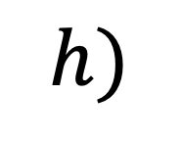
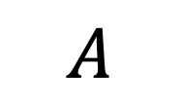
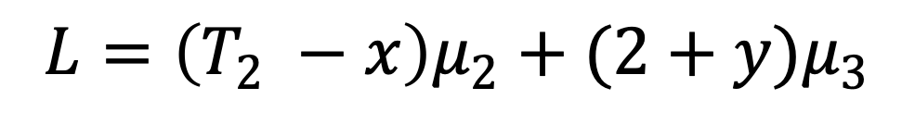

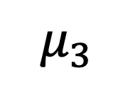
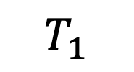




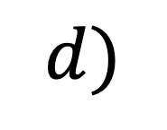
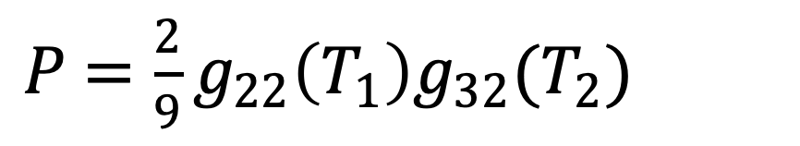
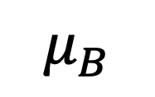
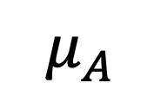

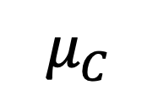












































































$$a)$$
$$b)$$
$$c)$$
$$d)$$
$$μ_{3}$$
$$μ_{3}$$
$$μ_{3}$$
$$μ_{3}$$
$$y$$
$$y$$
$$T_{2}$$
$$μ_{2}$$
$$T_{2}$$
$$μ_{2}$$
$$L$$
$$T_{2}$$
$$μ_{2}$$
$$L$$
$$T_{2}$$
$$μ_{2}$$
$$L$$
$$L$$
$$y$$
$$x$$
$$y$$
$$T_{1}$$
$$μ_{1}$$
$$x$$
$$T_{1}$$
$$μ_{1}$$
$$x$$
$$T_{1}$$
$$μ_{1}$$
$$x$$
$$T_{1}$$
$$μ_{1}$$
$$μ_{A}$$
$$μ_{B}$$
$$μ_{C}$$
$$μ_{D}$$
$$μ_{A}$$
$$μ_{B}$$
$$μ_{C}$$
$$μ_{D}$$
$$μ_{A}$$
$$μ_{B}$$
$$μ_{C}$$
$$μ_{D}$$
$$μ_{A}$$
$$μ_{B}$$
$$μ_{C}$$
$$μ_{D}$$
$$A$$
$$B$$
$$C$$
$$D$$
$$A$$
$$B$$
$$C$$
$$D$$
$$A$$
$$B$$
$$C$$
$$D$$
$$A$$
$$B$$
$$C$$
$$D$$
$$L=\left(T_{1}−x\right)μ_{1}+yμ_{2}$$
$$L=\left(T_{1}−x\right)μ_{1}+T_{2}μ_{2}+yμ_{3}$$
$$L=\left(T_{1}−x\right)μ_{1}+T_{2}μ_{2}+(2+ y{)μ}_{3}$$
$$L=(y −x)μ_{2}$$
$P$ $=g_{21}\left(T_{1}\right)g_{21}(T_{2})$
$P$ $={\frac{2}{3}g}_{21}\left(T_{1}\right)g_{22}(T_{2})$
$P$ $={\frac{1}{3}g}_{21}\left(T_{1}\right)g_{22}(T_{2})$
$P$ $={\frac{1}{3}g}_{22}\left(T_{1}\right)g_{31}(T_{2})$
$$e)$$
$$f)$$
$$g)$$
$$h)$$
$$μ_{3}$$
$$μ_{3}$$
$$μ_{3}$$
$$L$$
$$μ_{3}$$
$$L$$
$$y$$
$$L$$
$$y$$
$$x$$
$$y$$
$$y$$
$$T_{2}$$
$$μ_{2}$$
$$L$$
$$μ_{2}$$
$$μ_{2}$$
$$μ_{2}$$
$$x$$
$$T_{2}$$
$$T_{2}$$
$$T_{2}$$
$$T_{1}$$
$$μ_{1}$$
$$x$$
$$μ_{1}$$
$$x$$
$$T_{1}$$
$$T_{1}$$
$$μ_{1}$$
$$T_{1}$$
$$μ_{1}$$
$$μ_{A}$$
$$μ_{B}$$
$$μ_{C}$$
$$μ_{D}$$
$$μ_{A}$$
$$μ_{B}$$
$$μ_{C}$$
$$μ_{D}$$
$$μ_{A}$$
$$μ_{C}$$
$$μ_{D}$$
$$μ_{A}$$
$$μ_{C}$$
$$μ_{D}$$
$$μ_{B}$$
$$μ_{B}$$
$$A$$
$$B$$
$$C$$
$$D$$
$$A$$
$$B$$
$$C$$
$$D$$
$$A$$
$$B$$
$$C$$
$$D$$
$$A$$
$$B$$
$$C$$
$$D$$
$$L=\left(T_{2} −x\right)μ_{2}+yμ_{3}$$
$$L=\left(T_{2} −x\right)μ_{2}+(2+y)μ_{3}$$
$$L=(2+y−x)μ_{3}$$
$$L=\left(y −x\right)μ_{3}$$
$P$ $={\frac{2}{9}g}_{22}\left(T_{1}\right)g_{32}(T_{2})$
$P$ $={\frac{1}{9}g}_{22}\left(T_{1}\right)g_{32}(T_{2})$
$P$ $={\frac{1}{9}g}_{22}\left(T_{1}\right)g_{33}(T_{2})$
$P$ $={\frac{2}{9}g}_{22}\left(T_{1}\right)g_{33}(T_{2})$

Slide 3




















$$a)$$
$$b)$$
$$c)$$
$$d)$$
$$μ_{3}$$
$$μ_{3}$$
$$μ_{3}$$
$$μ_{3}$$
$$y$$
$$y$$
$$T_{2}$$
$$μ_{2}$$
$$T_{2}$$
$$μ_{2}$$
$$L$$
$$T_{2}$$
$$μ_{2}$$
$$L$$
$$T_{2}$$
$$μ_{2}$$
$$L$$
$$L$$
$$y$$
$$x$$
$$y$$
$$T_{1}$$
$$μ_{1}$$
$$x$$
$$T_{1}$$
$$μ_{1}$$
$$x$$
$$T_{1}$$
$$μ_{1}$$
$$x$$
$$T_{1}$$
$$μ_{1}$$
$$μ_{A}$$
$$μ_{B}$$
$$μ_{C}$$
$$μ_{D}$$
$$μ_{A}$$
$$μ_{B}$$
$$μ_{C}$$
$$μ_{D}$$
$$μ_{A}$$
$$μ_{B}$$
$$μ_{C}$$
$$μ_{D}$$
$$μ_{A}$$
$$μ_{B}$$
$$μ_{C}$$
$$μ_{D}$$
$$A$$
$$B$$
$$C$$
$$D$$
$$A$$
$$B$$
$$C$$
$$D$$
$$A$$
$$B$$
$$C$$
$$D$$
$$A$$
$$B$$
$$C$$
$$D$$
$$L=\left(T_{1}−x\right)μ_{1}+yμ_{2}$$
$$L=\left(T_{1}−x\right)μ_{1}+T_{2}μ_{2}+yμ_{3}$$
$$L=\left(T_{1}−x\right)μ_{1}+T_{2}μ_{2}+(2+ y{)μ}_{3}$$
$$L=(y −x)μ_{2}$$
$$e)$$
$$f)$$
$$g)$$
$$h)$$
$$μ_{3}$$
$$μ_{3}$$
$$μ_{3}$$
$$L$$
$$μ_{3}$$
$$L$$
$$y$$
$$L$$
$$y$$
$$x$$
$$y$$
$$y$$
$$T_{2}$$
$$μ_{2}$$
$$L$$
$$μ_{2}$$
$$μ_{2}$$
$$μ_{2}$$
$$x$$
$$x$$
$$T_{2}$$
$$T_{2}$$
$$T_{2}$$
$$T_{1}$$
$$μ_{1}$$
$$T_{1}$$
$$μ_{1}$$
$$x$$
$$μ_{1}$$
$$μ_{1}$$
$$T_{1}$$
$$T_{1}$$
$$μ_{A}$$
$$μ_{B}$$
$$μ_{C}$$
$$μ_{D}$$
$$μ_{A}$$
$$μ_{B}$$
$$μ_{C}$$
$$μ_{D}$$
$$μ_{A}$$
$$μ_{C}$$
$$μ_{D}$$
$$μ_{A}$$
$$μ_{D}$$
$$μ_{B}$$
$$μ_{B}$$
$$μ_{C}$$
$$A$$
$$B$$
$$C$$
$$D$$
$$A$$
$$B$$
$$C$$
$$D$$
$$A$$
$$B$$
$$C$$
$$D$$
$$A$$
$$B$$
$$C$$
$$D$$
$$L=\left(T_{2} −x\right)μ_{2}+yμ_{3}$$
$$L=\left(T_{2} −x\right)μ_{2}+(2+y)μ_{3}$$
$$L=(2+y−x)μ_{3}$$
$$L=\left(y −x\right)μ_{3}$$

Slide 4


















$$μ_{3}$$
$$L=\left(T_{1}−x\right)μ_{1}+yμ_{2}$$
$$μ_{2}$$
$$𝔼\left(L\right)=\int_{0}^{T_{1}}{\int_{0}^{T2}{e^{−x}}}e^{−y}\left(\left(T_{1}−x\right)μ_{1}+yμ_{2}\right)dydx$$
$$T_{2}$$
$$L$$
$$y$$
$$T_{1}$$
$$μ_{1}$$
$$x$$
$$μ_{A}$$
$$μ_{B}$$
$$μ_{C}$$
$$μ_{D}$$
$$A$$
$$B$$
$$C$$
$$D$$

Slide 5







































































$$a)$$
$$b)$$
$$c)$$
$$μ_{3}$$
$$μ_{3}$$
$$μ_{3}$$
$$L$$
$$L$$
$$y$$
$$y$$
$$T_{2}$$
$$μ_{2}$$
$$L$$
$$x$$
$$T_{2}$$
$$μ_{2}$$
$$T_{2}$$
$$μ_{2}$$
$$y$$
$$x$$
$$x$$
$$T_{1}$$
$$μ_{1}$$
$$T_{1}$$
$$μ_{1}$$
$$T_{1}$$
$$μ_{1}$$
$$μ_{A}$$
$$μ_{B}$$
$$μ_{C}$$
$$μ_{D}$$
$$μ_{A}$$
$$μ_{B}$$
$$μ_{C}$$
$$μ_{D}$$
$$μ_{A}$$
$$μ_{B}$$
$$μ_{C}$$
$$μ_{D}$$
$$A$$
$$B$$
$$C$$
$$D$$
$$A$$
$$B$$
$$C$$
$$D$$
$$A$$
$$B$$
$$C$$
$$D$$
$$L=\left(y−x\right)μ_{2}$$
$$L=\left(T_{2}−x\right)μ_{2}+yμ_{3}$$
$$L=\left(T_{2}−x\right)μ_{2}+(y+2)μ_{3}$$
$P$ $={\frac{1}{3}g}_{22}\left(T_{1}\right)g_{31}(T_{2})$
$P$ $={\frac{2}{3}g}_{22}\left(T_{1}\right)g_{32}(T_{2})$
$P$ $={\frac{1}{3}g}_{22}\left(T_{1}\right)g_{32}(T_{2})$
$$d)$$
$$e)$$
$$μ_{3}$$
$$L$$
$$μ_{3}$$
$$L$$
$$y$$
$$y$$
$$x$$
$$x$$
$$T_{2}$$
$$μ_{2}$$
$$T_{2}$$
$$μ_{2}$$
$$T_{1}$$
$$μ_{1}$$
$$T_{1}$$
$$μ_{1}$$
$$μ_{A}$$
$$μ_{B}$$
$$μ_{C}$$
$$μ_{D}$$
$$μ_{A}$$
$$μ_{B}$$
$$μ_{C}$$
$$μ_{D}$$
$$A$$
$$B$$
$$C$$
$$D$$
$$A$$
$$B$$
$$C$$
$$D$$
$$L=(2+y−x)μ_{3}$$
$$L=\left(y −x\right)μ_{3}$$
$P$ $={\frac{1}{9}g}_{22}\left(T_{1}\right)g_{33}(T_{2})$
$P$ $={\frac{2}{9}g}_{22}\left(T_{1}\right)g_{33}(T_{2})$

Slide 6









$$μ_{3}$$
$$μ_{3}$$
$$T_{2}$$
$$μ_{2}$$
$$T_{2}$$
$$μ_{2}$$
$$T_{1}$$
$$μ_{1}$$
$$T_{1}$$
$$μ_{1}$$
$$μ_{A}$$
$$μ_{B}$$
$$μ_{C}$$
$$μ_{D}$$
$$μ_{A}$$
$$μ_{B}$$
$$μ_{C}$$
$$μ_{D}$$
$$A$$
$$B$$
$$C$$
$$D$$
$$A$$
$$B$$
$$C$$
$$D$$
Parameters of branch 1:
$μ_{1}$ Substitution rate per coalescent units
$T_{1}$ Branch length in coalescent units
$t_{1}$= $T_{1}$.$μ_{1}$ Branch length in substitution units

Slide 7


Unbalanced species tree
$$μ_{3}$$
$$z$$
$$T_{2}$$
$$μ_{2}$$
$$y$$
$$T_{1}$$
$$μ_{1}$$
$$x$$
$$μ_{A}$$
$$μ_{B}$$
$$μ_{C}$$
$$μ_{D}$$
$$A$$
$$B$$
$$C$$
$$D$$

Slide 8














a)
Balanced species tree
$$μ_{3}$$
$$x$$
$$T_{1}$$
$$μ_{1}$$
$$μ_{2}$$
$$T_{2}$$
$$μ_{A}$$
$$μ_{B}$$
$$μ_{C}$$
$$μ_{D}$$
$$A$$
$$B$$
$$C$$
$$D$$

Slide 10


























a)
Balanced species tree
Unbalanced species tree
Gene tree
b)
$$μ_{3}$$
$$L_{D}={T_{D}μ}_{D}+{2μ}_{3}z+(T_{2}−y) μ_{2 }$$
$$μ_{3}$$
$$x$$
$$z$$
$$z$$
$$T_{2}$$
$$μ_{2}$$
$$L_{I}=\left(y −x\right)μ_{2}$$
$$T_{1}$$
$$μ_{1}$$
$$μ_{2}$$
$$y$$
$$x$$
$$y$$
$$T_{2}$$
$$T_{1}$$
$$μ_{1}$$
$$x$$
$$L_{A}={T_{A}μ}_{A}+{T_{1}μ}_{1}+xμ_{2 }$$
$$C$$
$$A$$
$$B$$
$$C$$
$$D$$
$$μ_{A}$$
$$y$$
$$μ_{A}$$
$$μ_{B}$$
$$μ_{C}$$
$$μ_{D}$$
$$A$$
$$L_{C}={T_{C}μ}_{C}+yμ_{2 }$$
$$μ_{B}$$
$$μ_{C}$$
$$μ_{D}$$
$$D$$
non-matching
$$A$$
$$B$$
$$C$$
$$A$$
$$L_{B}={T_{B}μ}_{B}+{T_{1}μ}_{1}+xμ_{2 }$$
matching
$$D$$
$$B$$
$$C$$
$$D$$
$$B$$
examples
$μ_{1}=N_{1}ν_{1}$ Substitution rate per coalescent units
$T_{1}=τ_{1}/N_{1}$ Branch length in coalescent units
$t_{1}=τ_{1}.ν_{1}$ = $T_{1}$.$μ_{1}$ Branch length in substitution units
$$c_{3}$$
$$c_{1}$$
$$d_{4}$$
$$a_{1}$$
$$b_{2}$$
$$c_{2}$$
$$d_{1}$$
$$a_{2}$$
$$d_{2}$$
$$d_{3}$$
$$b_{1}$$

Slide 11































$$μ_{3}$$
$$μ_{3}$$
$$x$$
$$z$$
$$T_{2}$$
$$μ_{2}$$
$$y$$
$$T_{1}$$
$$μ_{1}$$
$$μ_{2}$$
$$μ_{1}$$
$$x$$
$$T_{2}$$
$$T_{1}$$
$$μ_{A}$$
$$μ_{B}$$
$$μ_{C}$$
$$μ_{D}$$
$$μ_{A}$$
$$μ_{B}$$
$$y$$
$$μ_{C}$$
$$μ_{D}$$
$$A$$
$$B$$
$$C$$
$$D$$
$$A$$
$$B$$
$$C$$
$$D$$

Slide 12














non-matching
matching
examples
$$c_{3}$$
$$c_{1}$$
$$d_{4}$$
$$a_{1}$$
$$b_{2}$$
$$c_{2}$$
$$d_{1}$$
$$a_{2}$$
$$d_{2}$$
$$d_{3}$$
$$b_{1}$$
$$A$$
$$B$$
$$C$$
$$D$$

Slide 13










Gene tree
$$L_{D}={T_{D}μ}_{D}+{2μ}_{3}z+(T_{2}−y) μ_{2 }$$
a)
Balanced species tree
Unbalanced species tree
$$z$$
$$L_{I}=\left(y −x\right)μ_{2}$$
$$μ_{3}$$
$$x$$
$$y$$
$$μ_{3}$$
$$L_{A}={T_{A}μ}_{A}+{T_{1}μ}_{1}+xμ_{2 }$$
$$x$$
$$z$$
$$C$$
$$μ_{1}$$
$$T_{2}$$
$$μ_{2}$$
$$A$$
$$L_{C}={T_{C}μ}_{C}+yμ_{2 }$$
$$T_{1}$$
$$μ_{2}$$
$$x$$
$$y$$
$$L_{B}={T_{B}μ}_{B}+{T_{1}μ}_{1}+xμ_{2 }$$
$$D$$
$$T_{2}$$
$$T_{1}$$
$$μ_{1}$$
$$y$$
$$μ_{D}$$
$$B$$
$$μ_{A}$$
$$μ_{B}$$
$$μ_{C}$$
$$μ_{A}$$
$$μ_{B}$$
$$μ_{C}$$
$$μ_{D}$$
$$A$$
$$B$$
$$C$$
$$D$$
$$A$$
$$B$$
$$C$$
$$D$$

Slide 14














$$μ_{3}$$
$$T_{2}$$
$$μ_{2}$$
$$T_{1}$$
$$μ_{1}$$
$$μ_{A}$$
$$μ_{B}$$
$$μ_{C}$$
$$μ_{D}$$
$$A$$
$$B$$
$$C$$
$$D$$
$$y$$
$$x$$

Slide 15
























$$c_{3}$$
$$c_{1}$$
$$d_{4}$$
$$a_{1}$$
$$b_{2}$$
$$c_{2}$$
$$d_{1}$$
$$a_{2}$$
$$d_{2}$$
$$d_{3}$$
$$A$$
$$B$$
$$b_{1}$$
$$C$$
$$D$$
non-matching
matching
$$c_{3}$$
$$c_{1}$$
$$d_{4}$$
$$a_{1}$$
$$b_{2}$$
$$d_{1}$$
$$a_{1}$$
$$b_{2}$$
$$c_{2}$$
$$d_{1}$$
$$c_{2}$$
$$a_{2}$$
$$d_{2}$$
$$d_{3}$$
$$b_{1}$$

Slide 16












a)
Balanced species tree
Unbalanced species tree
Gene tree
b)
$$μ_{3}$$
$$L_{D}={T_{D}μ}_{D}+{2μ}_{3}z+(T_{2}−y) μ_{2 }$$
$$μ_{3}$$
$$x$$
$$z$$
$$z$$
$$T_{2}$$
$$μ_{2}$$
$$L_{I}=\left(y −x\right)μ_{2}$$
$$T_{1}$$
$$μ_{1}$$
$$μ_{2}$$
$$y$$
$$x$$
$$y$$
$$T_{2}$$
$$T_{1}$$
$$μ_{1}$$
$$x$$
$$L_{A}={T_{A}μ}_{A}+{T_{1}μ}_{1}+xμ_{2 }$$
$$C$$
$$A$$
$$B$$
$$C$$
$$D$$
$$μ_{A}$$
$$y$$
$$μ_{A}$$
$$μ_{B}$$
$$μ_{C}$$
$$μ_{D}$$
$$A$$
$$L_{C}={T_{C}μ}_{C}+yμ_{2 }$$
$$μ_{B}$$
$$μ_{C}$$
$$μ_{D}$$
$$D$$
non-matching
$$A$$
$$B$$
$$C$$
$$A$$
$$L_{B}={T_{B}μ}_{B}+{T_{1}μ}_{1}+xμ_{2 }$$
matching
$$D$$
$$B$$
$$C$$
$$D$$
$$B$$
examples
Parameters of branch 1:
$$c_{3}$$
$$c_{1}$$
$$d_{4}$$
$N_{1}$ Haploid effective population size
$τ_{1}$ Branch length in the units of number of generations
$ν_{1}$ Substitution rate per generation
$μ_{1}=N_{1}ν_{1}$ Substitution rate per coalescent units
$T_{1}=τ_{1}/N_{1}$ Branch length in coalescent units
$t_{1}=τ_{1}.ν_{1}$ = $T_{1}$.$μ_{1}$ Branch length in substitution units
$$a_{1}$$
$$b_{2}$$
$$d_{1}$$
$$a_{2}$$
$$c_{2}$$
$$d_{2}$$
$$d_{3}$$
$$b_{1}$$

Slide 17

























$$T_{i}$$
$$μ_{i}$$
$$μ_{j}$$
root branch
$$T_{j}$$
unroot
$$A$$
$$B$$
$μ_{i}T_{i}$ + $μ_{j}T_{j}$
$$C$$
$$D$$
$$A$$
$$B$$
$$C$$
$$D$$
balanced internal equation
$$T_{i}$$
$$μ_{i}$$
root branch
$$A$$
$$μ_{D}$$
unroot
$$B$$
$$D$$
$μ_{i}T_{i}$ + $μ_{D}T_{D}$
$$C$$
unbalanced root-adjacent terminal equation
$$A$$
$$B$$
$$C$$
$$D$$

Slide 18
$$T_{i}$$
$$μ_{i}$$
$$μ_{j}$$
$$T_{j}$$
$$A$$
$$B$$
$$C$$
$$D$$
$$T_{i}$$
$$μ_{i}$$
$$μ_{D}$$
$$A$$
$$B$$
$$C$$
$$D$$

Slide 19







































































$$a)$$
$$μ_{3}$$
$$b)$$
$$μ_{3}$$
$$c)$$
$$d)$$
$$μ_{3}$$
$$μ_{3}$$
$$L$$
$$L$$
$$y$$
$$y$$
$$x$$
$$L$$
$$T_{1}$$
$$μ_{1}$$
$$μ_{2}$$
$$T_{1}$$
$$μ_{1}$$
$$μ_{2}$$
$$T_{1}$$
$$μ_{1}$$
$$L$$
$$μ_{2}$$
$$T_{1}$$
$$μ_{1}$$
$$μ_{2}$$
$$x$$
$$T_{2}$$
$$x$$
$$T_{2}$$
$$x$$
$$T_{2}$$
$$T_{2}$$
$$μ_{A}$$
$$μ_{B}$$
$$μ_{C}$$
$$y$$
$$μ_{D}$$
$$μ_{A}$$
$$μ_{B}$$
$$μ_{C}$$
$$μ_{D}$$
$$μ_{A}$$
$$μ_{B}$$
$$μ_{A}$$
$$μ_{B}$$
$$y$$
$$μ_{C}$$
$$μ_{D}$$
$$μ_{C}$$
$$μ_{D}$$
$$A$$
$$B$$
$$C$$
$$D$$
$$A$$
$$B$$
$$C$$
$$D$$
$$A$$
$$B$$
$$C$$
$$D$$
$$A$$
$$B$$
$$C$$
$$D$$
$$L=\left(T_{1}−x\right)μ_{1}+(T_{2}− y)μ_{2}+2μ_{3}$$
$$L=\left(T_{1}−x\right)μ_{1}+(2+y)μ_{3}$$
$$L=\left(T_{1}−x\right)μ_{1}+yμ_{3}$$
$$L=(T_{2}− y)μ_{2}+(2+x)μ_{3}$$
$P$ $=g_{21}\left(T_{1}\right)g_{21}(T_{2})$
$P$ $={\frac{1}{3}g}_{21}\left(T_{1}\right)g_{22}(T_{2})$
$P$ $={\frac{2}{3}g}_{21}\left(T_{1}\right)g_{22}(T_{2})$
$P$ $={\frac{1}{3}g}_{22}\left(T_{1}\right)g_{21}(T_{2})$
$$e)$$
$$f)$$
$$g)$$
$$μ_{3}$$
$$μ_{3}$$
$$μ_{3}$$
$$L$$
$$x$$
$$L$$
$$x$$
$$L$$
$$y$$
$$x$$
$$y$$
$$T_{1}$$
$$μ_{1}$$
$$μ_{2}$$
$$T_{1}$$
$$μ_{1}$$
$$μ_{2}$$
$$T_{1}$$
$$μ_{1}$$
$$μ_{2}$$
$$T_{2}$$
$$T_{2}$$
$$T_{2}$$
$$μ_{A}$$
$$μ_{B}$$
$$μ_{C}$$
$$y$$
$$μ_{D}$$
$$μ_{A}$$
$$μ_{B}$$
$$μ_{C}$$
$$μ_{D}$$
$$μ_{A}$$
$$μ_{B}$$
$$μ_{C}$$
$$μ_{D}$$
$$A$$
$$B$$
$$C$$
$$D$$
$$A$$
$$B$$
$$C$$
$$D$$
$$A$$
$$B$$
$$C$$
$$D$$
$$L=(T_{2}− y)μ_{2}+xμ_{3}$$
$$L=(2+y −x)μ_{3}$$
$$L=(y −x)μ_{3}$$
$P$ $={\frac{2}{3}g}_{22}\left(T_{1}\right)g_{21}(T_{2})$
$P$ $={\frac{1}{9}g}_{22}\left(T_{1}\right)g_{22}(T_{2})$
$P$ $={\frac{2}{9}g}_{22}\left(T_{1}\right)g_{22}(T_{2})$

Slide 20








Species tree
Gene tree
HGT event
$$B$$
$$C$$
$$A$$
$$D$$
$$A$$
$$B$$
$$C$$
$$D$$

Slide 21











Species tree
Gene tree
Gene tree with HGT
HGT event
$$A$$
$$B$$
$$C$$
$$D$$
$$A$$
$$B$$
$$C$$
$$D$$
$$A$$
$$D$$
$$B$$
$$C$$

Slide 22







A)
$${\overline{L}}_{I}=\frac{Σ l_{i}}{C_{M}}$$
Matching
Non-matching
Species tree in SU
$$g_{1}$$
$$g_{2}$$
$$g_{K}$$
$${\overline{L}}_{I}^{′}=\frac{Σ l_{j}}{C_{NM}}$$
$$τ_{I}$$
d
$$T_{I}$$
d
C
b
c
b
c
a
c
a
b
a
A
B
C
D
B
Gene trees in SU
d
Species tree in CU
A
D

Slide 24





















$$a)$$
$$μ_{3}$$
$$b)$$
$$μ_{3}$$
$$L$$
$$L$$
$$y$$
$$y$$
$$x$$
$$x$$
$$T_{1}$$
$$μ_{1}$$
$$μ_{2}$$
$$T_{1}$$
$$μ_{1}$$
$$μ_{2}$$
$$T_{2}$$
$$T_{2}$$
$$μ_{A}$$
$$μ_{B}$$
$$μ_{C}$$
$$μ_{D}$$
$$μ_{A}$$
$$μ_{B}$$
$$μ_{C}$$
$$μ_{D}$$
$$A$$
$$B$$
$$C$$
$$D$$
$$A$$
$$B$$
$$C$$
$$D$$
$$L=(2+y −x)μ_{3}$$
$$L=(y −x)μ_{3}$$
$P$ $={\frac{1}{9}g}_{22}\left(T_{1}\right)g_{22}(T_{2})$
$P$ $={\frac{2}{9}g}_{22}\left(T_{1}\right)g_{22}(T_{2})$

Slide 25



























$$b)$$
$$μ_{3}$$
$$c)$$
$$μ_{3}$$
$$L$$
$$y$$
$$μ_{3}$$
$$y$$
$$T_{1}$$
$$μ_{1}$$
$$μ_{2}$$
$$T_{1}$$
$$μ_{1}$$
$$L$$
$$μ_{2}$$
$$x$$
$$T_{2}$$
$$x$$
$$T_{2}$$
$$μ_{1}$$
$$T_{1}$$
$$μ_{2}$$
$$T_{2}$$
$$μ_{A}$$
$$μ_{B}$$
$$μ_{C}$$
$$μ_{D}$$
$$μ_{A}$$
$$μ_{B}$$
$$μ_{C}$$
$$μ_{D}$$
$$A$$
$$B$$
$$C$$
$$D$$
$$A$$
$$B$$
$$C$$
$$D$$
$$μ_{A}$$
$$μ_{B}$$
$$μ_{C}$$
$$μ_{D}$$
$$L=\left(T_{1}−x\right)μ_{1}+(2 −y)μ_{3}$$
$$L=\left(T_{1}−x\right)μ_{1}+yμ_{3}$$
$P$ $={\frac{1}{3}g}_{21}\left(T_{1}\right)g_{22}(T_{2})$
$P$ $={\frac{2}{3}g}_{21}\left(T_{1}\right)g_{22}(T_{2})$
$$A$$
$$B$$
$$C$$
$$D$$

