Slide 1



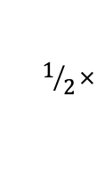
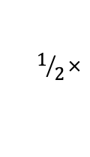














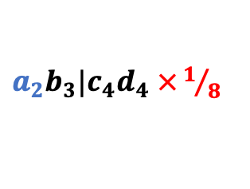








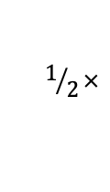





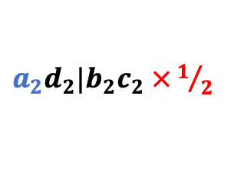



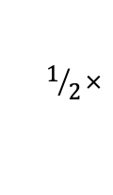


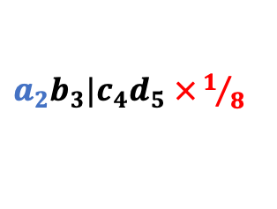




















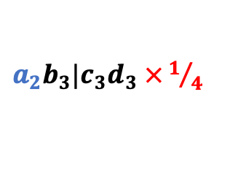






CASTLES-Pro
B)
$$a_{1}$$
$$c_{1}$$
$$b_{1}$$
$$d_{1}$$
$$a_{2}$$
$$b_{2}$$
$$c_{2}$$
$$d_{2}$$
$$b_{3}$$
$$c_{3}$$
$$d_{3}$$
$$c_{4}$$
$$d_{4}$$
$$d_{5}$$
$a_{1}c_{1}|b_{1}d_{1}$ $×1$
$a_{2}d_{2}|b_{2}c_{2}$ $×1/2$
$a_{2}b_{3}|c_{3}d_{3}$ $×1/4$
$a_{2}b_{3}|c_{4}d_{4}$ $×1/8$
$a_{2}b_{3}|c_{4}d_{5}$ $×1/8$
$$a_{1}c_{1}|b_{1}d_{2}$$
$$a_{1}c_{1}|b_{2}d_{2}$$
$$a_{2}b_{2}|c_{3}d_{3}$$
$$a_{2}b_{3}|c_{3}d_{4}$$
$$a_{2}b_{2}|c_{4}d_{5}$$
C)
Counter
Recursion (speciation)
Recursion (duplication)
$$w$$
$$w$$
$$w$$
$$w$$
$$w$$
$$u$$
$$v$$
$$u$$
$$v$$
$$u$$
$$v$$
$$u$$
$$v$$
$$=$$
$$+$$
$$1/2×$$
$$+$$
$$1/2×$$
$$w_{a}^{∙}$$
$$u_{a}^{∙}$$
$$v_{a}^{∙}$$
$$u_{a}^{∙}$$
$$v_{a}^{∙}$$
$$w$$
$$w$$
$$w$$
$$w$$
$$w$$
$$w$$
$$w$$
$$u$$
$$v$$
$$u$$
$$v$$
$$u$$
$$v$$
$$u$$
$$v$$
$$1/2×$$
$$u$$
$$v$$
$$u$$
$$v$$
$$=$$
$$+$$
$$+$$
$$+$$
$$+$$
$$1/2×$$
$$w_{ab}^{∙}$$
$$u_{ab}^{∙}$$
$$v_{ab}^{∙}$$
$$u_{a}^{∙}v_{b}^{∙}$$
$$u_{b}^{∙}v_{a}^{∙}$$
$$u_{ab}^{∙}$$
$$v_{ab}^{∙}$$

Slide 2

A)
CASTLES-Pro
$$t_{I}$$
B)
$$a_{1}$$
$$c_{1}$$
$$b_{1}$$
$$d_{1}$$
$$a_{2}$$
$$b_{2}$$
$$c_{2}$$
$$d_{2}$$
$$b_{3}$$
$$c_{3}$$
$$d_{3}$$
$$c_{4}$$
$$d_{4}$$
$$d_{5}$$
$a_{1}c_{1}|b_{1}d_{1}$ $×1$
$a_{2}d_{2}|b_{2}c_{2}$ $×1/2$
$a_{2}b_{3}|c_{3}d_{3}$ $×1/4$
$a_{2}b_{3}|c_{4}d_{4}$ $×1/8$
$a_{2}b_{3}|c_{4}d_{5}$ $×1/8$
$$a_{1}c_{1}|b_{1}d_{2}$$
$$a_{1}c_{1}|b_{2}d_{2}$$
$$a_{2}b_{2}|c_{3}d_{3}$$
$$a_{2}b_{3}|c_{3}d_{4}$$
$$a_{2}b_{2}|c_{4}d_{5}$$
C)
Counter
Recursion (speciation)
Recursion (duplication)
$$w$$
$$w$$
$$w$$
$$w$$
$$w$$
$$u$$
$$v$$
$$u$$
$$v$$
$$u$$
$$v$$
$$u$$
$$v$$
$$=$$
$$+$$
$$1/2×$$
$$+$$
$$1/2×$$
$$w_{a}^{∙}$$
$$u_{a}^{∙}$$
$$v_{a}^{∙}$$
$$u_{a}^{∙}$$
$$v_{a}^{∙}$$
$$w$$
$$w$$
$$w$$
$$w$$
$$w$$
$$w$$
$$w$$
$$u$$
$$v$$
$$u$$
$$v$$
$$u$$
$$v$$
$$u$$
$$v$$
$$1/2×$$
$$u$$
$$v$$
$$u$$
$$v$$
$$=$$
$$+$$
$$+$$
$$+$$
$$+$$
$$1/2×$$
$$w_{ab}^{∙}$$
$$u_{ab}^{∙}$$
$$v_{ab}^{∙}$$
$$u_{a}^{∙}v_{b}^{∙}$$
$$u_{b}^{∙}v_{a}^{∙}$$
$$u_{ab}^{∙}$$
$$v_{ab}^{∙}$$

Slide 3
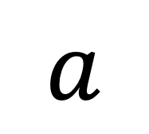
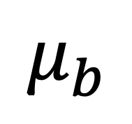
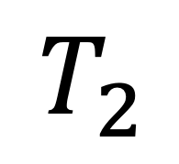
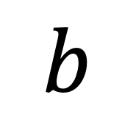
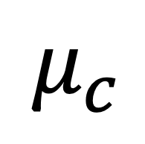
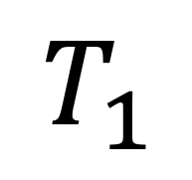
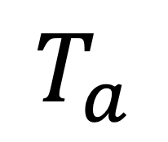
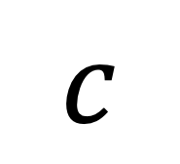
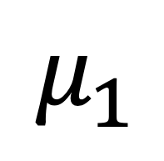
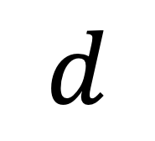
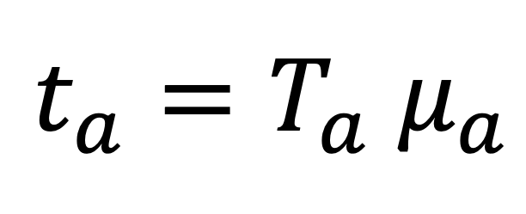
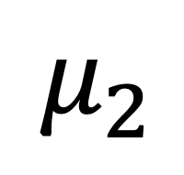
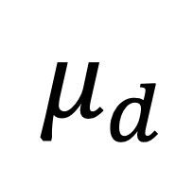
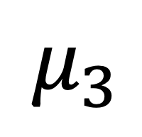
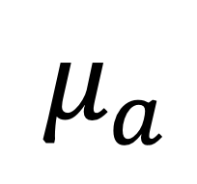
$${t_{a}=T_{a} μ}_{a}$$
$$μ_{3}$$
$$μ_{2}$$
$$T_{2}$$
$$T_{a}$$
$$μ_{a}$$
$$μ_{1}$$
$$T_{1}$$
$$μ_{b}$$
$$μ_{c}$$
$$μ_{d}$$
$$a$$
$$b$$
$$c$$
$$d$$

Slide 4

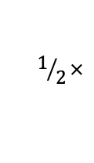





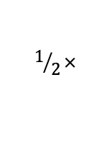
















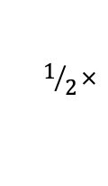















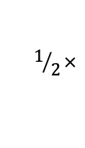
























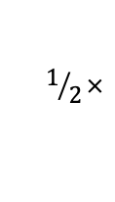










$$w$$
$$u$$
$$w$$
$$v$$
$$u$$
$$w$$
$$v$$
$$u$$
$$w$$
$$v$$
$$u$$
$$w$$
$$v$$
$$=$$
$$+$$
$$1/2×$$
$$+$$
$$1/2×$$
$$w_{a}^{∙}$$
$$u_{a}^{∙}$$
$$v_{a}^{∙}$$
$$u_{a}^{∙}$$
$$v_{a}^{∙}$$
$$w$$
$$w$$
$$w$$
$$w$$
$$w$$
$$w$$
$$w$$
$$u$$
$$v$$
$$u$$
$$v$$
$$u$$
$$v$$
$$u$$
$$v$$
$$1/2×$$
$$u$$
$$v$$
$$u$$
$$v$$
$$=$$
$$+$$
$$+$$
$$+$$
$$+$$
$$1/2×$$
$$w_{ab}^{∙}$$
$$u_{ab}^{∙}$$
$$v_{ab}^{∙}$$
$$u_{a}^{∙}v_{b}^{∙}$$
$$u_{b}^{∙}v_{a}^{∙}$$
$$u_{ab}^{∙}$$
$$v_{ab}^{∙}$$
$$w$$
$$u$$
$$w$$
$$v$$
$$u$$
$$w$$
$$v$$
$$u$$
$$w$$
$$v$$
$$u$$
$$w$$
$$v$$
$$u$$
$$w$$
$$v$$
$$u$$
$$w$$
$$v$$
$$+$$
$$+$$
$$+$$
$$1/2×$$
$$+$$
$$1/2×$$
$$w_{ab|c}^{∙}$$
$$u_{ab|c}^{∙}$$
$$v_{ab|c}^{∙}$$
$$u_{ab}^{∙}v_{c}^{∙}$$
$$u_{c}^{∙}v_{ab}^{∙}$$
$$u_{ab|c}^{∙}$$
$$v_{ab|c}^{∙}$$
$$u$$
$$w$$
$$v$$
$$u$$
$$w$$
$$v$$
$$u$$
$$w$$
$$v$$
$$u$$
$$w$$
$$v$$
$$+$$
$$+$$
$$+$$
$$u_{ab|cd}^{∙}$$
$$v_{ab|cd}^{∙}$$
$$u_{ab}^{∙}v_{cd}^{∙}$$
$$u_{cd}^{∙}v_{ab}^{∙}$$
$$w$$
$$w$$
$$w$$
$$u$$
$$w$$
$$v$$
$$u$$
$$w$$
$$v$$
$$u$$
$$w$$
$$v$$
$$u$$
$$w$$
$$v$$
$$u$$
$$v$$
$$u$$
$$v$$
$$+$$
$$+$$
$$+$$
$$+$$
$$+$$
$$w_{ab|cd}^{∙}$$
$$u_{ab|c}^{∙}v_{d}^{∙}$$
$${u_{d}^{∙}v}_{ab|c}^{∙}$$
$$u_{ab|d}^{∙}v_{c}^{∙}$$
$${u_{c}^{∙}v}_{ab|c}^{∙}$$
$$u_{ab|cd}^{∙}$$
$$v_{ab|cd}^{∙}$$
$$u$$
$$w$$
$$v$$
$$u$$
$$w$$
$$v$$
$$u$$
$$w$$
$$v$$
$$u$$
$$w$$
$$v$$
$$+$$
$$+$$
$$+$$
$$+$$
$$u_{cd|b}^{∙}v_{a}^{∙}$$
$$u_{a}^{∙}v_{cd|b}^{∙}$$
$$u_{cd|a}^{∙}v_{b}^{∙}$$
$$u_{b}^{∙}v_{cd|a}^{∙}$$

Slide 5












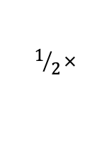





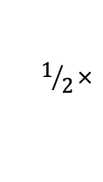

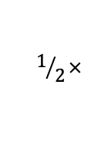









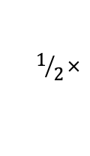
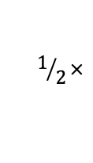
$$w$$
$$u$$
$$w$$
$$v$$
$$u$$
$$w$$
$$v$$
$$w$$
$$u$$
$$w$$
$$v$$
$$u$$
$$w$$
$$v$$
$$w$$
$$+$$
$$+$$
$$1/2×$$
$$+$$
$$1/2×$$
$$+$$
$$w_{a}^{a}$$
$$u_{a}^{a}$$
$$v_{a}^{a}$$
$$l_{w}w_{a}^{∙}$$
$$u_{a}^{a}$$
$$v_{a}^{a}$$
$$l_{w}w_{a}^{∙}$$
$$w$$
$$u$$
$$w$$
$$v$$
$$u$$
$$w$$
$$v$$
$$u$$
$$w$$
$$v$$
$$u$$
$$w$$
$$v$$
$$u$$
$$w$$
$$v$$
$$u$$
$$w$$
$$v$$
$$+$$
$$+$$
$$+$$
$$1/2×$$
$$+$$
$$1/2×$$
$$w_{ab}^{a}$$
$$u_{ab}^{a}$$
$$v_{ab}^{a}$$
$$u_{a}^{a}v_{b}^{∙}$$
$$u_{b}^{∙}v_{a}^{a}$$
$$u_{ab}^{a}$$
$$v_{ab}^{a}$$
$$w$$
$$u$$
$$w$$
$$v$$
$$u$$
$$w$$
$$v$$
$$w$$
$$u$$
$$w$$
$$v$$
$$u$$
$$w$$
$$v$$
$$w$$
$$+$$
$$+$$
$$1/2×$$
$$+$$
$$1/2×$$
$$+$$
$$w_{ab}^{x}$$
$$u_{ab}^{x}$$
$$v_{ab}^{x}$$
$$l_{w}w_{ab}^{∙}$$
$$u_{ab}^{x}$$
$$v_{ab}^{x}$$
$$l_{w}w_{ab}^{∙}$$

Slide 6







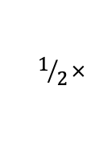
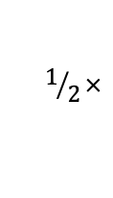


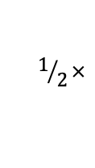



















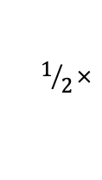


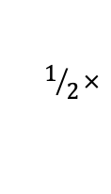



$$w$$
$$u$$
$$w$$
$$v$$
$$u$$
$$w$$
$$v$$
$$u$$
$$w$$
$$v$$
$$u$$
$$w$$
$$v$$
$$u$$
$$w$$
$$v$$
$$u$$
$$w$$
$$v$$
$$+$$
$$+$$
$$+$$
$$1/2×$$
$$+$$
$$1/2×$$
$$w_{ab|c}^{a}$$
$$u_{ab|c}^{a}$$
$$v_{ab|c}^{a}$$
$$u_{ab}^{a}v_{c}^{∙}$$
$$u_{c}^{∙}v_{ab}^{a}$$
$$u_{ab|c}^{a}$$
$$v_{ab|c}^{a}$$
$$w$$
$$u$$
$$w$$
$$v$$
$$u$$
$$w$$
$$v$$
$$u$$
$$w$$
$$v$$
$$u$$
$$w$$
$$v$$
$$u$$
$$w$$
$$v$$
$$u$$
$$w$$
$$v$$
$$+$$
$$+$$
$$+$$
$$1/2×$$
$$+$$
$$1/2×$$
$$w_{ab|c}^{c}$$
$$u_{ab|c}^{c}$$
$$v_{ab|c}^{c}$$
$$u_{ab}^{∙}v_{c}^{c}$$
$$u_{c}^{c}v_{ab}^{∙}$$
$$u_{ab|c}^{c}$$
$$v_{ab|c}^{c}$$
$$w$$
$$u$$
$$w$$
$$v$$
$$u$$
$$w$$
$$v$$
$$u$$
$$w$$
$$v$$
$$u$$
$$w$$
$$v$$
$$u$$
$$w$$
$$v$$
$$u$$
$$w$$
$$v$$
$$+$$
$$+$$
$$+$$
$$1/2×$$
$$+$$
$$1/2×$$
$$w_{ab|c}^{x}$$
$$u_{ab|c}^{x}$$
$$v_{ab|c}^{x}$$
$$u_{ab}^{x}v_{c}^{∙}$$
$$u_{c}^{x}v_{ab}^{∙}$$
$$u_{ab|c}^{x}$$
$$v_{ab|c}^{x}$$
$$w$$
$$u$$
$$w$$
$$v$$
$$u$$
$$w$$
$$v$$
$$w$$
$$u$$
$$w$$
$$v$$
$$u$$
$$w$$
$$v$$
$$w$$
$$+$$
$$+$$
$$1/2×$$
$$+$$
$$1/2×$$
$$+$$
$$w_{ab|c}^{d}$$
$$u_{ab|c}^{d}$$
$$v_{ab|c}^{d}$$
$${l_{w}w}_{ab|c}^{∙}$$
$$u_{ab|c}^{d}$$
$$v_{ab|c}^{d}$$
$${l_{w}w}_{ab|c}^{∙}$$

Slide 7








































$$u$$
$$w$$
$$v$$
$$u$$
$$w$$
$$v$$
$$u$$
$$w$$
$$v$$
$$u$$
$$w$$
$$v$$
$$+$$
$$+$$
$$+$$
$$u_{ab|cd}^{a}$$
$$v_{ab|cd}^{a}$$
$$u_{ab}^{a}v_{cd}^{∙}$$
$$u_{cd}^{∙}v_{ab}^{a}$$
$$u$$
$$w$$
$$v$$
$$u$$
$$w$$
$$v$$
$$u$$
$$w$$
$$v$$
$$u$$
$$w$$
$$v$$
$$w$$
$$+$$
$$+$$
$$+$$
$$+$$
$$w$$
$$w$$
$$u_{ab|c}^{a}v_{d}^{∙}$$
$${u_{d}^{∙}v}_{ab|c}^{a}$$
$$u_{ab|d}^{a}v_{c}^{∙}$$
$${u_{c}^{∙}v}_{ab|c}^{a}$$
$$u$$
$$v$$
$$+$$
$$u$$
$$v$$
$$u$$
$$w$$
$$v$$
$$u$$
$$w$$
$$v$$
$$u$$
$$w$$
$$v$$
$$u$$
$$w$$
$$v$$
$$w_{ab|cd}^{a}$$
$$+$$
$$+$$
$$+$$
$$+$$
$$u_{ab|cd}^{a}$$
$$v_{ab|cd}^{a}$$
$$u_{cd|b}^{a}v_{a}^{∙}$$
$$u_{cd|b}^{∙}v_{a}^{a}$$
$$u_{a}^{∙}v_{cd|b}^{a}$$
$$u_{a}^{a}v_{cd|b}^{∙}$$
$$u$$
$$w$$
$$v$$
$$u$$
$$w$$
$$v$$
$$+$$
$$+$$
$$u_{cd|a}^{a}v_{b}^{∙}$$
$$u_{b}^{∙}v_{cd|a}^{a}$$
$$u$$
$$w$$
$$v$$
$$u$$
$$w$$
$$v$$
$$+$$
$$u_{ab|cd}^{x}$$
$$v_{ab|cd}^{x}$$
$$w$$
$$w$$
$$u$$
$$w$$
$$v$$
$$u$$
$$w$$
$$v$$
$$u$$
$$v$$
$$u$$
$$v$$
$$w$$
$$+$$
$$+$$
$$+$$
$$+$$
$$w$$
$$w$$
$$u_{ab|c}^{x}v_{d}^{∙}$$
$${u_{d}^{∙}v}_{ab|c}^{x}$$
$$u_{ab|d}^{x}v_{c}^{∙}$$
$${u_{c}^{∙}v}_{ab|c}^{x}$$
$$u$$
$$v$$
$$+$$
$$u$$
$$v$$
$$u$$
$$w$$
$$v$$
$$u$$
$$w$$
$$v$$
$$u$$
$$w$$
$$v$$
$$u$$
$$w$$
$$v$$
$$w_{ab|cd}^{x}$$
$$+$$
$$+$$
$$+$$
$$+$$
$$u_{ab|cd}^{x}$$
$$v_{ab|cd}^{x}$$
$$u_{cd|b}^{x}v_{a}^{∙}$$
$$u_{a}^{∙}v_{cd|b}^{x}$$
$$u_{cd|a}^{x}v_{b}^{∙}$$
$$u_{b}^{∙}v_{cd|a}^{x}$$
$$u$$
$$w$$
$$v$$
$$u$$
$$w$$
$$v$$
$$u$$
$$w$$
$$v$$
$$u$$
$$w$$
$$v$$
$$+$$
$$+$$
$$+$$
$$+$$
$$u_{ab}^{x}v_{cd}^{∙}$$
$$u_{ab}^{∙}v_{cd}^{x}$$
$$u_{cd}^{x}v_{ab}^{∙}$$
$$u_{cd}^{∙}v_{ab}^{x}$$

