Slide 1




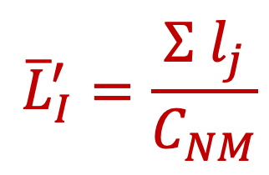
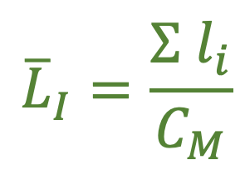
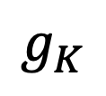
A)
$${\overline{L}}_{I}=\frac{Σ l_{i}}{C_{M}}$$
Matching
Non-matching
Species tree in SU
$$g_{1}$$
$$g_{2}$$
$$g_{K}$$
$${\overline{L}}_{I}^{′}=\frac{Σ l_{j}}{C_{NM}}$$
$$τ_{I}$$
d
$$T_{I}$$
d
b
C
a
b
c
a
c
b
a
c
d
A
B
C
D
B
Gene trees in SU
Species tree in CU
A
D

