Slide 1

Hardware requirements for training a deep neural network
Presented by : S.A.Eshtehardian
October 2020

Slide 2
Table of contents
Introduction to CPU
Introduction to GPU
What is cuda?
Introduction to TPU
TPU’s internal architecture
A comparison between CPU, GPU and TPU
Google’s cloud TPU and GPU
Getting started with Cuda in pytorch
Getting started with activating TPU in pytorch

Slide 3
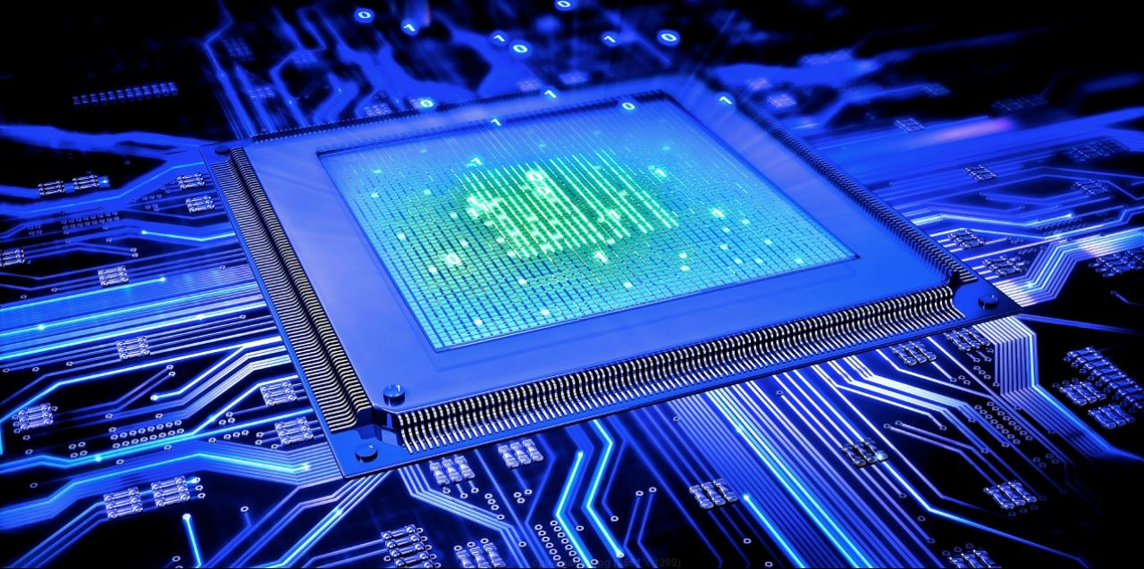
Introduction to CPU
The term CPU stands for Central Processing Unit of a computer, which usually consists of more than one core, some of the cores may be virtual. The cores can be paralleled.

Slide 4
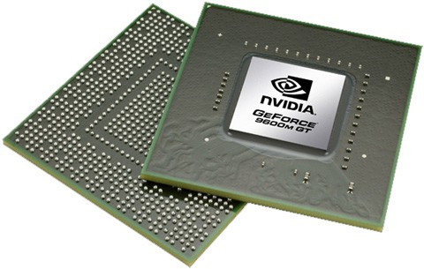
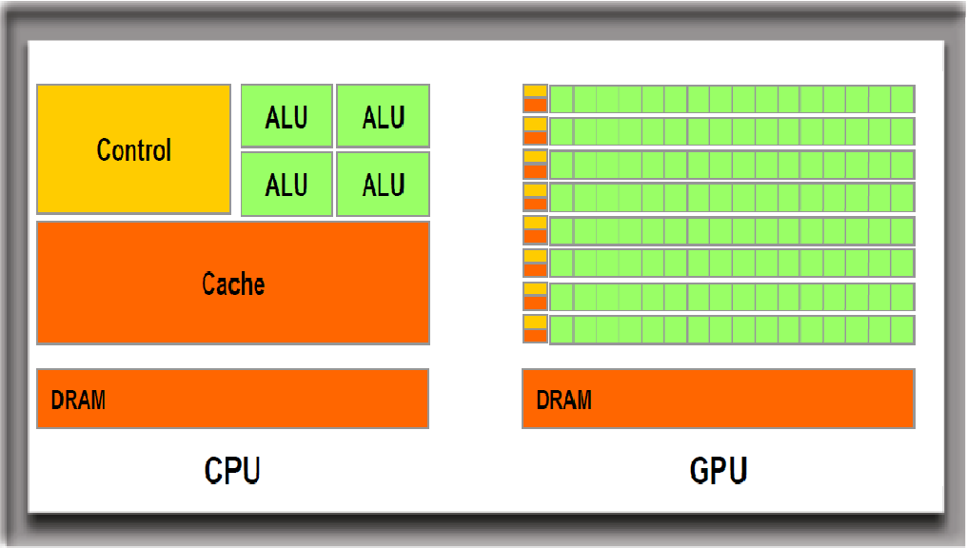
Introduction to GPU
The term GPU stems from Graphics Processing Unit, which consists of more than a thousands of cores, making it a perfects choice for parallel computing.

Slide 5
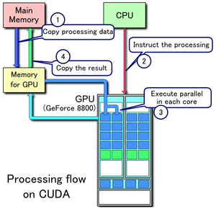
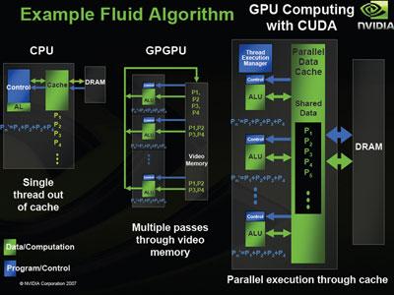
What is cuda?
Cuda is a parallel computing platform that makes it easier to use GPU for different goals with various programming languages.

Slide 6
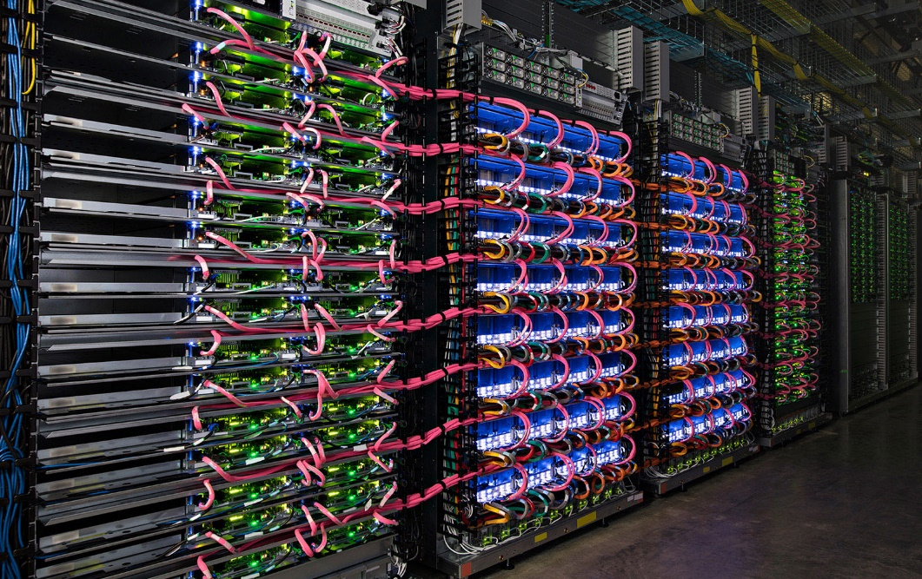
Introduction to TPU
The term TPU stems from Tensor Processing Unit, which has been defined as a hardware in order to make the parallel processing easier for problems including linear algebra( i.e. Deep Learning, Image Processing). They are first designed specifically for Google’s TensorFlow framework.

Slide 7
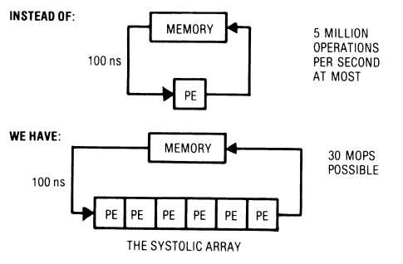
TPU’s internal architecture
Tensor Processing Unit (TPU), a custom ASIC, built specifically for machine learning — and tailored for TensorFlow, can handle massive multiplications and additions for neural networks, at great speeds while reducing the use of too much power and floor space. A typical cloud TPU has two systolic arrays of size 128 x 128, aggregating 32,768 ALUs (Arithmetic Logic Units) for 16-bit floating-point values in a single processor. Thousands of multipliers and adders are connected to each other directly to form a large physical matrix of operators, which forms a systolic array architecture as discussed above.

Slide 8
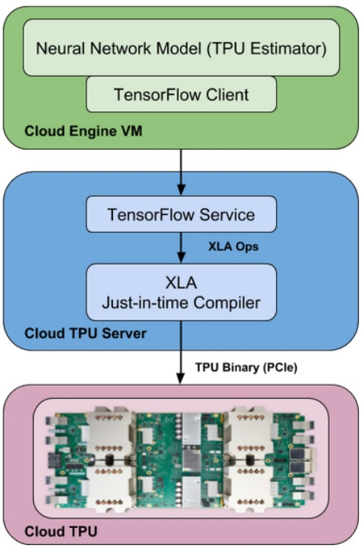
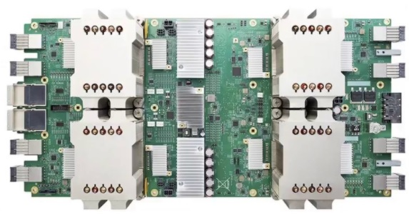
TPU’s internal architecture
It consists of four independent chips. Each chip consists of two calculation cores, called Tensor Cores, which include scalar, vector and matrix units (MXUs). In addition, each Tensor Core, with 8 GB chip memory (HBM), has been unified. Each of the 8 cores on the TPU can execute user accounts (XLA ops) independently. High-bandwidth interconnection paths allow the chips to communicate directly with each other.

Slide 9
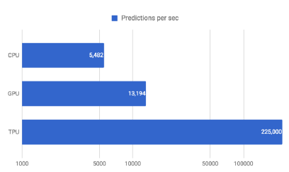
A comparison between CPU, GPU and TPU

Slide 10
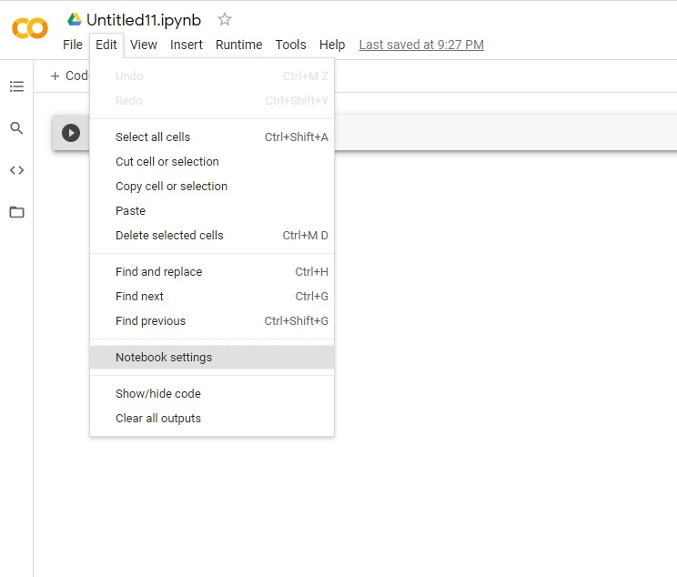
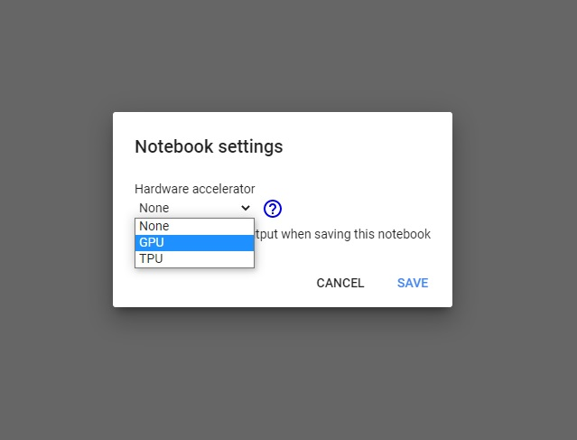
Google’s Cloud TPU and GPU

Slide 11
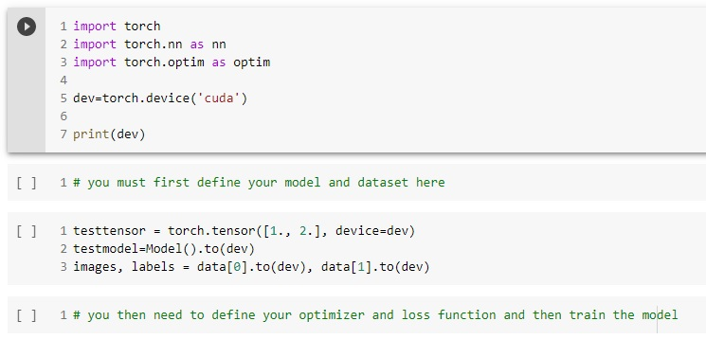
Getting started with cuda in pytorch

Slide 12
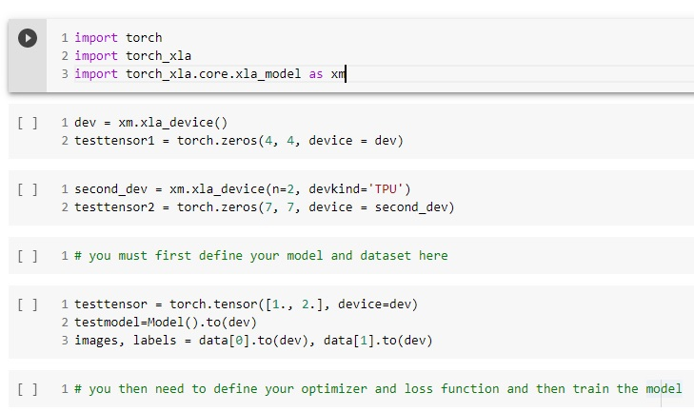
Getting started with activating TPU in pytorch

Slide 13


