Slide 1
Without outgroup
With outgroup

Slide 2
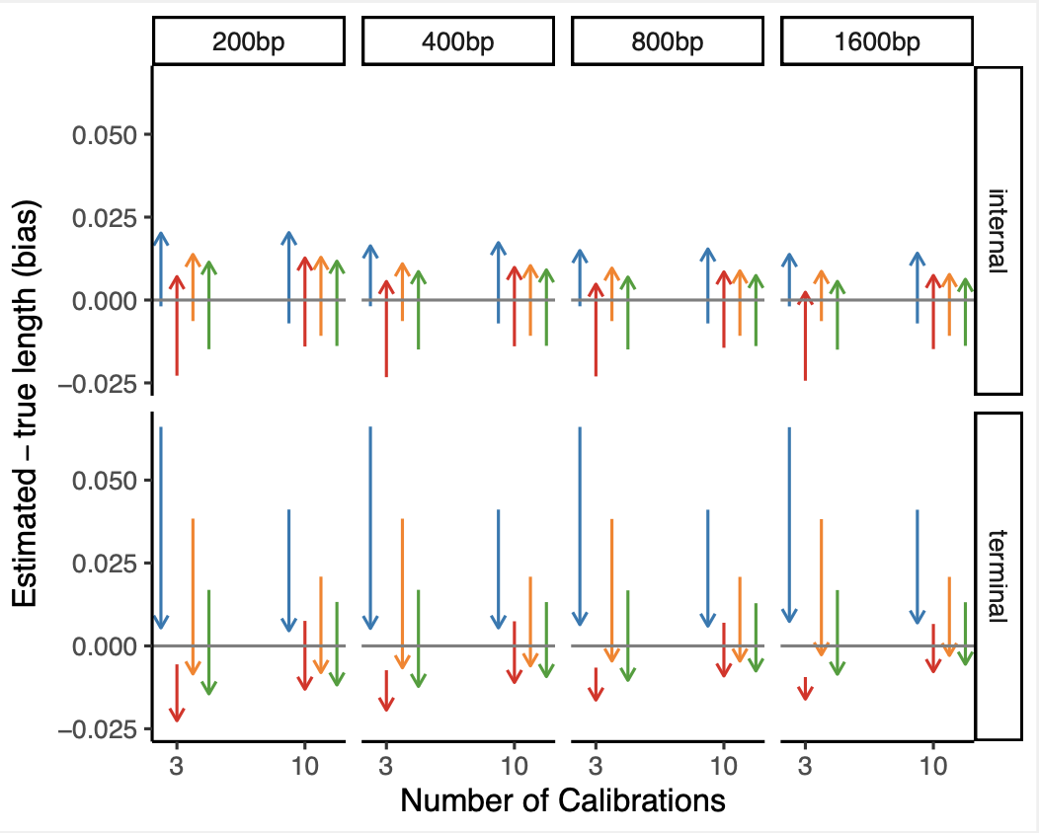
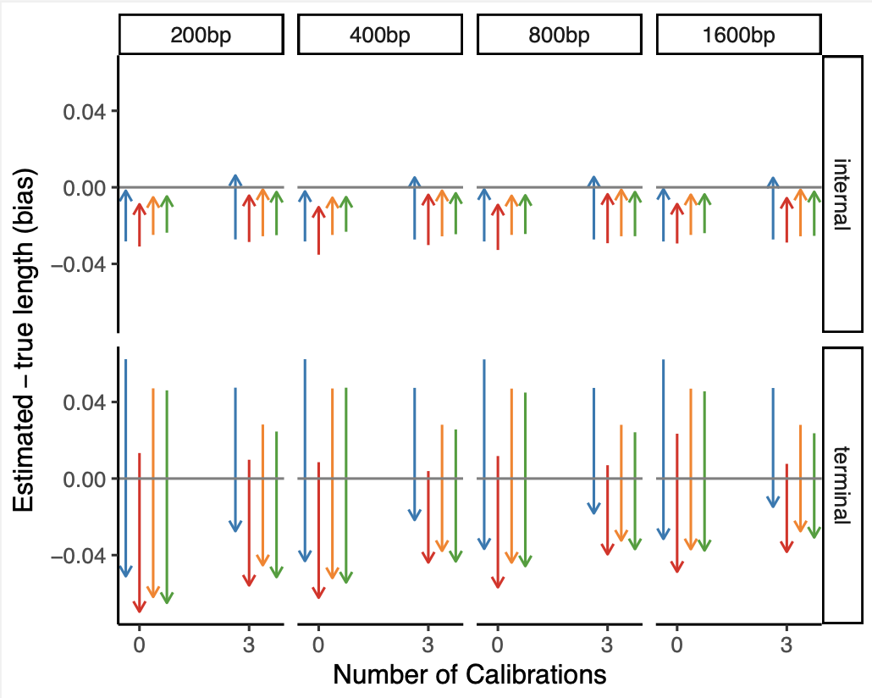
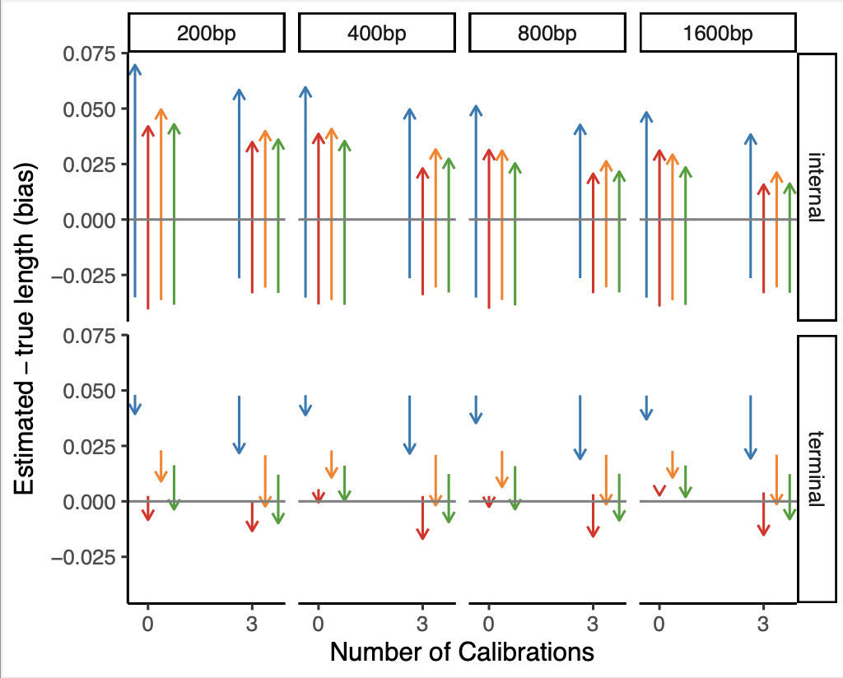
Root-fixed, with outgroup
Root-fixed, no outgroup
Root-unfixed, no outgroup

Slide 3
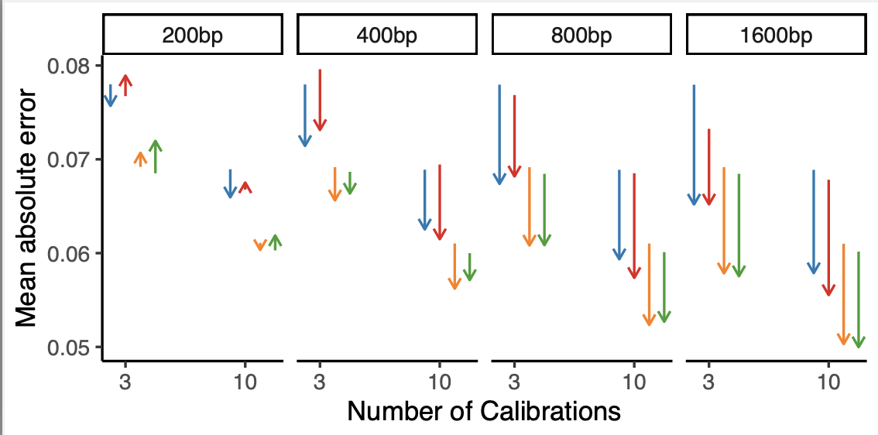
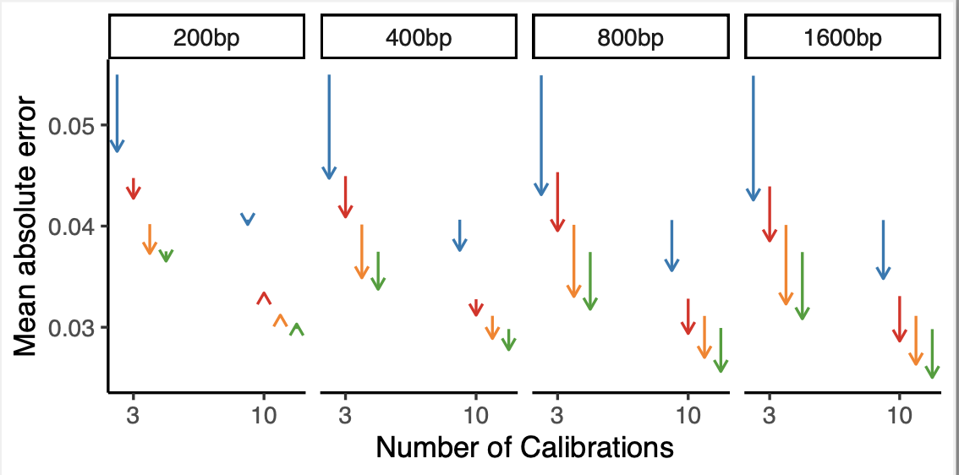
Root-fixed, no outgroup
Root-fixed, with outgroup

Slide 4
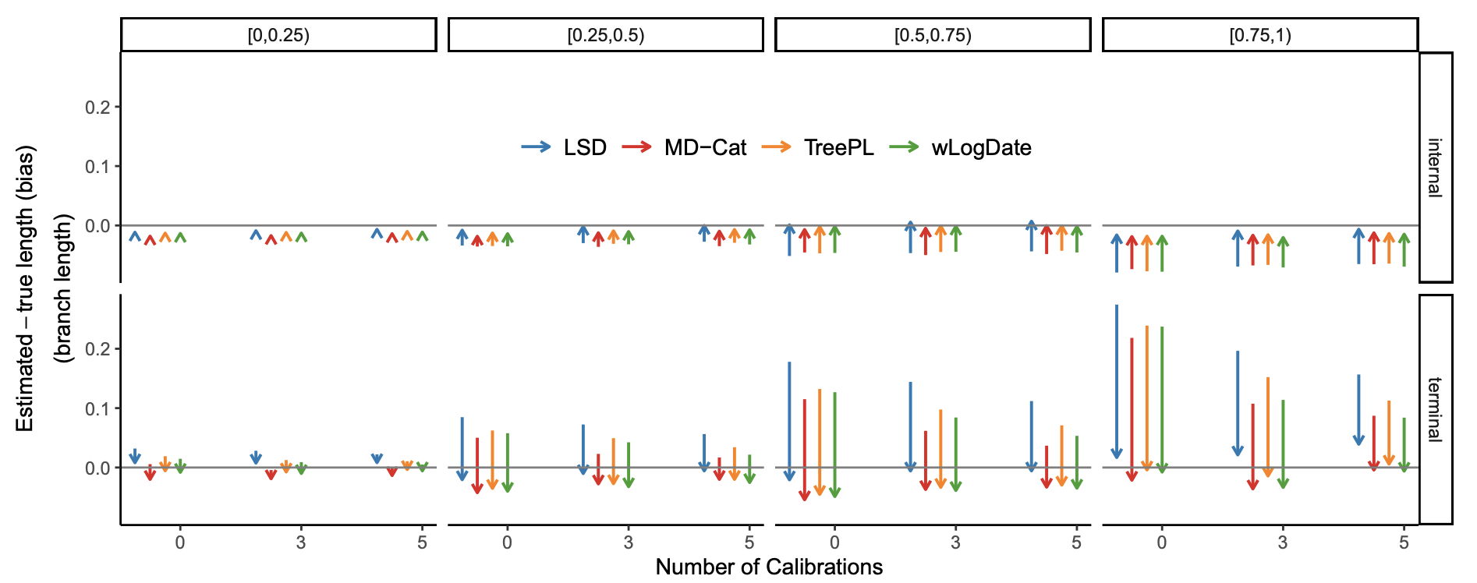
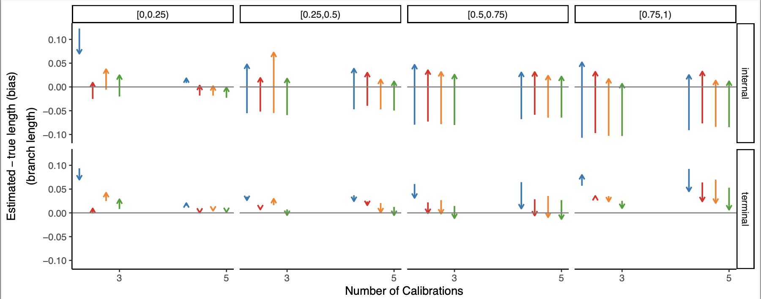
Root-fixed
Root-unfixed

Slide 5


Slide 6
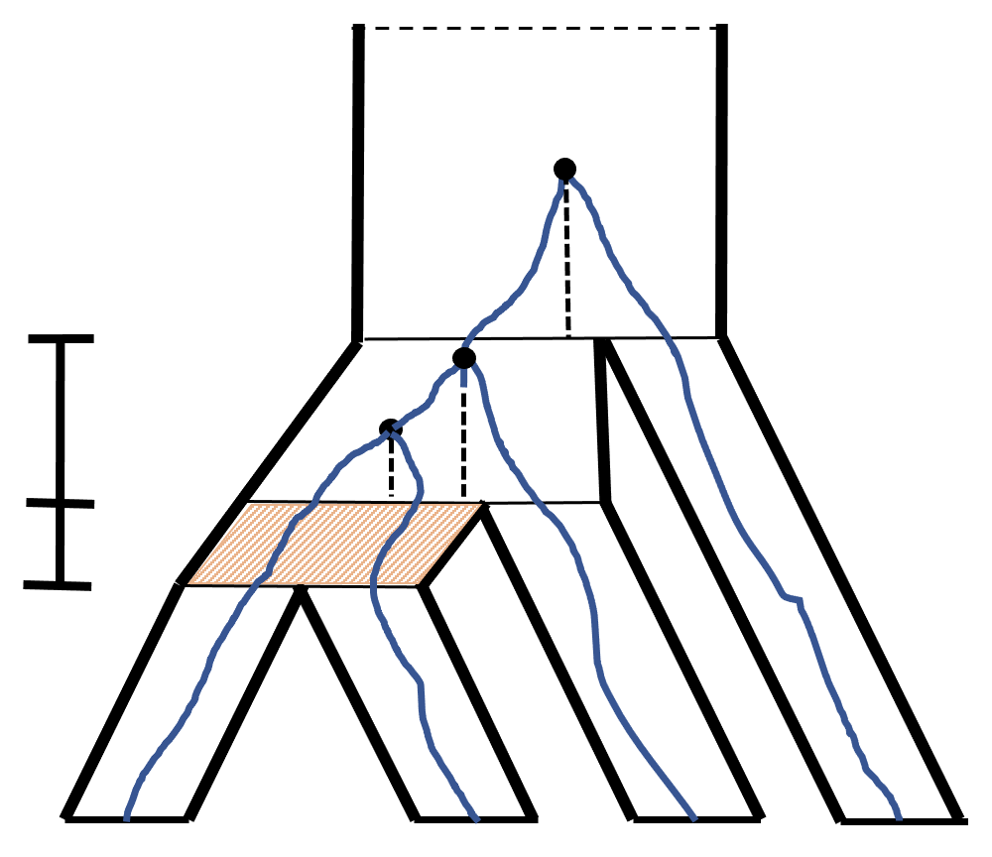
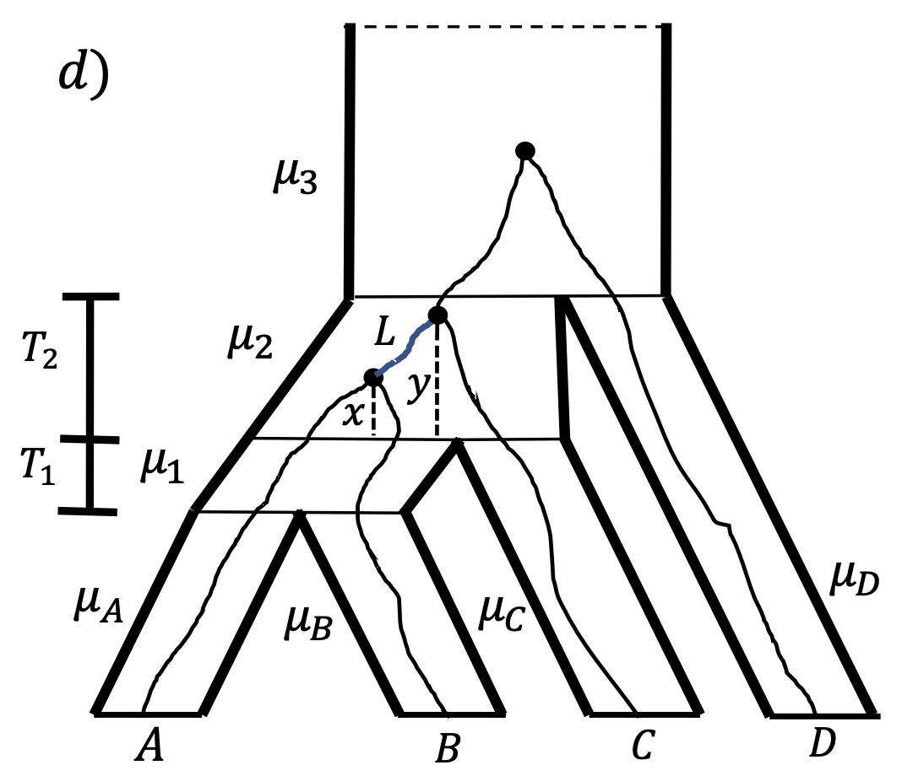




Gene divergence
GS gap
Species divergence
Incomplete lineage sorting
$$A$$
$$B$$
$$C$$
$$D$$

Slide 7

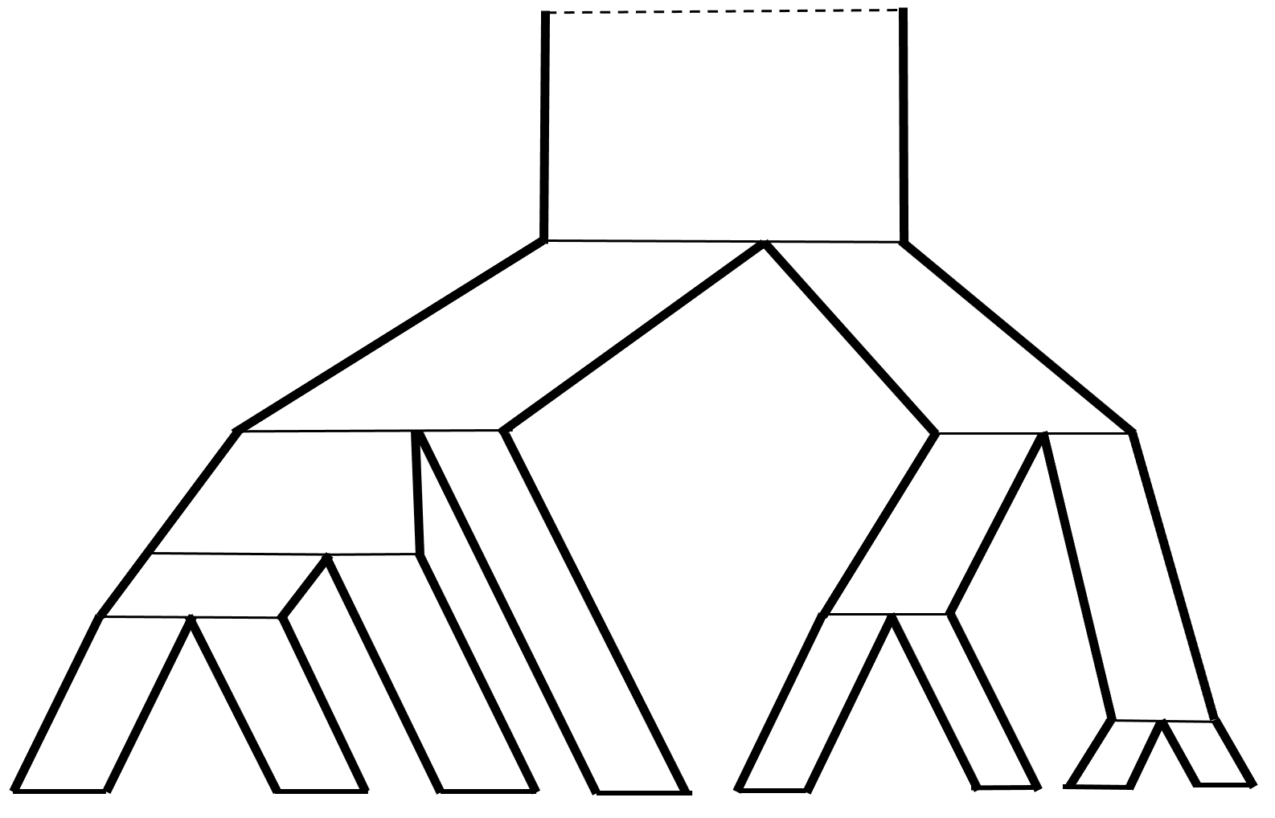








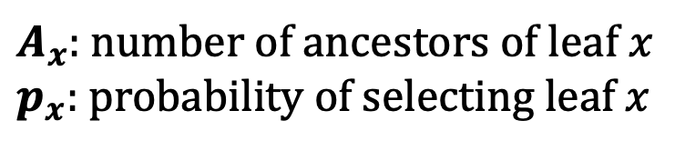






Gene divergence
GS gap
$$C_{3}$$
Species divergence
$$C_{2}$$
Incomplete lineage sorting
$$C_{1}$$
$$A$$
$$B$$
$$C$$
$$D$$
$$1/4$$
$$1/4$$
$$1/3$$
$$1/2$$
$$1/3$$
$$1/3$$
$$1/3$$
$$1/3$$
$$p_{x}=1/|A_{x}|$$
$A_{x}$: number of ancestors of leaf $x$
$p_{x}:$probability of selecting leaf $x$

Slide 8

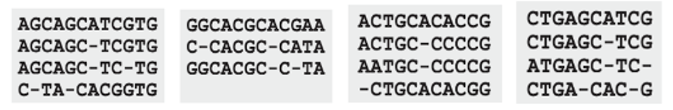
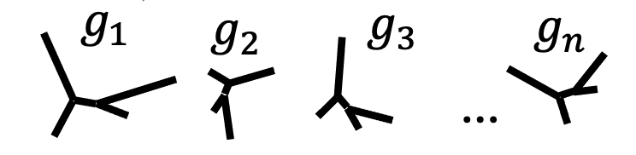



Traditional Pipelines
Bayesian Analysis
3MY
2.2
3MY
(T, $θ)$
1.7
1.3MY
1.3MY
0.8
$$b_{i}=μ_{i}Δt$$
1.3MY
1.3MY
1.1
2.4 MY
2.4 MY
mutation unit
time unit
SU branch length estimation
ML Dating
Gene tree estimation
Species tree estimation
3MY
2.2
1.7
1.3MY
0.8
$$b_{i}=μ_{i}Δt$$
1.3MY
1.1
2.4 MY
Rooting

Slide 9
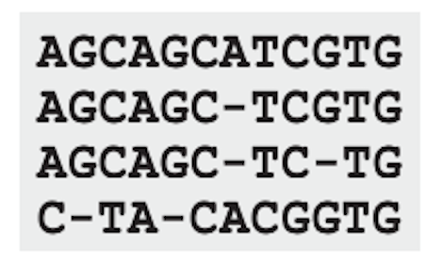
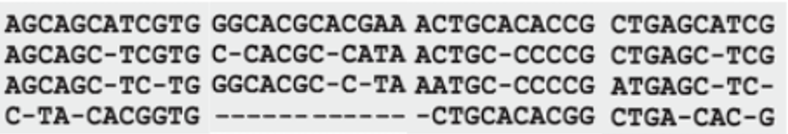



Traditional pipelines
Bayesian Analysis
Concatenation with ML
Rooting
ML Dating
3MY
(T, $θ)$
2.2
3MY
1.7
2.2
1.3MY
1.3MY
1.7
1.3MY
0.8
1.1
0.8
$$b_{i}=μ_{i}Δt$$
1.3MY
2.4 MY
1.1
2.4 MY
New pipeline
SU branch length estimation + Rooting
ML Dating
Gene tree estimation
Summary method
3MY
2.2
1.7
1.3MY
0.8
$$b_{i}=μ_{i}Δt$$
1.3MY
1.1
2.4 MY

Slide 10




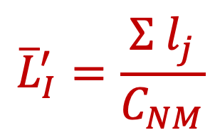
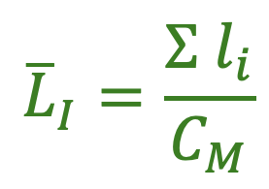

A)
$${\overline{L}}_{I}=\frac{Σ l_{i}}{C_{M}}$$
Matching
Non-matching
Species tree in SU
$$g_{1}$$
$$g_{2}$$
$$g_{K}$$
$${\overline{L}}_{I}^{′}=\frac{Σ l_{j}}{C_{NM}}$$
$$τ_{I}$$
d
$$T_{I}$$
d
C
b
c
b
c
a
c
a
b
a
A
B
C
D
B
Gene trees in SU
d
Species tree in CU
A
D

Slide 11
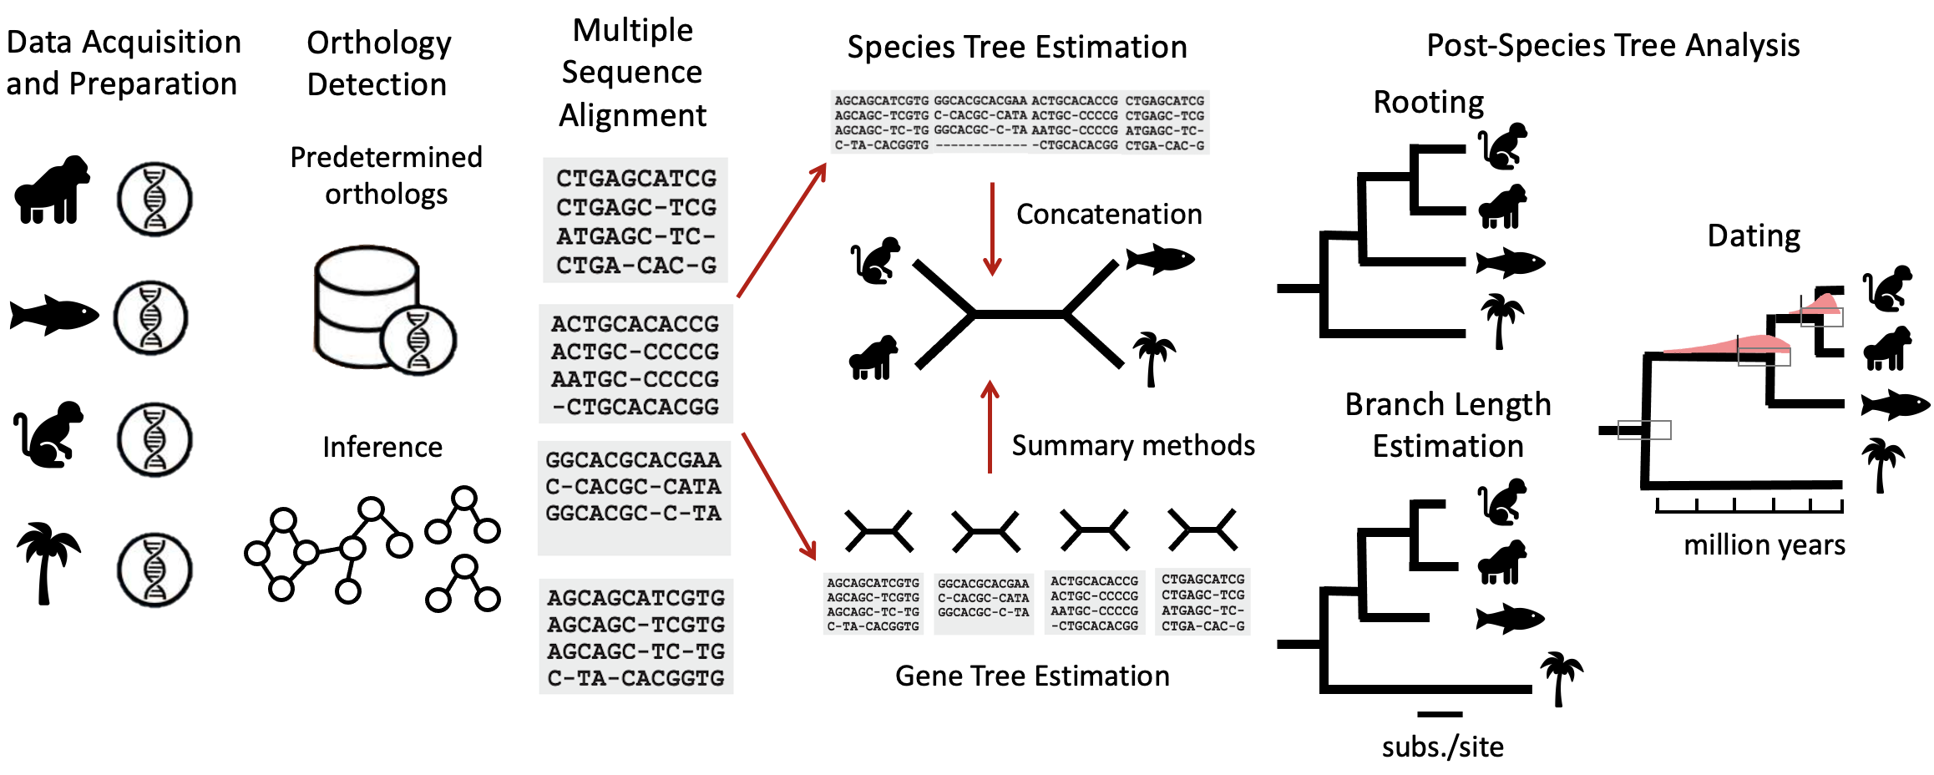

Slide 12






subs./site
million years

