Slide 1
Week 06

Slide 2
Warm-up (10 minutes)
Import the Belize_Airbnb_listings csv
Create a new dataframe that take the original dataset and groups the data by neighborhood and finds the average price, number of reviews, AND availability_365
Create an appropriate chart to show one of these graphically. Make sure you have labeled it sufficiently.

Slide 3
Today's Activities
Warmup (15 mins)
Homework Answers/Q&A (30 mins)
Install postgres and pgadmin (25 mins)
Intro to Databases (20 mins)
Break (15 mins)
Intro to SQL (15 mins)
Group Exercise and discussion of what makes a good visualization (60 mins)

Slide 4
Class Requirements
You must have turned in at least 5 of the first 6 assignments by April 14th to continue in this course!
You need to have an average of 70% or above on those assignments.

Slide 5
Homework Answers (30 mins)
To save some time I will discuss a subset of answers.
Voluntarily slack answers to the #datascience channel
Don't be shy!

Slide 6
Install postgres and pgadmin (20 mins)
Go to https://www.postgresql.org/download/ and select your OS
Click on “Download the Installer” and then download the most recent version available (V 13 as of this documentation)
Run the installer from the download in browser or your Downloads folder
Follow the setup prompt with defaults until it asks for a superuser password
Enter a password you’ll be sure to remember (this will be used later to access the DB)
Continue the setup with defaults until installation begins
Click finish (This will launch Stack Builder)
In Stack builder, select the “PostgreSQL 13 (x64) on port 5432” option and click Next
From the next screen, we can install additional add ons or drivers as wanted, but we don’t need any right now so hit “Cancel”
Open the start menu and locate the PostgreSQL 13 folder, expand it and click on pgAdmin 4

Slide 7
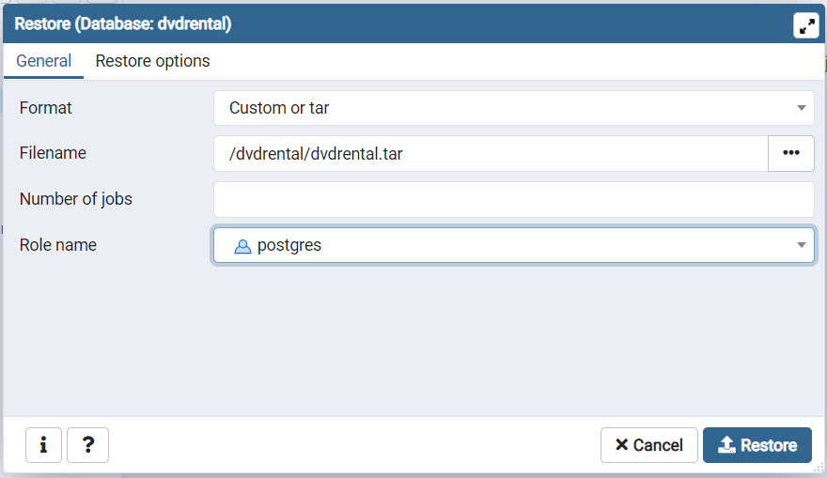
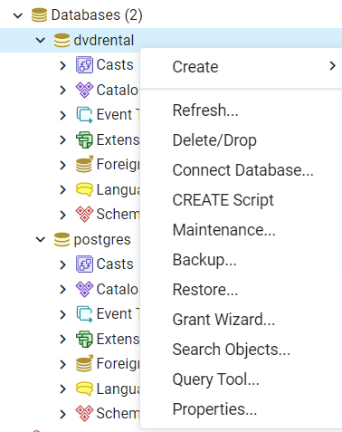
Connect to Homework Database
create database dvdrental;
**Be sure to copy the full path for the tar file and paste it into the file name**

Slide 8

Intro to Databases (15 mins)
https://www.edureka.co/blog/what-is-a-database/
Database Management Systems (DBMS)
Database – collection of records that can be added, modified, and managed AND processed into useful information
Many different types of databases, but we will mostly use RDBMS
Schema – logical configuration of all the tables in a relational database

Slide 9
DBMS
Collection of interrelated data
Set of programs to access the data
DBMS contains information about a particular enterprise
DBMS provides an environment that is both convenient and efficient to use.
Database Applications:
Banking: all transactions
Airlines: reservations, schedules
Universities: registration, grades
Sales: customers, products, purchases
Manufacturing: production, inventory, orders, supply chain
Human resources: employee records, salaries, tax deductions
Databases touch all aspects of our lives

Slide 10
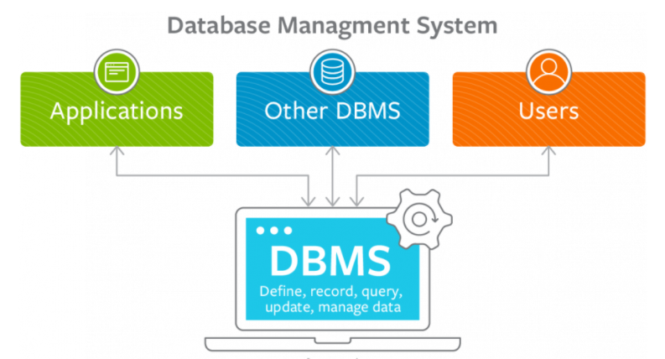

Slide 11
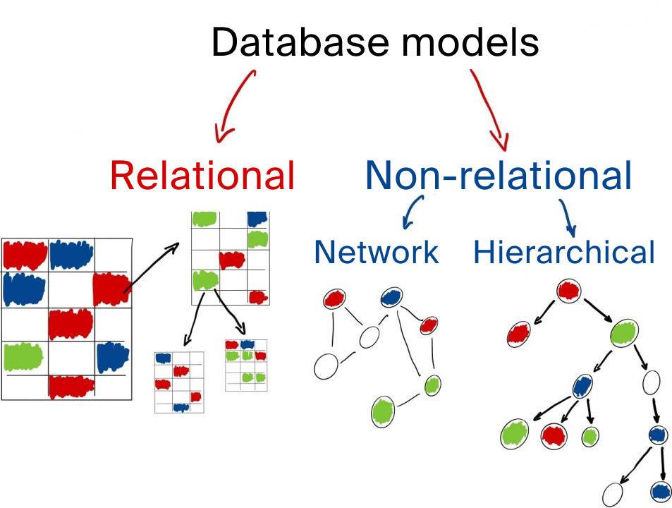

Slide 12
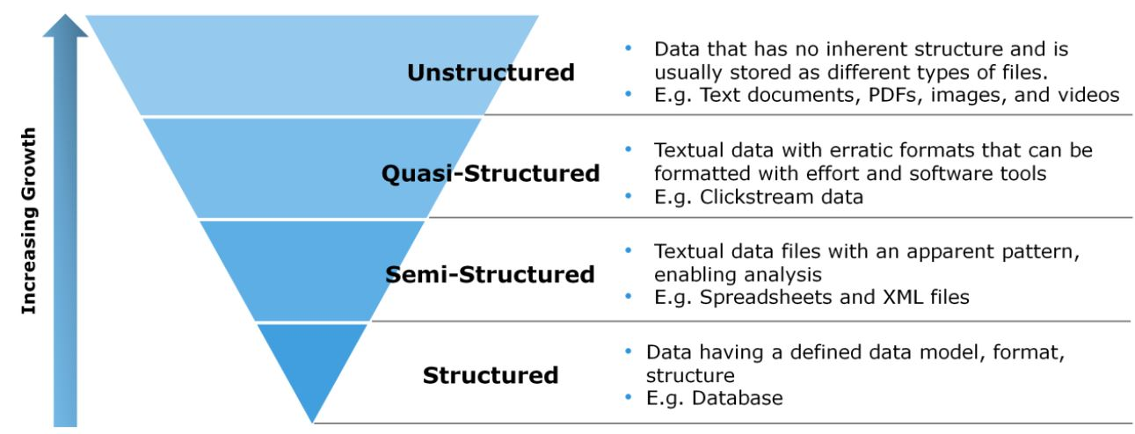
Types of Data

Slide 13
ACID
Properties of all databases transactions, that guarantee accuracy of database
Atomicity – The whole transaction either succeeds or fails when a changes is made to a database. “All or nothing”
Consistency – All data will follow rules, including constraints, cascades, and triggers
Isolation – All transactions will occur in isolation. So, no transaction can alter another uncommitted transaction
Durability – Once a transaction is committed it will stay in the system. Even if the system crashes, the data will persist.

Slide 14
Review (3 mins)
What is data?
What is a database?
What are the different types of data? Which is/are found in RDBMS?

Slide 15
Break (15 Minutes)
Attendance word: GoogleGuru

Slide 16
Intro to SQL
https://www.tutorialspoint.com/sql/sql-overview.htm
Structured Query Language
We can define data AND manipulate data

Slide 17
Select Statements
SELECT column1, column2, ... FROM table_name;
SELECT * FROM table_name;
Is this a DDL or DML command?

Slide 18
Limit
SELECT column_name(s) FROM table_name WHERE condition LIMIT number;
Different dialects of SQL have different ways of limiting
ROWNUM in Oracle
TOP in SQL Server
Can run:
SELECT count(*)
FROM table_name
To see how risky a select * is, but its always safer to use LIMIT

Slide 19
Where Clause
SELECT column1, column2, ... FROM table_name WHERE condition;
Operator | Meaning
= | Equals
> | Greater Than
< | Less Than
>= | Greater Than or Equal
<= | Less Than or Equal
<> (or !=) | Not Equal (depends on dialect)
BETWEEN | Between a range
LIKE | Pattern matching
IN | To specify multiple values

Slide 20
Data Model

Slide 21
Practice SQL
How many rows are in the payments table?
Select the first 5 records in the payments table?

Slide 22
Week 6 Group Exercise
Once you finish and have submitted your exercise properly, please feel free to go back to any previous homeworks and ask questions you have about them OR start working on next week’s assignment!

Slide 23
Data Visualization Goals

Slide 24
Matplotlib plotting
Edward Tufte’s
Graphical Integrity Principles:
Representations of numbers should match their true proportions.
Labeling should be clear, detailed and thorough.
Designs should show only data variations, not design variation.
Standardized units are best when representing money.
The number of dimensions visualized should equal the number of dimensions in the data.
Representations should not imply a subjective or false context.

Slide 25
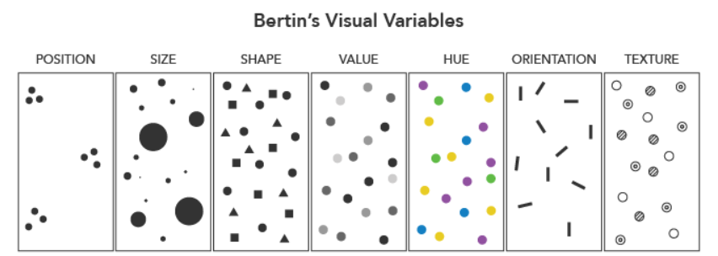
Visual Variables

Slide 26
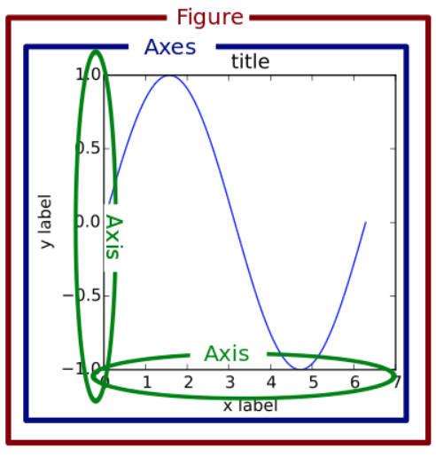
Components of a plot

