Slide 1
Week 17

Slide 2
Warm-up (10 minutes)
What are underfitting and overfitting? How do you avoid them?
What is cross validation?

Slide 3
Today's Activities
Warmup (15 mins)
Review Homework (30 mins)
Review Decision Tree Improvements (15 mins)
ROC Curve Reading (10 mins)
Ensemble Methods (15 mins)
Break (15 mins)
Random Forest (30 mins)
Group Exercise (50 mins)

Slide 4
Class Memo
To continue in this course, you must have completed 17 of the 18 assignments by July 7th!
Remember, for the whole course, you can miss one assignment, but you must complete all your group projects.

Slide 5
Review Homework

Slide 6

Review Decision Tree Optimizations

Slide 7
ROC Curve Reading
What is an ROC curve? Why is it useful over simply using the true positive and false positive rates?
What is AUC and what does it tell us?

Slide 8
Ensemble Methods
From the DataCamp, what do you know about ensemble methods?
The winners of machine learning competitions with million-dollar prizes almost always use ensemble methods
Ensemble methods – train many different models on the same dataset and aggregate the model predictions into one robust and fault-tolerant model

Slide 9
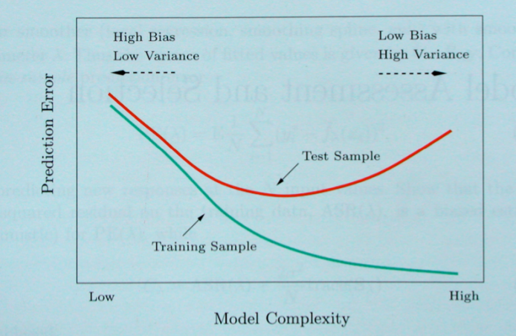
Bias-Variance Tradeoff
Notes:
Hastie, Tibshirani, Friedman “Elements of Statistical Learning” 2001

Slide 10
How do you reduce variance without increasing bias?
Averaging!
But, there begs the question: if we only have one training set where do multiple models come from?

Slide 11
Bootstrapping
Bootstrapping – random sample with replacement.
This method helps understand the bias and variance in a dataset
Basically, this is sampling with replacement, also called resampling
Why would we do this in practice?

Slide 12
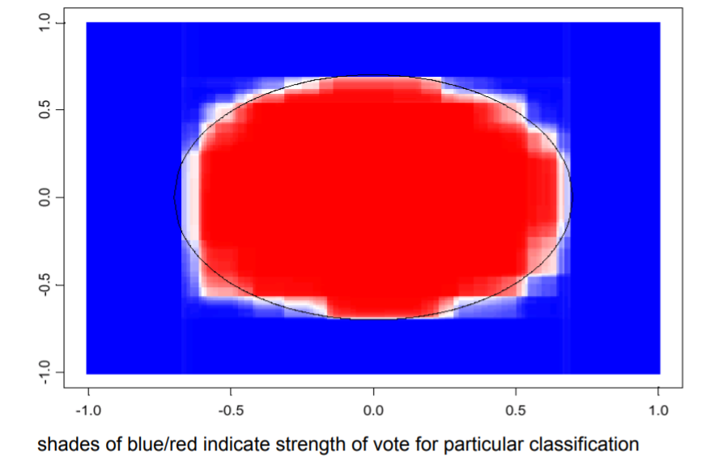
Bagging
Bagging - A way to decrease the variance of the model by generating additional training data
We take repeated bootstrapped samples, run models, and average them together to reduce variance
Bagging does not typically affect bias
Notes:
http://people.csail.mit.edu/dsontag/courses/ml12/slides/lecture12.pdf

Slide 13
Boosting
Boosting: method for converting rules of thumb and inclinations into rules for prediction
Boosting reduces bias
How? Two steps:
1) Produce a bunch of decently performing models
2) Sort based on a performance function where those with good predictive results are given a higher weight in the final model.

Slide 14
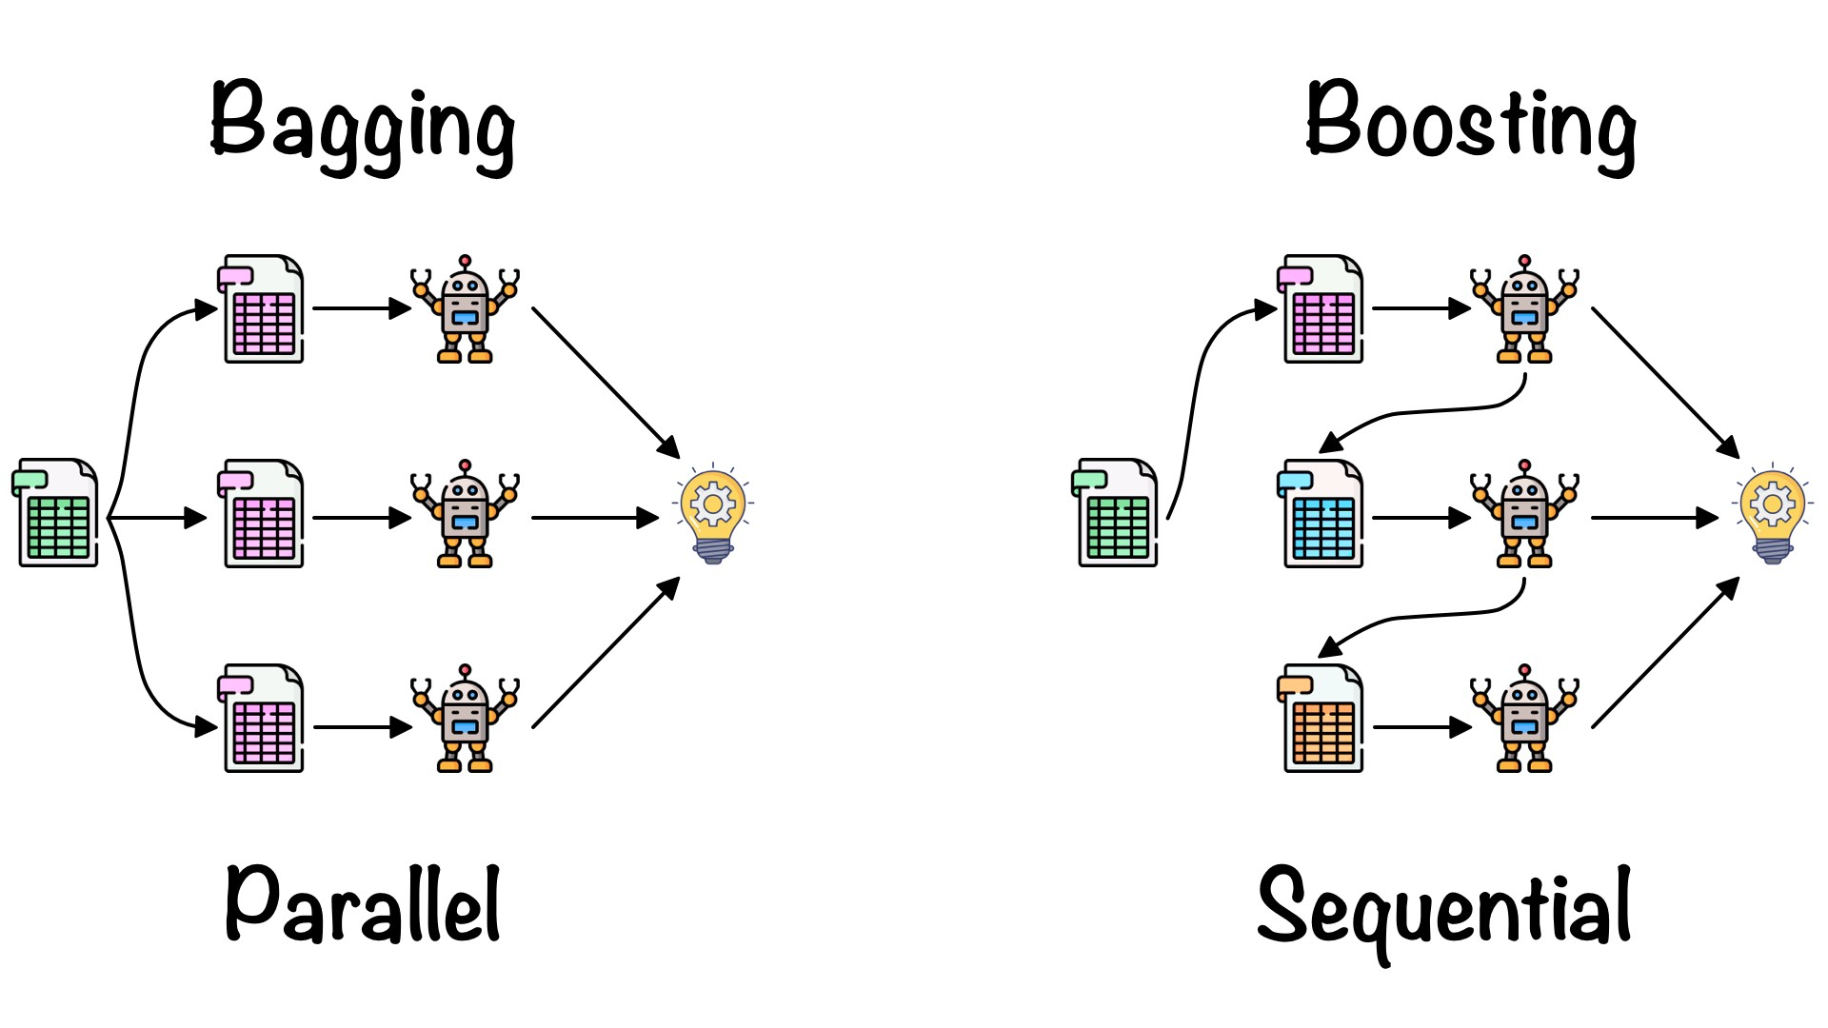
Notes:
https://towardsdatascience.com/ensemble-learning-bagging-boosting-3098079e5422

Slide 15
Break (15 Minutes)
Attendance word:CSSConjurer

Slide 16
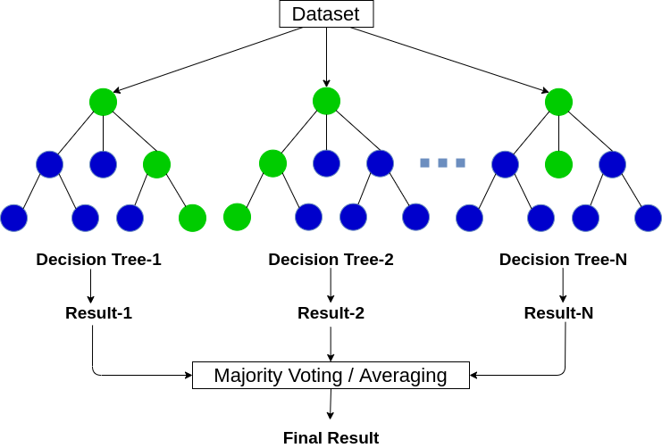
Random Forest
Random forest is a type of ensemble method that runs multiple decision tree algorithms (often several hundred) where each of the trees gets a vote and the result/prediction is determined by those votes
What is this also called?
Bagging
Notes:
https://www.analyticsvidhya.com/blog/2020/05/decision-tree-vs-random-forest-algorithm/

Slide 17
Week 17 Group Exercise
Once you finish and have submitted your exercise in Canvas via a github link, use the remaining time to work on your homework.

