Slide 1
Facebook
We are not using this ppt. just use to organize info

Slide 2
Have scripts done by MONDAY NIGHT 3/7
Have audio done by WEDNESDAY NIGHT 3/9
Have summary done by THURSDAY NIGHT 3/10
Optional meeting on WEDNESDAY 3/9 at 4:30 Loop Library

Slide 3
Video Outline
Introduction
Do you really know how Facebook’s News Feed works? Milos
Facebook/News Feed
Timeline of Facebook over the years (visual) Laura
Facebook definition
News Feed (2006), “likes” (2009),
Algorithm Jasmine
Factors
Always changing and adjusting
Solution - (we all agree because based on these frameworks…) YT
Be aware that Facebook is filtering the content on your News Feed
Frameworks (Pictures and quotes of the theorists while talking about them)
Kant Laura
Utilitarian Jasmine
Social Contract Yong Shan
Aristotle Milos

Slide 4
What is Facebook?
Facebook allows you to send messages and post status updates to keep in touch with your friends and family. You can also share different types of content such as photos, links, and more. But sharing something on Facebook is a bit different from other types of online communication. Unlike email or instant messaging, which are relatively private, the things you share on Facebook are more public, which means they'll usually be seen by lots of other people.
While Facebook offers privacy tools to help you limit who can see the things you share, it's important to understand that Facebook is designed to be more open and social than traditional communication tools. We'll talk more about sharing and controlling your privacy in our lessons on Understanding Facebook Privacy and Adjusting Your Privacy Settings.

Slide 5
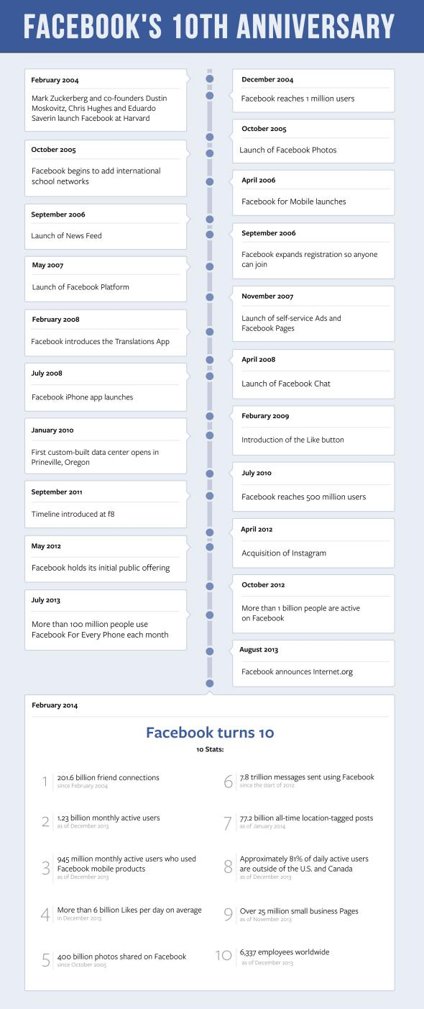
Take a look at this timeline!
http://www.slate.com/content/dam/slate/blogs/future_tense/2014/02/03/Facebook_10th_Timeline.jpeg.CROP.promovar-mediumlarge.jpeg
More detail
http://www.knowyourmobile.com/apps/facebook/21807/history-facebook-all-major-updates-changes-2004-2016
Really helpful too!
https://en.wikipedia.org/wiki/Timeline_of_Facebook

Slide 6
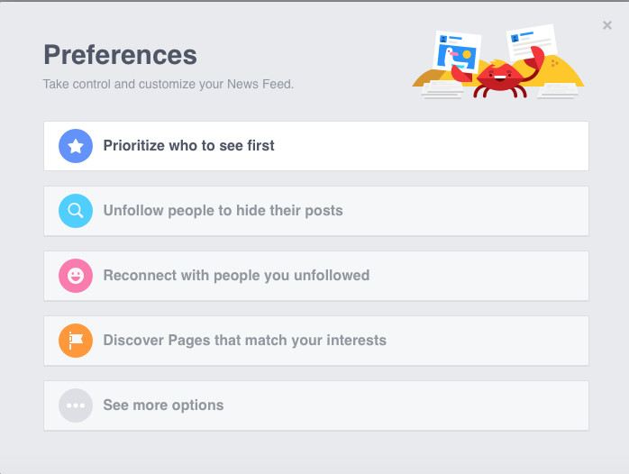
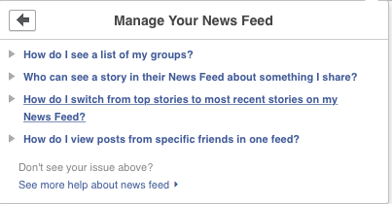
Screenshot these from FB looks good to use!
Shows facebook really does care about YOUR personal preferences!

Slide 7
2006 News Feed - Milos
Before the News feed in 2006
For years, the News Feed has been fueled by automated software that tracks each user’s actions to serve them the posts they’re most likely to engage with.
That proved successful in helping News Feed generate more revenue for Facebook than any other part of the site.
But it’s also led to a growing anxiety about how much Facebook knows, and how the company can use that knowledge to influence what users buy, how they vote, even how they feel.2006: News feed launched
Controversial, some outraged by update
Earliest days, Facebook was essentially a directory of profile pages.
Users could list their favorite bands, post pictures or write on each others’ profiles, but these activities were mostly discrete.
As the social network grew, Facebook engineers noticed that some people were navigating the site in unexpected ways.
Every user had access to a page showing when all their friends had last made a change to their profiles.
A growing number of people began bouncing from this page to different users’ profiles to figure out what their friends were up to.
Facebook realized they needed to provide an easier solution.
The point of the news feed: “a personalized list of news stories throughout the day, so you’ll know when Mark adds Britney Spears to his Favorites or when your crush is single again.”
Factor of News Feed that was less obvious to users: it wasn’t showing people all the potential stories they could be seeing.
There was simply too much content to show everyone everything

Slide 8
Timeline - Milos
Fun facts throughout the years
2004: Mark Zuckerberg and his co-founders launch Facebook at Harvard University
2005: Photos could be posted
2006: News Feed launched
2007: Facebook platform
2008: Chat through fb
2009: “Like” button
2010: 500 million users
2011: Timeline
2013: Search Bar
2014: Trending topics
2015: Update to News feed
Less intuitive factors to the algorithm
2016: “Reactions”
new reactions are "love", "haha", "wow", "yay", "sad", and "anger" to a post

Slide 9
Timeline Milos
I’m going to show a 2004, 2009 and 2016 screenshot of what fb looked like back then and then to now.
Talk long enough so I can show three photos so ppl. Can compare them
Just say something showing how Fb has really changed over time.
Even how a one year update really makes a difference
Say how they have really changed their layout and algorithms to fit personally to you. - fb trying to please you

Slide 10
Algorithms - Jasmine
Present
News Feed NOW
Completely personalized but still highly engaging to Facebook’s users so they’ll keep coming back and seeing more ads from the company’s 2 million advertisers
Facebook says it uses thousands of factors to determine what shows up in any individual user’s feed.
Biggest influences are pretty obvious
How close you are to a person is an increasingly important metric
how often you like their posts
write on their Timeline
click through their photos
talk with them on Messenger
Facebook’s chat service.
The post-type is also a big factor, as Facebook hopes to show more links to people who click lots of links, more videos to people who watch lots of videos and so forth.
The algorithm also assumes that content that has attracted a lot of engagement has wide appeal and will place it in more people’s feeds.
Use a phone with a slow mobile connection and you may see less video.
Writing “congratulations” in a comment signals the post is probably about a big life event, so it will get a boost.
Liking an article after you clicked it is a stronger positive signal than liking before, since it means you probably read the piece and enjoyed it.

Slide 11
Deliverables
Role of authors: Regulators
Target Audience: Facebook users

Slide 12
Solution
We all believe it is ethical of Facebook to filter our news feed
If people do not feel it is ethical
Free will: they must realize they signed up with Facebook
Signed away their rights: Terms and Conditions

Slide 13
Attention Grabber
Do you really know how Facebook works?
Do you know how Facebook organizes your news feeds?
Many people don’t know about Facebook’s algorithm that goes into News Feed content
Facebook can change the content being shared or viewed to alter your mood
https://www.facebook.com/about/privacy/ --Data policy

Slide 14
Our Issue
Issue: Is it ethical that Facebook filters it’s users News Feeds?
We could talk about how Facebook promotes a certain post depending of the number of “likes" the post or comment gets and it also depends on how many times people have shared a certain post. It also depends how close you are to a person and judged by how often you like their posts, write on their Timeline, click through their photos or talk with them on Messenger (Facebook’s chat service). We would focus on stuff like this. We would look at how Facebook organizes their content to your personal Facebook page (what you see first, the order in which it is presented).
Facebook algorithms, You and your contacts, Groups more than individuals, We used this article to help create this idea for the project.
http://time.com/3950525/facebook-news-feed-algorithm/
Need to make issue a statement for Frameworks - like principles from paper
I will not sign up with Facebook if they filter my news feed.
I will not use Facebook because they filter my news feed.

Slide 15
Kant (Script) - I will not use Facebook because they filter my news feed.
Maxim: I will use Facebook to filter my news feed.
Universal moral rule: Everyone should use Facebook to filter their news feed.
Meaningless: If everyone let Facebook filter their news feed, there is no privacy.
Means to an end:
When you control what other people see, and use it to benefit you (Facebook company) then you are using people as means to an end.
Ads → revenue
Facebook is trying to cater to you,
controlling your mood, feelings
Ethical: because you agreed to facebook’s terms and conditions when signing up

Slide 16
Utilitarianism Rule - I will not use Facebook because they filter my news feed.
Happiness, satisfied with their service and organization
Moral Rule: Facebook can filter everyone’s News Feed
Actors: Facebook, Facebook users
Good: Facebook users get a personalized News Feed that caters to their interests, users can still adjust the content seen,
Harm: Facebook determines what goes onto your News Feed, what is put on your News Feed can affect your mood/behavior
Conclusion: It is ethical because users agree to the Terms and Conditions, and although Facebook has the ultimate power about what is put on your News Feed, you still have some power and access to adjust the content.

Slide 17
Utilitarian (Script)

Slide 18
Facebook Algorithms
Factors: closeness to friend, post-type (video, link, photos, etc), post engagement, how Facebook is accessed (mobile, computer, tablet, etc), types of engagement on a post (“congratulations” = a big moment in your life), timing of when you “like” content, time spent reading a post, etc
2-3 changes are done to the algorithm a week

Slide 19
Algorithm (Script)
Most Facebook users

Slide 20
Social Contract(Script) - I will not use Facebook because they filter my news feed.
It is ethical to allow Facebook to determine what shows up in our news feed.
According to the Fourth Amendment to the Constitution, everyone has the right to protect their privacy.
However, by using or accessing Facebook, we agree to the Facebook Policy which include them to govern our relationship with users and others who interact with Facebook, as well as Facebook brands, products and services, which we call the “Facebook Services” or “Services”. That means we are willing to share our private information with Facebook. So, Facebook has the legal right to determine what shows up in our news feed.
By giving Facebook the right to do that, we have some benefits such as making our world more open and connected with others, and receive more new and fun things that surround us,

Slide 21
Aristotle’s Theory (Goals of Facebook)
Facebook wants us to become more open and connected with each other
It’s no doubt that Facebook wants to get more subscribers to increase revenue
Executives of Facebook crave large amounts of connectivity so that they can become the largest social networking website with the most amount of users
Engage our audience
With its 1 billion-plus active users, Facebook is gathering new information every second that can help it build up long-term knowledge about the world: people's interests, favorite restaurants, good hotels
Facebook wants to use our news feeds to advertise products
Facebook's platform, perhaps more so than any other, allows businesses to connect with potential customers. It helps developers create apps, nearly 18 million local businesses find customers, and big brands to tell their story.
Eventually, Facebook could build an ad network to place its ads on websites outside of Facebook. Using its knowledge from its vast user base, an external ad network could increase revenue 200%.
http://www.fool.com/investing/general/2013/08/30/facebooks-new-goals.aspx

Slide 22
*62% of people didn’t know that their News Feeds were being filtered (UIUC researcher, Karrie Karahalios)
1.19 billion monthly active Facebook users
*Facebook sometimes adjusts content to alter moods/behavior Can Facebook influence the way you think, vote, consume, etc?

Slide 23
Facebook information on news feed privacy
https://www.facebook.com/help/420576494648116

Slide 24
News feed past
For years, the News Feed has been fueled by automated software that tracks each user’s actions to serve them the posts they’re most likely to engage with.
That proved successful in helping News Feed generate more revenue for Facebook than any other part of the site. But it’s also led to a growing anxiety about how much Facebook knows, and how the company can use that knowledge to influence what users buy, how they vote, even how they feel.

Slide 25
2006 News Feed
Controversial launch of the News Feed in 2006.
The debut of the “Like” button in 2009
earliest days, Facebook was essentially a directory of profile pages. Users could list their favorite bands, post pictures or write on each others’ profiles, but these activities were mostly discrete.
As the social network grew, Facebook engineers noticed that some people were navigating the site in unexpected ways. Every user had access to a page showing when all their friends had last made a change to their profiles. A growing number of people began bouncing from this page to different users’ profiles to figure out what their friends were up to.
“Users are usually pretty lazy. They’re not really willing to jump through a lot of hoops to do most things,”
Facebook realized they needed to provide an easier solution.

Slide 26
2006 News feed cont
founded in 2004
blog post announcing the new feature was true to the company’s dorm room origins, describing it as “a personalized list of news stories throughout the day, so you’ll know when Mark adds Britney Spears to his Favorites or when your crush is single again.”
outraged by update
another factor of News Feed that was less obvious to users: it wasn’t showing people all the potential stories they could be seeing. Even in those days, Cox says, the feed was curated because there was simply too much content to show everyone everything.

Slide 27
News feed now 1
completely personalized but still highly engaging to Facebook’s users so they’ll keep coming back and seeing more ads from the company’s 2 million advertisers.
Facebook says the average user has access to about 1,500 posts per day but only looks at 300. (A user who scrolls endlessly will eventually see every post from their friends and a smattering of posts from Pages they follow.)
Facebook says it uses thousands of factors to determine what shows up in any individual user’s feed.
biggest influences are pretty obvious. How close you are to a person is an increasingly important metric, as judged by how often you like their posts, write on their Timeline, click through their photos or talk with them on Messenger, Facebook’s chat service.
The post-type is also a big factor, as Facebook hopes to show more links to people who click lots of links, more videos to people who watch lots of videos and so forth. The algorithm also assumes that content that has attracted a lot of engagement has wide appeal and will place it in more people’s feeds.

Slide 28
News feed now 2
less intuitive factors to the algorithm.
Use a phone with a slow mobile connection and you may see less video.
Writing “congratulations” in a comment signals the post is probably about a big life event, so it will get a boost.
Liking an article after you clicked it is a stronger positive signal than liking before, since it means you probably read the piece and enjoyed it.

Slide 29
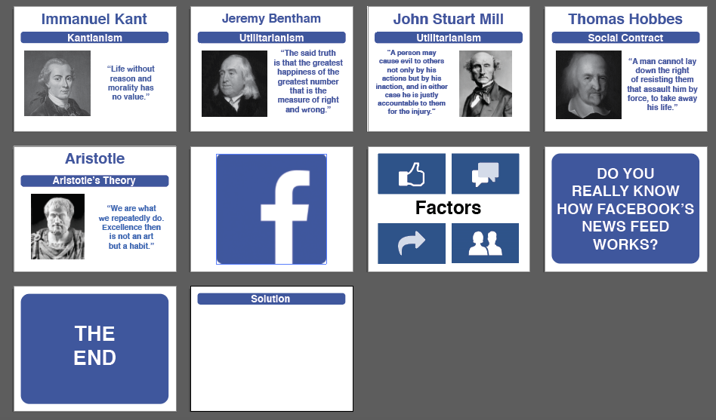

Slide 30
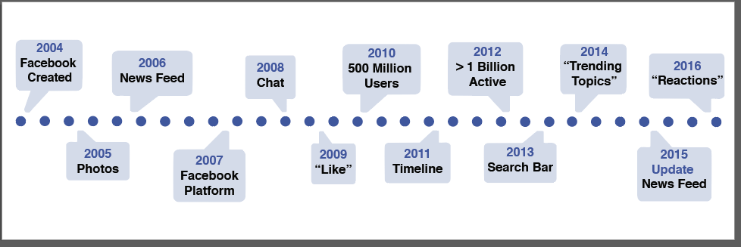
Timeline (there is no gray outline)

