Slide 1
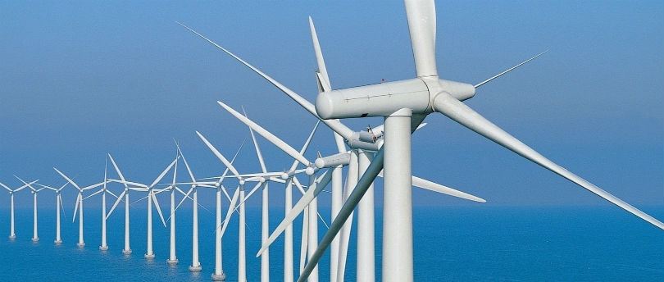
WIND

Slide 2
WIND
Currently the fastest growing production of electricity in the world
Single wind turbine can power 500 homes
Enough wind to power the country 10 times over
American wind power is a $10 billion a year industry
Uses no water
By 2030, it will save nearly 30 trillion bottle of water

Slide 3
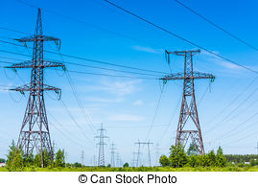
ELECTRIC

Slide 5
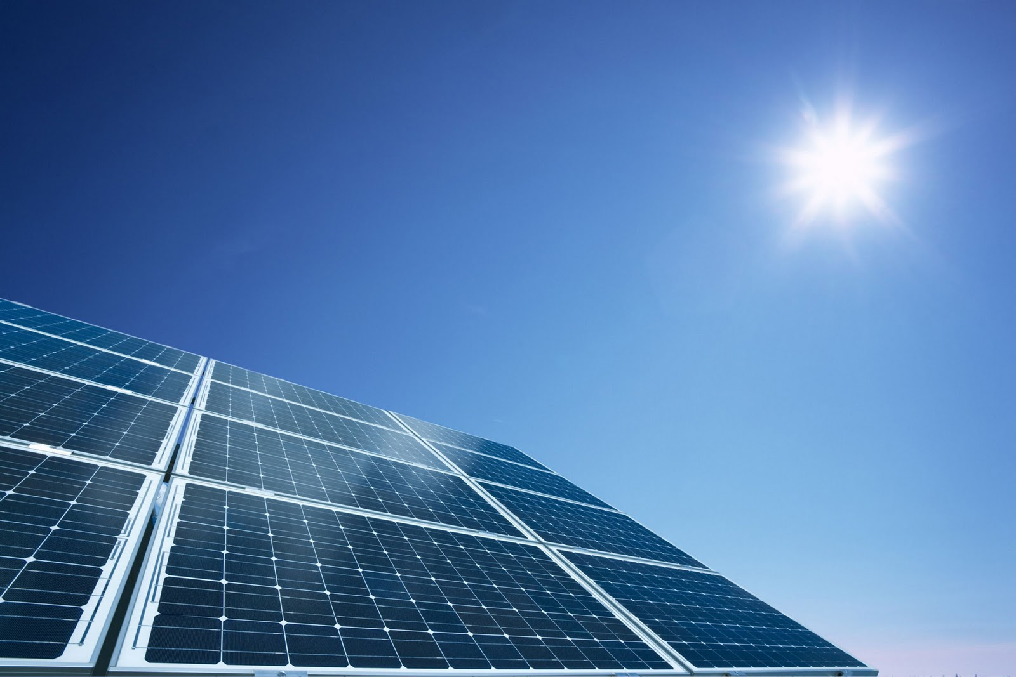
Solar Power
Solar power is produced by collecting sunlight and converting it into electricity.

Slide 6

Renewable Sustainable
Solar power Yes Yes
Natural Gas No No
Source: http://www.conserve-energy-future.com/pros-and-cons-of-solar-energy.php

Slide 7
Environmental Impact of Electrical Generation
Solar power
No fuel is burned.
No greenhouse gases produced.
Fossil Fuels
Release stored carbon
Natural Gas
Release methane
Source: http://mysolar.com/natural-gas-for-electricity-production/

Slide 8
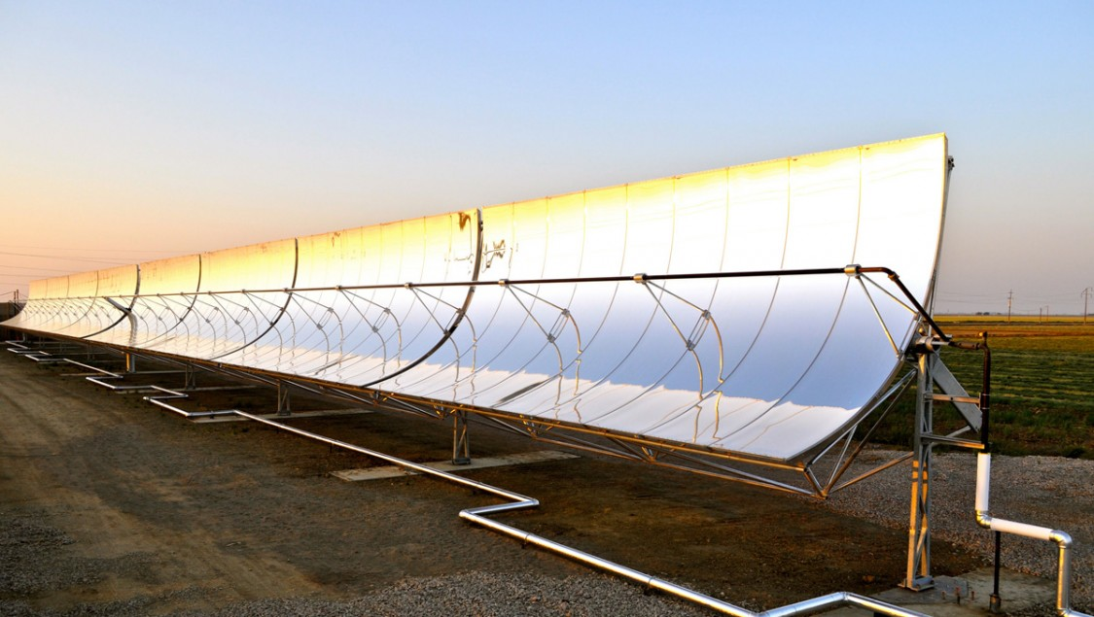
Impact on Water Resources
Solar Power
Solar Desalination
Natural Gas
Boiler and combined cycle turbine systems require water.
The discharge of used water can kill fish and other sea animals.
Source: http://www.msn.com/en-us/money/markets/the-way-humans-get-electricity-is-about-to-change-forever/ar-AAbZhP2#image=2

Slide 9
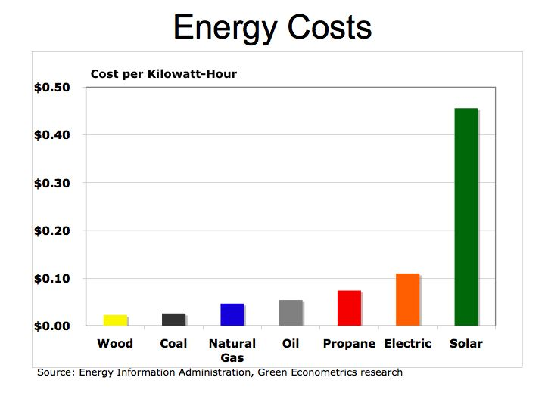
Source:https://www.google.com/search?q=Reduces+Electricity+Costs+solar+energy&biw=1280&bih=611&source=lnms&tbm=isch&sa=X&ved=0ahUKEwjwoPrXtajLAhUK4SYKHREICAQQ_AUIBygC#imgrc=laE2wVQXpNpSrM%3A

Slide 10

Source: http://shrinkthatfootprint.com/solar-panels-for-home-owners

Slide 11
Aristotle’s ethical theory
Moral rule: I should use solar power instead of natural gas.
Universal moral rule: everyone should use solar power instead of natural.
Intend: slow down the global warming- decrease the release of greenhouse gas such as CO2, methane.

Slide 12
rule utilitarianism
Universal Moral Rule: everyone should use solar power.
Affected people: all the people in the world
Good: renewable, sustainable, clean
Bad: Now, the cost is higher than other energy source.
For the long term, everyone use solar power will create more happiness.

