Slide 1
System Design
Arturo Alvarez
Sunny Syed
Austin Chase
Yongshang Tang
Tabish Ansari
Michael Weiss

Slide 2
Three Users based on use cases
Student (New/Returning)
Faculty Advisor
Administrator

Slide 3
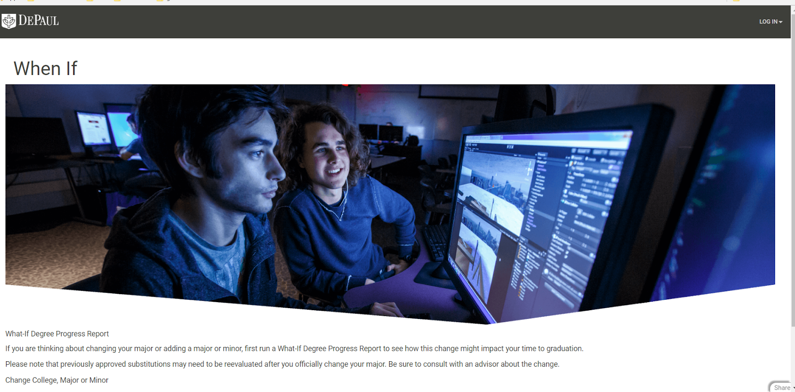
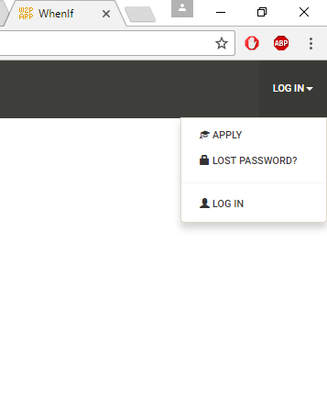
Students
Welcome to the homepage where you can login or apply

Slide 4
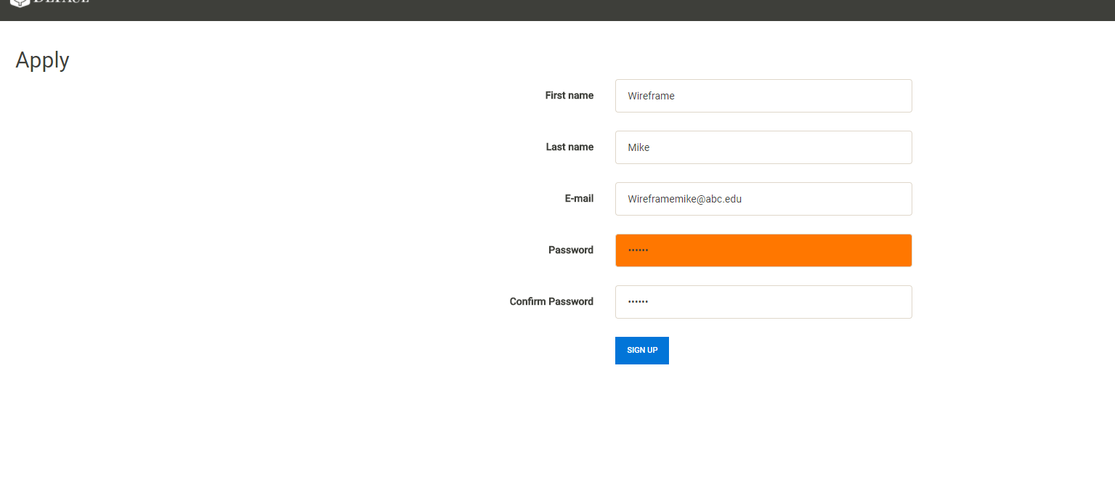
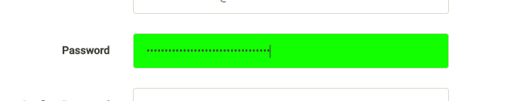
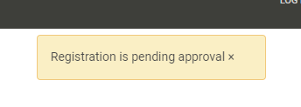
Students - applying
Students can apply for an account with password strength verification
Approval requires verification from Admin

Slide 5
Faculty/Student Application
The student and faculty application looks the same
It requires approval from the admin

Slide 6
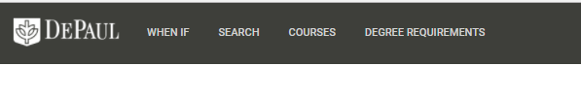
Student logging in
New navigation bar appears at the top of the screen

Slide 7
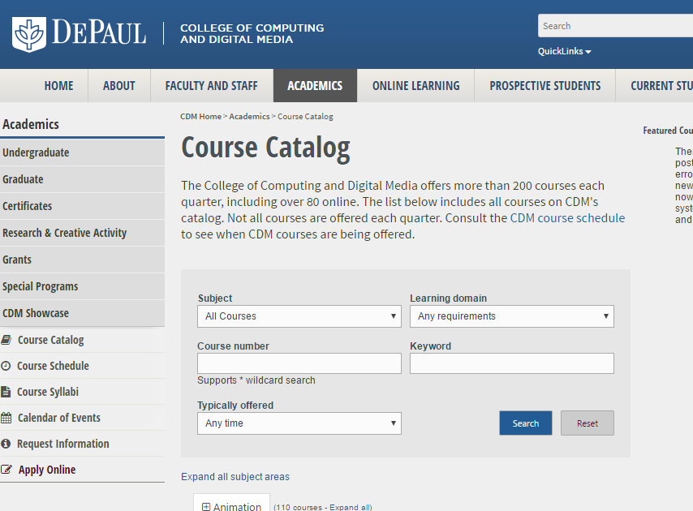
Students research
When clicking on course requirements it opens the course catalog in a new tab

Slide 8
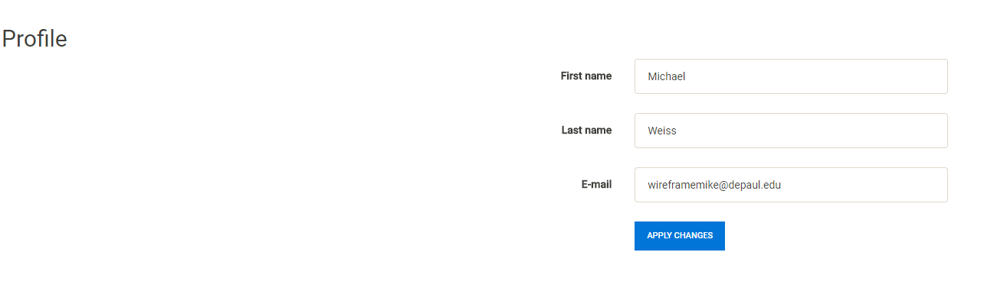
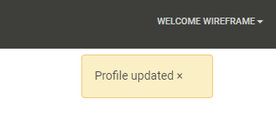
Student edit profile
Student profile
Updated name to user profile

Slide 9
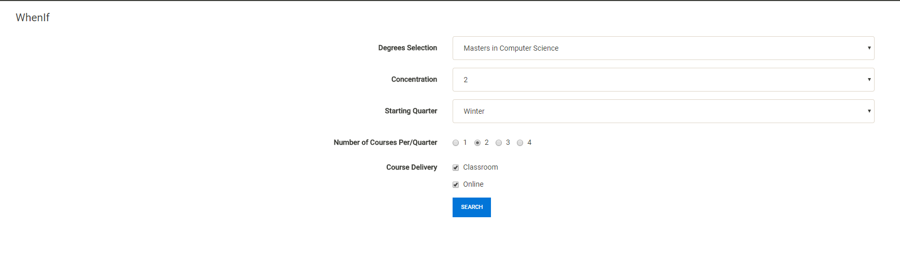
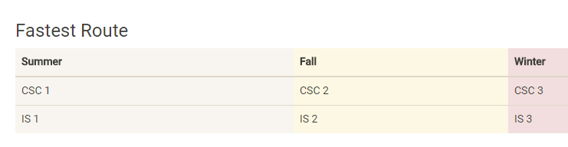
Student whenif

Slide 10
Had to draw up frames from here on

Slide 11
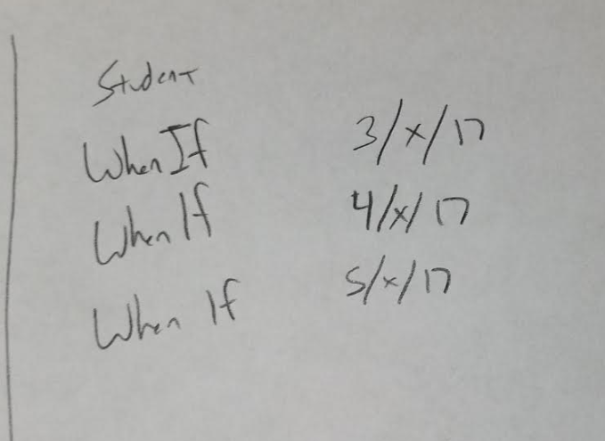
Student - Whenif
Students looking up their shortest path

Slide 12
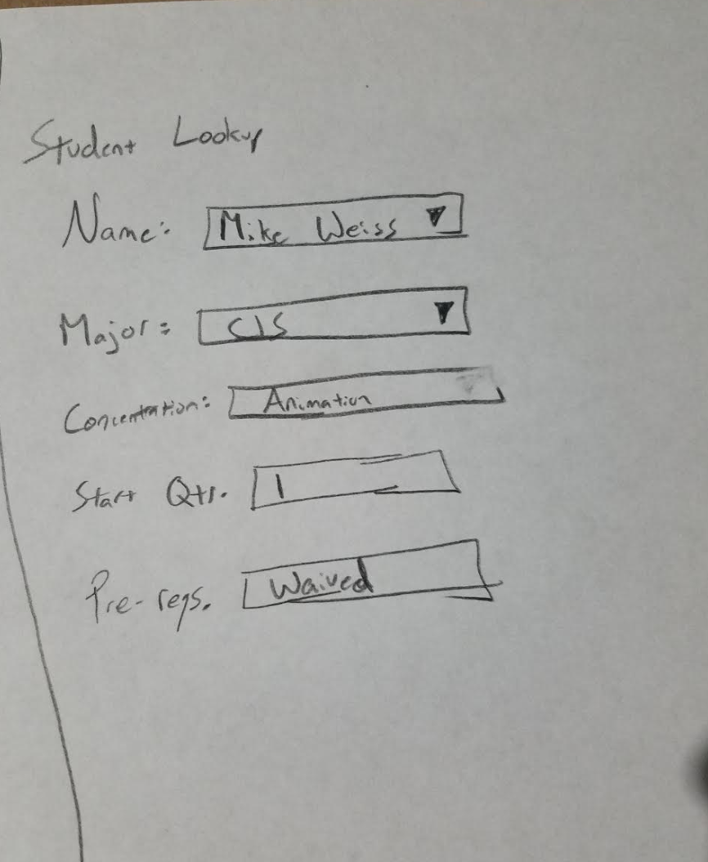
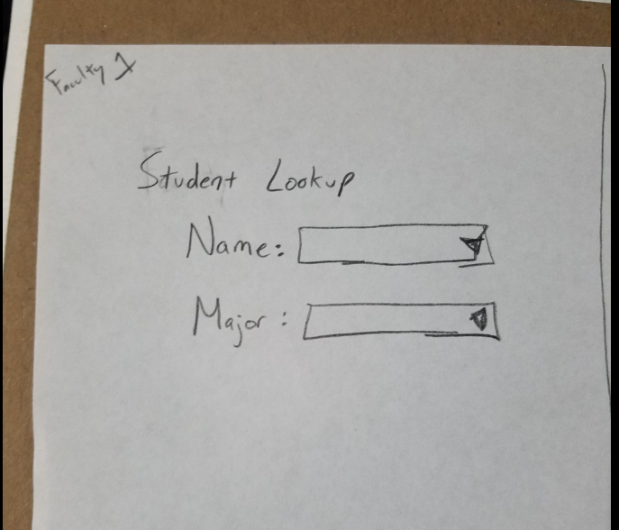
Faculty lookup
Student Account information after selecting student discuss options…(prereq or not)
Look up students in the system

Slide 13
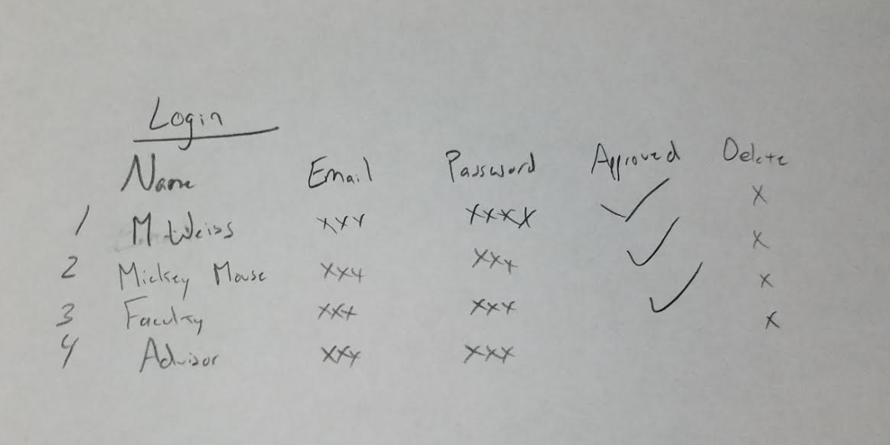
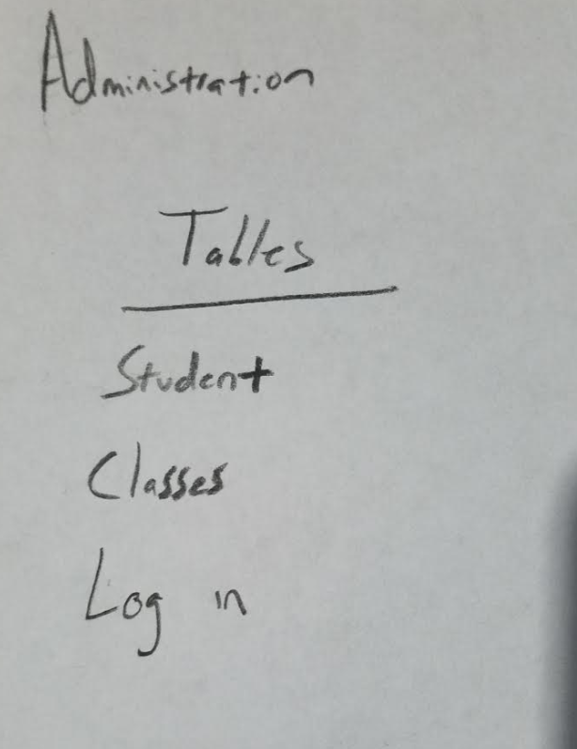
Administrator – Delete/update/Approve records
Administration can view and edit tables

Slide 14
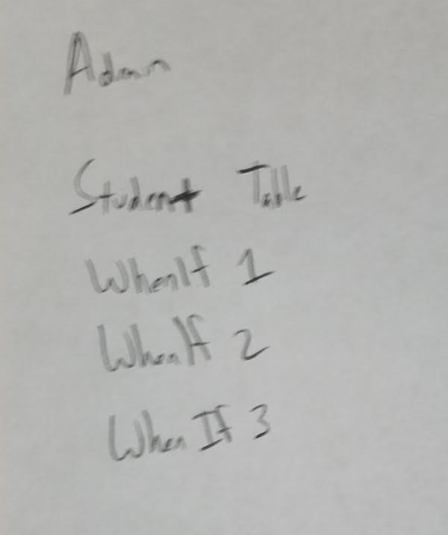
Administrator - Data reports
Administration has access to whenif report and copies to add to DB / student views

Slide 15
faculty

Slide 16
faculty

Slide 17
faculty

Slide 18
faculty

Slide 19
Administrator

Slide 20
Administrator

Slide 21
Administrator

