Slide 1
SYSTEM DESIGN
Arturo Alvarez
Sunny Syed
Austin Chase
Yongshang Tang
Tabish Ansari
Michael Weiss

Slide 2
THREE USERS BASED ON USE CASES
Student (New/Returning)
Faculty Advisor
Administrator

Slide 3
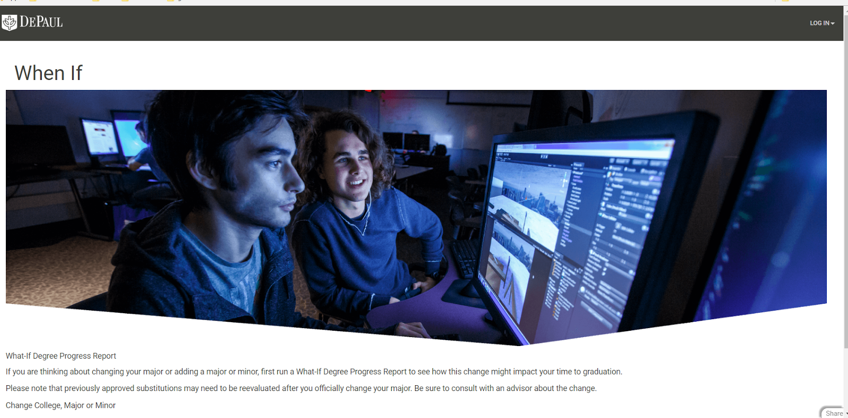
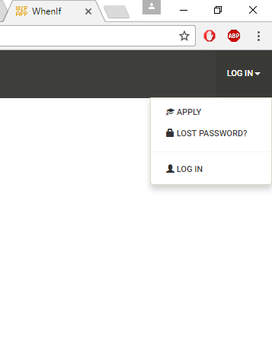
STUDENTS
Welcome to the homepage where you can login or apply

Slide 4
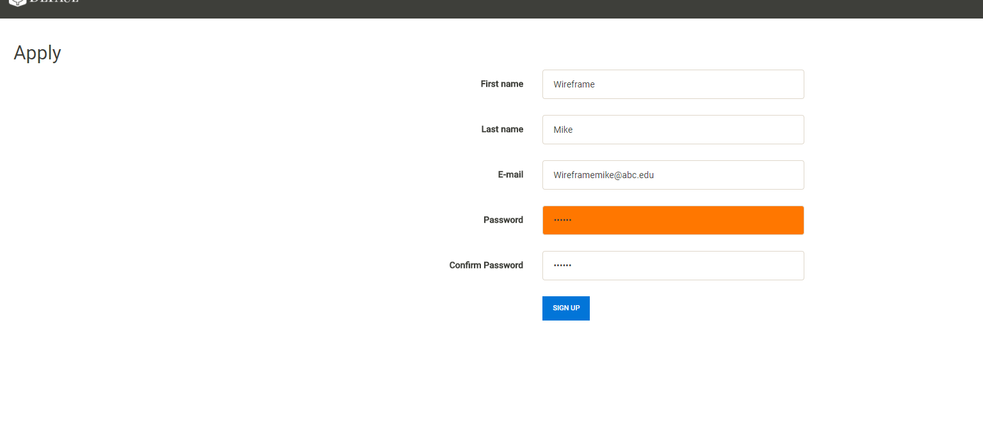
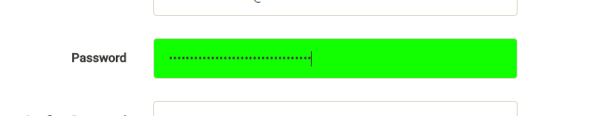
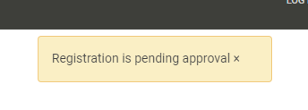
STUDENTS - APPLYING
Students can apply for an account with password strength verification
Approval requires verification from Admin

Slide 5
FACULTY/STUDENT APPLICATION
The student and faculty application looks the same
It requires approval from the admin

Slide 6
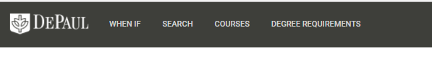
STUDENT LOGGING IN
New navigation bar appears at the top of the screen

Slide 7
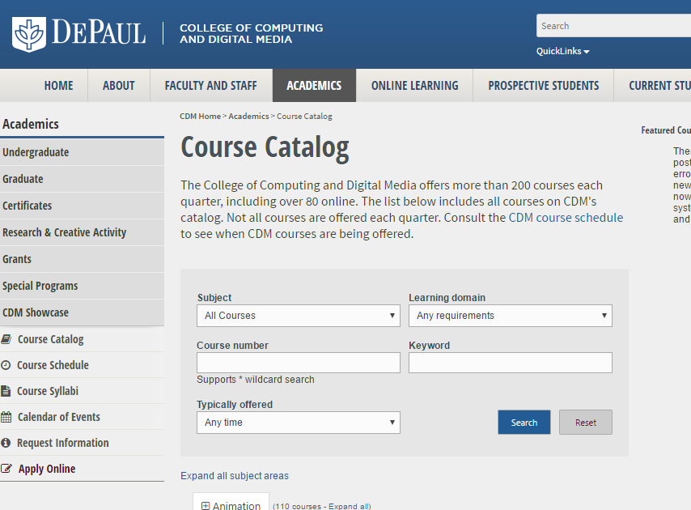
STUDENTS RESEARCH
When clicking on course requirements it opens the course catalog in a new tab

Slide 8
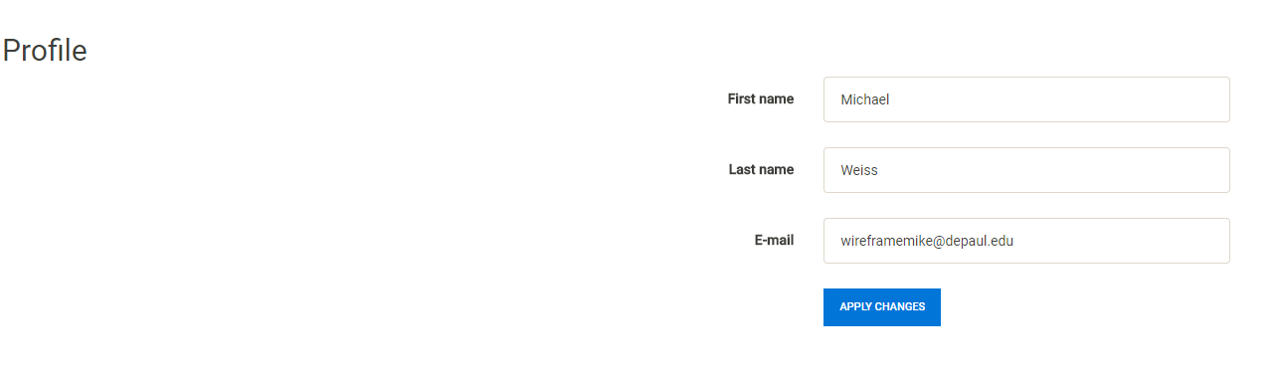
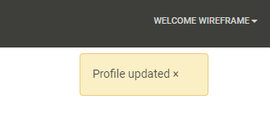
STUDENT EDIT PROFILE
Student profile
Updated name to user profile

Slide 9
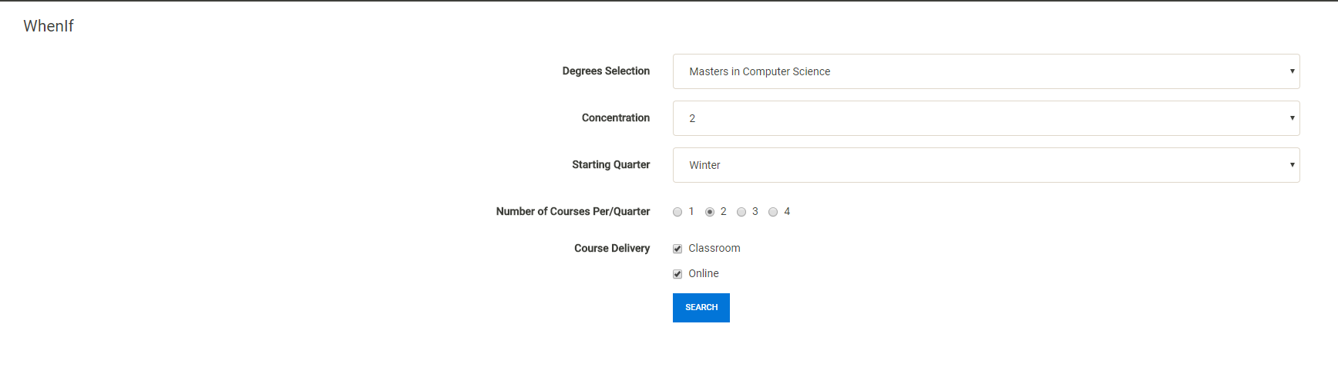
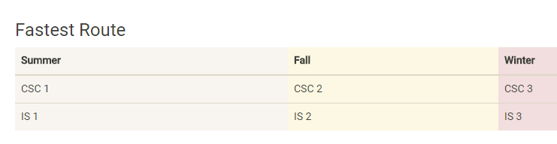
STUDENT WHENIF

Slide 10
HAD TO DRAW UP FRAMES FROM HERE ON

Slide 11
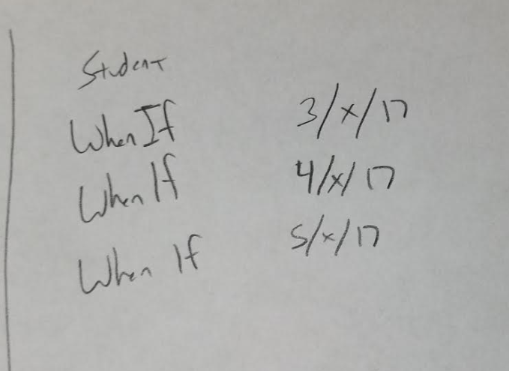
STUDENT - WHENIF
Students looking up their shortest path

Slide 12
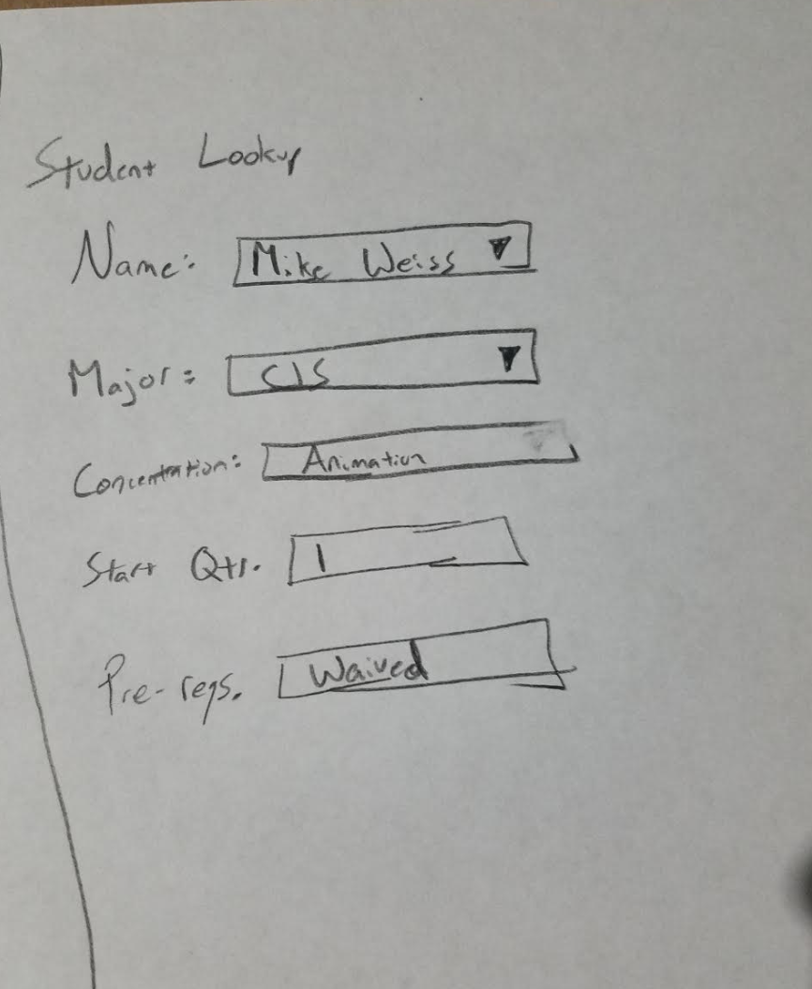
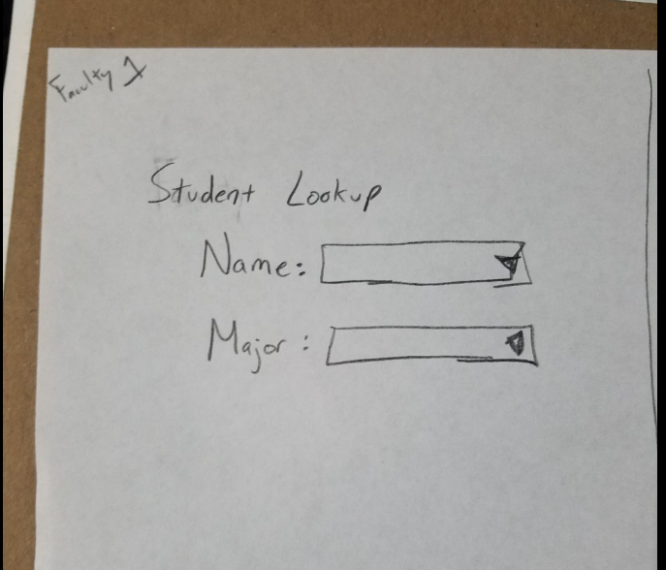
FACULTY LOOKUP
Student Account information after selecting student discuss options…(prereq or not)
Look up students in the system

Slide 13
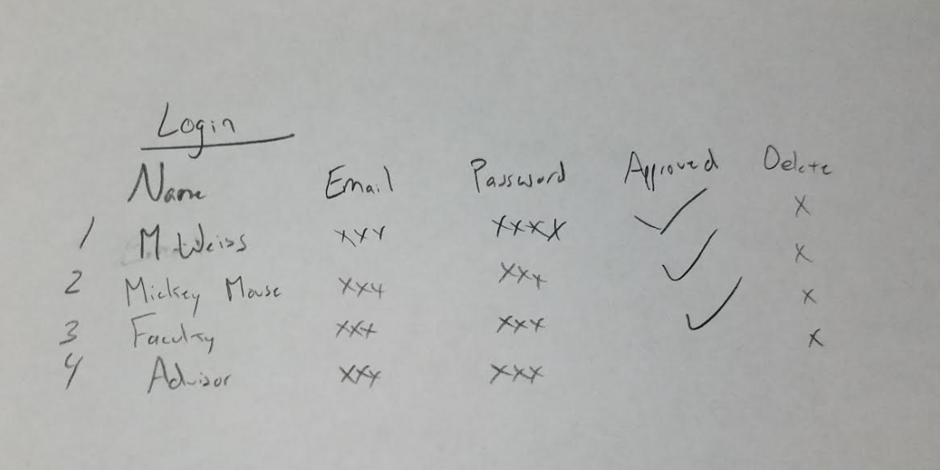
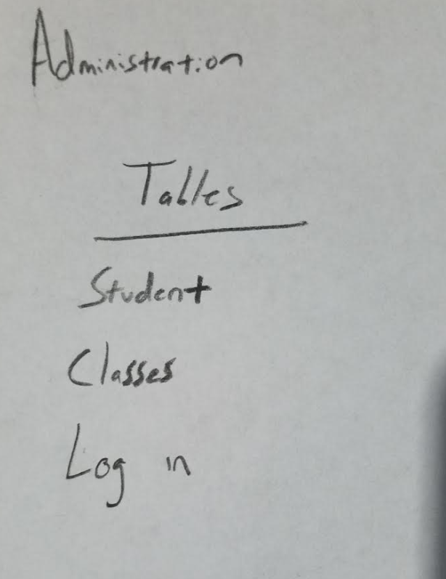
ADMINISTRATOR – DELETE/UPDATE/APPROVE RECORDS
Administration can view and edit tables

Slide 14
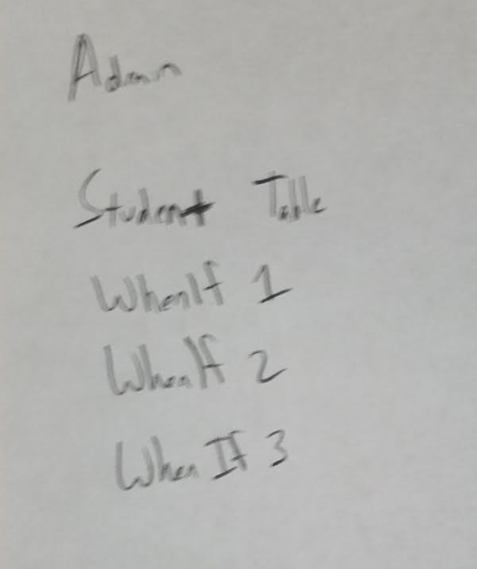
ADMINISTRATOR - DATA REPORTS
Administration has access to whenif report and copies to add to DB / student views

Slide 15
Q & A

