Slide 1
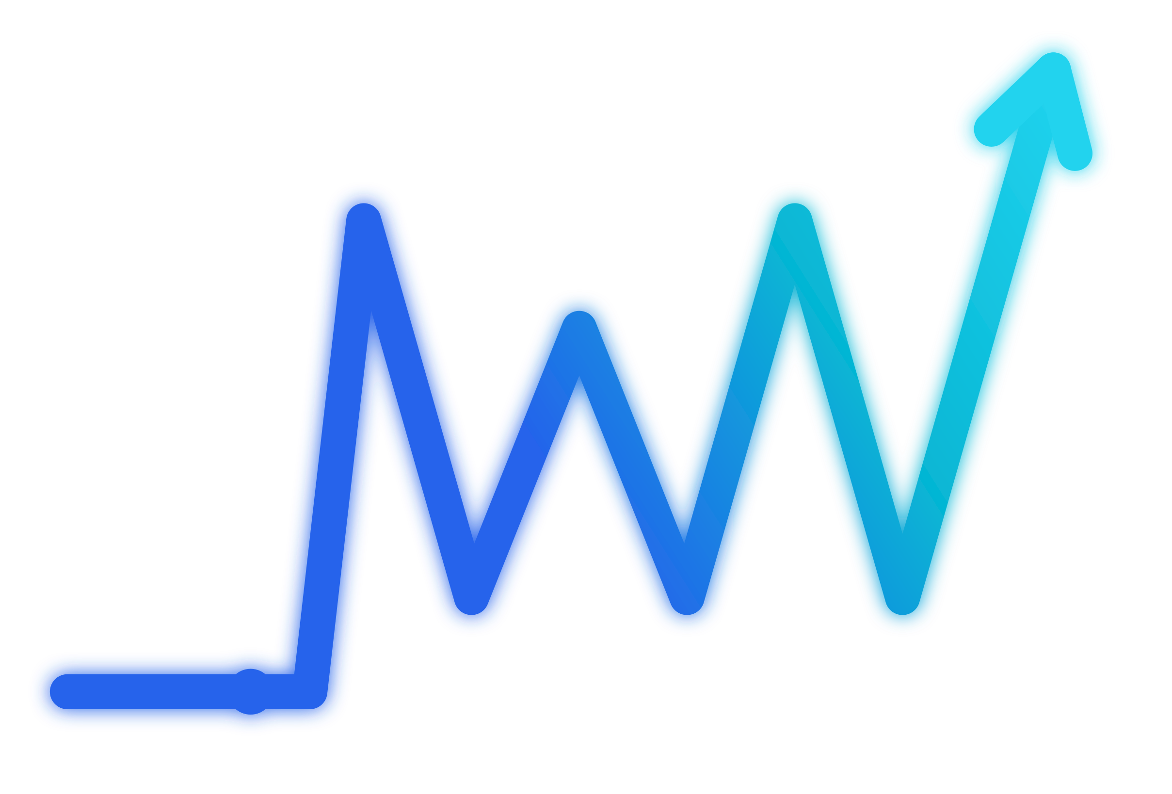
AMERICAS AGENTIC AI HACKATHON 2026 · SONG / CX
WattNext
The Kill Bill Shock Agent
Detect. Decide. Deliver.
Live demo → wattnext-ai.streamlit.app
Notes:
Hook: every month millions open a spiked utility bill and their only option is a call-center queue. WattNext acts. This is a live demo, not a video.

Slide 2
Bill shock has nowhere to go
56%
A spike hits — the customer waits in a call-center queue for answers.
High-bill calls are the costliest — multi-system investigations, the most staff-heavy contacts.
of utility complaints are about billing — the #1 category, more than all others combined.
Data-rich, decision-poor — today's systems report the problem — they don't resolve it.
Source: Tridens, 2026
Notes:
Billing is 56% of utility complaints — the biggest, most expensive category. Systems are data-rich but decision-poor. WattNext acts.

Slide 3
An agent that acts — not just answers
1
2
3
DETECT
DECIDE
DELIVER
Reads the spike from usage data — a spike is an alert, not a diagnosis.
Verifies the bill is right, then picks one of five routes.
Completes the action — with the customer's consent.
Different resolution for every customer.
Notes:
It detects the shock, decides the fix with one real AI call, delivers a completed action — a different resolution per customer. Let me show you live.

Slide 4
Five vetted routes — one safety layer
Bill Review & Correction — Is the bill even right? Estimated-to-actual, wrong rate, meter error — checked first.
Payment Flexibility — Valid bill, needs time — due-date extension or an installment plan.
Assistance Qualification — Pre-screen and prepare aid applications; the agency decides eligibility — no false promises.
Budget Billing — Smooth seasonal swings into a level monthly amount (not debt relief).
Lower Future Bills — Rate/plan review + efficiency and rebates to cut the root cause.
Human handoff wraps all five — for safety, disputed bills, and eligibility-sensitive cases.

Slide 5
LIVE DEMO
Real Gemini reasoning, streamed live. Dwayne → Bill Review · Maria → Assistance · Earl → Human handoff
Notes:
Switch to the live app. Run Maria (assistance, accept). Run James (different route — budget billing), then Decline to show the human handoff. Point at the LIVE GEMINI badge.

Slide 6
Same agent. Different route.
Dwayne
Maria
Bill +85% · estimated-then-actual read
Low-income · medical · bill valid
→ Bill Review — verify first
→ Assistance Qualification
We verify the bill before we treat it — a different outcome per customer.
Notes:
Same agent, different customer, different route — that's real per-customer reasoning, the differentiator. Let it land.

Slide 7
Autonomous — and safe by design
One real AI call, wrapped in rules It diagnoses & recommends — safety and eligibility never depend on the model.
Five vetted routes + human handoff Emergencies like imminent shutoff or medical risk escalate to a person, automatically.
You authorize every action WattNext prepares and forecasts the outcome; nothing changes without explicit consent.
Auditable Every check, recommendation, consent and action is logged.
Notes:
Genuinely autonomous but safe: one real call decides, guardrails stop it inventing a route or acting without consent, everything auditable.

Slide 8
Cents to decide. Dollars to ignore.
100–800×
~$1.6M / year
saved per 1,000,000 accounts (base case)
cost advantage per deflected call — an agent handles a bill-shock call for $6–$12; WattNext resolves it for cents of AI inference.
Conservative: 500K contacts × 40% deflected × $8/call.
Anchors: $6.47 avg call · 30–60% AI deflection (Gitnux, 2026)
Notes:
An agent call costs $6-12; a WattNext resolution costs cents — 100 to 800x. For a 1M-account utility, conservatively $1.6M a year. Numbers sit at the low-mid of published ranges.

Slide 9
Built to scale
Routes are configuration, not per-customer code. Add a resolution path once — every customer can reach it.
Same agent — any customer, any utility. The reasoning generalizes; only the inputs change.
$0.97M
$1.6M
$3.6M
Conservative · per 1M accts / yr
Base · per 1M accts / yr
Optimistic · per 1M accts / yr
Notes:
Routes are config not code, so it scales for free. Sensitivity range shows even the conservative case is compelling.

Slide 10
From two customers to two million.
WattNext turns bill shock into a resolved outcome — faster for customers, cheaper for utilities, safe by design.
The ask: invest to help us scale it.
wattnext-ai.streamlit.app
Notes:
WattNext turns a bill-shock moment into a resolved outcome. We're asking for your investment to take it from two customers to two million.

