Slide 1
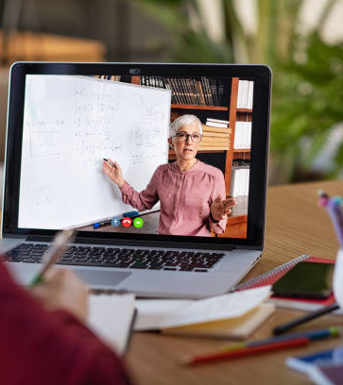
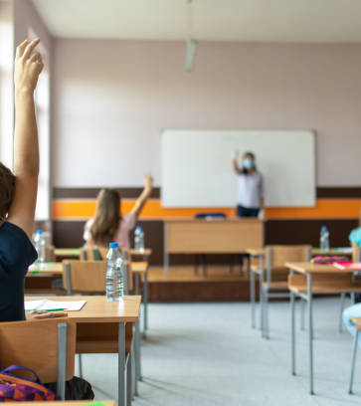
ONLINE EDUCATION VS FACE TO FACE EDUCATION

Slide 2
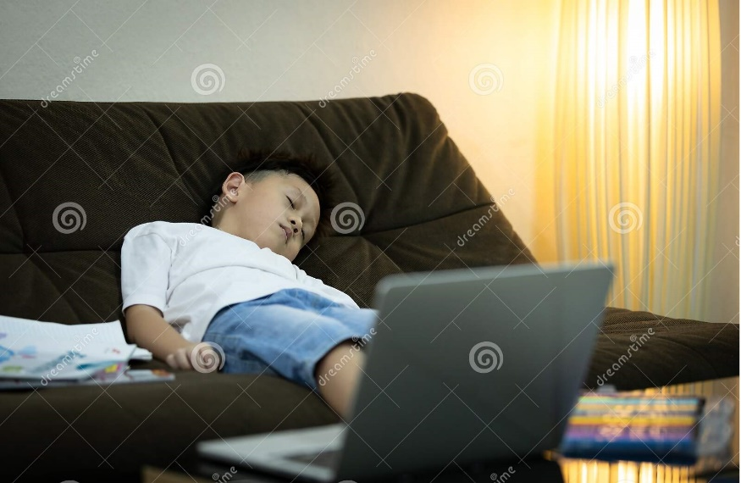
Why did we choose this topic?
Teachers’ and students’ struggles regarding online lessons.
Showing the advantages and disadvantages of both sides.
Comparing online education and face-to-face education with the help of the resources we found.
To determine the problems that prevent teachers from using online education tools effectively.
To provide solutions for the problems we determined in general.

Slide 3

Online Education
Online education is a flexible instructional delivery system that encompasses any kind of learning that takes place via the Internet
Distance education started with radio, vcr, tv books, etc.
With the invention of computers and the Internet, online education gradually increased and became ubiquitous today with the impact of Covid-19.

Slide 4
Advantages of Online Education
Rapid and effective way of learning
Comfortable
Way easier to collaborate with teachers as well as study groups.
Diversity of instructors.
Time-saving i.e. time is precious, students and teachers can save their time and energy by not commuting to their schools every workday.
Suitable for people with disabilities and for people who can’t afford a university degree or a training program.

Slide 5
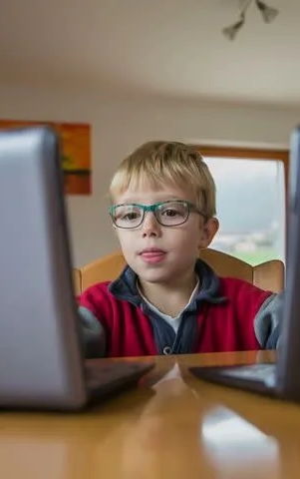
Disadvantages of Online Education
Evaluation and measurement are usually inaccurate.
Some teachers and students want to stay away from online education due to the lack of technical knowledge.
Technical difficulties may occur occasionally.
Excessive studying may result in health issues e.g. eyesight problems, spine problems.
May create a sense of isolation, particularly in asynchronous lessons.

Slide 6

Face to face education
Face to face education is an education or training that is provided in-person whether in a one-on-one session or in a group setting. This type of learning is disadvantageous when it comes to flexibility. The students need to attend the course accordingly to the schedule.

Slide 7

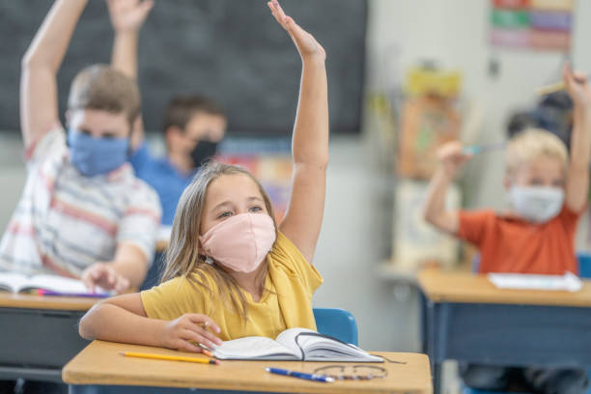
Advantages of Face to Face Education
Better interaction between teachers and students.
More accurate assessment on exams.
More convenient for social interaction.
More materials can be used. e.g., labs, projections, experiments.
Different activities can be provided by institutions.

Slide 8
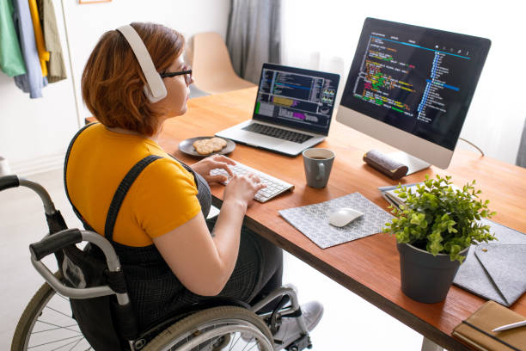
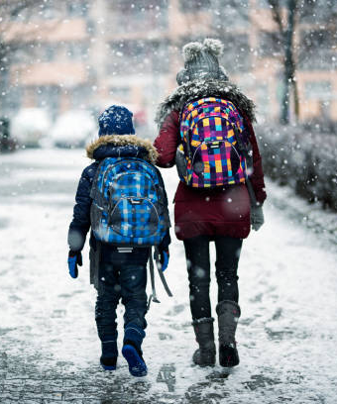
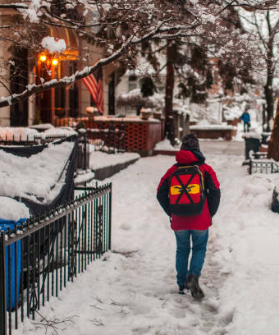
Disadvantages of face to face education
May not be suitable for people with disabilities and bad economic backgrounds.
Students may expend money and time when commuting to work or school.
Students’ success levels and educational backgrounds may be incompatible with each other, and this may slow down the learning process.

Slide 9
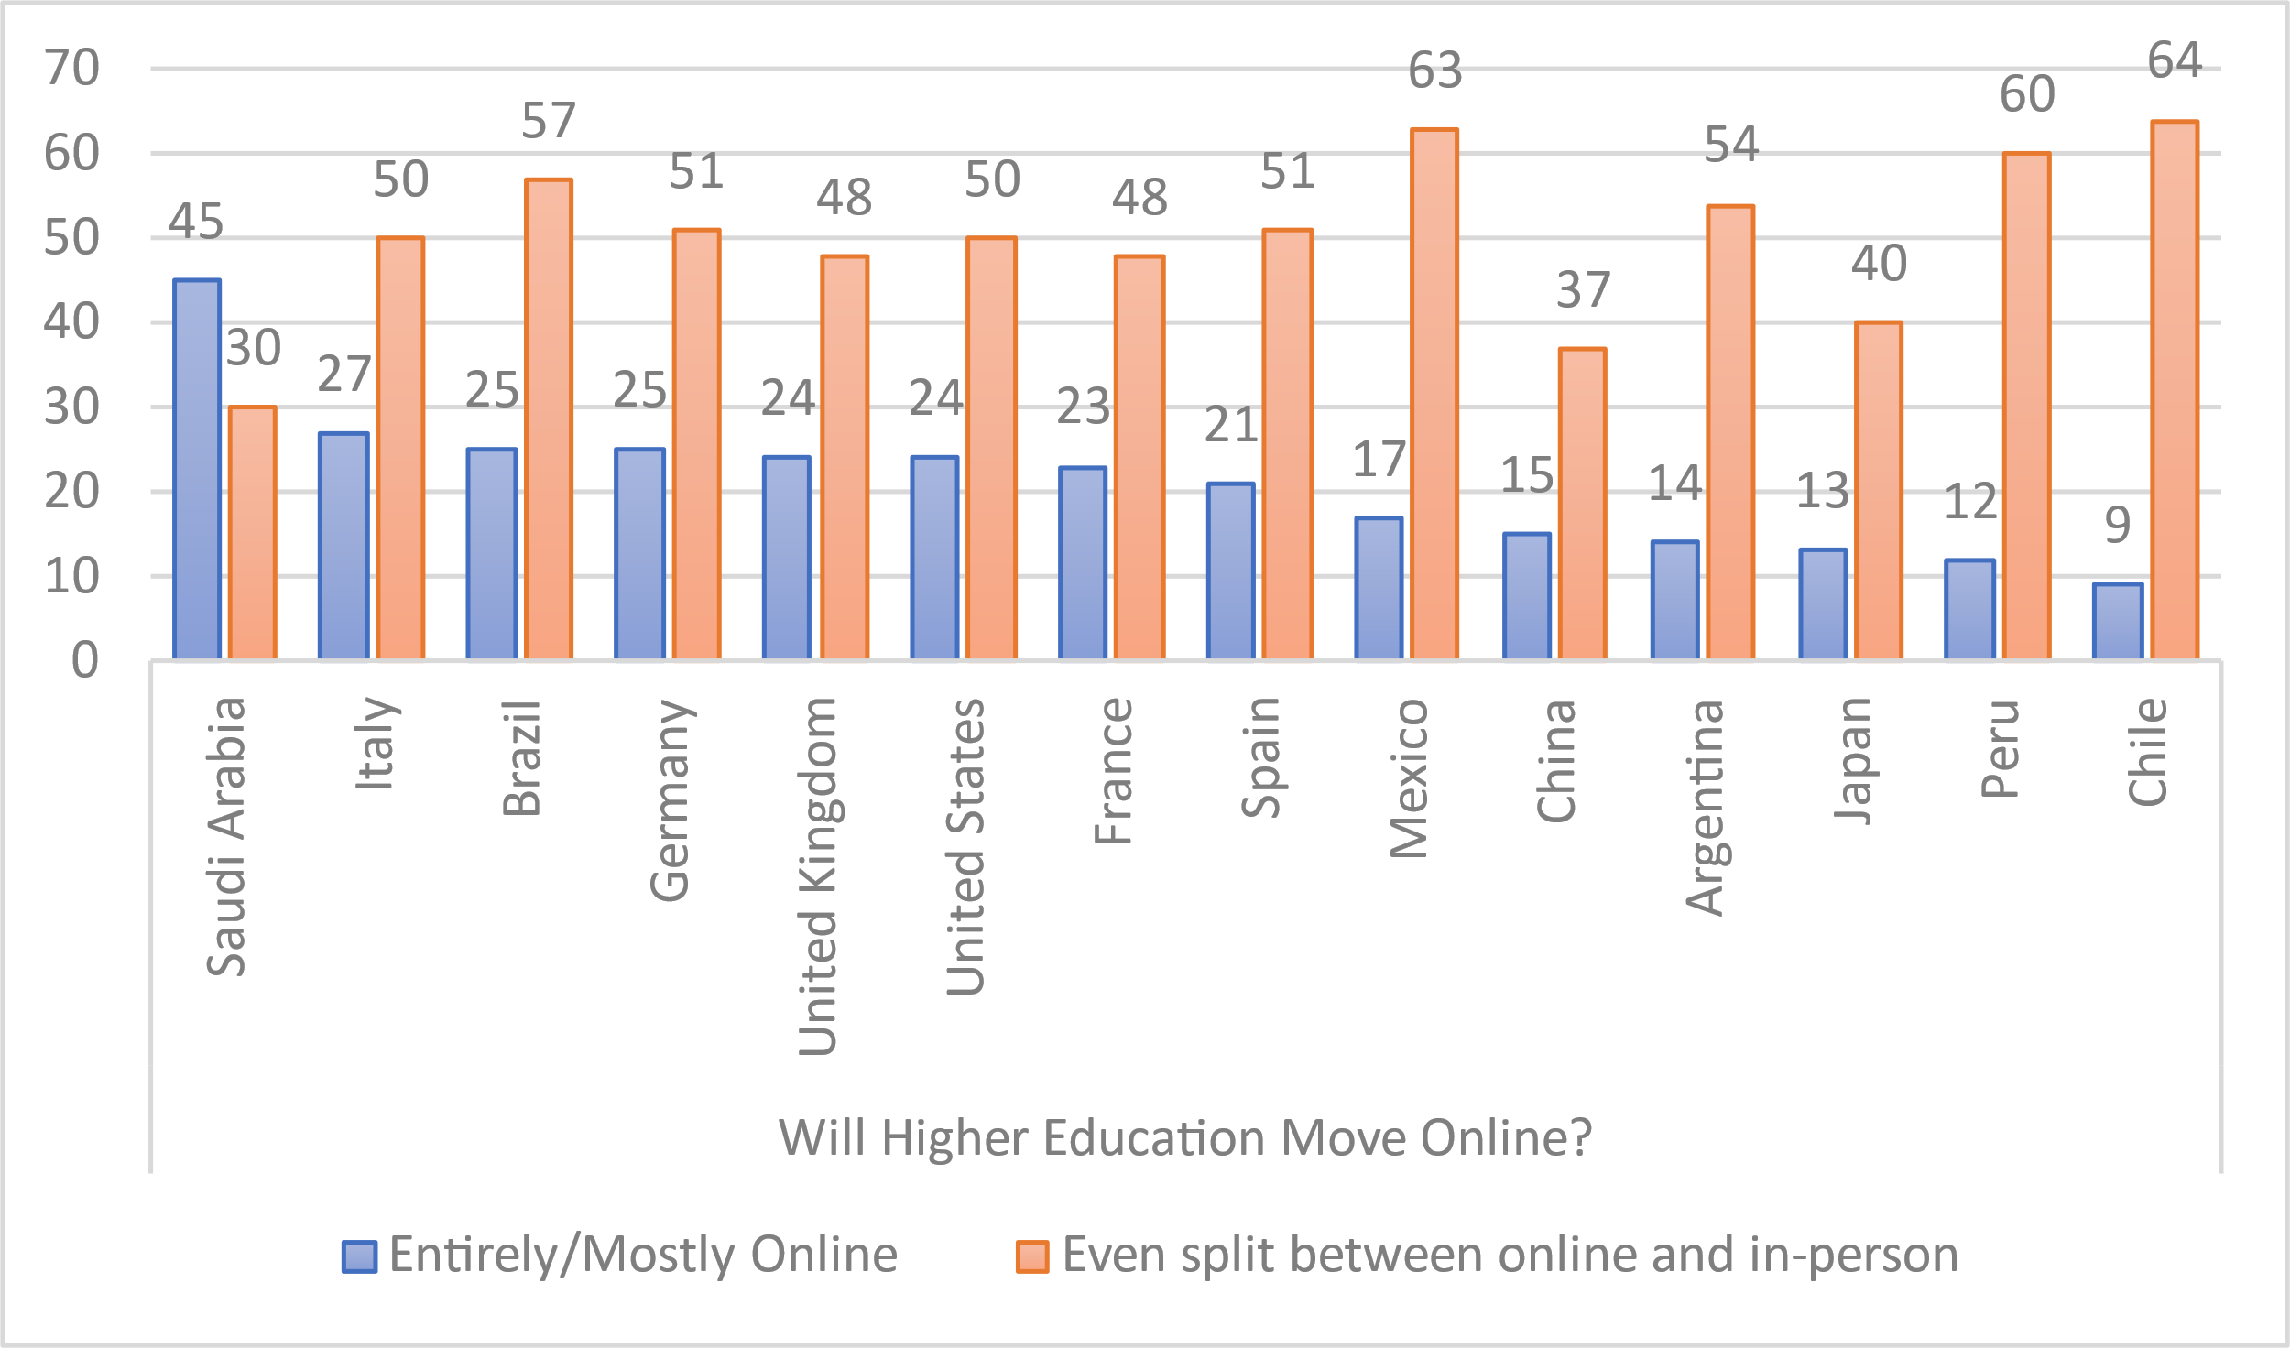

Slide 10
Thanks for Listening.
Muhammed Behlül Uğur
Muhammed Sinan
Mert Özen
Yunus Teke

