Slide 1

Microsoft Access E-Commerce Group Project
POBRES DIABLOS
Muhammed Sinan / 2508620
Muhammed Behlül Uğur / 2567659
Yunus Teke / 2508638

Slide 2

Description of the Project
An e-commmerce database using Microsoft Access. Products, product categories, product inventory, customers, orders, order details etc. will be included to the database.
We decided to make a pet-food e-commerce database, which sells various types of pet foods all around the world.

Slide 3
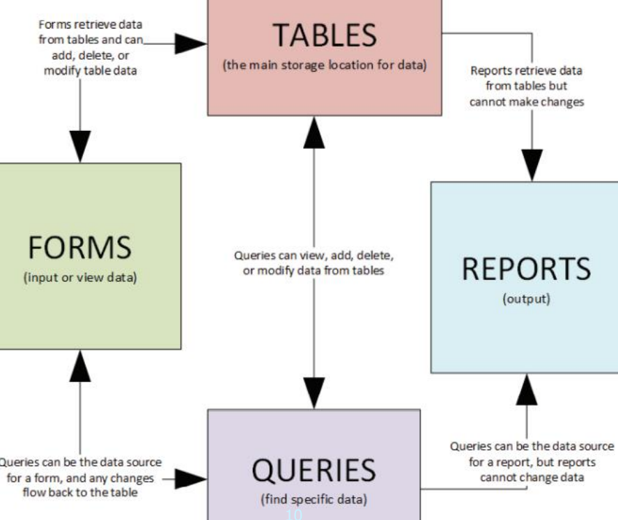

Slide 4
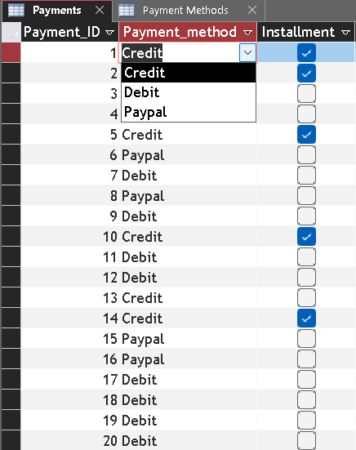
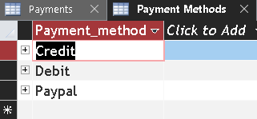
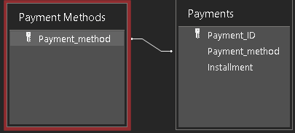
Progress-Payments Tables

Slide 5
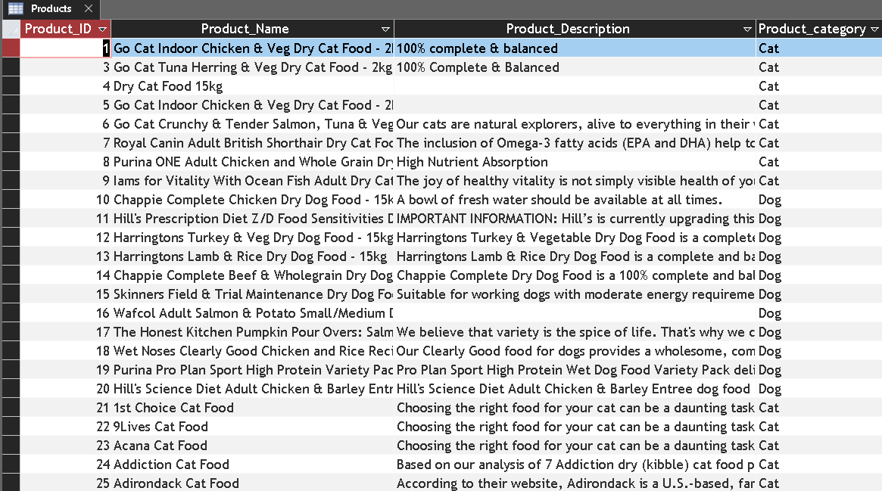
PRODUCTS TABLE

Slide 6
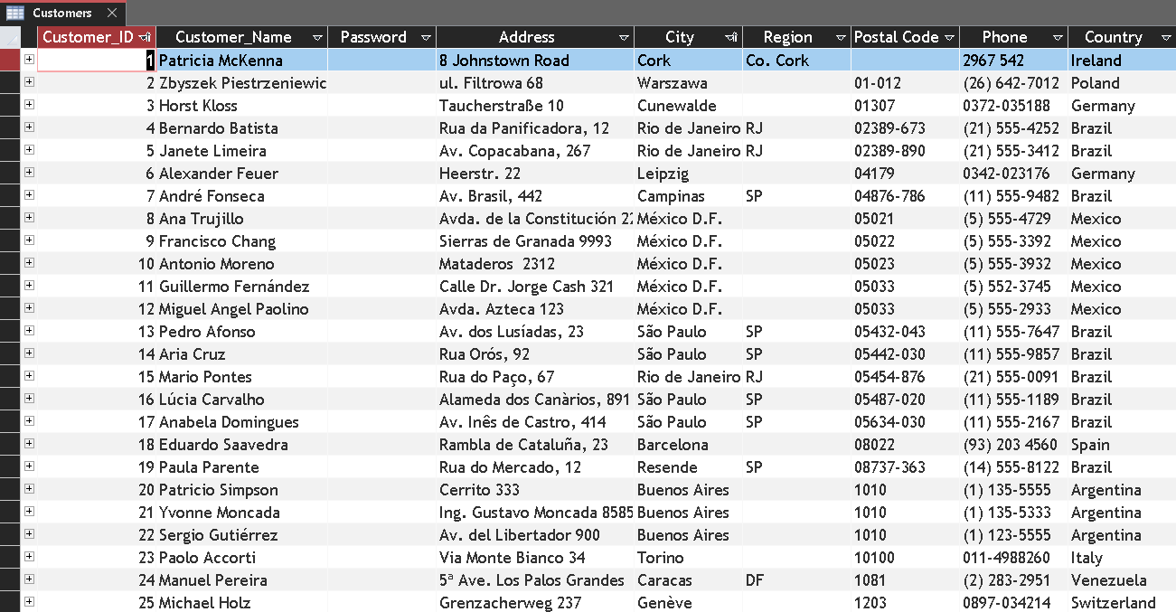
CUSTOMERS TABLE

Slide 7
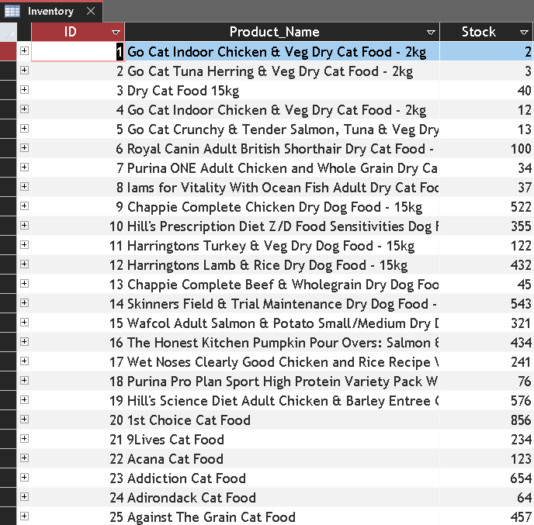
INVENTORY TABLE

Slide 8
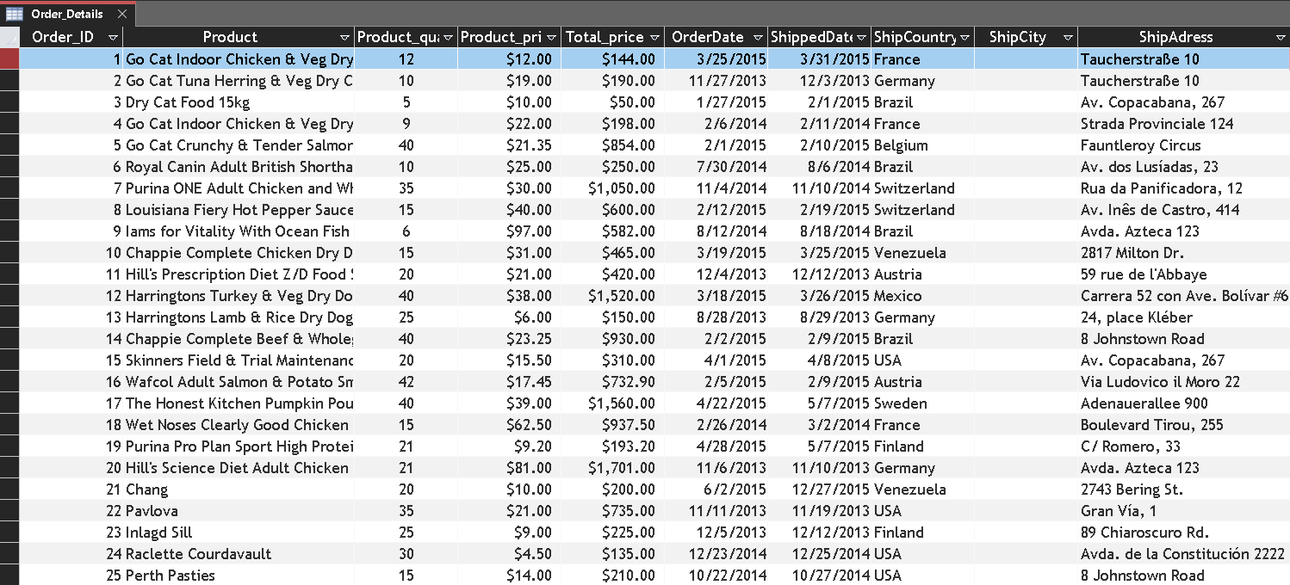
ORDER DETAILS TABLE

Slide 9
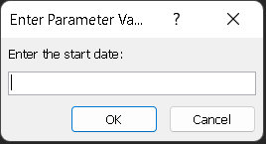
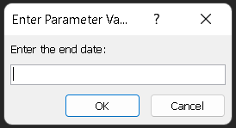


TOTAL REVENUE BETWEEN CERTAIN DATES QUERY

Slide 10
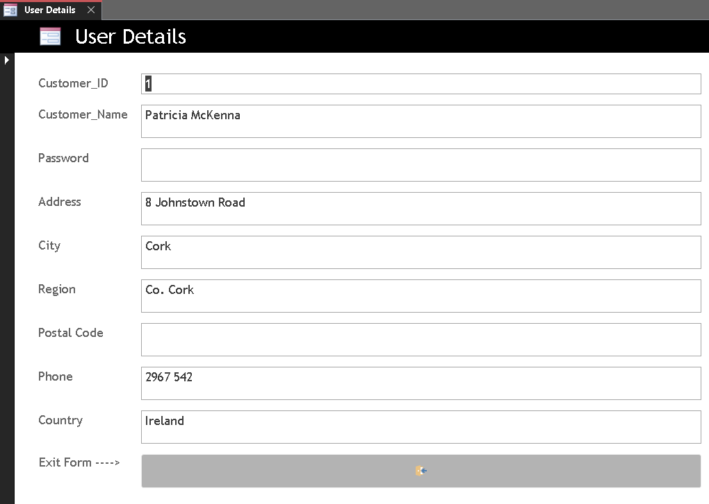
USER DETAILS FORM

Slide 11
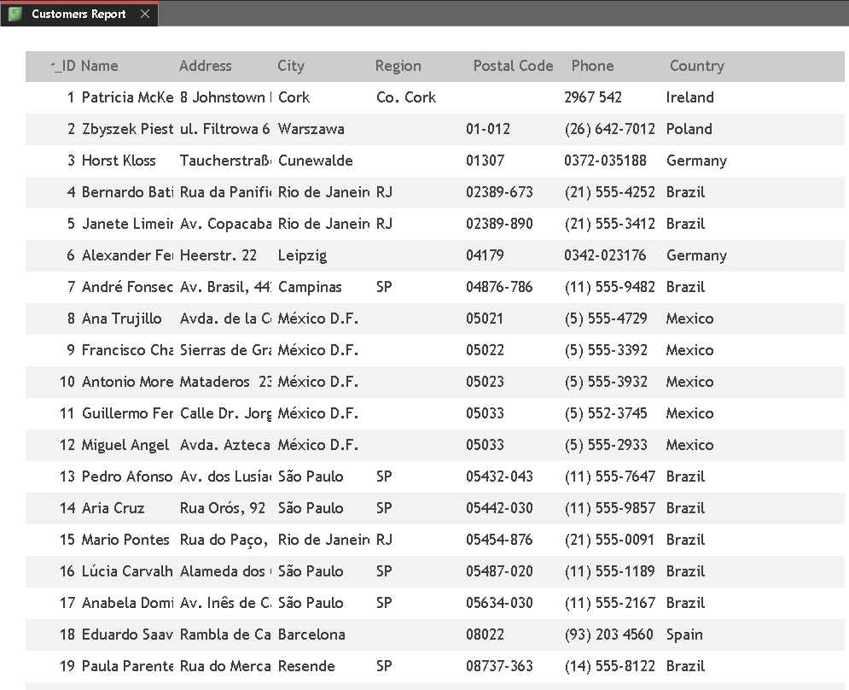
CUSTOMERS REPORT

