Slide 1

YOUR DIGITAL AGENDA
Group#10 POBRES DIABLOS
Muhammed Sinan / 2508620
Muhammed Behlül Uğur / 2567659
Yunus Teke / 2508638

Slide 2
Work sharıng
Yunus Teke:
Front-end, Debugging
Muhammed Behlül Uğur
Back-end, Login System, Debugging
Muhammed Sinan
Back-end, Register System, Password Recovery

Slide 3


WHAT IS "YOUR DIGITAL AGENDA"
We prepared a daybook website that is aimed to be helpful for those who need a website solution for their daily tasks.

Slide 4
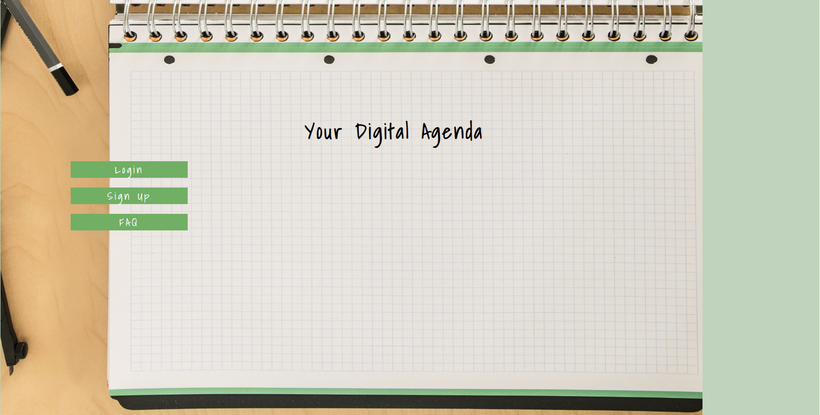
Maın page

Slide 5
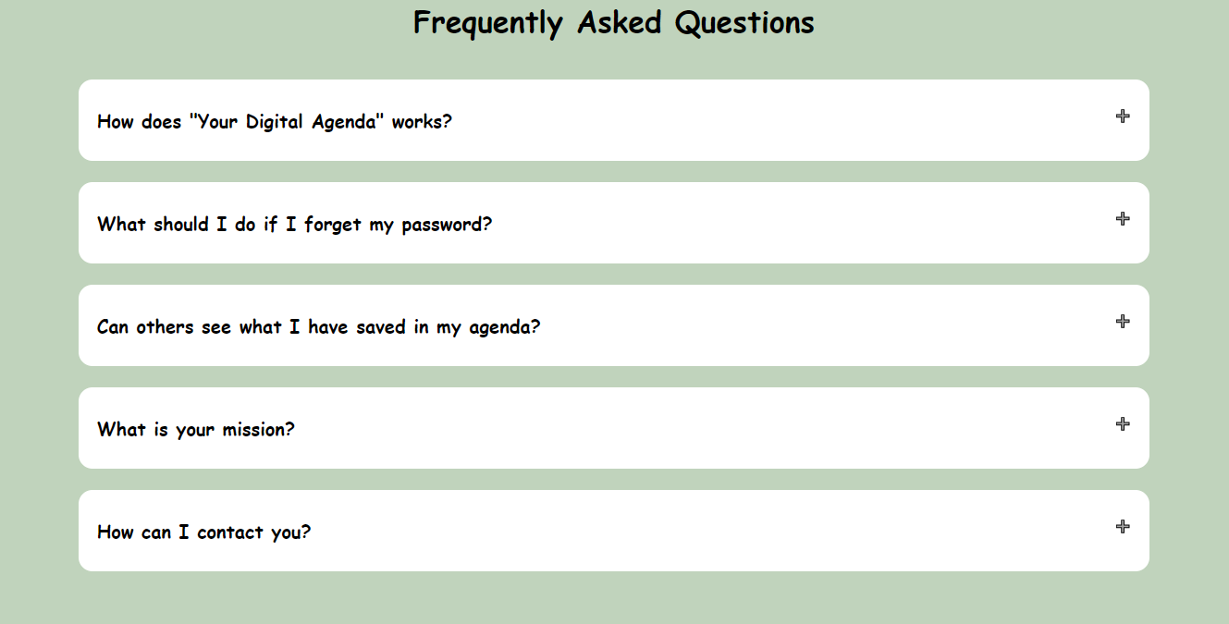

Slide 6
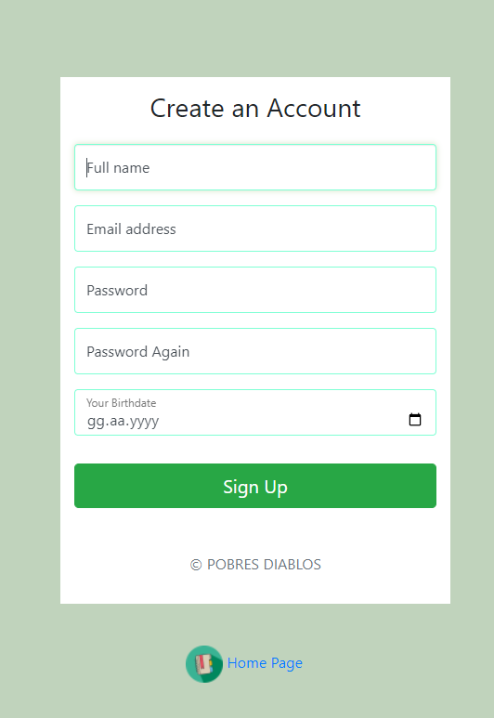
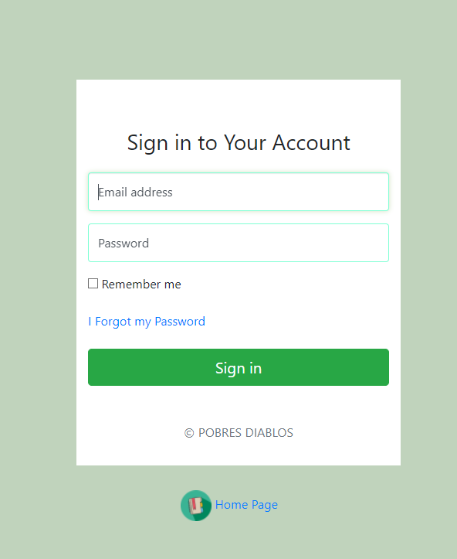
Regıster and logın system

Slide 7
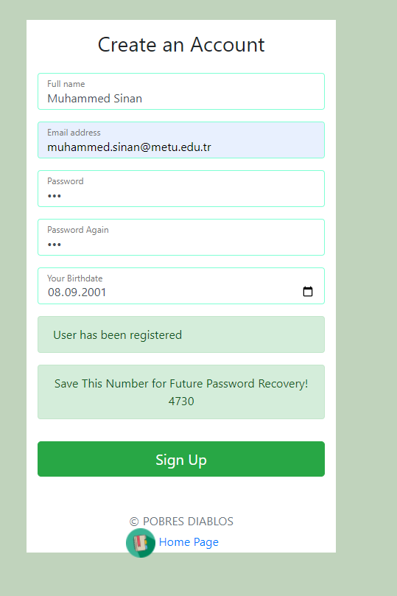
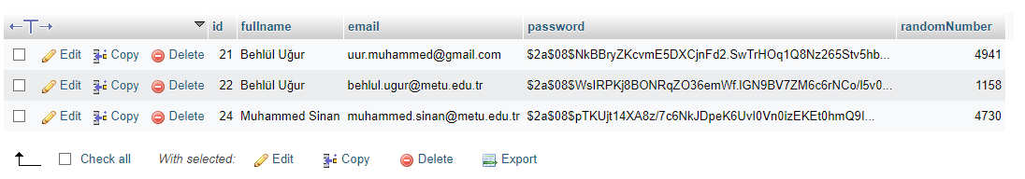

Slide 8
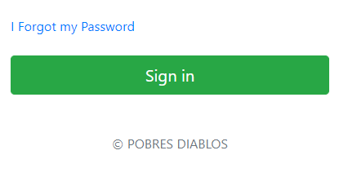
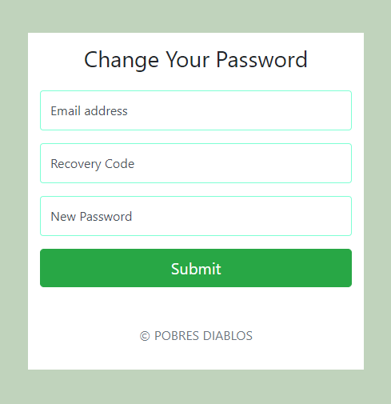
Password recovery

Slide 9
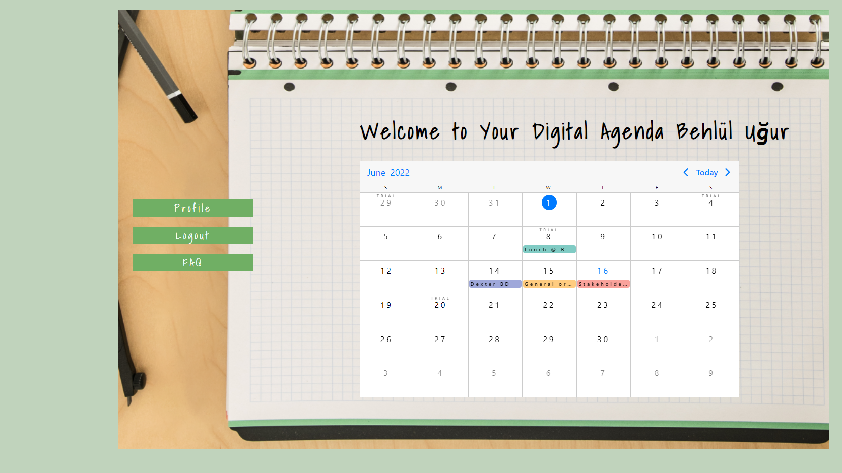
Logged ın maın page

Slide 10
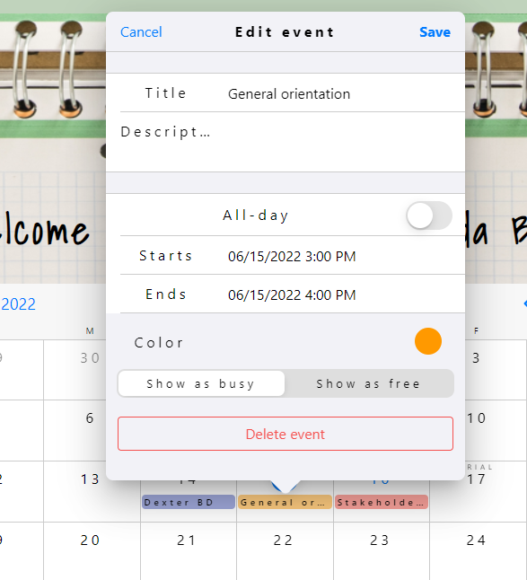
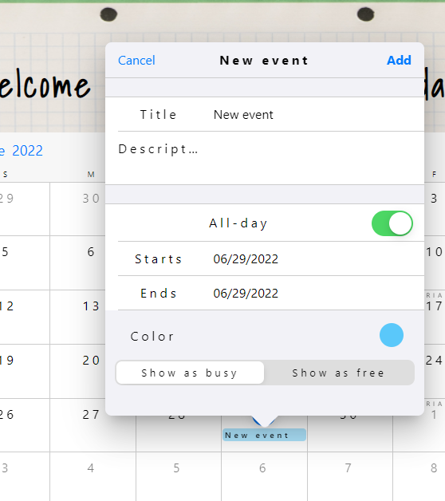
Calendar features
Adding-Deleting Events

Slide 11
Technologıes we learned and used so far
HTML
CSS
JAVASCRIPT
NODE.JS
EXPRESS.JS
XAMPP
EJS
MYSQL
COOKIES
PASSWORD ENCRYPTION
ADOBE PHOTOSHOP
CANVA

Slide 12
Thanks for lıstenıng to us
You can ask your questions now

