Slide 1

SLEEP and Neuroscience in the Classroom

Slide 2
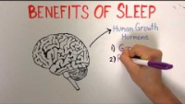

Slide 3
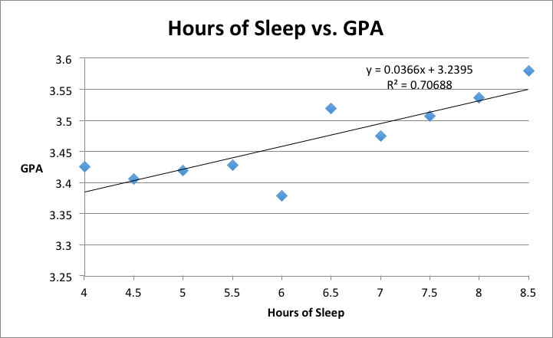
(SiOWfa15: Science in Our World: Certainty and Controversy, 2015).

Slide 4
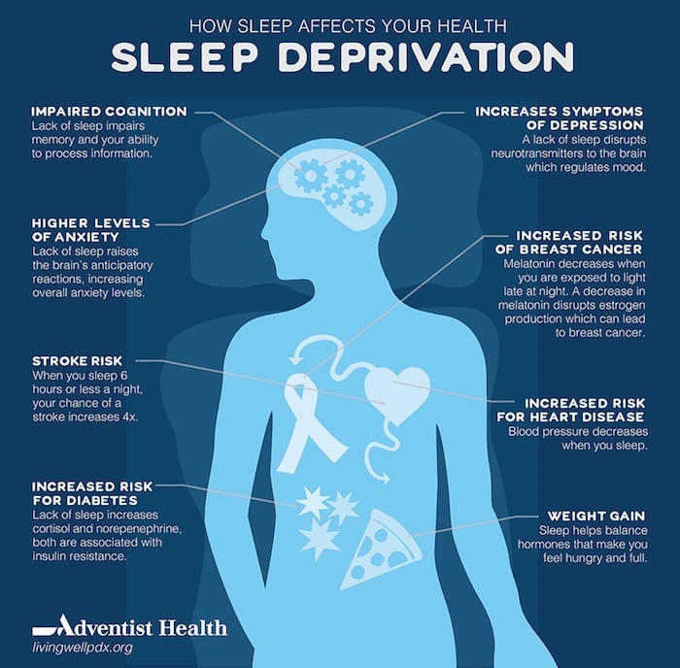

Slide 5


Slide 6

Conclusion
Sleep is crucial for cognitive functioning and academic success.
Understanding the neuroscience of sleep can help optimize learning capabilities.
Practical strategies to improve sleep habits can enhance academic performance.
Creating a nurturing environment that supports students' well-being and sleep can contribute to their educational journey.
Embracing the power of sleep can unlock students' full potential.

Slide 7
EXCERCISE and Neuroscience in the Classroom

Slide 8
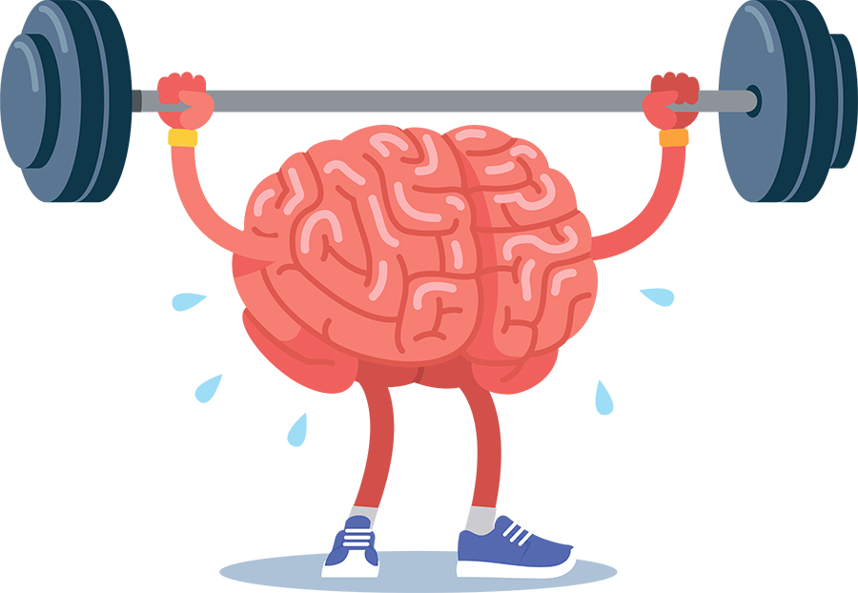
Fitness Matters to the Brain
Physically active and aerobically fit children consistently outperform sedentary peers academically.
Regular physical activity improves brain structure and function underlying academic performance.
Aerobic fitness has the strongest relationship with mathematics, reading, and English performance.
Physical activity enriches cognitive development and lifelong brain health.

Slide 9

Run, Mice, Run
Running triggers the production of new neurons in the hippocampus, improving memory.
Exercise-induced chemical changes in the brain regulate neurogenesis, synaptic plasticity, and learning.
Physical exercise increases levels of brain-derived neurotrophic factor (BDNF) linked to neuron growth.
Exercise enhances neural connections, synapse flexibility, and the production of brain chemicals.

Slide 10
Exercise and Children's Mental Performance
Physically fit children exhibit better relational memory and larger hippocampal volumes.
Physically fit children absorb and retain new information more effectively.
Higher fitness levels positively impact neurocognitive function in challenging learning situations.

Slide 11

How Much and What Kind?
Moderate exercise (30 minutes for adults, 20 minutes for children) leads to 5-10% improvement in cognition.
Both single bouts of exercise and long-term participation in physical activity benefit cognitive function.
Cardiovascular exercise has the greatest impact on academic achievement, but all types of physical activity contribute to enhanced performance.
Integrating movement and physical activity into the school day supports learning and cognitive development.

Slide 12

Walking to School Gets an A
Walking or biking to school improves a child's ability to concentrate in the classroom.
The benefits of exercise in the morning last half the day and outperform the impact of breakfast and lunch.
Exercise has a significant and lasting effect on concentration levels.

Slide 13

Elite Athletes Excel Off the Court, Too
Elite athletes excel not only in their sport but also in cognitive tasks involving change and distraction.
Years of specific physical training enhance cognitive abilities, including memory and multitasking.
Athletes demonstrate faster information processing, improved perception, and better task management.

Slide 14
Conclusion
Regular exercise has been shown to have a significant positive impact on cognitive functions and academic performance in children.
Physically active children generally outperform their sedentary peers, with improvements seen in memory, attention, problem-solving, and executive function.
Exercise promotes the growth of new neurons, enhances brain structure and functioning, and stimulates the production of important brain chemicals.
Both short-term bursts of activity and long-term participation in physical activity contribute to improved cognitive abilities.
Integrating exercise into the school day and promoting active lifestyles can have profound benefits for children's cognitive development and overall well-being.
Educators, administrators, and parents should recognize the importance of exercise in supporting children's academic success and prioritize physical activity as an essential part of their education.
By harnessing the power of exercise, we can optimize children's brain health, unlock their full potential, and set them on a path to lifelong learning and achievement.

Slide 15
Nutrition and Neuroscience in the Classroom

Slide 16

- Neuroscience can help teachers understand how students learn and remember information.
- Nutrition can affect students' brain function, attention, and mood.
- Applying insights from neuroscience and nutrition can help teachers design effective and engaging lessons for students.
- This topic is relevant to student learning and academic performance because it can help teachers optimize students' cognitive potential and well-being.

Slide 17

Why Nutrition Matters
- Nutrition is essential for maintaining physical and mental health, as well as preventing diseases and infections.
- Nutrition influences brain development and cognitive function, especially in children and adolescents. A balanced diet can enhance learning, memory, and creativity.
- Nutrition affects mood, energy levels, and concentration. Poor nutrition can lead to stress, fatigue, and irritability. Good nutrition can boost mood, motivation, and focus.

Slide 18
Brain Development
- The brain is not fully developed at birth. It undergoes significant changes during childhood and adolescence.
- Nutrition plays a vital role in supporting brain development. It provides the building blocks for brain cells, neural connections, and myelin sheaths.
- Essential nutrients such as omega-3 fatty acids, vitamins, and minerals are crucial for optimal brain function and learning.

Slide 19
Cognitive Function
- Nutrition is a crucial component to cognitive development, especially in the early years of life.
- Certain nutrients, such as iron, iodine, zinc, B vitamins, DHA, and omega-3 polyunsaturated fatty acids, have been shown to enhance cognitive ability by providing building blocks for brain function.
- A balanced diet positively influences executive functions like decision-making and problem-solving by maintaining optimal blood supply to the brain and preventing oxidative stress and inflammation.

Slide 20
Neurotransmitters and Mood
- Neurotransmitters are chemical messengers that influence mood and emotions in the brain.
- Nutrition affects neurotransmitter production and balance by providing the building blocks and cofactors for their synthesis and metabolism.
- Healthy fats, protein, and complex carbohydrates are essential for optimal neurotransmitter function because they support neuronal membrane integrity, neurotransmitter transport, and blood glucose regulation.

Slide 21

Energy and Concentration
- Nutrition affects energy levels and concentration by providing the brain with essential nutrients and fuel.
- Blood sugar levels influence brain function and mood. Balanced meals and snacks help maintain stable blood sugar levels and prevent energy dips and cravings.
- Sugary foods and beverages can cause spikes and crashes in blood sugar levels, which impair energy and concentration. They can also interfere with learning and memory processes in the brain.

Slide 22
Brain-Boosting Foods
- To enhance cognitive function and memory, students should eat foods that nourish their brains.
- Fruits and vegetables are rich in antioxidants, which protect brain cells from damage and inflammation.
- Whole grains provide glucose, which is the main fuel for the brain.
- Lean proteins supply amino acids, which are the building blocks of neurotransmitters, the chemical messengers in the brain.
- Healthy fats, especially omega-3 fatty acids, support brain structure and function.
- Some examples of brain-boosting foods are blueberries, salmon, nuts, and dark chocolate. They contain nutrients such as anthocyanins, DHA, vitamin E, and flavonoids, which have been shown to improve brain health.

Slide 23
Healthy Eating Tips
- Healthy eating habits support brain development and learning outcomes in students.
- Teachers can promote healthy eating in the classroom by:
- Encouraging students to eat a balanced breakfast every morning and providing healthy snacks if needed.
- Explaining how hydration affects cognitive functions and reminding students to drink water regularly.
- Introducing students to a variety of nutritious foods and discussing their benefits for the brain and body.
- Creating a positive and supportive environment for students to enjoy their meals and snacks.

Slide 24
Practical Strategies
- Neuroscience shows that nutrition affects brain development and learning outcomes.
- Incorporating nutrition education into the curriculum can help students develop healthy eating habits and improve their academic performance.
- Some examples of nutrition education activities are:
- Cooking classes: Students can learn about food groups, ingredients, and recipes while preparing and tasting different dishes.
- Nutrition-themed projects: Students can research, and present topics related to nutrition, such as food labels, dietary guidelines, or cultural cuisines.
- Guest speakers: Students can hear from experts in the field of nutrition, such as dietitians, chefs, or farmers.
- Collaboration between teachers, parents, and the community is essential for creating a supportive environment for nutrition education.
- Teachers can communicate with parents about the goals and benefits of nutrition education and provide them with resources and tips for reinforcing the lessons at home.
- Parents can support their children's learning by providing nutritious meals and snacks, encouraging physical activity, and modeling healthy behaviors.
- The community can offer opportunities for students to learn about nutrition outside the classroom, such as visiting local farms, markets, or restaurants.

Slide 25
Conclusion
Nutrition plays a vital role in overall health and well-being.
Proper nutrition supports brain development, cognitive function, and mood regulation.
A balanced diet provides essential nutrients for optimal brain growth and neural connections.
Nutritional choices impact energy levels, concentration, and academic performance.
Brain-boosting foods include fruits, vegetables, whole grains, lean proteins, and healthy fats.
Encouraging healthy eating habits in the classroom promotes optimal cognitive function.
Collaboration between teachers, parents, and the community is crucial for successful implementation.
Prioritizing nutrition in the classroom enhances learning outcomes and student success.

Slide 26

Thank you

Slide 27

Prepared by Muhammed sinan 2508620 Yunus teke 2508638 Batuhan sariaslan 2508604

Slide 28
References
Scalise, K., & Felde, M. (2017). Why Neuroscience Matters in the Classroom. Pearson.
SiOWfa15: Science in Our World: Certainty and Controversy. (2015). Sleep and Grades [Graph]. Retrieved from https://sites.psu.edu/siowfa15/wp-content/uploads/sites/29639/2015/10/sleep.png
TEDx Talks. (2016, May 31). The benefits of a good night’s sleep - Shai Marcu [Video]. YouTube. https://youtu.be/MBVpK4EiwmM?t=30
Patel, N. (2017). Sleep Deprivation Infographic [Infographic]. Neil Patel. Retrieved from https://neilpatel.com/wp-content/uploads/2017/08/sleep-deprivation-infographic.gif
GoodTherapy. (2015). Sleep Hygiene Infographic [Infographic]. Retrieved from http://www.goodtherapy.org/blog/wp-content/uploads/2015/10/sleep-hygiene-infographic-goodtherapy.org_1.jpg

