Slide 1
Student Performance Prediction Project
Yunus Teke & Atakan Karataş
Project Development & Management Class
Speedrunners

Slide 2
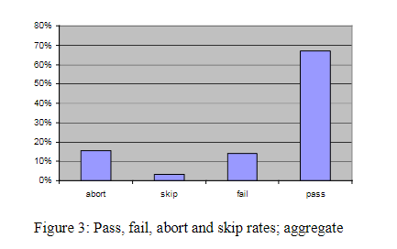
Problem Focused
• Problem: Teachers often struggle to identify at-risk students early on.
• Consequences: Failure to provide timely support can result in students falling behind, higher dropout rates, and lower overall academic performance.
• Affected: Primarily students, but also impacts teachers and school outcomes.
• Supporting Data: Research indicates that failure rates in introductory programming courses are a significant issue. According to the paper "Failure Rates in Introductory Programming" by Jens Bennedsen and Michael E. Caspersen (2007), only 72% of students pass these courses, meaning 28% of students struggle to meet the requirements for success.
Notes:
https://dl.acm.org/doi/epdf/10.1145/1272848.1272879

Slide 3
SolutION
Proposed Solution: Develop a predictive model that assesses students' likelihood of passing or failing based on features like study hours, attendance, sleep hours, exam scores etc.
Key Features: User-friendly interface for teachers, graphing capabilities, and operates entirely on a local machine, ensuring student data privacy. No server or internet connection is required, so only the teacher can view the results directly.
Benefits: Enables teachers to proactively identify and support at-risk students.

Slide 4
Innovatıon
Innovation: An existing Hugging Face model, adapted specifically for education data, fined-tuned for this project
Differentiation: Offline use without servers, allowing teachers easy access to predictions and insights.
Unique Value: Focus on a holistic, data-driven approach to student performance, incorporating multiple student data points.

Slide 5
Goals and ObjectIves
• Main Goal: Assist teachers in identifying students who may require additional support.
• Objectives:
- Accurately predict at-risk students based on multi-factor inputs.
- Provide actionable insights for teachers through visual reports and graphs.

Slide 6
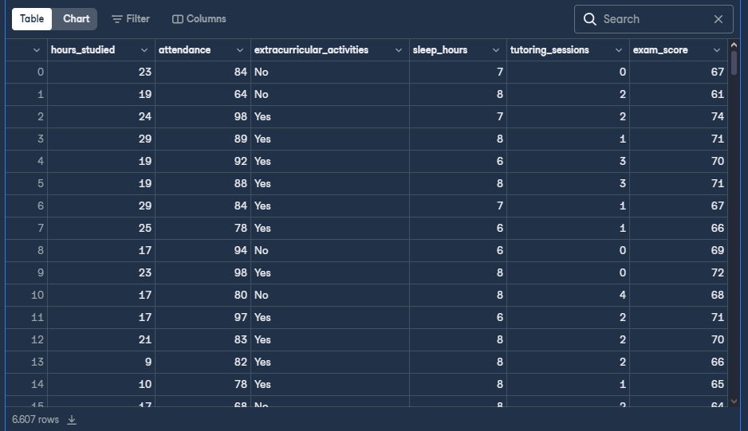
ImplementatIon Plan
• Key Tasks:
- Data preparation and feature engineering.
- Model fine-tuning and training.
- GUI design and development.
• Resources: Dataset gathered from Datacamp, Hugging Face pre-trained models, and local machine requirements.
• Risks: Model performance limitations (can be solved with more data).
Notes:
https://huggingface.co/nukimayasari/student-performance-model
https://projects.datacamp.com/projects/2623

Slide 7
Schedule
• Timeline:
-Completing the Documentations: Nov 11 – Nov 30
- Data Preparation & Feature Engineering: Dec 1 – Jan 30(May be delayed)
- Model Training & Testing: Feb 1 – Feb 28
- GUI Development: Jan 30 - Dec 10
• Major Milestones:
- Initial prototype ready by Jan 30.
- Complete project by Feb 28.

Slide 8
References
Bennedsen, J., & Caspersen, M. E. (2007). Failure rates in introductory programming. ACM SIGCSE Bulletin, 39(2), 32-36. https://doi.org/10.1145/1272848.1272879

