Slide 1
Table8 Forest plot

Slide 2
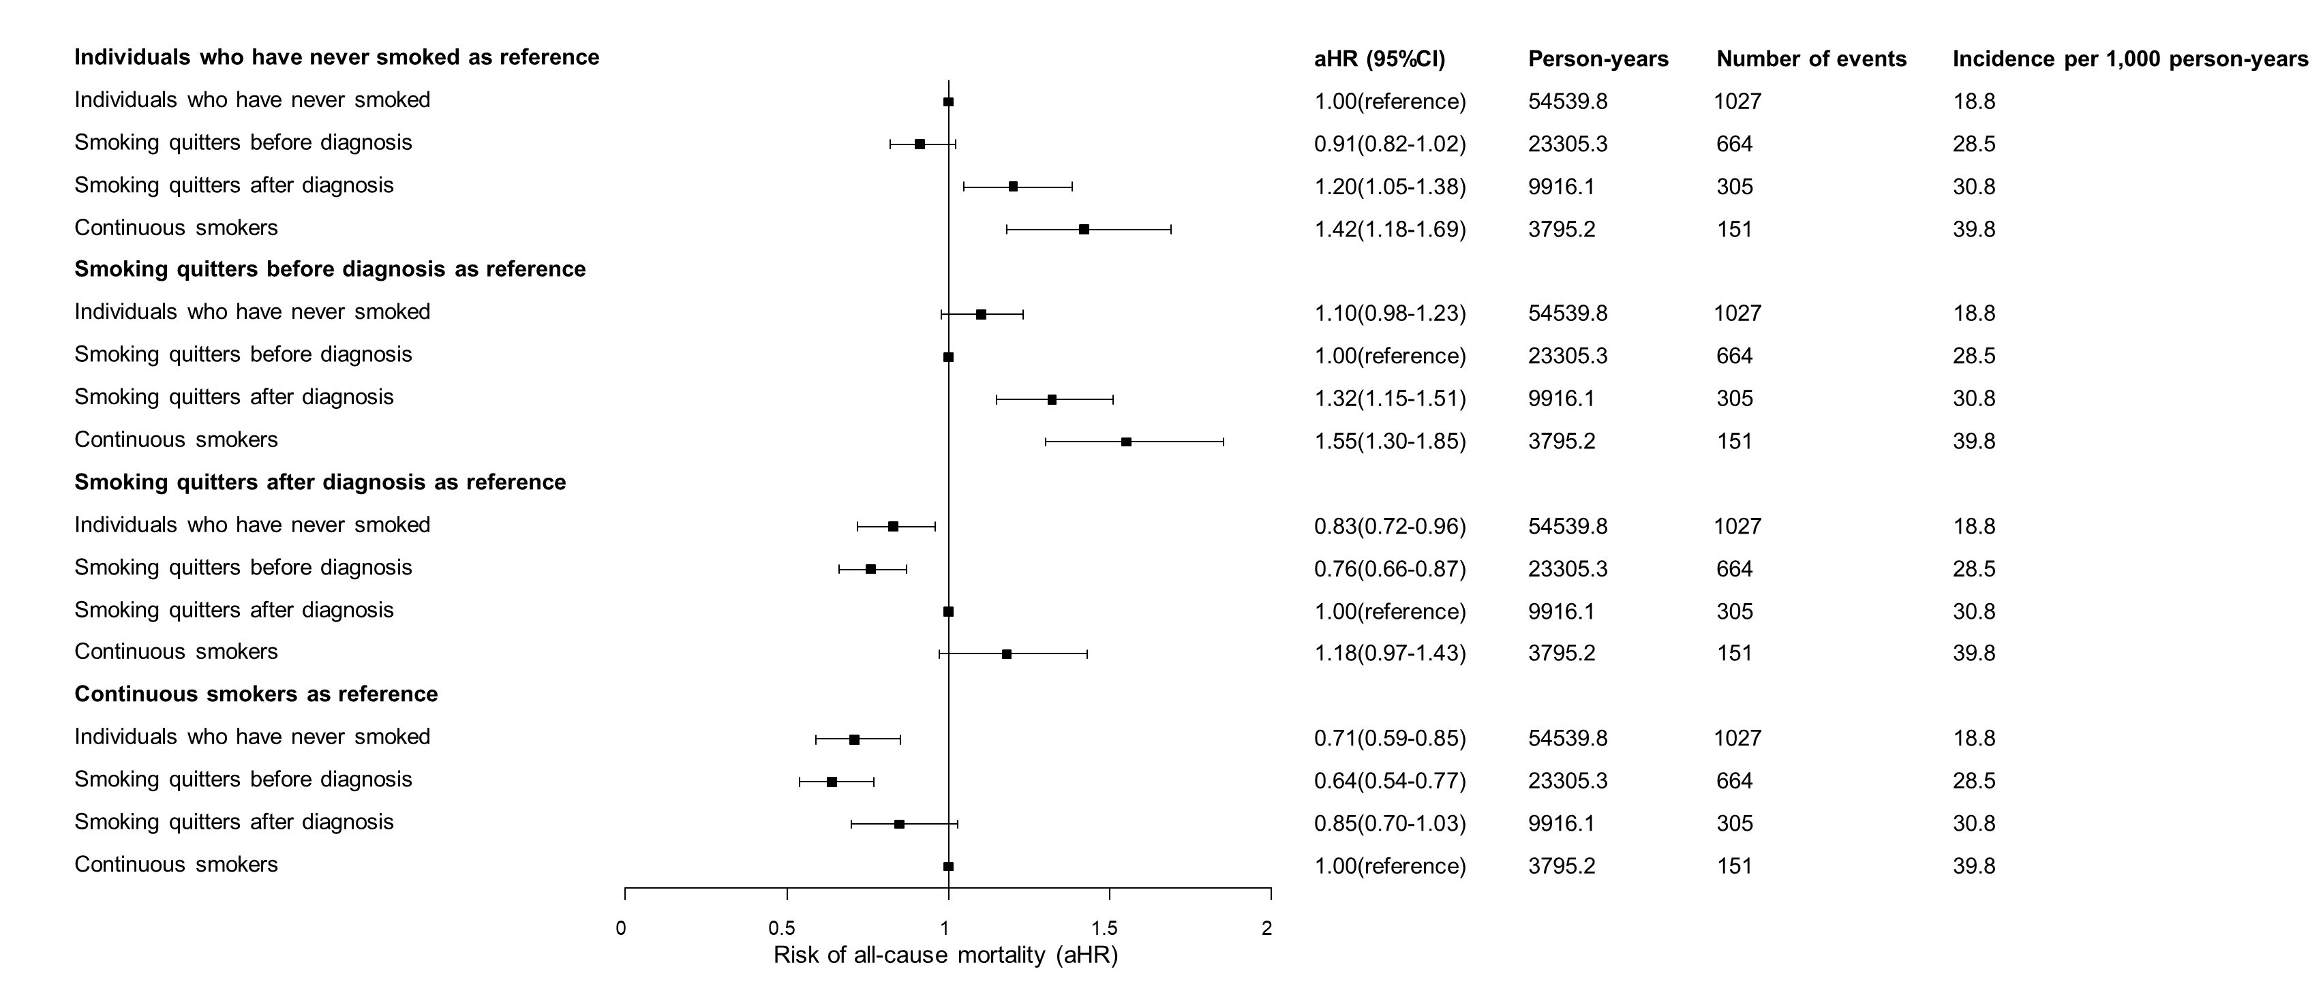

Slide 3
Table10 Forest plot

Slide 4
