Slide 1
All-cause mortality
(1.Never-smokers
2.Smoking quitters before diagnosis
3.Smoking quitters after diagnosis
4.Continuous smokers after diagnosis)

Slide 2
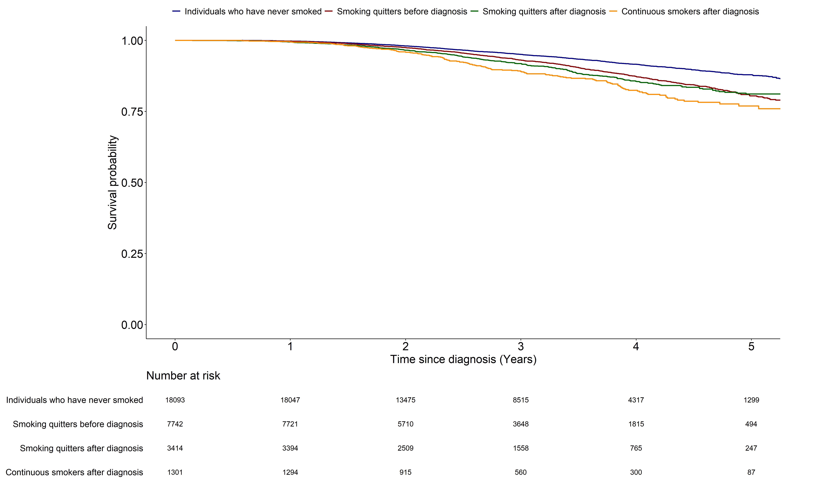
 | Never-smokers | Smoking quitters before diagnosis | Smoking quitters after diagnosis
Smoking quitters before diagnosis | <0.001 | - | -
Smoking quitters after diagnosis | <0.001 | 0.149 | -
Continuous smokers after diagnosis | <0.001 | <0.001 | 0.013

Slide 3
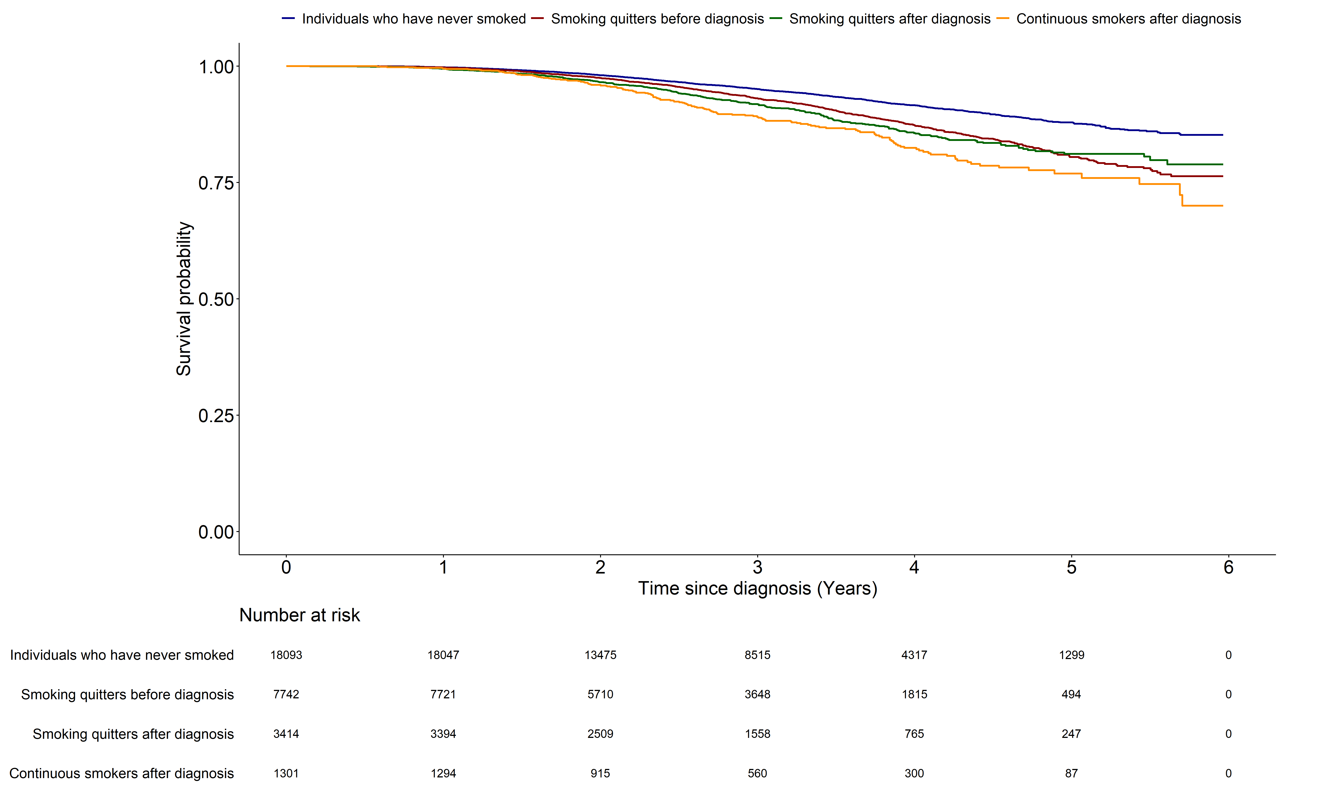

Slide 4
Lung-cancer mortality
(1.Never-smokers
2.Smoking quitters before diagnosis
3.Smoking quitters after diagnosis
4.Continuous smokers after diagnosis)

Slide 5
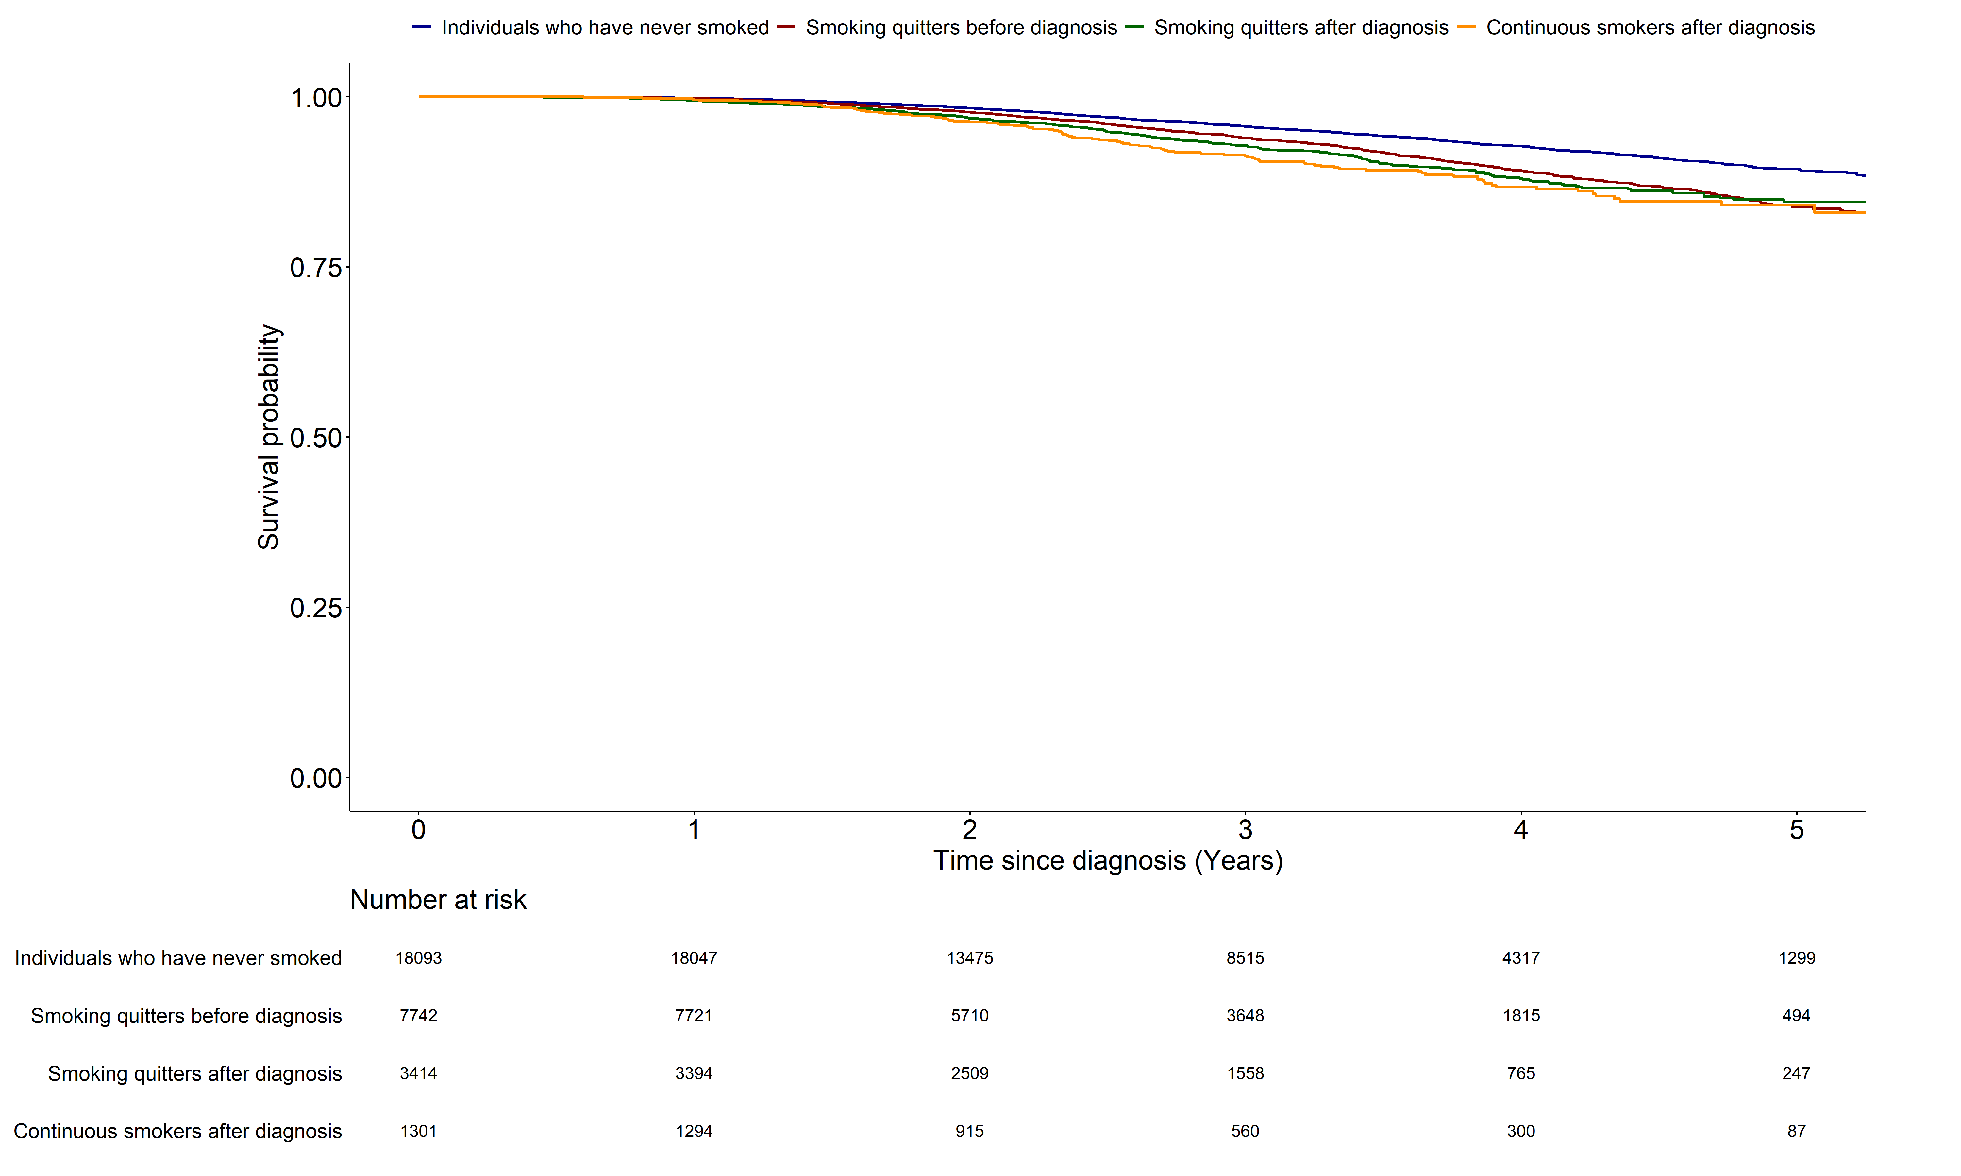
 | Never-smokers | Smoking quitters before diagnosis | Smoking quitters after diagnosis
Smoking quitters before diagnosis | <0.001 | - | -
Smoking quitters after diagnosis | <0.001 | 0.212 | -
Continuous smokers after diagnosis | <0.001 | 0.040 | 0.244

Slide 6
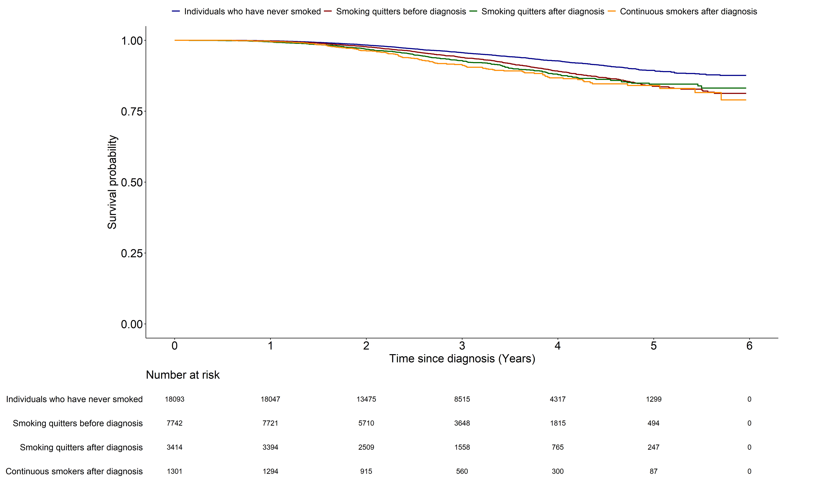

Slide 7
All-cause mortality
(1. Smoking quitters without NTP use
2. Smoking quitters after NTP use
3. Continuous smokers)

Slide 8
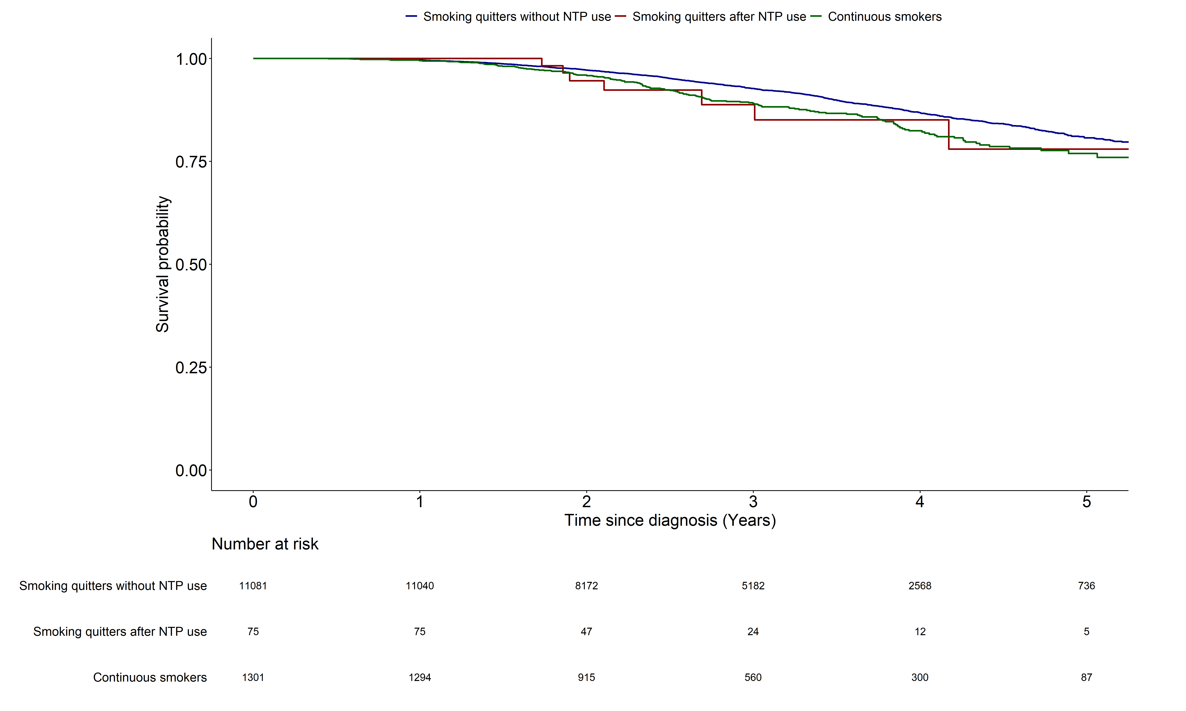
 | Smoking quitters without NTP use | Smoking quitters after NTP use
Smoking quitters after NTP use | 0.631 | -
Continuous smokers | <0.001 | 0.974

Slide 9
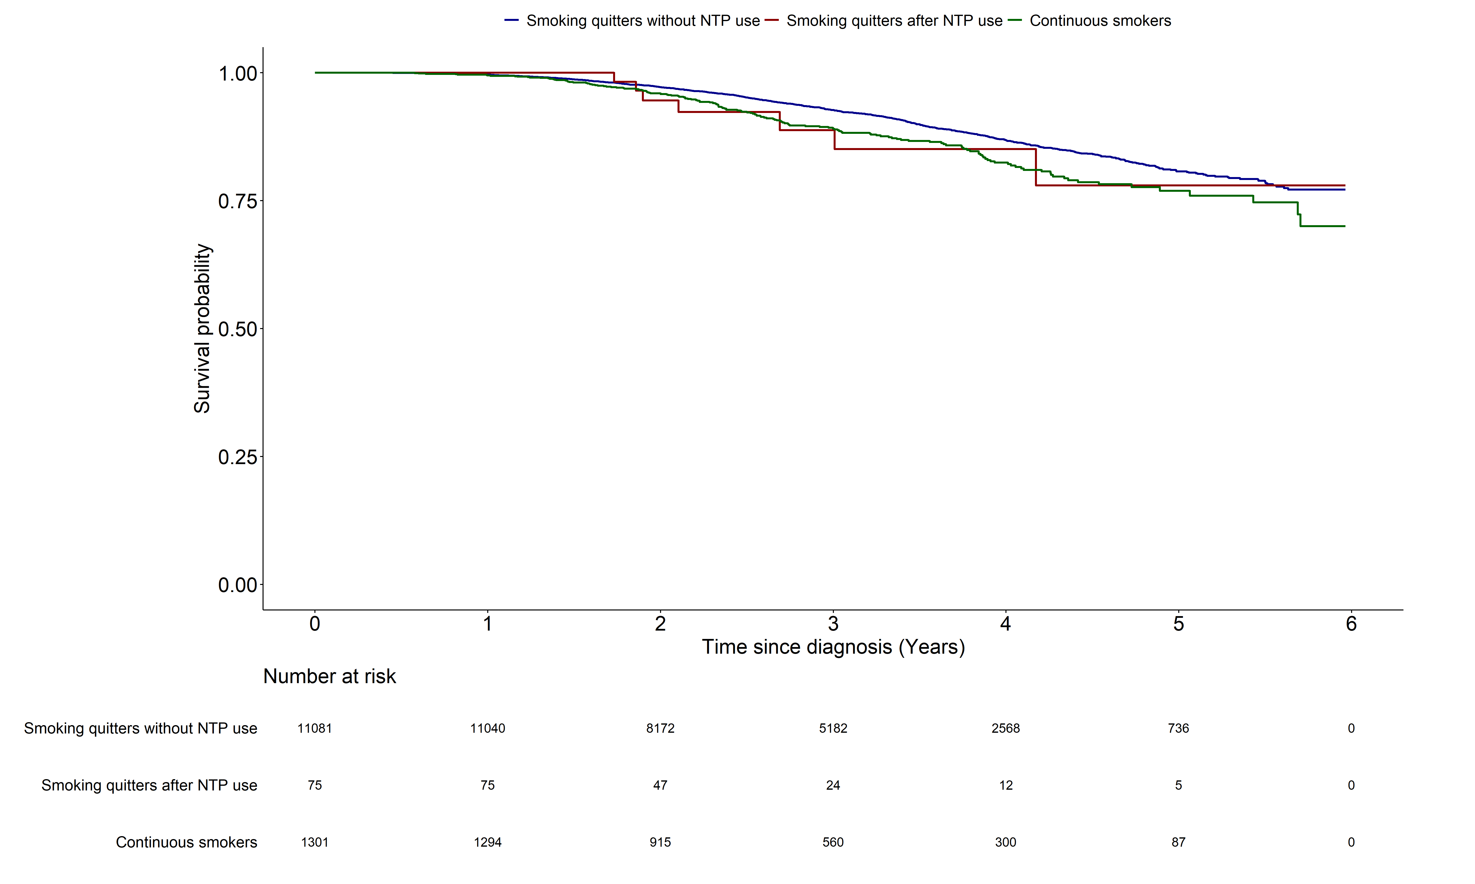

Slide 10
Lung-cancer mortality
(1. Smoking quitters without NTP use
2. Smoking quitters after NTP use
3. Continuous smokers)

Slide 11
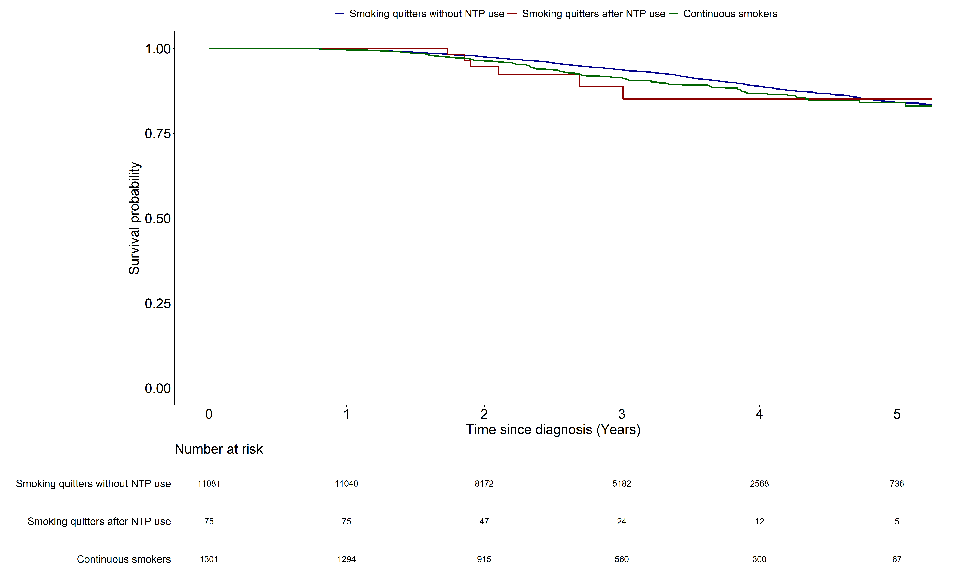
 | Smoking quitters without NTP use | Smoking quitters after NTP use
Smoking quitters after NTP use | 0.638 | -
Continuous smokers | 0.138 | 0.775

Slide 12
