Slide 1
All-cause mortality (1.AGED 50-80, ≥20PYs smoking
2. AGED 50-80, <20PYs smoking
3. AGED 50-80, individuals who have never-smoked)
Multivariable cox model: smoking status, pack_year 제외

Slide 2
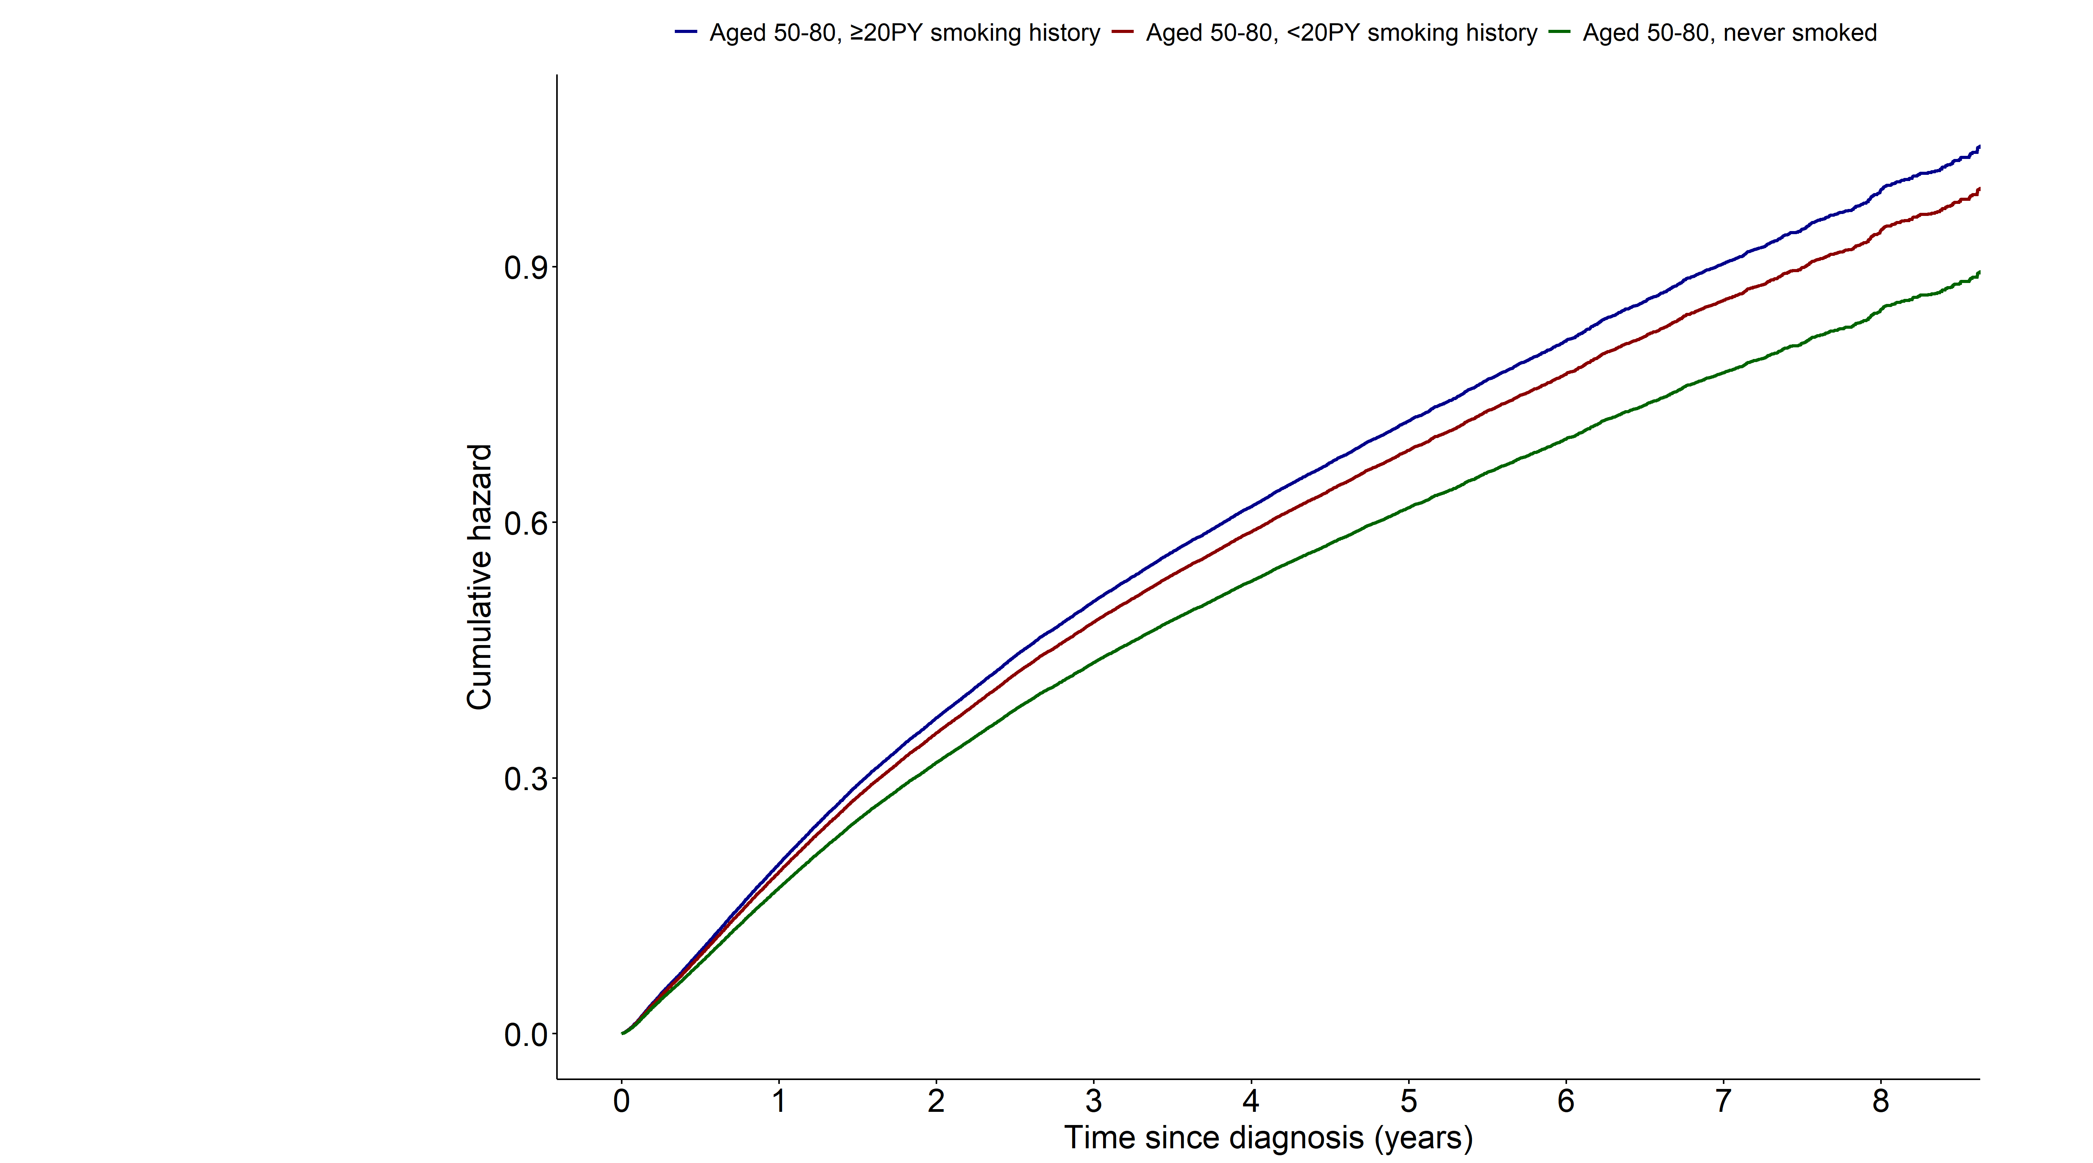
Notes:
> fit15 <- coxph(surv_all ~ grouptype+AGE+SEX+G1E_BMI+income+cci_group+activity
+ +non_small_yn+SEER_GRP+surgery_yn+radio_yn+system_yn
+ ,data=as.data.frame(data1))
> summary(fit15)$coefficients
coef exp(coef) se(coef) z Pr(>|z|)
grouptype002 -0.049015507 0.9521664 0.0127513805 -3.8439373 1.210760e-04
grouptype003 -0.152760068 0.8583356 0.0126156831 -12.1087432 9.493765e-34
AGE 0.039128658 1.0399043 0.0006570674 59.5504444 0.000000e+00
SEX1 0.478290783 1.6133145 0.0141481425 33.8059065 1.614969e-250
G1E_BMI -0.030243381 0.9702094 0.0017669367 -17.1162793 1.122229e-65
income2 -0.042334825 0.9585488 0.0160312854 -2.6407630 8.271957e-03
income3 -0.044025108 0.9569299 0.0152434660 -2.8881298 3.875400e-03
income4 -0.080008241 0.9231087 0.0140417140 -5.6978971 1.212942e-08
income5 -0.149039354 0.8615352 0.0131742669 -11.3129144 1.132637e-29
cci_group>=5 0.403579879 1.4971748 0.0152542062 26.4569571 3.034603e-154
cci_group1-2 0.086667553 1.0905341 0.0125781270 6.8903385 5.565979e-12
cci_group3-4 0.226420315 1.2541027 0.0173470578 13.0523757 6.159621e-39
activityactive -0.119803195 0.8870950 0.0110015905 -10.8896250 1.291711e-27
non_small_yn1 -0.277502333 0.7576738 0.0131030722 -21.1784175 1.510211e-99
SEER_GRP2 0.742774938 2.1017597 0.0165858592 44.7836274 0.000000e+00
SEER_GRP7 1.486575632 4.4219273 0.0170340060 87.2710527 0.000000e+00
SEER_GRP9 0.665000519 1.9444915 0.0228311168 29.1269378 1.637132e-186
surgery_ynyes -1.120583757 0.3260894 0.0138557537 -80.8749767 0.000000e+00
radio_ynyes 0.003156192 1.0031612 0.0110764411 0.2849464 7.756852e-01
system_ynyes -0.243976695 0.7835059 0.0106121395 -22.9903400 5.823143e-117
> exp(confint(fit15))
2.5 % 97.5 %
grouptype002 0.9286645 0.9762630
grouptype003 0.8373724 0.8798237
AGE 1.0385659 1.0412443
SEX1 1.5691922 1.6586776
G1E_BMI 0.9668552 0.9735752
income2 0.9288987 0.9891453
income3 0.9287629 0.9859512
income4 0.8980500 0.9488667
income5 0.8395742 0.8840707
cci_group>=5 1.4530753 1.5426128
cci_group1-2 1.0639782 1.1177528
cci_group3-4 1.2121804 1.2974748
activityactive 0.8681716 0.9064309
non_small_yn1 0.7384633 0.7773840
SEER_GRP2 2.0345349 2.1712057
SEER_GRP7 4.2767338 4.5720499
SEER_GRP9 1.8593972 2.0334802
surgery_ynyes 0.3173530 0.3350663
radio_ynyes 0.9816178 1.0251773
system_ynyes 0.7673777 0.7999730

Slide 3
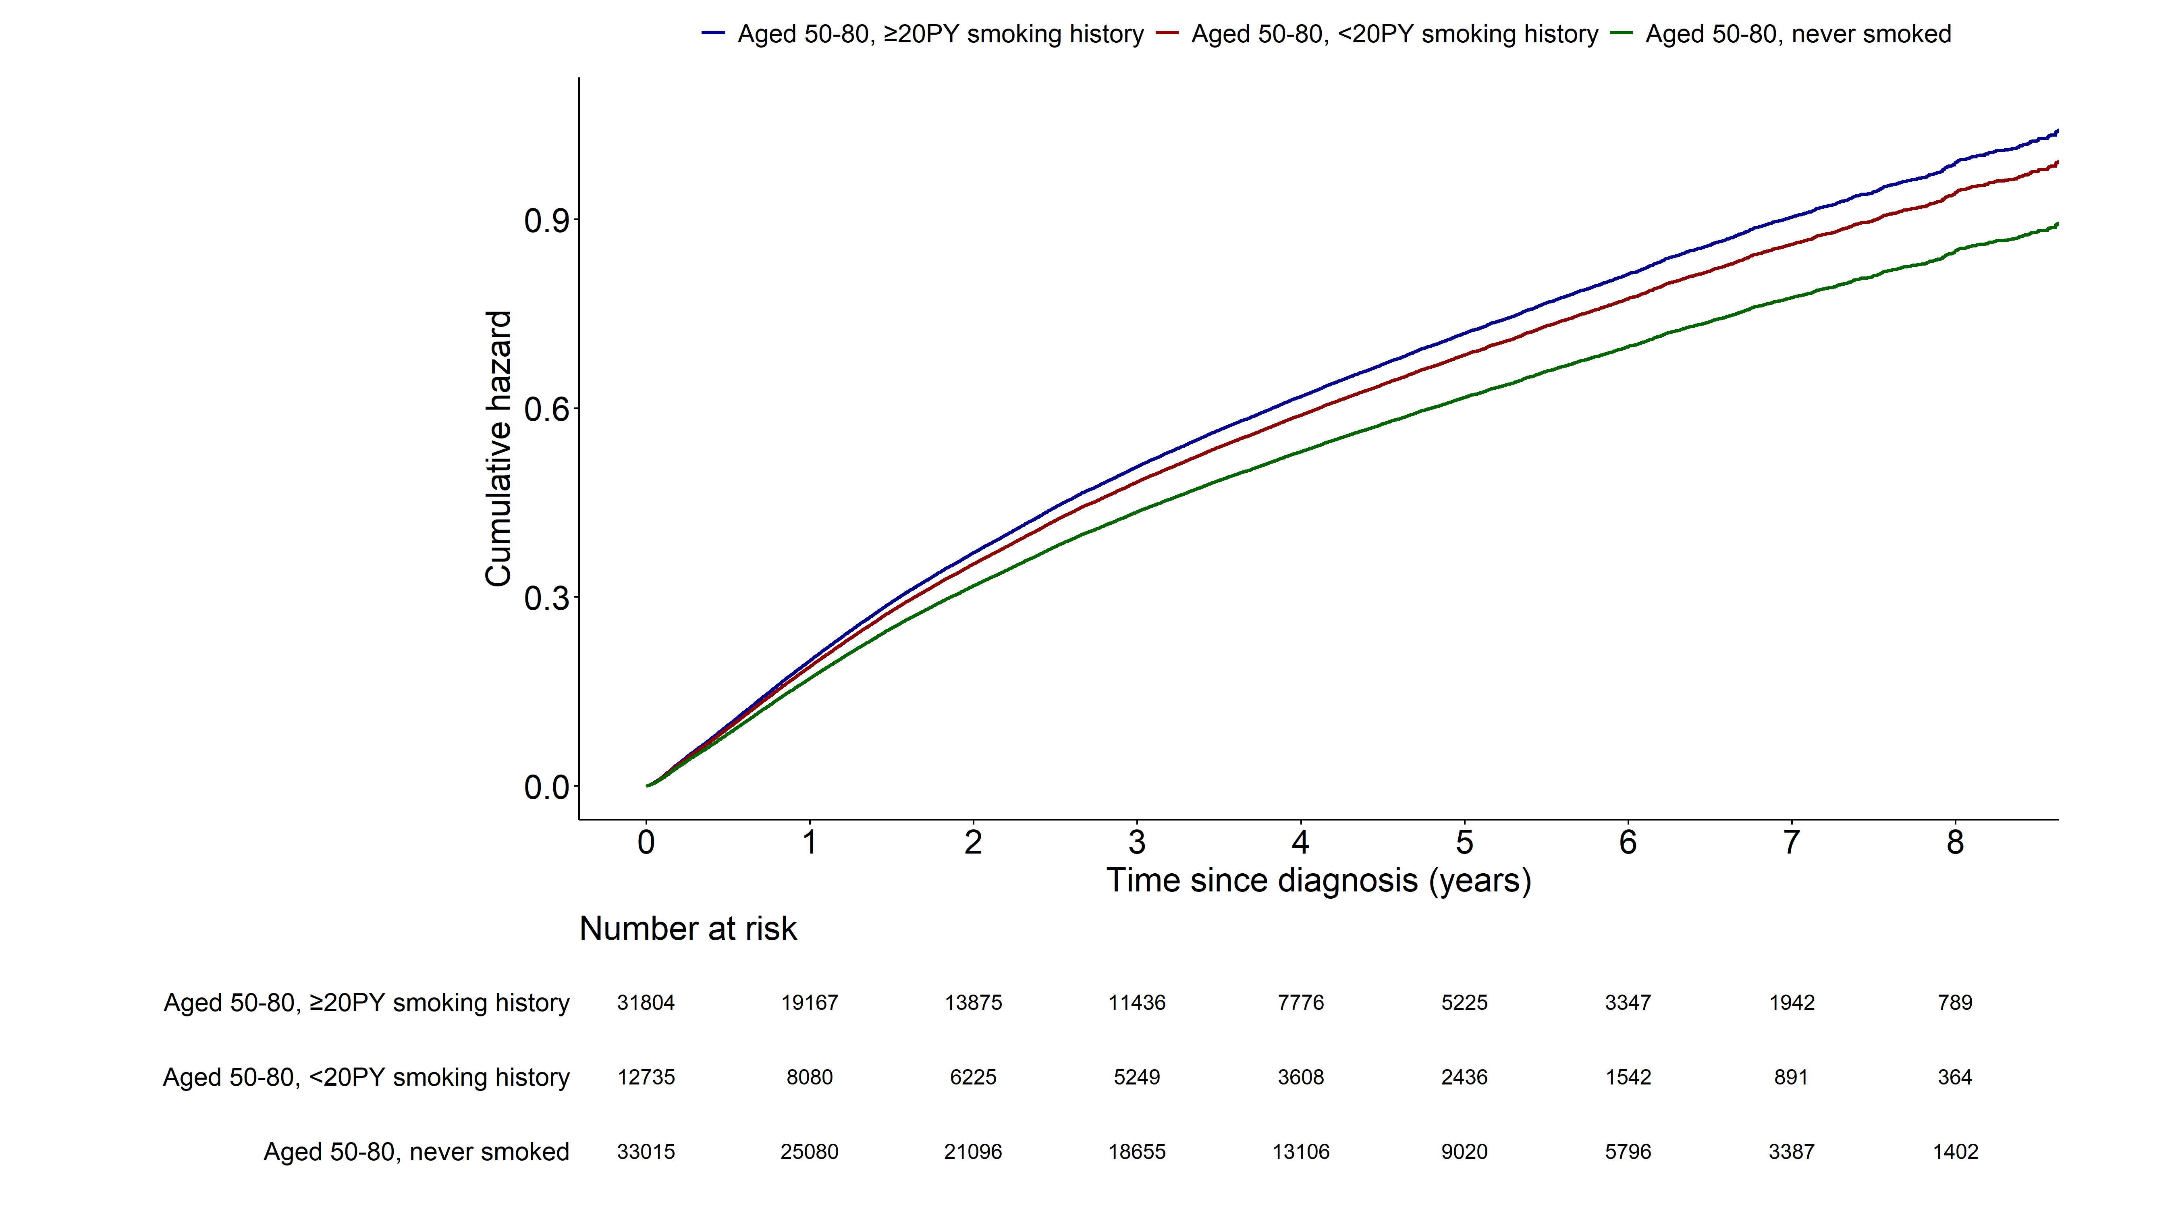
Notes:
> fit15 <- coxph(surv_all ~ grouptype+AGE+SEX+G1E_BMI+income+cci_group+activity
+ +non_small_yn+SEER_GRP+surgery_yn+radio_yn+system_yn
+ ,data=as.data.frame(data1))
> summary(fit15)$coefficients
coef exp(coef) se(coef) z Pr(>|z|)
grouptype002 -0.049015507 0.9521664 0.0127513805 -3.8439373 1.210760e-04
grouptype003 -0.152760068 0.8583356 0.0126156831 -12.1087432 9.493765e-34
AGE 0.039128658 1.0399043 0.0006570674 59.5504444 0.000000e+00
SEX1 0.478290783 1.6133145 0.0141481425 33.8059065 1.614969e-250
G1E_BMI -0.030243381 0.9702094 0.0017669367 -17.1162793 1.122229e-65
income2 -0.042334825 0.9585488 0.0160312854 -2.6407630 8.271957e-03
income3 -0.044025108 0.9569299 0.0152434660 -2.8881298 3.875400e-03
income4 -0.080008241 0.9231087 0.0140417140 -5.6978971 1.212942e-08
income5 -0.149039354 0.8615352 0.0131742669 -11.3129144 1.132637e-29
cci_group>=5 0.403579879 1.4971748 0.0152542062 26.4569571 3.034603e-154
cci_group1-2 0.086667553 1.0905341 0.0125781270 6.8903385 5.565979e-12
cci_group3-4 0.226420315 1.2541027 0.0173470578 13.0523757 6.159621e-39
activityactive -0.119803195 0.8870950 0.0110015905 -10.8896250 1.291711e-27
non_small_yn1 -0.277502333 0.7576738 0.0131030722 -21.1784175 1.510211e-99
SEER_GRP2 0.742774938 2.1017597 0.0165858592 44.7836274 0.000000e+00
SEER_GRP7 1.486575632 4.4219273 0.0170340060 87.2710527 0.000000e+00
SEER_GRP9 0.665000519 1.9444915 0.0228311168 29.1269378 1.637132e-186
surgery_ynyes -1.120583757 0.3260894 0.0138557537 -80.8749767 0.000000e+00
radio_ynyes 0.003156192 1.0031612 0.0110764411 0.2849464 7.756852e-01
system_ynyes -0.243976695 0.7835059 0.0106121395 -22.9903400 5.823143e-117
> exp(confint(fit15))
2.5 % 97.5 %
grouptype002 0.9286645 0.9762630
grouptype003 0.8373724 0.8798237
AGE 1.0385659 1.0412443
SEX1 1.5691922 1.6586776
G1E_BMI 0.9668552 0.9735752
income2 0.9288987 0.9891453
income3 0.9287629 0.9859512
income4 0.8980500 0.9488667
income5 0.8395742 0.8840707
cci_group>=5 1.4530753 1.5426128
cci_group1-2 1.0639782 1.1177528
cci_group3-4 1.2121804 1.2974748
activityactive 0.8681716 0.9064309
non_small_yn1 0.7384633 0.7773840
SEER_GRP2 2.0345349 2.1712057
SEER_GRP7 4.2767338 4.5720499
SEER_GRP9 1.8593972 2.0334802
surgery_ynyes 0.3173530 0.3350663
radio_ynyes 0.9816178 1.0251773
system_ynyes 0.7673777 0.7999730

Slide 4
Lung cancer mortality mortality (1.AGED 50-80, ≥20PYs smoking
2. AGED 50-80, <20PYs smoking
3. AGED 50-80, individuals who have never-smoked)
Multivariable cox model: smoking status, pack_year 제외

Slide 5
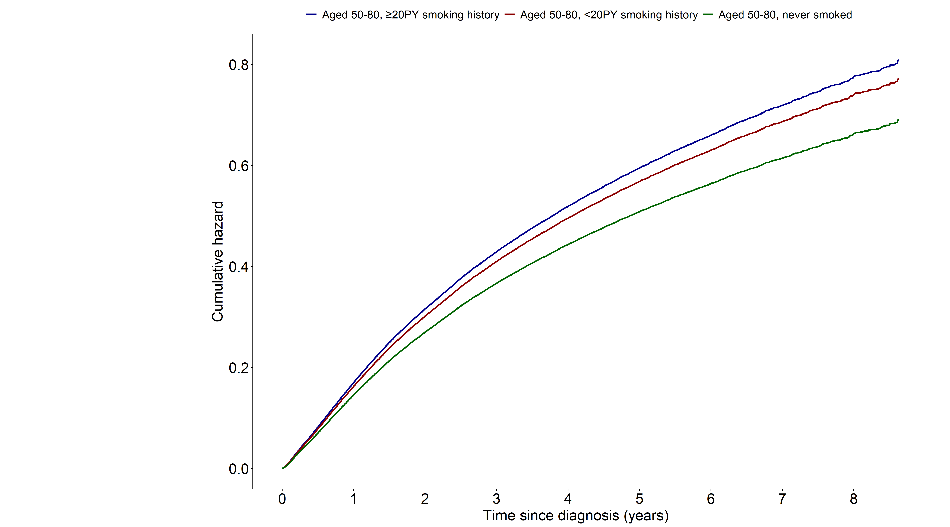
Notes:
> fit15 <- coxph(surv_lungcancer ~ grouptype+AGE+SEX+G1E_BMI+income+cci_group+activity
+ +non_small_yn+SEER_GRP+surgery_yn+radio_yn+system_yn
+ ,data=data1)
> summary(fit15)$coefficients
coef exp(coef) se(coef) z Pr(>|z|)
grouptype002 -0.04598770 0.9550537 0.0132755257 -3.464096 5.320160e-04
grouptype003 -0.15728234 0.8544628 0.0132030760 -11.912553 1.018114e-32
AGE 0.03757755 1.0382925 0.0006827445 55.038971 0.000000e+00
SEX1 0.45189020 1.5712794 0.0147510908 30.634358 4.269917e-206
G1E_BMI -0.02999719 0.9704483 0.0018408532 -16.295263 1.066431e-59
income2 -0.04280632 0.9580969 0.0166787868 -2.566513 1.027268e-02
income3 -0.04172961 0.9591291 0.0158575243 -2.631534 8.500038e-03
income4 -0.08292087 0.9204240 0.0146386415 -5.664519 1.474374e-08
income5 -0.14648351 0.8637400 0.0137362901 -10.663979 1.500376e-26
cci_group>=5 0.37283936 1.4518511 0.0158494583 23.523792 2.328873e-122
cci_group1-2 0.08339702 1.0869733 0.0130533033 6.388959 1.670184e-10
cci_group3-4 0.19502071 1.2153362 0.0182121084 10.708299 9.305571e-27
activityactive -0.11713293 0.8894669 0.0114677655 -10.214102 1.714590e-24
non_small_yn1 -0.29180813 0.7469118 0.0134030793 -21.771723 4.301552e-105
SEER_GRP2 0.88130755 2.4140541 0.0184330487 47.811274 0.000000e+00
SEER_GRP7 1.65146296 5.2146030 0.0187792236 87.940960 0.000000e+00
SEER_GRP9 0.75581984 2.1293565 0.0250150765 30.214572 1.524426e-200
surgery_ynyes -1.17606058 0.3084916 0.0148958618 -78.952168 0.000000e+00
radio_ynyes 0.01741658 1.0175691 0.0114001718 1.527747 1.265753e-01
system_ynyes -0.22097700 0.8017351 0.0110235480 -20.045905 2.191577e-89
> exp(confint(fit15))
2.5 % 97.5 %
grouptype002 0.9305241 0.9802299
grouptype003 0.8326350 0.8768628
AGE 1.0369040 1.0396828
SEX1 1.5265016 1.6173707
G1E_BMI 0.9669532 0.9739560
income2 0.9272833 0.9899345
income3 0.9297777 0.9894071
income4 0.8943911 0.9472145
income5 0.8407961 0.8873100
cci_group>=5 1.4074436 1.4976598
cci_group1-2 1.0595169 1.1151412
cci_group3-4 1.1727198 1.2595012
activityactive 0.8696979 0.9096853
non_small_yn1 0.7275463 0.7667929
SEER_GRP2 2.3283956 2.5028640
SEER_GRP7 5.0261604 5.4101107
SEER_GRP9 2.0274750 2.2363576
surgery_ynyes 0.2996153 0.3176309
radio_ynyes 0.9950848 1.0405615
system_ynyes 0.7845988 0.8192457

Slide 6
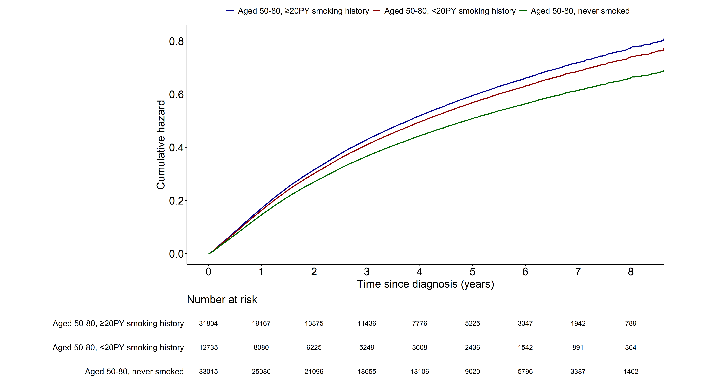
Notes:
> fit15 <- coxph(surv_lungcancer ~ grouptype+AGE+SEX+G1E_BMI+income+cci_group+activity
+ +non_small_yn+SEER_GRP+surgery_yn+radio_yn+system_yn
+ ,data=data1)
> summary(fit15)$coefficients
coef exp(coef) se(coef) z Pr(>|z|)
grouptype002 -0.04598770 0.9550537 0.0132755257 -3.464096 5.320160e-04
grouptype003 -0.15728234 0.8544628 0.0132030760 -11.912553 1.018114e-32
AGE 0.03757755 1.0382925 0.0006827445 55.038971 0.000000e+00
SEX1 0.45189020 1.5712794 0.0147510908 30.634358 4.269917e-206
G1E_BMI -0.02999719 0.9704483 0.0018408532 -16.295263 1.066431e-59
income2 -0.04280632 0.9580969 0.0166787868 -2.566513 1.027268e-02
income3 -0.04172961 0.9591291 0.0158575243 -2.631534 8.500038e-03
income4 -0.08292087 0.9204240 0.0146386415 -5.664519 1.474374e-08
income5 -0.14648351 0.8637400 0.0137362901 -10.663979 1.500376e-26
cci_group>=5 0.37283936 1.4518511 0.0158494583 23.523792 2.328873e-122
cci_group1-2 0.08339702 1.0869733 0.0130533033 6.388959 1.670184e-10
cci_group3-4 0.19502071 1.2153362 0.0182121084 10.708299 9.305571e-27
activityactive -0.11713293 0.8894669 0.0114677655 -10.214102 1.714590e-24
non_small_yn1 -0.29180813 0.7469118 0.0134030793 -21.771723 4.301552e-105
SEER_GRP2 0.88130755 2.4140541 0.0184330487 47.811274 0.000000e+00
SEER_GRP7 1.65146296 5.2146030 0.0187792236 87.940960 0.000000e+00
SEER_GRP9 0.75581984 2.1293565 0.0250150765 30.214572 1.524426e-200
surgery_ynyes -1.17606058 0.3084916 0.0148958618 -78.952168 0.000000e+00
radio_ynyes 0.01741658 1.0175691 0.0114001718 1.527747 1.265753e-01
system_ynyes -0.22097700 0.8017351 0.0110235480 -20.045905 2.191577e-89
> exp(confint(fit15))
2.5 % 97.5 %
grouptype002 0.9305241 0.9802299
grouptype003 0.8326350 0.8768628
AGE 1.0369040 1.0396828
SEX1 1.5265016 1.6173707
G1E_BMI 0.9669532 0.9739560
income2 0.9272833 0.9899345
income3 0.9297777 0.9894071
income4 0.8943911 0.9472145
income5 0.8407961 0.8873100
cci_group>=5 1.4074436 1.4976598
cci_group1-2 1.0595169 1.1151412
cci_group3-4 1.1727198 1.2595012
activityactive 0.8696979 0.9096853
non_small_yn1 0.7275463 0.7667929
SEER_GRP2 2.3283956 2.5028640
SEER_GRP7 5.0261604 5.4101107
SEER_GRP9 2.0274750 2.2363576
surgery_ynyes 0.2996153 0.3176309
radio_ynyes 0.9950848 1.0405615
system_ynyes 0.7845988 0.8192457

Slide 7
All cause mortality (1.AGED 50-80, ≥20years smoking
2. AGED 50-80, <20years smoking)
Multivariable cox model: 모든 변수 포함

Slide 8
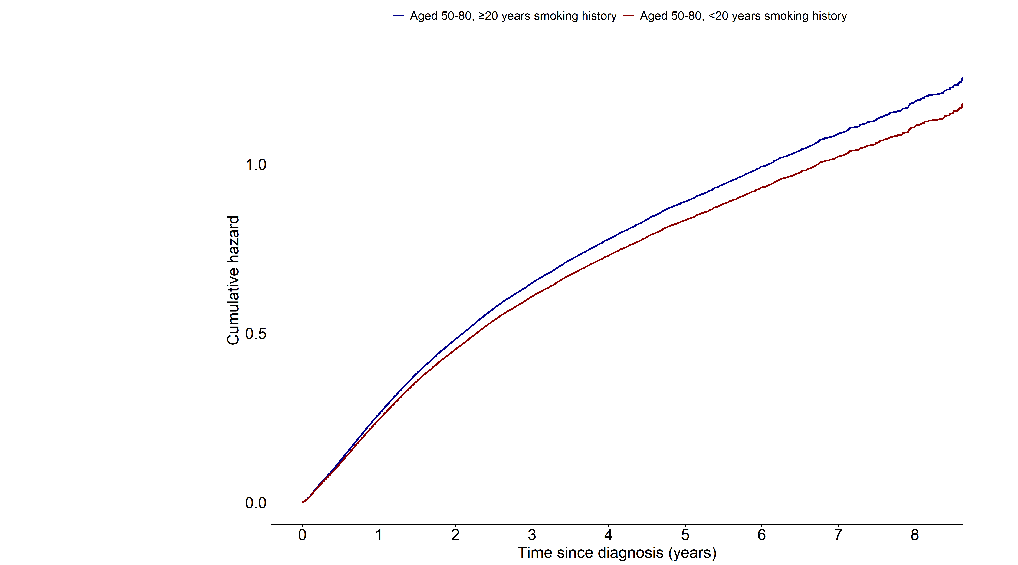
Notes:
> fit3 <- coxph(surv_all ~ smk_20+AGE+SEX+q_smk_yn2+pack_year+G1E_BMI+income+cci_group+activity
+ +non_small_yn+SEER_GRP+surgery_yn+radio_yn+system_yn
+ ,data=data11)
> summary(fit3)$coefficients
coef exp(coef) se(coef) z Pr(>|z|)
smk_20<20 -0.064050308 0.9379578 0.0208448287 -3.072719 2.121179e-03
AGE 0.038122957 1.0388590 0.0008452254 45.103894 0.000000e+00
SEX1 0.192445986 1.2122110 0.0324412886 5.932131 2.990272e-09
q_smk_yn2Current smoker 0.159945470 1.1734469 0.0119208069 13.417336 4.786120e-41
pack_year 0.001259944 1.0012607 0.0002864521 4.398448 1.090280e-05
G1E_BMI -0.029301176 0.9711239 0.0022885479 -12.803392 1.569434e-37
income2 -0.036439756 0.9642162 0.0196388527 -1.855493 6.352584e-02
income3 -0.036687099 0.9639777 0.0187750828 -1.954031 5.069752e-02
income4 -0.057360462 0.9442536 0.0173443549 -3.307155 9.424888e-04
income5 -0.117160808 0.8894422 0.0165240667 -7.090313 1.338088e-12
cci_group>=5 0.385729703 1.4706871 0.0192831707 20.003438 5.140421e-89
cci_group1-2 0.069343949 1.0718048 0.0158492032 4.375233 1.213031e-05
cci_group3-4 0.191179085 1.2106762 0.0216640327 8.824723 1.097312e-18
activityactive -0.078489235 0.9245120 0.0136029315 -5.770024 7.926045e-09
non_small_yn1 -0.212070527 0.8089076 0.0151421219 -14.005338 1.445912e-44
SEER_GRP2 0.654308512 1.9238118 0.0203665441 32.126634 1.872876e-226
SEER_GRP7 1.384801445 3.9940328 0.0209838979 65.993528 0.000000e+00
SEER_GRP9 0.593241104 1.8098448 0.0282130922 21.027156 3.701837e-98
surgery_ynyes -1.078708007 0.3400346 0.0171684057 -62.830995 0.000000e+00
radio_ynyes -0.054418369 0.9470358 0.0135833550 -4.006254 6.168934e-05
system_ynyes -0.262504411 0.7691230 0.0132644264 -19.790107 3.622751e-87
> exp(confint(fit3))
2.5 % 97.5 %
smk_20<20 0.9004097 0.9770717
AGE 1.0371394 1.0405814
SEX1 1.1375334 1.2917912
q_smk_yn2Current smoker 1.1463479 1.2011865
pack_year 1.0006988 1.0018230
G1E_BMI 0.9667777 0.9754897
income2 0.9278073 1.0020538
income3 0.9291495 1.0001114
income4 0.9126939 0.9769047
income5 0.8610976 0.9187197
cci_group>=5 1.4161407 1.5273344
cci_group1-2 1.0390222 1.1056217
cci_group3-4 1.1603461 1.2631894
activityactive 0.9001890 0.9494922
non_small_yn1 0.7852536 0.8332742
SEER_GRP2 1.8485302 2.0021592
SEER_GRP7 3.8330996 4.1617228
SEER_GRP9 1.7124832 1.9127419
surgery_ynyes 0.3287830 0.3516712
radio_ynyes 0.9221556 0.9725873
system_ynyes 0.7493851 0.7893807

Slide 9
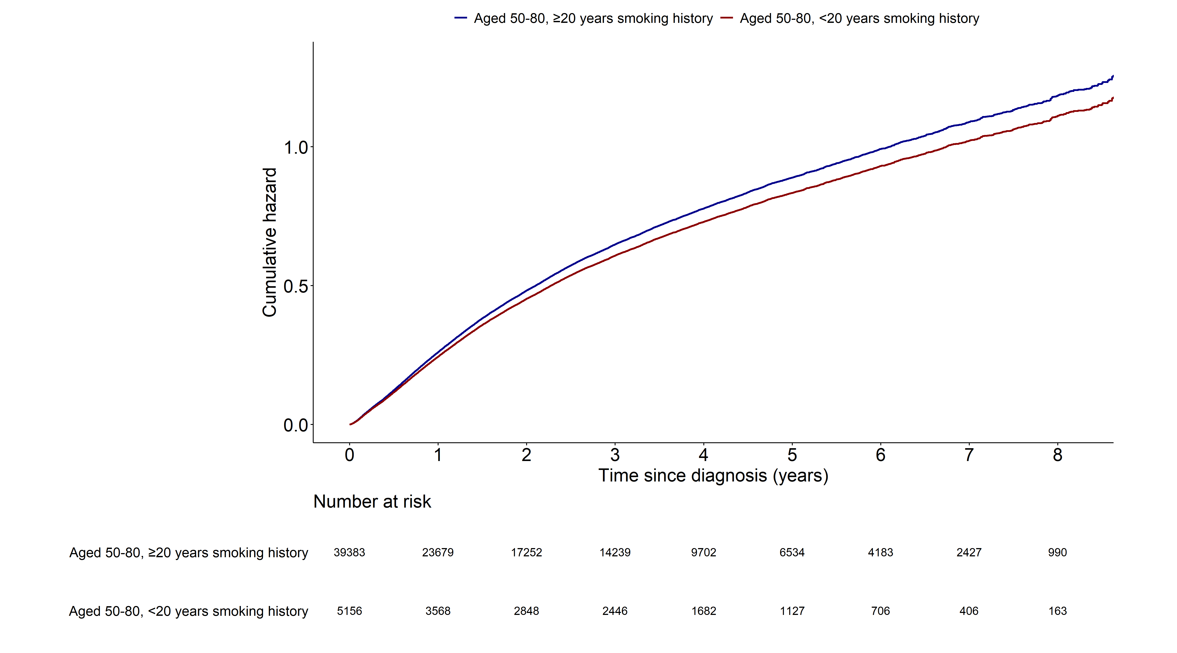
Notes:
> fit3 <- coxph(surv_all ~ smk_20+AGE+SEX+q_smk_yn2+pack_year+G1E_BMI+income+cci_group+activity
+ +non_small_yn+SEER_GRP+surgery_yn+radio_yn+system_yn
+ ,data=data11)
> summary(fit3)$coefficients
coef exp(coef) se(coef) z Pr(>|z|)
smk_20<20 -0.064050308 0.9379578 0.0208448287 -3.072719 2.121179e-03
AGE 0.038122957 1.0388590 0.0008452254 45.103894 0.000000e+00
SEX1 0.192445986 1.2122110 0.0324412886 5.932131 2.990272e-09
q_smk_yn2Current smoker 0.159945470 1.1734469 0.0119208069 13.417336 4.786120e-41
pack_year 0.001259944 1.0012607 0.0002864521 4.398448 1.090280e-05
G1E_BMI -0.029301176 0.9711239 0.0022885479 -12.803392 1.569434e-37
income2 -0.036439756 0.9642162 0.0196388527 -1.855493 6.352584e-02
income3 -0.036687099 0.9639777 0.0187750828 -1.954031 5.069752e-02
income4 -0.057360462 0.9442536 0.0173443549 -3.307155 9.424888e-04
income5 -0.117160808 0.8894422 0.0165240667 -7.090313 1.338088e-12
cci_group>=5 0.385729703 1.4706871 0.0192831707 20.003438 5.140421e-89
cci_group1-2 0.069343949 1.0718048 0.0158492032 4.375233 1.213031e-05
cci_group3-4 0.191179085 1.2106762 0.0216640327 8.824723 1.097312e-18
activityactive -0.078489235 0.9245120 0.0136029315 -5.770024 7.926045e-09
non_small_yn1 -0.212070527 0.8089076 0.0151421219 -14.005338 1.445912e-44
SEER_GRP2 0.654308512 1.9238118 0.0203665441 32.126634 1.872876e-226
SEER_GRP7 1.384801445 3.9940328 0.0209838979 65.993528 0.000000e+00
SEER_GRP9 0.593241104 1.8098448 0.0282130922 21.027156 3.701837e-98
surgery_ynyes -1.078708007 0.3400346 0.0171684057 -62.830995 0.000000e+00
radio_ynyes -0.054418369 0.9470358 0.0135833550 -4.006254 6.168934e-05
system_ynyes -0.262504411 0.7691230 0.0132644264 -19.790107 3.622751e-87
> exp(confint(fit3))
2.5 % 97.5 %
smk_20<20 0.9004097 0.9770717
AGE 1.0371394 1.0405814
SEX1 1.1375334 1.2917912
q_smk_yn2Current smoker 1.1463479 1.2011865
pack_year 1.0006988 1.0018230
G1E_BMI 0.9667777 0.9754897
income2 0.9278073 1.0020538
income3 0.9291495 1.0001114
income4 0.9126939 0.9769047
income5 0.8610976 0.9187197
cci_group>=5 1.4161407 1.5273344
cci_group1-2 1.0390222 1.1056217
cci_group3-4 1.1603461 1.2631894
activityactive 0.9001890 0.9494922
non_small_yn1 0.7852536 0.8332742
SEER_GRP2 1.8485302 2.0021592
SEER_GRP7 3.8330996 4.1617228
SEER_GRP9 1.7124832 1.9127419
surgery_ynyes 0.3287830 0.3516712
radio_ynyes 0.9221556 0.9725873
system_ynyes 0.7493851 0.7893807

Slide 10
Lung cancer mortality (1.AGED 50-80, ≥20years smoking
2. AGED 50-80, <20years smoking)
Multivariable cox model: 모든 변수 포함

Slide 11
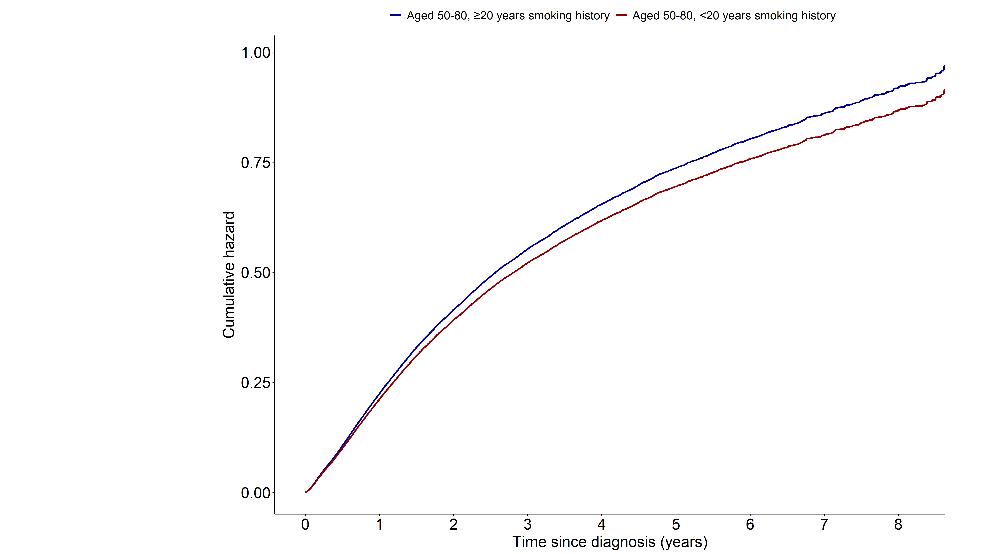
Notes:
> fit3 <- coxph(surv_lungcancer ~ smk_20+AGE+SEX+q_smk_yn2+pack_year+G1E_BMI+income+cci_group+activity
+ +non_small_yn+SEER_GRP+surgery_yn+radio_yn+system_yn
+ ,data=data11)
> summary(fit3)$coefficients
coef exp(coef) se(coef) z Pr(>|z|)
smk_20<20 -0.058518551 0.9431607 0.0216851801 -2.698550 6.964219e-03
AGE 0.036708539 1.0373906 0.0008782744 41.796209 0.000000e+00
SEX1 0.183830686 1.2018123 0.0336700489 5.459769 4.767547e-08
q_smk_yn2Current smoker 0.160142318 1.1736779 0.0124258723 12.887813 5.271770e-38
pack_year 0.001265257 1.0012661 0.0002988470 4.233795 2.297805e-05
G1E_BMI -0.028626487 0.9717794 0.0023813942 -12.020894 2.759703e-33
income2 -0.037026210 0.9636509 0.0203979561 -1.815192 6.949438e-02
income3 -0.038293927 0.9624300 0.0195211089 -1.961668 4.980119e-02
income4 -0.058857940 0.9428407 0.0180455763 -3.261627 1.107748e-03
income5 -0.119297097 0.8875441 0.0172207007 -6.927540 4.282208e-12
cci_group>=5 0.357501240 1.4297523 0.0200277999 17.850250 2.877443e-71
cci_group1-2 0.067773299 1.0701227 0.0164297196 4.125043 3.706656e-05
cci_group3-4 0.158422502 1.1716611 0.0227264871 6.970831 3.150742e-12
activityactive -0.075829165 0.9269746 0.0141660649 -5.352874 8.656798e-08
non_small_yn1 -0.223733763 0.7995280 0.0154878051 -14.445802 2.664385e-47
SEER_GRP2 0.770672180 2.1612185 0.0224844999 34.275709 1.806099e-257
SEER_GRP7 1.524996520 4.5951276 0.0229676944 66.397458 0.000000e+00
SEER_GRP9 0.669797996 1.9538426 0.0307115534 21.809317 1.892816e-105
surgery_ynyes -1.136209717 0.3210335 0.0184508526 -61.580337 0.000000e+00
radio_ynyes -0.044571755 0.9564070 0.0139946229 -3.184920 1.447940e-03
system_ynyes -0.237878727 0.7882983 0.0137845301 -17.256934 9.924231e-67
> exp(confint(fit3))
2.5 % 97.5 %
smk_20<20 0.9039143 0.9841112
AGE 1.0356064 1.0391779
SEX1 1.1250625 1.2837979
q_smk_yn2Current smoker 1.1454391 1.2026129
pack_year 1.0006798 1.0018527
G1E_BMI 0.9672542 0.9763257
income2 0.9258848 1.0029574
income3 0.9263023 0.9999667
income4 0.9100765 0.9767845
income5 0.8580876 0.9180117
cci_group>=5 1.3747164 1.4869916
cci_group1-2 1.0362119 1.1051432
cci_group3-4 1.1206170 1.2250303
activityactive 0.9015911 0.9530726
non_small_yn1 0.7756225 0.8241702
SEER_GRP2 2.0680443 2.2585906
SEER_GRP7 4.3928607 4.8067077
SEER_GRP9 1.8397036 2.0750630
surgery_ynyes 0.3096314 0.3328555
radio_ynyes 0.9305302 0.9830033
system_ynyes 0.7672858 0.8098862

Slide 12
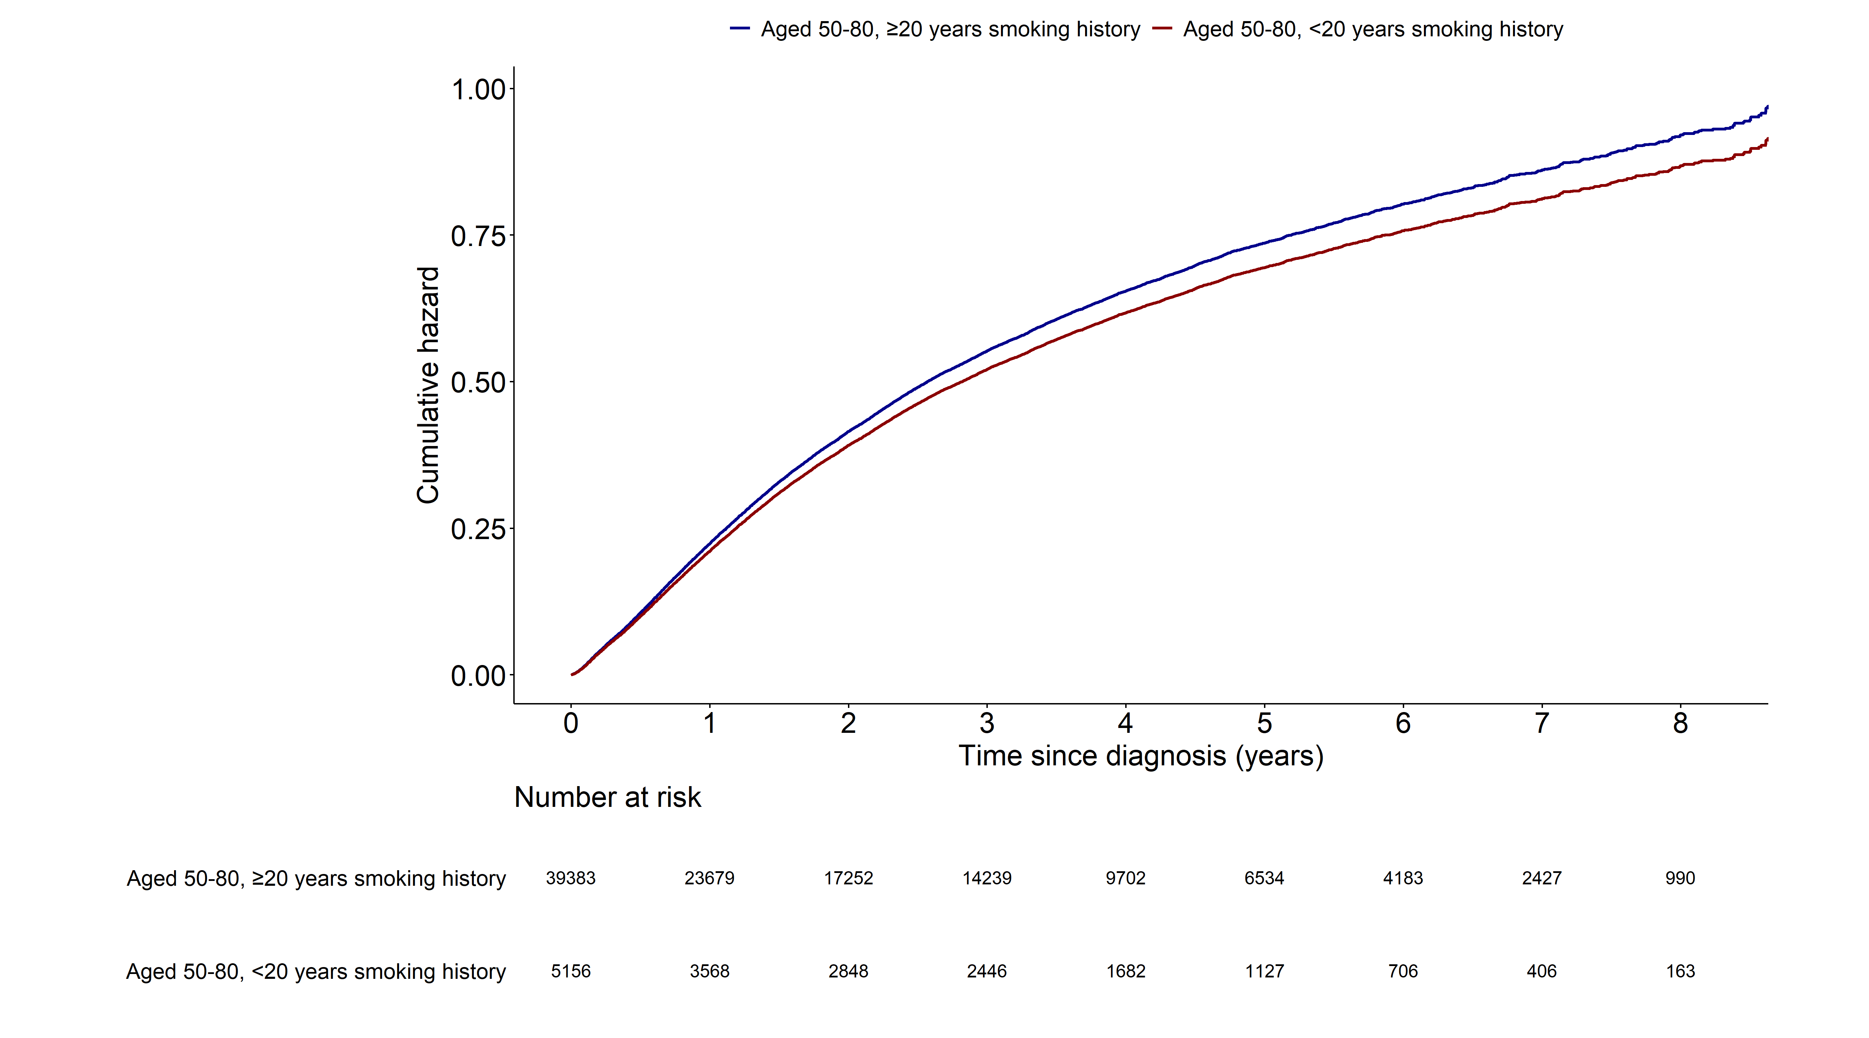
Notes:
> fit3 <- coxph(surv_lungcancer ~ smk_20+AGE+SEX+q_smk_yn2+pack_year+G1E_BMI+income+cci_group+activity
+ +non_small_yn+SEER_GRP+surgery_yn+radio_yn+system_yn
+ ,data=data11)
> summary(fit3)$coefficients
coef exp(coef) se(coef) z Pr(>|z|)
smk_20<20 -0.058518551 0.9431607 0.0216851801 -2.698550 6.964219e-03
AGE 0.036708539 1.0373906 0.0008782744 41.796209 0.000000e+00
SEX1 0.183830686 1.2018123 0.0336700489 5.459769 4.767547e-08
q_smk_yn2Current smoker 0.160142318 1.1736779 0.0124258723 12.887813 5.271770e-38
pack_year 0.001265257 1.0012661 0.0002988470 4.233795 2.297805e-05
G1E_BMI -0.028626487 0.9717794 0.0023813942 -12.020894 2.759703e-33
income2 -0.037026210 0.9636509 0.0203979561 -1.815192 6.949438e-02
income3 -0.038293927 0.9624300 0.0195211089 -1.961668 4.980119e-02
income4 -0.058857940 0.9428407 0.0180455763 -3.261627 1.107748e-03
income5 -0.119297097 0.8875441 0.0172207007 -6.927540 4.282208e-12
cci_group>=5 0.357501240 1.4297523 0.0200277999 17.850250 2.877443e-71
cci_group1-2 0.067773299 1.0701227 0.0164297196 4.125043 3.706656e-05
cci_group3-4 0.158422502 1.1716611 0.0227264871 6.970831 3.150742e-12
activityactive -0.075829165 0.9269746 0.0141660649 -5.352874 8.656798e-08
non_small_yn1 -0.223733763 0.7995280 0.0154878051 -14.445802 2.664385e-47
SEER_GRP2 0.770672180 2.1612185 0.0224844999 34.275709 1.806099e-257
SEER_GRP7 1.524996520 4.5951276 0.0229676944 66.397458 0.000000e+00
SEER_GRP9 0.669797996 1.9538426 0.0307115534 21.809317 1.892816e-105
surgery_ynyes -1.136209717 0.3210335 0.0184508526 -61.580337 0.000000e+00
radio_ynyes -0.044571755 0.9564070 0.0139946229 -3.184920 1.447940e-03
system_ynyes -0.237878727 0.7882983 0.0137845301 -17.256934 9.924231e-67
> exp(confint(fit3))
2.5 % 97.5 %
smk_20<20 0.9039143 0.9841112
AGE 1.0356064 1.0391779
SEX1 1.1250625 1.2837979
q_smk_yn2Current smoker 1.1454391 1.2026129
pack_year 1.0006798 1.0018527
G1E_BMI 0.9672542 0.9763257
income2 0.9258848 1.0029574
income3 0.9263023 0.9999667
income4 0.9100765 0.9767845
income5 0.8580876 0.9180117
cci_group>=5 1.3747164 1.4869916
cci_group1-2 1.0362119 1.1051432
cci_group3-4 1.1206170 1.2250303
activityactive 0.9015911 0.9530726
non_small_yn1 0.7756225 0.8241702
SEER_GRP2 2.0680443 2.2585906
SEER_GRP7 4.3928607 4.8067077
SEER_GRP9 1.8397036 2.0750630
surgery_ynyes 0.3096314 0.3328555
radio_ynyes 0.9305302 0.9830033
system_ynyes 0.7672858 0.8098862

Slide 13
All cause mortality (1.AGED 50-80, ≥20PY smoking
2. AGED 40-49, ≥20PY smoking)
Multivariable cox model: age 변수 제외

Slide 14
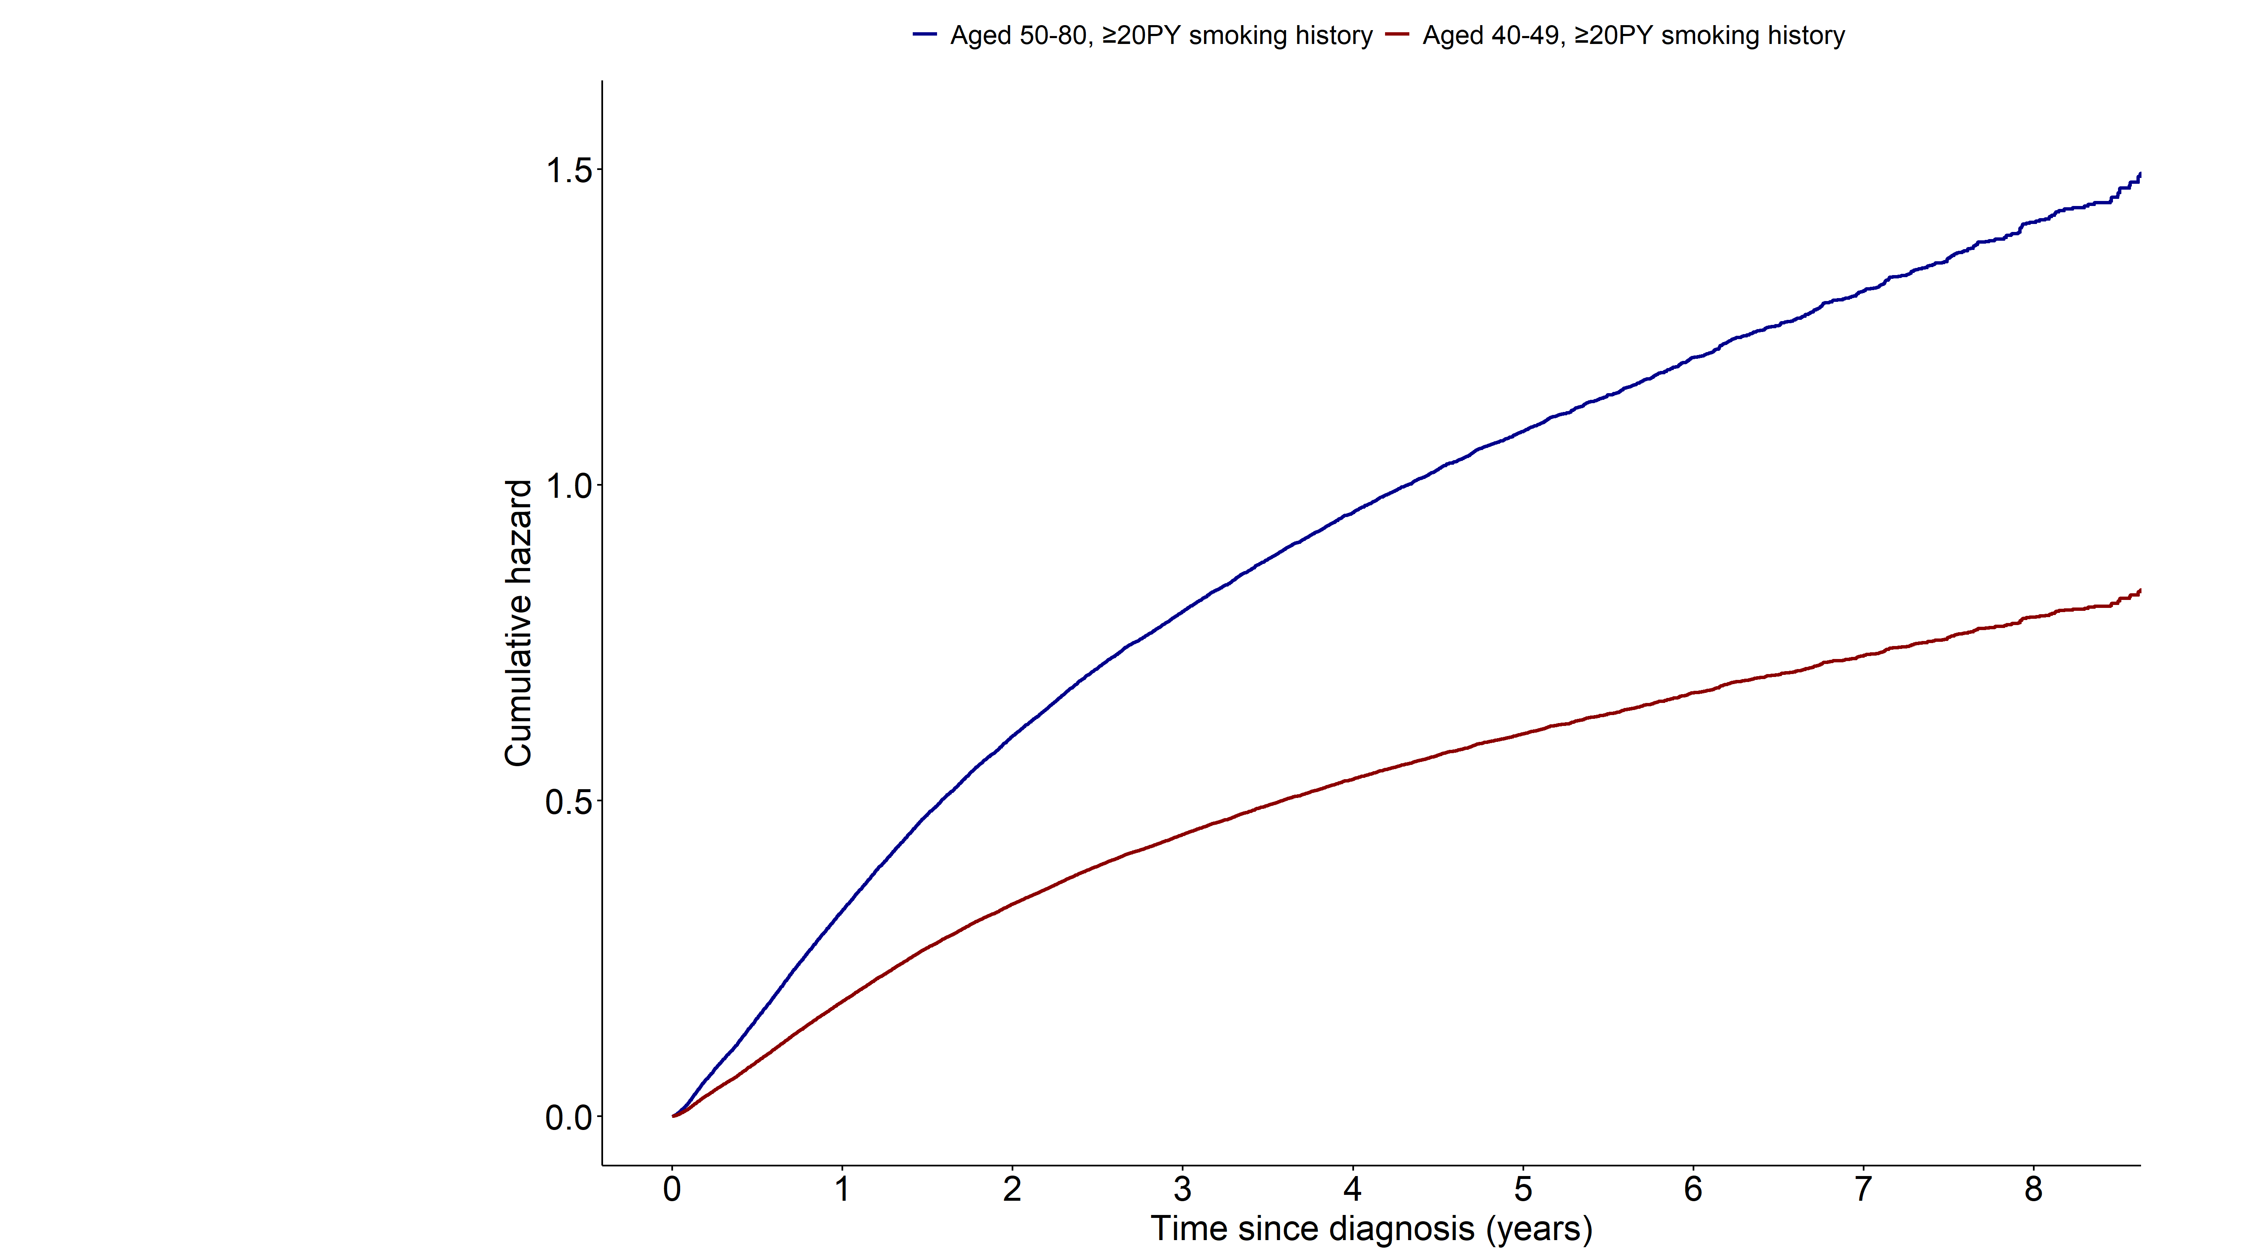
Notes:
> fit15 <- coxph(surv_all ~ grouptype+SEX+q_smk_yn2+pack_year+G1E_BMI+income+cci_group+activity
+ +non_small_yn+SEER_GRP+surgery_yn+radio_yn+system_yn
+ ,data=as.data.frame(data3))
>
> summary(fit15)$coefficients
coef exp(coef) se(coef) z Pr(>|z|)
grouptype002 -0.583070188 0.5581820 0.0525327213 -11.099181 1.265985e-28
SEX1 0.077066154 1.0801135 0.0515721401 1.494337 1.350876e-01
q_smk_yn2Current smoker 0.071210981 1.0738078 0.0135312191 5.262717 1.419417e-07
pack_year 0.002440033 1.0024430 0.0003335548 7.315237 2.569275e-13
G1E_BMI -0.039836704 0.9609463 0.0026197885 -15.206076 3.222898e-52
income2 -0.064477956 0.9375568 0.0228446278 -2.822456 4.765737e-03
income3 -0.069094367 0.9332386 0.0218470699 -3.162638 1.563468e-03
income4 -0.041590574 0.9592624 0.0200465589 -2.074699 3.801445e-02
income5 -0.029562065 0.9708706 0.0190581169 -1.551154 1.208649e-01
cci_group>=5 0.430335542 1.5377734 0.0225486299 19.084776 3.379249e-81
cci_group1-2 0.134703097 1.1441970 0.0184302114 7.308820 2.694986e-13
cci_group3-4 0.286318153 1.3315160 0.0250271796 11.440288 2.630096e-30
activityactive -0.066617018 0.9355534 0.0161674826 -4.120432 3.781621e-05
non_small_yn1 -0.198001868 0.8203683 0.0172772503 -11.460265 2.088746e-30
SEER_GRP2 0.620638968 1.8601162 0.0234436431 26.473657 1.949320e-154
SEER_GRP7 1.336583480 3.8060179 0.0242346466 55.151763 0.000000e+00
SEER_GRP9 0.557261397 1.7458847 0.0329695120 16.902325 4.325135e-64
surgery_ynyes -1.141330864 0.3193937 0.0196974163 -57.943176 0.000000e+00
radio_ynyes -0.102405930 0.9026631 0.0156943191 -6.525032 6.798716e-11
system_ynyes -0.360399037 0.6973980 0.0152491226 -23.634083 1.720736e-123
> exp(confint(fit15))
2.5 % 97.5 %
grouptype002 0.5035701 0.6187166
SEX1 0.9762726 1.1949994
q_smk_yn2Current smoker 1.0457039 1.1026669
pack_year 1.0017879 1.0030986
G1E_BMI 0.9560248 0.9658932
income2 0.8965039 0.9804895
income3 0.8941213 0.9740673
income4 0.9223033 0.9977026
income5 0.9352744 1.0078216
cci_group>=5 1.4712922 1.6072587
cci_group1-2 1.1036033 1.1862839
cci_group3-4 1.2677780 1.3984585
activityactive 0.9063727 0.9656737
non_small_yn1 0.7930535 0.8486240
SEER_GRP2 1.7765802 1.9475802
SEER_GRP7 3.6294621 3.9911624
SEER_GRP9 1.6366351 1.8624270
surgery_ynyes 0.3072981 0.3319654
radio_ynyes 0.8753196 0.9308607
system_ynyes 0.6768627 0.7185562

Slide 15
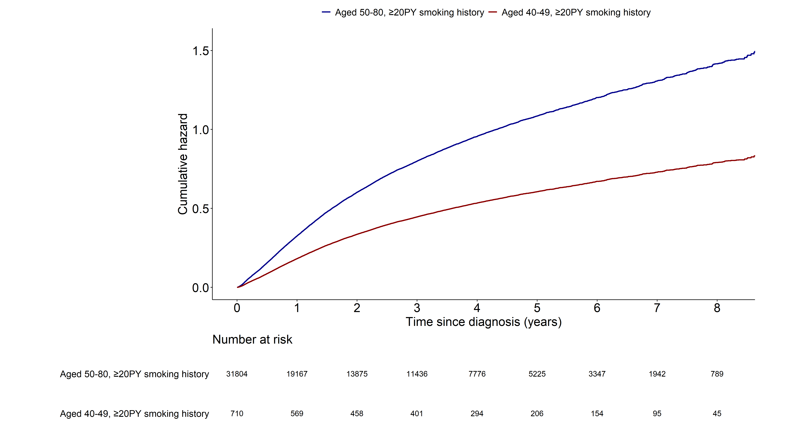
Notes:
> fit15 <- coxph(surv_all ~ grouptype+SEX+q_smk_yn2+pack_year+G1E_BMI+income+cci_group+activity
+ +non_small_yn+SEER_GRP+surgery_yn+radio_yn+system_yn
+ ,data=as.data.frame(data3))
>
> summary(fit15)$coefficients
coef exp(coef) se(coef) z Pr(>|z|)
grouptype002 -0.583070188 0.5581820 0.0525327213 -11.099181 1.265985e-28
SEX1 0.077066154 1.0801135 0.0515721401 1.494337 1.350876e-01
q_smk_yn2Current smoker 0.071210981 1.0738078 0.0135312191 5.262717 1.419417e-07
pack_year 0.002440033 1.0024430 0.0003335548 7.315237 2.569275e-13
G1E_BMI -0.039836704 0.9609463 0.0026197885 -15.206076 3.222898e-52
income2 -0.064477956 0.9375568 0.0228446278 -2.822456 4.765737e-03
income3 -0.069094367 0.9332386 0.0218470699 -3.162638 1.563468e-03
income4 -0.041590574 0.9592624 0.0200465589 -2.074699 3.801445e-02
income5 -0.029562065 0.9708706 0.0190581169 -1.551154 1.208649e-01
cci_group>=5 0.430335542 1.5377734 0.0225486299 19.084776 3.379249e-81
cci_group1-2 0.134703097 1.1441970 0.0184302114 7.308820 2.694986e-13
cci_group3-4 0.286318153 1.3315160 0.0250271796 11.440288 2.630096e-30
activityactive -0.066617018 0.9355534 0.0161674826 -4.120432 3.781621e-05
non_small_yn1 -0.198001868 0.8203683 0.0172772503 -11.460265 2.088746e-30
SEER_GRP2 0.620638968 1.8601162 0.0234436431 26.473657 1.949320e-154
SEER_GRP7 1.336583480 3.8060179 0.0242346466 55.151763 0.000000e+00
SEER_GRP9 0.557261397 1.7458847 0.0329695120 16.902325 4.325135e-64
surgery_ynyes -1.141330864 0.3193937 0.0196974163 -57.943176 0.000000e+00
radio_ynyes -0.102405930 0.9026631 0.0156943191 -6.525032 6.798716e-11
system_ynyes -0.360399037 0.6973980 0.0152491226 -23.634083 1.720736e-123
> exp(confint(fit15))
2.5 % 97.5 %
grouptype002 0.5035701 0.6187166
SEX1 0.9762726 1.1949994
q_smk_yn2Current smoker 1.0457039 1.1026669
pack_year 1.0017879 1.0030986
G1E_BMI 0.9560248 0.9658932
income2 0.8965039 0.9804895
income3 0.8941213 0.9740673
income4 0.9223033 0.9977026
income5 0.9352744 1.0078216
cci_group>=5 1.4712922 1.6072587
cci_group1-2 1.1036033 1.1862839
cci_group3-4 1.2677780 1.3984585
activityactive 0.9063727 0.9656737
non_small_yn1 0.7930535 0.8486240
SEER_GRP2 1.7765802 1.9475802
SEER_GRP7 3.6294621 3.9911624
SEER_GRP9 1.6366351 1.8624270
surgery_ynyes 0.3072981 0.3319654
radio_ynyes 0.8753196 0.9308607
system_ynyes 0.6768627 0.7185562

Slide 16
Lung cancer mortality (1.AGED 50-80, ≥20PY smoking
2. AGED 40-49, ≥20PY smoking)
Multivariable cox model: age 변수 제외

Slide 17
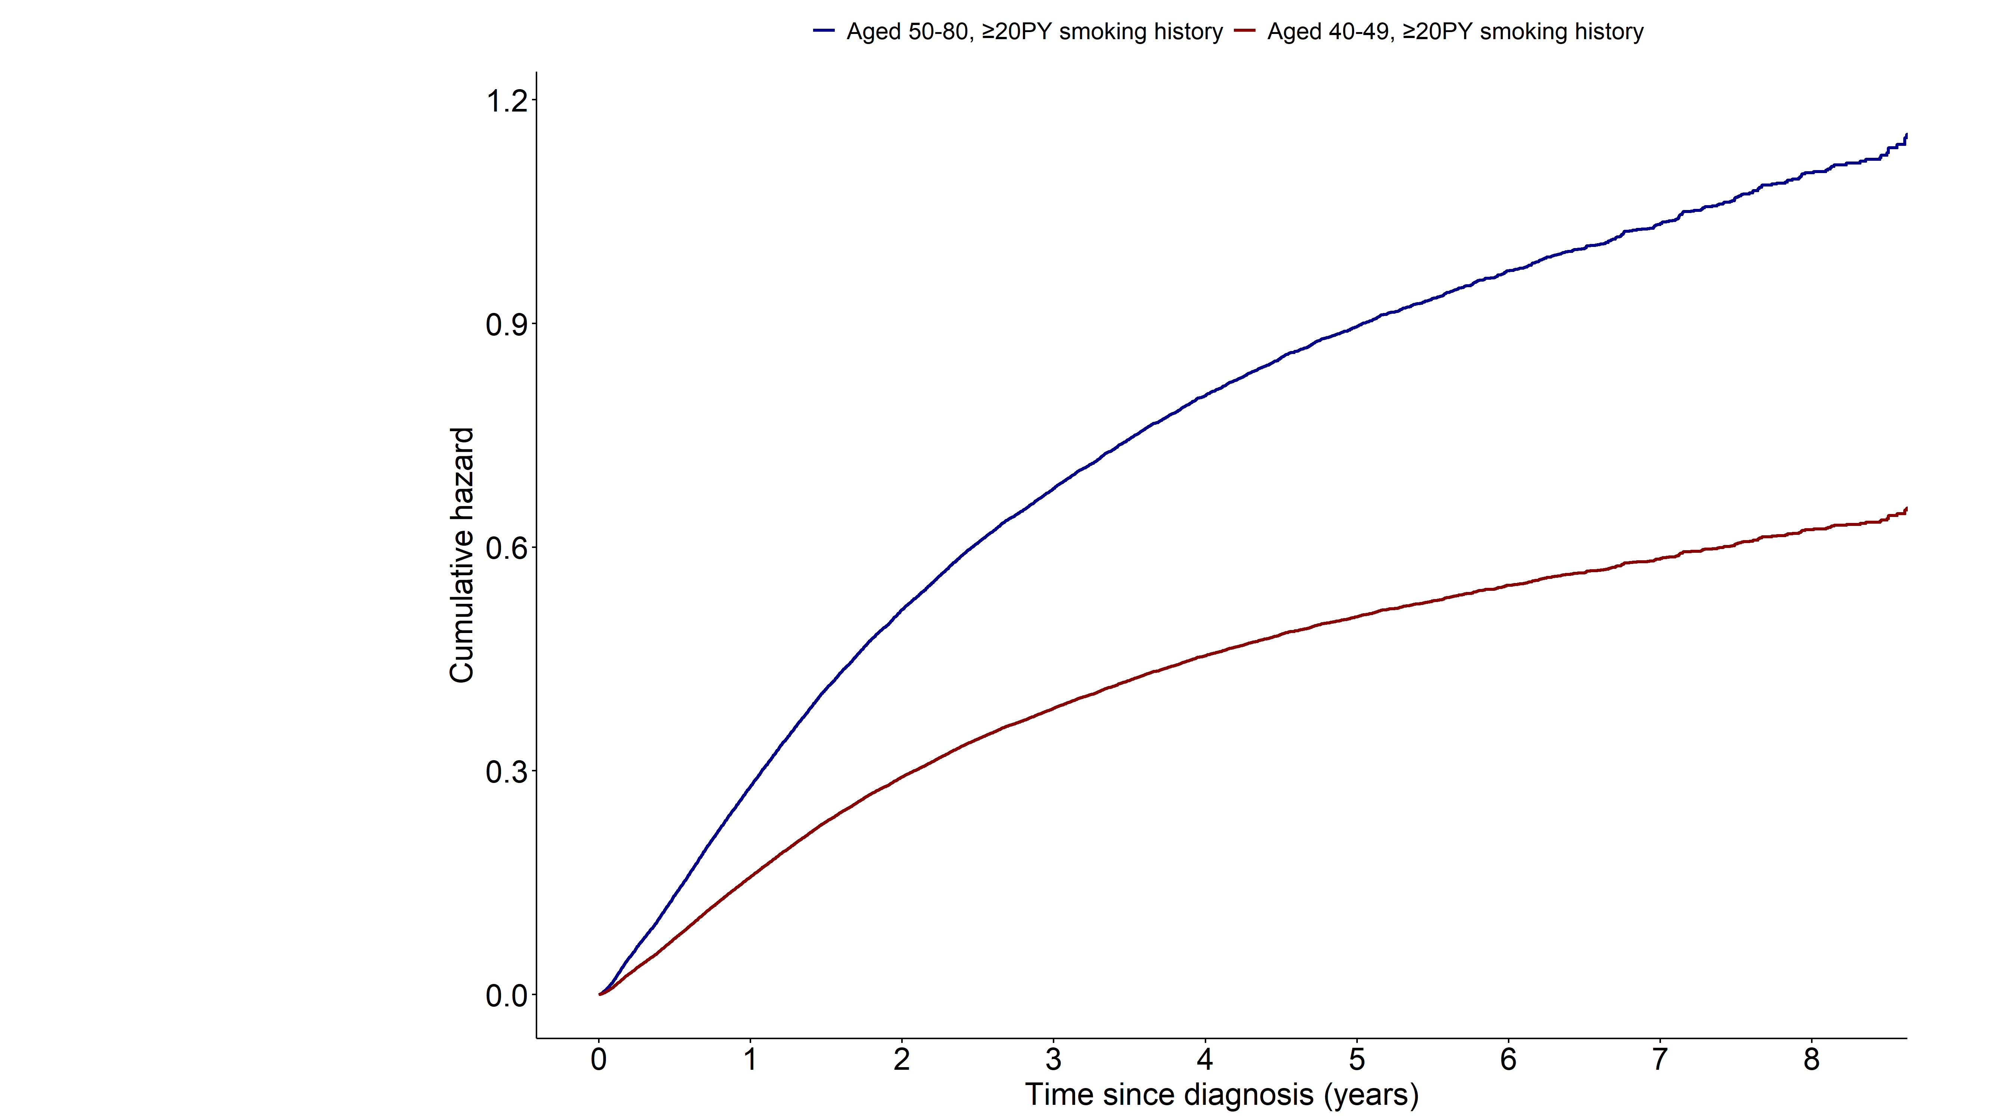
Notes:
> fit15 <- coxph(surv_lungcancer ~ grouptype+SEX+q_smk_yn2+pack_year+G1E_BMI+income+cci_group+activity
+ +non_small_yn+SEER_GRP+surgery_yn+radio_yn+system_yn
+ ,data=as.data.frame(data3))
>
> summary(fit15)$coefficients
coef exp(coef) se(coef) z Pr(>|z|)
grouptype002 -0.570043662 0.5655007 0.0543140550 -10.495325 9.076478e-26
SEX1 0.066469710 1.0687286 0.0533340476 1.246290 2.126578e-01
q_smk_yn2Current smoker 0.076268552 1.0792524 0.0141075862 5.406208 6.437286e-08
pack_year 0.002445699 1.0024487 0.0003478448 7.031006 2.050490e-12
G1E_BMI -0.038866237 0.9618794 0.0027273439 -14.250582 4.445622e-46
income2 -0.061518699 0.9403354 0.0237488044 -2.590391 9.586686e-03
income3 -0.070395683 0.9320250 0.0227484786 -3.094523 1.971299e-03
income4 -0.041082625 0.9597498 0.0208684540 -1.968647 4.899361e-02
income5 -0.027721997 0.9726587 0.0198582617 -1.395993 1.627166e-01
cci_group>=5 0.402607566 1.4957198 0.0234132142 17.195741 2.857809e-66
cci_group1-2 0.129347054 1.1380850 0.0191107265 6.768296 1.303080e-11
cci_group3-4 0.250533582 1.2847107 0.0262521682 9.543348 1.382938e-21
activityactive -0.064359689 0.9376677 0.0168430604 -3.821140 1.328363e-04
non_small_yn1 -0.206188851 0.8136794 0.0176830112 -11.660279 2.033739e-31
SEER_GRP2 0.732688008 2.0806659 0.0258328200 28.362680 5.839508e-177
SEER_GRP7 1.471652274 4.3564272 0.0264713844 55.594080 0.000000e+00
SEER_GRP9 0.623245481 1.8649710 0.0358849699 17.367870 1.444916e-67
surgery_ynyes -1.194484653 0.3028600 0.0211668442 -56.431872 0.000000e+00
radio_ynyes -0.094616814 0.9097215 0.0161668941 -5.852504 4.842263e-09
system_ynyes -0.329749257 0.7191040 0.0158508106 -20.803306 4.039851e-96
> exp(confint(fit15))
2.5 % 97.5 %
grouptype002 0.5083947 0.6290214
SEX1 0.9626522 1.1864937
q_smk_yn2Current smoker 1.0498194 1.1095105
pack_year 1.0017655 1.0031324
G1E_BMI 0.9567514 0.9670349
income2 0.8975688 0.9851396
income3 0.8913823 0.9745207
income4 0.9212867 0.9998188
income5 0.9355287 1.0112624
cci_group>=5 1.4286337 1.5659562
cci_group1-2 1.0962450 1.1815219
cci_group3-4 1.2202799 1.3525435
activityactive 0.9072189 0.9691384
non_small_yn1 0.7859619 0.8423743
SEER_GRP2 1.9779414 2.1887255
SEER_GRP7 4.1361662 4.5884177
SEER_GRP9 1.7383080 2.0008633
surgery_ynyes 0.2905525 0.3156888
radio_ynyes 0.8813475 0.9390089
system_ynyes 0.6971071 0.7417951

Slide 18
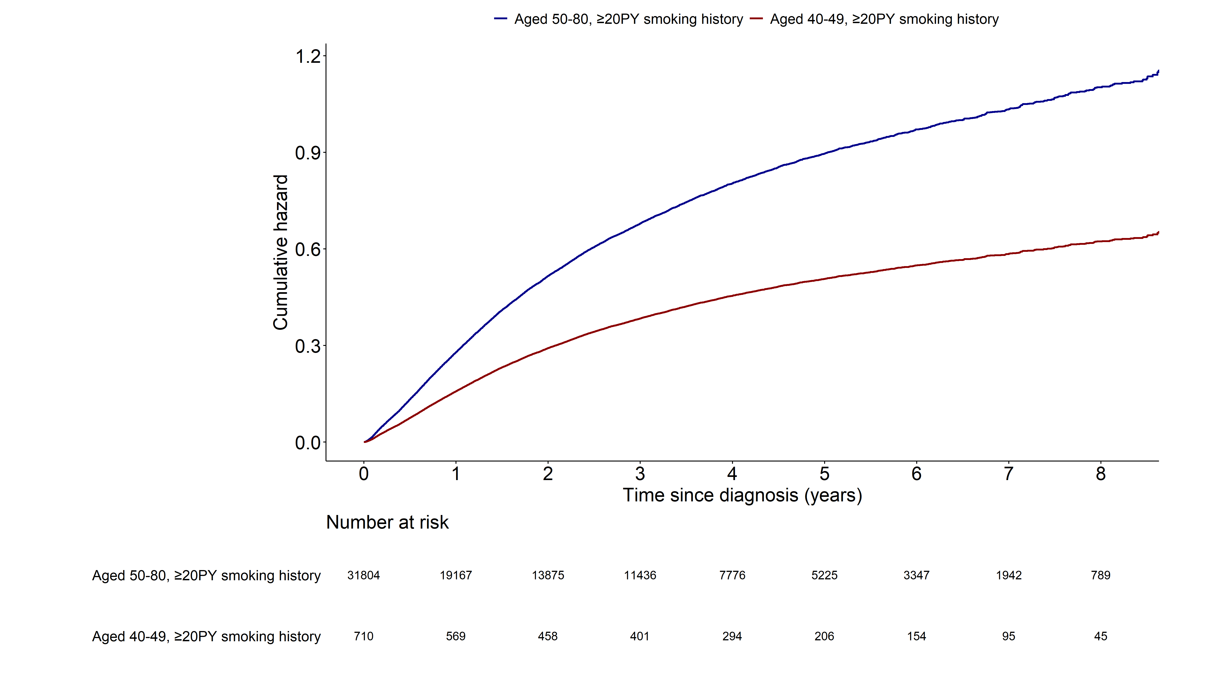
Notes:
> fit15 <- coxph(surv_lungcancer ~ grouptype+SEX+q_smk_yn2+pack_year+G1E_BMI+income+cci_group+activity
+ +non_small_yn+SEER_GRP+surgery_yn+radio_yn+system_yn
+ ,data=as.data.frame(data3))
>
> summary(fit15)$coefficients
coef exp(coef) se(coef) z Pr(>|z|)
grouptype002 -0.570043662 0.5655007 0.0543140550 -10.495325 9.076478e-26
SEX1 0.066469710 1.0687286 0.0533340476 1.246290 2.126578e-01
q_smk_yn2Current smoker 0.076268552 1.0792524 0.0141075862 5.406208 6.437286e-08
pack_year 0.002445699 1.0024487 0.0003478448 7.031006 2.050490e-12
G1E_BMI -0.038866237 0.9618794 0.0027273439 -14.250582 4.445622e-46
income2 -0.061518699 0.9403354 0.0237488044 -2.590391 9.586686e-03
income3 -0.070395683 0.9320250 0.0227484786 -3.094523 1.971299e-03
income4 -0.041082625 0.9597498 0.0208684540 -1.968647 4.899361e-02
income5 -0.027721997 0.9726587 0.0198582617 -1.395993 1.627166e-01
cci_group>=5 0.402607566 1.4957198 0.0234132142 17.195741 2.857809e-66
cci_group1-2 0.129347054 1.1380850 0.0191107265 6.768296 1.303080e-11
cci_group3-4 0.250533582 1.2847107 0.0262521682 9.543348 1.382938e-21
activityactive -0.064359689 0.9376677 0.0168430604 -3.821140 1.328363e-04
non_small_yn1 -0.206188851 0.8136794 0.0176830112 -11.660279 2.033739e-31
SEER_GRP2 0.732688008 2.0806659 0.0258328200 28.362680 5.839508e-177
SEER_GRP7 1.471652274 4.3564272 0.0264713844 55.594080 0.000000e+00
SEER_GRP9 0.623245481 1.8649710 0.0358849699 17.367870 1.444916e-67
surgery_ynyes -1.194484653 0.3028600 0.0211668442 -56.431872 0.000000e+00
radio_ynyes -0.094616814 0.9097215 0.0161668941 -5.852504 4.842263e-09
system_ynyes -0.329749257 0.7191040 0.0158508106 -20.803306 4.039851e-96
> exp(confint(fit15))
2.5 % 97.5 %
grouptype002 0.5083947 0.6290214
SEX1 0.9626522 1.1864937
q_smk_yn2Current smoker 1.0498194 1.1095105
pack_year 1.0017655 1.0031324
G1E_BMI 0.9567514 0.9670349
income2 0.8975688 0.9851396
income3 0.8913823 0.9745207
income4 0.9212867 0.9998188
income5 0.9355287 1.0112624
cci_group>=5 1.4286337 1.5659562
cci_group1-2 1.0962450 1.1815219
cci_group3-4 1.2202799 1.3525435
activityactive 0.9072189 0.9691384
non_small_yn1 0.7859619 0.8423743
SEER_GRP2 1.9779414 2.1887255
SEER_GRP7 4.1361662 4.5884177
SEER_GRP9 1.7383080 2.0008633
surgery_ynyes 0.2905525 0.3156888
radio_ynyes 0.8813475 0.9390089
system_ynyes 0.6971071 0.7417951

Slide 19
All cause mortality (1.AGED 50-80, <20PY smoking
2. AGED 40-49, <20PY smoking)
Multivariable cox model: age 변수 제외

Slide 20
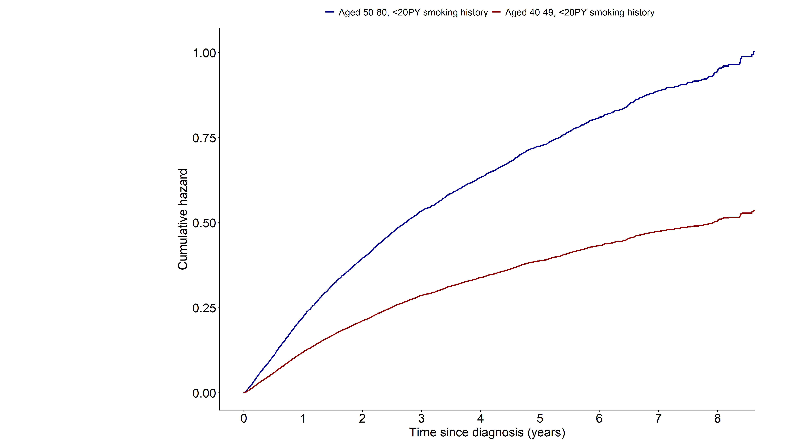
Notes:
> fit15 <- coxph(surv_all ~ grouptype+SEX+q_smk_yn2+pack_year+G1E_BMI+income+cci_group+activity
+ +non_small_yn+SEER_GRP+surgery_yn+radio_yn+system_yn
+ ,data=as.data.frame(data4))
>
> summary(fit15)$coefficients
coef exp(coef) se(coef) z Pr(>|z|)
grouptype002 -0.625366712 0.5350652 0.051068982 -12.2455293 1.775153e-34
SEX1 0.336593402 1.4001696 0.040797760 8.2502912 1.580091e-16
q_smk_yn2Current smoker 0.138367872 1.1483979 0.022287461 6.2083282 5.355123e-10
pack_year 0.004947060 1.0049593 0.002138439 2.3133974 2.070080e-02
G1E_BMI -0.041559245 0.9592925 0.004321006 -9.6179551 6.715288e-22
income2 -0.050673932 0.9505886 0.036885863 -1.3738036 1.695027e-01
income3 0.004101759 1.0041102 0.035134610 0.1167441 9.070628e-01
income4 -0.023094883 0.9771698 0.033058419 -0.6986082 4.847969e-01
income5 -0.027930255 0.9724562 0.031076217 -0.8987662 3.687772e-01
cci_group>=5 0.487830971 1.6287795 0.034683523 14.0652083 6.213966e-45
cci_group1-2 0.167416156 1.1822462 0.028531083 5.8678514 4.414786e-09
cci_group3-4 0.430422172 1.5379066 0.040662921 10.5851267 3.493080e-26
activityactive -0.075489861 0.9272891 0.024341667 -3.1012610 1.926984e-03
non_small_yn1 -0.353342303 0.7023367 0.030278671 -11.6696766 1.821142e-31
SEER_GRP2 0.766560078 2.1523496 0.040459115 18.9465361 4.716244e-80
SEER_GRP7 1.410361696 4.0974372 0.041445110 34.0296287 8.124738e-254
SEER_GRP9 0.692289125 1.9982846 0.053895751 12.8449667 9.179136e-38
surgery_ynyes -1.247013490 0.2873617 0.032911173 -37.8902784 3.720799e-314
radio_ynyes -0.020108248 0.9800926 0.025833504 -0.7783787 4.363458e-01
system_ynyes -0.352702220 0.7027864 0.024686906 -14.2870159 2.636678e-46
> exp(confint(fit15))
2.5 % 97.5 %
grouptype002 0.4841018 0.5913937
SEX1 1.2925684 1.5167282
q_smk_yn2Current smoker 1.0993128 1.1996748
pack_year 1.0007561 1.0091802
G1E_BMI 0.9512025 0.9674513
income2 0.8842912 1.0218565
income3 0.9372916 1.0756922
income4 0.9158633 1.0425800
income5 0.9149933 1.0335278
cci_group>=5 1.5217371 1.7433515
cci_group1-2 1.1179496 1.2502406
cci_group3-4 1.4200958 1.6654911
activityactive 0.8840880 0.9726013
non_small_yn1 0.6618691 0.7452786
SEER_GRP2 1.9882636 2.3299772
SEER_GRP7 3.7777582 4.4441678
SEER_GRP9 1.7979649 2.2209230
surgery_ynyes 0.2694107 0.3065088
radio_ynyes 0.9317032 1.0309951
system_ynyes 0.6695914 0.7376272

Slide 21
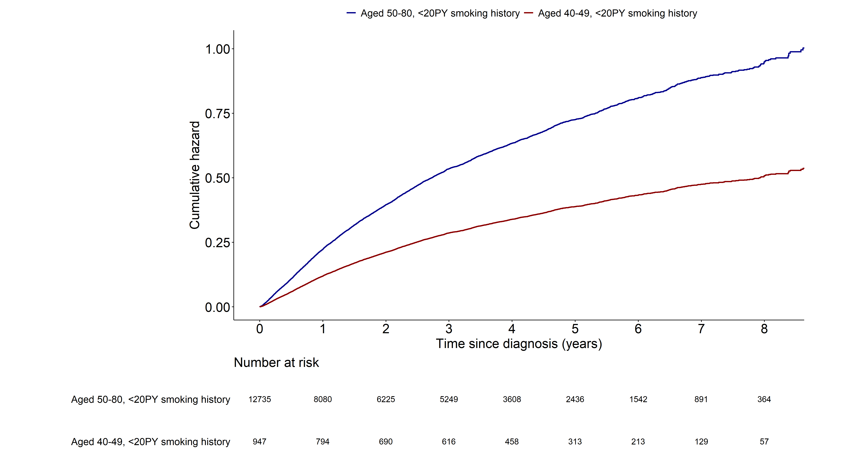
Notes:
> fit15 <- coxph(surv_all ~ grouptype+SEX+q_smk_yn2+pack_year+G1E_BMI+income+cci_group+activity
+ +non_small_yn+SEER_GRP+surgery_yn+radio_yn+system_yn
+ ,data=as.data.frame(data4))
>
> summary(fit15)$coefficients
coef exp(coef) se(coef) z Pr(>|z|)
grouptype002 -0.625366712 0.5350652 0.051068982 -12.2455293 1.775153e-34
SEX1 0.336593402 1.4001696 0.040797760 8.2502912 1.580091e-16
q_smk_yn2Current smoker 0.138367872 1.1483979 0.022287461 6.2083282 5.355123e-10
pack_year 0.004947060 1.0049593 0.002138439 2.3133974 2.070080e-02
G1E_BMI -0.041559245 0.9592925 0.004321006 -9.6179551 6.715288e-22
income2 -0.050673932 0.9505886 0.036885863 -1.3738036 1.695027e-01
income3 0.004101759 1.0041102 0.035134610 0.1167441 9.070628e-01
income4 -0.023094883 0.9771698 0.033058419 -0.6986082 4.847969e-01
income5 -0.027930255 0.9724562 0.031076217 -0.8987662 3.687772e-01
cci_group>=5 0.487830971 1.6287795 0.034683523 14.0652083 6.213966e-45
cci_group1-2 0.167416156 1.1822462 0.028531083 5.8678514 4.414786e-09
cci_group3-4 0.430422172 1.5379066 0.040662921 10.5851267 3.493080e-26
activityactive -0.075489861 0.9272891 0.024341667 -3.1012610 1.926984e-03
non_small_yn1 -0.353342303 0.7023367 0.030278671 -11.6696766 1.821142e-31
SEER_GRP2 0.766560078 2.1523496 0.040459115 18.9465361 4.716244e-80
SEER_GRP7 1.410361696 4.0974372 0.041445110 34.0296287 8.124738e-254
SEER_GRP9 0.692289125 1.9982846 0.053895751 12.8449667 9.179136e-38
surgery_ynyes -1.247013490 0.2873617 0.032911173 -37.8902784 3.720799e-314
radio_ynyes -0.020108248 0.9800926 0.025833504 -0.7783787 4.363458e-01
system_ynyes -0.352702220 0.7027864 0.024686906 -14.2870159 2.636678e-46
> exp(confint(fit15))
2.5 % 97.5 %
grouptype002 0.4841018 0.5913937
SEX1 1.2925684 1.5167282
q_smk_yn2Current smoker 1.0993128 1.1996748
pack_year 1.0007561 1.0091802
G1E_BMI 0.9512025 0.9674513
income2 0.8842912 1.0218565
income3 0.9372916 1.0756922
income4 0.9158633 1.0425800
income5 0.9149933 1.0335278
cci_group>=5 1.5217371 1.7433515
cci_group1-2 1.1179496 1.2502406
cci_group3-4 1.4200958 1.6654911
activityactive 0.8840880 0.9726013
non_small_yn1 0.6618691 0.7452786
SEER_GRP2 1.9882636 2.3299772
SEER_GRP7 3.7777582 4.4441678
SEER_GRP9 1.7979649 2.2209230
surgery_ynyes 0.2694107 0.3065088
radio_ynyes 0.9317032 1.0309951
system_ynyes 0.6695914 0.7376272

Slide 22
Lung cancer mortality (1.AGED 50-80, <20PY smoking
2. AGED 40-49, <20PY smoking)
Multivariable cox model: age 변수 제외

Slide 23
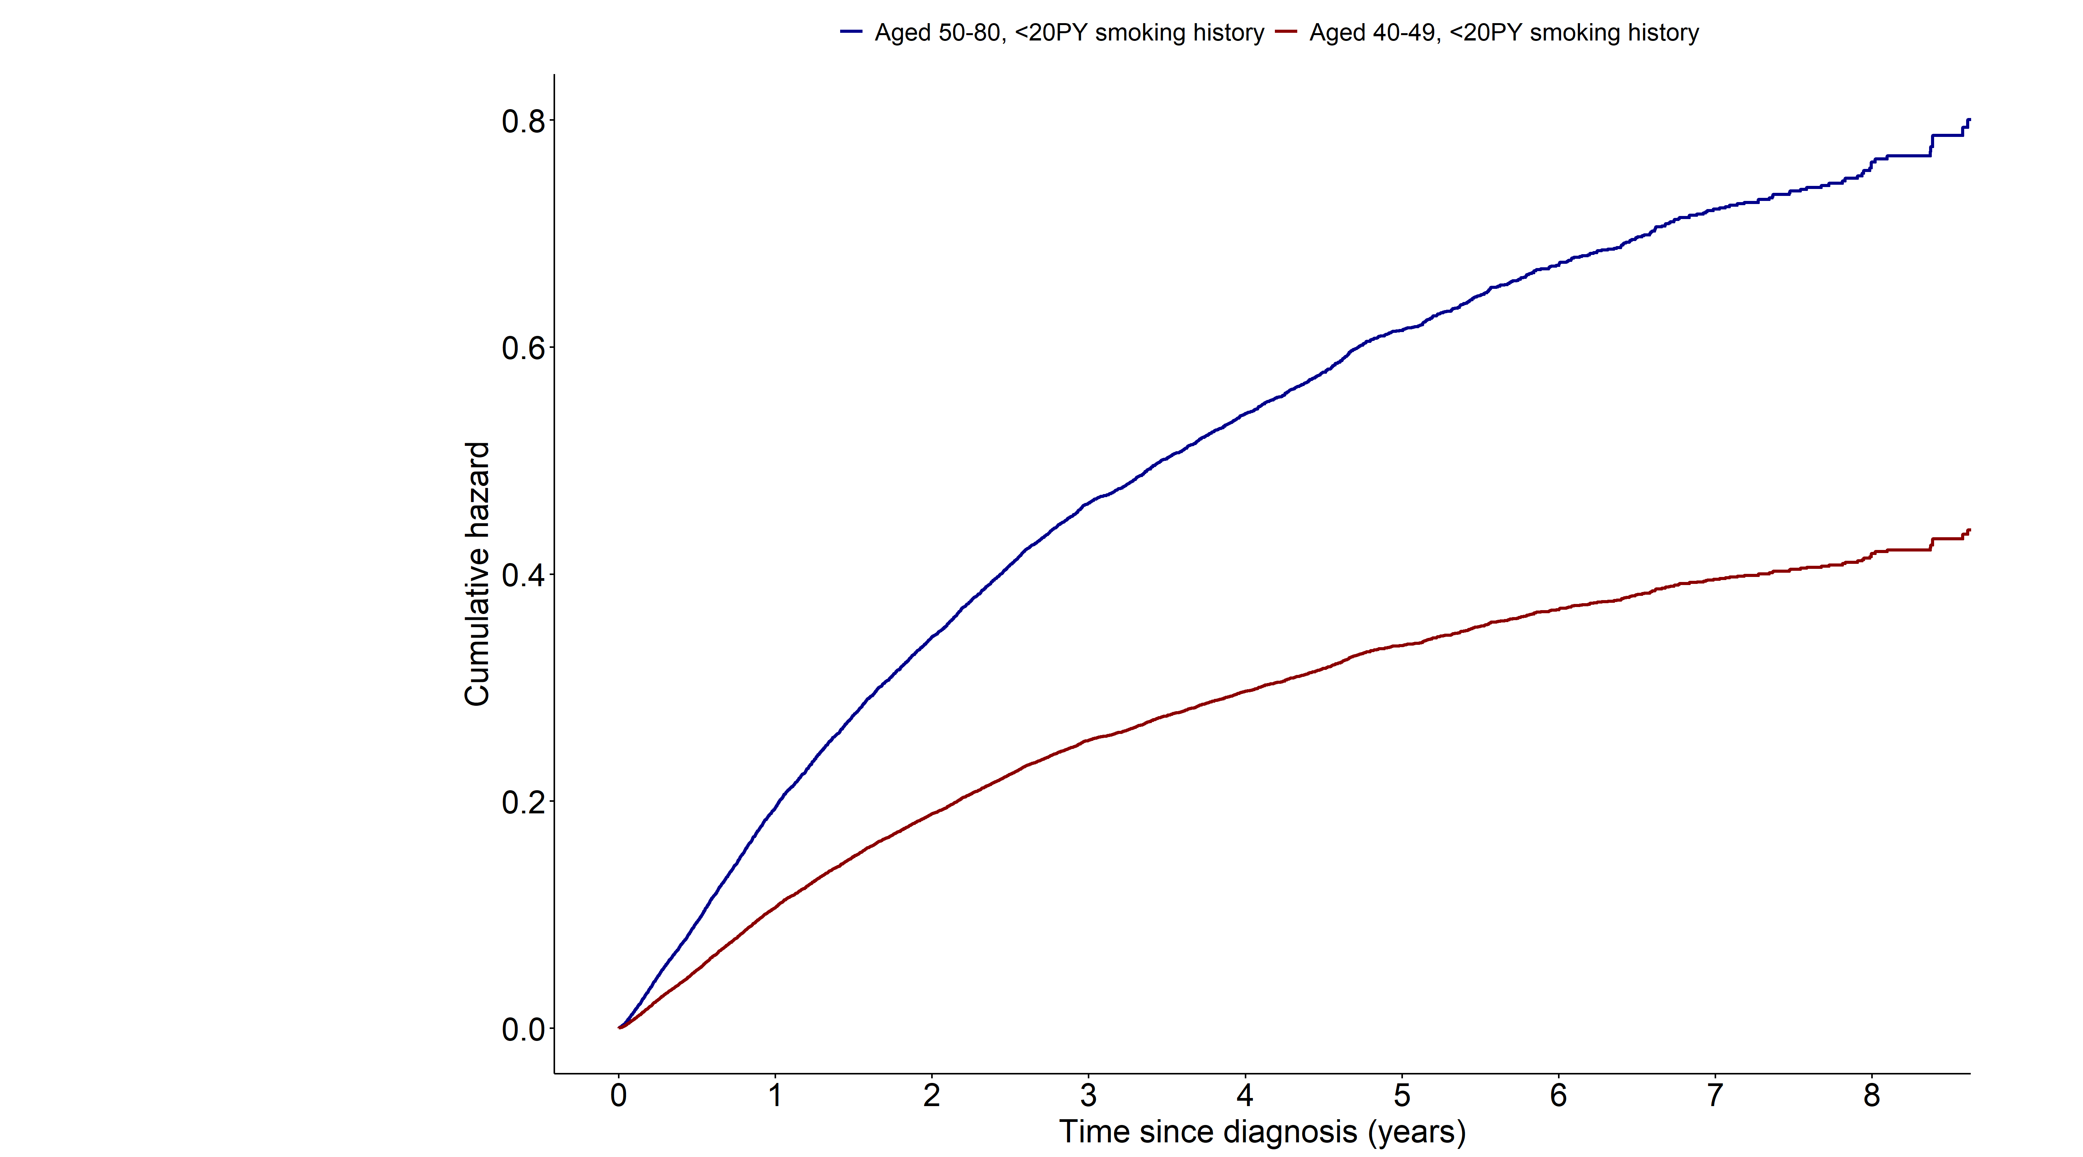
Notes:
> fit15 <- coxph(surv_lungcancer ~ grouptype+SEX+q_smk_yn2+pack_year+G1E_BMI+income+cci_group+activity
+ +non_small_yn+SEER_GRP+surgery_yn+radio_yn+system_yn
+ ,data=as.data.frame(data4))
> summary(fit15)$coefficients
coef exp(coef) se(coef) z Pr(>|z|)
grouptype002 -0.600966048 0.5482817 0.052592032 -11.4269410 3.067245e-30
SEX1 0.330681710 1.3919167 0.042393153 7.8003565 6.173252e-15
q_smk_yn2Current smoker 0.129413764 1.1381610 0.023176791 5.5837654 2.353662e-08
pack_year 0.005569175 1.0055847 0.002224339 2.5037436 1.228870e-02
G1E_BMI -0.040603877 0.9602094 0.004486231 -9.0507760 1.419558e-19
income2 -0.059192675 0.9425252 0.038209605 -1.5491570 1.213440e-01
income3 0.005679059 1.0056952 0.036328110 0.1563269 8.757754e-01
income4 -0.035596326 0.9650298 0.034337053 -1.0366739 2.998879e-01
income5 -0.049050213 0.9521333 0.032342117 -1.5166049 1.293665e-01
cci_group>=5 0.441495793 1.5550315 0.035975501 12.2721234 1.278557e-34
cci_group1-2 0.157797113 1.1709286 0.029483328 5.3520795 8.694919e-08
cci_group3-4 0.378259676 1.4597420 0.042689589 8.8607007 7.951305e-19
activityactive -0.073456134 0.9291769 0.025318922 -2.9012347 3.716954e-03
non_small_yn1 -0.377047671 0.6858834 0.030881453 -12.2095185 2.765207e-34
SEER_GRP2 0.888510577 2.4315054 0.044778253 19.8424574 1.280444e-87
SEER_GRP7 1.567277097 4.7935780 0.045510863 34.4374288 6.945505e-260
SEER_GRP9 0.792688488 2.2093282 0.058669303 13.5111285 1.344446e-41
surgery_ynyes -1.295870084 0.2736597 0.035333931 -36.6749482 1.832124e-294
radio_ynyes -0.004776260 0.9952351 0.026542596 -0.1799470 8.571942e-01
system_ynyes -0.331492968 0.7178512 0.025595222 -12.9513612 2.308246e-38
> exp(confint(fit15))
2.5 % 97.5 %
grouptype002 0.4945809 0.6078133
SEX1 1.2809380 1.5125104
q_smk_yn2Current smoker 1.0876159 1.1910550
pack_year 1.0012103 1.0099783
G1E_BMI 0.9518034 0.9686896
income2 0.8745182 1.0158206
income3 0.9365778 1.0799134
income4 0.9022211 1.0322110
income5 0.8936513 1.0144425
cci_group>=5 1.4491615 1.6686359
cci_group1-2 1.1051829 1.2405854
cci_group3-4 1.3425753 1.5871338
activityactive 0.8841927 0.9764498
non_small_yn1 0.6456006 0.7286796
SEER_GRP2 2.2272036 2.6545479
SEER_GRP7 4.3845081 5.2408136
SEER_GRP9 1.9693406 2.4785611
surgery_ynyes 0.2553492 0.2932831
radio_ynyes 0.9447841 1.0483802
system_ynyes 0.6827280 0.7547813

Slide 24
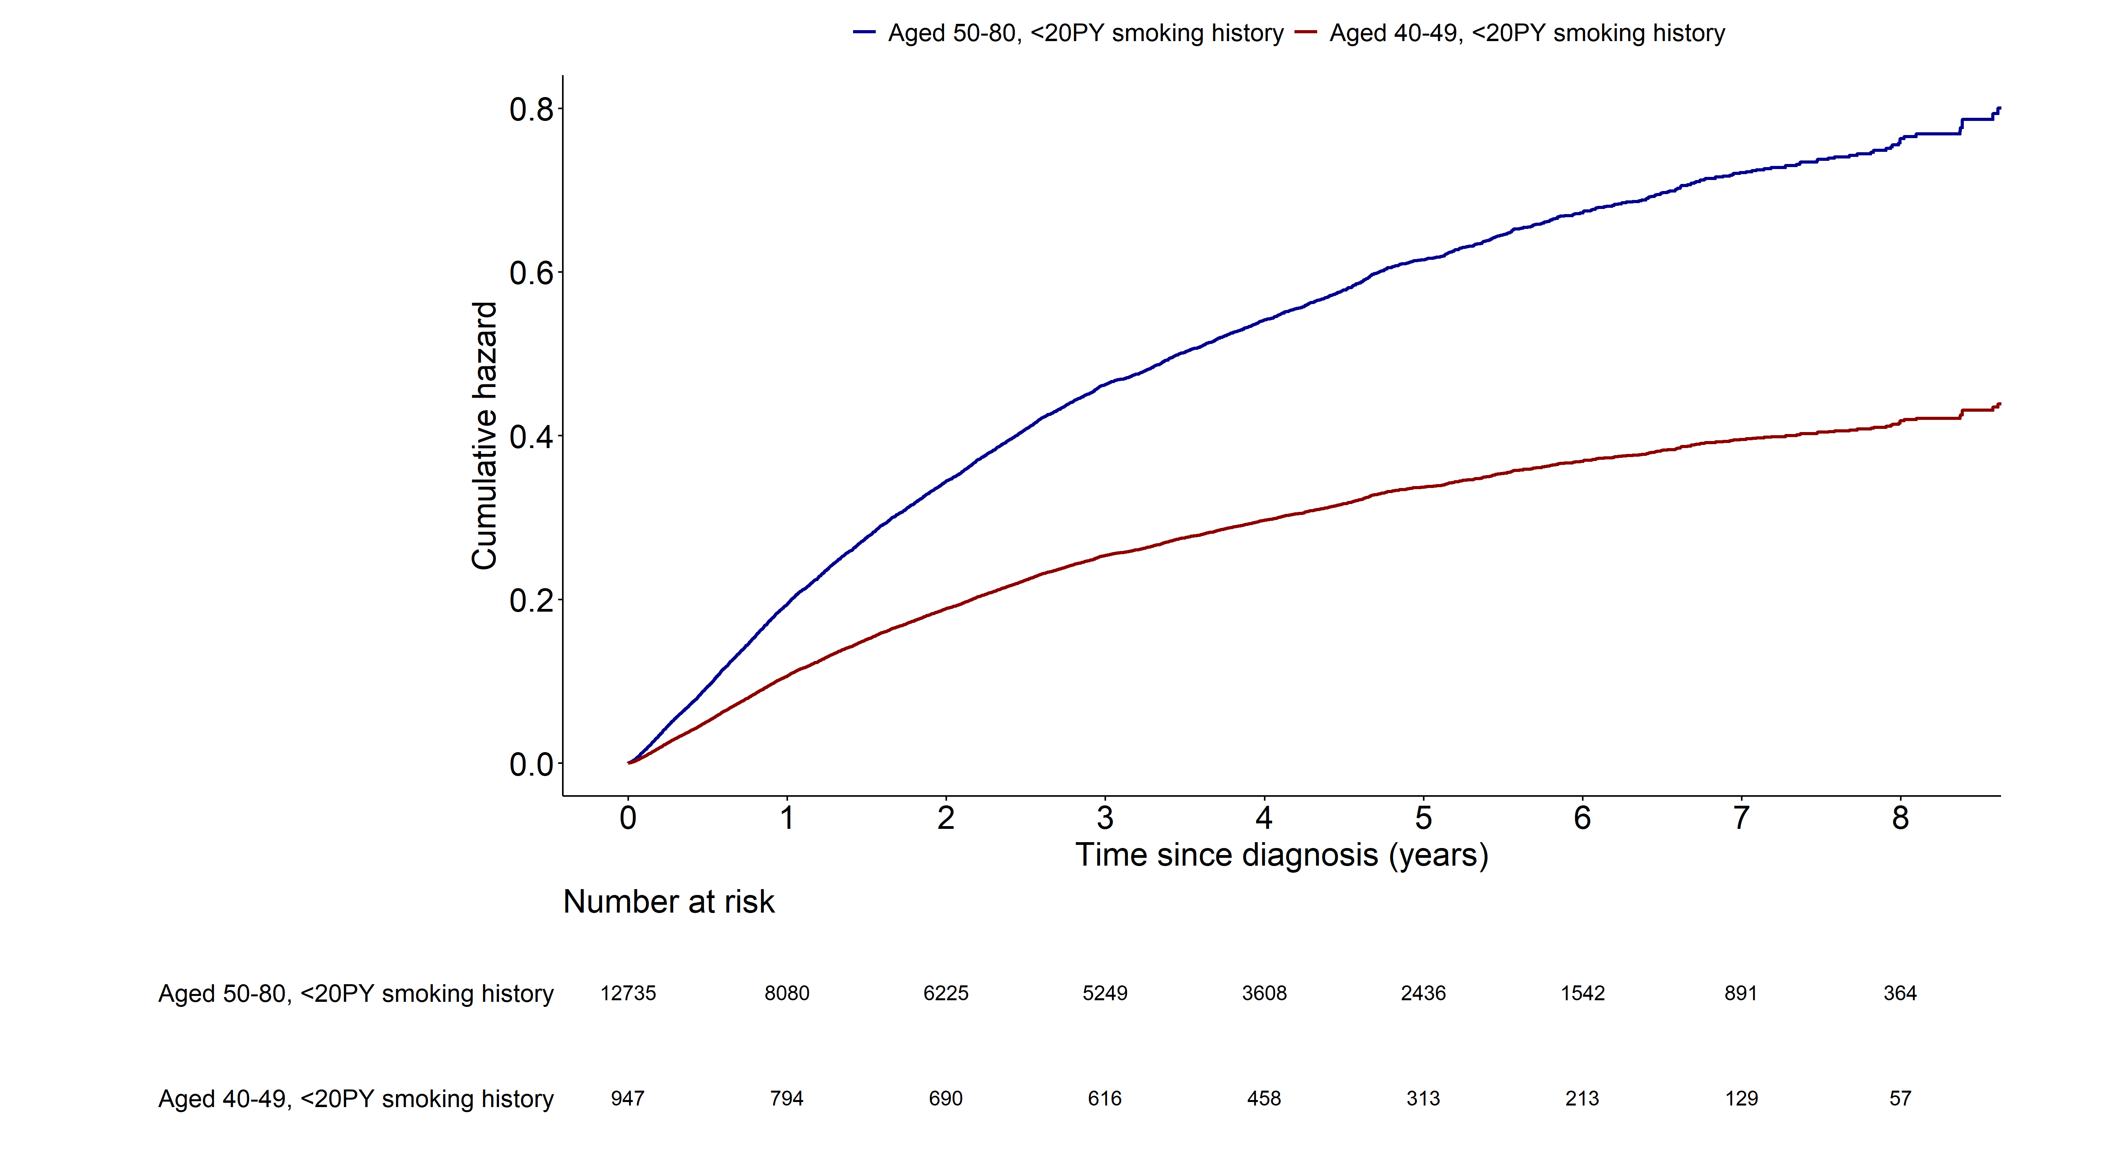
Notes:
> fit15 <- coxph(surv_lungcancer ~ grouptype+SEX+q_smk_yn2+pack_year+G1E_BMI+income+cci_group+activity
+ +non_small_yn+SEER_GRP+surgery_yn+radio_yn+system_yn
+ ,data=as.data.frame(data4))
> summary(fit15)$coefficients
coef exp(coef) se(coef) z Pr(>|z|)
grouptype002 -0.600966048 0.5482817 0.052592032 -11.4269410 3.067245e-30
SEX1 0.330681710 1.3919167 0.042393153 7.8003565 6.173252e-15
q_smk_yn2Current smoker 0.129413764 1.1381610 0.023176791 5.5837654 2.353662e-08
pack_year 0.005569175 1.0055847 0.002224339 2.5037436 1.228870e-02
G1E_BMI -0.040603877 0.9602094 0.004486231 -9.0507760 1.419558e-19
income2 -0.059192675 0.9425252 0.038209605 -1.5491570 1.213440e-01
income3 0.005679059 1.0056952 0.036328110 0.1563269 8.757754e-01
income4 -0.035596326 0.9650298 0.034337053 -1.0366739 2.998879e-01
income5 -0.049050213 0.9521333 0.032342117 -1.5166049 1.293665e-01
cci_group>=5 0.441495793 1.5550315 0.035975501 12.2721234 1.278557e-34
cci_group1-2 0.157797113 1.1709286 0.029483328 5.3520795 8.694919e-08
cci_group3-4 0.378259676 1.4597420 0.042689589 8.8607007 7.951305e-19
activityactive -0.073456134 0.9291769 0.025318922 -2.9012347 3.716954e-03
non_small_yn1 -0.377047671 0.6858834 0.030881453 -12.2095185 2.765207e-34
SEER_GRP2 0.888510577 2.4315054 0.044778253 19.8424574 1.280444e-87
SEER_GRP7 1.567277097 4.7935780 0.045510863 34.4374288 6.945505e-260
SEER_GRP9 0.792688488 2.2093282 0.058669303 13.5111285 1.344446e-41
surgery_ynyes -1.295870084 0.2736597 0.035333931 -36.6749482 1.832124e-294
radio_ynyes -0.004776260 0.9952351 0.026542596 -0.1799470 8.571942e-01
system_ynyes -0.331492968 0.7178512 0.025595222 -12.9513612 2.308246e-38
> exp(confint(fit15))
2.5 % 97.5 %
grouptype002 0.4945809 0.6078133
SEX1 1.2809380 1.5125104
q_smk_yn2Current smoker 1.0876159 1.1910550
pack_year 1.0012103 1.0099783
G1E_BMI 0.9518034 0.9686896
income2 0.8745182 1.0158206
income3 0.9365778 1.0799134
income4 0.9022211 1.0322110
income5 0.8936513 1.0144425
cci_group>=5 1.4491615 1.6686359
cci_group1-2 1.1051829 1.2405854
cci_group3-4 1.3425753 1.5871338
activityactive 0.8841927 0.9764498
non_small_yn1 0.6456006 0.7286796
SEER_GRP2 2.2272036 2.6545479
SEER_GRP7 4.3845081 5.2408136
SEER_GRP9 1.9693406 2.4785611
surgery_ynyes 0.2553492 0.2932831
radio_ynyes 0.9447841 1.0483802
system_ynyes 0.6827280 0.7547813

Slide 25
All cause mortality (1.AGED 50-80, Never-smoker
2. AGED 40-49, Never-smoker)
Multivariable cox model: age 변수 제외

Slide 26
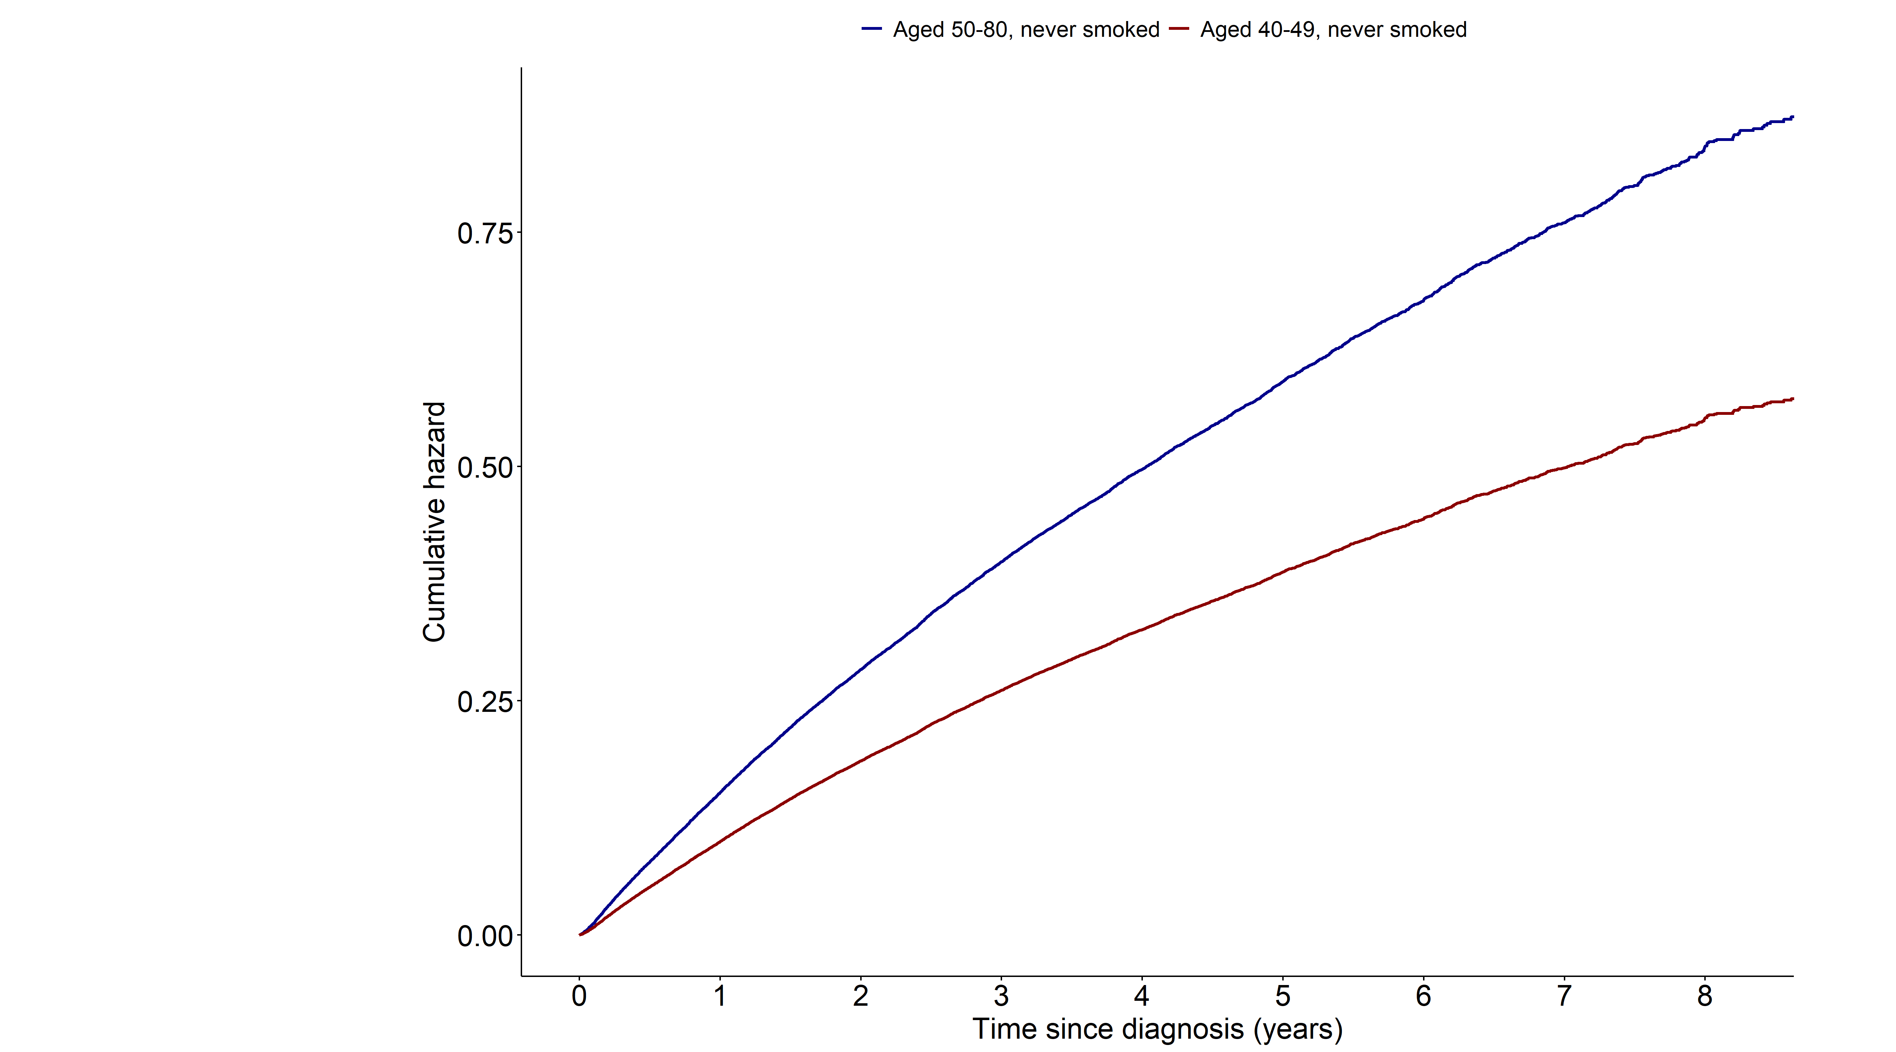
Notes:
> fit15 <- coxph(surv_all ~ grouptype+SEX+G1E_BMI+income+cci_group+activity
+ +non_small_yn+SEER_GRP+surgery_yn+radio_yn+system_yn
+ ,data=as.data.frame(data5))
>
> summary(fit15)$coefficients
coef exp(coef) se(coef) z Pr(>|z|)
grouptype002 -0.42219085 0.6556089 0.038581394 -10.942861 7.189429e-28
SEX1 0.59636504 1.8155075 0.015280593 39.027611 0.000000e+00
G1E_BMI -0.02535899 0.9749599 0.002771656 -9.149399 5.725117e-20
income2 -0.06927586 0.9330692 0.027071534 -2.558993 1.049759e-02
income3 -0.04620402 0.9548471 0.025565199 -1.807301 7.071529e-02
income4 -0.08262475 0.9206966 0.023509220 -3.514568 4.404703e-04
income5 -0.06195555 0.9399247 0.021395678 -2.895704 3.783091e-03
cci_group>=5 0.50011634 1.6489131 0.024243787 20.628639 1.518632e-94
cci_group1-2 0.18799447 1.2068268 0.020045219 9.378519 6.690587e-21
cci_group3-4 0.44028738 1.5531535 0.028502284 15.447442 7.849717e-54
activityactive -0.16697952 0.8462169 0.018522708 -9.014854 1.971321e-19
non_small_yn1 -0.46713749 0.6267939 0.026589342 -17.568599 4.286271e-69
SEER_GRP2 0.91834870 2.5051502 0.028253580 32.503799 9.423077e-232
SEER_GRP7 1.65961323 5.2572771 0.029112840 57.006229 0.000000e+00
SEER_GRP9 0.80025462 2.2261077 0.038498307 20.786748 5.704784e-96
surgery_ynyes -1.26989621 0.2808608 0.022989685 -55.237650 0.000000e+00
radio_ynyes 0.10226024 1.1076717 0.018661687 5.479689 4.260740e-08
system_ynyes -0.31221461 0.7318245 0.017230987 -18.119369 2.241502e-73
> exp(confint(fit15))
2.5 % 97.5 %
grouptype002 0.6078610 0.7071074
SEX1 1.7619403 1.8707033
G1E_BMI 0.9696779 0.9802706
income2 0.8848518 0.9839142
income3 0.9081816 1.0039105
income4 0.8792360 0.9641123
income5 0.9013242 0.9801783
cci_group>=5 1.5723942 1.7291558
cci_group1-2 1.1603325 1.2551843
cci_group3-4 1.4687680 1.6423873
activityactive 0.8160470 0.8775023
non_small_yn1 0.5949656 0.6603249
SEER_GRP2 2.3701961 2.6477883
SEER_GRP7 4.9656942 5.5659815
SEER_GRP9 2.0643168 2.4005789
surgery_ynyes 0.2684864 0.2938055
radio_ynyes 1.0678892 1.1489362
system_ynyes 0.7075219 0.7569618

Slide 27
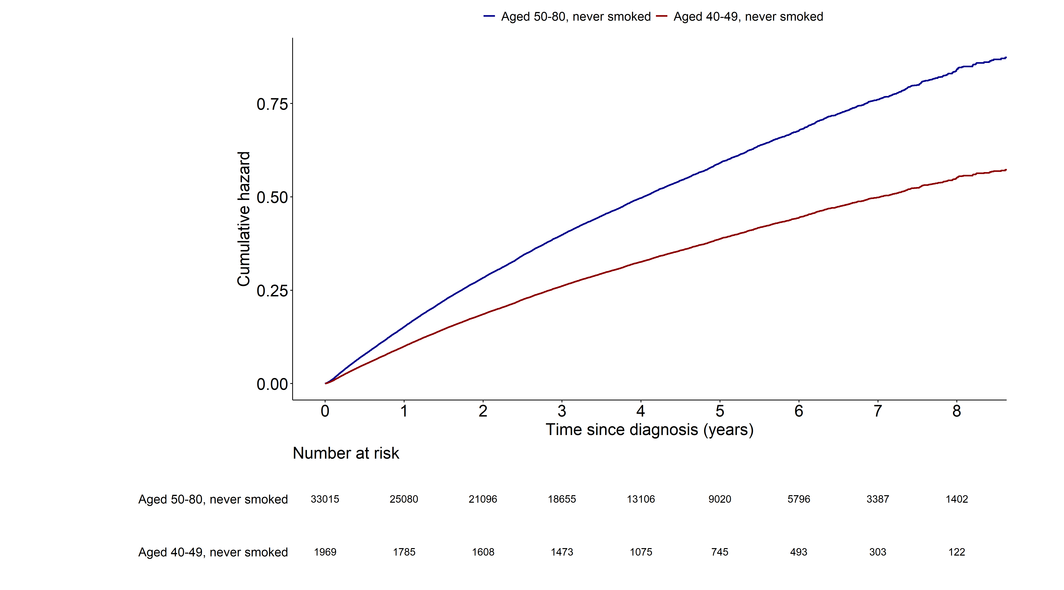
Notes:
> fit15 <- coxph(surv_all ~ grouptype+SEX+G1E_BMI+income+cci_group+activity
+ +non_small_yn+SEER_GRP+surgery_yn+radio_yn+system_yn
+ ,data=as.data.frame(data5))
>
> summary(fit15)$coefficients
coef exp(coef) se(coef) z Pr(>|z|)
grouptype002 -0.42219085 0.6556089 0.038581394 -10.942861 7.189429e-28
SEX1 0.59636504 1.8155075 0.015280593 39.027611 0.000000e+00
G1E_BMI -0.02535899 0.9749599 0.002771656 -9.149399 5.725117e-20
income2 -0.06927586 0.9330692 0.027071534 -2.558993 1.049759e-02
income3 -0.04620402 0.9548471 0.025565199 -1.807301 7.071529e-02
income4 -0.08262475 0.9206966 0.023509220 -3.514568 4.404703e-04
income5 -0.06195555 0.9399247 0.021395678 -2.895704 3.783091e-03
cci_group>=5 0.50011634 1.6489131 0.024243787 20.628639 1.518632e-94
cci_group1-2 0.18799447 1.2068268 0.020045219 9.378519 6.690587e-21
cci_group3-4 0.44028738 1.5531535 0.028502284 15.447442 7.849717e-54
activityactive -0.16697952 0.8462169 0.018522708 -9.014854 1.971321e-19
non_small_yn1 -0.46713749 0.6267939 0.026589342 -17.568599 4.286271e-69
SEER_GRP2 0.91834870 2.5051502 0.028253580 32.503799 9.423077e-232
SEER_GRP7 1.65961323 5.2572771 0.029112840 57.006229 0.000000e+00
SEER_GRP9 0.80025462 2.2261077 0.038498307 20.786748 5.704784e-96
surgery_ynyes -1.26989621 0.2808608 0.022989685 -55.237650 0.000000e+00
radio_ynyes 0.10226024 1.1076717 0.018661687 5.479689 4.260740e-08
system_ynyes -0.31221461 0.7318245 0.017230987 -18.119369 2.241502e-73
> exp(confint(fit15))
2.5 % 97.5 %
grouptype002 0.6078610 0.7071074
SEX1 1.7619403 1.8707033
G1E_BMI 0.9696779 0.9802706
income2 0.8848518 0.9839142
income3 0.9081816 1.0039105
income4 0.8792360 0.9641123
income5 0.9013242 0.9801783
cci_group>=5 1.5723942 1.7291558
cci_group1-2 1.1603325 1.2551843
cci_group3-4 1.4687680 1.6423873
activityactive 0.8160470 0.8775023
non_small_yn1 0.5949656 0.6603249
SEER_GRP2 2.3701961 2.6477883
SEER_GRP7 4.9656942 5.5659815
SEER_GRP9 2.0643168 2.4005789
surgery_ynyes 0.2684864 0.2938055
radio_ynyes 1.0678892 1.1489362
system_ynyes 0.7075219 0.7569618

Slide 28
Lung cancer mortality (1.AGED 50-80, Never-smoker
2. AGED 40-49, Never-smoker)
Multivariable cox model: age 변수 제외

Slide 29
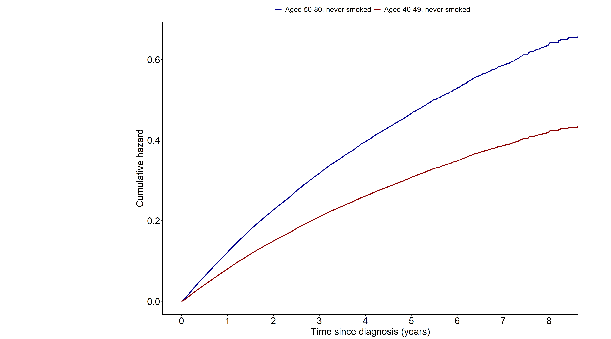
Notes:
> fit15 <- coxph(surv_lungcancer ~ grouptype+SEX+G1E_BMI+income+cci_group+activity
+ +non_small_yn+SEER_GRP+surgery_yn+radio_yn+system_yn
+ ,data=as.data.frame(data5))
>
> summary(fit15)$coefficients
coef exp(coef) se(coef) z Pr(>|z|)
grouptype002 -0.41632395 0.6594666 0.039999602 -10.408202 2.274768e-25
SEX1 0.56637054 1.7618608 0.015973103 35.457765 2.202094e-275
G1E_BMI -0.02522143 0.9750940 0.002891301 -8.723210 2.704245e-18
income2 -0.07080729 0.9316414 0.028258988 -2.505656 1.222246e-02
income3 -0.03428630 0.9662948 0.026609669 -1.288490 1.975753e-01
income4 -0.08851608 0.9152884 0.024594565 -3.599010 3.194310e-04
income5 -0.05674625 0.9448338 0.022337692 -2.540381 1.107317e-02
cci_group>=5 0.46106131 1.5857561 0.025207548 18.290605 9.831771e-75
cci_group1-2 0.17921354 1.1962762 0.020841526 8.598868 8.050602e-18
cci_group3-4 0.40687788 1.5021207 0.029975134 13.573847 5.723743e-42
activityactive -0.16367419 0.8490186 0.019336811 -8.464384 2.575099e-17
non_small_yn1 -0.48864504 0.6134570 0.027200121 -17.964811 3.675256e-72
SEER_GRP2 1.10162160 3.0090415 0.031809079 34.632301 8.250853e-263
SEER_GRP7 1.87998051 6.5533771 0.032526268 57.798839 0.000000e+00
SEER_GRP9 0.91986961 2.5089632 0.042758491 21.513145 1.172781e-102
surgery_ynyes -1.30755591 0.2704803 0.024708001 -52.920343 0.000000e+00
radio_ynyes 0.12405016 1.1320727 0.019153560 6.476611 9.380539e-11
system_ynyes -0.28843198 0.7494378 0.017868744 -16.141705 1.299032e-58
> exp(confint(fit15))
2.5 % 97.5 %
grouptype002 0.6097406 0.7132479
SEX1 1.7075572 1.8178914
G1E_BMI 0.9695839 0.9806354
income2 0.8814439 0.9846976
income3 0.9171903 1.0180283
income4 0.8722139 0.9604901
income5 0.9043604 0.9871185
cci_group>=5 1.5093143 1.6660694
cci_group1-2 1.1483945 1.2461542
cci_group3-4 1.4164131 1.5930144
activityactive 0.8174434 0.8818135
non_small_yn1 0.5816093 0.6470487
SEER_GRP2 2.8271721 3.2026105
SEER_GRP7 6.1486355 6.9847613
SEER_GRP9 2.3072688 2.7282891
surgery_ynyes 0.2576939 0.2839012
radio_ynyes 1.0903621 1.1753788
system_ynyes 0.7236452 0.7761497

Slide 30
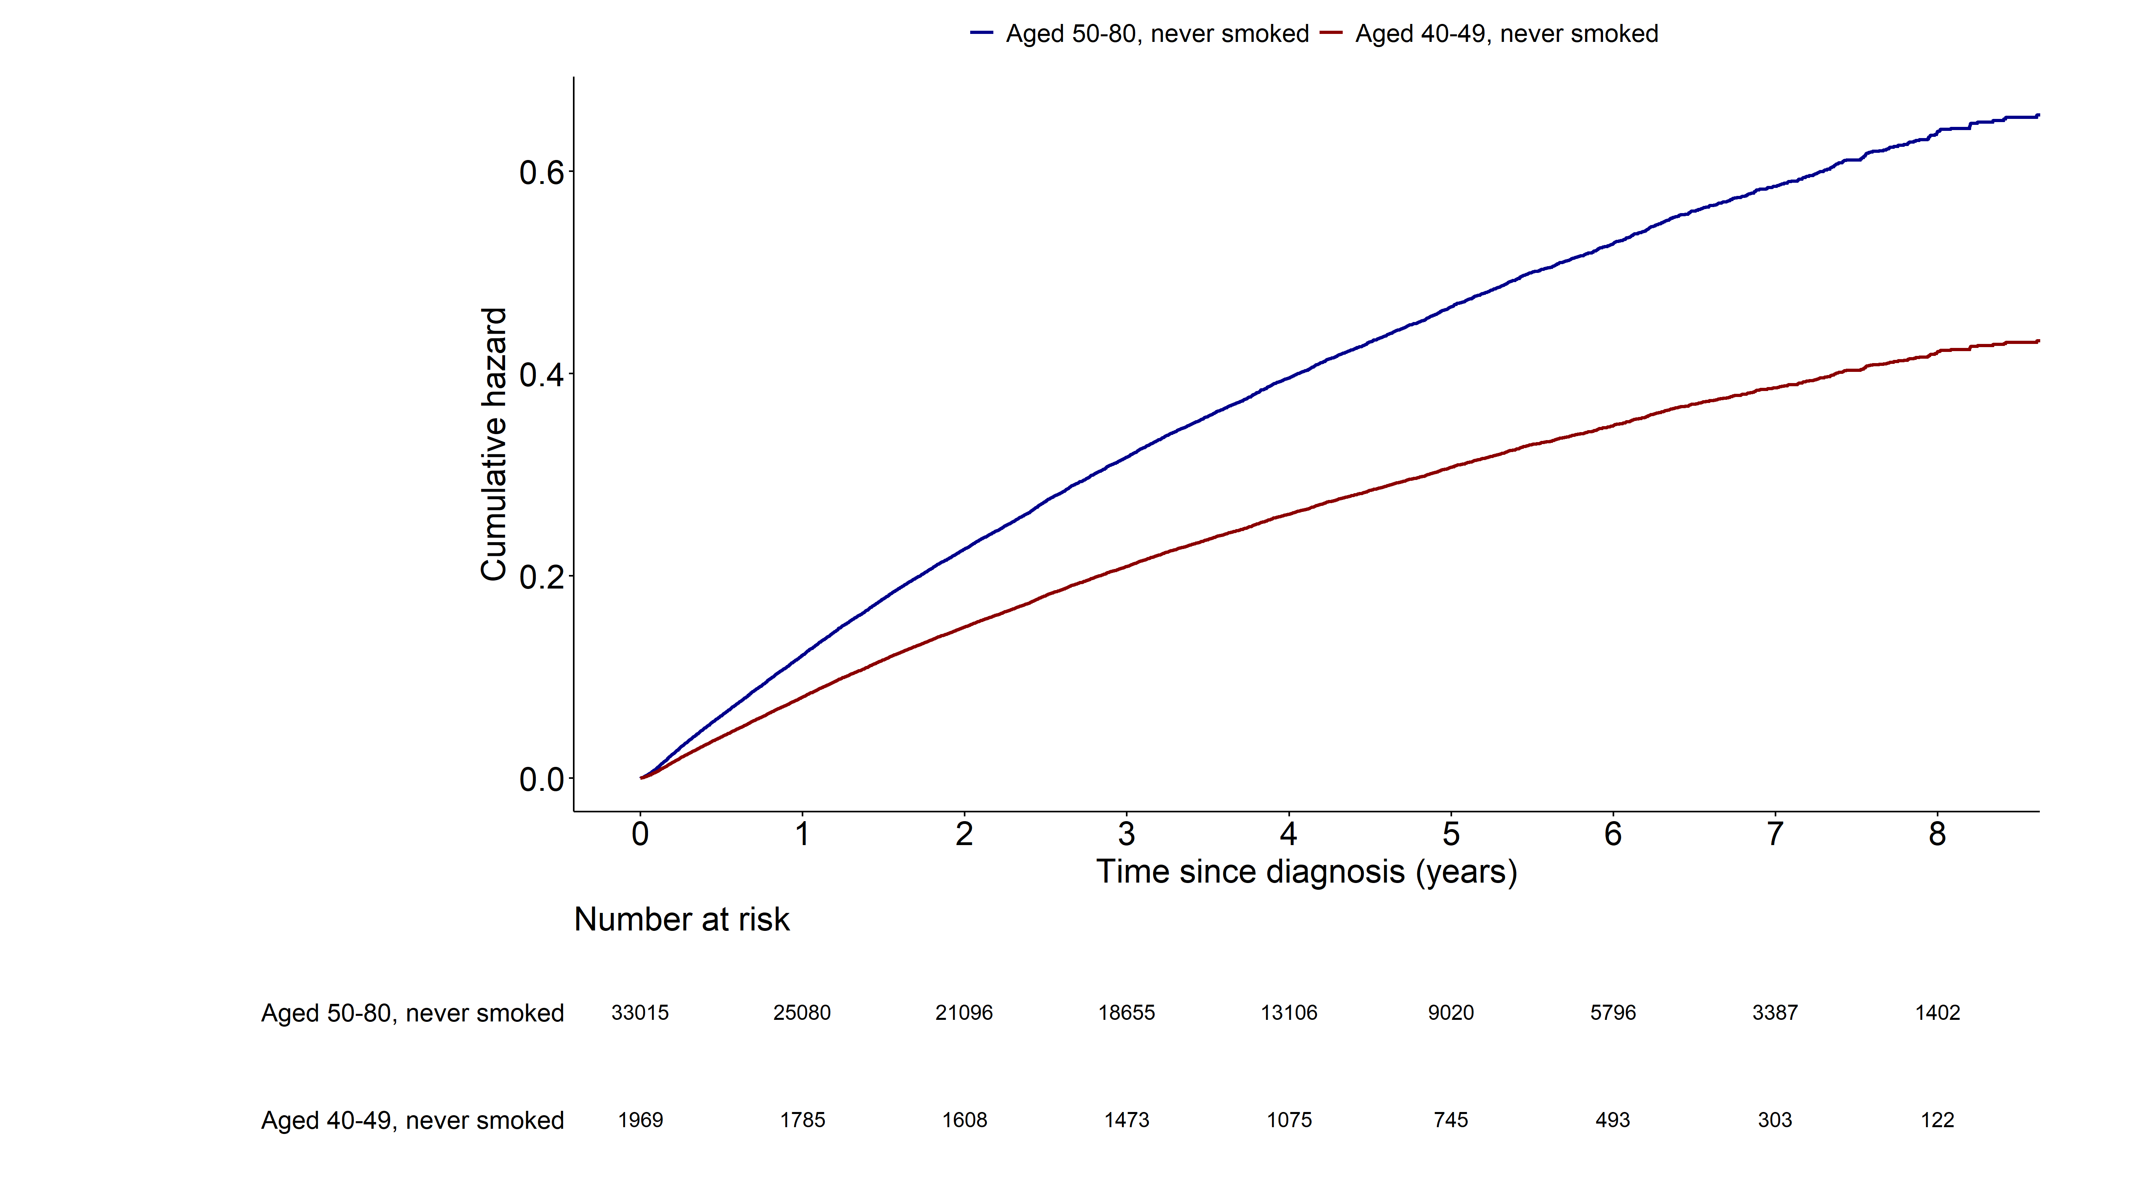
Notes:
> fit15 <- coxph(surv_lungcancer ~ grouptype+SEX+G1E_BMI+income+cci_group+activity
+ +non_small_yn+SEER_GRP+surgery_yn+radio_yn+system_yn
+ ,data=as.data.frame(data5))
>
> summary(fit15)$coefficients
coef exp(coef) se(coef) z Pr(>|z|)
grouptype002 -0.41632395 0.6594666 0.039999602 -10.408202 2.274768e-25
SEX1 0.56637054 1.7618608 0.015973103 35.457765 2.202094e-275
G1E_BMI -0.02522143 0.9750940 0.002891301 -8.723210 2.704245e-18
income2 -0.07080729 0.9316414 0.028258988 -2.505656 1.222246e-02
income3 -0.03428630 0.9662948 0.026609669 -1.288490 1.975753e-01
income4 -0.08851608 0.9152884 0.024594565 -3.599010 3.194310e-04
income5 -0.05674625 0.9448338 0.022337692 -2.540381 1.107317e-02
cci_group>=5 0.46106131 1.5857561 0.025207548 18.290605 9.831771e-75
cci_group1-2 0.17921354 1.1962762 0.020841526 8.598868 8.050602e-18
cci_group3-4 0.40687788 1.5021207 0.029975134 13.573847 5.723743e-42
activityactive -0.16367419 0.8490186 0.019336811 -8.464384 2.575099e-17
non_small_yn1 -0.48864504 0.6134570 0.027200121 -17.964811 3.675256e-72
SEER_GRP2 1.10162160 3.0090415 0.031809079 34.632301 8.250853e-263
SEER_GRP7 1.87998051 6.5533771 0.032526268 57.798839 0.000000e+00
SEER_GRP9 0.91986961 2.5089632 0.042758491 21.513145 1.172781e-102
surgery_ynyes -1.30755591 0.2704803 0.024708001 -52.920343 0.000000e+00
radio_ynyes 0.12405016 1.1320727 0.019153560 6.476611 9.380539e-11
system_ynyes -0.28843198 0.7494378 0.017868744 -16.141705 1.299032e-58
> exp(confint(fit15))
2.5 % 97.5 %
grouptype002 0.6097406 0.7132479
SEX1 1.7075572 1.8178914
G1E_BMI 0.9695839 0.9806354
income2 0.8814439 0.9846976
income3 0.9171903 1.0180283
income4 0.8722139 0.9604901
income5 0.9043604 0.9871185
cci_group>=5 1.5093143 1.6660694
cci_group1-2 1.1483945 1.2461542
cci_group3-4 1.4164131 1.5930144
activityactive 0.8174434 0.8818135
non_small_yn1 0.5816093 0.6470487
SEER_GRP2 2.8271721 3.2026105
SEER_GRP7 6.1486355 6.9847613
SEER_GRP9 2.3072688 2.7282891
surgery_ynyes 0.2576939 0.2839012
radio_ynyes 1.0903621 1.1753788
system_ynyes 0.7236452 0.7761497

