Slide 1
Lung cancer mortality (1.AGED 50-80, ≥20PYs smoking
2. AGED 50-80, <20PYs smoking
3. AGED 50-80, individuals who have never-smoked)
Fine-gray model: smoking status, pack_year 제외

Slide 2
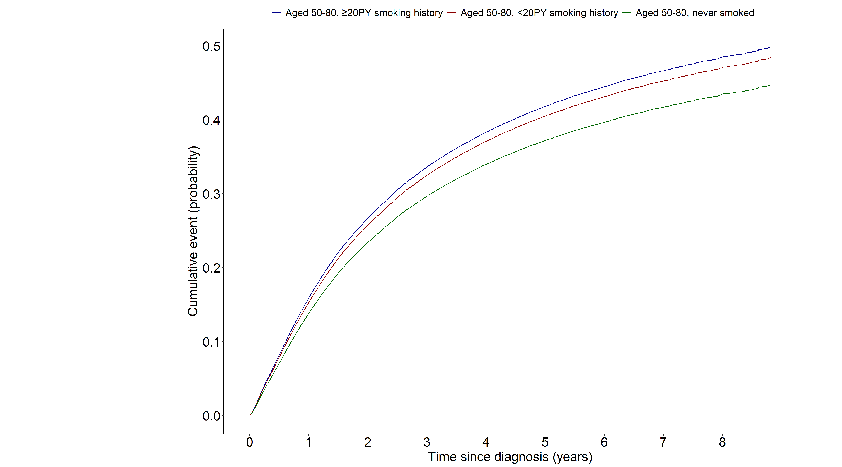
Notes:
> m1<-model.matrix(~grouptype+AGE+SEX+G1E_BMI+income
+ +cci_group+activity+non_small_yn+SEER_GRP+surgery_yn+radio_yn+system_yn,data=data1)[,-1]
> crr1_1_1 <- crr(ftime=data1$day_diff,fstatus=data1$dth_type, cencode=0, cov1=m1, failcode=1)
> summary(crr1_1_1)
Competing Risks Regression
Call:
crr(ftime = data1$day_diff, fstatus = data1$dth_type, cov1 = m1,
failcode = 1, cencode = 0)
coef exp(coef) se(coef) z p-value
grouptype003 -0.1518 0.859 0.014514 -10.46 0.0e+00
grouptype002 -0.0418 0.959 0.014575 -2.87 4.2e-03
AGE 0.0335 1.034 0.000712 47.03 0.0e+00
SEX1 0.3952 1.485 0.015314 25.81 0.0e+00
G1E_BMI -0.0258 0.974 0.001962 -13.17 0.0e+00
income2 -0.0293 0.971 0.018078 -1.62 1.0e-01
income3 -0.0259 0.974 0.017291 -1.50 1.3e-01
income4 -0.0790 0.924 0.016010 -4.94 7.9e-07
income5 -0.1262 0.881 0.015020 -8.40 0.0e+00
cci_group1-2 0.0722 1.075 0.013057 5.53 3.2e-08
cci_group3-4 0.1503 1.162 0.019363 7.76 8.4e-15
cci_group>=5 0.3028 1.354 0.017310 17.49 0.0e+00
activityactive -0.1013 0.904 0.012058 -8.40 0.0e+00
non_small_yn1 -0.2674 0.765 0.014878 -17.97 0.0e+00
SEER_GRP2 0.8443 2.326 0.018424 45.83 0.0e+00
SEER_GRP7 1.5596 4.757 0.019984 78.04 0.0e+00
SEER_GRP9 0.7086 2.031 0.026387 26.85 0.0e+00
surgery_ynyes -1.0932 0.335 0.015214 -71.86 0.0e+00
radio_ynyes 0.0433 1.044 0.012319 3.52 4.4e-04
system_ynyes -0.1321 0.876 0.012687 -10.42 0.0e+00
exp(coef) exp(-coef) 2.5% 97.5%
grouptype003 0.859 1.164 0.835 0.884
grouptype002 0.959 1.043 0.932 0.987
AGE 1.034 0.967 1.033 1.035
SEX1 1.485 0.674 1.441 1.530
G1E_BMI 0.974 1.026 0.971 0.978
income2 0.971 1.030 0.937 1.006
income3 0.974 1.026 0.942 1.008
income4 0.924 1.082 0.895 0.953
income5 0.881 1.135 0.856 0.908
cci_group1-2 1.075 0.930 1.048 1.103
cci_group3-4 1.162 0.860 1.119 1.207
cci_group>=5 1.354 0.739 1.308 1.400
activityactive 0.904 1.107 0.883 0.925
non_small_yn1 0.765 1.307 0.743 0.788
SEER_GRP2 2.326 0.430 2.244 2.412
SEER_GRP7 4.757 0.210 4.574 4.947
SEER_GRP9 2.031 0.492 1.929 2.139
surgery_ynyes 0.335 2.984 0.325 0.345
radio_ynyes 1.044 0.958 1.019 1.070
system_ynyes 0.876 1.141 0.855 0.898
Num. cases = 77554
Pseudo Log-likelihood = -468939
Pseudo likelihood ratio test = 42783 on 20 df,

Slide 3
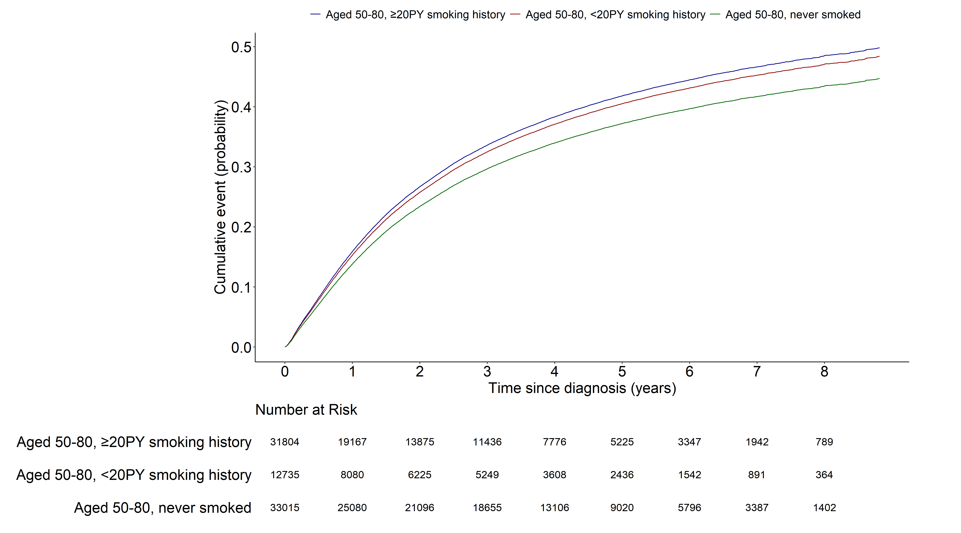
Notes:
> m1<-model.matrix(~grouptype+AGE+SEX+G1E_BMI+income
+ +cci_group+activity+non_small_yn+SEER_GRP+surgery_yn+radio_yn+system_yn,data=data1)[,-1]
> crr1_1_1 <- crr(ftime=data1$day_diff,fstatus=data1$dth_type, cencode=0, cov1=m1, failcode=1)
> summary(crr1_1_1)
Competing Risks Regression
Call:
crr(ftime = data1$day_diff, fstatus = data1$dth_type, cov1 = m1,
failcode = 1, cencode = 0)
coef exp(coef) se(coef) z p-value
grouptype003 -0.1518 0.859 0.014514 -10.46 0.0e+00
grouptype002 -0.0418 0.959 0.014575 -2.87 4.2e-03
AGE 0.0335 1.034 0.000712 47.03 0.0e+00
SEX1 0.3952 1.485 0.015314 25.81 0.0e+00
G1E_BMI -0.0258 0.974 0.001962 -13.17 0.0e+00
income2 -0.0293 0.971 0.018078 -1.62 1.0e-01
income3 -0.0259 0.974 0.017291 -1.50 1.3e-01
income4 -0.0790 0.924 0.016010 -4.94 7.9e-07
income5 -0.1262 0.881 0.015020 -8.40 0.0e+00
cci_group1-2 0.0722 1.075 0.013057 5.53 3.2e-08
cci_group3-4 0.1503 1.162 0.019363 7.76 8.4e-15
cci_group>=5 0.3028 1.354 0.017310 17.49 0.0e+00
activityactive -0.1013 0.904 0.012058 -8.40 0.0e+00
non_small_yn1 -0.2674 0.765 0.014878 -17.97 0.0e+00
SEER_GRP2 0.8443 2.326 0.018424 45.83 0.0e+00
SEER_GRP7 1.5596 4.757 0.019984 78.04 0.0e+00
SEER_GRP9 0.7086 2.031 0.026387 26.85 0.0e+00
surgery_ynyes -1.0932 0.335 0.015214 -71.86 0.0e+00
radio_ynyes 0.0433 1.044 0.012319 3.52 4.4e-04
system_ynyes -0.1321 0.876 0.012687 -10.42 0.0e+00
exp(coef) exp(-coef) 2.5% 97.5%
grouptype003 0.859 1.164 0.835 0.884
grouptype002 0.959 1.043 0.932 0.987
AGE 1.034 0.967 1.033 1.035
SEX1 1.485 0.674 1.441 1.530
G1E_BMI 0.974 1.026 0.971 0.978
income2 0.971 1.030 0.937 1.006
income3 0.974 1.026 0.942 1.008
income4 0.924 1.082 0.895 0.953
income5 0.881 1.135 0.856 0.908
cci_group1-2 1.075 0.930 1.048 1.103
cci_group3-4 1.162 0.860 1.119 1.207
cci_group>=5 1.354 0.739 1.308 1.400
activityactive 0.904 1.107 0.883 0.925
non_small_yn1 0.765 1.307 0.743 0.788
SEER_GRP2 2.326 0.430 2.244 2.412
SEER_GRP7 4.757 0.210 4.574 4.947
SEER_GRP9 2.031 0.492 1.929 2.139
surgery_ynyes 0.335 2.984 0.325 0.345
radio_ynyes 1.044 0.958 1.019 1.070
system_ynyes 0.876 1.141 0.855 0.898
Num. cases = 77554
Pseudo Log-likelihood = -468939
Pseudo likelihood ratio test = 42783 on 20 df,

Slide 4
Lung cancer mortality (1.AGED 50-80, ≥20years smoking
2. AGED 50-80, <20years smoking)
Fine-gray model: 모든 변수 포함

Slide 5
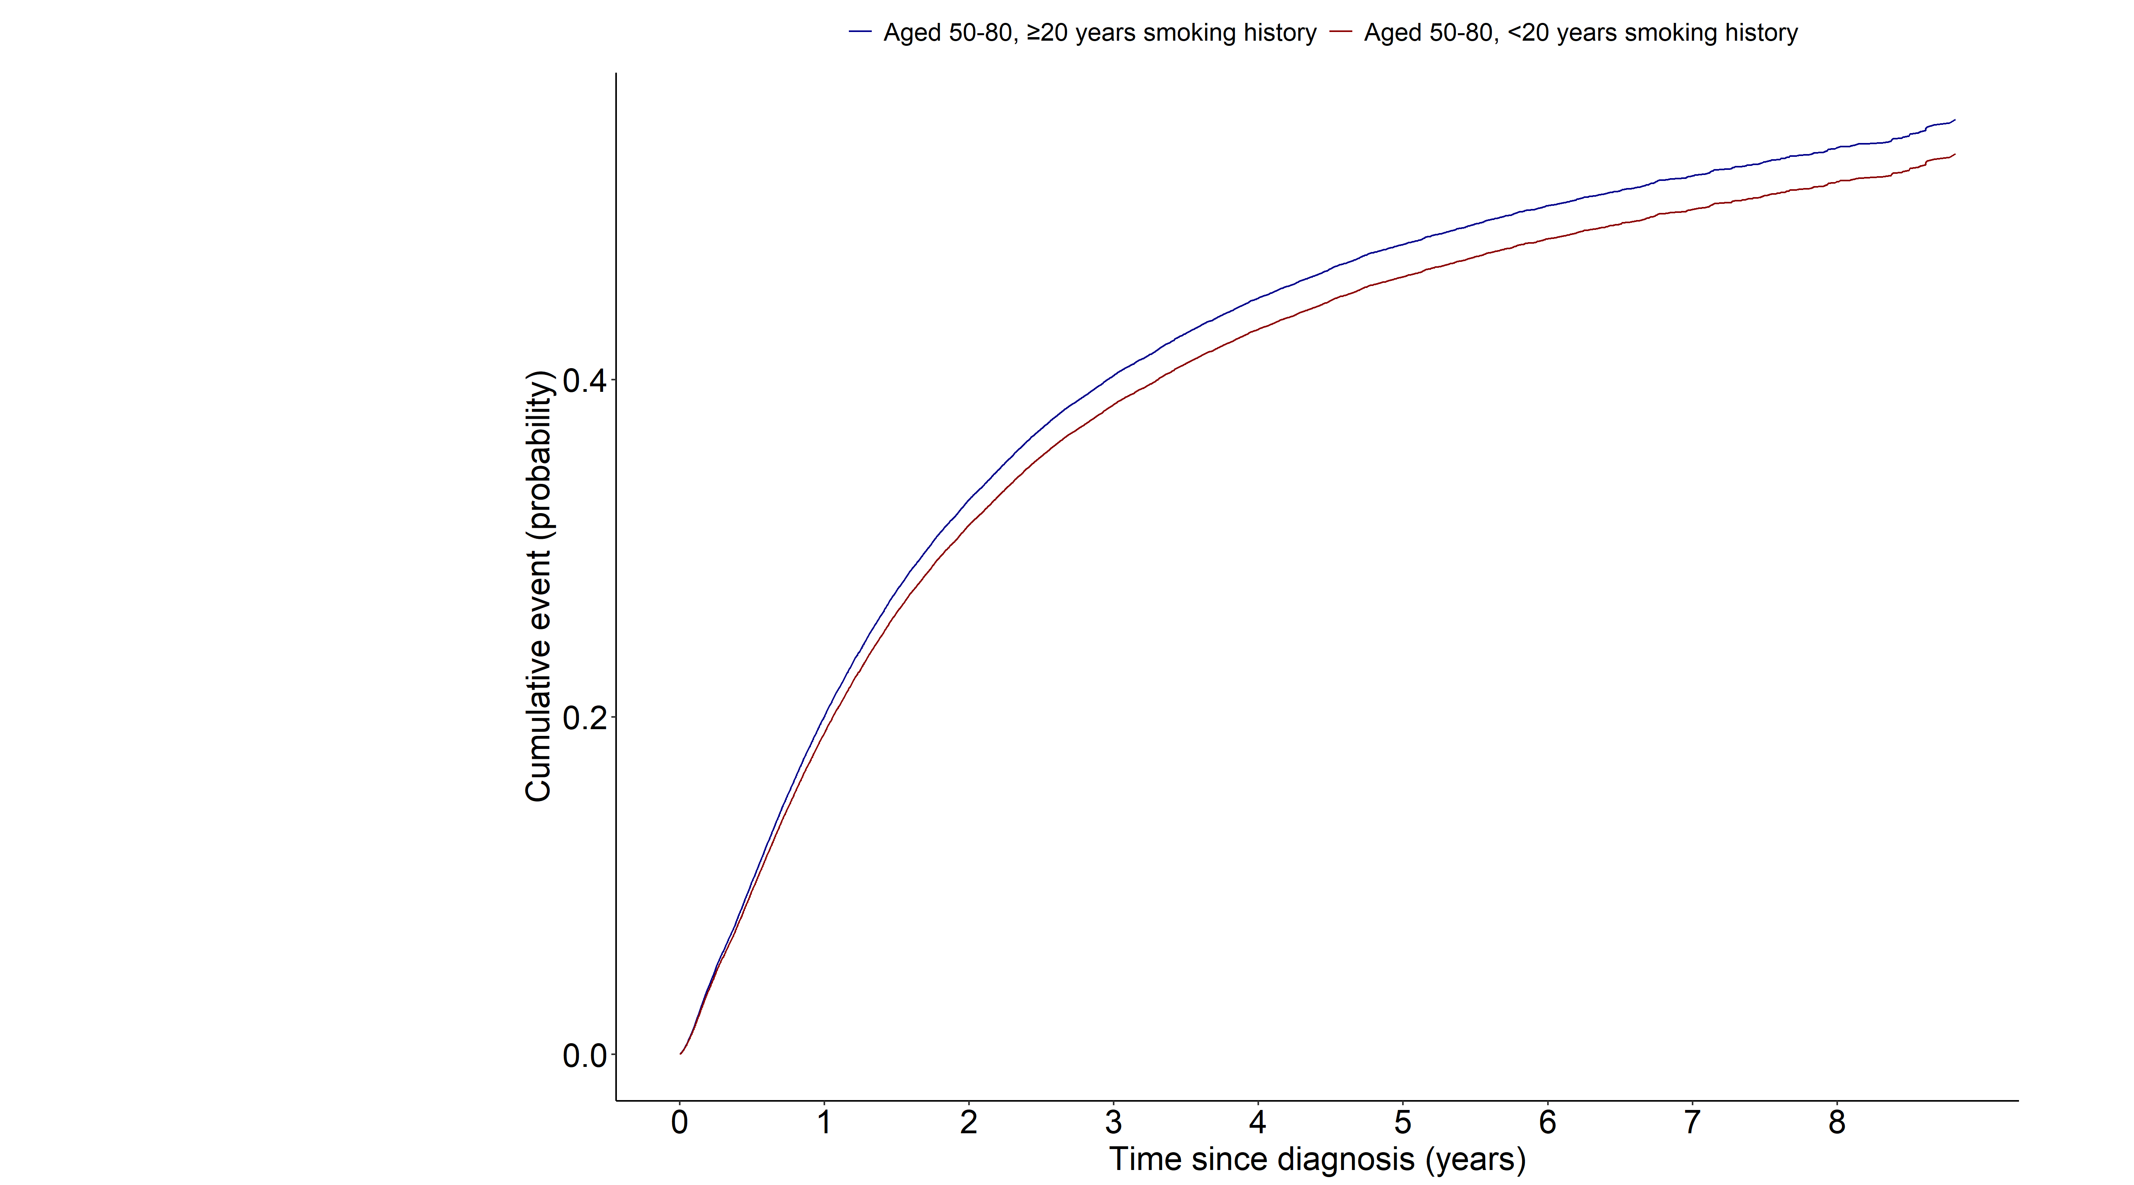
Notes:
> m1<-model.matrix(~smk_20+AGE+SEX+q_smk_yn2+pack_year+G1E_BMI+income
+ +cci_group+activity+non_small_yn+SEER_GRP+surgery_yn+radio_yn+system_yn,data=data11)[,-1]
> crr11_1 <- crr(ftime=data11$day_diff,fstatus=data11$dth_type, cencode=0, cov1=m1, failcode=1)
> summary(crr11_1)
Competing Risks Regression
Call:
crr(ftime = data11$day_diff, fstatus = data11$dth_type, cov1 = m1,
failcode = 1, cencode = 0)
coef exp(coef) se(coef) z p-value
smk_20<20 -0.05696 0.945 0.022482 -2.53 1.1e-02
AGE 0.03220 1.033 0.000922 34.92 0.0e+00
SEX1 0.17617 1.193 0.035549 4.96 7.2e-07
q_smk_yn2Current smoker 0.14079 1.151 0.013238 10.64 0.0e+00
pack_year 0.00119 1.001 0.000322 3.68 2.3e-04
G1E_BMI -0.02464 0.976 0.002503 -9.84 0.0e+00
income2 -0.02627 0.974 0.021958 -1.20 2.3e-01
income3 -0.02345 0.977 0.021006 -1.12 2.6e-01
income4 -0.05281 0.949 0.019554 -2.70 6.9e-03
income5 -0.10421 0.901 0.018665 -5.58 2.4e-08
cci_group>=5 0.28802 1.334 0.021862 13.17 0.0e+00
cci_group1-2 0.05943 1.061 0.016411 3.62 2.9e-04
cci_group3-4 0.11878 1.126 0.023818 4.99 6.1e-07
activityactive -0.06576 0.936 0.014789 -4.45 8.7e-06
non_small_yn1 -0.20916 0.811 0.016589 -12.61 0.0e+00
SEER_GRP2 0.73041 2.076 0.022285 32.78 0.0e+00
SEER_GRP7 1.42759 4.169 0.024164 59.08 0.0e+00
SEER_GRP9 0.61947 1.858 0.032114 19.29 0.0e+00
surgery_ynyes -1.04757 0.351 0.018517 -56.57 0.0e+00
radio_ynyes -0.01639 0.984 0.014828 -1.11 2.7e-01
system_ynyes -0.14761 0.863 0.015754 -9.37 0.0e+00
exp(coef) exp(-coef) 2.5% 97.5%
smk_20<20 0.945 1.059 0.904 0.987
AGE 1.033 0.968 1.031 1.035
SEX1 1.193 0.838 1.112 1.279
q_smk_yn2Current smoker 1.151 0.869 1.122 1.181
pack_year 1.001 0.999 1.001 1.002
G1E_BMI 0.976 1.025 0.971 0.980
income2 0.974 1.027 0.933 1.017
income3 0.977 1.024 0.937 1.018
income4 0.949 1.054 0.913 0.986
income5 0.901 1.110 0.869 0.935
cci_group>=5 1.334 0.750 1.278 1.392
cci_group1-2 1.061 0.942 1.028 1.096
cci_group3-4 1.126 0.888 1.075 1.180
activityactive 0.936 1.068 0.910 0.964
non_small_yn1 0.811 1.233 0.785 0.838
SEER_GRP2 2.076 0.482 1.987 2.169
SEER_GRP7 4.169 0.240 3.976 4.371
SEER_GRP9 1.858 0.538 1.745 1.979
surgery_ynyes 0.351 2.851 0.338 0.364
radio_ynyes 0.984 1.017 0.956 1.013
system_ynyes 0.863 1.159 0.837 0.890
Num. cases = 44539
Pseudo Log-likelihood = -287559
Pseudo likelihood ratio test = 21071 on 21 df,

Slide 6
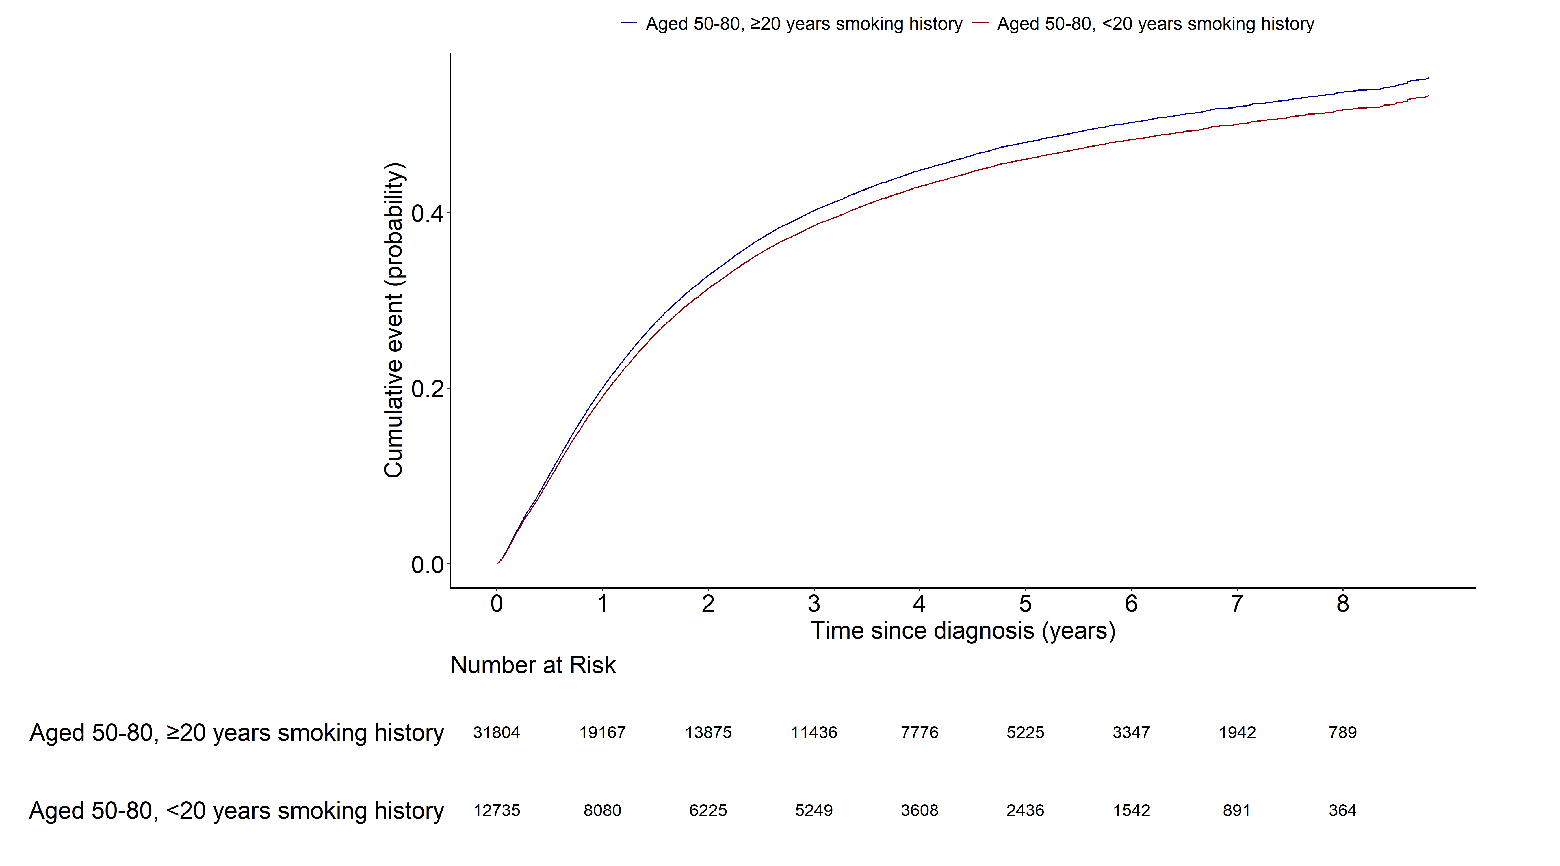
Notes:
> m1<-model.matrix(~smk_20+AGE+SEX+q_smk_yn2+pack_year+G1E_BMI+income
+ +cci_group+activity+non_small_yn+SEER_GRP+surgery_yn+radio_yn+system_yn,data=data11)[,-1]
> crr11_1 <- crr(ftime=data11$day_diff,fstatus=data11$dth_type, cencode=0, cov1=m1, failcode=1)
> summary(crr11_1)
Competing Risks Regression
Call:
crr(ftime = data11$day_diff, fstatus = data11$dth_type, cov1 = m1,
failcode = 1, cencode = 0)
coef exp(coef) se(coef) z p-value
smk_20<20 -0.05696 0.945 0.022482 -2.53 1.1e-02
AGE 0.03220 1.033 0.000922 34.92 0.0e+00
SEX1 0.17617 1.193 0.035549 4.96 7.2e-07
q_smk_yn2Current smoker 0.14079 1.151 0.013238 10.64 0.0e+00
pack_year 0.00119 1.001 0.000322 3.68 2.3e-04
G1E_BMI -0.02464 0.976 0.002503 -9.84 0.0e+00
income2 -0.02627 0.974 0.021958 -1.20 2.3e-01
income3 -0.02345 0.977 0.021006 -1.12 2.6e-01
income4 -0.05281 0.949 0.019554 -2.70 6.9e-03
income5 -0.10421 0.901 0.018665 -5.58 2.4e-08
cci_group>=5 0.28802 1.334 0.021862 13.17 0.0e+00
cci_group1-2 0.05943 1.061 0.016411 3.62 2.9e-04
cci_group3-4 0.11878 1.126 0.023818 4.99 6.1e-07
activityactive -0.06576 0.936 0.014789 -4.45 8.7e-06
non_small_yn1 -0.20916 0.811 0.016589 -12.61 0.0e+00
SEER_GRP2 0.73041 2.076 0.022285 32.78 0.0e+00
SEER_GRP7 1.42759 4.169 0.024164 59.08 0.0e+00
SEER_GRP9 0.61947 1.858 0.032114 19.29 0.0e+00
surgery_ynyes -1.04757 0.351 0.018517 -56.57 0.0e+00
radio_ynyes -0.01639 0.984 0.014828 -1.11 2.7e-01
system_ynyes -0.14761 0.863 0.015754 -9.37 0.0e+00
exp(coef) exp(-coef) 2.5% 97.5%
smk_20<20 0.945 1.059 0.904 0.987
AGE 1.033 0.968 1.031 1.035
SEX1 1.193 0.838 1.112 1.279
q_smk_yn2Current smoker 1.151 0.869 1.122 1.181
pack_year 1.001 0.999 1.001 1.002
G1E_BMI 0.976 1.025 0.971 0.980
income2 0.974 1.027 0.933 1.017
income3 0.977 1.024 0.937 1.018
income4 0.949 1.054 0.913 0.986
income5 0.901 1.110 0.869 0.935
cci_group>=5 1.334 0.750 1.278 1.392
cci_group1-2 1.061 0.942 1.028 1.096
cci_group3-4 1.126 0.888 1.075 1.180
activityactive 0.936 1.068 0.910 0.964
non_small_yn1 0.811 1.233 0.785 0.838
SEER_GRP2 2.076 0.482 1.987 2.169
SEER_GRP7 4.169 0.240 3.976 4.371
SEER_GRP9 1.858 0.538 1.745 1.979
surgery_ynyes 0.351 2.851 0.338 0.364
radio_ynyes 0.984 1.017 0.956 1.013
system_ynyes 0.863 1.159 0.837 0.890
Num. cases = 44539
Pseudo Log-likelihood = -287559
Pseudo likelihood ratio test = 21071 on 21 df,

Slide 7
Lung cancer mortality (1.AGED 50-80, ≥20PY smoking
2. AGED 40-49, ≥20PY smoking)
Fine-gray model: age 변수 제외

Slide 8
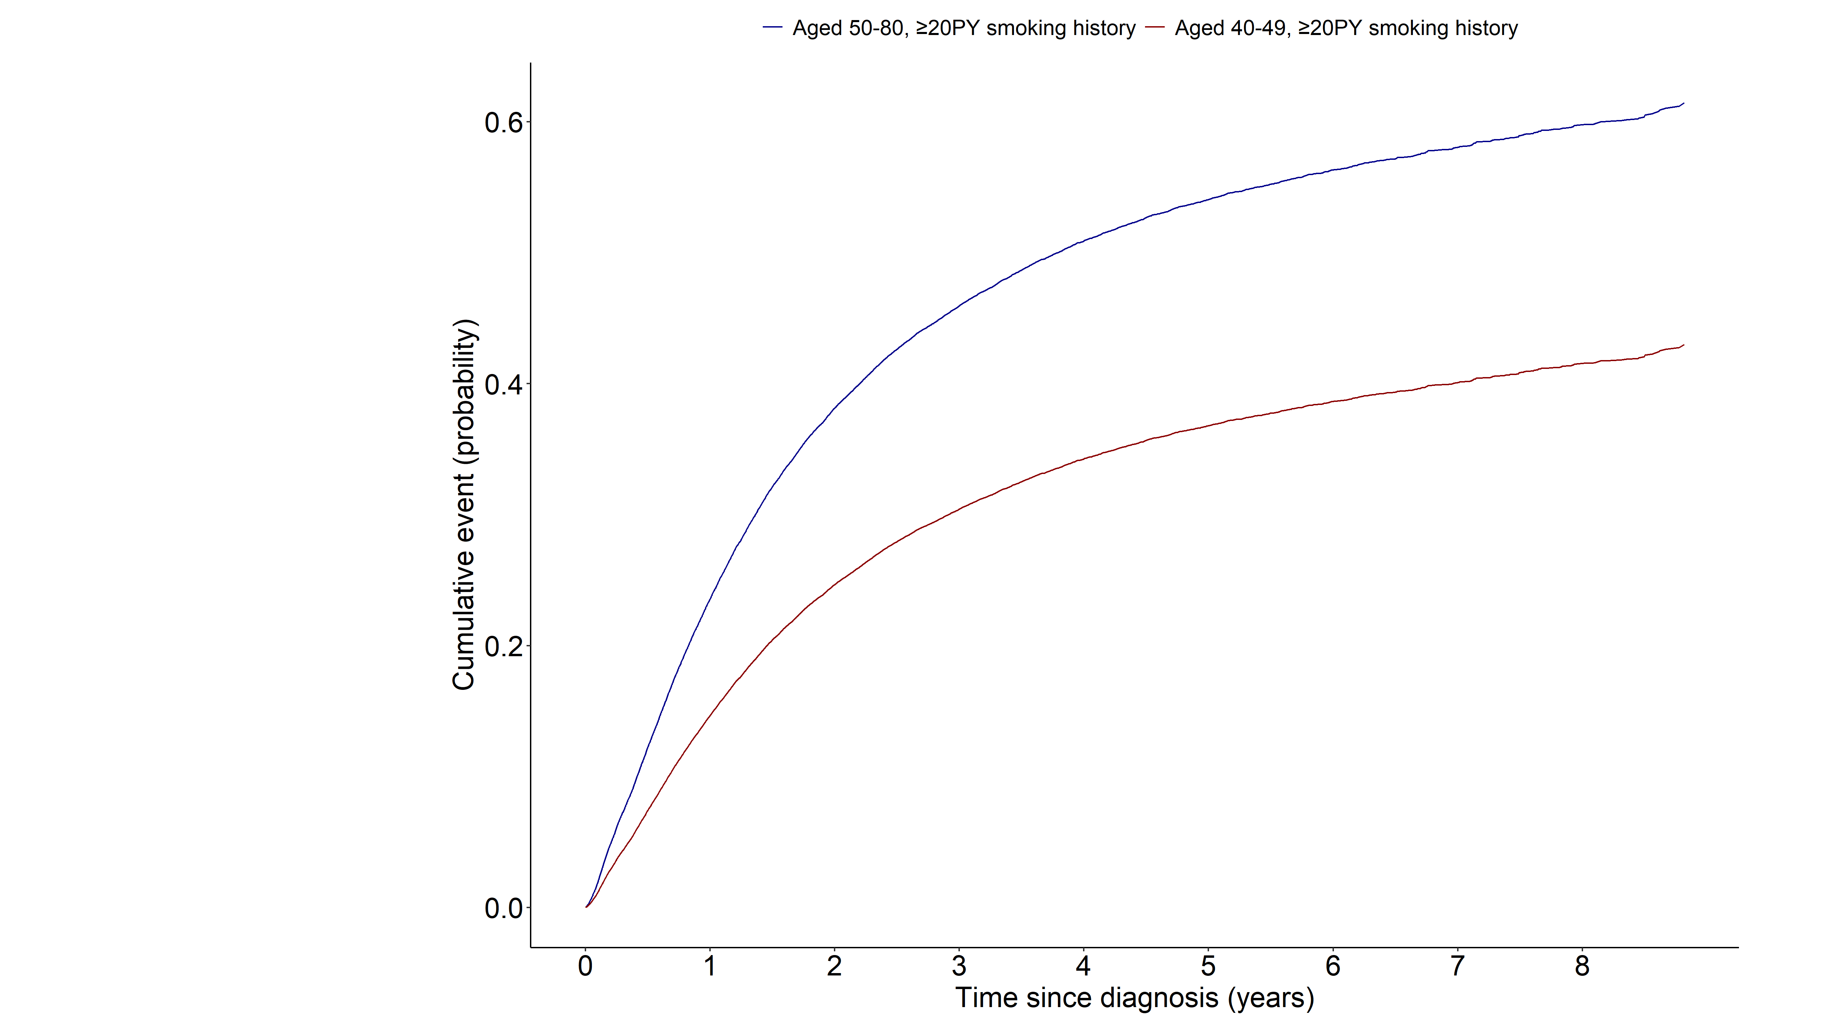
Notes:
> m1<-model.matrix(~grouptype+SEX+q_smk_yn2+pack_year+G1E_BMI+income
+ +cci_group+activity+non_small_yn+SEER_GRP+surgery_yn+radio_yn+system_yn,data=data3)[,-1]
> crr3_1 <- crr(ftime=data3$day_diff,fstatus=data3$dth_type, cencode=0, cov1=m1, failcode=1)
> summary(crr3_1)
Competing Risks Regression
Call:
crr(ftime = data3$day_diff, fstatus = data3$dth_type, cov1 = m1,
failcode = 1, cencode = 0)
coef exp(coef) se(coef) z p-value
grouptype002 -0.52841 0.590 0.051012 -10.359 0.0e+00
SEX1 0.06831 1.071 0.055342 1.234 2.2e-01
q_smk_yn2Current smoker 0.07129 1.074 0.014849 4.801 1.6e-06
pack_year 0.00226 1.002 0.000373 6.068 1.3e-09
G1E_BMI -0.03421 0.966 0.002837 -12.059 0.0e+00
income2 -0.04395 0.957 0.025258 -1.740 8.2e-02
income3 -0.04826 0.953 0.024278 -1.988 4.7e-02
income4 -0.03285 0.968 0.022341 -1.471 1.4e-01
income5 -0.01557 0.985 0.021262 -0.732 4.6e-01
cci_group>=5 0.33809 1.402 0.025402 13.310 0.0e+00
cci_group1-2 0.11642 1.123 0.019076 6.103 1.0e-09
cci_group3-4 0.20216 1.224 0.027352 7.391 1.5e-13
activityactive -0.05726 0.944 0.017414 -3.288 1.0e-03
non_small_yn1 -0.18895 0.828 0.018615 -10.150 0.0e+00
SEER_GRP2 0.69921 2.012 0.025688 27.219 0.0e+00
SEER_GRP7 1.38518 3.996 0.027857 49.724 0.0e+00
SEER_GRP9 0.57412 1.776 0.037523 15.300 0.0e+00
surgery_ynyes -1.10331 0.332 0.021297 -51.807 0.0e+00
radio_ynyes -0.06766 0.935 0.016879 -4.009 6.1e-05
system_ynyes -0.23147 0.793 0.018171 -12.738 0.0e+00
exp(coef) exp(-coef) 2.5% 97.5%
grouptype002 0.590 1.696 0.533 0.652
SEX1 1.071 0.934 0.961 1.193
q_smk_yn2Current smoker 1.074 0.931 1.043 1.106
pack_year 1.002 0.998 1.002 1.003
G1E_BMI 0.966 1.035 0.961 0.972
income2 0.957 1.045 0.911 1.006
income3 0.953 1.049 0.909 0.999
income4 0.968 1.033 0.926 1.011
income5 0.985 1.016 0.944 1.026
cci_group>=5 1.402 0.713 1.334 1.474
cci_group1-2 1.123 0.890 1.082 1.166
cci_group3-4 1.224 0.817 1.160 1.291
activityactive 0.944 1.059 0.913 0.977
non_small_yn1 0.828 1.208 0.798 0.859
SEER_GRP2 2.012 0.497 1.913 2.116
SEER_GRP7 3.996 0.250 3.783 4.220
SEER_GRP9 1.776 0.563 1.650 1.911
surgery_ynyes 0.332 3.014 0.318 0.346
radio_ynyes 0.935 1.070 0.904 0.966
system_ynyes 0.793 1.260 0.766 0.822
Num. cases = 32514
Pseudo Log-likelihood = -207288
Pseudo likelihood ratio test = 13903 on 20 df,

Slide 9
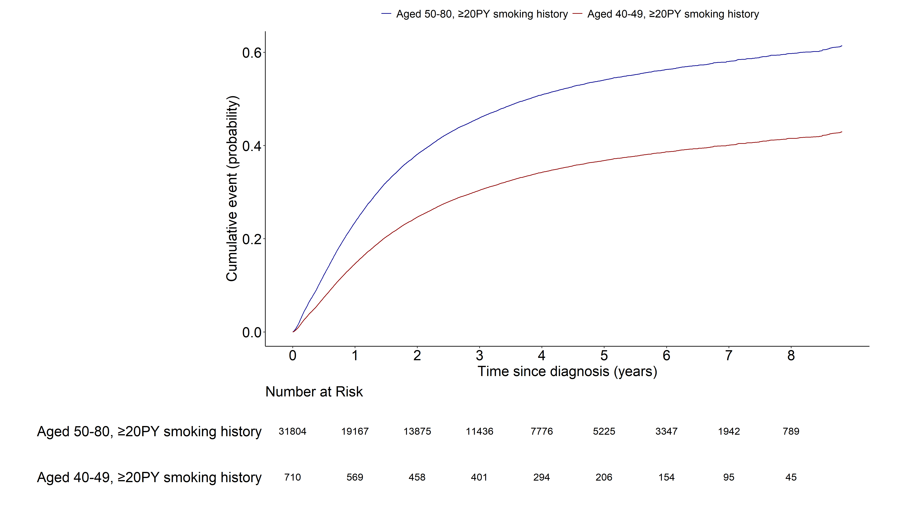
Notes:
> m1<-model.matrix(~grouptype+SEX+q_smk_yn2+pack_year+G1E_BMI+income
+ +cci_group+activity+non_small_yn+SEER_GRP+surgery_yn+radio_yn+system_yn,data=data3)[,-1]
> crr3_1 <- crr(ftime=data3$day_diff,fstatus=data3$dth_type, cencode=0, cov1=m1, failcode=1)
> summary(crr3_1)
Competing Risks Regression
Call:
crr(ftime = data3$day_diff, fstatus = data3$dth_type, cov1 = m1,
failcode = 1, cencode = 0)
coef exp(coef) se(coef) z p-value
grouptype002 -0.52841 0.590 0.051012 -10.359 0.0e+00
SEX1 0.06831 1.071 0.055342 1.234 2.2e-01
q_smk_yn2Current smoker 0.07129 1.074 0.014849 4.801 1.6e-06
pack_year 0.00226 1.002 0.000373 6.068 1.3e-09
G1E_BMI -0.03421 0.966 0.002837 -12.059 0.0e+00
income2 -0.04395 0.957 0.025258 -1.740 8.2e-02
income3 -0.04826 0.953 0.024278 -1.988 4.7e-02
income4 -0.03285 0.968 0.022341 -1.471 1.4e-01
income5 -0.01557 0.985 0.021262 -0.732 4.6e-01
cci_group>=5 0.33809 1.402 0.025402 13.310 0.0e+00
cci_group1-2 0.11642 1.123 0.019076 6.103 1.0e-09
cci_group3-4 0.20216 1.224 0.027352 7.391 1.5e-13
activityactive -0.05726 0.944 0.017414 -3.288 1.0e-03
non_small_yn1 -0.18895 0.828 0.018615 -10.150 0.0e+00
SEER_GRP2 0.69921 2.012 0.025688 27.219 0.0e+00
SEER_GRP7 1.38518 3.996 0.027857 49.724 0.0e+00
SEER_GRP9 0.57412 1.776 0.037523 15.300 0.0e+00
surgery_ynyes -1.10331 0.332 0.021297 -51.807 0.0e+00
radio_ynyes -0.06766 0.935 0.016879 -4.009 6.1e-05
system_ynyes -0.23147 0.793 0.018171 -12.738 0.0e+00
exp(coef) exp(-coef) 2.5% 97.5%
grouptype002 0.590 1.696 0.533 0.652
SEX1 1.071 0.934 0.961 1.193
q_smk_yn2Current smoker 1.074 0.931 1.043 1.106
pack_year 1.002 0.998 1.002 1.003
G1E_BMI 0.966 1.035 0.961 0.972
income2 0.957 1.045 0.911 1.006
income3 0.953 1.049 0.909 0.999
income4 0.968 1.033 0.926 1.011
income5 0.985 1.016 0.944 1.026
cci_group>=5 1.402 0.713 1.334 1.474
cci_group1-2 1.123 0.890 1.082 1.166
cci_group3-4 1.224 0.817 1.160 1.291
activityactive 0.944 1.059 0.913 0.977
non_small_yn1 0.828 1.208 0.798 0.859
SEER_GRP2 2.012 0.497 1.913 2.116
SEER_GRP7 3.996 0.250 3.783 4.220
SEER_GRP9 1.776 0.563 1.650 1.911
surgery_ynyes 0.332 3.014 0.318 0.346
radio_ynyes 0.935 1.070 0.904 0.966
system_ynyes 0.793 1.260 0.766 0.822
Num. cases = 32514
Pseudo Log-likelihood = -207288
Pseudo likelihood ratio test = 13903 on 20 df,

Slide 10
Lung cancer mortality (1.AGED 50-80, <20PY smoking
2. AGED 40-49, <20PY smoking)
Fine-gray model: age 변수 제외

Slide 11
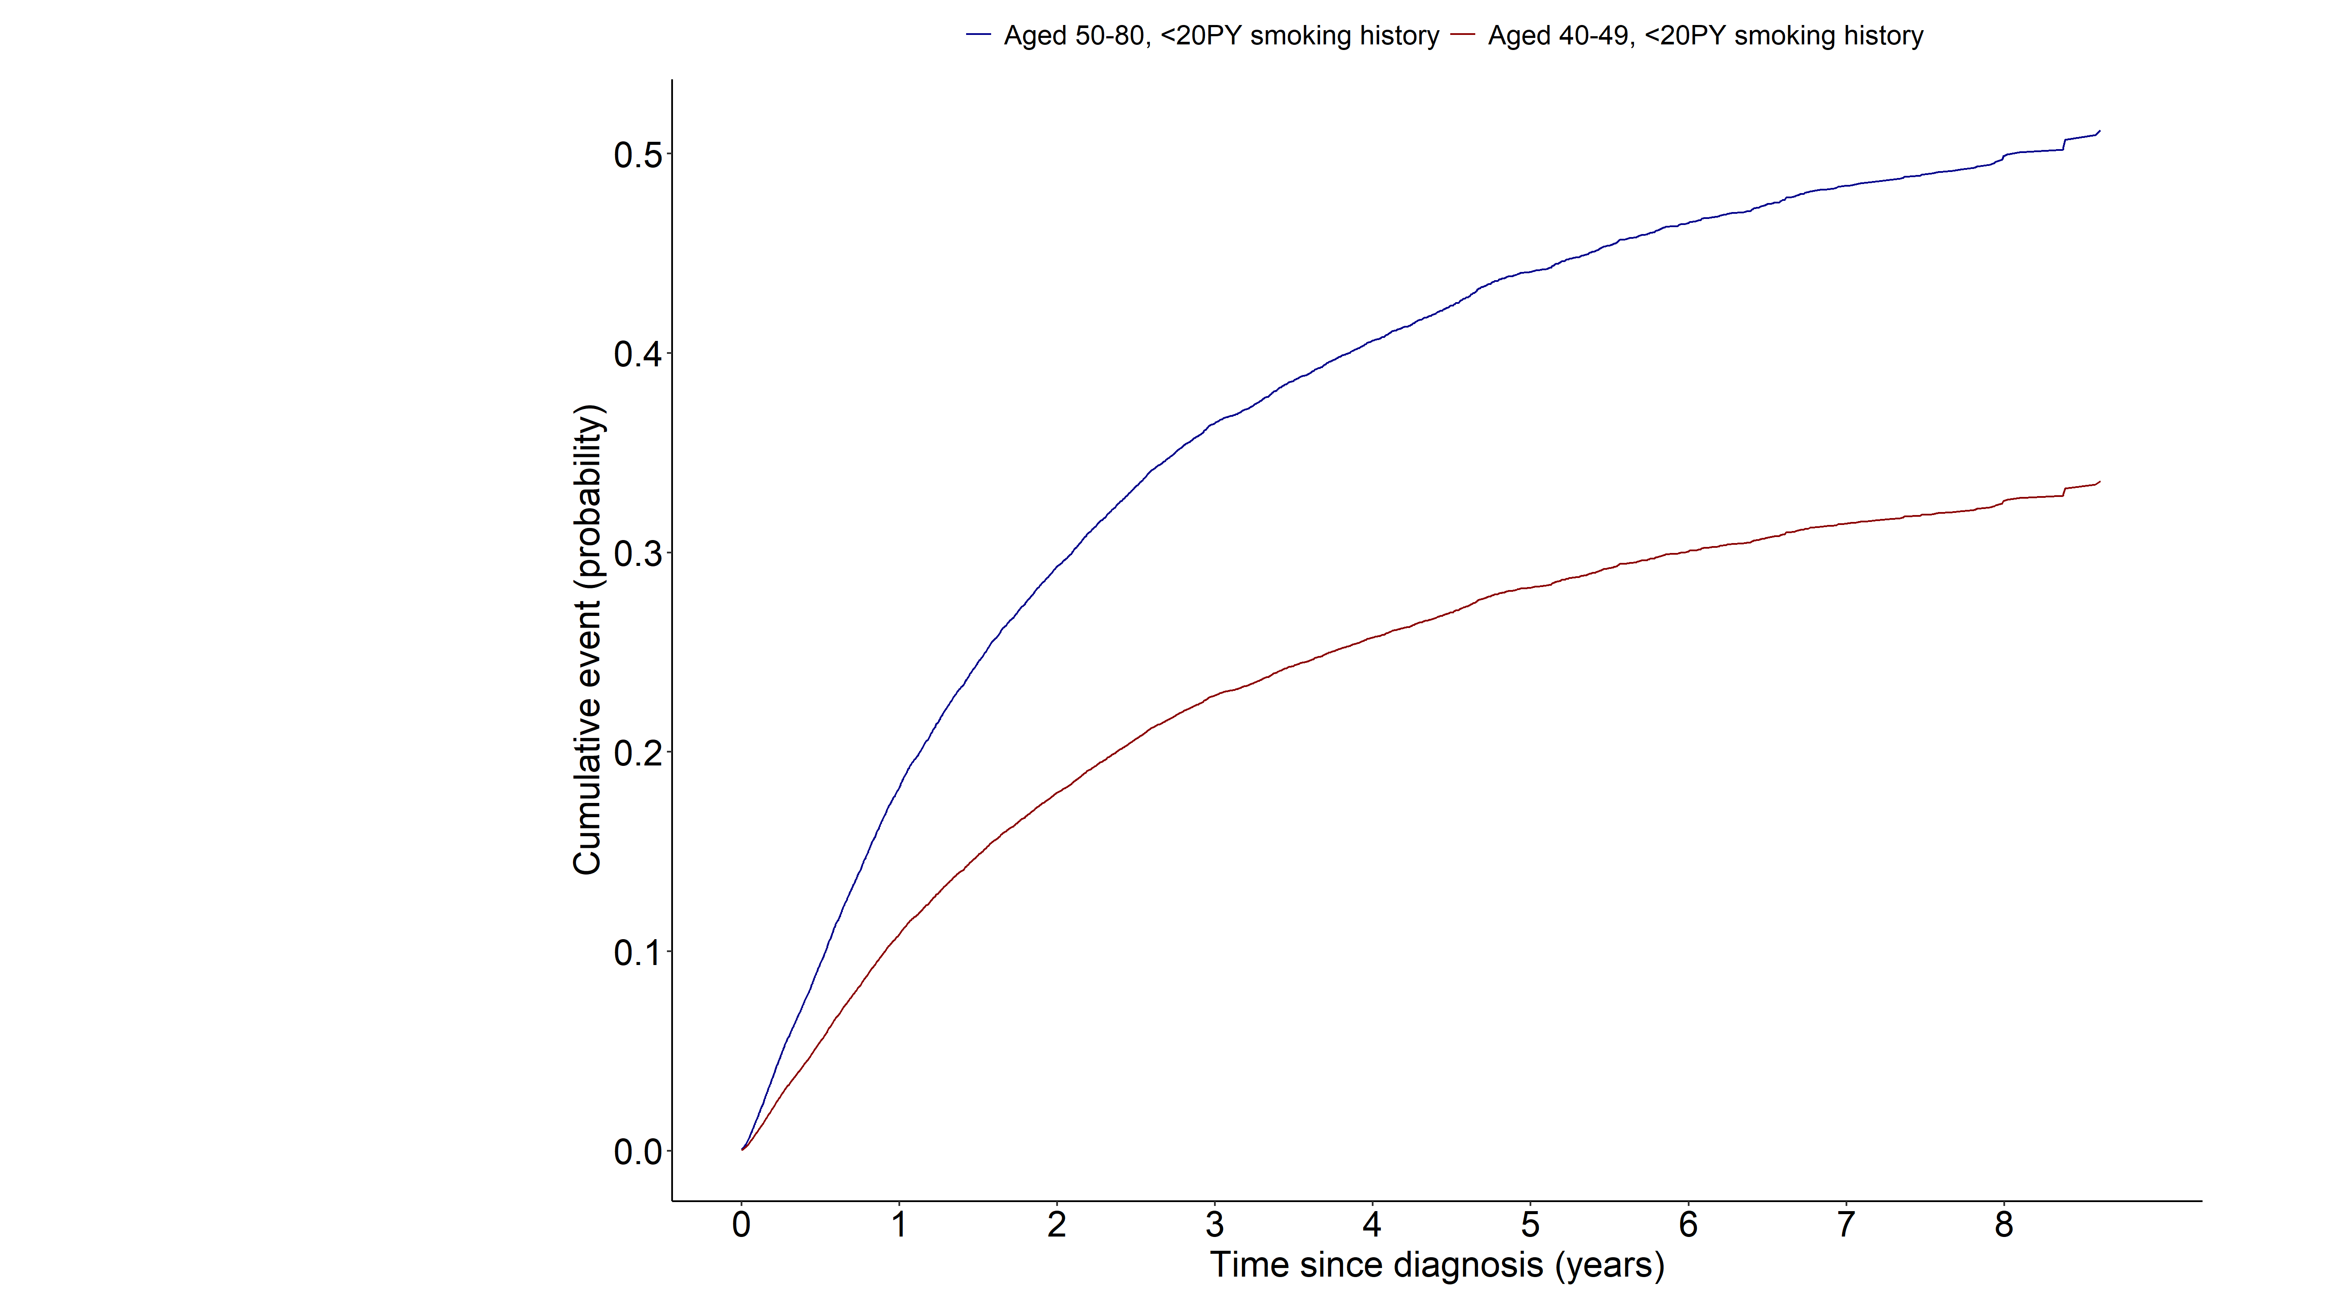
Notes:
> m1<-model.matrix(~grouptype+SEX+q_smk_yn2+pack_year+G1E_BMI+income
+ +cci_group+activity+non_small_yn+SEER_GRP+surgery_yn+radio_yn+system_yn,data=data4)[,-1]
> crr4_1 <- crr(ftime=data4$day_diff,fstatus=data4$dth_type, cencode=0, cov1=m1, failcode=1)
> summary(crr4_1)
Competing Risks Regression
Call:
crr(ftime = data4$day_diff, fstatus = data4$dth_type, cov1 = m1,
failcode = 1, cencode = 0)
coef exp(coef) se(coef) z p-value
grouptype002 -0.56048 0.571 0.04910 -11.414 0.0e+00
SEX1 0.31155 1.366 0.04393 7.092 1.3e-12
q_smk_yn2Current smoker 0.10565 1.111 0.02435 4.338 1.4e-05
pack_year 0.00566 1.006 0.00236 2.402 1.6e-02
G1E_BMI -0.03540 0.965 0.00462 -7.659 1.9e-14
income2 -0.05657 0.945 0.04027 -1.405 1.6e-01
income3 0.01441 1.015 0.03843 0.375 7.1e-01
income4 -0.03699 0.964 0.03667 -1.009 3.1e-01
income5 -0.05772 0.944 0.03464 -1.666 9.6e-02
cci_group>=5 0.35273 1.423 0.03873 9.107 0.0e+00
cci_group1-2 0.12877 1.137 0.02914 4.419 9.9e-06
cci_group3-4 0.30228 1.353 0.04471 6.761 1.4e-11
activityactive -0.06507 0.937 0.02583 -2.519 1.2e-02
non_small_yn1 -0.37463 0.688 0.03235 -11.580 0.0e+00
SEER_GRP2 0.84802 2.335 0.04463 19.003 0.0e+00
SEER_GRP7 1.49114 4.442 0.04797 31.082 0.0e+00
SEER_GRP9 0.75531 2.128 0.06164 12.253 0.0e+00
surgery_ynyes -1.20960 0.298 0.03597 -33.626 0.0e+00
radio_ynyes 0.01759 1.018 0.02801 0.628 5.3e-01
system_ynyes -0.24260 0.785 0.02880 -8.424 0.0e+00
exp(coef) exp(-coef) 2.5% 97.5%
grouptype002 0.571 1.752 0.519 0.629
SEX1 1.366 0.732 1.253 1.488
q_smk_yn2Current smoker 1.111 0.900 1.060 1.166
pack_year 1.006 0.994 1.001 1.010
G1E_BMI 0.965 1.036 0.957 0.974
income2 0.945 1.058 0.873 1.023
income3 1.015 0.986 0.941 1.094
income4 0.964 1.038 0.897 1.035
income5 0.944 1.059 0.882 1.010
cci_group>=5 1.423 0.703 1.319 1.535
cci_group1-2 1.137 0.879 1.074 1.204
cci_group3-4 1.353 0.739 1.239 1.477
activityactive 0.937 1.067 0.891 0.986
non_small_yn1 0.688 1.454 0.645 0.733
SEER_GRP2 2.335 0.428 2.139 2.548
SEER_GRP7 4.442 0.225 4.044 4.880
SEER_GRP9 2.128 0.470 1.886 2.402
surgery_ynyes 0.298 3.352 0.278 0.320
radio_ynyes 1.018 0.983 0.963 1.075
system_ynyes 0.785 1.275 0.742 0.830
Num. cases = 13682
Pseudo Log-likelihood = -71618
Pseudo likelihood ratio test = 6799 on 20 df,

Slide 12
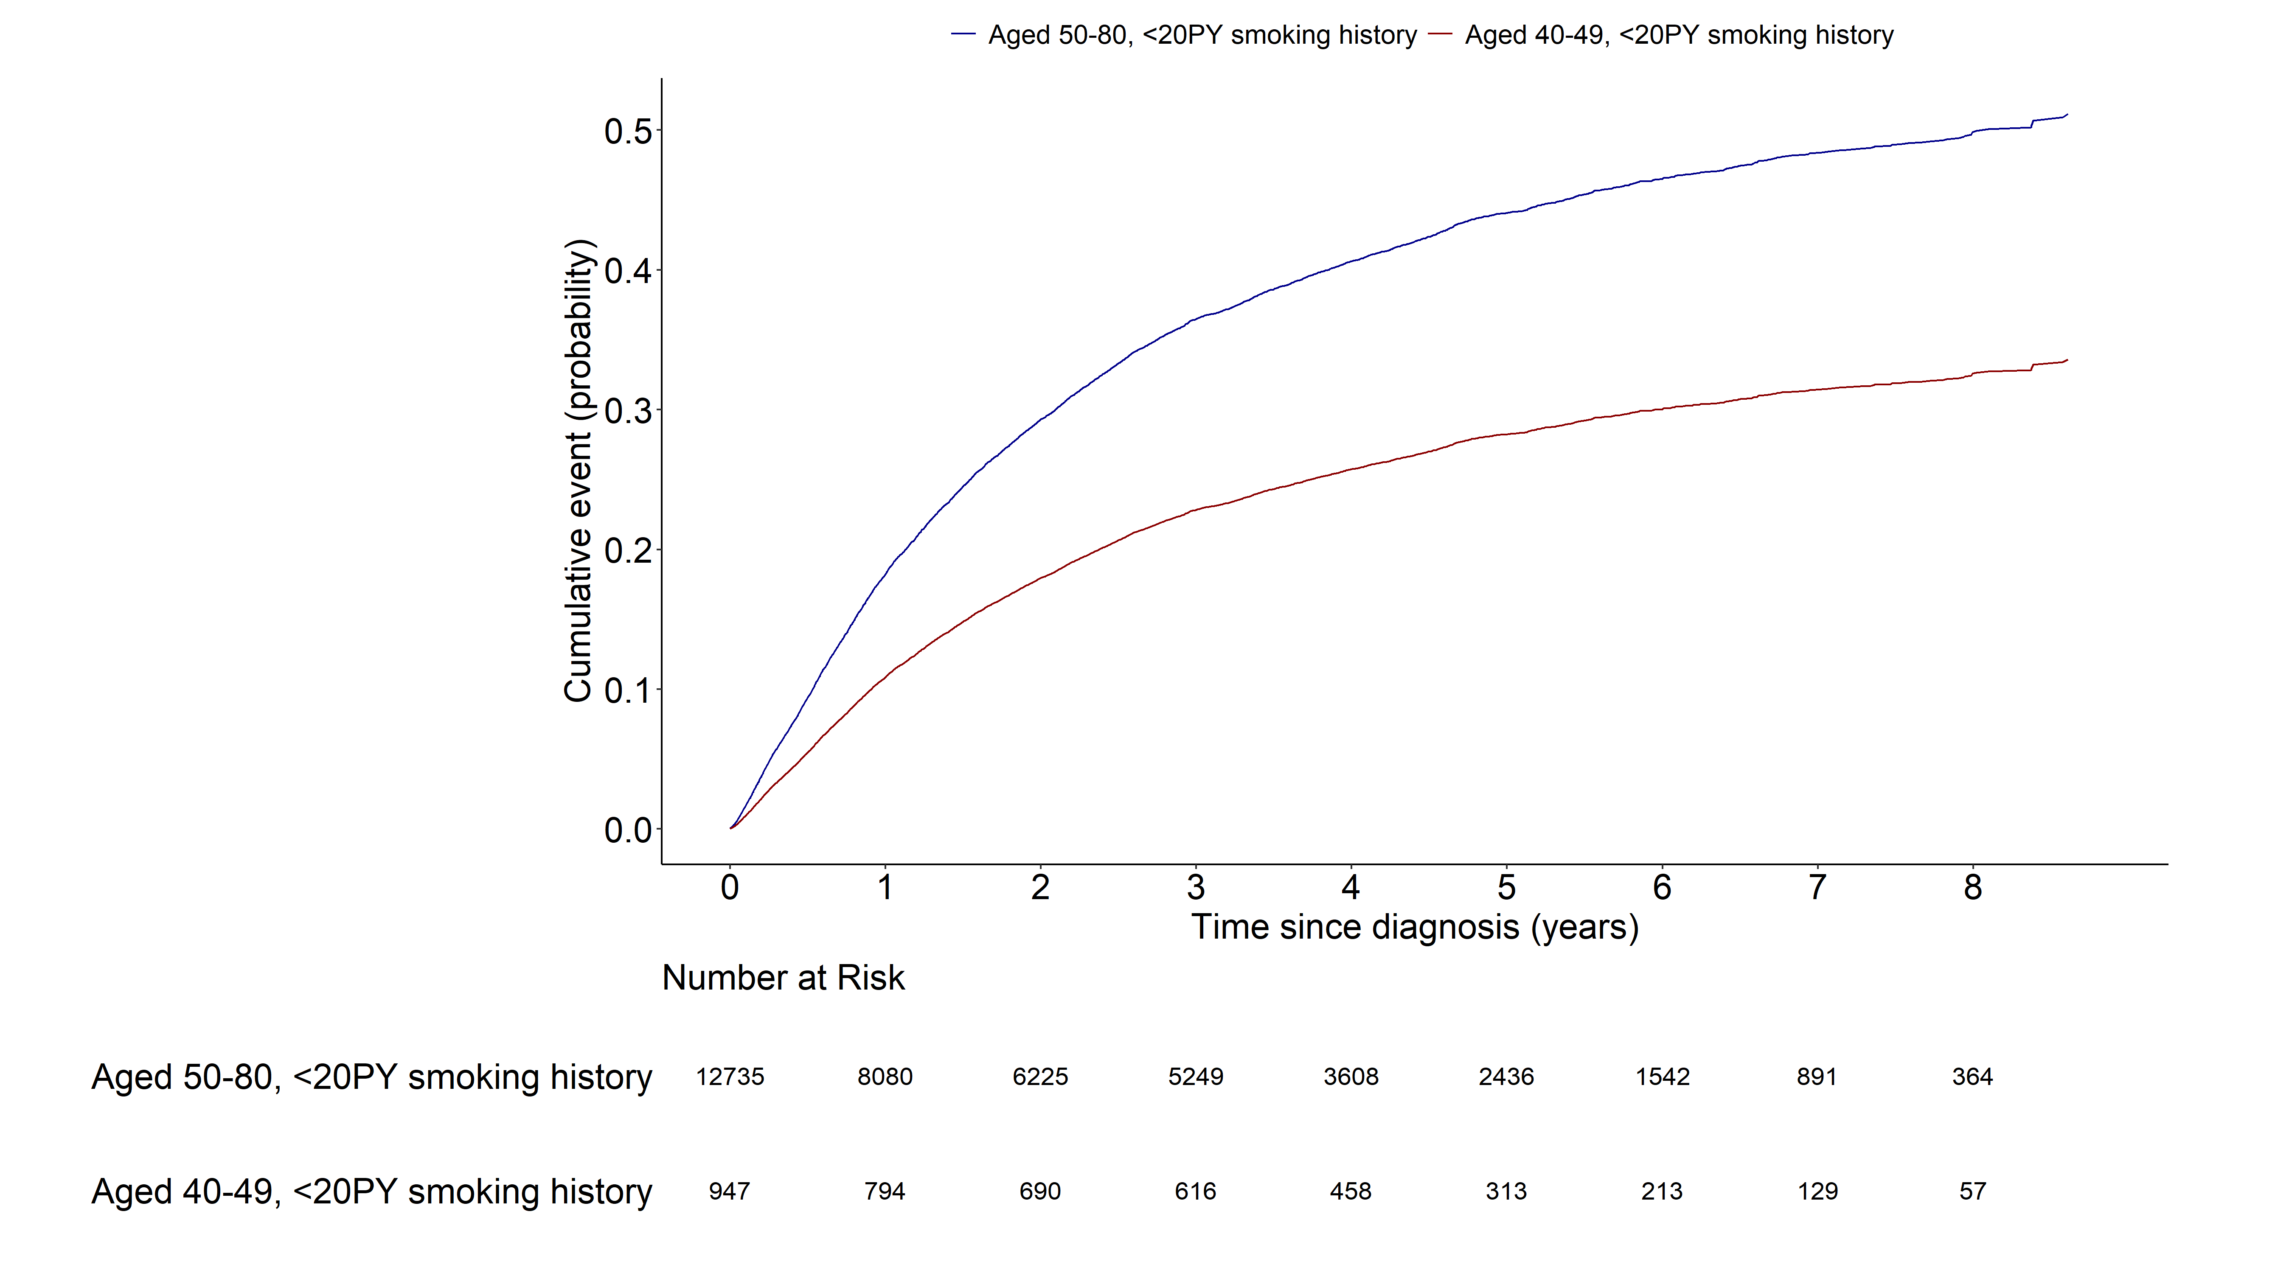
Notes:
> m1<-model.matrix(~grouptype+SEX+q_smk_yn2+pack_year+G1E_BMI+income
+ +cci_group+activity+non_small_yn+SEER_GRP+surgery_yn+radio_yn+system_yn,data=data4)[,-1]
> crr4_1 <- crr(ftime=data4$day_diff,fstatus=data4$dth_type, cencode=0, cov1=m1, failcode=1)
> summary(crr4_1)
Competing Risks Regression
Call:
crr(ftime = data4$day_diff, fstatus = data4$dth_type, cov1 = m1,
failcode = 1, cencode = 0)
coef exp(coef) se(coef) z p-value
grouptype002 -0.56048 0.571 0.04910 -11.414 0.0e+00
SEX1 0.31155 1.366 0.04393 7.092 1.3e-12
q_smk_yn2Current smoker 0.10565 1.111 0.02435 4.338 1.4e-05
pack_year 0.00566 1.006 0.00236 2.402 1.6e-02
G1E_BMI -0.03540 0.965 0.00462 -7.659 1.9e-14
income2 -0.05657 0.945 0.04027 -1.405 1.6e-01
income3 0.01441 1.015 0.03843 0.375 7.1e-01
income4 -0.03699 0.964 0.03667 -1.009 3.1e-01
income5 -0.05772 0.944 0.03464 -1.666 9.6e-02
cci_group>=5 0.35273 1.423 0.03873 9.107 0.0e+00
cci_group1-2 0.12877 1.137 0.02914 4.419 9.9e-06
cci_group3-4 0.30228 1.353 0.04471 6.761 1.4e-11
activityactive -0.06507 0.937 0.02583 -2.519 1.2e-02
non_small_yn1 -0.37463 0.688 0.03235 -11.580 0.0e+00
SEER_GRP2 0.84802 2.335 0.04463 19.003 0.0e+00
SEER_GRP7 1.49114 4.442 0.04797 31.082 0.0e+00
SEER_GRP9 0.75531 2.128 0.06164 12.253 0.0e+00
surgery_ynyes -1.20960 0.298 0.03597 -33.626 0.0e+00
radio_ynyes 0.01759 1.018 0.02801 0.628 5.3e-01
system_ynyes -0.24260 0.785 0.02880 -8.424 0.0e+00
exp(coef) exp(-coef) 2.5% 97.5%
grouptype002 0.571 1.752 0.519 0.629
SEX1 1.366 0.732 1.253 1.488
q_smk_yn2Current smoker 1.111 0.900 1.060 1.166
pack_year 1.006 0.994 1.001 1.010
G1E_BMI 0.965 1.036 0.957 0.974
income2 0.945 1.058 0.873 1.023
income3 1.015 0.986 0.941 1.094
income4 0.964 1.038 0.897 1.035
income5 0.944 1.059 0.882 1.010
cci_group>=5 1.423 0.703 1.319 1.535
cci_group1-2 1.137 0.879 1.074 1.204
cci_group3-4 1.353 0.739 1.239 1.477
activityactive 0.937 1.067 0.891 0.986
non_small_yn1 0.688 1.454 0.645 0.733
SEER_GRP2 2.335 0.428 2.139 2.548
SEER_GRP7 4.442 0.225 4.044 4.880
SEER_GRP9 2.128 0.470 1.886 2.402
surgery_ynyes 0.298 3.352 0.278 0.320
radio_ynyes 1.018 0.983 0.963 1.075
system_ynyes 0.785 1.275 0.742 0.830
Num. cases = 13682
Pseudo Log-likelihood = -71618
Pseudo likelihood ratio test = 6799 on 20 df,

Slide 13
Lung cancer mortality (1.AGED 50-80, Never-smoker
2. AGED 40-49, Never-smoker)
Multivariable cox model: age 변수 제외

Slide 14
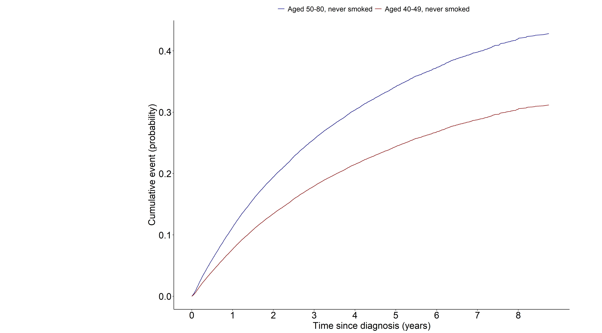
Notes:
> m1<-model.matrix(~grouptype+SEX+G1E_BMI+income
+cci_group+activity+non_small_yn+SEER_GRP+surgery_yn+radio_yn+system_yn,data=data5)[,-1]
> crr5_1 <- crr(ftime=data5$day_diff,fstatus=data5$dth_type, cencode=0, cov1=m1, failcode=1)
> summary(crr5_1)
Competing Risks Regression
Call:
crr(ftime = data5$day_diff, fstatus = data5$dth_type, cov1 = m1,
failcode = 1, cencode = 0)
coef exp(coef) se(coef) z p-value
grouptype002 -0.4024 0.669 0.03785 -10.632 0.0e+00
SEX1 0.4990 1.647 0.01719 29.036 0.0e+00
G1E_BMI -0.0222 0.978 0.00311 -7.129 1.0e-12
income2 -0.0471 0.954 0.02999 -1.571 1.2e-01
income3 -0.0128 0.987 0.02860 -0.447 6.6e-01
income4 -0.0878 0.916 0.02675 -3.282 1.0e-03
income5 -0.0380 0.963 0.02418 -1.572 1.2e-01
cci_group>=5 0.3888 1.475 0.02692 14.440 0.0e+00
cci_group1-2 0.1563 1.169 0.02064 7.574 3.6e-14
cci_group3-4 0.3399 1.405 0.03252 10.453 0.0e+00
activityactive -0.1411 0.868 0.01997 -7.065 1.6e-12
non_small_yn1 -0.4354 0.647 0.03237 -13.452 0.0e+00
SEER_GRP2 1.0717 2.920 0.03217 33.310 0.0e+00
SEER_GRP7 1.8042 6.075 0.03549 50.843 0.0e+00
SEER_GRP9 0.8783 2.407 0.04583 19.164 0.0e+00
surgery_ynyes -1.2342 0.291 0.02611 -47.263 0.0e+00
radio_ynyes 0.1436 1.154 0.02075 6.921 4.5e-12
system_ynyes -0.1998 0.819 0.02060 -9.695 0.0e+00
exp(coef) exp(-coef) 2.5% 97.5%
grouptype002 0.669 1.495 0.621 0.720
SEX1 1.647 0.607 1.593 1.704
G1E_BMI 0.978 1.022 0.972 0.984
income2 0.954 1.048 0.900 1.012
income3 0.987 1.013 0.933 1.044
income4 0.916 1.092 0.869 0.965
income5 0.963 1.039 0.918 1.009
cci_group>=5 1.475 0.678 1.399 1.555
cci_group1-2 1.169 0.855 1.123 1.217
cci_group3-4 1.405 0.712 1.318 1.497
activityactive 0.868 1.152 0.835 0.903
non_small_yn1 0.647 1.546 0.607 0.689
SEER_GRP2 2.920 0.342 2.742 3.110
SEER_GRP7 6.075 0.165 5.667 6.513
SEER_GRP9 2.407 0.415 2.200 2.633
surgery_ynyes 0.291 3.435 0.277 0.306
radio_ynyes 1.154 0.866 1.108 1.202
system_ynyes 0.819 1.221 0.787 0.853
Num. cases = 34984
Pseudo Log-likelihood = -159486
Pseudo likelihood ratio test = 19778 on 18 df,

Slide 15
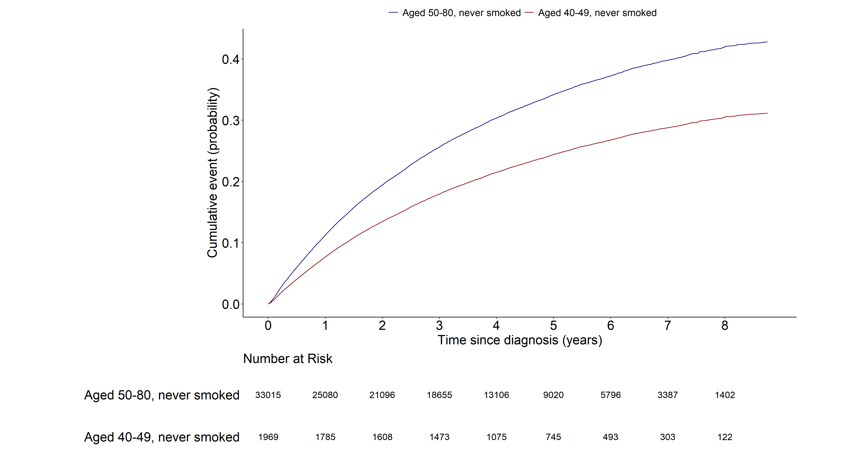
Notes:
> m1<-model.matrix(~grouptype+SEX+G1E_BMI+income
+cci_group+activity+non_small_yn+SEER_GRP+surgery_yn+radio_yn+system_yn,data=data5)[,-1]
> crr5_1 <- crr(ftime=data5$day_diff,fstatus=data5$dth_type, cencode=0, cov1=m1, failcode=1)
> summary(crr5_1)
Competing Risks Regression
Call:
crr(ftime = data5$day_diff, fstatus = data5$dth_type, cov1 = m1,
failcode = 1, cencode = 0)
coef exp(coef) se(coef) z p-value
grouptype002 -0.4024 0.669 0.03785 -10.632 0.0e+00
SEX1 0.4990 1.647 0.01719 29.036 0.0e+00
G1E_BMI -0.0222 0.978 0.00311 -7.129 1.0e-12
income2 -0.0471 0.954 0.02999 -1.571 1.2e-01
income3 -0.0128 0.987 0.02860 -0.447 6.6e-01
income4 -0.0878 0.916 0.02675 -3.282 1.0e-03
income5 -0.0380 0.963 0.02418 -1.572 1.2e-01
cci_group>=5 0.3888 1.475 0.02692 14.440 0.0e+00
cci_group1-2 0.1563 1.169 0.02064 7.574 3.6e-14
cci_group3-4 0.3399 1.405 0.03252 10.453 0.0e+00
activityactive -0.1411 0.868 0.01997 -7.065 1.6e-12
non_small_yn1 -0.4354 0.647 0.03237 -13.452 0.0e+00
SEER_GRP2 1.0717 2.920 0.03217 33.310 0.0e+00
SEER_GRP7 1.8042 6.075 0.03549 50.843 0.0e+00
SEER_GRP9 0.8783 2.407 0.04583 19.164 0.0e+00
surgery_ynyes -1.2342 0.291 0.02611 -47.263 0.0e+00
radio_ynyes 0.1436 1.154 0.02075 6.921 4.5e-12
system_ynyes -0.1998 0.819 0.02060 -9.695 0.0e+00
exp(coef) exp(-coef) 2.5% 97.5%
grouptype002 0.669 1.495 0.621 0.720
SEX1 1.647 0.607 1.593 1.704
G1E_BMI 0.978 1.022 0.972 0.984
income2 0.954 1.048 0.900 1.012
income3 0.987 1.013 0.933 1.044
income4 0.916 1.092 0.869 0.965
income5 0.963 1.039 0.918 1.009
cci_group>=5 1.475 0.678 1.399 1.555
cci_group1-2 1.169 0.855 1.123 1.217
cci_group3-4 1.405 0.712 1.318 1.497
activityactive 0.868 1.152 0.835 0.903
non_small_yn1 0.647 1.546 0.607 0.689
SEER_GRP2 2.920 0.342 2.742 3.110
SEER_GRP7 6.075 0.165 5.667 6.513
SEER_GRP9 2.407 0.415 2.200 2.633
surgery_ynyes 0.291 3.435 0.277 0.306
radio_ynyes 1.154 0.866 1.108 1.202
system_ynyes 0.819 1.221 0.787 0.853
Num. cases = 34984
Pseudo Log-likelihood = -159486
Pseudo likelihood ratio test = 19778 on 18 df,

