Slide 1
All cause mortality(1. Aged 50-80, >= 20PY smoking history 2. Aged 50-80, < 20PY smoking history 3. Aged 50-80, never smoked)

Slide 2
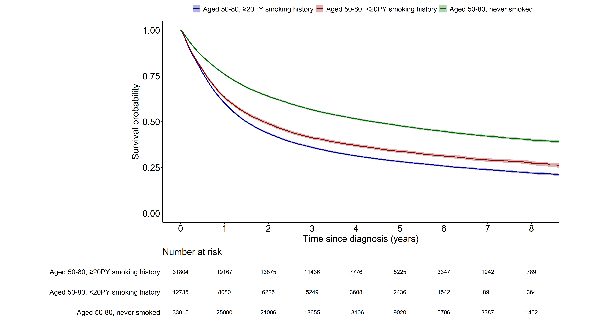
 | 1. Aged 50-80, >= 20PY smoking history | Aged 50-80, < 20PY smoking history
Aged 50-80, < 20PY smoking history | <0.001 | -
Aged 50-80, never smoked | <0.001 | <0.001

Slide 3
Lung cancer mortality(1. Aged 50-80, >= 20PY smoking history 2. Aged 50-80, < 20PY smoking history 3. Aged 50-80, never smoked)

Slide 4
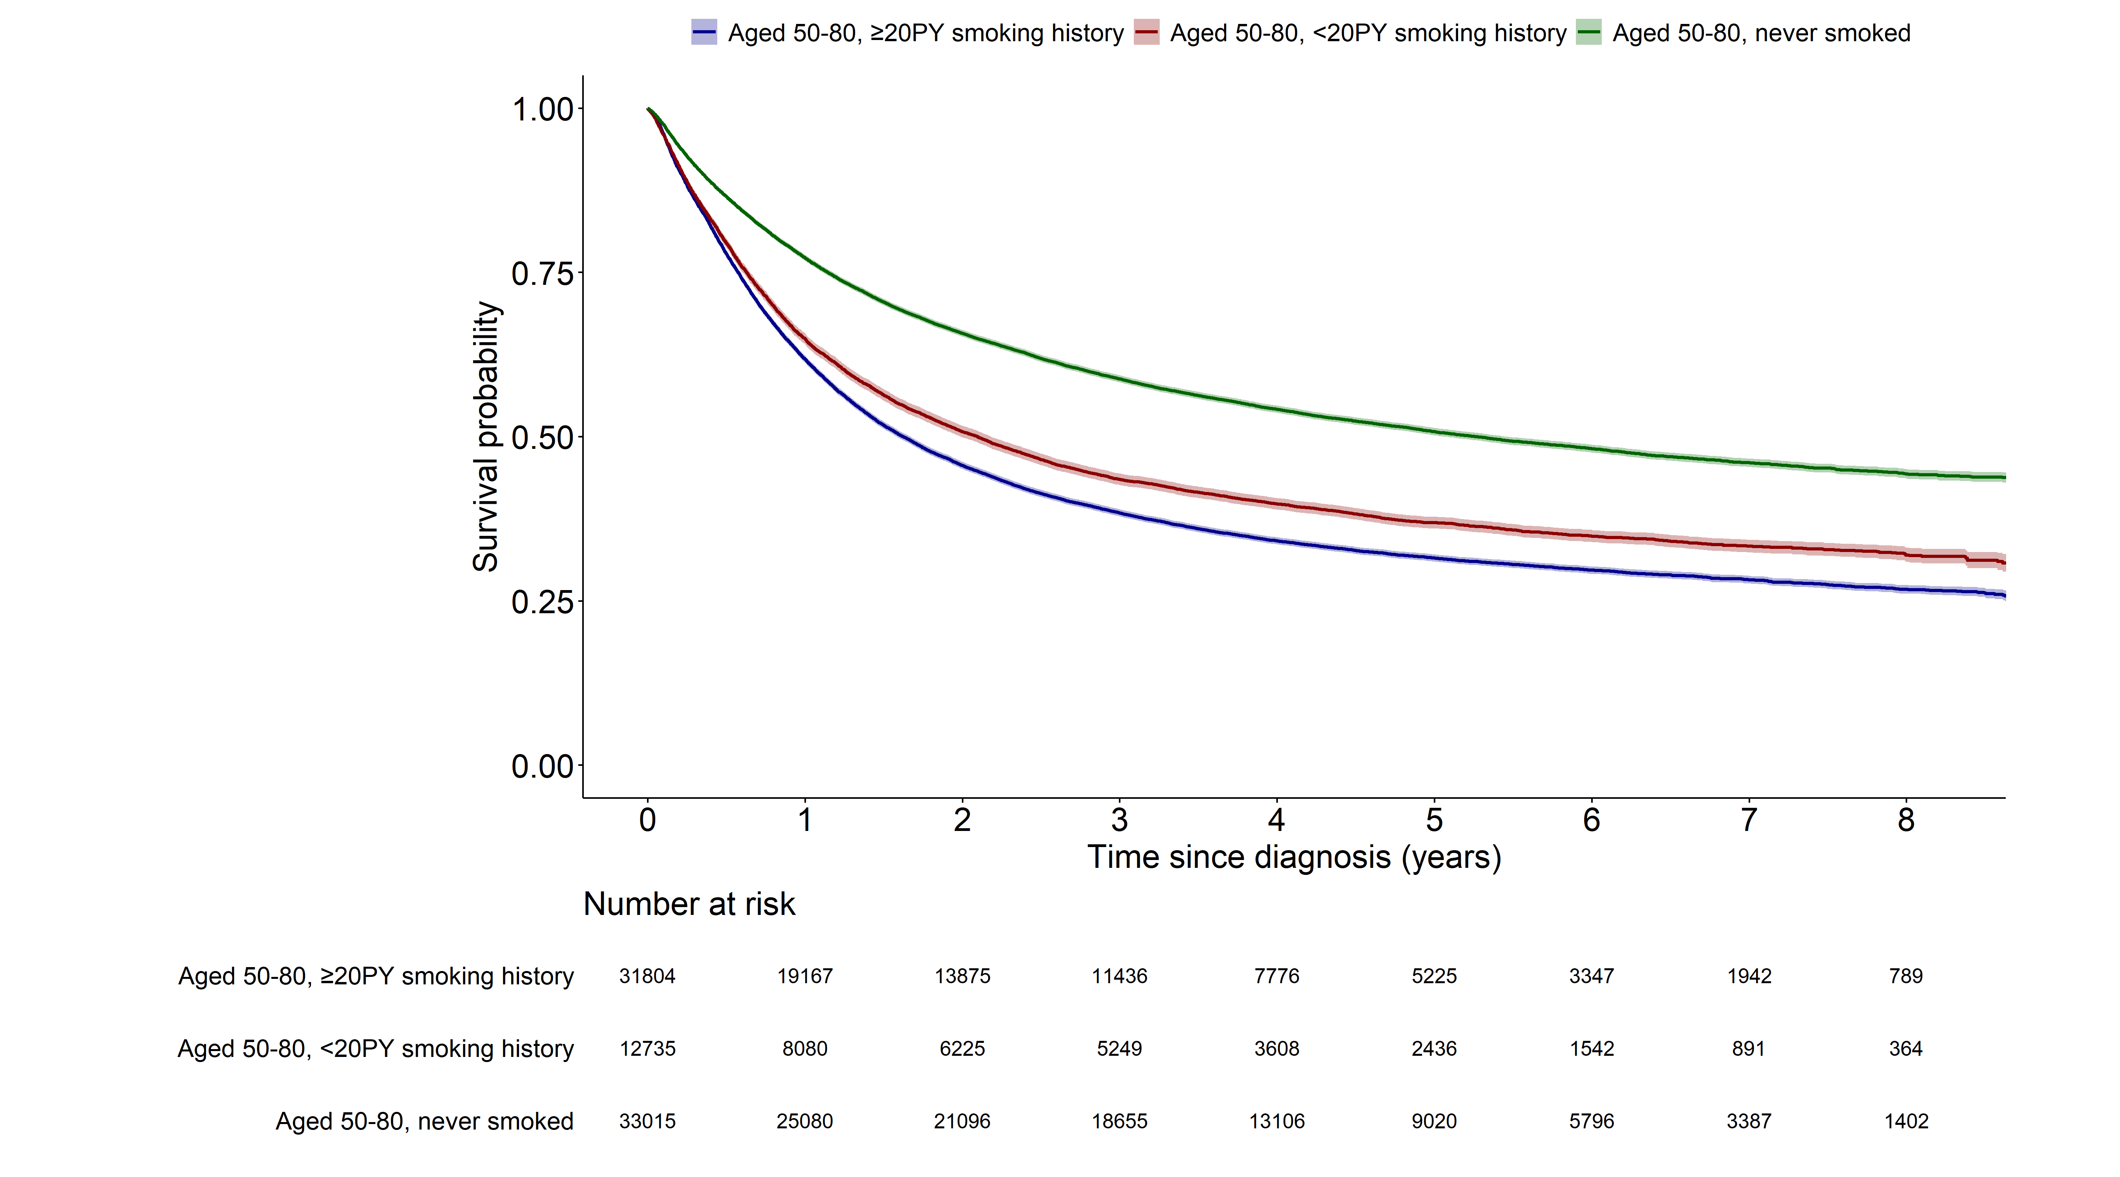
 | 1. Aged 50-80, >= 20PY smoking history | Aged 50-80, < 20PY smoking history
Aged 50-80, < 20PY smoking history | <0.001 | -
Aged 50-80, never smoked | <0.001 | <0.001

Slide 5
All mortality(1. Aged 50-80, >= 20years smoking history 2. Aged 50-80, < 20years smoking history)

Slide 6
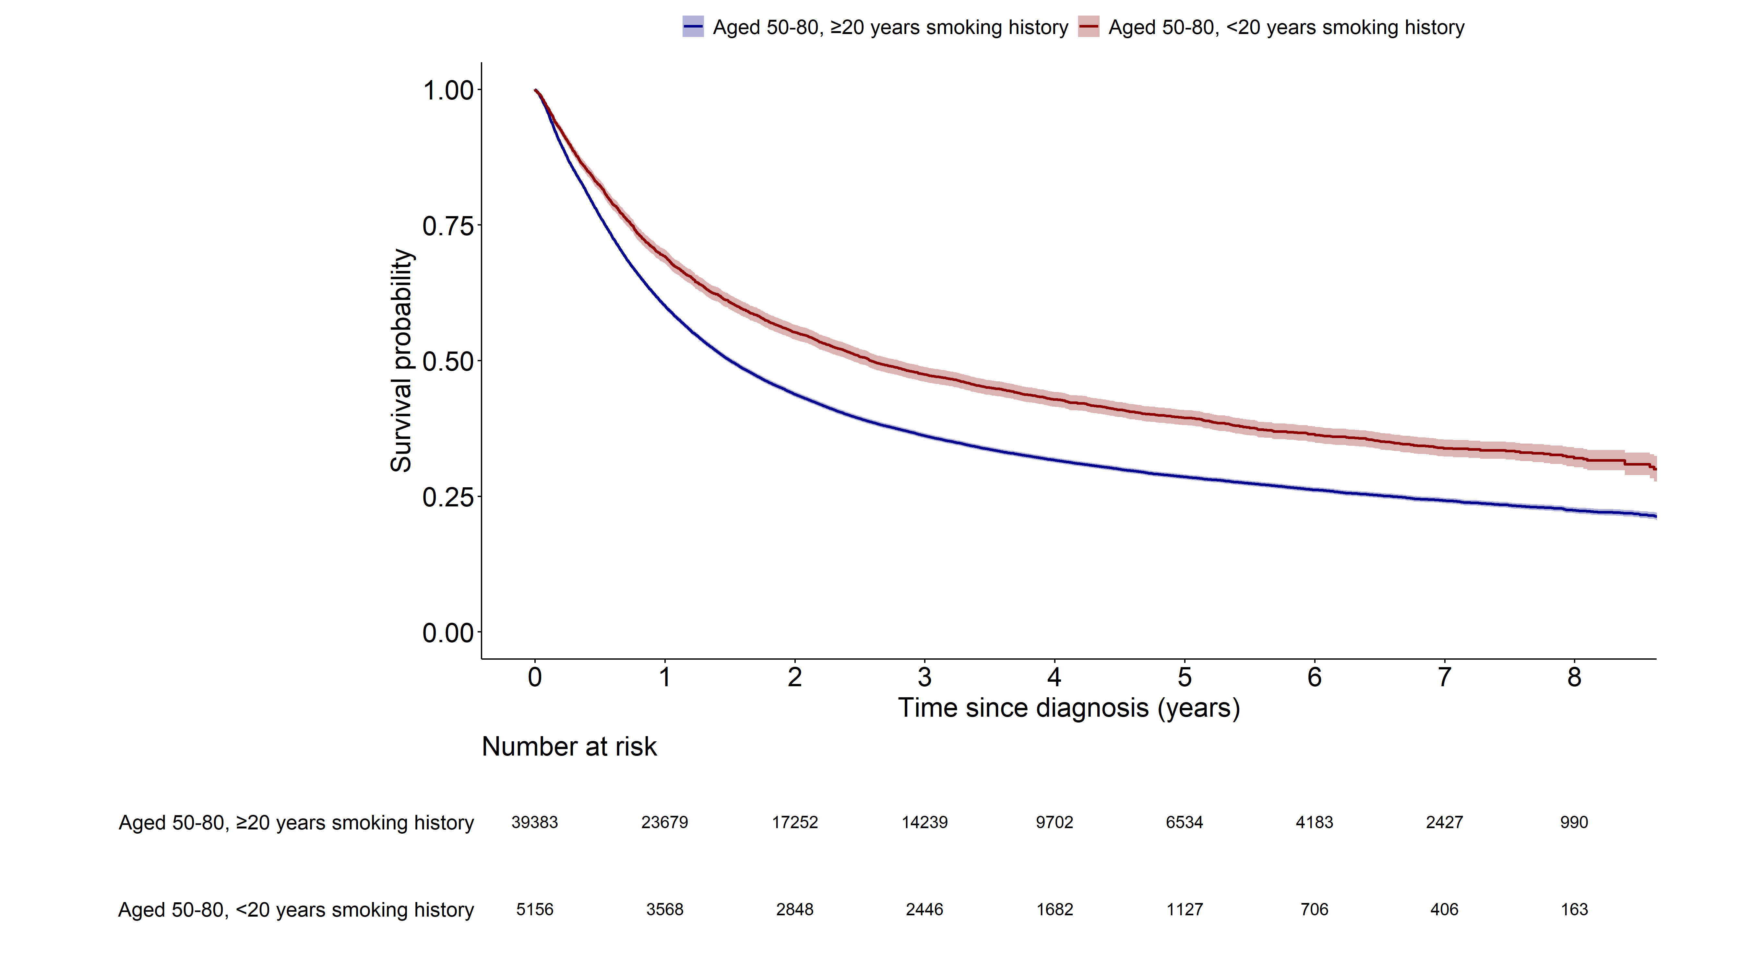
 | 1. Aged 50-80, >= 20years smoking history
Aged 50-80, < 20years smoking history | <0.001

Slide 7
Lung cancer mortality(1. Aged 50-80, >= 20years smoking history 2. Aged 50-80, < 20years smoking history)

Slide 8
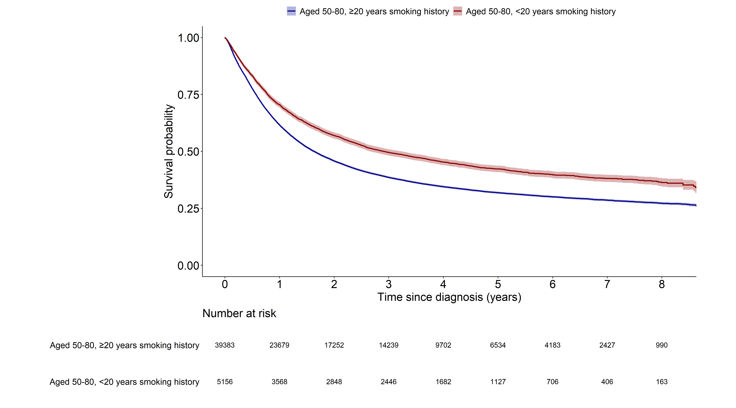
 | 1. Aged 50-80, >= 20years smoking history
Aged 50-80, < 20years smoking history | <0.001

Slide 9
All cause mortality(1.aged, 50-80, >=20PY smoking history, 2.aged, 40-49, >=20PY smoking history,

Slide 10
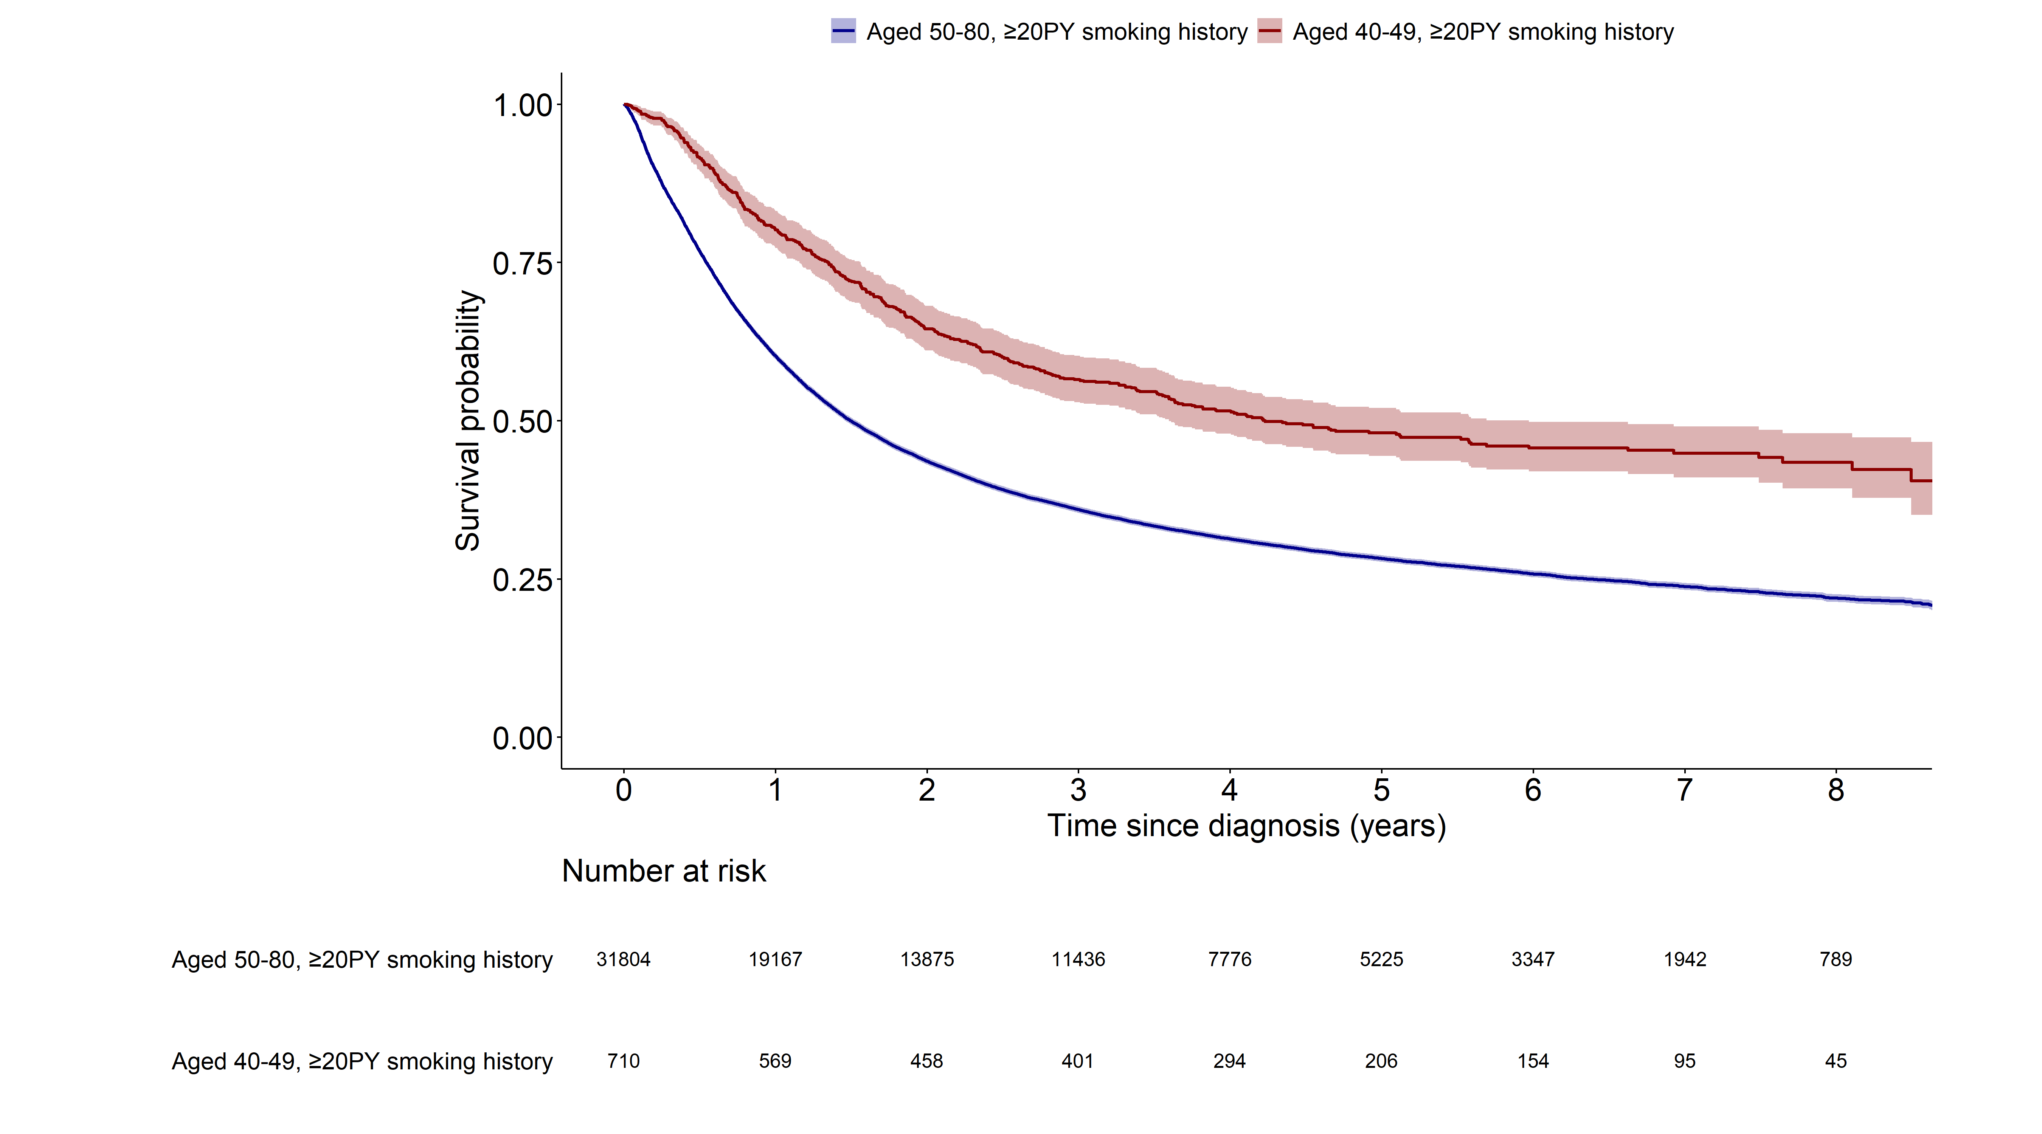
 | Aged, 50-80, >=20PY smoking history
Aged, 40-49, >=20PY smoking history | <0.001

Slide 11
Lung cancer mortality(1.aged, 50-80, >=20PY smoking history, 2.aged, 40-49, >=20PY smoking history)

Slide 12
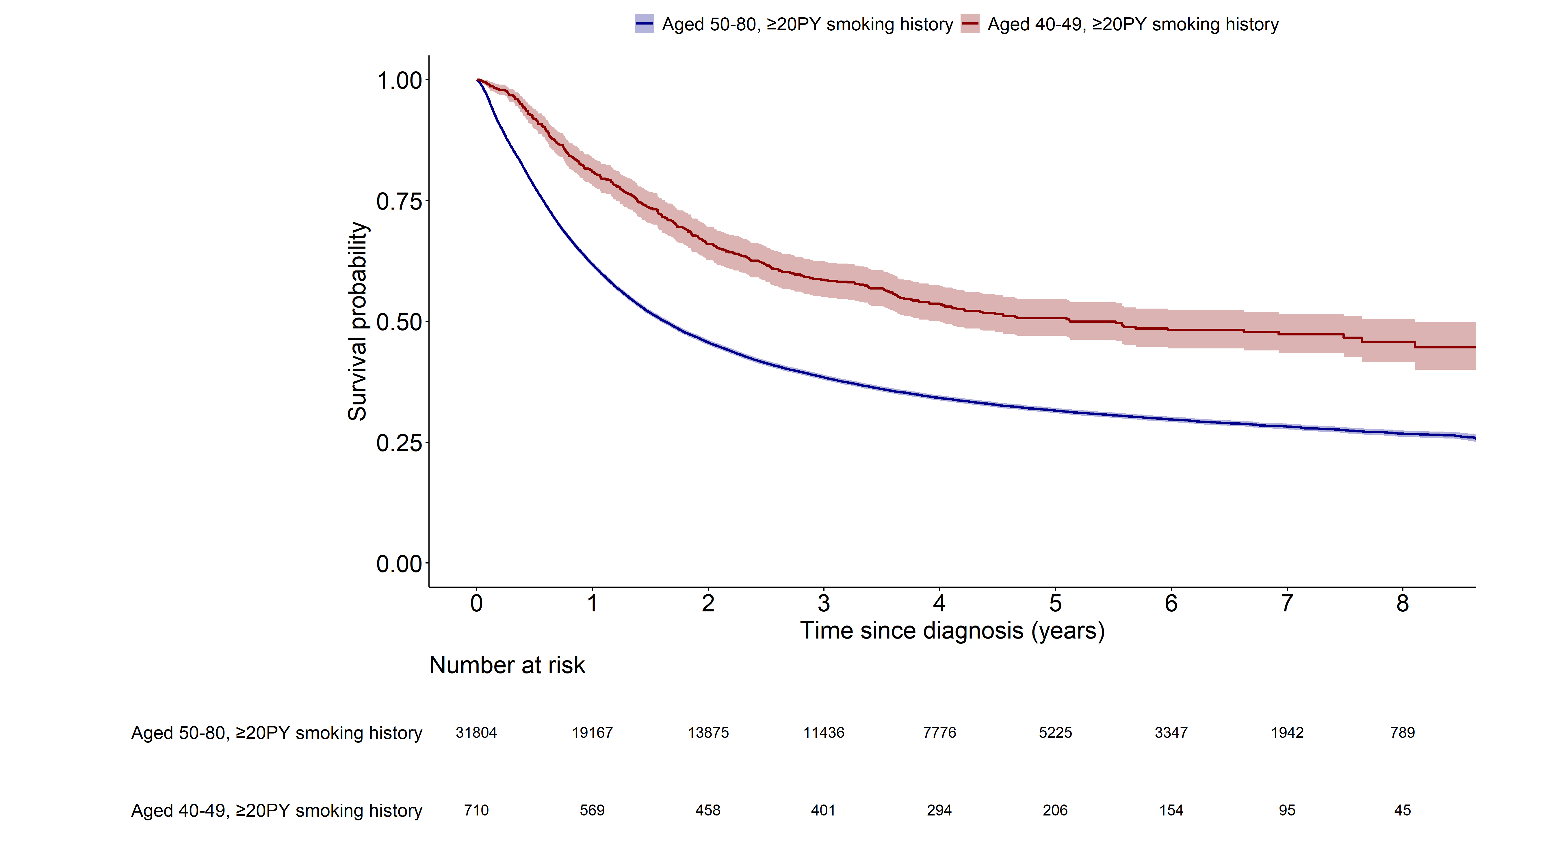
 | Aged, 50-80, >=20PY smoking history
Aged, 40-49, >=20PY smoking history | <0.001

Slide 13
All cause mortality(1.aged, 50-80, <20PY smoking history, 2.aged, 40-49, <20PY smoking history)

Slide 14
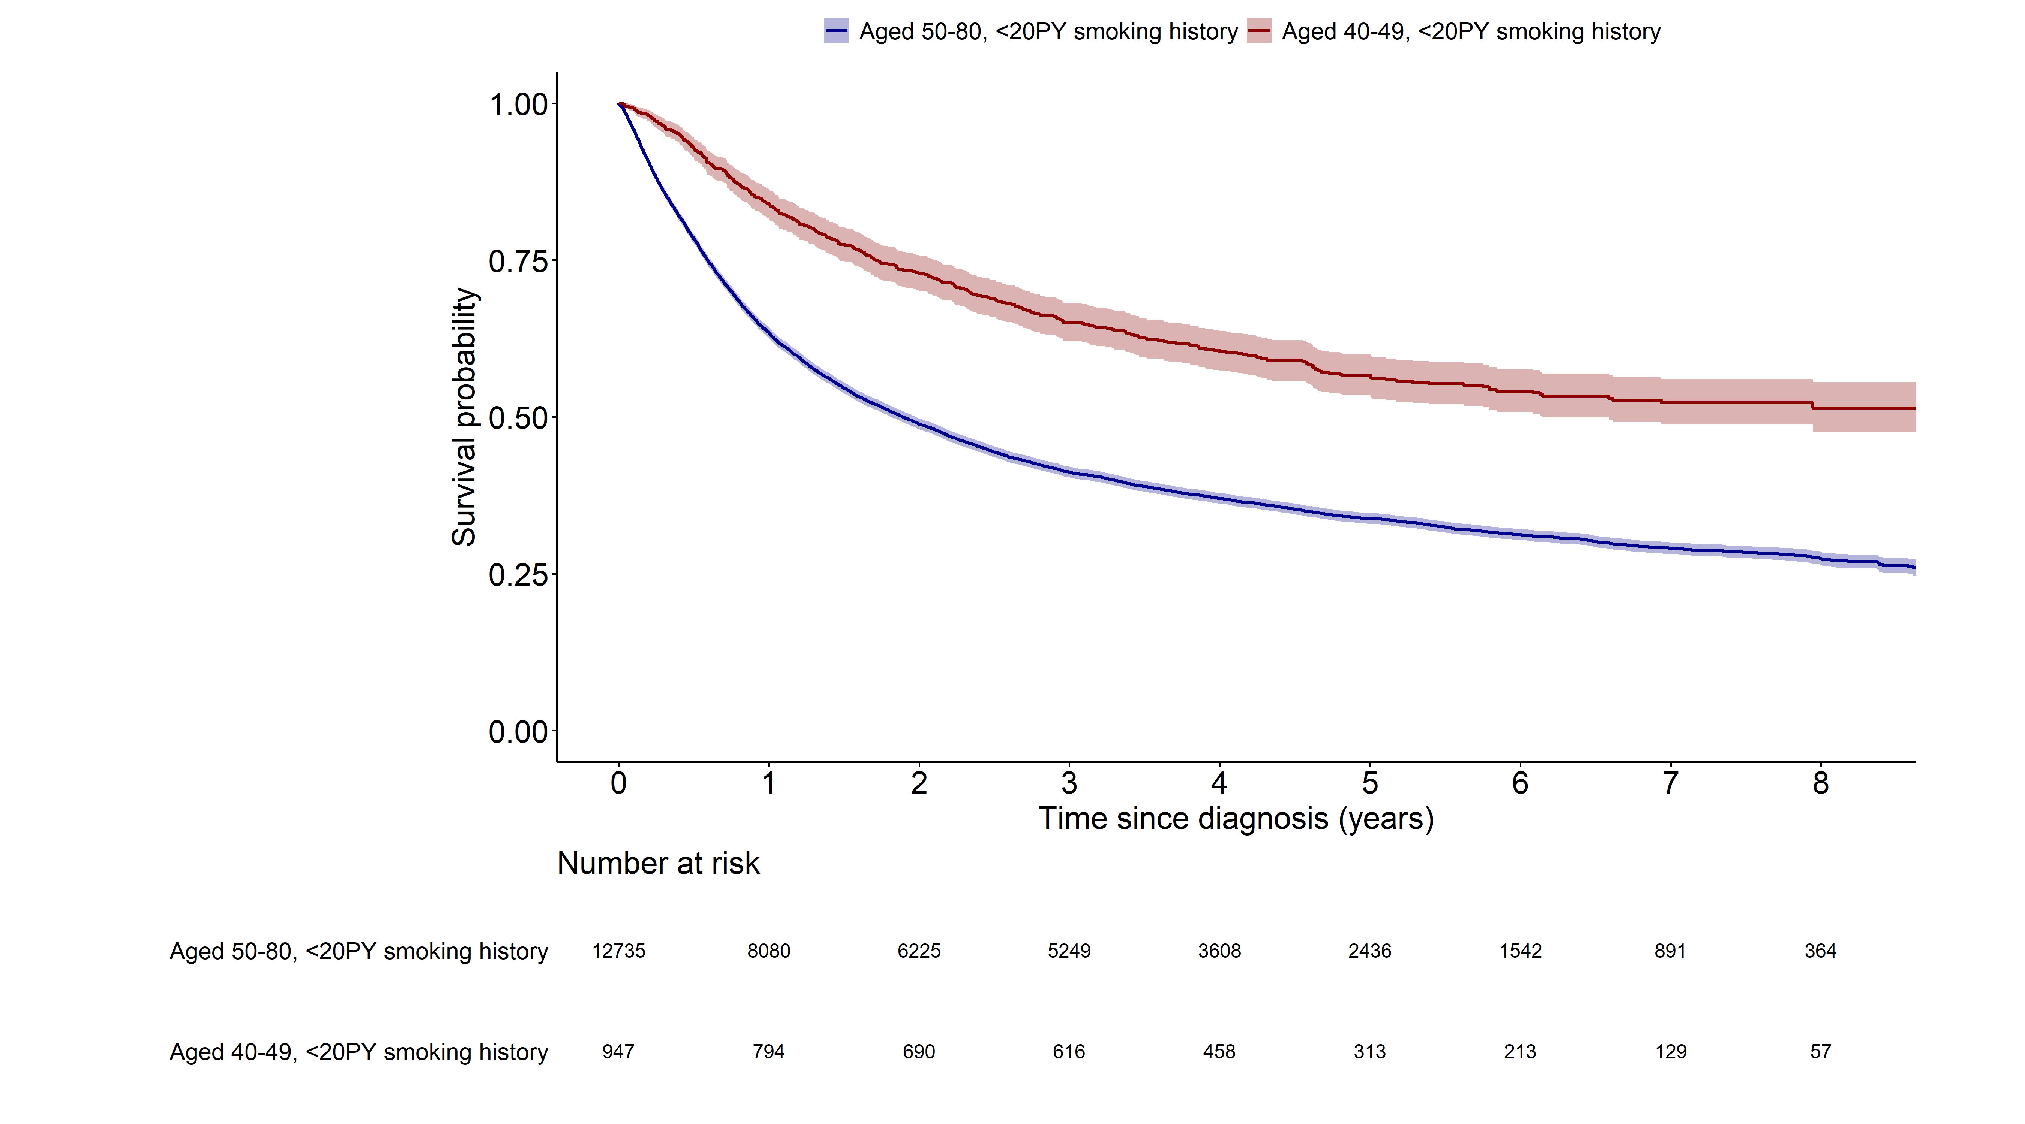
 | Aged, 50-80, <20PY smoking history
Aged, 40-49, <20PY smoking history | <0.001

Slide 15
Lung cancer mortality(1.aged, 50-80, <20PY smoking history, 2.aged, 40-49, <20PY smoking history,

Slide 16
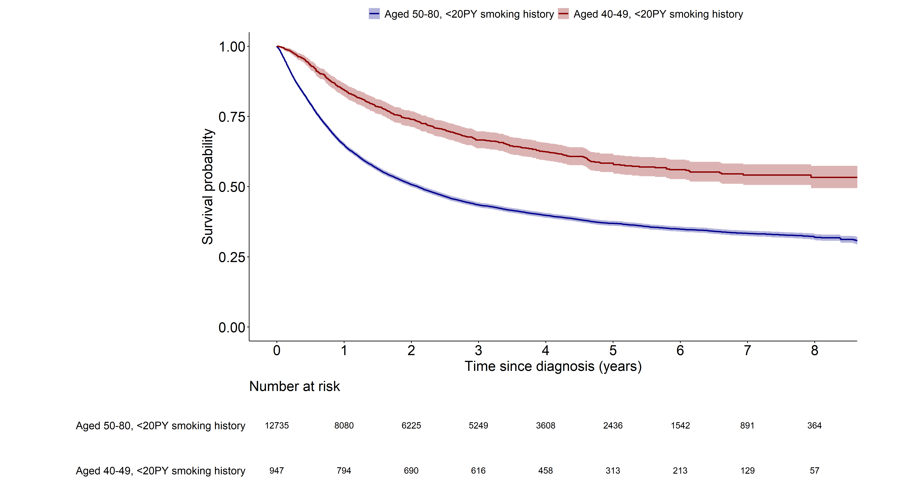
 | Aged, 50-80, <20PY smoking history
Aged, 40-49, <20PY smoking history | <0.001

Slide 17
All cause mortality(1.aged, 50-80, never smoked, 2.aged 40-49 never smoked)

Slide 18
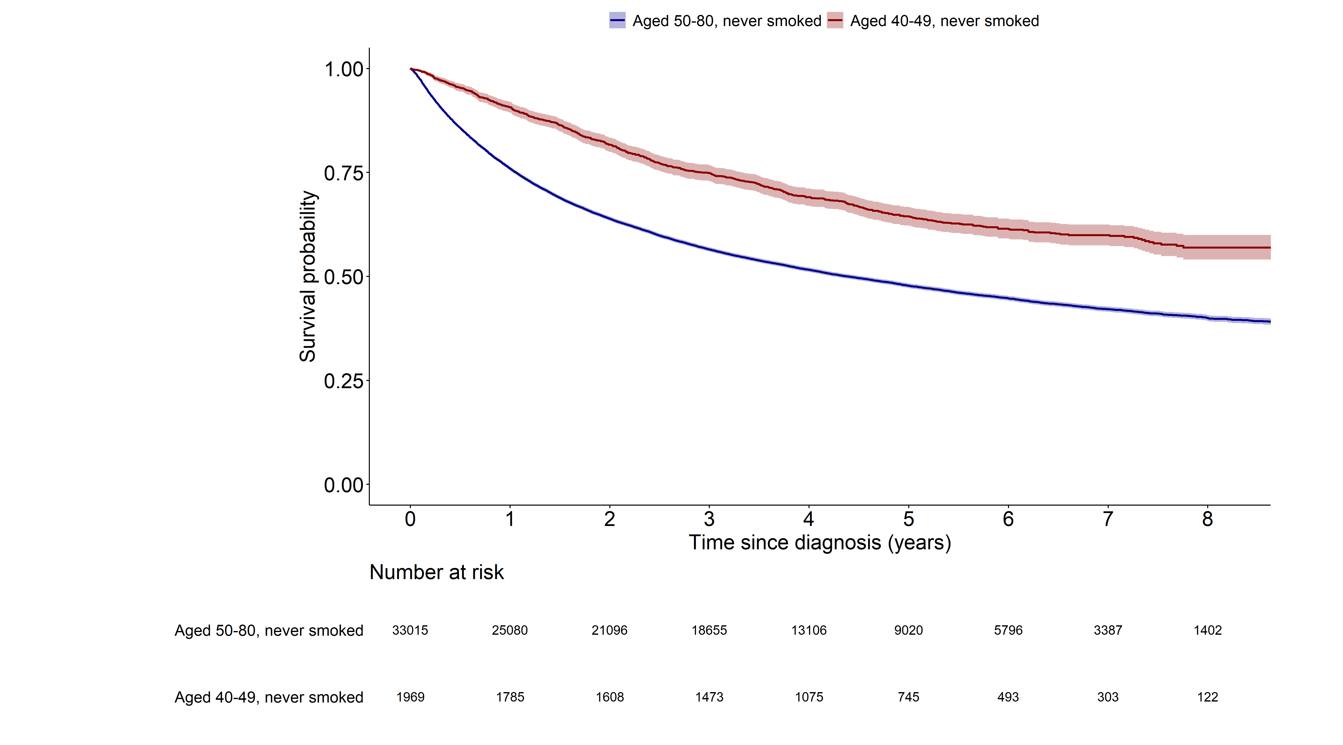
 | Aged, 50-80, never smoked
Aged, 40-49, never smoked | <0.001

Slide 19
Lung cancer mortality(1.aged, 50-80, never smoked, 2.aged 40-49 never smoked)

Slide 20
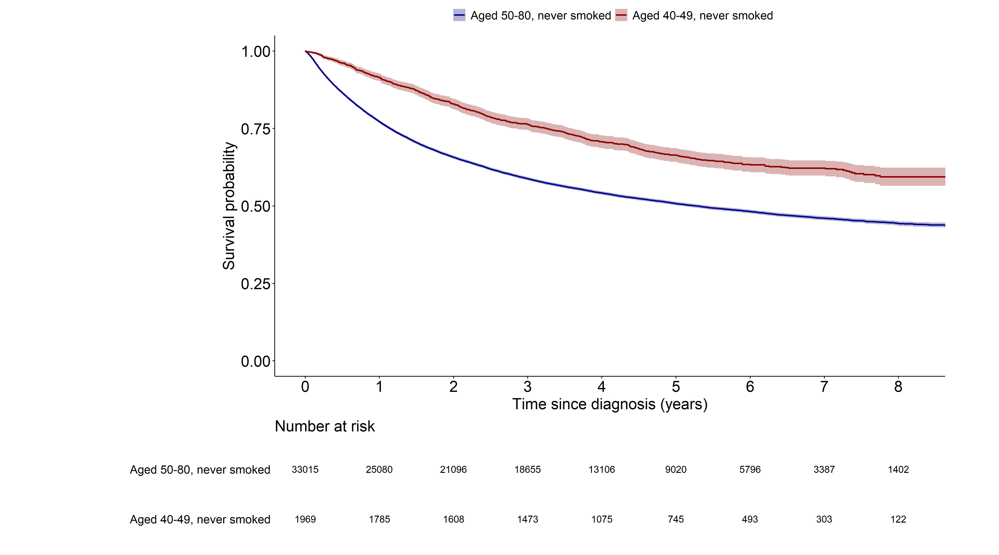
 | Aged, 50-80, never smoked
Aged, 40-49, never smoked | <0.001

Slide 21
All cause mortality(1.Included in the analysis, 2.Excluded from the analysis)

Slide 22
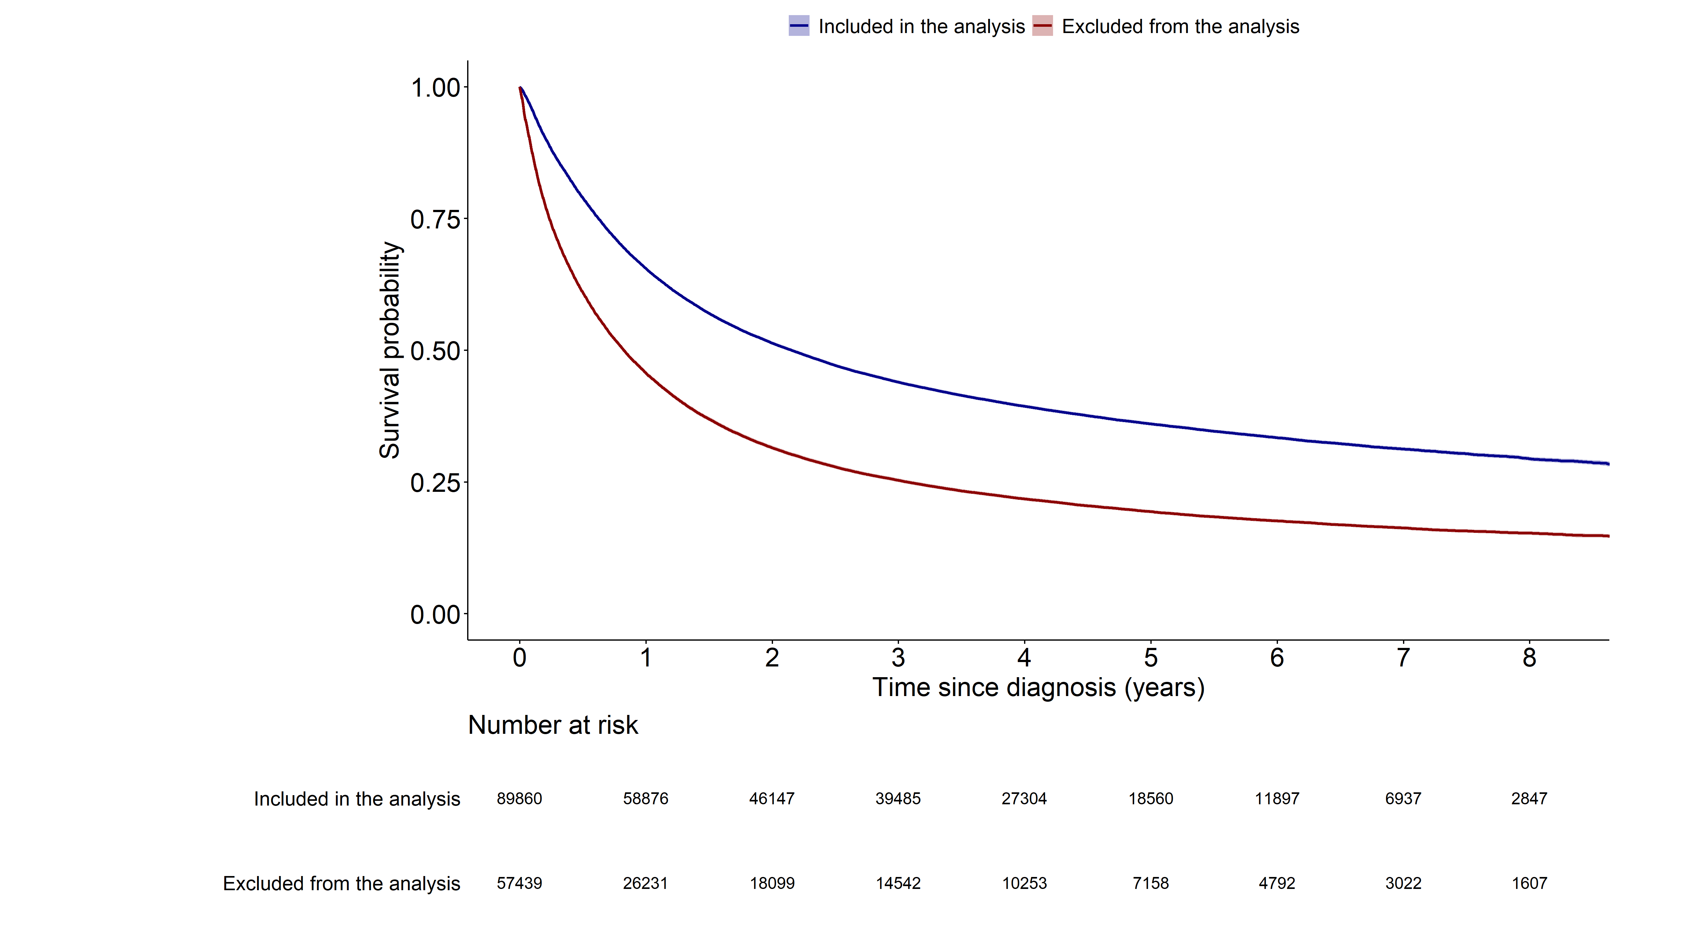
 | Included in the analysis
Excluded from the analysis | <0.001

Slide 23
Lung cancer mortality(1.Included in the analysis, 2.Excluded from the analysis)

Slide 24
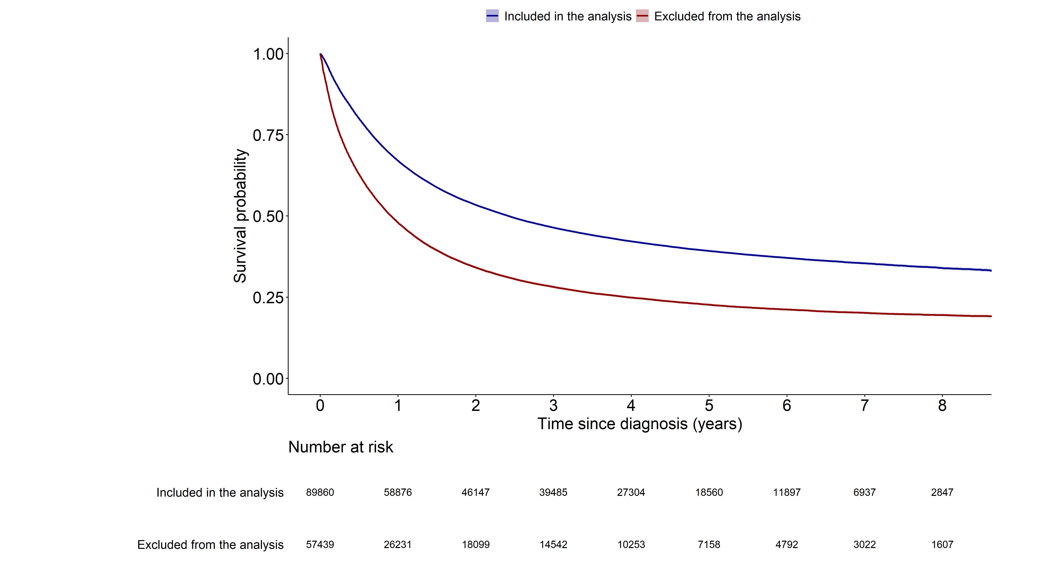
 | Included in the analysis
Excluded from the analysis | <0.001

