Slide 1
Algorithms
Term Project
Group 26
TH Yang
Jan 11, 2018

Slide 2
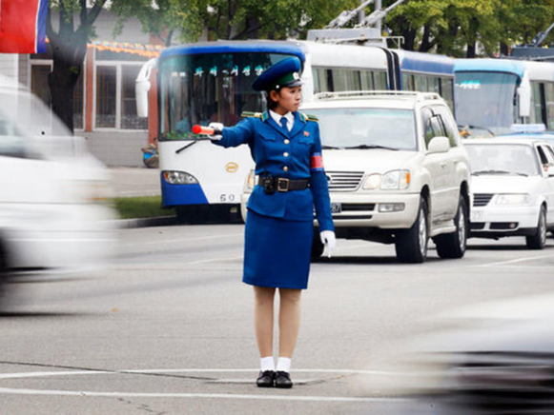
Intersection Manager (abbr. IM)
Four sequences of cars are waiting to pass
Schedule their priority of passing the intersection
No conflict allowed for cars scheduled in each round
Objective: Minimize the average waiting time
http://www.arabnews.com/sites/default/files/styles/ph3_660_400/public/14/05/2016//1449735505033829100.jpg?itok=oEjWeDX5

Slide 3
IM_{D} ∈ NP
Existence of prj_v3.zip/checker may support this :)
It’s easily to check if output fits input and meets given bound.
  Same car appears exactly once in the same or later round, in the same order as input.
  All cars are not conflict in each round.
  Average waiting time meets given upper bound.

Slide 4
How to solve IM problem?
(Average waiting time) = (Total waiting time) / (Total number of cars)
Total number of cars is in constant with given input
Objective: Minimize total waiting time
We need to look into every possible decision.
Construct decision tree; record latency respectively
Explore branches, find minimal sum of latency

Slide 5
Root
N:1S
S:1N
1
N:1S
E:1N
1
E:1N
W:1E
0
S:1N
1
W:1E
1
- N: 1S 00 00
- E: 1N 00 00
- S: 1N 00 00
- W: 00 1E 00
W:1E
0
S:1N
0

Slide 6
IM is pseudo-polynomial
How wide is the decision tree?
Each node has 3 children at most
number of child: 1 ~ 3
How deep is the decision tree?
Each round can consume 2 cars at most
depth: n/2 ~ n
Hard to estimate from size of input(number of cars)

Slide 7

Construct the entire tree?
Got the best solution in 5 public cases. But…
public_cases\input_5.txt costs 6.5 seconds.
case1 didn’t stop after several days!
Heuristic method: sacrifice optimality
任何的搜尋問題中，每個節點都有 b 個選擇以及到達目標的深度 d ，一個毫無技巧的演算法通常都要搜尋 b^{d} 個節點才能找到答案。啟發式演算法藉由使用某種切割機制降低了分叉率（branching factor）以改進搜尋效率，由 b^{d} 降到較低的 b'。…啟發式為每個要解決特定問題的搜尋樹的每個節點提供了較低的分叉率，因此它們擁有較佳效率的計算能力。(https://zh.wikipedia.org/wiki/启发式搜索)
Cut off some branches
http://tbnews.com.tw/uploads/allimg/140815/21-140Q5164305W5.jpg

Slide 8
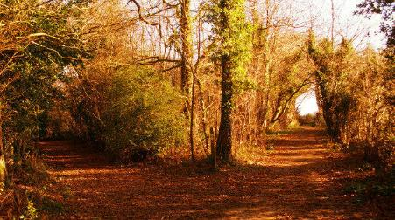

Two roads diverged in a yellow wood,
And sorry I could not travel both.
Branch scheduling lanes with more cars is prior
Always preserve 2 branches at most
Probability of preserving only 1 branch increases with the depth of the tree.
Prevent from too many forks [O(2^{depth})→O(depth)]
We should bound the size tightly
  But adjusting boundary parameters is a strange job
http://mediad.publicbroadcasting.net/p/radiowest/files/styles/medium/public/201511/road_not_taken_.jpg

Slide 9
Effect of heuristic method
(60%) Correctness
(20%) Quality
(15%) Runtime
( 5%) Memory
Sacrifice Quality to exchange for acceptable Runtime
Loosen boundary resulting in worse Runtime and unchanged Quality
Exploring 10⁸ nodes costs about 9 minutes on my laptop

Slide 10
Procedure
Root
N:1S
S:1N
1
N:1S
E:1N
1
E:1N
W:1E
0
S:1N
1
W:1E
1
Declare global state
Main()
Read in input file, parse file into state
Explore(root)
Parse the best arrangement from the tree, create output file
Explore(node n)
Calculate Avail = {all possible arrangements at this state}
Use heuristic method to reduce |Avail| to 2 or 1
for each arrangement in Avail
Construct c as child of n
Practice arrangement, update state
Store arrangement used and latency caused by this step in c
Explore(c)
Rollback state
Delete branches with non-minimum sum of latency
W:1E
0
S:1N
0

Slide 11
Result
 | Input1 | Input2 | Input3 | Input4 | Input5 | Case1 | Case5 | Case10
Total rounds | 2 | 63 | 55 | 48 | 69 | 22414 | 349672 | 1928797
Average round | 0.666667 | 3.31579 | 2.75 | 3 | 3.45 | 69.8255 | 246.075 | 640.371
Nodes explored | 9 | 3240 | 5224 | 2286 | 35521 | 429891 | 2835494 | 10227
Runtime (second) | 0.020 | 0.045 | 0.038 | 0.054 | 0.090 | 0.853 | 12.954 | 0.136

Slide 12
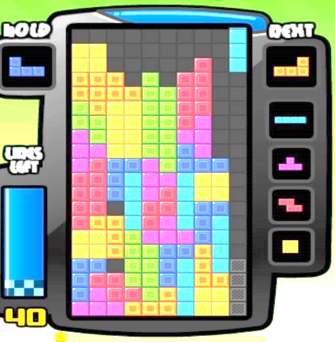
Extensions?
From off-line to on-line?
  “Epilogue: Algorithms That Run Forever”
  On-line IM involves data flow.
  Only focus on first k rounds is possible.
  k is small enough to not using heuristic.
Multiple lanes in each direction?
  Maybe alternate conflict() to looking up a table
k
https://i.ytimg.com/vi/pLpjkD7nmhs/maxresdefault.jpg

Slide 13

Thanks for your listening
https://www.cats.org.uk/uploads/images/featurebox_sidebar_kids/grief-and-loss.jpg

