Slide 1
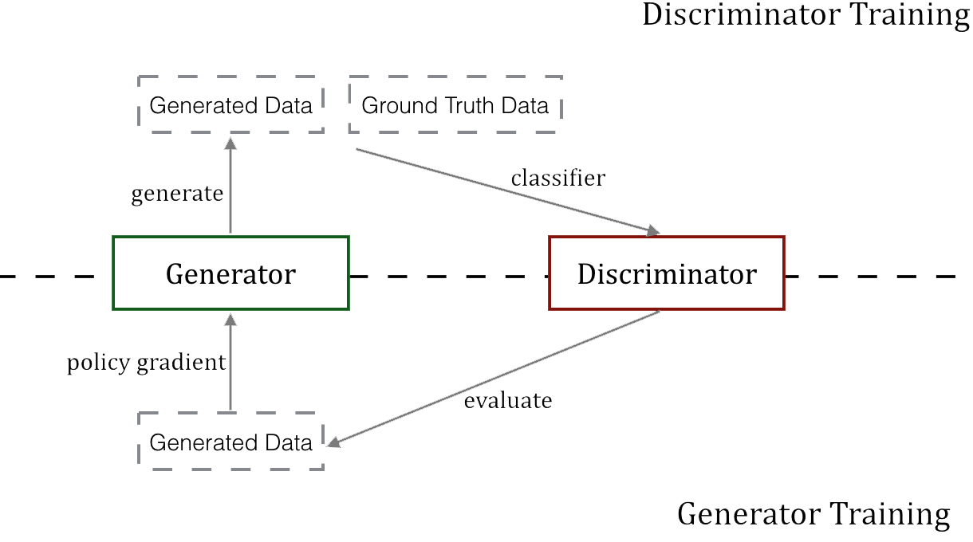
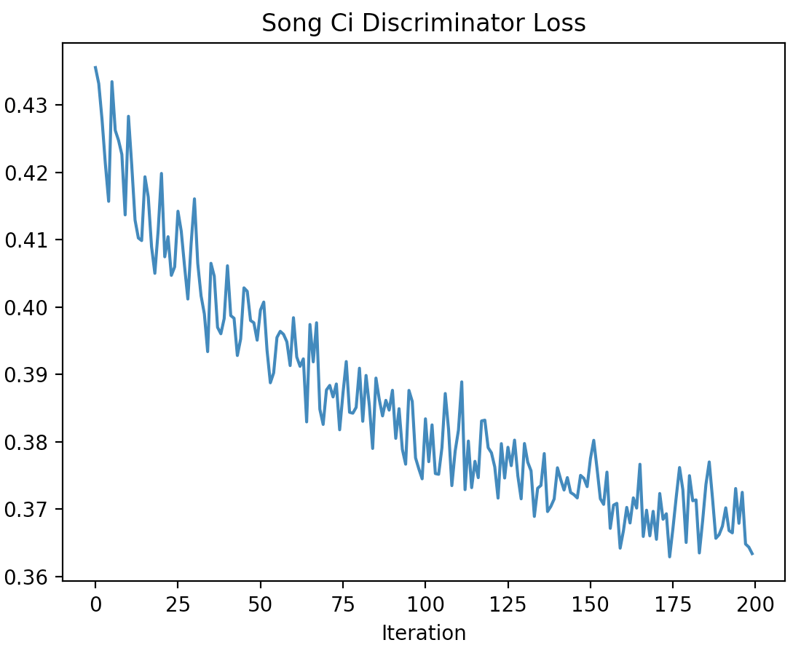
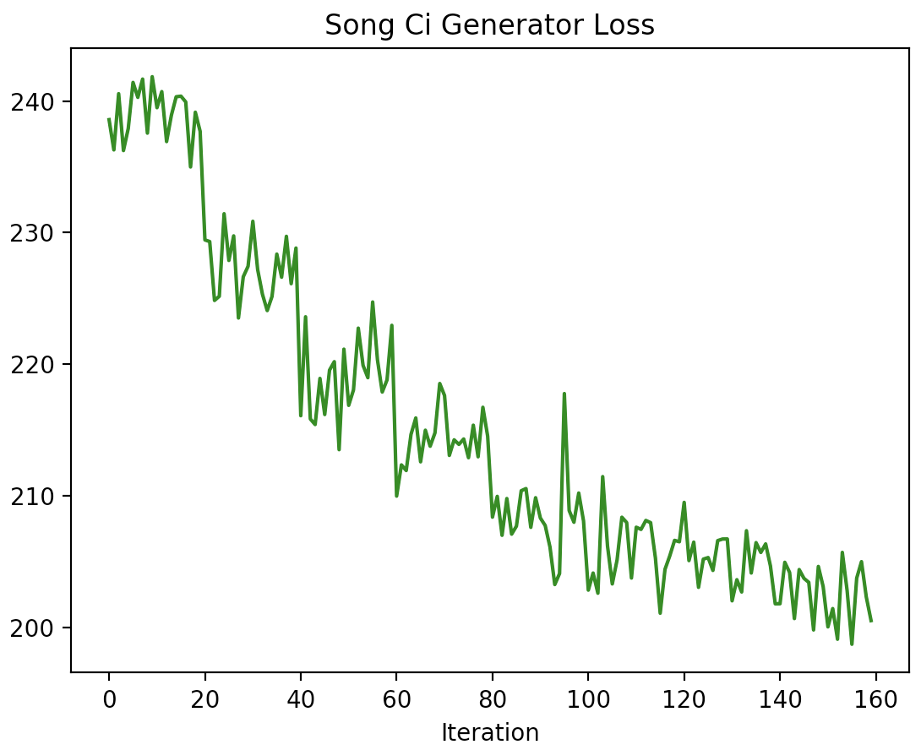
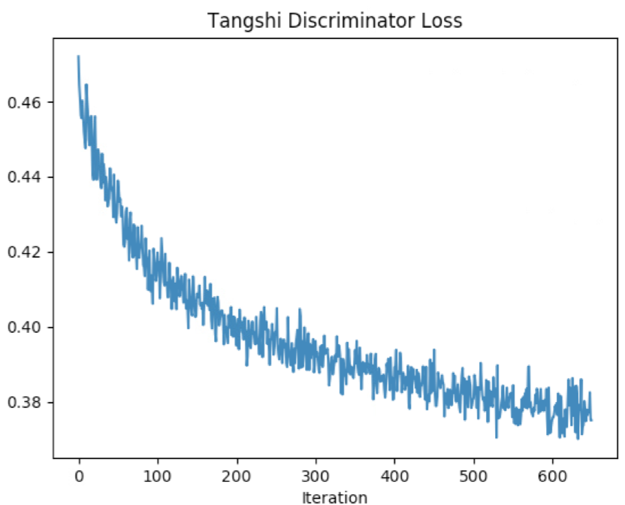
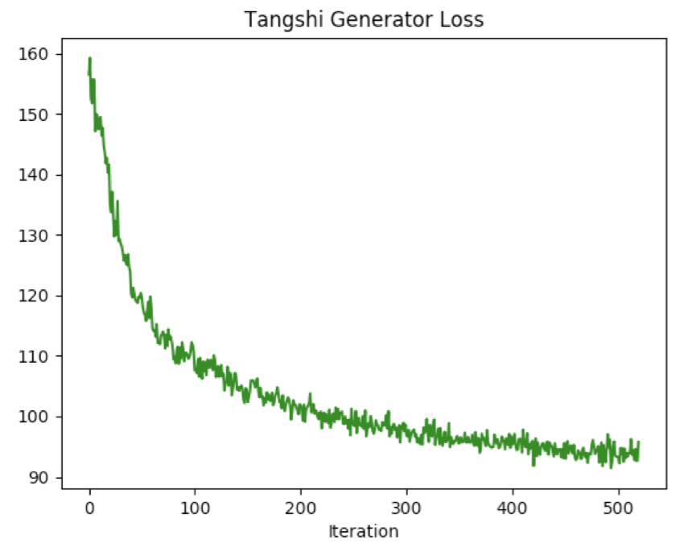
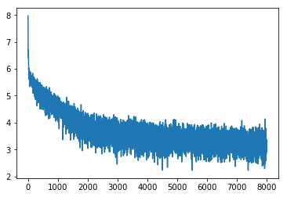
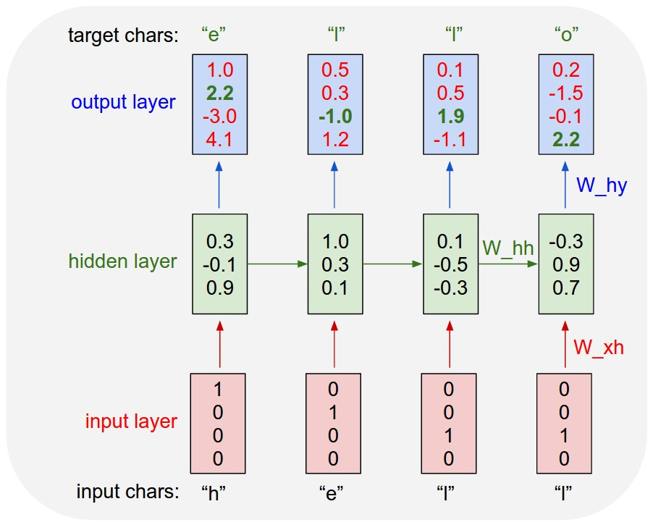
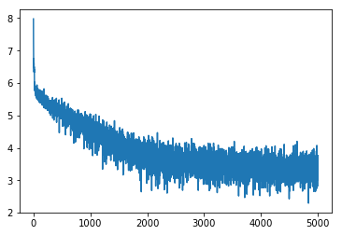
Generating Chinese Poetry with Recurrent Neural Network
Yang Tian, Wenhao Yu
Introduction
Seq GAN
Recurrent neural network (RNN) has been widely used in Natural Language Processing (NLP). In particular, Long short term memory network (LSTM) outperforms vanilla RNN thanks to its robust through-time gradient computation. Character level RNN has been utilized as language generation model^{[1]}. The network structure is straightforward but it is so powerful that researchers use it to generate Paul Graham’s essays, Shakespeare’s scripts and even Linux source code.
Chinese generation, on the other hand, presents a different set of challenges from English. One such challenge is that each Chinese character denotes a single complete meaning. In other words, Chinese is sparser than English. This makes Chinese poetry generation a challenging but interesting task. In this project, we explore a few approaches for training generative models that ‘writes’ Chinese poetries.
Character-level RNN model suffers from exposure bias [2], which causes trouble in generating long sequences using the trained model. In machine translation, one can use reinforcement learning to directly optimize BLEU metric for the generated sentences. However, for tasks like poem generation, we don’t always have such a metric. In the work by Yu et al [3]. , they proposed to use the idea of Generative Adversarial Network to learn such a metric for sequence generating problems, thus they named their algorithm SeqGan. In this project, we tested the effect of using SeqGan for Chinese poetry generation.
Character-level RNN
Character level RNN takes a single character from a chunk of text and predicts the probability of next character over the characters vocabulary. In the training phase, we have ground truth of next character and will use gradient-based method, such as Adam, to minimize the loss between desired and predicted characters. At next step, we will supply the next true character and desire the next two character. In the validation/testing phase, we will draw sample from a multinomial distribution which is parameterized by the outputs of RNN. We could control the diversity of sample by adjusting the hyper-parameter, temperature. The lower temperature will lead to the less diverse results and vice versa.
Results
We evaluate SeqGan on two tasks: Songci Generation and Tangshi Generation. Songci contains longer paragraphs with varying setence length, while Tangshi is more regular.
牀
前
看
月
光
，
疑
是
地
上
霜
。舉頭望山月
，低頭思故鄉
。
前
看
月
光
，
疑
是
地
上
霜
。舉頭望山月
，低頭思故鄉
。
<EOP>
Embedding encoder
LSTM
LSTM
Linear decoder
Song Ci
A few technical points for performance improvement:
Dropout in embedding and LSTM unit
Gradient clip to avoid gradient explosion
Weight initialization in range of [-0.1, 0.1]
Tang Shi
Results
Song Ci Results:
1.春遊古城非學，白雨作楚相。不辭山樓觀不見，來朝白浪忽。四方急追，意行無乃天。不辭山陽曉，自古不留觀。
君看巧更，不見樓中天。不辭山心汲汲，此心浩難。不能從高來，但使遠行看無留。不能孤石上，應怪此能獨眠。
2.我本山中人，此語與時。不辭山似雪，萬事無事無。歸來自偃，不須鳴百回。我本不自勝，不見空自知。古人不見，
來朝白浪忽已今。不辭山陽曉，自古不留觀。君看巧更，不見樓中天。不辭山心汲汲，此心浩難。不能從高來
"predicted = solver.evaluate(start_with='牀前看月光', temperature=0.1)",
"print("length: %d, %s" % (len(predicted), predicted))”
"length: 48, 牀前看月光，疑是天上春。山川摇白雪，飒入琼楼卧。夷齐游春草，因人不可见。何时不可见，惆躇泪相待。”
"predicted = solver.evaluate(start_with='牀前看月光', temperature=0.2)",
"print("length: %d, %s" % (len(predicted), predicted))”
"length: 24, 牀前看月光，望入白铜鞮。江城回渌水，花月使人迷。”
"predicted = solver.evaluate(start_with='牀前看月光', temperature=0.4)",
"print("length: %d, %s" % (len(predicted), predicted))”
"length: 24, 牀前看月光，舟出白水亭。明月落如梦，早断愁何思。”
"predicted = solver.evaluate(start_with='牀前看月光', temperature=0.8)",
"print("length: %d, %s" % (len(predicted), predicted))”
"length: 36, 牀前看月光，独当送人樽。春风发有情，秋风笑何行。戍生安见此，泪向眼中人。”
"predicted = solver.evaluate(start_with='牀前看月光', temperature=1.0)",
"print("length: %d, %s" % (len(predicted), predicted))”
"length: 36, 牀前看月光，幽窗峨汉去。花下如飖花，刀曲远流山。天杯有已鸟，空笑生迁游。"
Char-RNN
SeqGan
1.春遊古城自不可悲，誰取誰石得似。不能從我來，但使遠行看無留。不能孤石上，應怪此能獨眠。不如此不留，
不見樓中亦何人，但見野水浮。君看巧更幾，白花摇江江水。我欲然三百尺，此意誰復遺。君先去，此心浩難
2.我本山中人，此語與時。不辭山似雪，萬事無事誰所之。天人不復見，夜來如仙子。吾觀不死同，不見樓中夜人。
山川同一色，萬人事所難。不能從我來，但使遠行看無留。不能孤石上，不愛此誰所安。不能從我知，此語可憐
Tang Shi Results:
1.春陽如若花，一朝風亭。長風入少室，飄落成飛蓬。
2.白玉一杯，綠楊三月時。春風開紫玉，千春愁已成。
Char-RNN
1.春陽如若花馬，樓騎五花明。五馬一事萬人，爲君前看。
2.白玉誰家子，風流天下聞。白水綠水，一見平生。寄言向一水，空悲遠行。春風無事，豈爲漢帝王。
前
看
月
光
Topics oriented poetry generation
We are also interested in supplying the RNN with extra gist so that the generated poetry is related to the given topics. We first cut poetry lines according to parts of speech and only retain noun related words. Then we build topics dictionary and use bag of words to generate topics for training data. Finally PCA is used to reduce the dimensionalities of topic representation to the size of LSTM hidden state so that they can be used as initial hidden state.
SeqGan
References
[1] The Unreasonable Effectiveness of Recurrent Neural Networks, https://karpathy.github.io/2015/05/21/rnn-effectiveness/
[2] Yu, L., Zhang, W., Wang, J., & Yu, Y. (2017, February). SeqGAN: Sequence Generative Adversarial Nets with Policy Gradient. In AAAI (pp. 2852-2858).
[3] Bachman, P., and Precup, D. 2015. Data generation as sequential decision making. In NIPS, 3249–3257.
"predicted = solver.evaluate(start_with='牀前看月光', temperature=0.1, topics=["霜","月光","故鄉"])",
"print("length: %d, %s" % (len(predicted), predicted))”
"length: 24, 牀前看月光，疑是地上时。春风吹不尽，总是酒离情。”
"predicted = solver.evaluate(start_with='牀前看月光', temperature=0.2, topics=["霜","月光","故鄉"])",
"print("length: %d, %s" % (len(predicted), predicted))”
"length: 48, 牀前看月光，花明玉亭亭。山花娇欲醉，檐燕语飞飞。曲在竹庭空，空声弄云里。晚晚送君别，相思不见君。”
"predicted = solver.evaluate(start_with='牀前看月光', temperature=0.4, topics=["霜","月光","故鄉"])",
"print("length: %d, %s" % (len(predicted), predicted))”
"length: 24, 牀前看月光，水绿月如飞。山莺若未尽，更是别离情。”
"predicted = solver.evaluate(start_with='牀前看月光', temperature=0.8, topics=["霜","月光","故鄉"])",
"print("length: %d, %s" % (len(predicted), predicted))”
"length: 36, 牀前看月光，霜里艳江叶。弄月落万里，孤花落玉头。空看向明月，飞笑吹红钩。”
"predicted = solver.evaluate(start_with='牀前看月光', temperature=1.0, topics=["霜","月光","故鄉"])",
"print("length: %d, %s" % (len(predicted), predicted))”
"length: 24, 牀前看月光，饮船夜生寒。蚕稽起无妓，舟落更长还。"
牀
前
看
月

