Slide 1
Bridging the Gap between Cameras
By Dimitrios Makris, Tim Ellis, James Black,
Digital Imaging Research Centre,
@ Kingston University, Kingston-upon-Thames, Surrey, UK.

Slide 2
Idea
Network of cameras
  Overlapping viewfields
  Blind spots
Problem: design automated system to determine camera connectivity
  Topology
  Temporal and spacial information
Network calibration

Slide 3
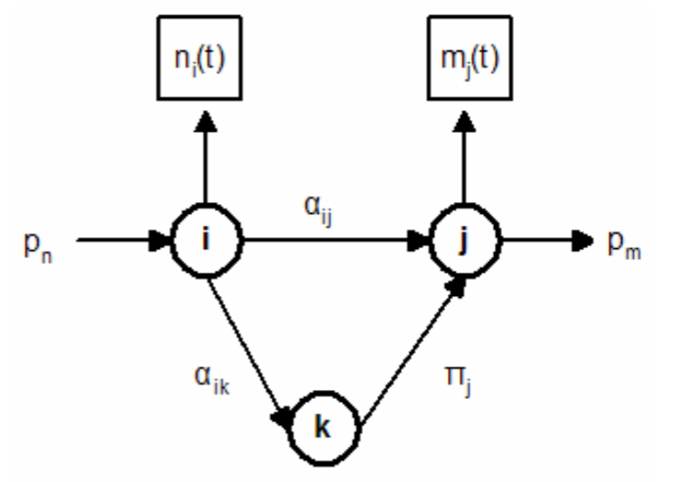



Graphical Model

Slide 4

Implementation
Initially, N entry/exit zones are learnt using Expectation Maximization over an dataset of observed trajectories.
The network of N entry/exit zones is represented as a Gaussian mixture model.
Each new entry/exit point x is classified to the y-th entry/exit zone using maximum-a-posteriori (MAP).

Slide 5
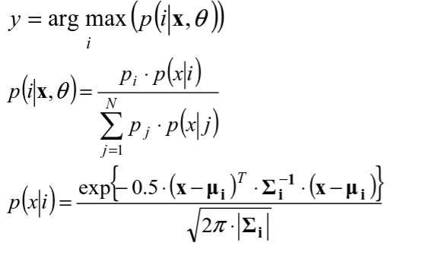

Slide 6

Update Cross-Correlation
For each exit-entry pair i → j, accumulate events of disappearance at i and appearance at j within some time T.
Let t1 be the time when there's a disappearance at i, and t2 be the time when there's an appearance at j.

Slide 7




Estimate Covariance
If there exists a valid link between exit i and entrance j, then we have a peak at Cij.
We take the peak that are above a threshold and use that to define the transition probabilities.

Slide 8

Implications
If transition time is approximately 0, then the two cameras are looking at overlapping zones.
If transition time is strictly positive, then there's an unseen zone between the 2 cameras.
If transition time is strictly negative, then the two zones are partially or completely visible in both cameras.

Slide 9
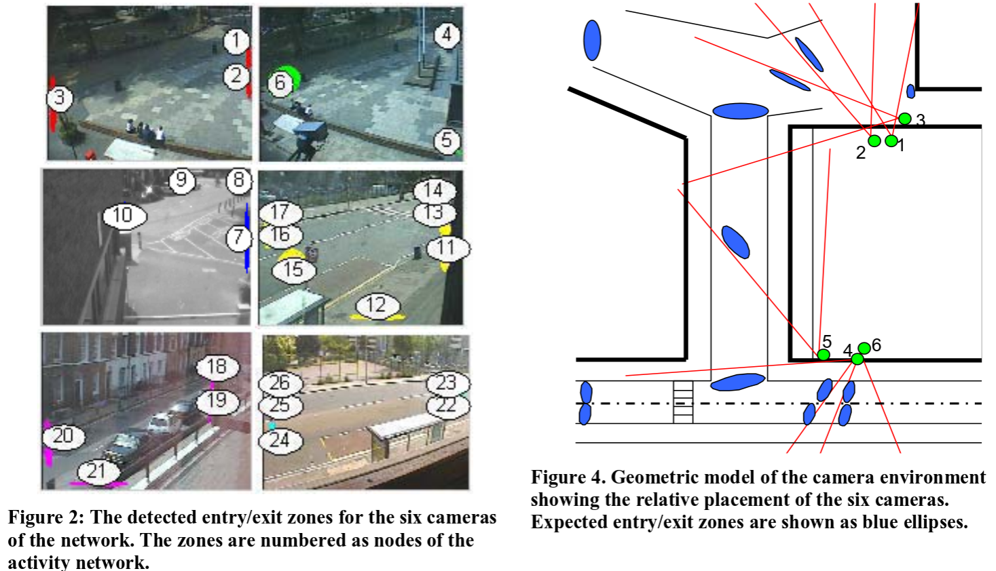
Experimental Results
6 cameras, 13 hours

Slide 10
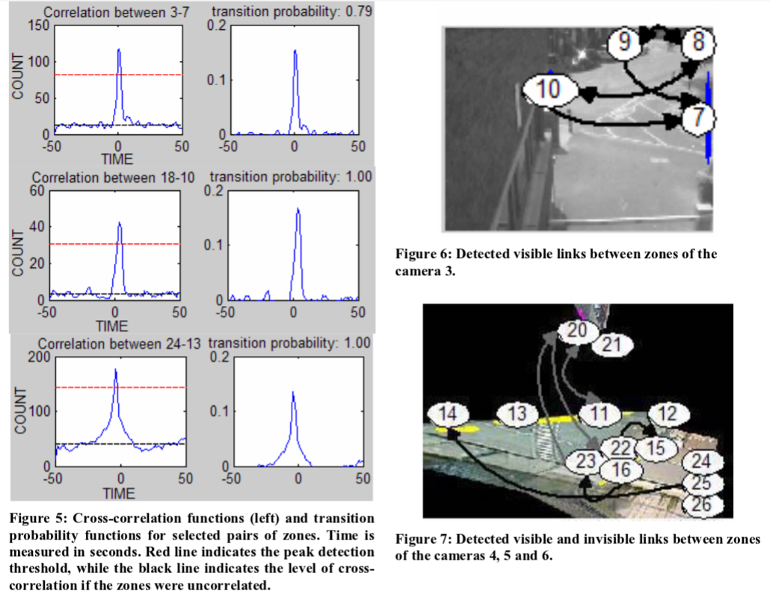
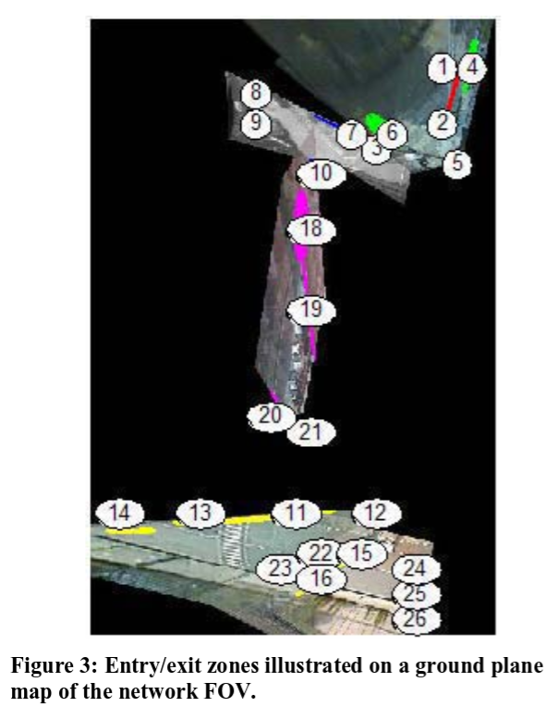

Slide 11
Remarks
Redundant links
  Filtering them is for future research
The total transition probability for some links is equal to 1.
  No uncertainty about the motion of the targets across these links.
  Justified by the fact that most of the links represent restricted traffic flow.

Slide 12
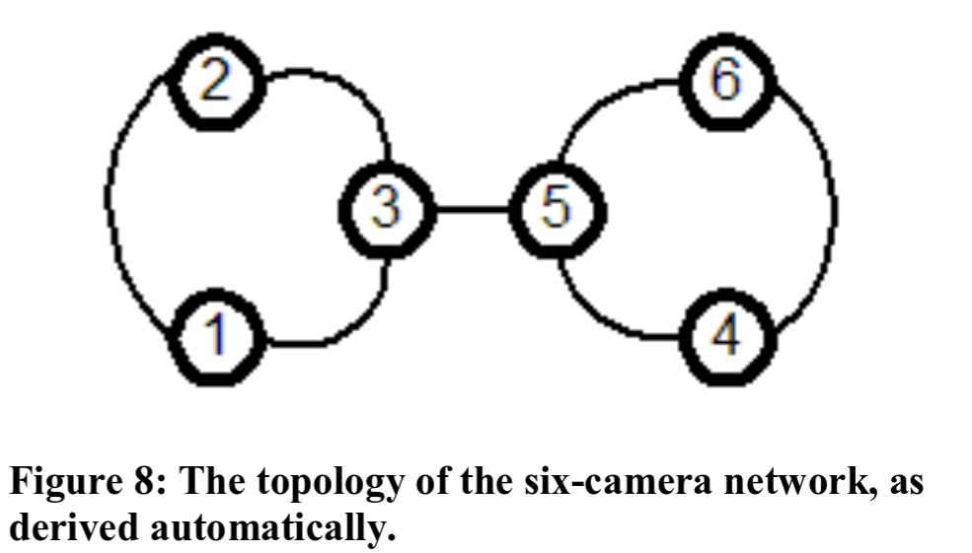
Topology
For each pair of cameras, any link between the cameras with a transition time not too large indicates a correspondence.
  Whether two cameras are disjoint, adjacent or overlapping is determined with the sign of the transition times between their zones.

