Slide 1
My Capstone Project
A common problem in travelling overseas is choosing where to stay
Even among cities, each district or borough comes along with its unique and distinct experiences
This project is meant to provide an analysis based on the venues and activities we are interested in such as food, shopping or other recreational activities
At the end, we should be able to identify the differences in surroundings between the 4 main attractions in Paris and using it as part of our decision-making process based on our own personality and interests

Slide 2
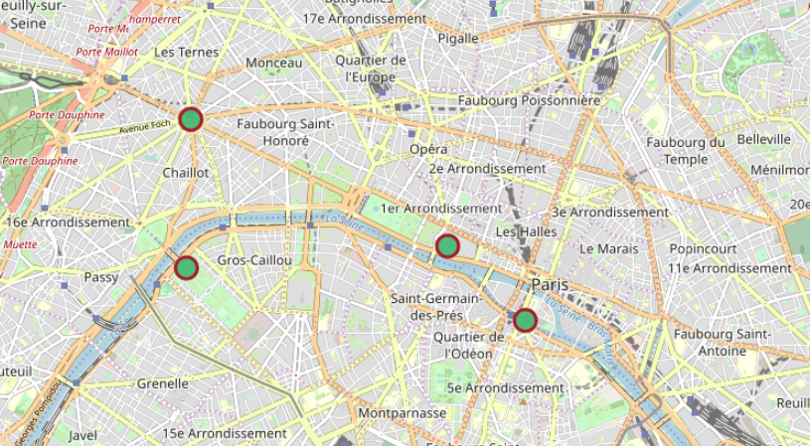
Map Visualization
Arc de Triomphe
Musee du Louvre
Tour Eiffel
Notre Dame de Paris

Slide 3
Map Visualization
Based on the map, here are some factors that may affect our decision.
River Seine is quite some distance from Arc de Triomphe. May not be ideal if we want to enjoy breakfast by the river
Musée du Louvre & Notre Dame de Paris are very close together so deciding to stay near either location has the added advantage of being able to visit both attractions easily within a day

Slide 4
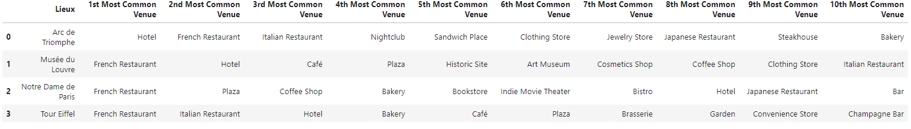
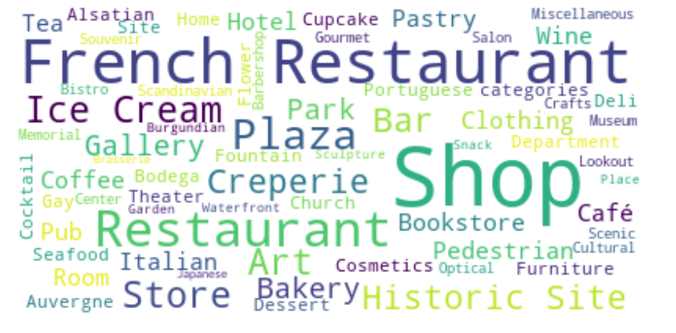
Most common venues per attraction
Word Cloud Visualization

Slide 5
Venue Analysis
Musée du Louvre seems to be an ideal shopping destination for the ladies, with a myriad of plazas and cosmetic shops. A much-needed rest for the feet can be enjoyed in the multitude of cafes and bars too.
Notre Dame de Paris has the most diverse and international culinary selections, with burgers, Mexican & Japanese food. It seems to be the ideal location for those who want a laidback experience away from the stereotypical Paris stuff and do some chill book shopping in the many bookstores in the area.

Slide 6
Venue Analysis
Arc de Triomphe seems to be the ideal destination for single men, but they might want to think twice if travelling with their romantic partner since jewelry stores are aplenty in the area. Otherwise, it seems like a men’s paradise with men’s shops, nightclubs and movie theatres to occupy themselves with to avoid being their spouses’ personal butler for another day.
Tour Eiffel offers the ultimate Paris experience. With 1 or 2 trips to any of the top notched French / Italian restaurants, that will ensure you end up eating bread for the rest of your stay, which is convenient because there are many bakeries and even more gardens where you can just sit and take in the sights (for free!)

Slide 7
Conclusion
Using the information and analysis provided in this project, it provides a determinate linkage between our choice of hotel and the type of neighborhood venues we are interested in. We can explore other cities and compare the boroughs as it has been done in this example. There is only so much leave we get as working adults and in order to maximize our experience, it is best to do our due diligence beforehand.

Slide 8
End
Thank you for joining

