Slide 1
Simulation of Correlated Single-Cell RNA-Seq Data and Evaluation of Co-Expression eQTL Mapping Methods
Yutong Liu
4.24

Slide 2
Contents
Introduction
Simulation
Method Comparison
Discussion

Slide 3
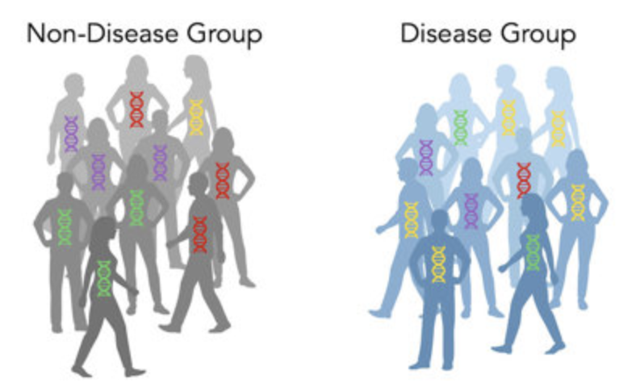
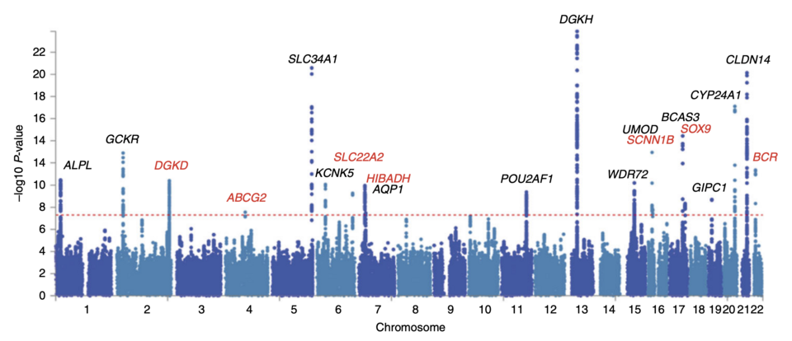
Introduction
GWAS
？
Notes:
People have been interested in genetic risky factors and mechanisms for complex disease since the inception of genetics. Thanks to sequencing techniques, GWAS provides an initial step by identifying SNPs related to disease status. There have been 128,550 associations and over 4,000 publications reported in the GWAS catalog.
Although GWAS is a big success, like significant SNP identified around gene IL28B facilitated the development of personalized Hepatitis C treatment. However, most GWAS variants are hard to interpret, because of reasons like linkage disequilibrium makes it hard to identify the truly causal SNP, complex disease often implicates interactions of multiple cell types, it is unclear which cell types are the true drivers of a disease (i.e., in which cell type GWAS variants act) and which are the consequence of the disease pathogenic processes, and 90% GWAS variants falling in non-coding regions, which does not directly affect the coding sequence of a gene.

Slide 4
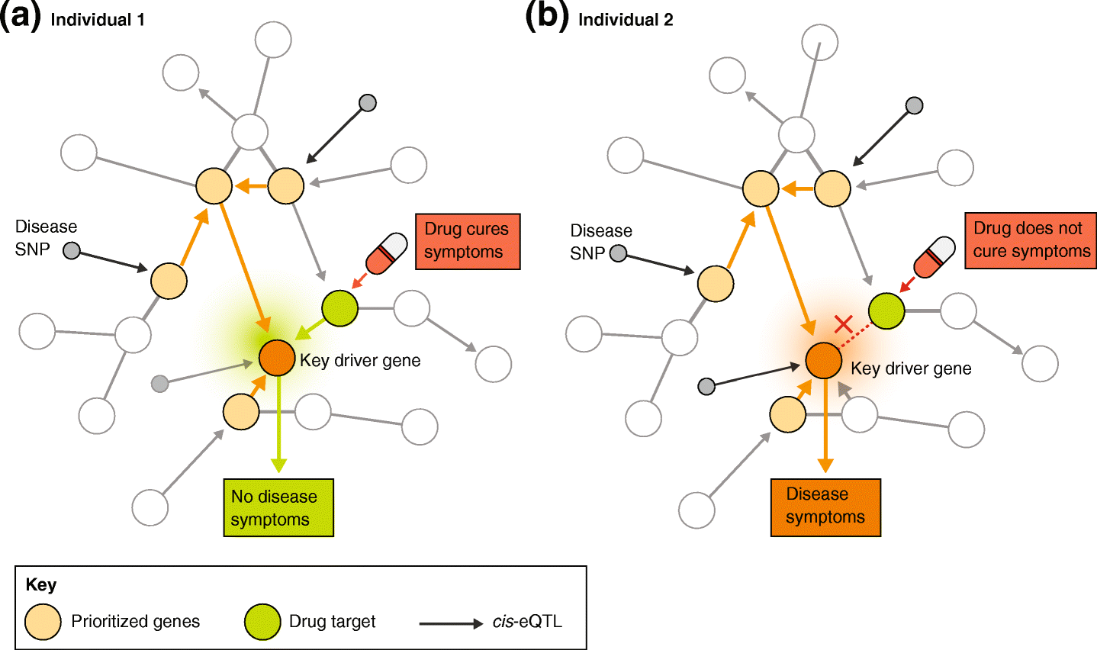
Introduction
[1] van der Wijst, M.G.P., de Vries, D.H., Brugge, H. et al. An integrative approach for building personalized gene regulatory networks for precision medicine. Genome Med 10, 96 (2018). https://doi.org/10.1186/s13073-018-0608-4
Notes:
Considering that, many studies seek to build gene regulatory networks, and based on them, we found we not only care about the eQTL variants, but also variants could modify the correlation of 2 genes in the network. Like in this figure, there are regulatory network for 2 different individual, the orange dot is the key drive genes for a specific disease, and the green dot is the drug target gene for the disease, the yellow ones are genes activated and associated with the regulation of the disease. The only difference for the 2 individual is that, some variants changed the relationship between the drug target and disease key drive gene, which can be seen as a co-expression eQTL. Because of it, when the two individuals take the same drug, there would be different treatment outcome. The individual with co-expression between would be cured, but the one without would still be diseased. That’s the motivation for co-expression eQTLs, which is identify variants could affect the co-expression of 2 genes.

Slide 5
Introduction
Co-expression eQTL
[1] van der Wijst, M.G.P., de Vries, D.H., Brugge, H. et al. An integrative approach for building personalized gene regulatory networks for precision medicine. Genome Med 10, 96 (2018). https://doi.org/10.1186/s13073-018-0608-4
Notes:
Considering that, many studies seek to build gene regulatory networks, and based on them, we found we not only care about the eQTL variants, but also variants could modify the correlation of 2 genes in the network. Like in this figure, there are regulatory network for 2 different individual, the orange dot is the key drive genes for a specific disease, and the green dot is the drug target gene for the disease, the yellow ones are genes activated and associated with the regulation of the disease. The only difference for the 2 individual is that, some variants changed the relationship between the drug target and disease key drive gene, which can be seen as a co-expression eQTL. Because of it, when the two individuals take the same drug, there would be different treatment outcome. The individual with co-expression between would be cured, but the one without would still be diseased. That’s the motivation for co-expression eQTLs, which is identify variants could affect the co-expression of 2 genes.

Slide 6
Introduction
Goal: whether co-expression of two genes affected by genotype
Statistical test:
H₀: β₁ = 0
Given: ∑ = β₀ +β₁ g
Data: single-cell RNA-Seq data
Cell 1 Cell 2 … … Cell m
Gene 1
Gene 2
…
Gene n
Ind 1 Ind 2 Ind 3
Notes:
Although CS-CORE measures co-expression, we still need a new method in detecting co-eQTL because of the difference in goal, data, and statistical test. the goal of CS-CORE is to see whether 2 gene are co-expressed, and for co-eQTL is to see whether co-expression of two genes are affected by genotype.
The data for CS-CORE use cells form the same individual, while in co-eQTL identification, we need to deal with cells from different individuals, which may violate the assumption of independent cells, and for statistical test, CS-CORE test whether the correlation between 2 genes are equal to 0, while for co-eQTL identification, we try to model the co-expression by genotype and test whether beta1 (the coefficient for genotype) equal to 0.

Slide 7
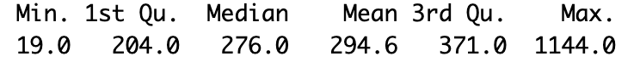
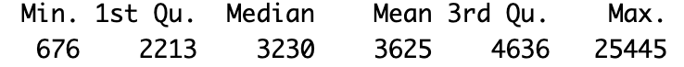
Simulation
Goal:
2 genes whose co-expression modulated by genotype
Data: OneK1K data - 981 individuals 289000 CD4 TCM cells
Number of cells in each individual:
Sequencing depth:
Notes:
The goal of my simulation is to get two genes whose co-expression is modulated by genotype. As for our simulation, we borrow information from real data to mimic the real scRNA-Seq data as much as possible. We use OneK1K data with 981 individuals and 289000 CD4 TCM cells. The information used from the OneK1K data include number of cells in each individual and we can see it’s quite unbalanced, also sequencing depth which also have a big variance.

Slide 8
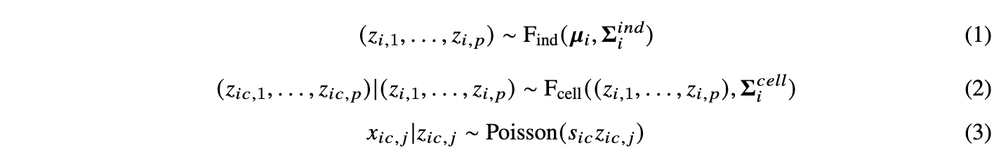
Simulation
Data: scRNA-Seq data
Model:
Cell 1 Cell 2 … … Cell m
Gene 1
Gene 2
…
Gene n
Ind 1 Ind 2 Ind 3
z: latent expression level
x: UMI count
s: sequencing depth
i: individual
c: cell
j: gene
Notes:
Based on all these difference, we will introduce a hierarchical model based on CS-CORE to help measure co-expression, but a little bit different. In both models, we see z as the latent expression level, x as the UMI count, s as the sequencing depth. i as the index for individual, c as index for cell and j for genes. both model see UMI counts follows a Poisson distribution determined by sequencing depth and latent expression level, but we add another layer of model to account for non-independence caused by repeated measurement within the same individual.

Slide 9

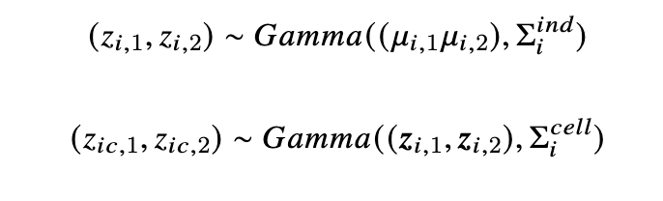
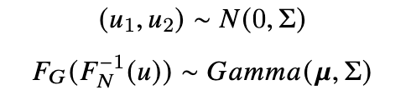

Simulation
Genotype:
Co-expression:
Copula:
Expression level (μ): based on the OneK1K data after SCTransform, with option: 100th, 200th, 400th, 800th, 1600th, 3200th
Notes:
There’s two parts in our simulation, firstly we simulate genotypes by binomial distribution. Then, we simulate the co-expression with the covariance modulated by genotype. Based on our model before, we use 2 layer of bivariate gamma distribution, and because there’s no closed form of bivariate gamma, we will use the copula to make our z correlated with specified correlation. and after get the latent expression, together with sequencing depth from real data, we can simulate the UMI counts.
To see how our method perform under different expression level, we tune the expression level mu based on real data, and set expression level of genes around 100th highest expressed gene, and 200,400, 800, 1600, and 3200.

Slide 10
Methods Comparison
Spearman-correlation-based method
Moment-based method (Memento)
Notes:
We compare our method with two current exist methods, the Spearman-correlation-based method and a Moment-based method (Memento). we also use the OLS estimator assuming iid random error epsilon from our model as a benchmark.

Slide 11
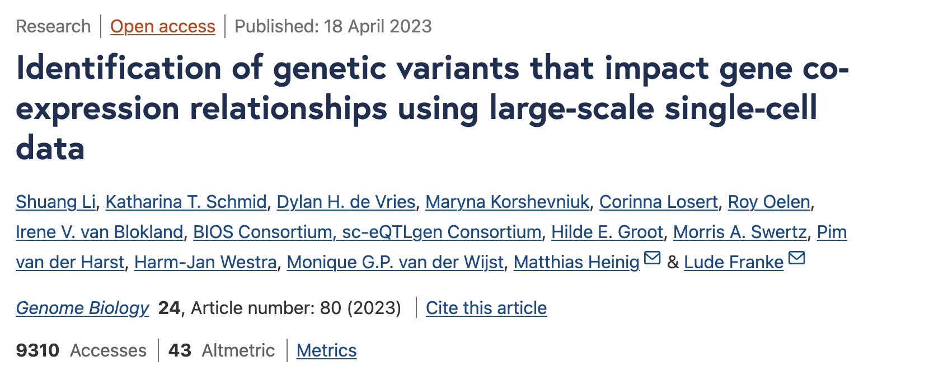
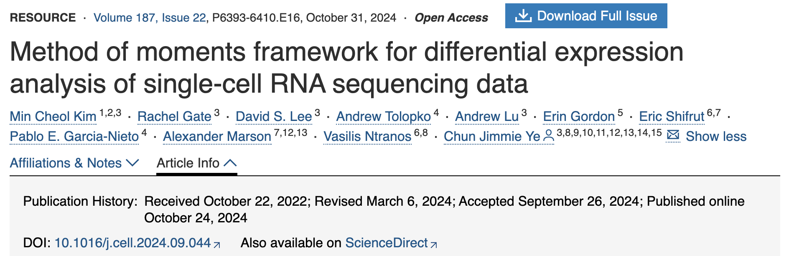
Methods Comparison
For individual i = 1, …, n, estimate ρ_{i}
Associate ρ_{i} with g_{i}, and test by correlation test statistics
Assuming a hypergeometric distribution for sequencing of scRNA-Seq
Estimate moments of gene expression, including μ, σ, and ρ
Fit linear model between ρ_{i} and g_{i}, and test by Bootstrap
Notes:
Both of the methods are two step method, firstly they estimate co-expression, and then test whether co-expression modified by genotype. For the first method, they estimate co-expression by spearman correlation rho, and test by significance of correlation between the rho and genotype.
For memento, they have a strong assumption for the scRNA-Seq data. they think the scRNA-Seq is like sample some mRNA from total mRNA from each cell using a specific sequencing efficiency (or to say selection rate), and based on the distribution, they estimate rho based on moments of the distribution, and they also link rho and genotype by linear model, but test by Bootstrap because they lack assumption of their residuals.

Slide 12
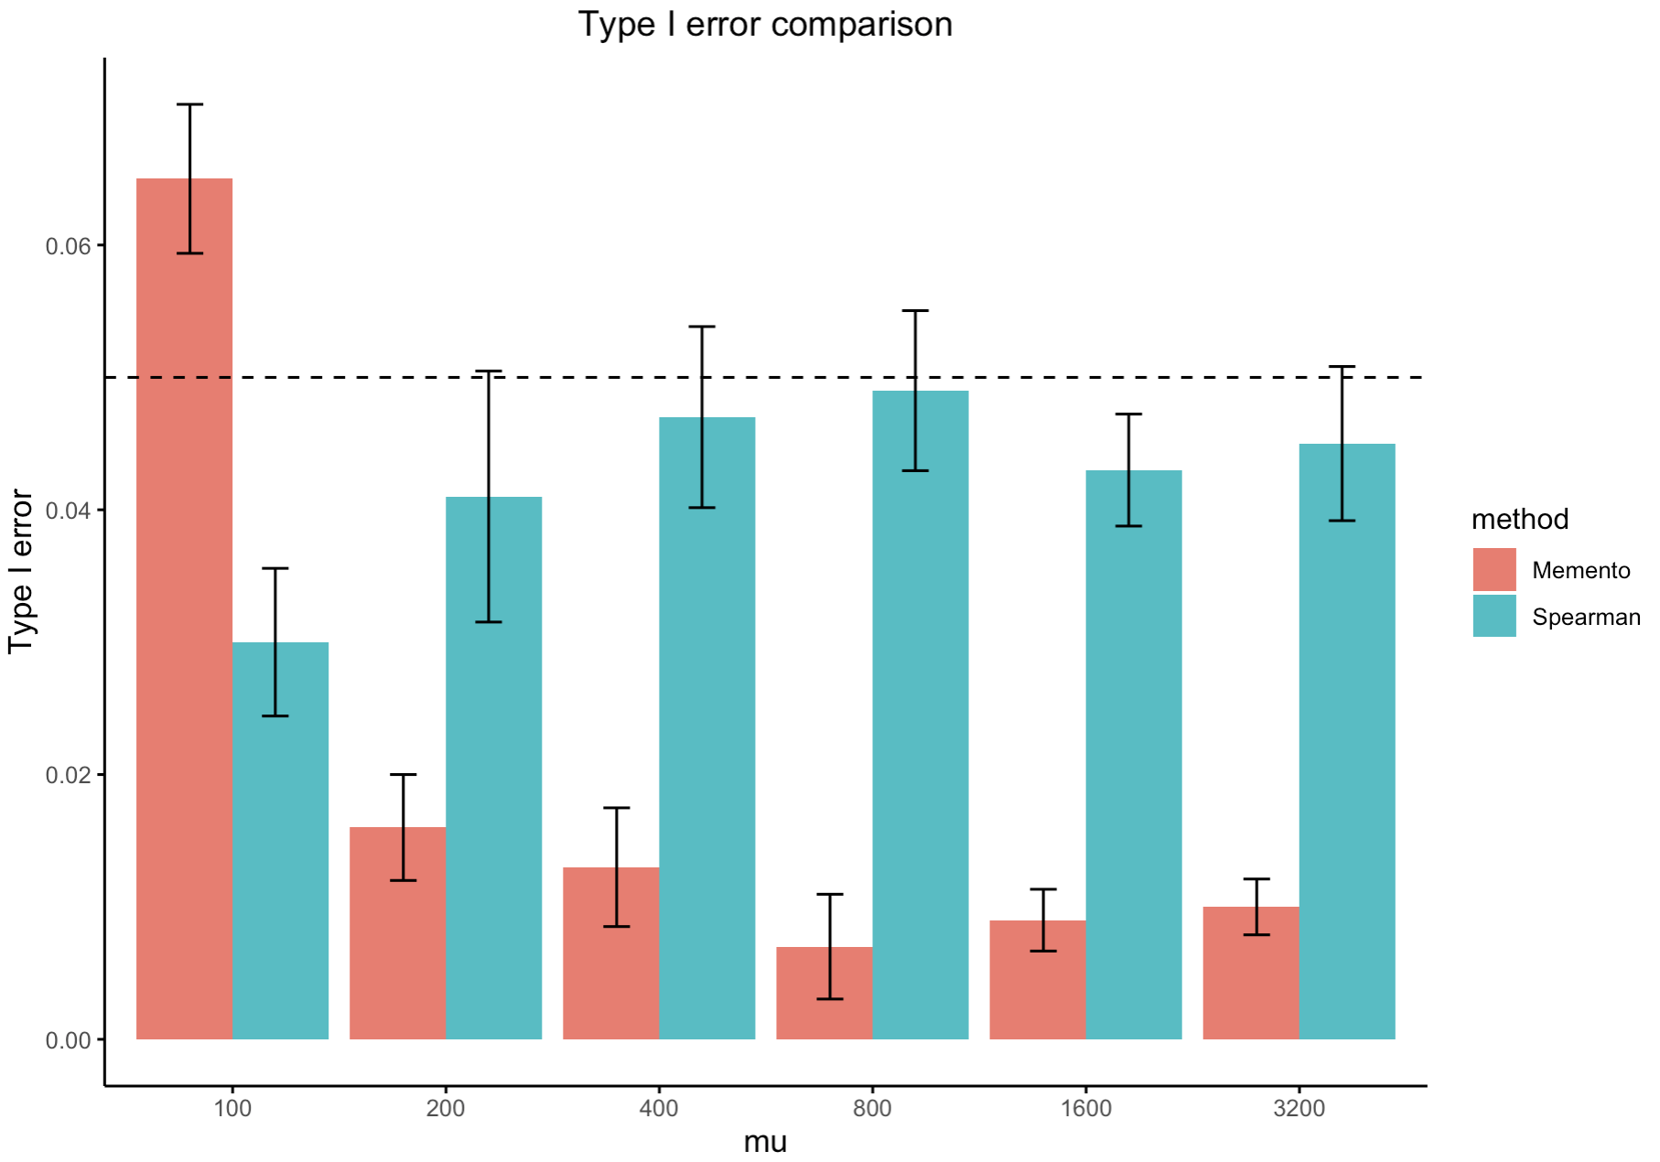
Methods Comparison
Notes:
Following would be results we can get from simulation and compare between methods, as for Type I error, under null (there’s co-expression but not effected by genotype) GEE, Spearman and Memento all have type I error smaller than 0.05, but OLS would give too much false positives.

Slide 13
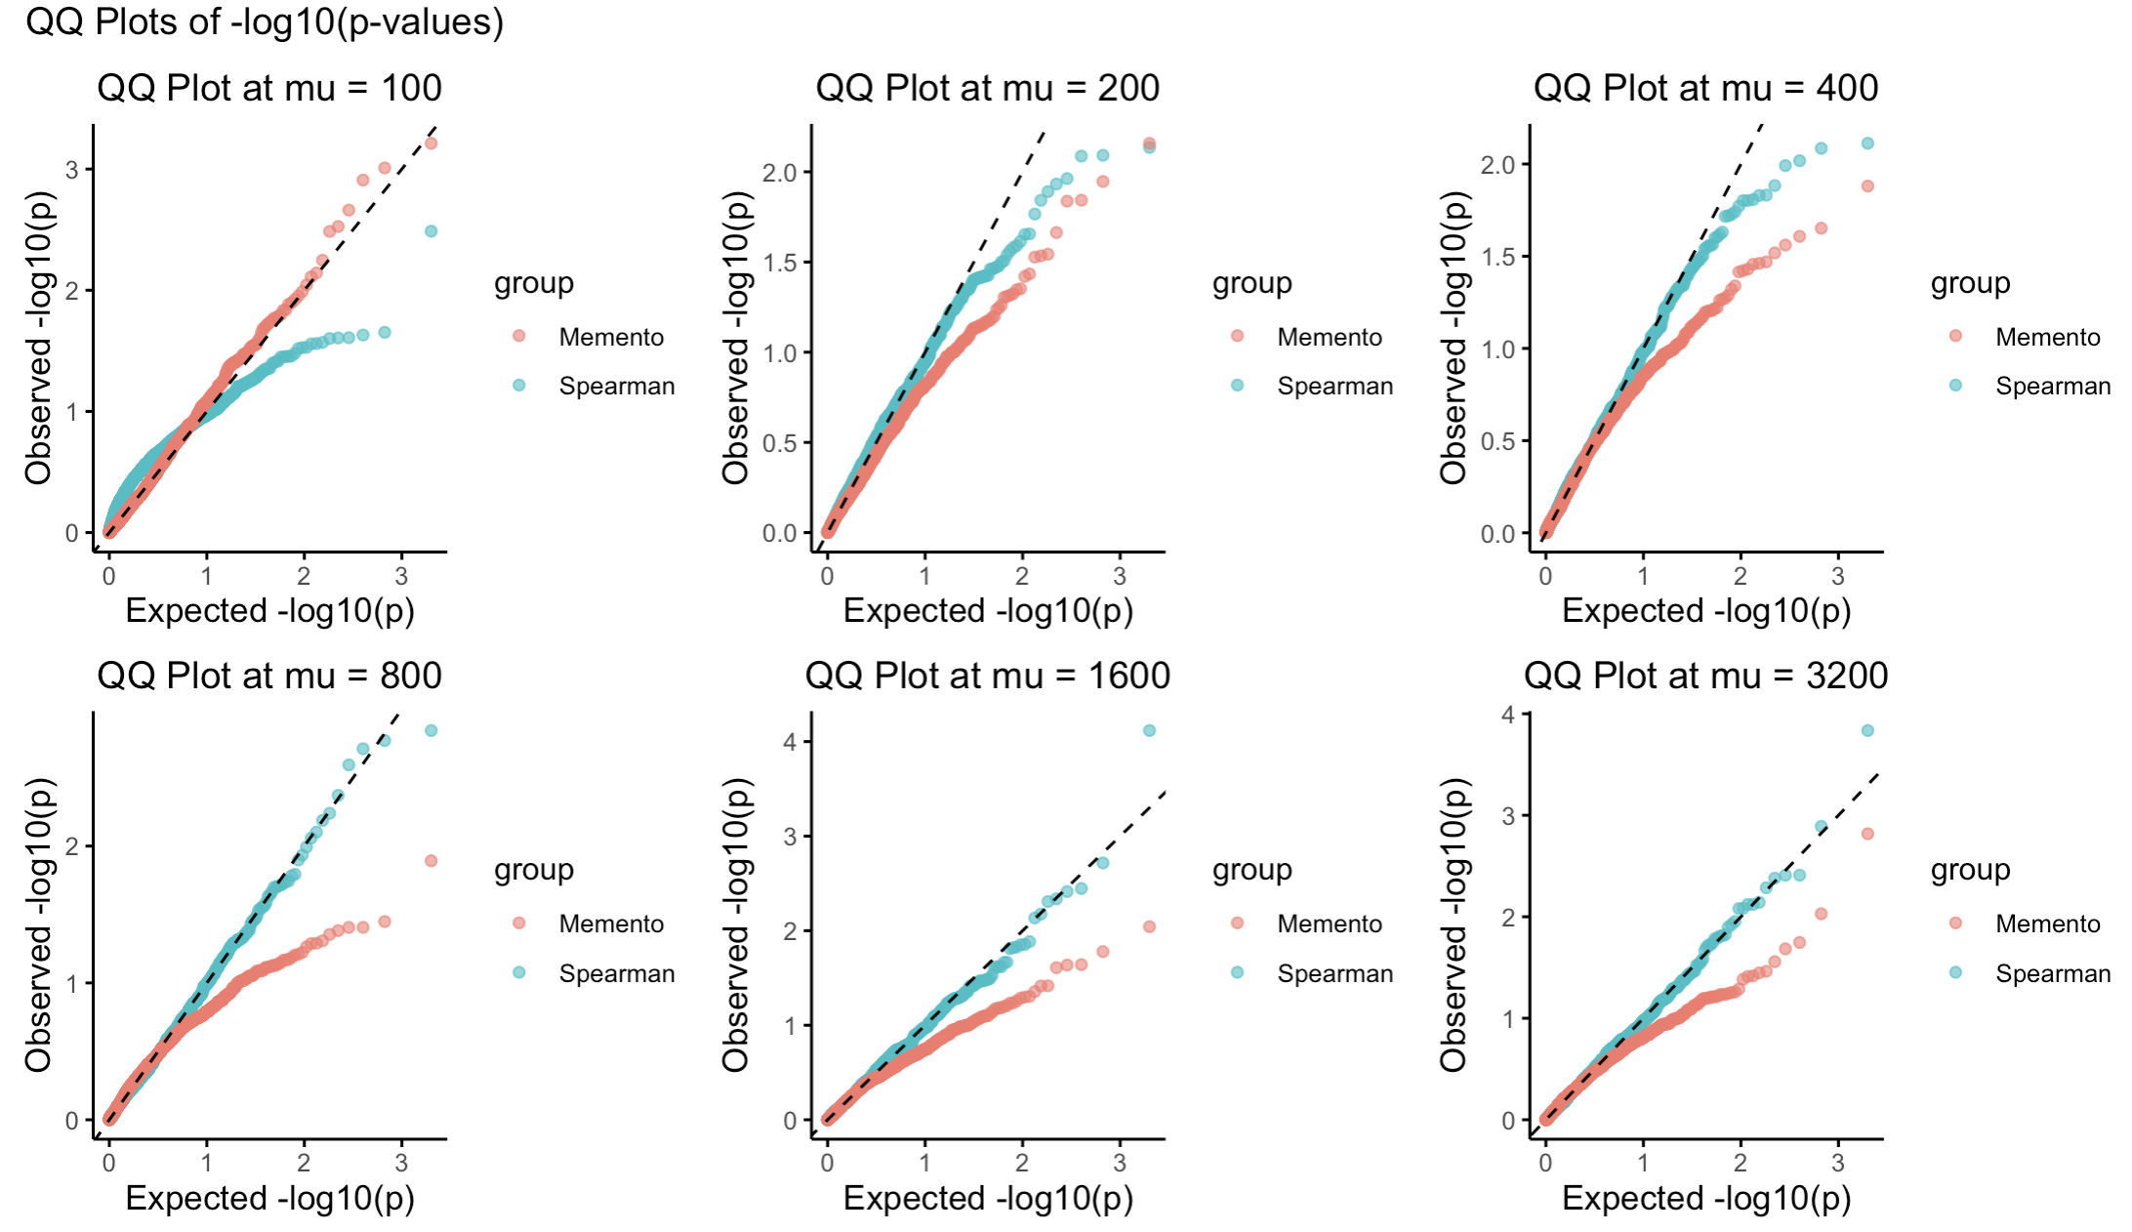
Methods Comparison
Notes:
Here is the QQ plot for 3 methods, y axis are observed log p values, and x-axis would be p-values expected under null. Dots of methods are expected to locate on diagonal. and we can see the problem of spearman method is it’s easily get biased estimation because of the limited sampling in simulation, especially the expression level is high, for Memento, it tend to be an overly conservative method, which have a larger than expected p under null.

Slide 14
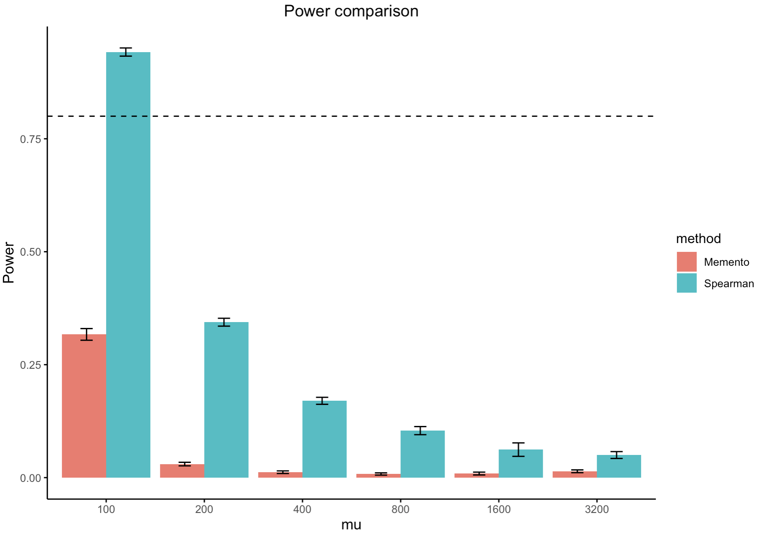
Methods Comparison
Notes:
For Power, we expression level get smaller, power for all the methods start to decrease, but comparatively our method has better power under the same condition. OLS is because it’s easy to get positive even in under null.

Slide 15
Discussion
For type I error, spearman method is easily biased in high expression level, Memento is conservative method based on simulation;
All methods get a lower power in identify co-eQTL when expression level become lower, but comparatively Spearman method works better

Slide 16
Thank you!

