Slide 1
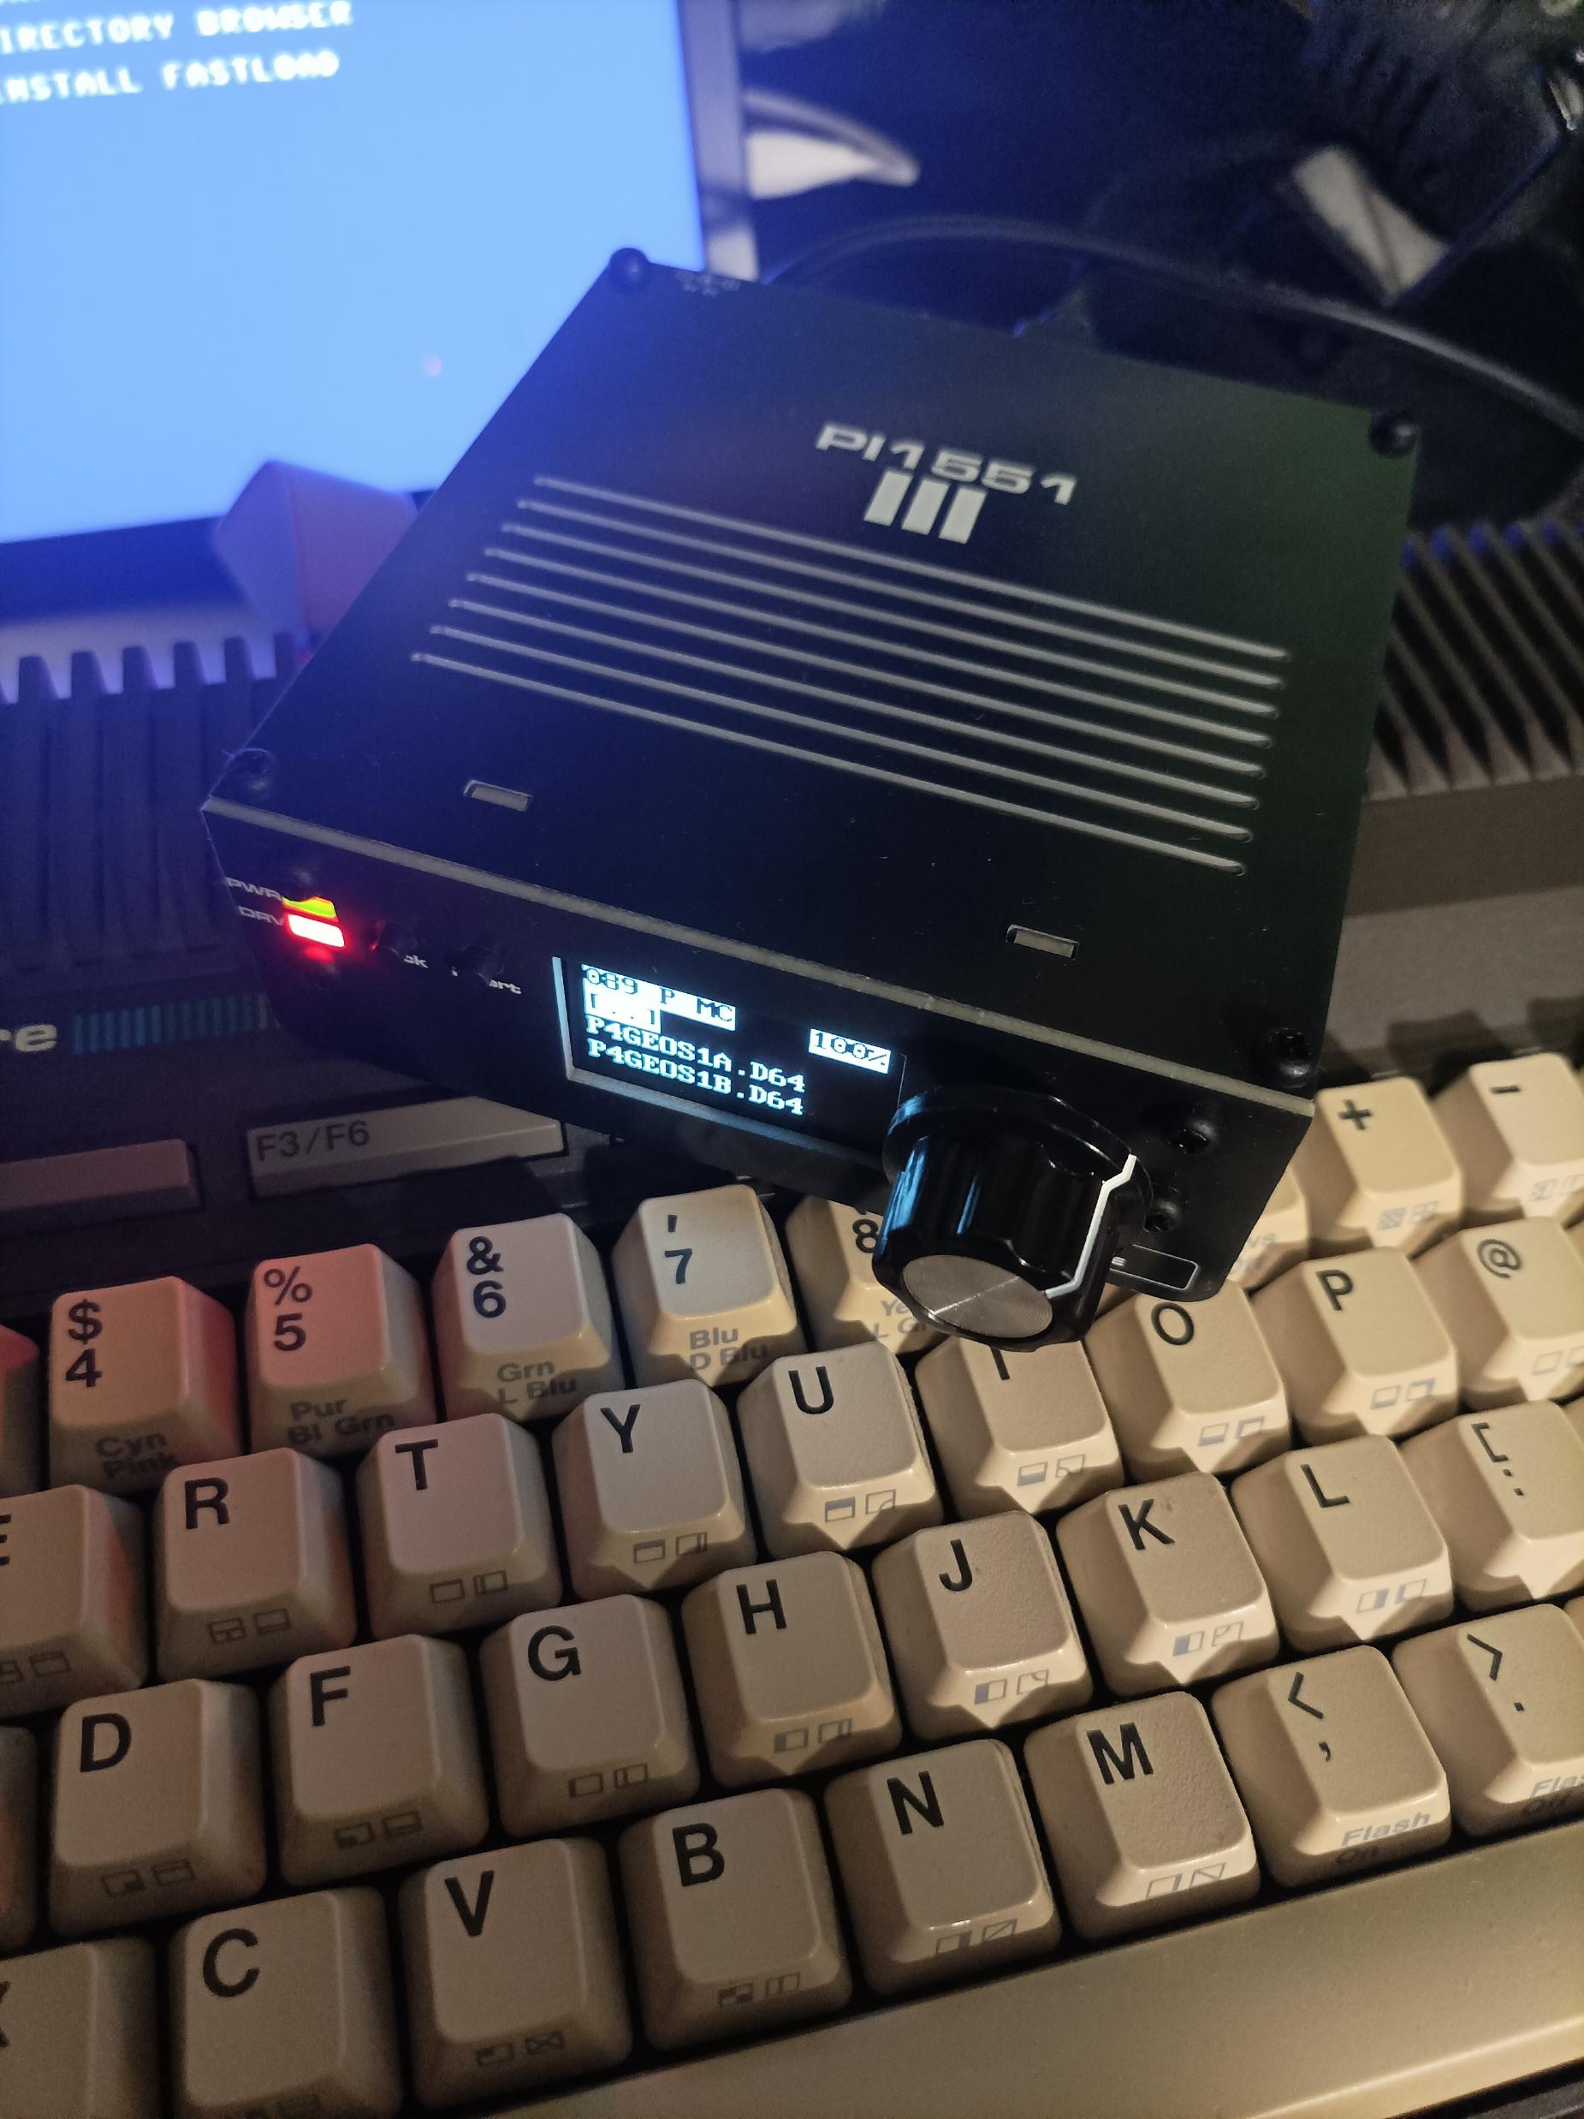
Pi1551
1551 disk drive emulator
1531 TAP player
Notes:
Hello, my name is Maciej.
And this talk is about Pi1551 – a cycle-exact Commodore 1551 disk drive emulator, built around a Raspberry Pi 3.
It also acts as a tape drive, can play TAP files.

Slide 2
A little about me
Involved with C64 and C128 since 1992
GEOS, C128, hardware
Plus/4 owner since June 2024
Notes:
I have been involved with the C64 and C128 since 1992
My main interests were the C64 and C128, GEOS, hardware expansions.
I bought my first Plus/4 in 2024, and immediately started looking for a convenient storage solution.

Slide 3
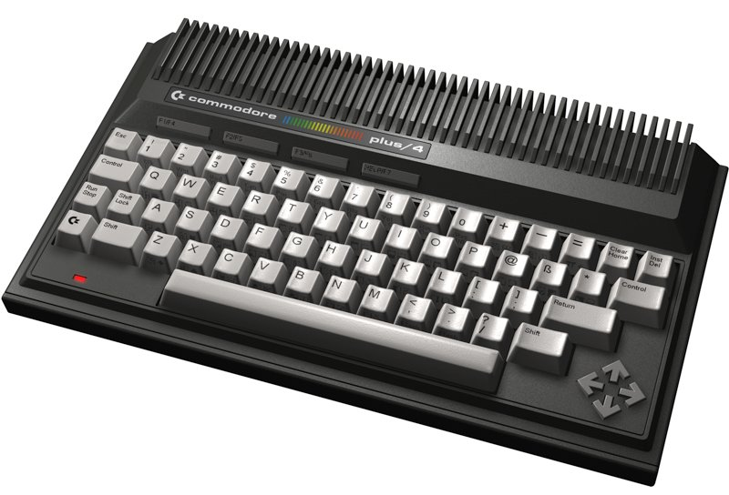
Data storage problem
Tapecart is fast, but can’t support disk images
1541 is slow and I don’t want to copy data to real floppies
SD2IEC is faster but not compatible and still SLOW!
Ultimate II+ powerful but not convenient to control
Let’s review the native
1551 disk drive
Notes:
On the C64, I was used to the convenience of the Ultimate cartridge.
I wanted something similar for the Plus/4: easy access to files,
but also compatibility with disk games and demos and their loaders.
The options I tried did not give me that combination.
So I looked at the Plus/4’s own disk drive: the 1551.

Slide 4
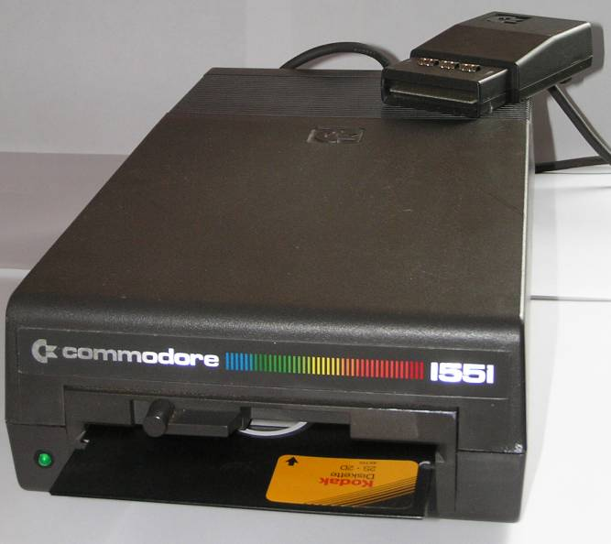
Native solution: Commodore 1551
Designed for C16/116/Plus4
Graphite finish
Almost the same DOS as 1541
Four times faster than 1541
Parallel data transfer (TCBM)
Connected through a cartridge?!
Rare and expensive
Notes:
That’s the native solution for C16/116/Plus4 line of computers. Commodore 1551 disk drive.
It was designed for these computers. Even has this cool graphite finish to match.
Internally it’s very similar to well known 1541 drive. The important difference is the connection.
It uses parallel bus called TCBM instead of serial IEC.
It connects through that cartridge, as visible on the photo, called paddle.
This paddle contains the port chip responsible for the parallel communication.
I wanted one of those but then I saw the prices on ebay. Besides, that wouldn’t solve the convenience problem.

Slide 5
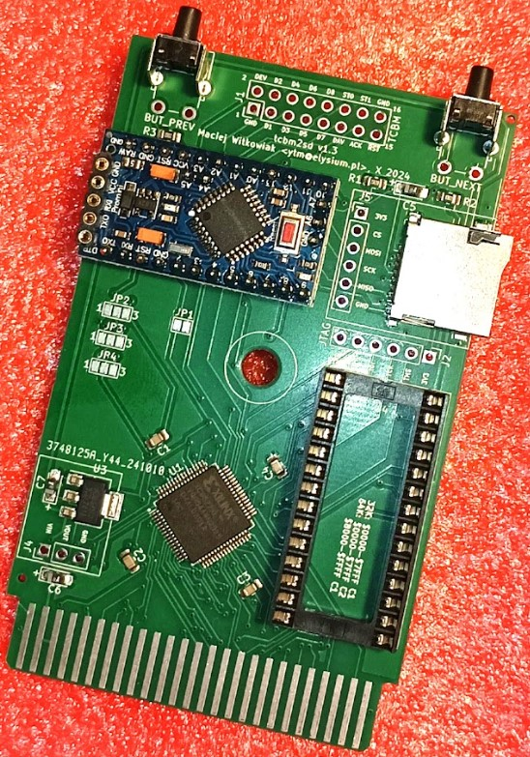
tcbm2sd
  replaces the original paddle
  simulates 1551-like device with an SD card
  32K / 64K cartridge (1-2 32K banks)
  somewhat compatible (SD2IEC-like)
  can’t execute drive code
  exposes TCBM connection
  but can disable itself if a cable is connected to TCBM connector
Notes:
Ok, this is where my previous presentation in December 2024 ended.
I have solved the 1551 cartridge problem. The tcbm2sd started as a modern replacement for the paddle.
I put on the board also an Arduino that simulates a TCBM device resembling 1551 over SD card.
Think of it as a similar approach how SD2IEC simulates an IEC device resembling 1541.
It’s convenient and fast, has its own fastloader, but it cannot execute drive code, so games and demos with native fastloaders
couldn’t run.
I have patched some games – the newest titles for Plus/4 for a native fastloader for this device, but I would never be able to patch demos.
So I had the interface and the next step was to emulate the drive behind it – on the other end of the TCBM cable

Slide 6
Pi1541 comes in
https://cbm-pi1541.firebaseapp.com/
uses Raspberry pi for cycle-exact real-time emulation of 1541/81
emulates the hard parts: analog stuff and D64/G64 images
and the easy parts: 6502 CPU and VIA ports
It should be easy, right?
just replace 2x VIA emulation with CPU port and TPI ports
simplify circuit, parallel TCBM bus is much simpler than IEC
rename to Pi1551
Notes:
Pi1541 project emulates 1541 in real time. This was my solid starting point.
It already contained all the difficult pieces like the disk image handling, GCR coding/decoding and realtime emulation
My plan was to adapt it to the 1551 processor and interface hardware, then connect it to tcbm2sd.
It should have been easy, but in practice I quickly got stuck because while I can code in C,
I was no expert on bare metal ARM programming with strict timing requirements.

Slide 7
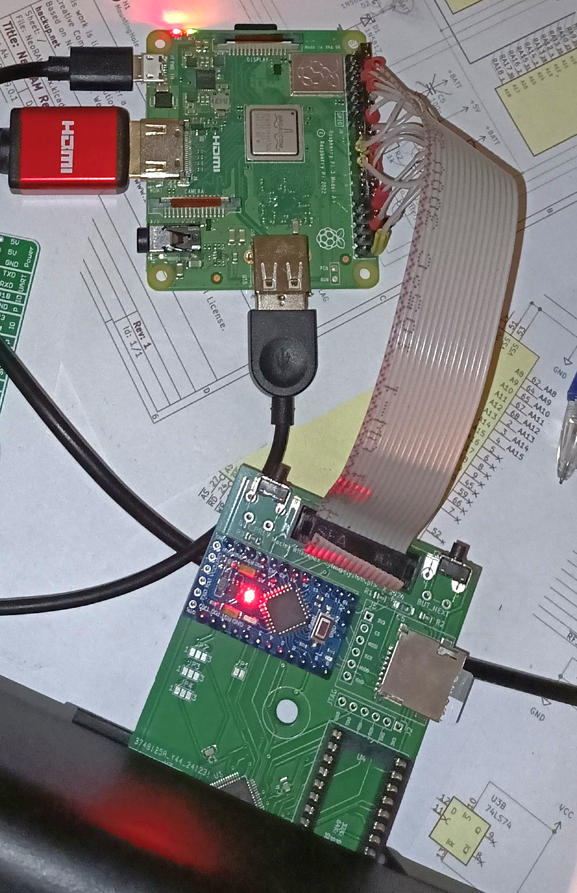
First success
Started in September 2024
Project stalled until August 2025
Got first results in October 2025
Devil is in the details
Compatibility
2MHz CPU timing issues
Notes:
The project was stuck for months, I had a hard time debugging because each test meant recompilation,
putting new code on the SD card, rebooting Pi and hoping for the best.
AI assistants helped me a lot here, finding silly bugs and problems to get this running.
The photo shows the first successful version, that was really just 16 wires between Raspberry PI GPIO connector and the tcbm2sd.
Getting communication right was only the beginning. The compatibility was a problem.
For example several demos use bitfire fastloader, which relies on pullup resistors in the drive.
My 2MHz CPU emulation also needed more work, it had too much jitter to be useful.

Slide 8
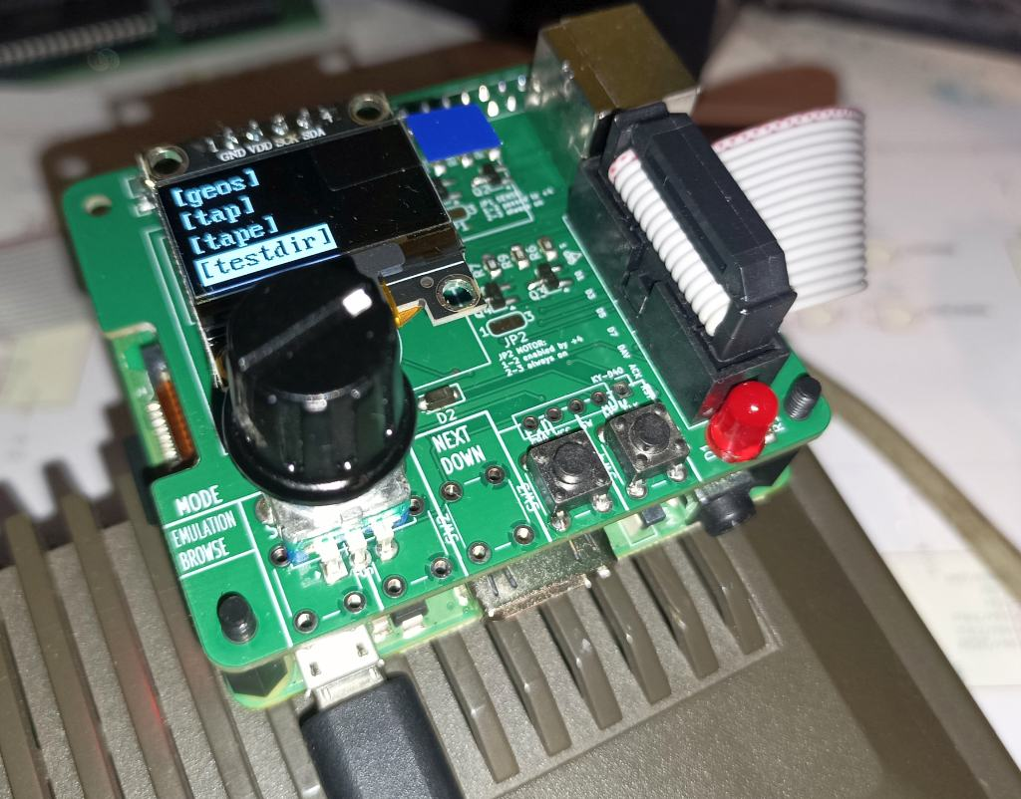

It works!
Resolved the remaining problems by early 2026
Two interfaces, one Pi1551 firmware
Notes:
By early 2026, I had resolved the remaining problems.
There is one Pi1551 firmware, but two Raspberry Pi interface flavours.
On the left that’s the minimal DIY HAT version. It has the same size as Raspberry Pi 3A.
The box on the right there is Pi1551-III. This is the more complete version. Its mechanical design is based on tebl’s Pi1541-III concept.
Several circuit boards form the case, so it does not need a 3D-printed enclosure.
It also has an OLED display and convenient front controls.
Both versions run exactly the same firmware.

Slide 9
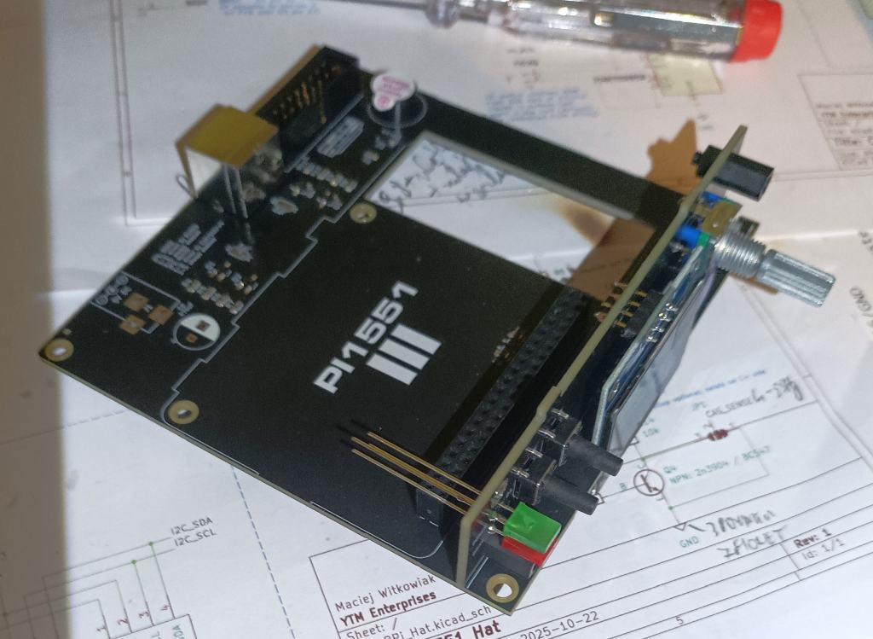
Pi1551-III
https://github.com/ytmytm/Pi1551-III
Notes:
This is the inside of Pi1551-III hidden between top and bottom covers and behind the faceplate with RaspberryPi removed.
We have a main board which holds the important parts and the front panel with display and controls.
L-E-Ds are not soldered yet in that photo.

Slide 10
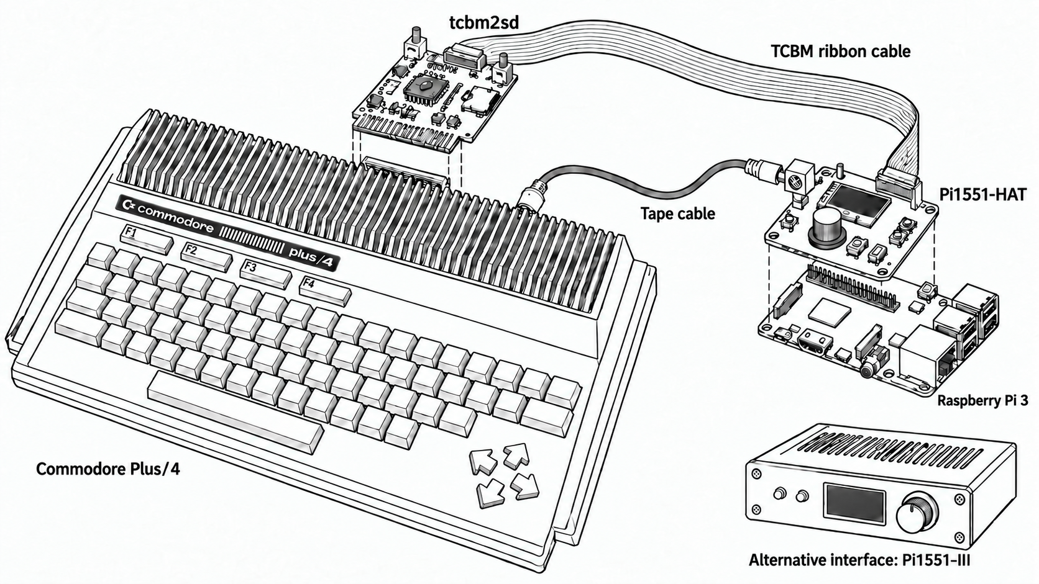
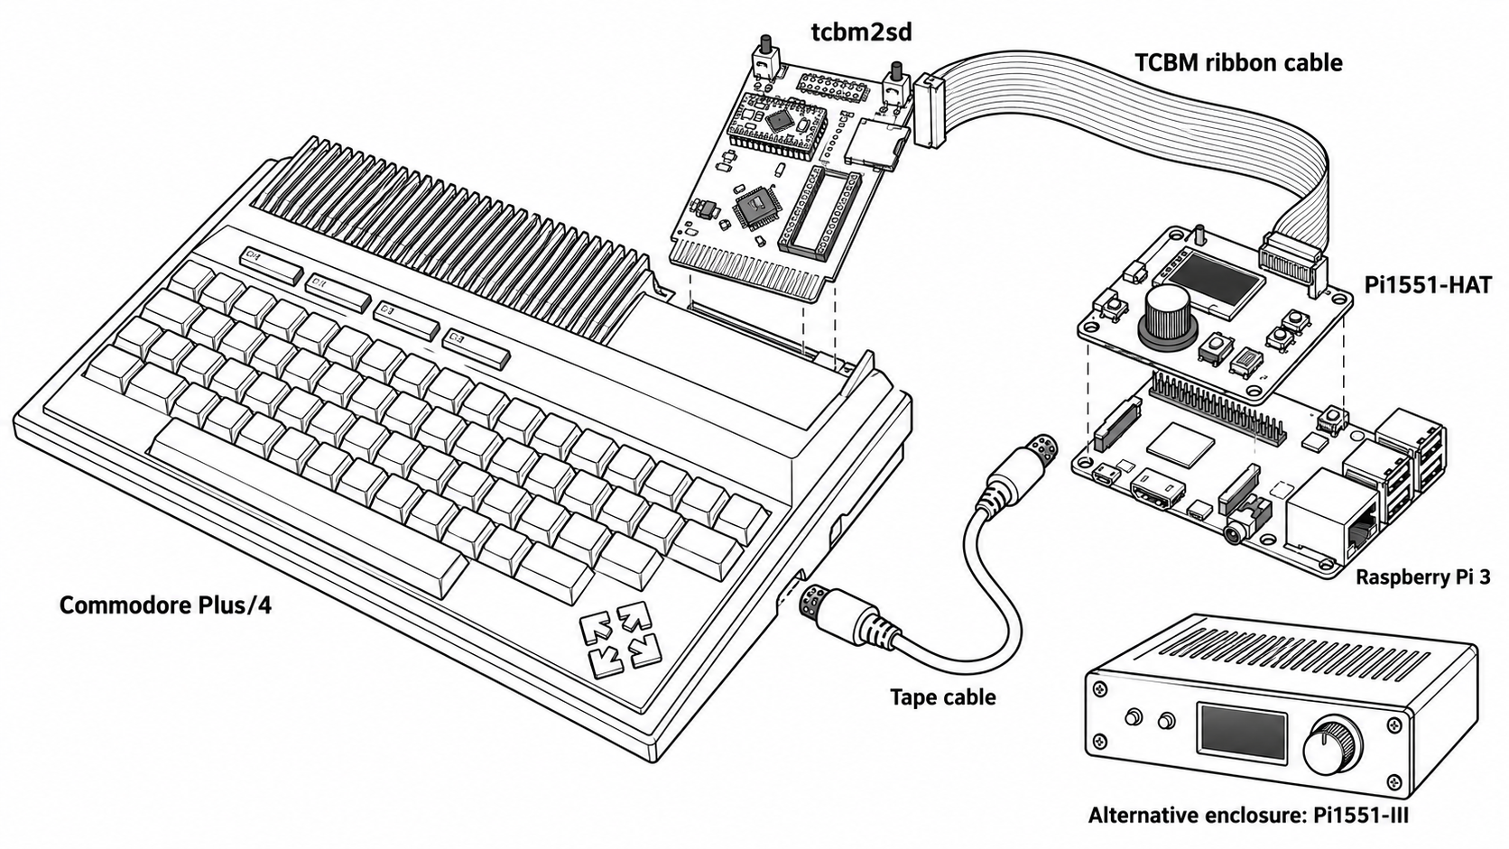
Architecture
Notes:
Let’s have a look how all of this is connected on this almost correct image.
For disk access, tcbm2sd plugs into the cartridge port. A sixteen-wire ribbon cable connects it to the Pi1551 interface,
which sits on top of the Raspberry Pi GPIO header. The Raspberry Pi runs the drive emulation.
With the ribbon cable disconnected, tcbm2sd can work as a standalone SD-card device again.
The second cable connects the computer’s tape port directly to the Pi1551 tape interface.
Tape playback works independently of the disk connection.

Slide 11
Three modes
Browser
PRG files loaded directly from SD or from D71/80/81/82 images
Select D64/G64 disk images or disk flip lists (LST)
Select TAP files to play
Emulation
Cycle-exact 1551 emulation within D64/G64
Alternative DOS ROMs
8KB RAMBOard
Tape
TAP playback
Independent of the disk mode and TCBM connection
Notes:
Pi1551 has three practical modes.
Browser mode provides file-level access to the SD card and supported disk images. This is also where you select disks and tapes.
This resembles operation of SD2IEC and TCBM2SD.
Once we enter a D64 or G64 disk image. the emulation starts. It’s a cycle-exact 1551 emulation, running the DOS ROM, original one
Or alternatives. We can also emulate 8KB RAMBOard expansion with ROM patched to cache whole tracks in RAM for even faster operation.
The third mode, which runs independently in parallel is the tape player for TAP files.
Once you select a TAP file in the browser it becomes the active tape, the virtual PLAY button
will be pressed and its data stream will be played back according to the motor control line from the computer.

Slide 12
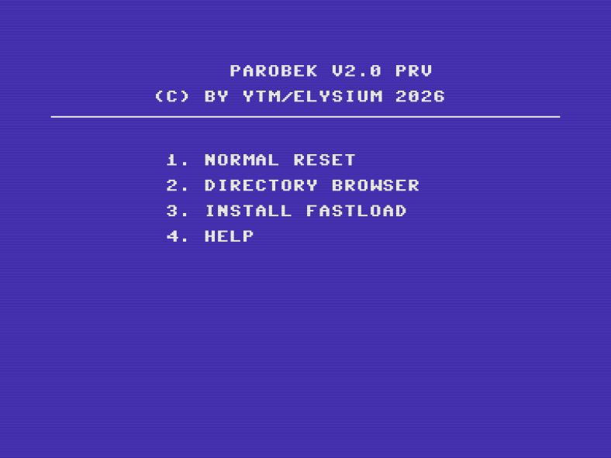
Parobek ROM
Directory browser
DOS wedge
Automatic fastloader selection
  1551 with/without RAMBoard
  1541 with parallel cable
  1571/81 with burst interface
  1541/71/81 with JiffyDOS (even without JiffyDOS Kernal)
Supports also Pi1541, Pi1551 (SD2IEC test pending)
Notes:
Hardware compatibility is only half of convenience. The other half is software inside the computer.
The tcbm2sd provides a socket for external function ROM, so it’s very easy to populate it with something useful.
If you know Action Replay on the C64, the idea will feel familiar: a directory browser, a DOS wedge and fast loaders.
Parobek automatically selects the best available transfer method.
The name means a hired farmhand in Polish. It is a pun inspired by The Servant ROM for C128.
It is not as sophisticated, but it gets the job done.
Let’s see all of this in action.

Slide 13
DEMO
Notes:
Pi1551-III
Connection
Controls
Browser mode and DOS wedge: dollar and slash
Directory browser
Enter image
Start demo with fastloader
B. TAP
Tape cable connected
Choose TAP file, but don’t click on it yet
LOAD, press play on tape
Clicking on TAP starts the tape
LOADs, finds a file- that was sped up quite a lot
TAP player shows the tape counter and percentage of the TAP file
C. HAT
Tiny hat
Now I have entered the fastloader mode, the function key brings the Directory browser from Parobek, no need to load it from disk
It’s not well visible, I’m going there into a D81 disk image with a game patched for tcbm2sd – Alpharay
So even though it’s not emulation 1581 you can still load files from there, just with TCBM protocol
D. Flipping disk
This last part shows how multiple disks can be selected via LST file, same like on SD2IEC. Then the turn of the encoder switches the current disk
Again I’m using DOS wedge for quick directory listing with dollar sign instead of basic command DIR

Slide 14
The system is now complete
TCBM2SD replaces the paddle, Pi1551 replaced the 1551 drive
large Pi1551-III or small Pi1551-HAT interface
Parobek ROM provides all the convenience I have been missing
TAP player if you are into this sort of thing
fastloaders for everything else: TCBM, IEC, JiffyDOS
disconnect the ribbon cable and TCBM2SD is back – not 100% compatible but super fast for single-file programs and patched games
Notes:
So in conclusion, the complete system consists of three projects. tcbm2sd provides the computer-side interface and can still operate on its own.
Pi1551 provides exact drive emulation, while Parobek makes the complete system convenient to control.
Together, they solve the problem that started this project.

Slide 15
What comes next?
Firmware development continues:
better on-device user interface, menu system, settings
clearer status feedback
support for tape recording
even more compatibility testing
implement missing tcbm2sd features in the browser mode
Notes:
The main hardware designs are working, and the core emulator is usable. The next stage is mainly firmware development.
Now the goal is to make it more polished and easier to use.
I want to improve the on-device menu, make the current mode and drive status easier to understand,
and eventually add tape recording because it’s already supported by the hardware.

Slide 16

Where to get it?
Hardware
TCBM2SD: https://github.com/ytmytm/plus4-tcbm2sd
Pi1551-HAT: https://github.com/ytmytm/Pi1551-HAT
Pi1551-III: https://github.com/ytmytm/Pi1551-III
Firmware
Pi1551: https://github.com/ytmytm/Pi1551
Parobek ROM: https://github.com/ytmytm/plus4-parobek
Want to purchase? Contact me: ytm@elysium.pl
Notes:
This project was possible because other developers documented and published their work.
Especially Pi1541, Pi1541-III and many other community projects.
All firmware, hardware designs and documentation are published as open-source projects on GitHub as well.
You are free to take it and use it.
The repositories contain manufacturing files, bills of materials, assembly instructions and SD-card files, everything you need.
People interested in buying something ready to use can also contact me directly as I keep a small stock of assembled units.

Slide 17
Thank you!
ytm@elysium.pl
https://github.com/ytmytm

Slide 18
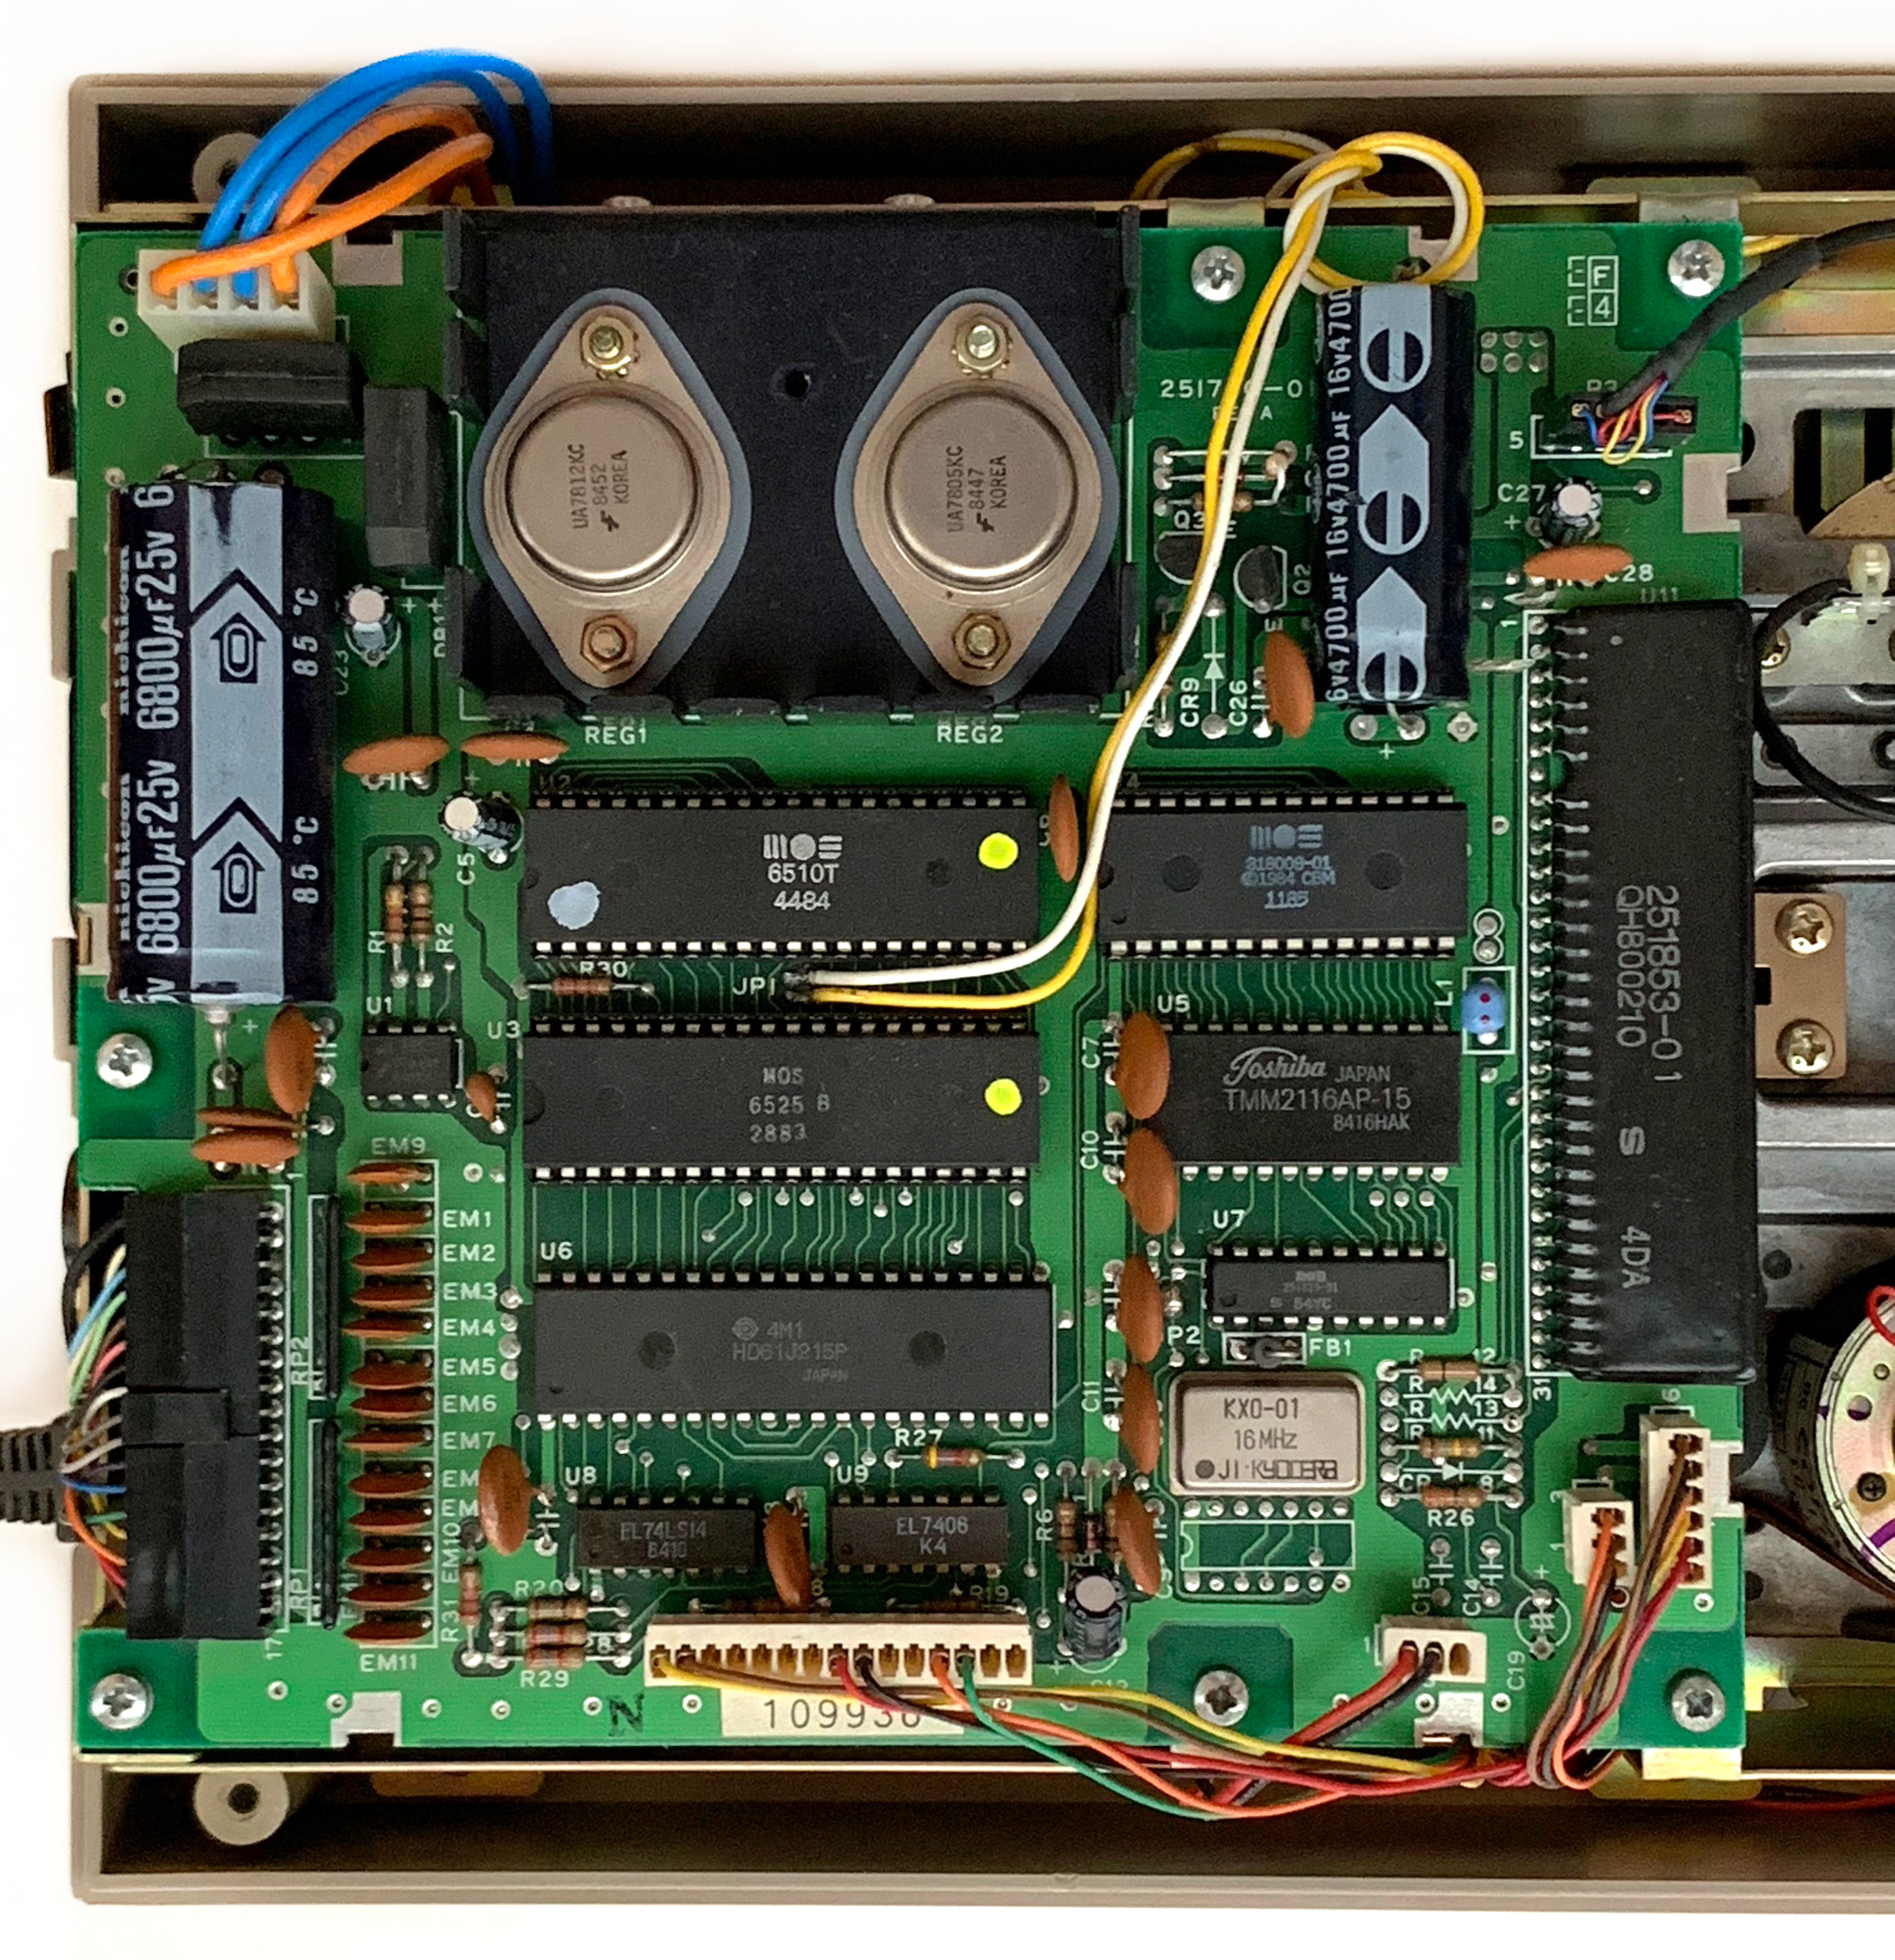
Surprise side project
XXX zdjecia side by side
Pi1551-III vs 1551-rePico
Notes:
Pi1551 is an emulator, but the same research led to a second project. This is Pi1551-Pico.
Instead of emulating the complete drive on a Raspberry Pi 3, it recreates the electronics around a real drive mechanism and a real 6510T processor.
Reuses Pi1551-III form factor and front panel
Almost by accident I’ve built a computer.

Slide 19
1551-rePico
Based on 1541-rePico: https://github.com/fook42/1541-rePico
Recreates 1551, reuses Pi1551-III form factor and front panel
  Analog parts, power, 2MHz CPU clock, 100Hz IRQ provided by Pico
  Glue logic and TPI provided by CPLD, same as in tcbm2sd
  RAMBoard expansion integrated
  64K ROM for alternative drive DOS options
  Original 6510T CPU or MOS CPU replacer
  https://github.com/monotech/MOS_CPU_Replacer
  It’s fun to build a computer, but surprisingly it’s not 100% compatible
Notes:
Pi1551 is an emulator, but the same research led to a second project. This is Pi1551-Pico.
Instead of emulating the complete drive on a Raspberry Pi 3, it recreates the electronics around a real drive mechanism and a real 6510T processor.
A Raspberry Pi Pico provides the clock, interrupt timing and control functions. A CPLD implements the TPI and glue logic.
The design also integrates the RAMBoard expansion and space for alternative drive ROMs.
An original 6510T CPU can be used, but the MOS CPU Replacer is another possible option.
This project is not published yet and under development.

