Slide 1
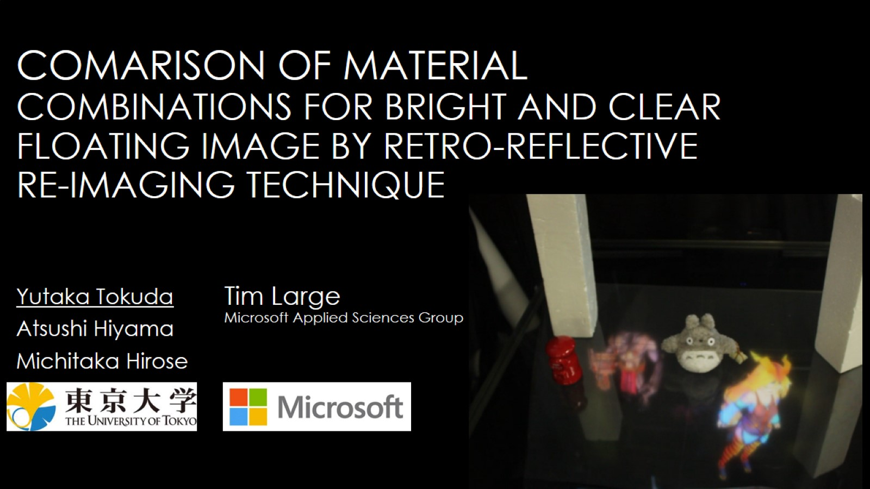
Comarison of material combinations for bright and clear floating image by retro-reflective re-imaging technique

Slide 2
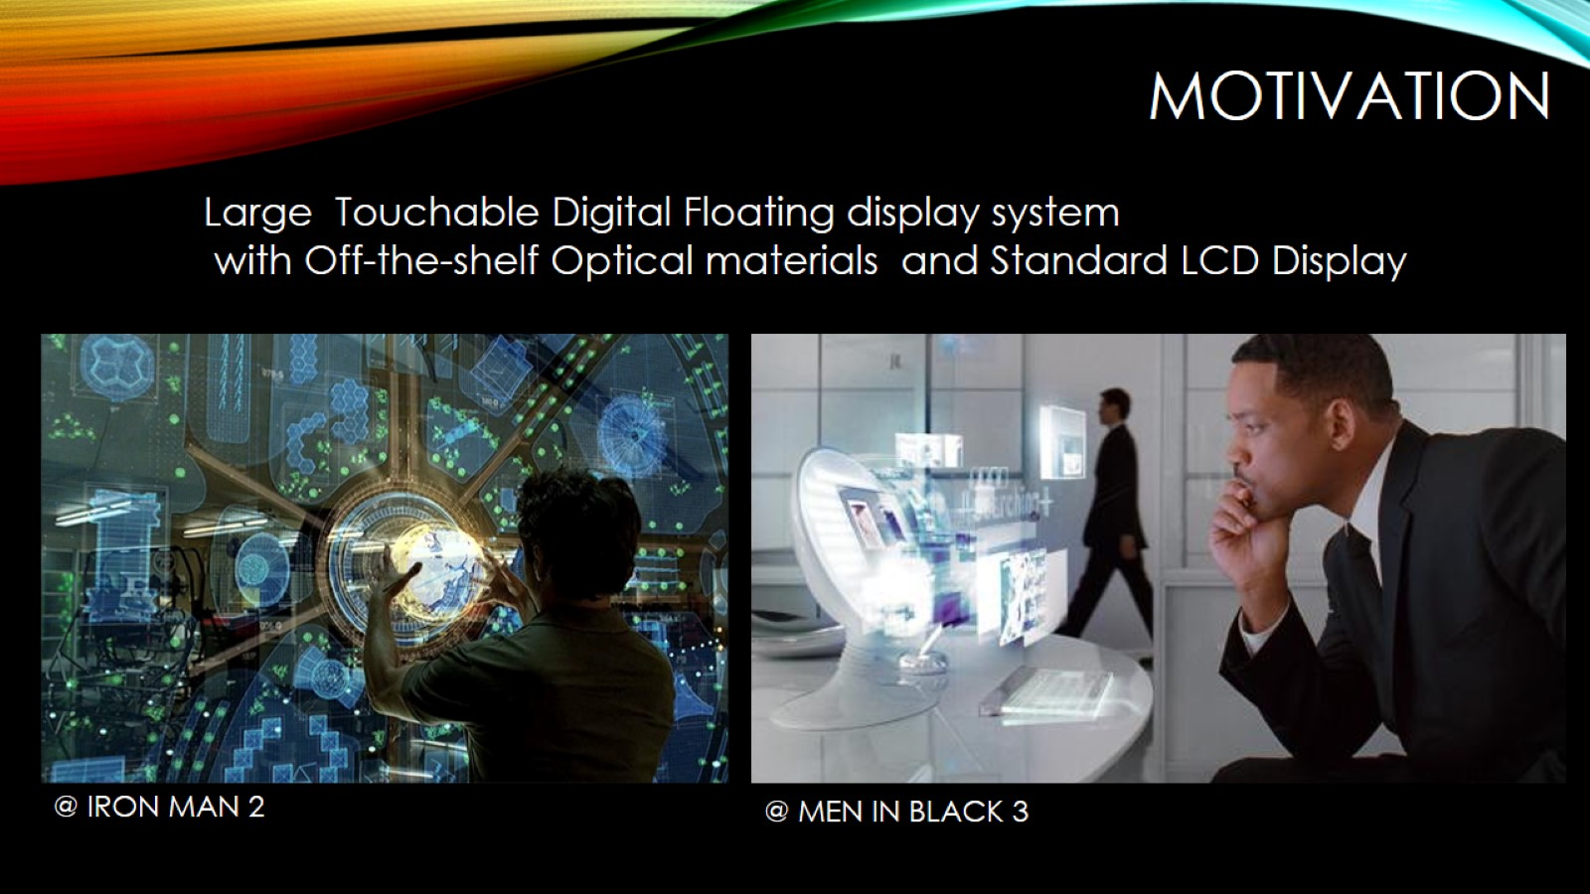
Motivation

Slide 3
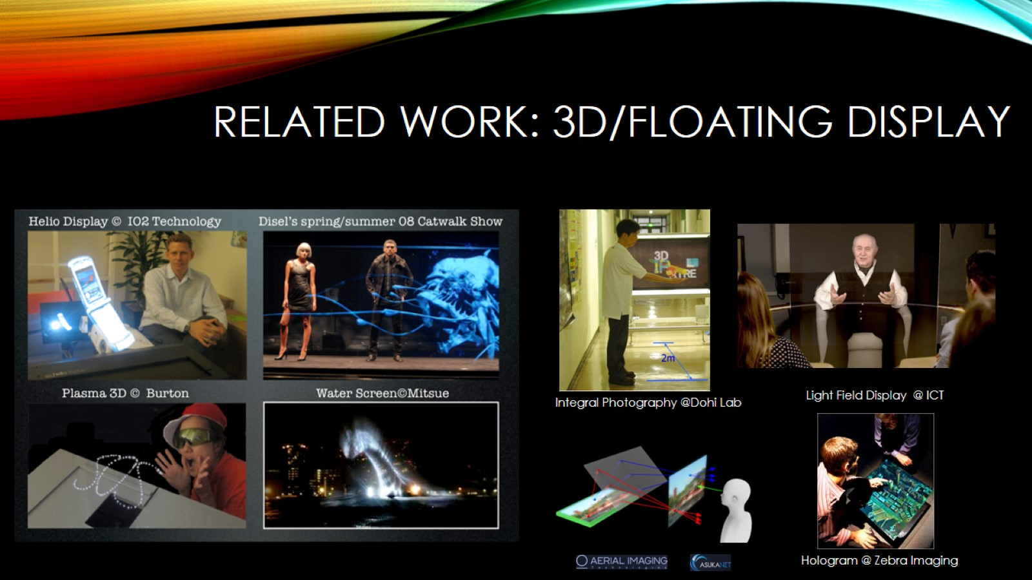
Related Work: 3D/Floating display

Slide 4
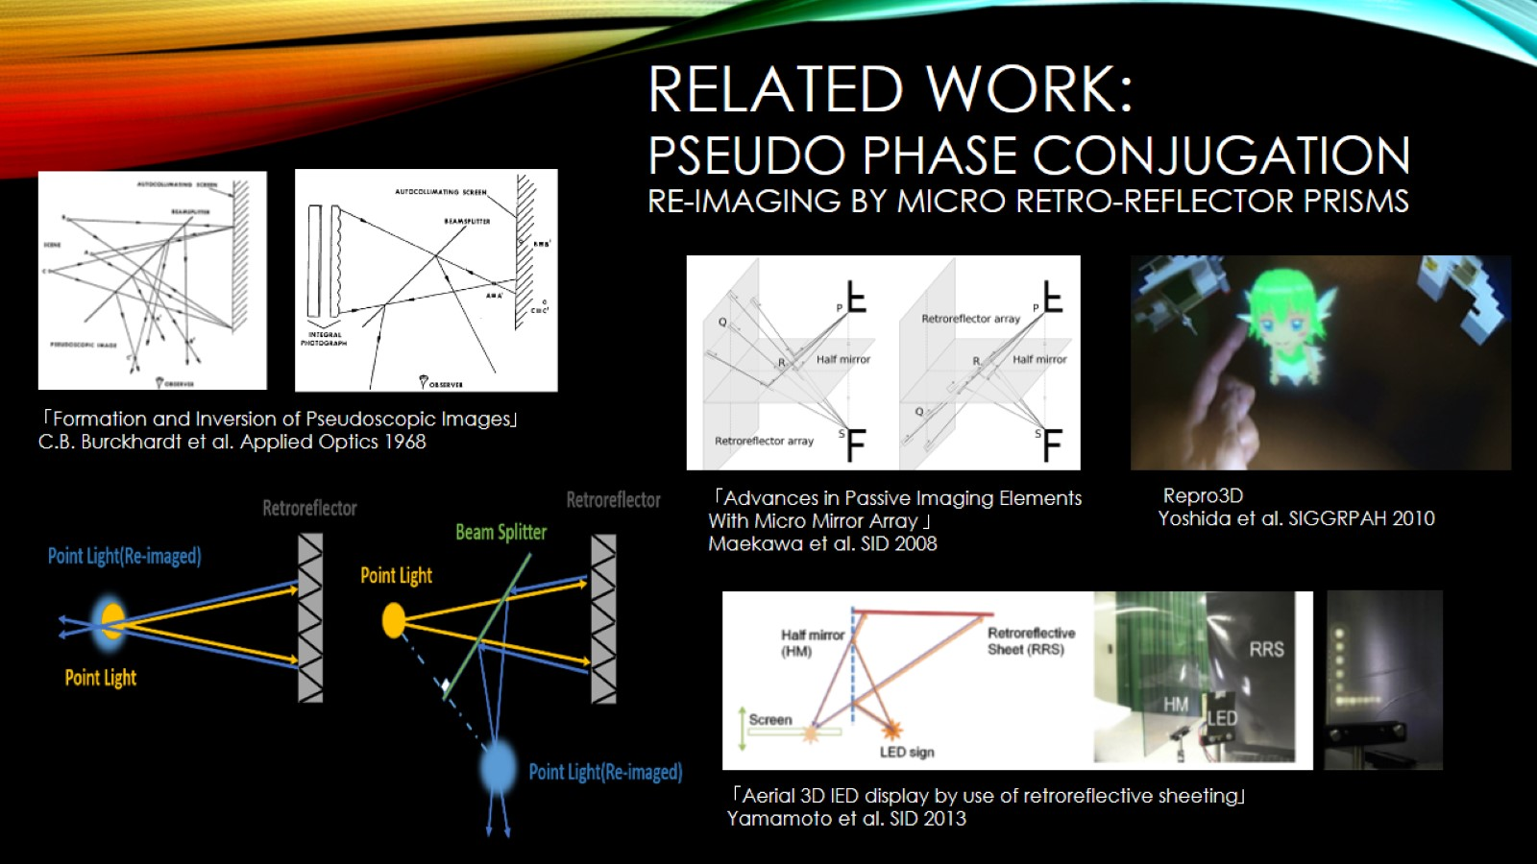
Pseudo phase conjugation Re-imaging by micro retro-reflector prisms

Slide 5
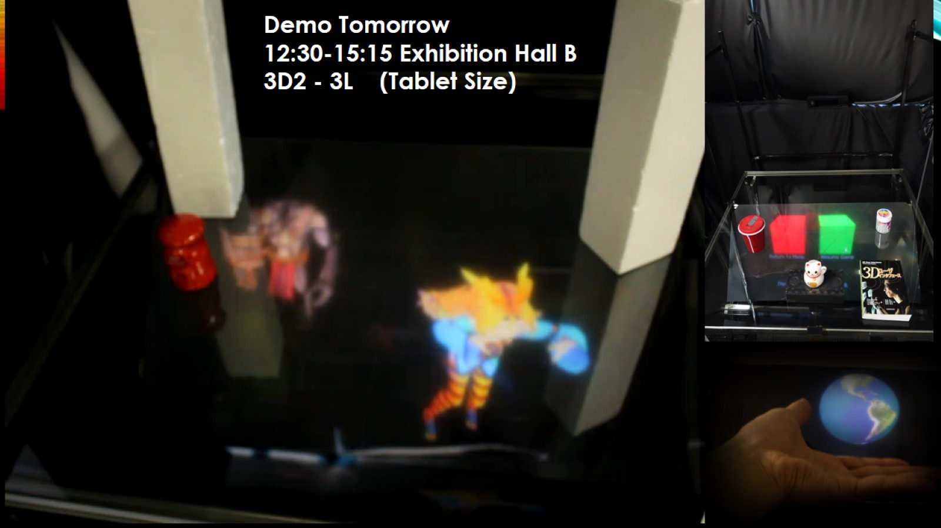

Slide 6
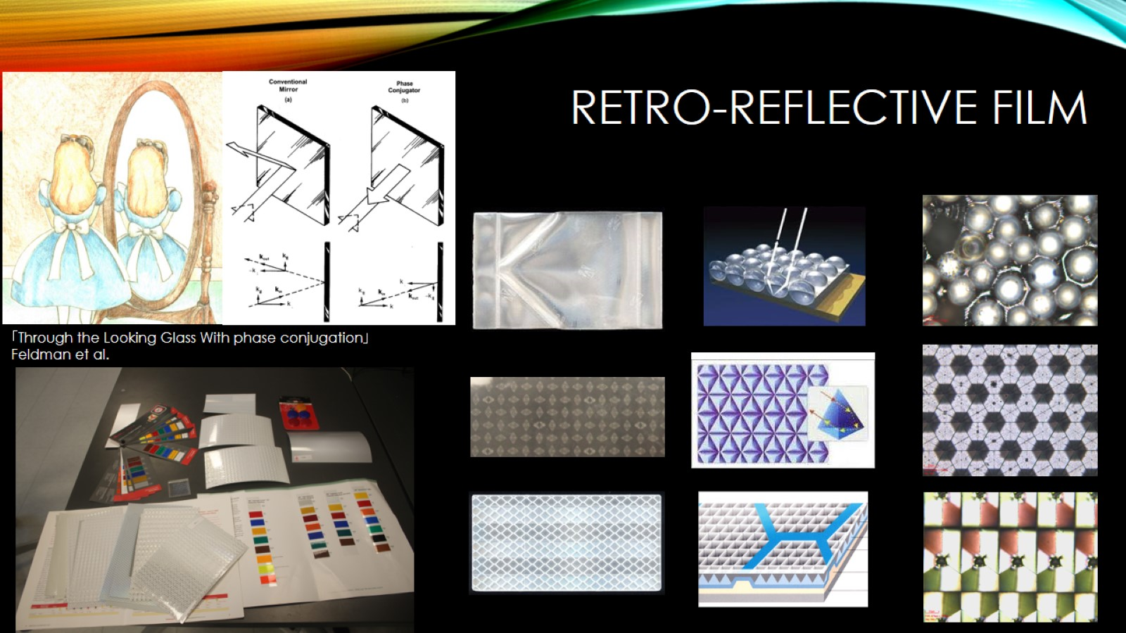
Retro-reflective Film

Slide 7
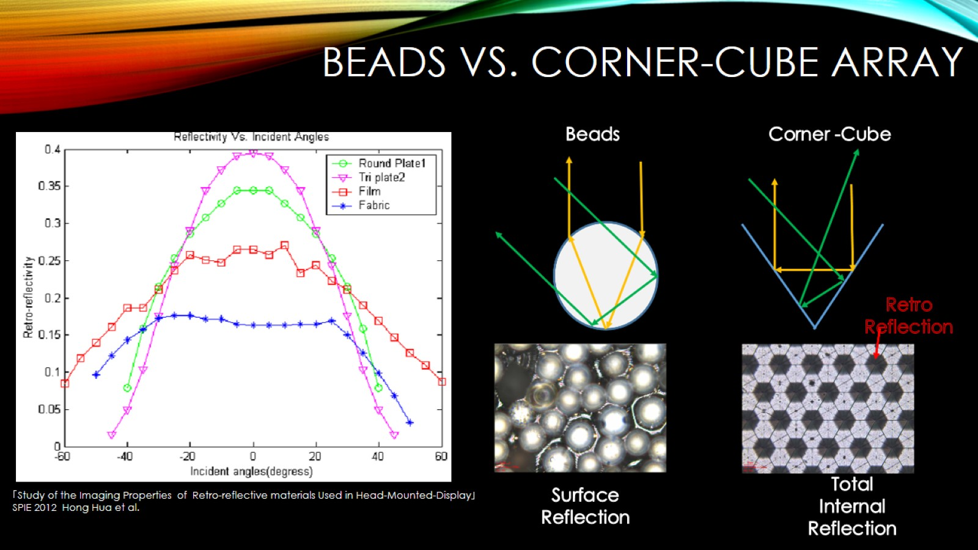
Beads vs. Corner-cube array

Slide 8
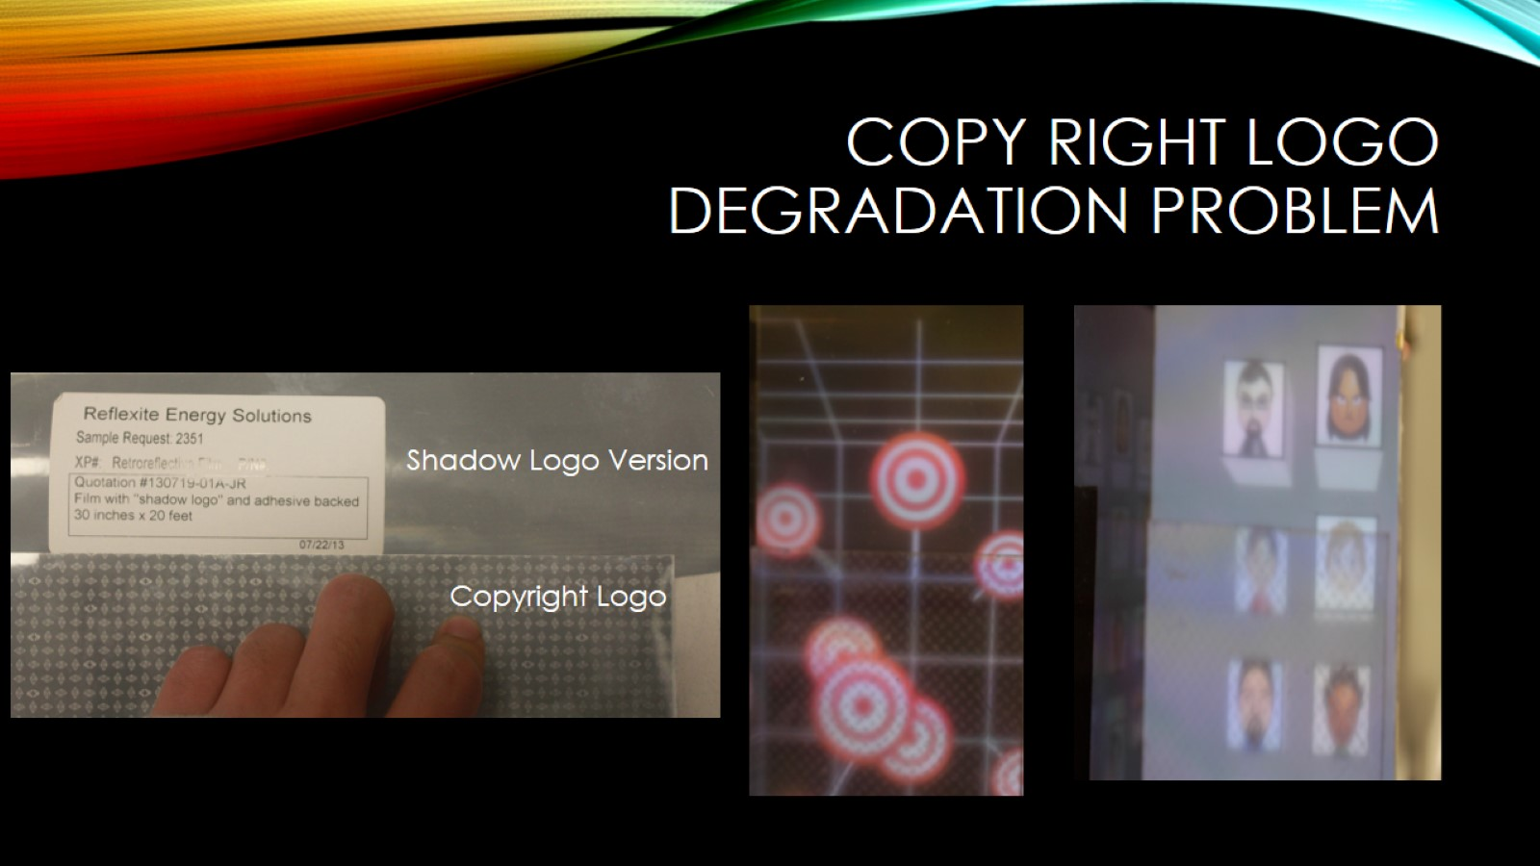
Copy Right Logo Degradation Problem

Slide 9
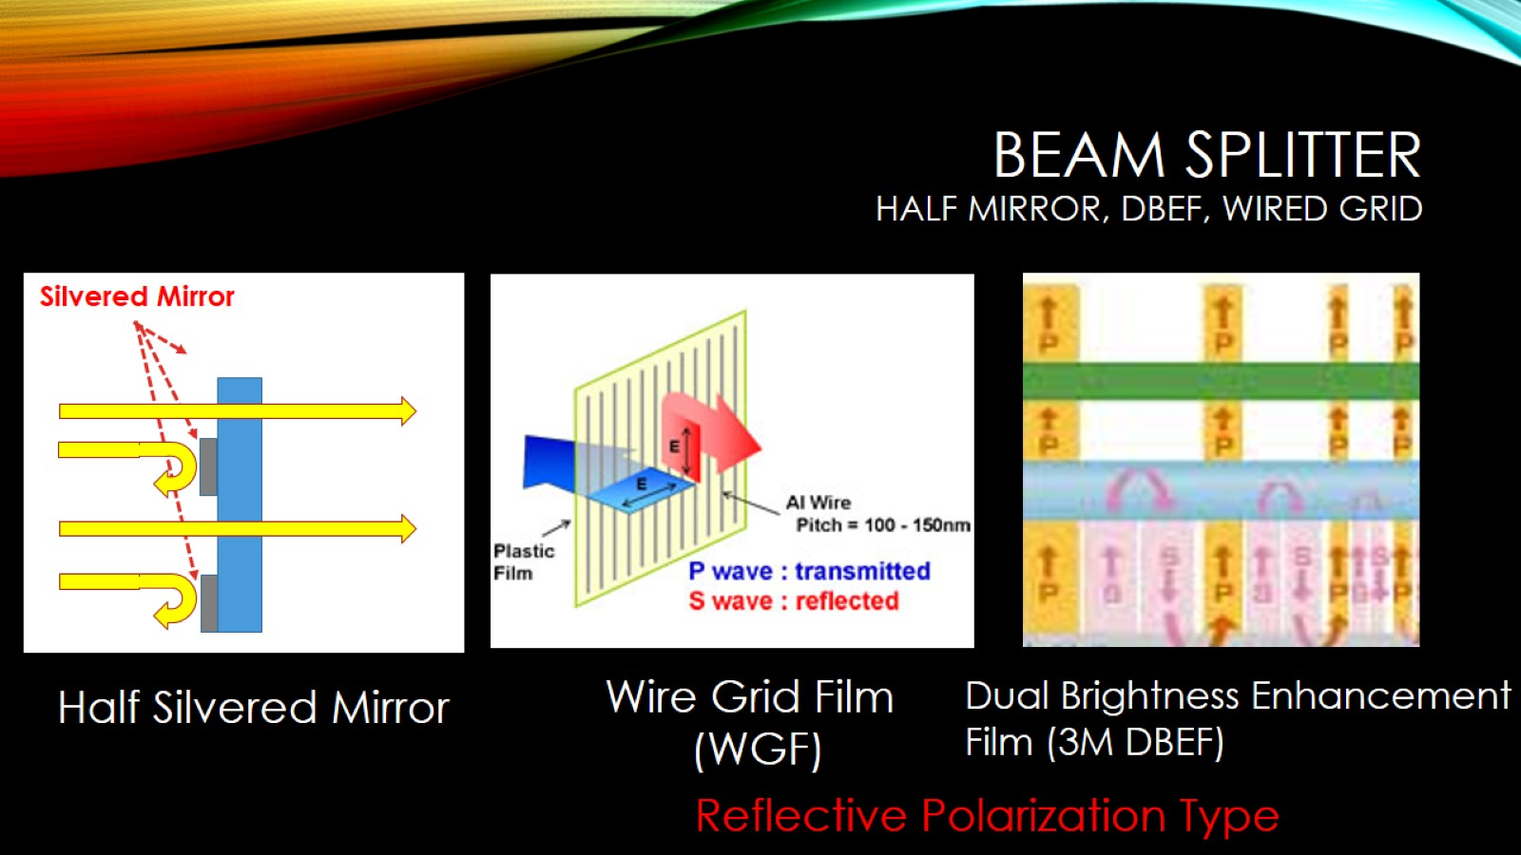
Beam Splitter Half mirror, DBEF, Wired Grid

Slide 10
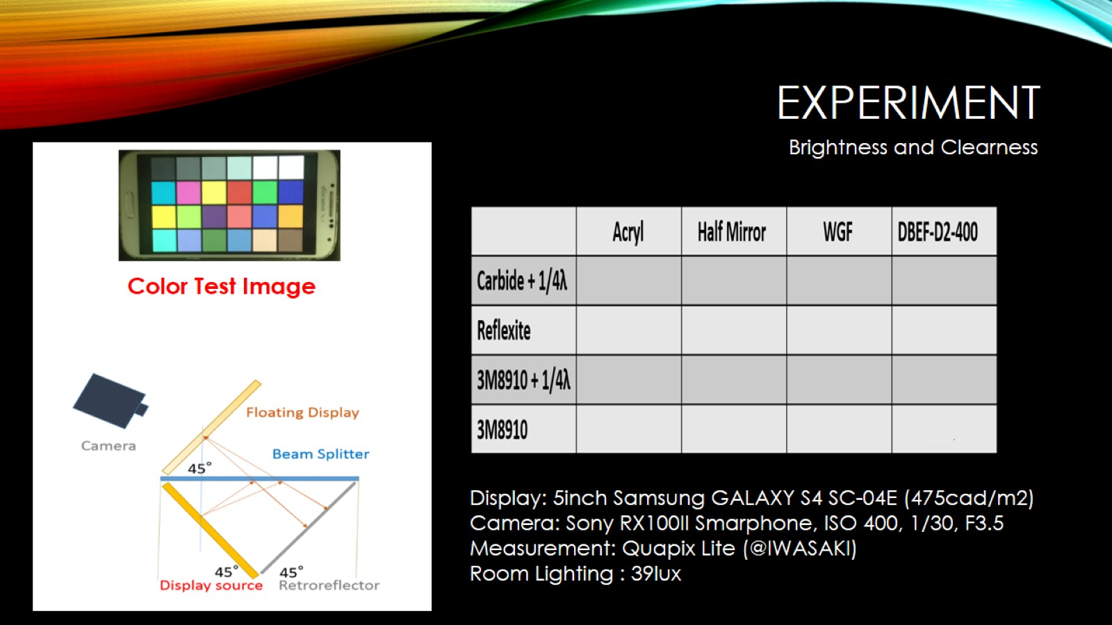
Experiment

Slide 11
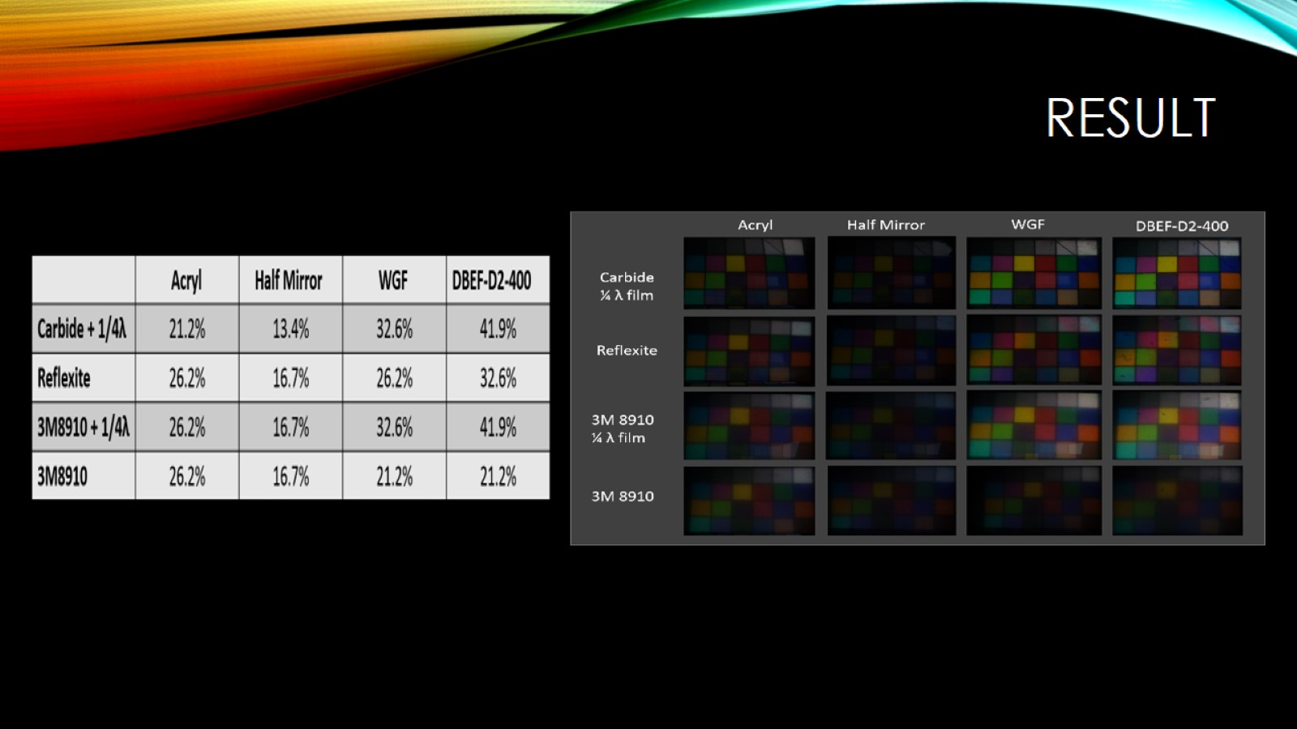
Result

Slide 12
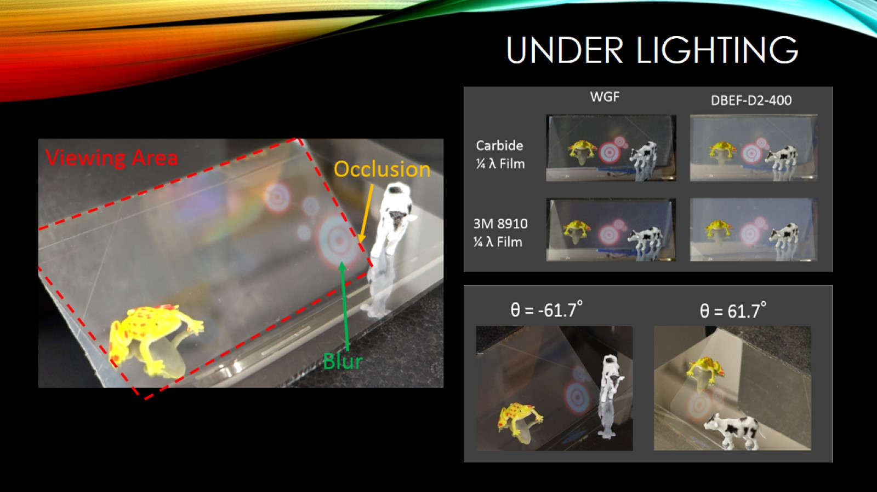
Under Lighting

Slide 13
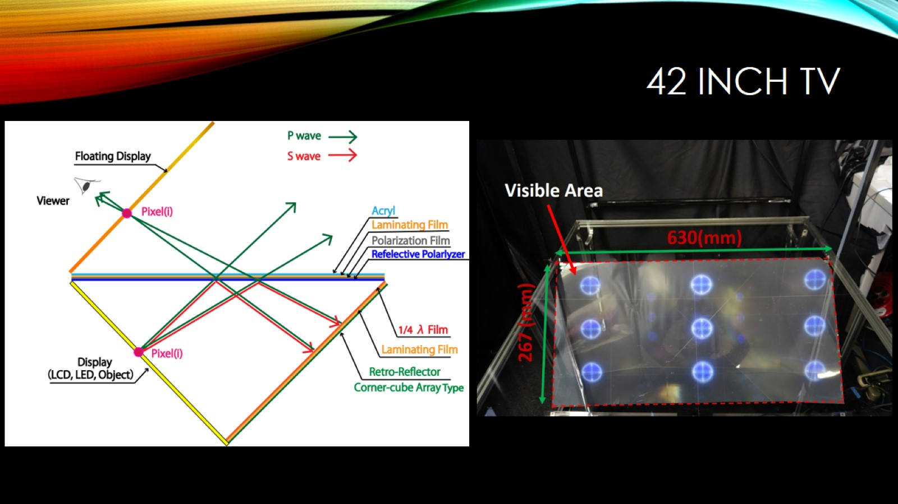
42 inch TV

Slide 14
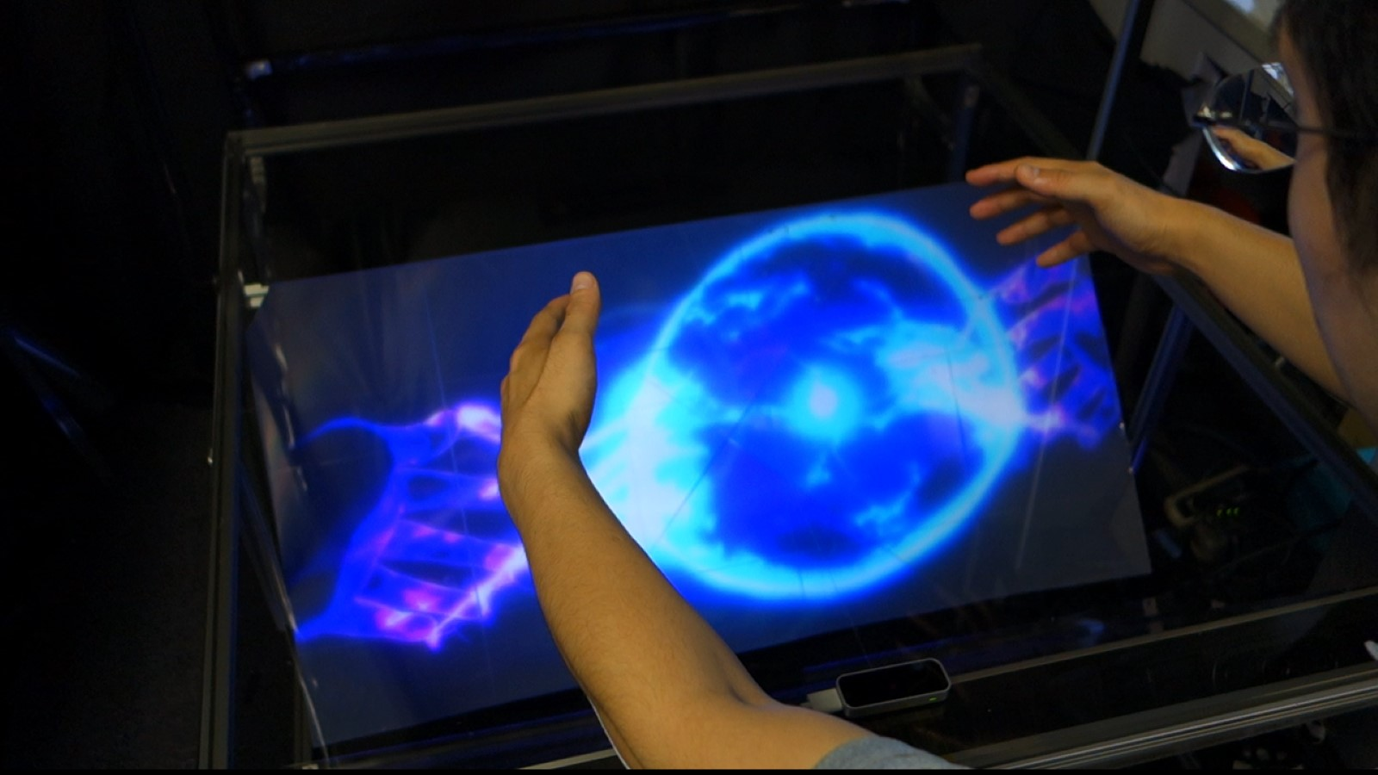
42inch

Slide 15
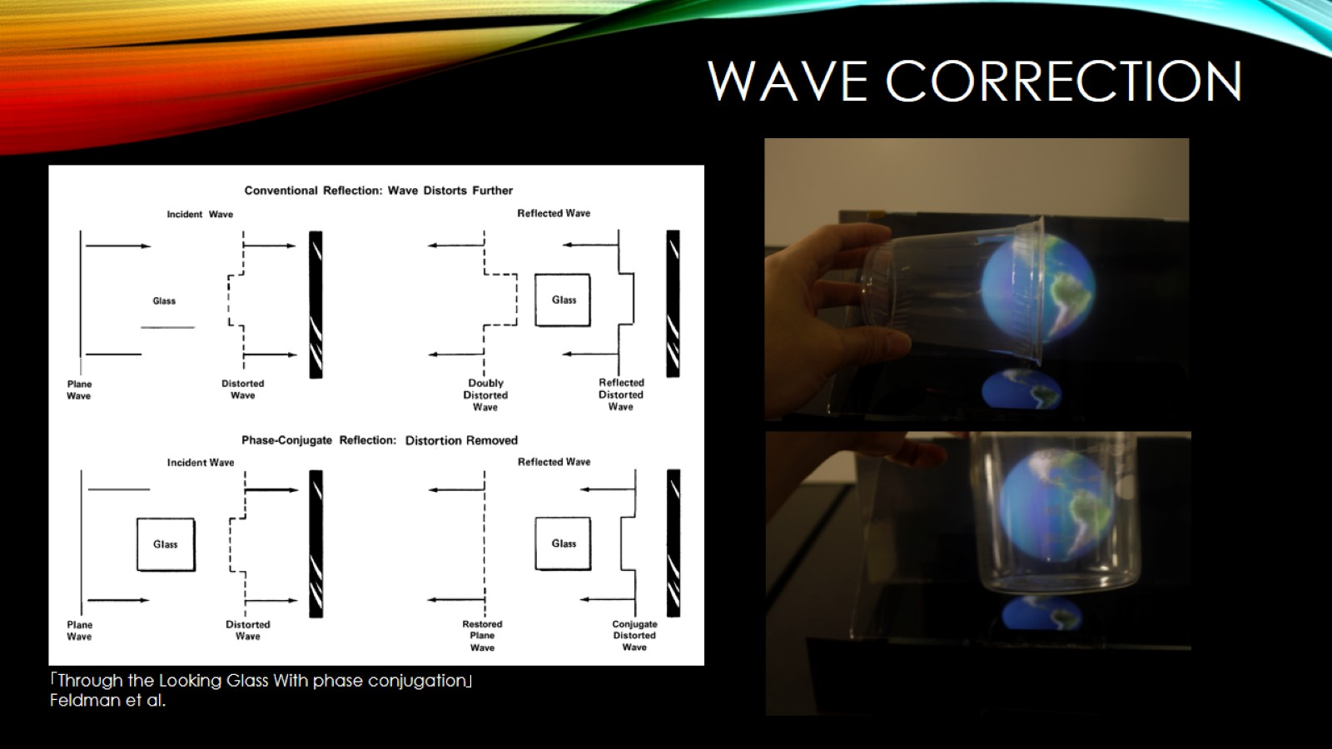
Wave Correction

Slide 16
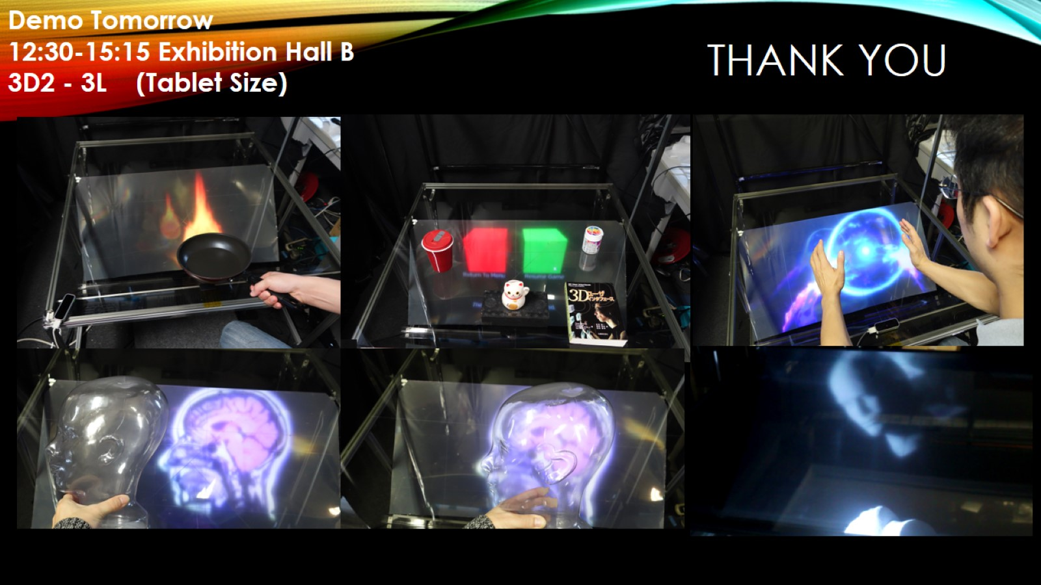
Thank you

